Slide 1
SOA Modeling: Partitioning Model to Take into Account Chemistry
Mass
oxidation
Carbon
Number
accretion
Molecular Polarity
# of carbons and molecular polarity gives us information about partitioning compounds and OPM properties (can calculate K_{p})
Accretion Reactions (any phase): C number increases, polarity increases/decreases
Oxidation (particle/heterogeneous): C number stays/decreases, polarity increases/decreases
Next step…how do we “move compounds” on the grid…

Slide 2
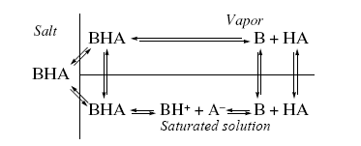
SOA Modeling: Do Low-Molecular Weight Amines Contribute to New Particle Growth?
HA = Acids, could include inorganic acids, such as sulfuric and organic acids, such as acetic
B = Bases, could include inorganic bases, such as ammonia and organic bases, such as dimethylamine
HA
B
OH⁻
HA
B
A⁻
H⁺
BH⁺
H₂O
H₂O
Gas-Phase
Particle-Phase

