Slide 1
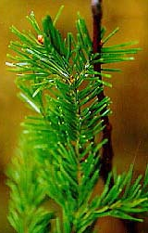
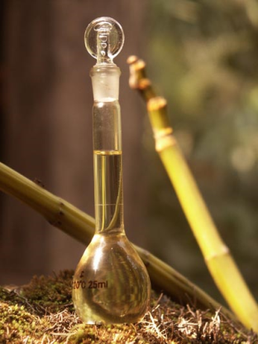
Huff Hartz Research Group
What are aerosol yields from a precursor mixture that reflects the complexity of atmospheric emissions?
Do the aerosol yields in smog chamber experiments mimic those found in the atmosphere?
What are the oxidation products of
biogenic precursor mixtures?
Our approach: essential oils

Slide 2
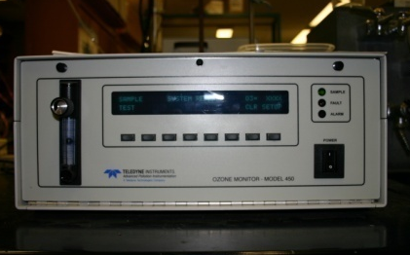
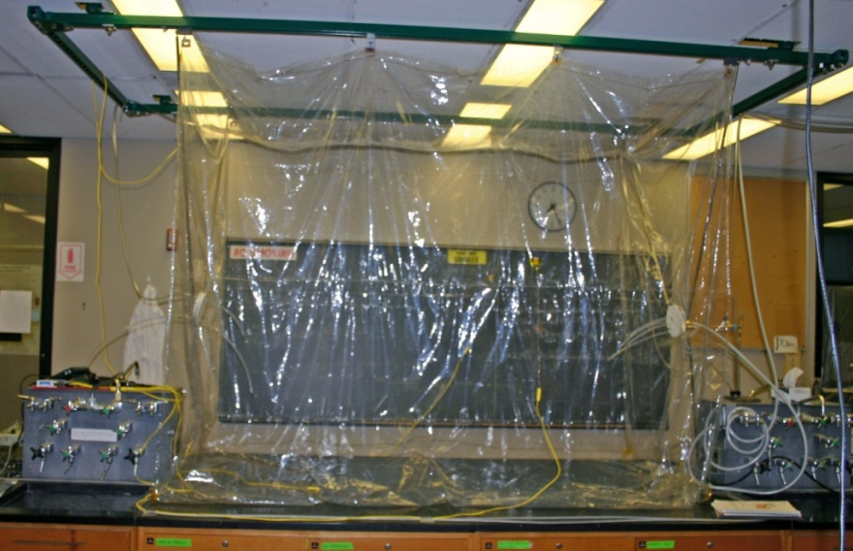
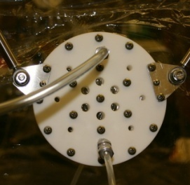
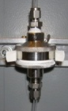
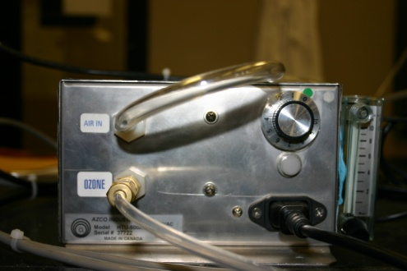
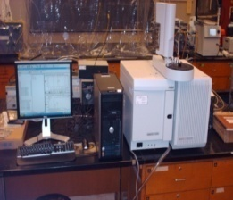
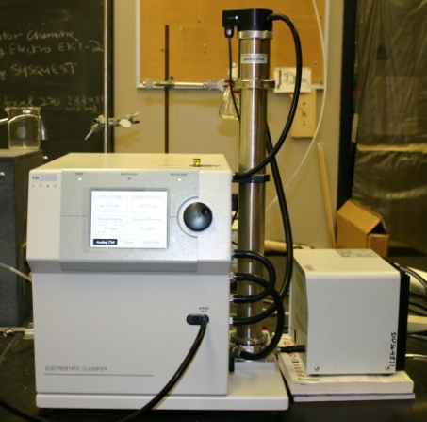
SIUC Environmental Chamber
Air Filtration System
Ozone Monitor
Injection Port
Headspace SPME
Filter Samples
5 m³ Teflon Chamber
Ozone Generator
IS
Solid-Phase Microextraction
α-pinene SOA
extract
Ion trap GCMS
IS
blank
Scanning Mobility Particle Sizer
Notes:
We begin the experiment by flushing the bag with clean, dried air. RH for all experiments is < 10%. Next we add a radical conditioner, 2-butanol, about 13 ppm in concentration. 2-butanol

Slide 3
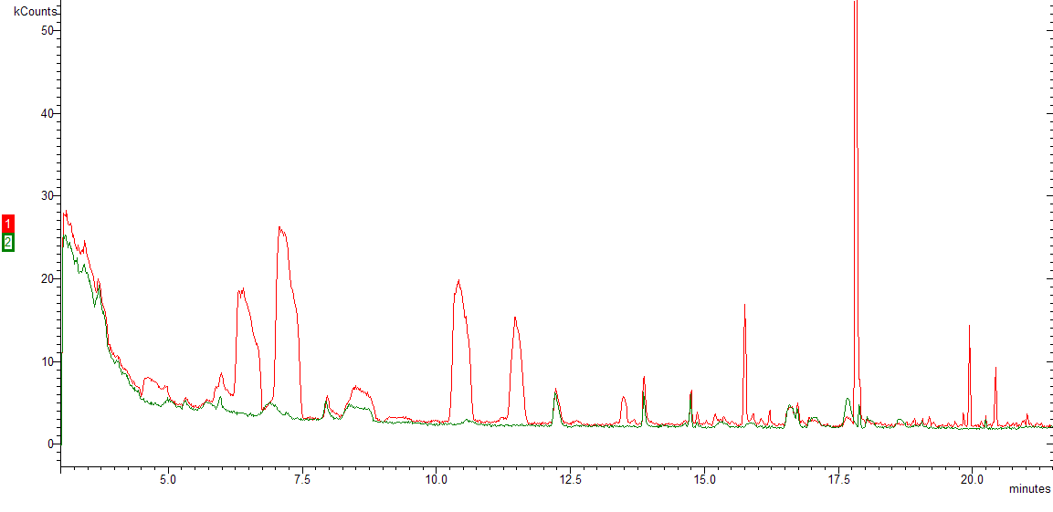
SOA from Siberian Fir Needle Oil
 | M_{o}, μg/m³
bornyl acetate | 780
camphene | 523
α-pinene | 280
3-carene | 210
limonene | 105
terpinolene | 26
α-terpineol | 6
β-pinene | 18
borneol | 20
sesquiterpenes | <20
Total M_{o}, μg/m³ | 665
SOA Mass, μg/m³ | 282
bornyl acetate
camphene
α-pinene
3-carene
limonene
terpinolene
β-pinene
α-terpineol
borneol
camphene
bornyl acetate
α-pinene
3-carene
β-caryophyllene
Total Ion Count
limonene
borneol
β-pinene
terpinolene
α-terpineol
humulene
Yield = 0.42
borneol
C₁₅H₂₄
If we apply the two- component
model of Presto et al.:
Yield = 0.32
Time, min.

