Slide 1
Atmospheric Chemistry fundamentals: Particles
NSF-NCAR Workshop
May 2018
Kelley Barsanti (UC Riverside), John Orlando (NCAR)
5 themes + 1 Regimes

Slide 2
Theme 1 of 5: Precursors
Findings: Highly variable SOA formation (OA enhancement > 1) from diluted smoke emissions, primarily driven by variability in SOA precursors
Opportunities: Quantify known and potential precursors as a function of burn phase/combustion conditions and fuel type (laboratory and field), develop SOA mechanisms and model parameterization for range of conditions
Other Topics:
biogenic VOCs (terrestrial and marine terpenes)
biological materials (pollen, fungi, bacteria)
amines
methanesulfonic acid
sea ice/sea salt
Tkacik et al.
JGR-Atmospheres
Volume122, Issue11
16 June 2017
Pages 6043-6058

Slide 3
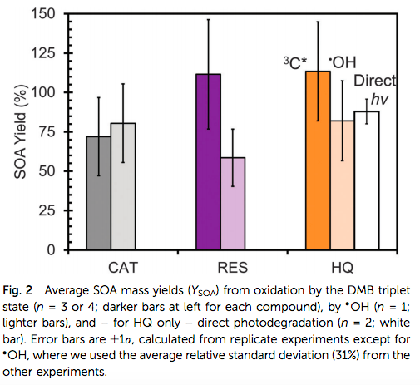
Theme 2 of 5: Formation Pathways
Findings: Significant SOA production in aqueous solutions of benzene-diols (catechol, resorcinol, hydroquinone) with an excited organic chromophore or OH, for RES and HQ faster than gas-phase oxidation
Opportunities: Studies of chemically diverse solutions and wider range of conditions, mechanism development, coordinated field measurements
Other Topics:
role of NH₃
cloud processing
NO₃ oxidation
Cl/ClNO₂ chemistry
multiphase reactions
Smith et al.
Phys. Chem. Chem. Phys., 2015
17, 10227-10237

Slide 4
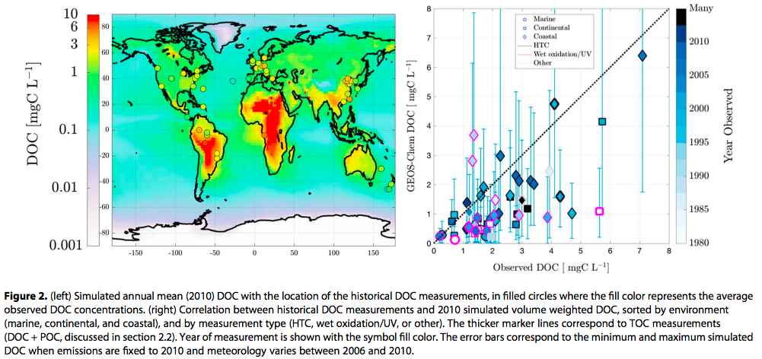
Theme 3 of 5: Atmospheric Processing
Safieddine and Heald, 2017
Geophysical Research Letters
44, 11,672–11,681
Other Topics:
dry deposition
surface reactions (minerals, PAHs)
photochemical aging
hygroscopicity
Findings: Global simulation of dissolved organic carbon (DOC) in precipitation, reproduce spatial variability, modest low bias, oxidation state of DOC vs. reactive OC
Opportunities: long term/distributed measurements of DOC, improved emissions measurements (IVOCs, marine I/VOCs)

Slide 5
Theme 4 of 5: Climate-Relevant Processes, Particles, and properties
Findings: Organic (biogenic) material in sea surface microlayer nucleates ice (mixed-phase and high-altitude conditions), may be an important source of INP in remote marine environments
Opportunities: Field measurements INPs, distribution of biological material, nature of particle formation and biological content
Wilson et al., Nature volume525
pages 234–2381
10 September 2015
Russell
Nature volume525
pages 194–195
10 September 2015
Other Topics:
other ice nuclei
aerosol-cloud interactions
aerosol mixing state
brown carbon
new particle formation
stratospheric aerosols

Slide 6
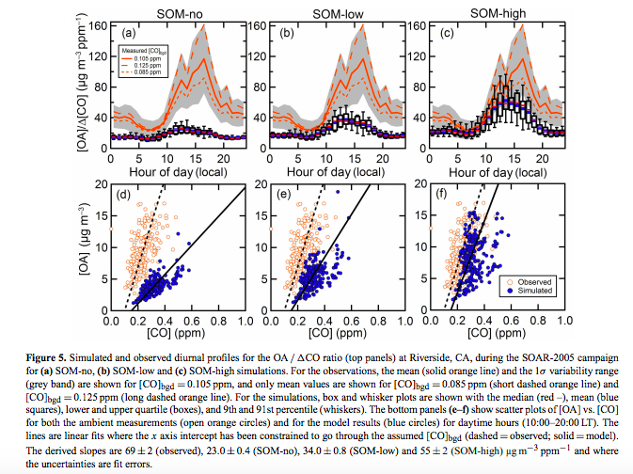
Theme 5 of 5: Connecting measurements and models
Findings: Statistical oxidation model (SOM) parameterizations of chamber data account for vapor wall loss; predicted mass, precursor contribution, oxidation state all sensitive to wall loss parameterizations
Opportunities: Characterize wall loss (ICARUS), evaluate existing and develop new SOA parameterizations
Other Topics:
temporal and spatial variability
phase state
volatility distribution and evolution
kinetics/thermodynamics
Cappa et al.
Atmos. Chem. Phys., 16, 3041-3059, 2016

Slide 7
Underexplored regimes
https://transect.org/transect.html
CMAQ AERO6i https://www.airqualitymodeling.org/index.php/File:Cmaq51_aero6i_schematic2.jpg

