Slide 1
Chemistry/Composition in the Climate System
Akua A. Asa-Awuku, UMD
Andrew Gettelman, NCAR
Notes:
Paint a Hazy and Cloudy Picture with some spectacular sunsets that is evolving day to day….

Slide 2
Key Issues (Top to Bottom)
TOA Radiative effects of ‘Composition’ (e.g. Ozone, particulates)
Stratospheric composition, dynamics and coupling to tropospheric climate
Stratosphere-Troposphere Exchange (STE)
Aerosol-Cloud Interactions (ACI)
Composition Effects on Aerosols
Composition Effects on Droplets
Composition Effects on Scattering, Radiation (Direct Effects)
Aerosol deposition on snow. Surface effects.
Summary and some ideas for discussion

Slide 3
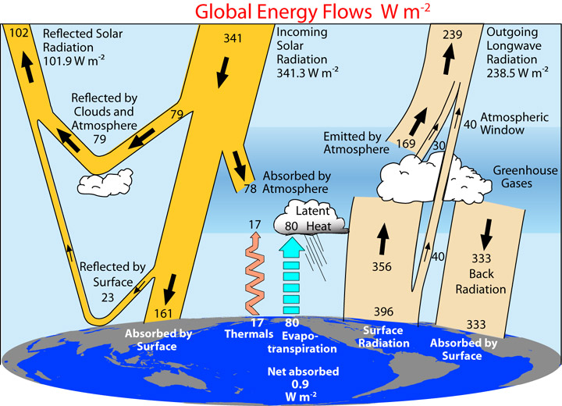
Overview: ‘The Climate System’
Where does composition fit?
CO₂: Global Carbon Cycle
Chemically Active Greenhouse Gases (O₃, CH₄, Halocarbons)
Short lived Species (CO, NOx) Effects on GHGs
RF feedbacks to dynamics
Particulates (aerosols) Direct:
Scattering
Absorption
Cloud - Aerosol Effects
Cloud Drop Chemical effects (surfaces, radiation)
Feedbacks to drops
Chem Phase partitioning
Surface Albedo Changes (snow)

Slide 4
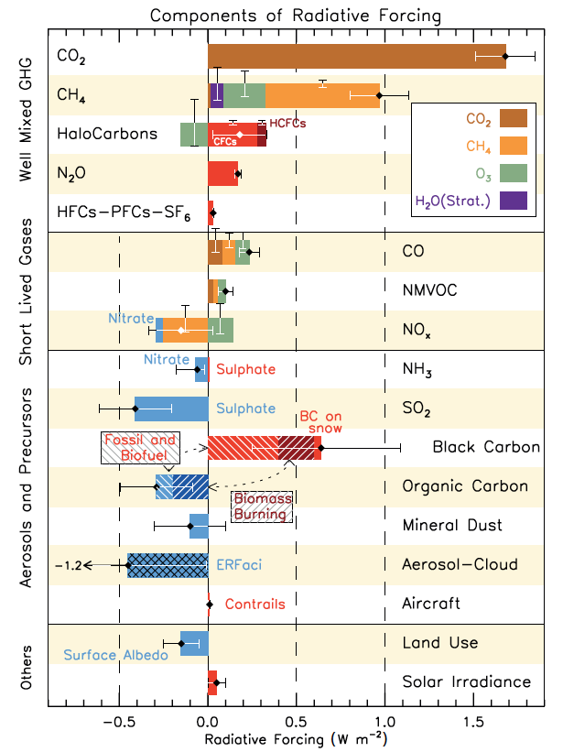
Composition Affects Radiative Forcing
Well mixed gases affect composition and RF
Composition from Short Lived Gases Matters
Aerosols are the largest uncertainty in Anthropogenic RF
Myhre et al, 2014, IPCC AR5, Fig 8.17

Slide 5
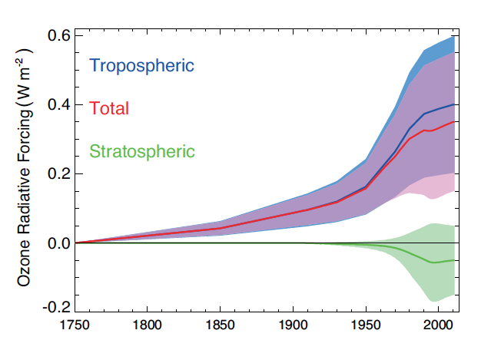
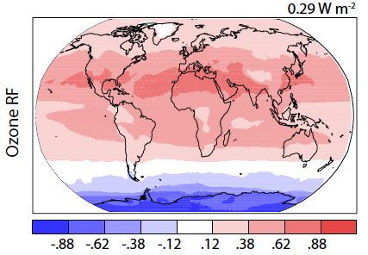
Direct Radiative Effects: Tropospheric Ozone
Myhre et al, 2014, IPCC AR5, Fig 8.7 (Left) & Fig 8.23 (Right)

Slide 6
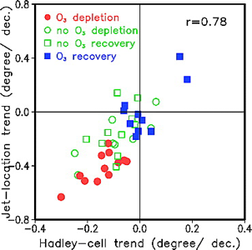
Stratosphere-Troposphere Coupling
Stratospheric Composition (e.g. Ozone Depletion) alters tropospheric circulation: Mid-Latitude Jet and Hadley Cell Position
Why? Response of the Jet to UTLS temperature gradients (a result of stratospheric composition)
Son et al 2009, GRL, Fig 2

Slide 7
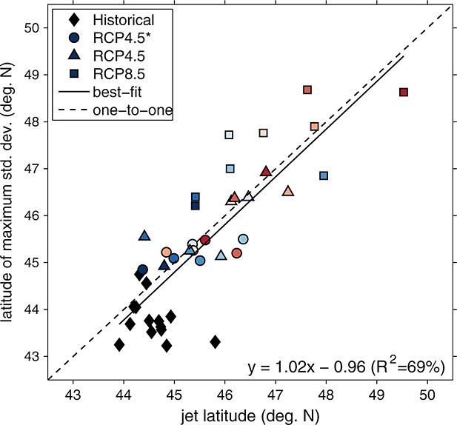
Stratosphere-Troposphere Coupling (2)
The mid-latitude jet responds to climate change as well as composition change.
Climate change will move the jet, and affect composition: Here, variability of ozone over Eastern N. America
Barnes and Fiore, 2013, GRL, Fig 4

Slide 8
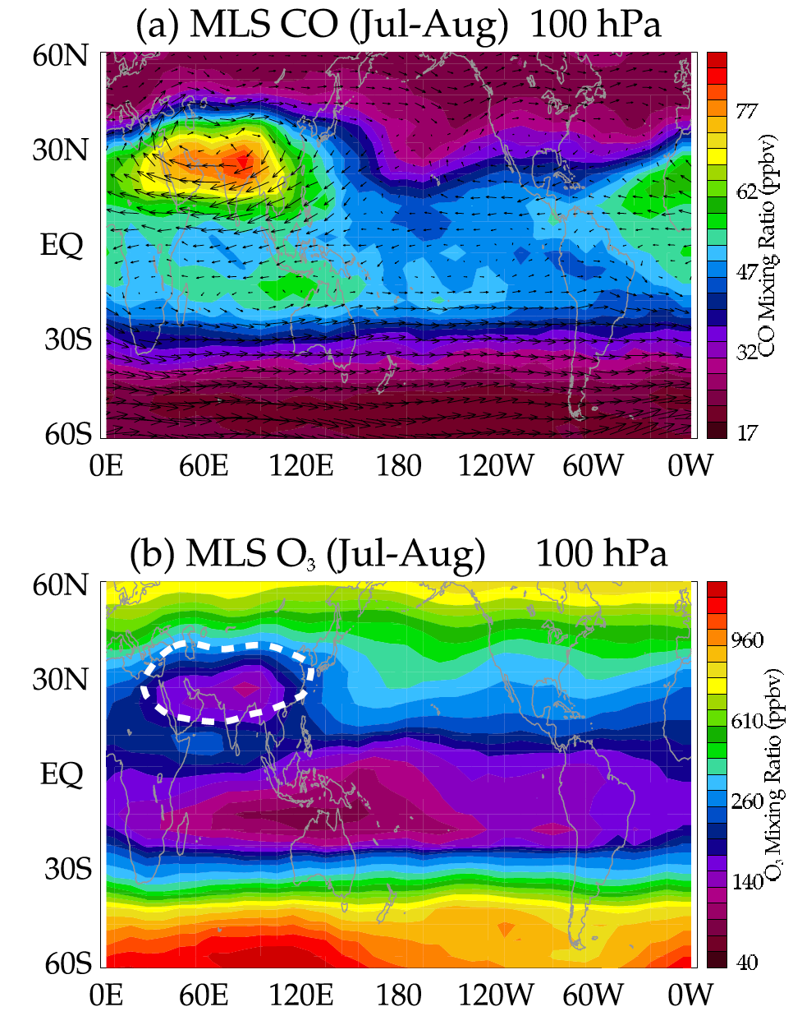
UTLS Composition and Climate
The Upper Troposphere and Lower Stratosphere (UTLS) regulates stratospheric composition and can affect radiative forcing
The Tropical Tropopause Layer (TTL) sets the boundary conditions for the stratosphere
E.g.: anything that affects TTL water vapor (or ozone) can affect climate (includes anthropogenic pollutants)
Asian Monsoon Anticyclone is a clear example
Stratospheric aerosol RF
Extratropical UTLS regulates Stratosphere- Troposphere Exchange (STE)
Lifetime of radiatively active Species
Impacts on tropospheric Ozone
Park et al 2007, JGR, Fig. 5

Slide 9
Aerosol Impacts
A clear day in Beijing (Sep 19, 2016, 6:00 LT looking west)

Slide 10
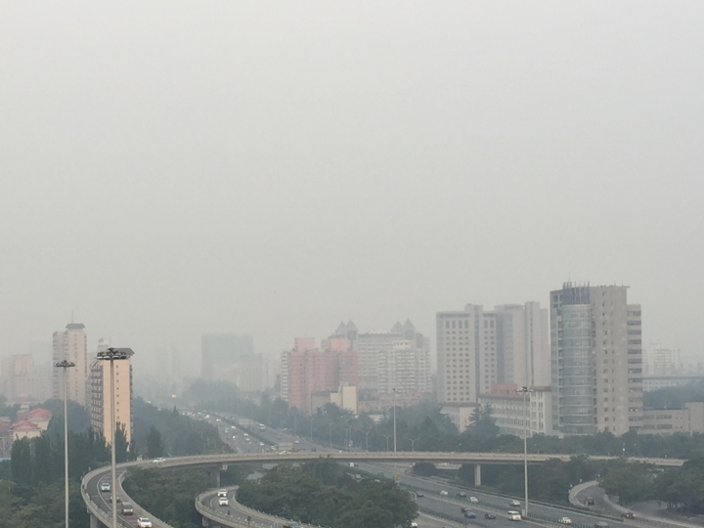
Aerosol Impacts
Direct Impact
Water Uptake
Semi-Direct Effects (no clouds)
Likely climatological changes in N. China
A clear day in Beijing (Sep 22, 2016, 6:00 LT looking west)
PM2.5 ~80 μgm⁻³

Slide 11
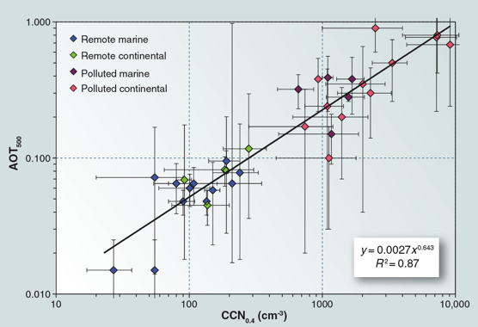
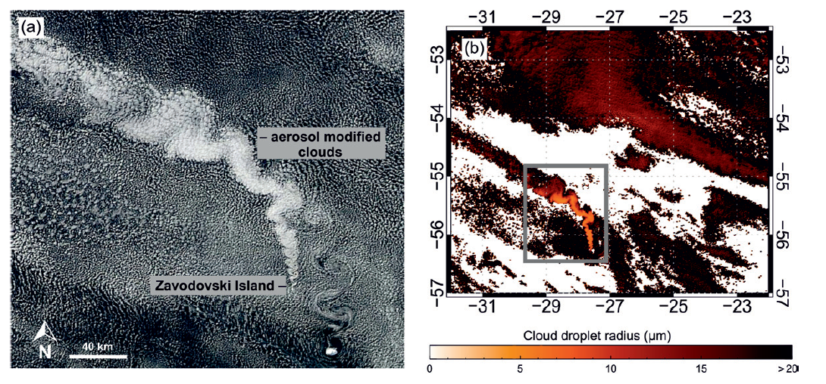
Aerosol-Cloud Interactions (ACI)
Aerosols increase CCN
Cloud drop number increases
Clouds get brighter: cooling effect
Magnitude (subsequent feedbacks) uncertain
CCN v. Aerosol Optical Thickness
Rosenfeld et al, Science 2008
“Volcano Tracks”
Schmidt et al 2014, ACP

Slide 12
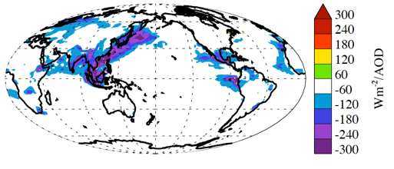
Aerosol-Cloud Interactions (2)
Simulated effect of Aerosols: Impact of anthropogenic aerosols, per unit of AOD
SW All Sky Aerosol Kernel (dR/dAOD)
Challenge to go from processes and in-situ to satellite relationships
Quantitative Disagreement between Observations, Small scale models, Global Models
Critical uncertainties in cloud microphysical responses, feedbacks
‘Anthropogenic Aerosol Kernel’
Gettelman et al 2016, J. Climate
Gettelman et al 2016

Slide 13
Composition Effects on Aerosol
CESM2, 1850 Simulations: Full (200+ species) v. simplified chemistry. Differences in SOA evolution → AOD differences of 10-20% (shown) → ~1Wm⁻² change in Cloud Radiative Effect → affects ENSO
AOD

Slide 14
Gas-phase Chemistry and Aerosol microphysics
Bzdek and Reid, J. Chem Physics 2017
Transformative Pathways: Daytime Chemistry, Nighttime Chemistry, Aqueous Chemistry, Surface Chemistry
Sources: Biogenic VOCs/Aerosol, Marine Aerosol, Mineral Dust, Biomass Burning, Black Carbon, Arctic
Bzdek, Bryan R., and Jonathan P. Reid. "Perspective: Aerosol microphysics: From molecules to the chemical physics of aerosols." The Journal of chemical physics 147.22 (2017): 220901.

Slide 15
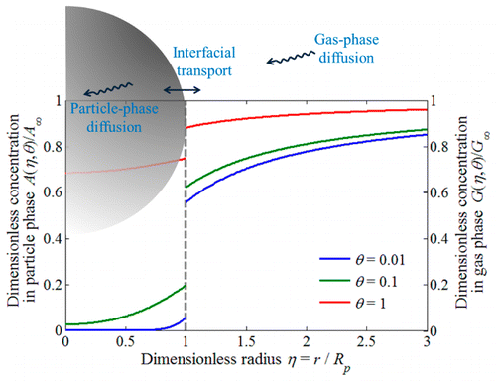
Gas-Phase and Particle Phase Partitioning
(e.g., ) but not limited to:
Burkart, et al. "Organic Condensation and Particle Growth to CCN Sizes in the Summertime Marine Arctic Is Driven by Materials More Semivolatile Than at Continental Sites." Geophysical Research Letters 44.20 (2017).
Vizenor, A. E., and A. A. Asa-Awuku. "Gas-phase kinetics modifies the CCN activity of a biogenic SOA." Physical Chemistry Chemical Physics 20.9 (2018): 6591-6597.
Sareen, N., et al. "Surfactants from the gas phase may promote cloud droplet formation." Proceedings of the National Academy of Sciences 110.8 (2013): 2723-2728.
Mai,, et al. "Under what conditions can equilibrium gas–particle partitioning be expected to hold in the atmosphere?." Environmental science & technology 49.19 (2015): 11485-11491.
Mai et., al J. Phys Chem A. 2015.

Slide 16
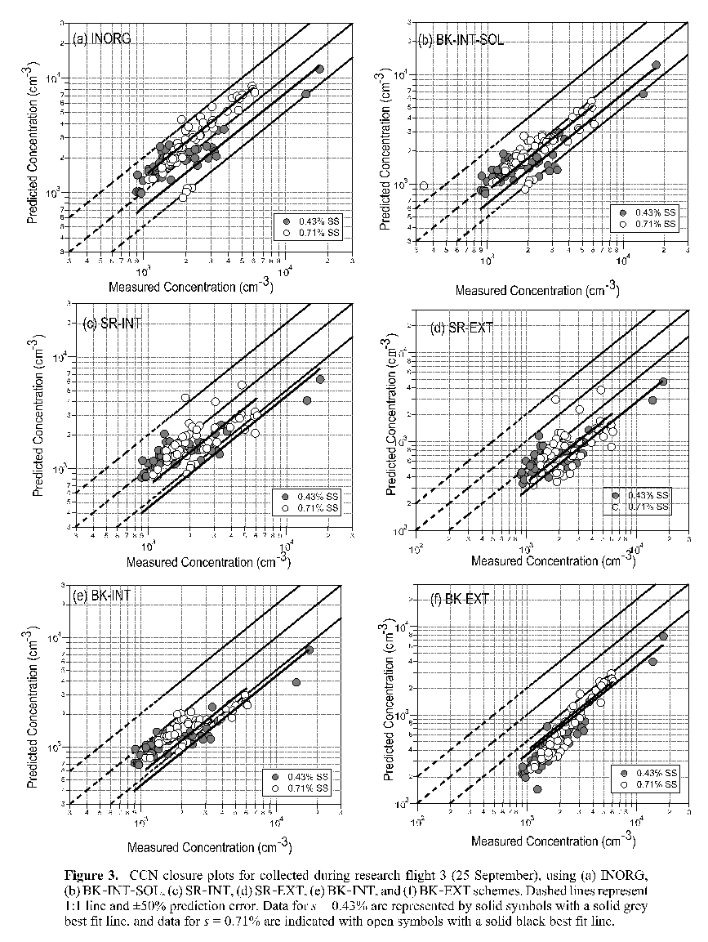
Mixing State: Internal vs. External
(e.g., ) but not limited to:
Ching et al. "A three‐dimensional sectional representation of aerosol mixing state for simulating optical properties and cloud condensation nuclei." Journal of Geophysical Research: Atmospheres 121.10 (2016): 5912-5929.
Ervens, B., et al. "CCN predictions using simplified assumptions of organic aerosol composition and mixing state: a synthesis from six different locations." Atmospheric Chemistry and Physics 10.10 (2010): 4795-4807.
Gaston, C. J., et al. "The Cloud Nucleating Properties and Mixing State of Marine Aerosols Sampled along the Southern California Coast." Atmosphere 9.2 (2018): 52.
Schill, et al. "The impact of aerosol particle mixing state on the hygroscopicity of sea spray aerosol." ACS central science 1.3 (2015): 132-141.
Sullivan, R. C., et al. "Effect of chemical mixing state on the hygroscopicity and cloud nucleation properties of calcium mineral dust particles." Atmospheric Chemistry and Physics 9.10 (2009): 3303-3316.
Wang, J., et al. "The importance of aerosol mixing state and size-resolved composition on CCN concentration and the variation of the importance with atmospheric aging of aerosols." Atmospheric Chemistry and Physics 10.15 (2010): 7267-7283.
Asa-Awuku et al, 2010, JGR

Slide 17
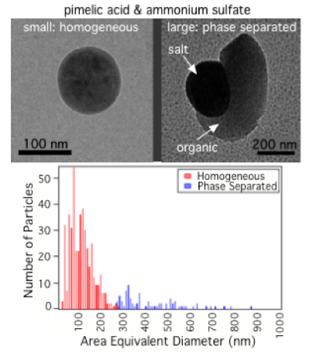
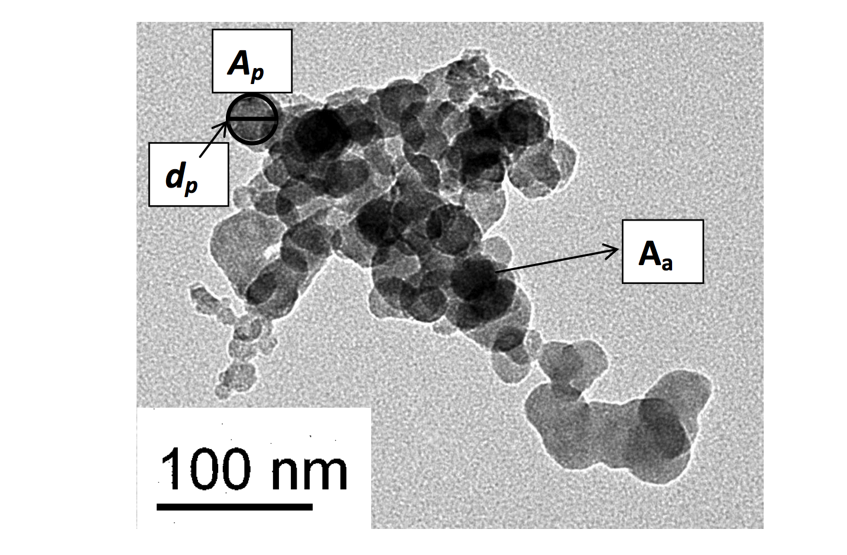
Particle Morphology & Phase State
(e.g., ) but not limited to:
Altaf, et al. "Effect of Particle Morphology on Cloud Condensation Nuclei Activity." ACS Earth and Space Chemistry (2018).
Slade, et al. "Cloud droplet activation through oxidation of organic aerosol influenced by temperature and particle phase state." Geophysical Research Letters 44.3 (2017): 1583-1591.
Marsh, et al. "Amorphous phase state diagrams and viscosity of ternary aqueous organic/organic and inorganic/organic mixtures." Physical Chemistry Chemical Physics (2018).
DeRieux, W., et al. "Predicting the glass transition temperature and viscosity of secondary organic material using molecular composition." Atmospheric Chemistry and Physics 18.9 (2018): 6331-6351.
Gorkowski, K. et al.,. "Emulsified and Liquid–Liquid Phase-Separated States of α-Pinene Secondary Organic Aerosol Determined Using Aerosol Optical Tweezers." Environmental Science & Technology 51.21 (2017): 12154-12163
Freedman et al. 2009
Giordano et al, 2014, ACP

Slide 18
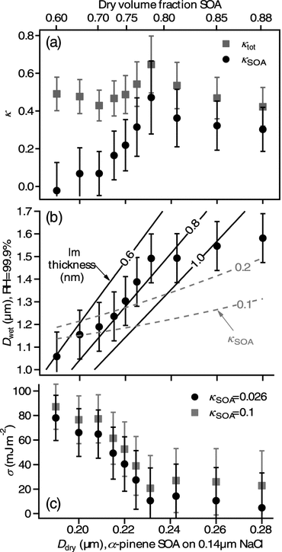
Surfactant Chemistry for Droplets
(e.g., ) but not limited to:
Boyer, H. C., et al., . (2016). Statistical Thermodynamic Model for Surface Tension of Organic and Inorganic Aqueous Mixtures. The Journal of Physical Chemistry A, 121(1), 198-205.
Giordano, M., et al. "Changes in droplet surface tension affect the observed hygroscopicity of photochemically aged biomass burning aerosol." Environmental science & technology 47.19 (2013): 10980-10986.
Ovadnevaite, Jurgita, et al. "Surface tension prevails over solute effect in organic-influenced cloud droplet activation." Nature 546.7660 (2017): 637.
Noziere,B. , Baduel, C. and J. Jaffrezo. "The dynamic surface tension of atmospheric aerosol surfactants reveals new aspects of cloud activation." Nature communications 5 (2014): 3335.
Sareen, N., et al. "Surfactants from the gas phase may promote cloud droplet formation." Proceedings of the National Academy of Sciences 110.8 (2013): 2723-2728.
Ruehl, R. and K. R. Wilson. "Surface organic monolayers control the hygroscopic growth of submicrometer particles at high relative humidity." The Journal of Physical Chemistry A 118.22 (2014): 3952-3966.
Ruehl et al, 2012, GRL

Slide 19
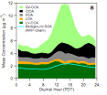
Slightly Soluble, Partially Soluble, Insoluble, Hydrophilic, Hydrophobic, Carbonaceous Compounds
(e.g., ) but not limited to:
El-Sayed,et al.,. "The effects of isoprene and NO x on secondary organic aerosols formed through reversible and irreversible uptake to aerosol water." Atmospheric Chemistry and Physics 18.2 (2018): 1171-1184.
Jing, Bo, et al. "Hygroscopic behavior of multicomponent organic aerosols and their internal mixtures with ammonium sulfate." Atmospheric Chemistry and Physics 16.6 (2016): 4101-4118.
Xu, Lu, et al. "Chemical characterization of water-soluble organic aerosol in contrasting rural and urban environments in the southeastern United States." Environmental science & technology 51.1 (2016): 78-88.
Li, K, et al. "Enhanced Light Scattering of Secondary Organic Aerosols by Multiphase Reactions." Environmental science & technology 51.3 (2017): 1285-1292.
Miyazaki, et al. "Contribution of dissolved organic matter to submicron water-soluble organic aerosols in the marine boundary layer over the eastern equatorial Pacific." Atmospheric Chemistry and Physics 16.12 (2016): 7695-7707.
Hayes et al, 2015, ACP

Slide 20
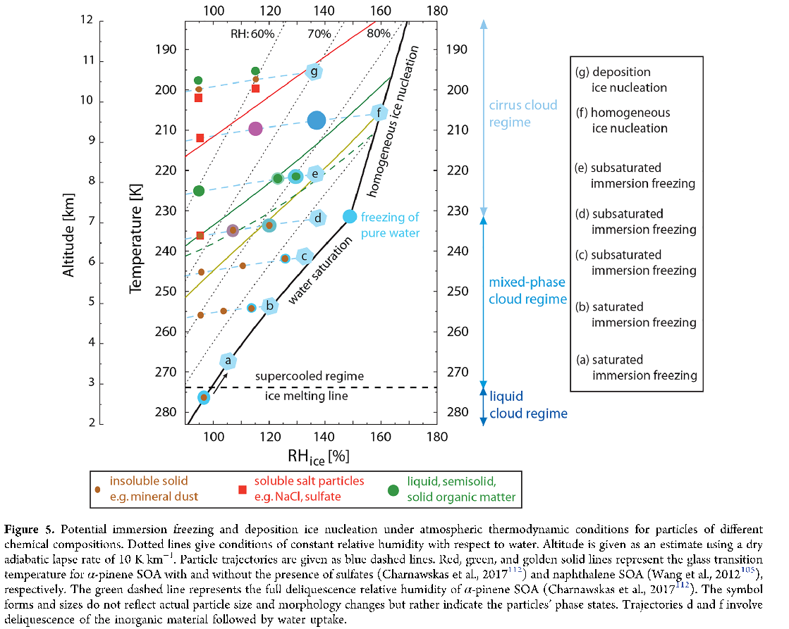
Soluble, Semi-solid, Insoluble Compounds for Ice Nucleation
Knopf, D A., P. A. Alpert, and B. Wang. "The Role of Organic Aerosol in Atmospheric Ice Nucleation: A Review." ACS Earth and Space Chemistry 2.3 (2018): 168-202.

Slide 21
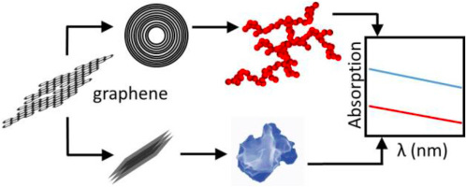
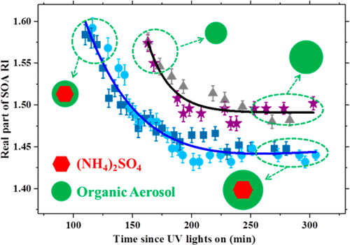
Direct Effects and Particle Scattering
(e.g., ) but not limited to:
Veghte, D. P., and M. A. Freedman. "The necessity of microscopy to characterize the optical properties of size-selected, nonspherical aerosol particles." Analytical chemistry 84.21 (2012): 9101-9108.
Lack, et al. "Brown carbon and internal mixing in biomass burning particles." Proceedings of the National Academy of Sciences 109.37 (2012): 14802-14807.
Bahreini, R., et al. "Characterizing emissions and optical properties of particulate matter from PFI and GDI light-duty gasoline vehicles." Journal of Aerosol Science 90 (2015): 144-153.
Zangmeister, C. D., et al. "Measured in-situ mass absorption spectra for nine forms of highly-absorbing carbonaceous aerosol." Carbon 136 (2018): 85-93.
Li., et al. "Effects of Gas-Particle Partitioning on Refractive Index and Chemical Composition of m-Xylene Secondary Organic Aerosol." The Journal of Physical Chemistry A 122.12 (2018): 3250-3260.
Zangmeister et., al Carbon. 2018.
Li. et., al J. Phys Chem A. 2018.

Slide 22
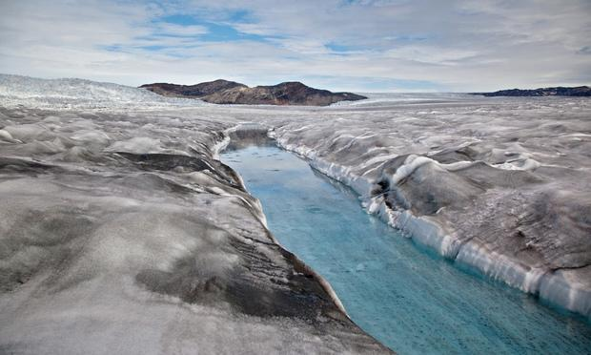
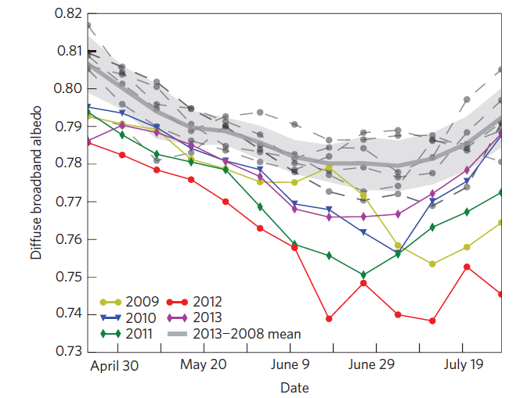
Surface Effects: Black Carbon on Snow
MODIS Albedo over Greenland > 2000m
2003
Black Carbon Deposition on Snow/Ice changes albedo and surface melting
Decreasing albedo as BC increases...
Dumont et al 2014, Nature Geoscience

Slide 23
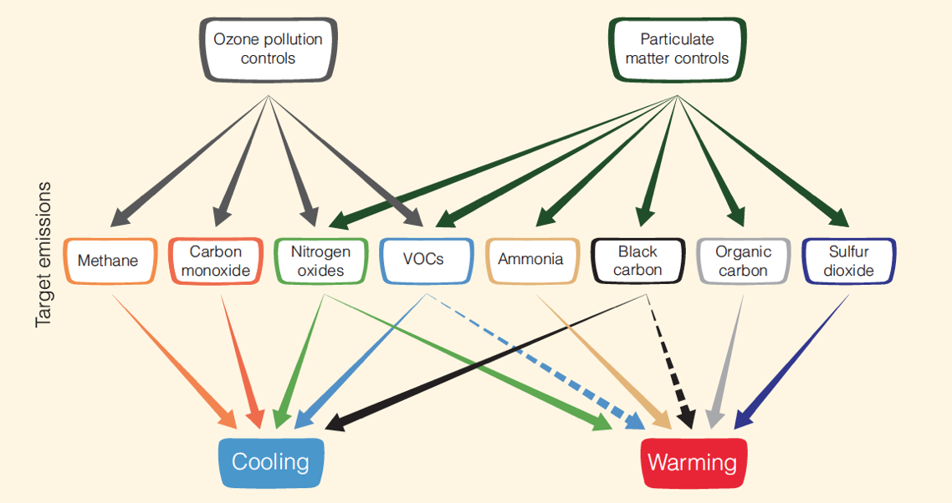
Impact of Pollution Controls on Climate
Myhre et al, 2014, IPCC AR5, CH8

Slide 24
Summary
Radiative effects of ‘Composition’ are significant
Stratospheric Composition impacts tropospheric climate
Aerosol-Cloud Interactions impact climate: Large, highly uncertain
Especially: Ice Nucleation, Cloud Microphysics
Composition Effects on Aerosols:
Mixing State, Morphology, Carbonaceous Compounds
Droplet Surfactant Chemistry
Composition Effects on Scattering, Radiation.
Aerosol deposition on snow. Surface effects
Climate Policy Implications of Regulation

Slide 25
Where do we go from here? Ideas for discussion
Theme: Integrate models with observations (for climate)
Test lab work in models at different scales
Strategies for testing global climate impacts in lab and field (identify critical processes)
Integrated modeling (include chemistry, coupled components like cryosphere)
Theme: Gas and particle phase are connected: treat holistically
Evolution of constituents in the climate system
Pathways for Gas phase radiative forcing
How do regional, persistent aspects of composition RF alter dynamics, T_{s} (Beijing to O₃ Hole)
Especially: role of air pollution in regional and global climate
Understand policy aspects of pollution controls and their climate impact (including aerosols)
Aerosol Cloud Interactions
Bridge lab particle scale studies with in situ and global impacts (integrate lab with models)
Constraining cloud and aerosol microphysics from the process to global scale (key regions) e.g. carbonaceous, organics downwind of emissions, volcanoes as natural sulfur laboratories
Regional scale aerosol effects on meteorology and chemistry (regional studies)

