Slide 1
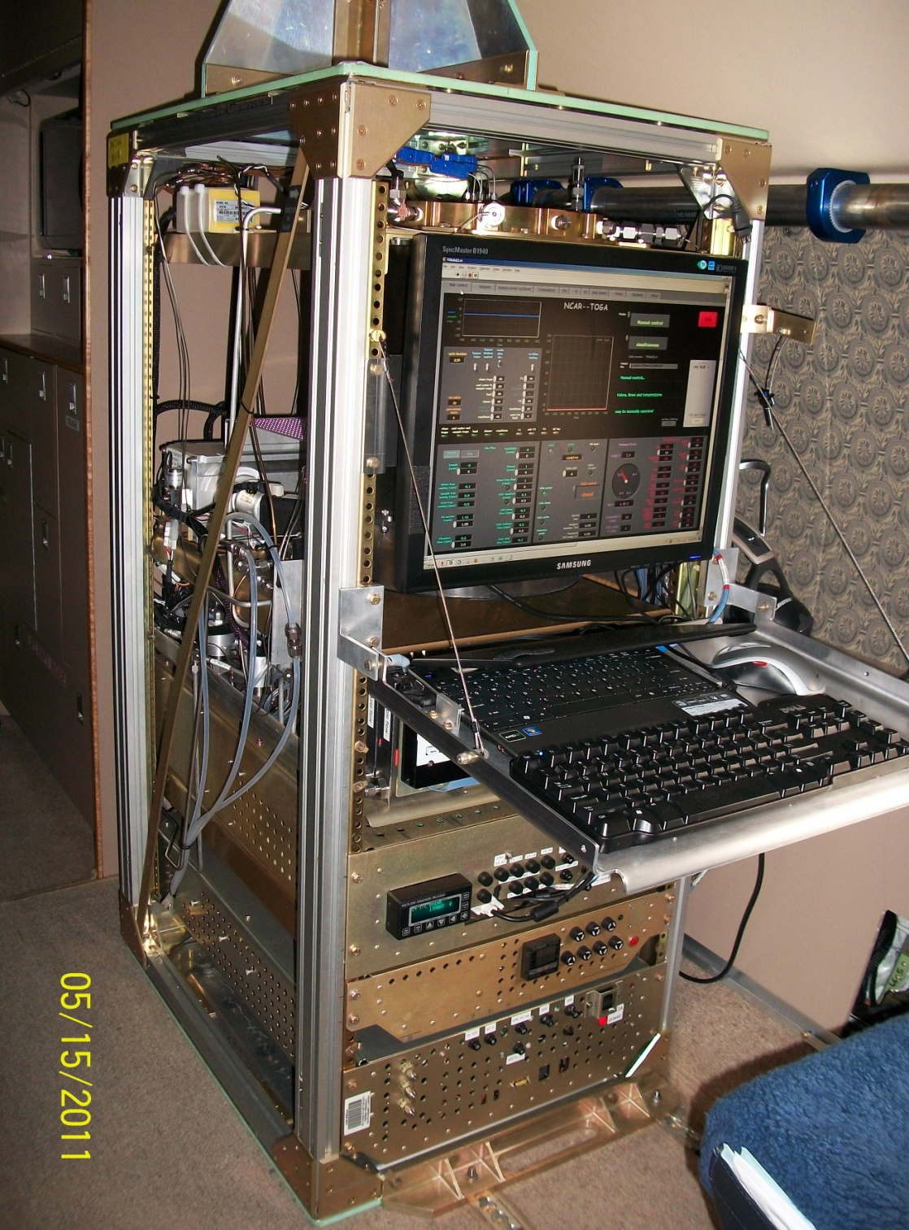
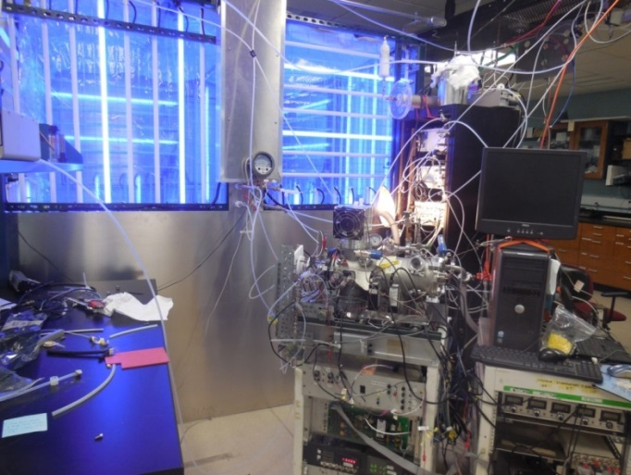
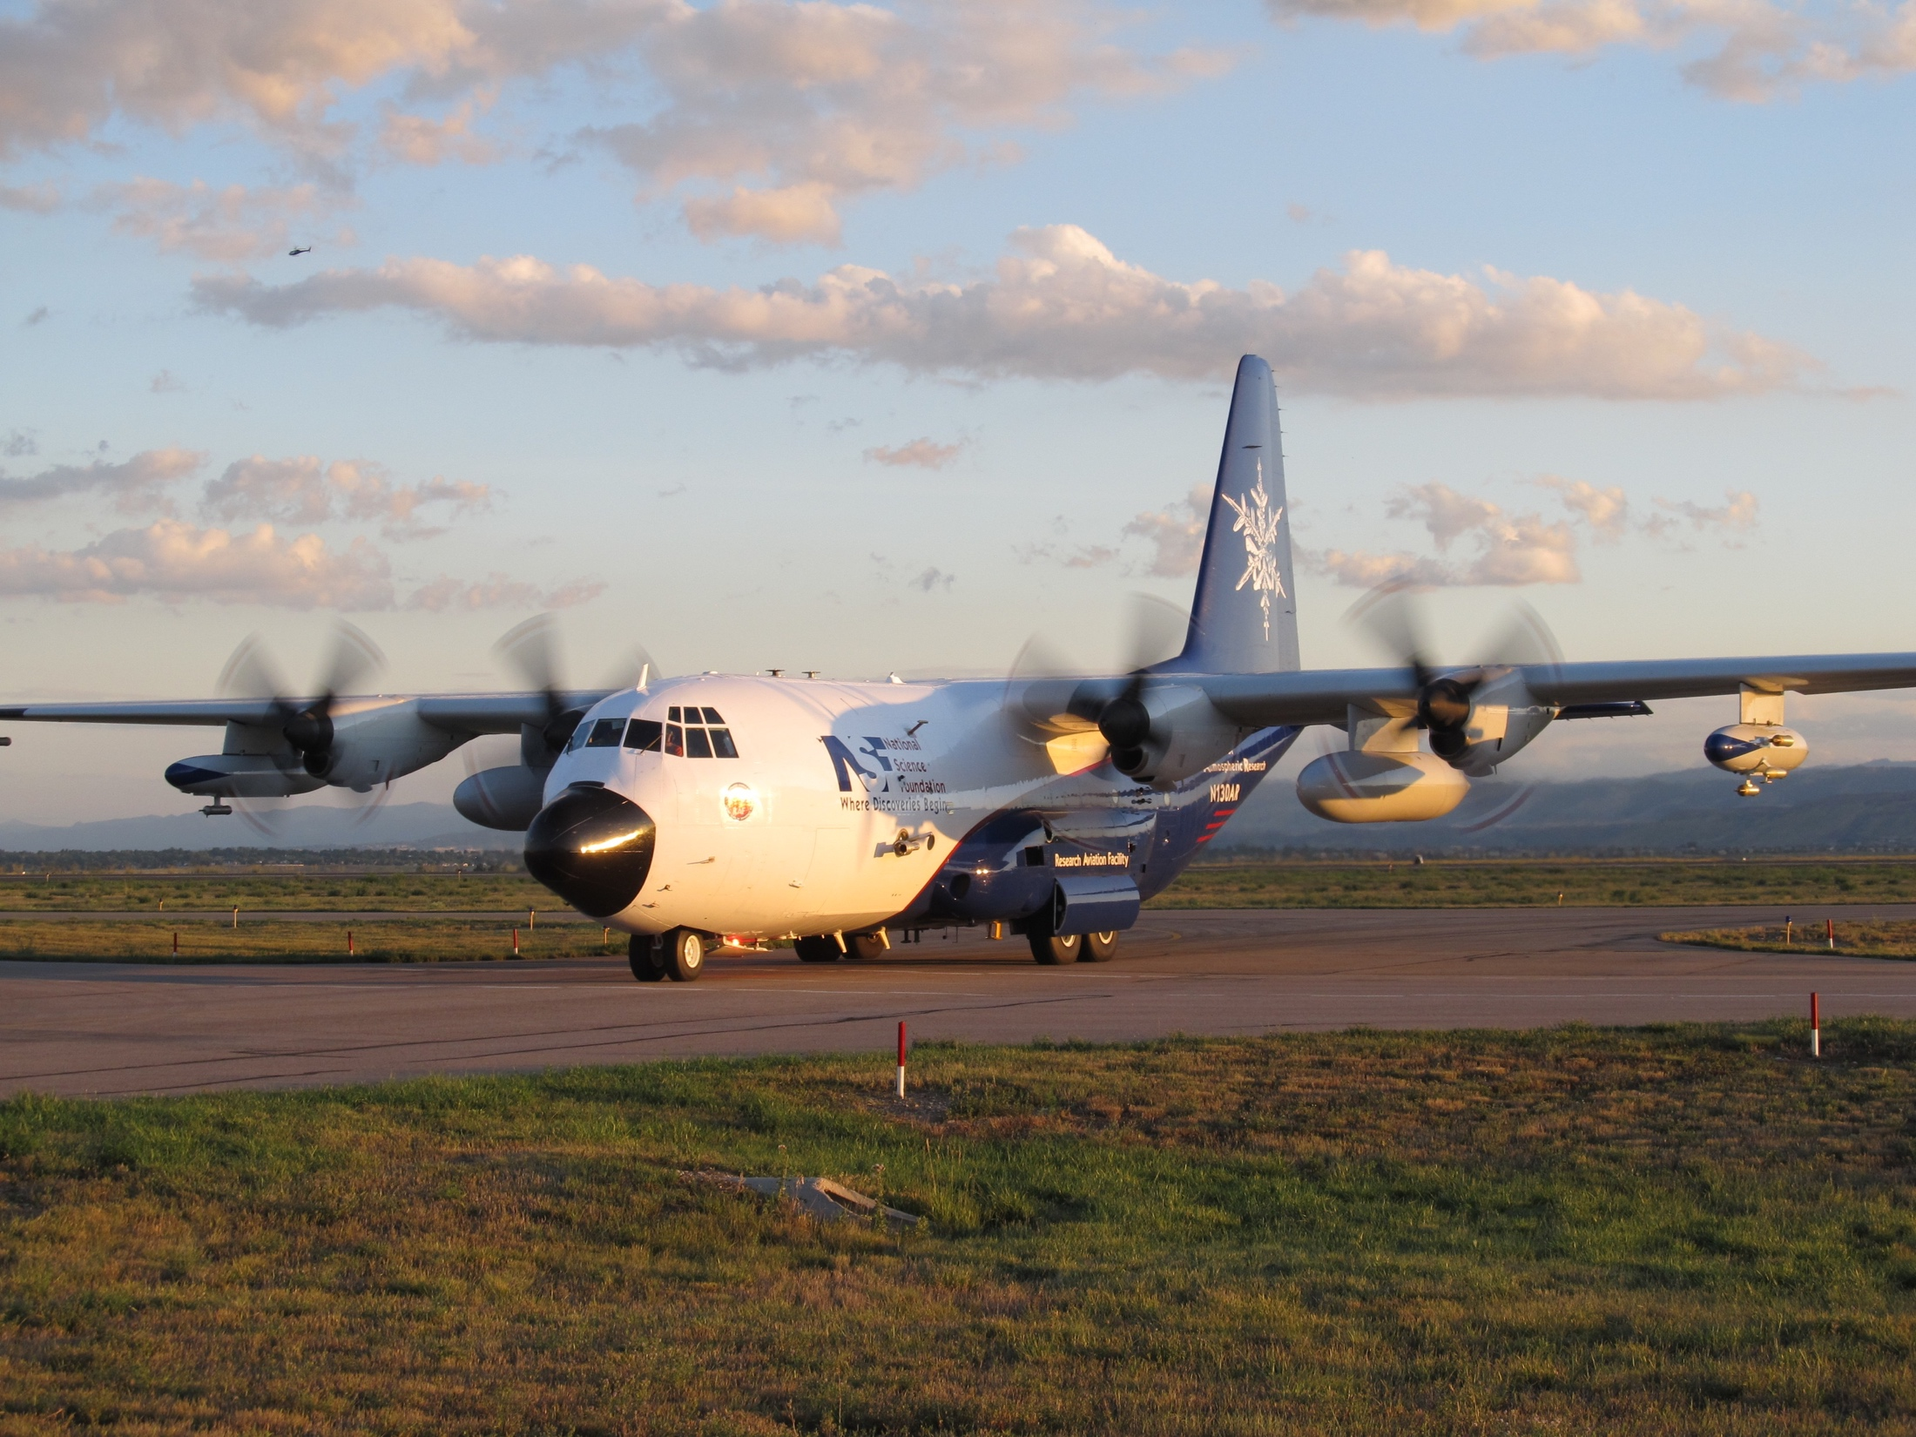
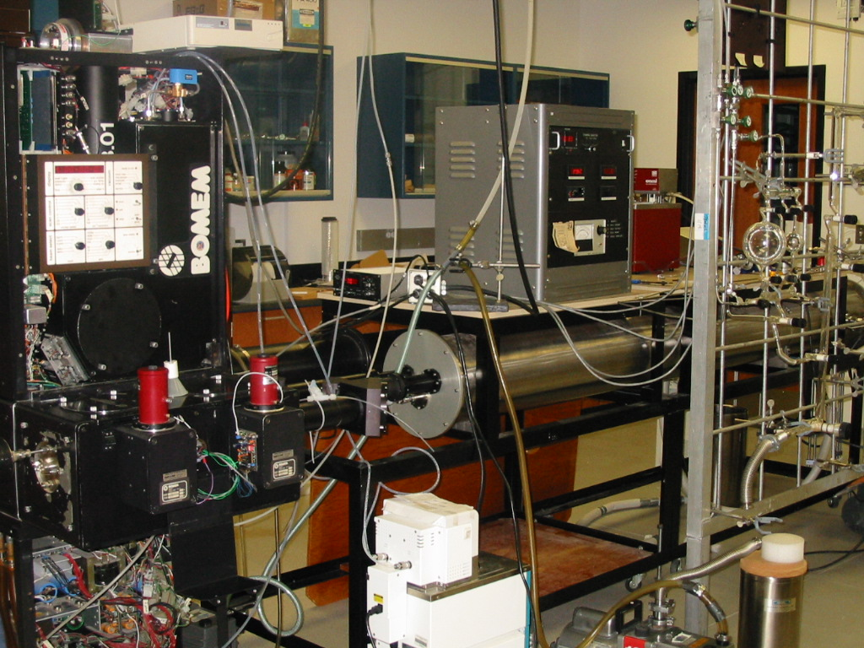
THIS HALF OF THE PRESENTATION:
An overview of NCAR ACOM ‘process studies’ activities
Topics, Activities and Problems in Gas-phase Atmospheric Chemistry
Autoxidation
Organic Nitrates
Chemistry of Oxygenates and Multifunctional Species
Aromatics – esp. oxygenated, wildfire emissions…
Others…
Kelley will follow with a perspective on condensed phase chemistry topics / questions

Slide 2
NCAR ‘Big Chamber’
10 m³ Teflon Bag (Zhang et al., AMT, 2018)
NO₃⁻ TOF-CIMS, PTR-MS, GC-FID, …
Amenable to inclusion of additional instrumentation
Focusing on continuous-flow mode
Low, steady-state NO_{x} conditions
Early focus - OH and NO₃ Isoprene Oxidation experiments
Oxygenated aromatics (wildfire emissions)
NO₃-initiated oxidation of BVOC
Xuan Zhang

Slide 3
NCAR ‘Little Chamber’
50 L stainless steel, T-regulated (220-350 K)
FTIR, GC-FID
Amenable to inclusion of additional instrumentation
(TOGA, PTR-MS, CIMS, CEAS, HPLC, …)
No-cost collaborators on multiple NSF proposals
Oxidation of organics by OH, NO₃, O₃, Cl, Br
Relative rate studies
Mechanistic studies (end-products)
Alkoxy, peroxy radical reaction pathways
Nitrate production from RO₂/NO reactions (poster)
OH site of attack on oxygenates / multi-functionals
Geoff Tyndall

Slide 4
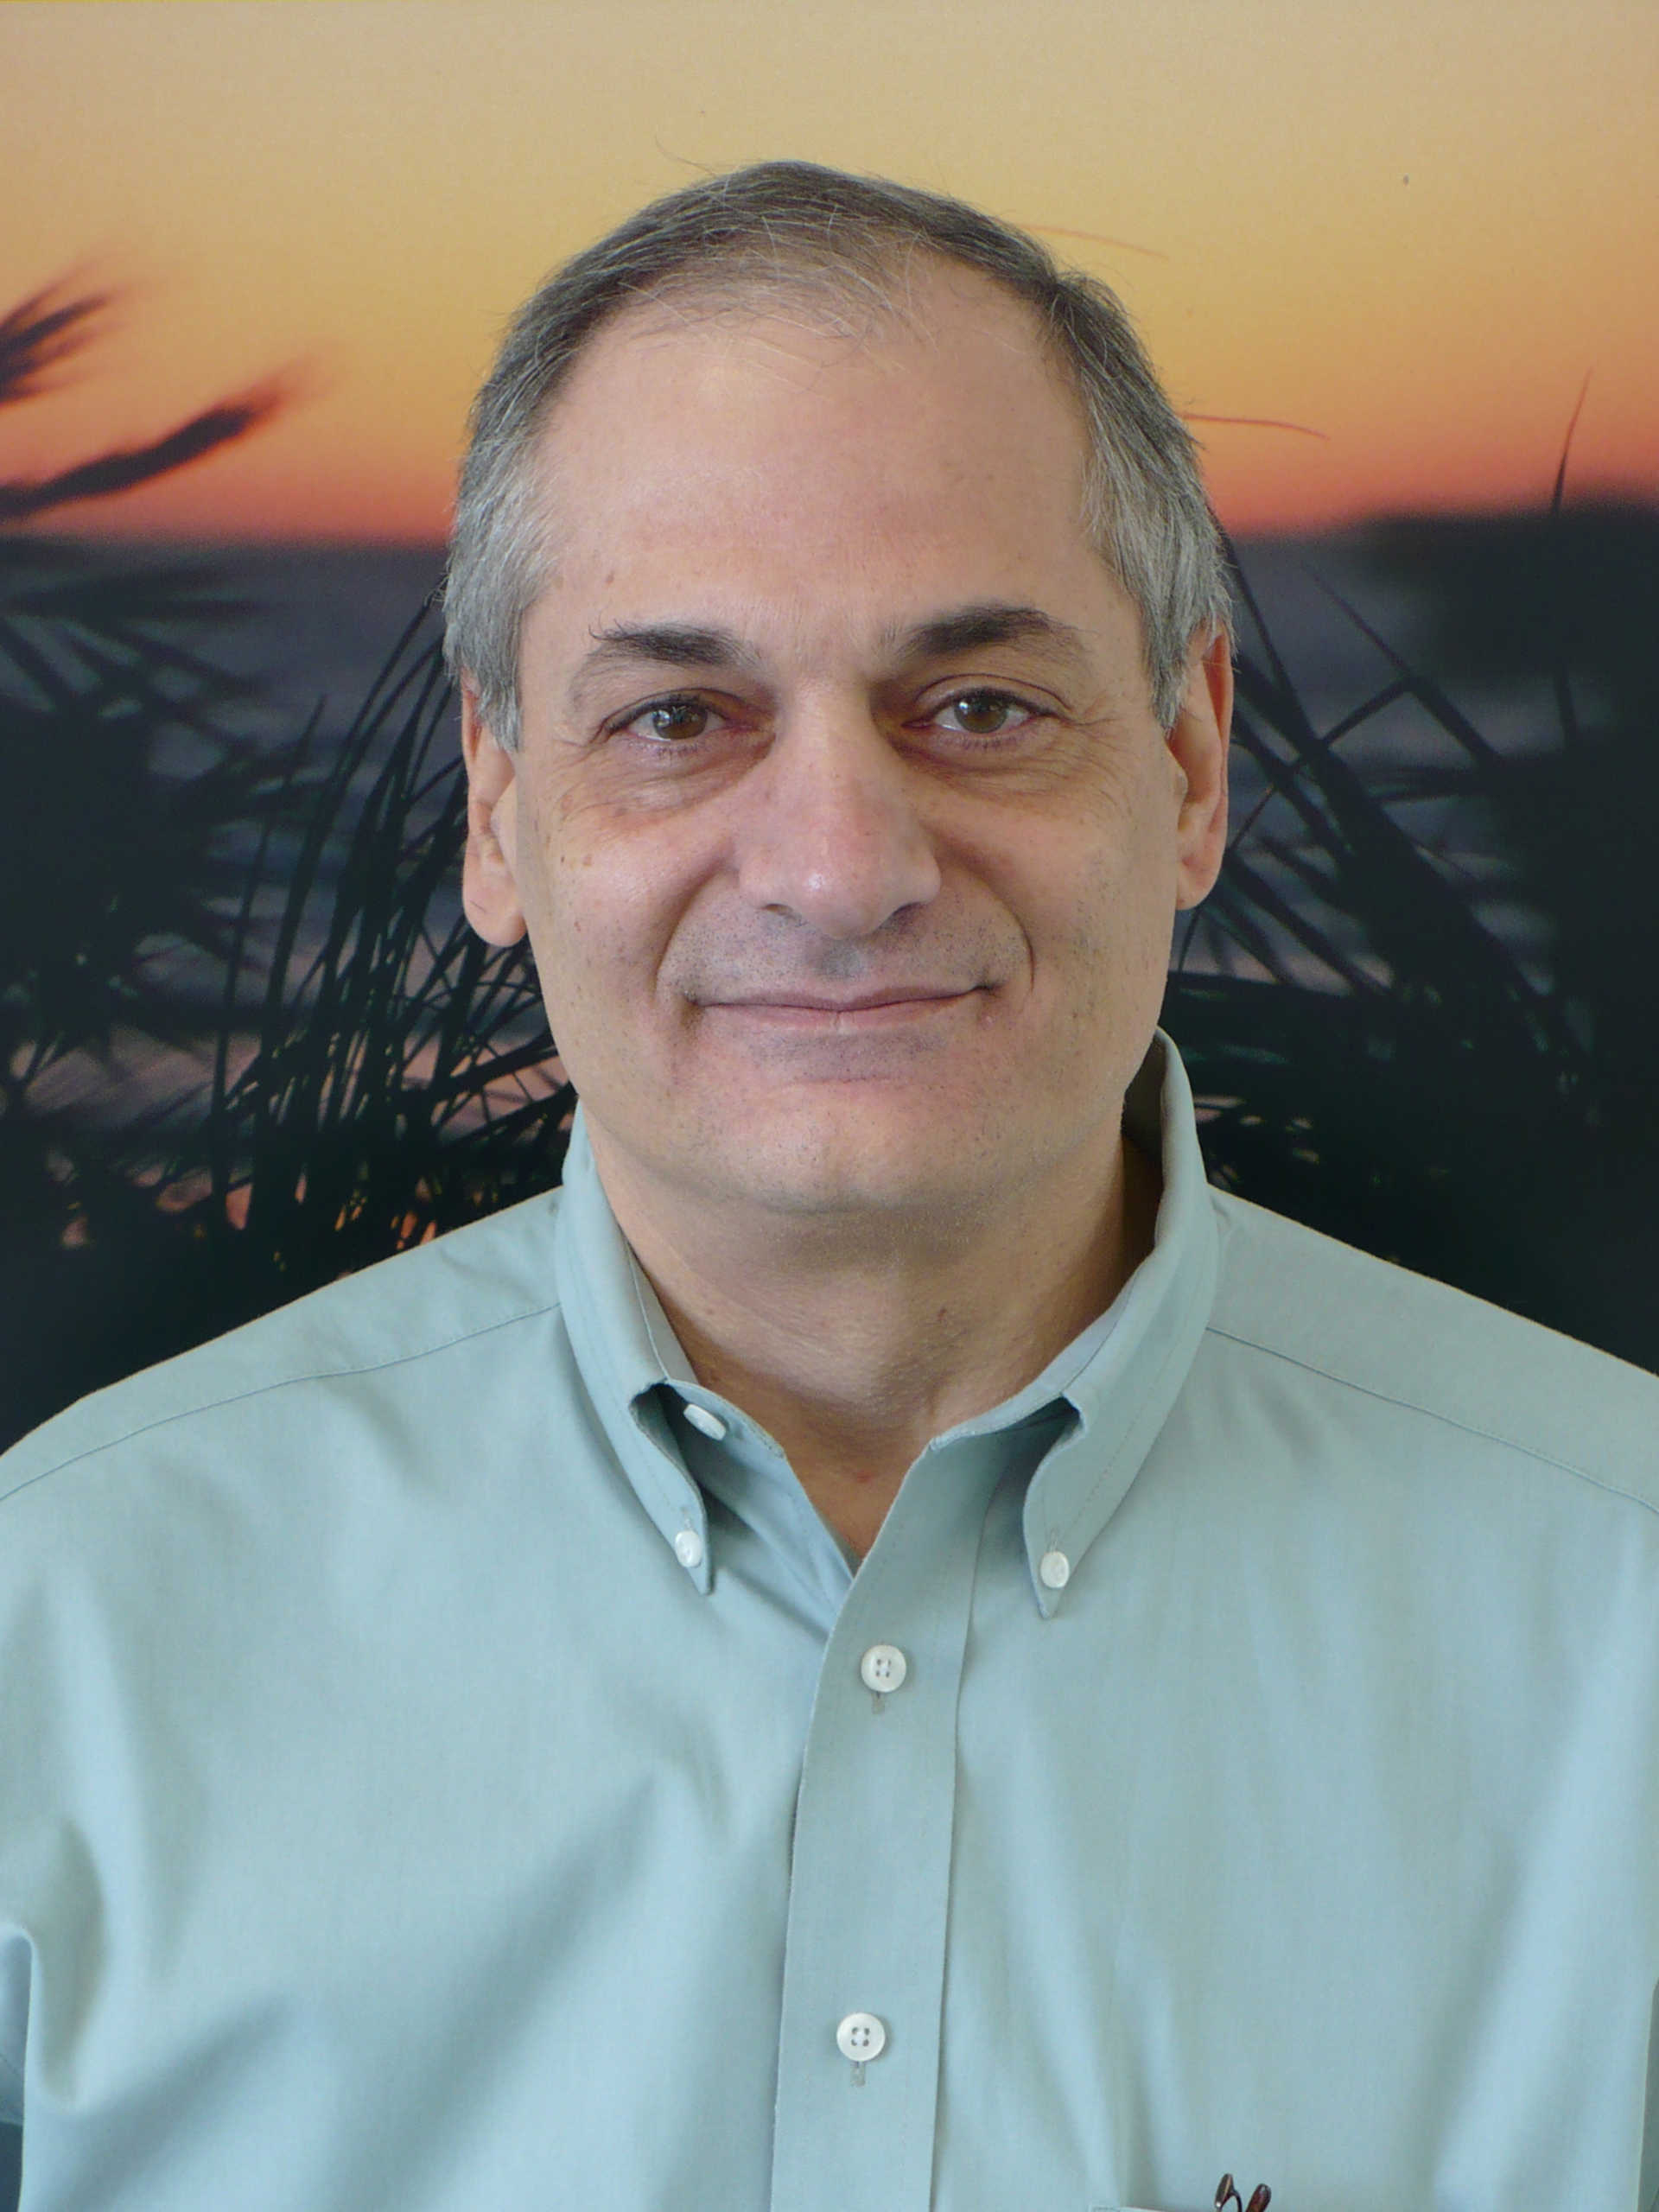
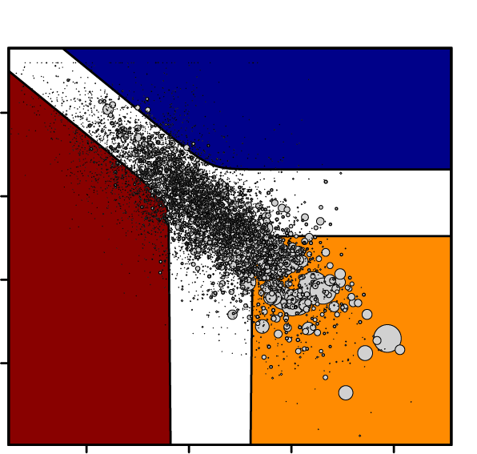
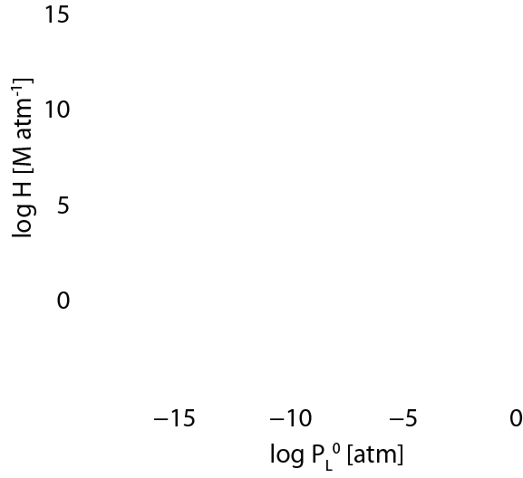
GECKO-A
Generator for Explicit Chemistry and Kinetics of Organics in the Atmosphere
INITIALIZE: Data base of laboratory measurements, for the most part evaluated critically
PROCESS: Molecular structure parser
Structure-Activity Relations (SARs)
Estimate: kinetics, products, and their properties, e.g.:
thermal and photolysis rxns
explicit molecular structures
enthalpy ΔH, vapor pressure P_{sat}, Henry’s law H_{sol}, spectra σ(λ)
Recursive: VOCs → OVOCs → CO₂, H₂O
OUTPUT: Detailed chemical mechanism, species, and their properties
POST-PROCESSING:
Box model: Emissions & deposition, photo-chemistry,
dilution/ventilation, evolving BL height,…,
Simulate: Chambers, PBLs, Lagrangian parcels…
SOME APPLICATIONS:
Detailed atomic and molecular budgets
Indicator Ratios, e.g. O/C, N/C, OH reactivity, PAM
Systematic mechanism reduction
SOA yields (good agreement in chambers, improved in field)
Condensed phase chemistry (clouds, aq. Aerosols)
Sasha Madronich
α-pinene oxidation (t = 5τ)
Cloud Aqueous
phase
Organic
Particle
phase
NB: Next version of Leeds MCM will be derived from GECKO-A

Slide 5
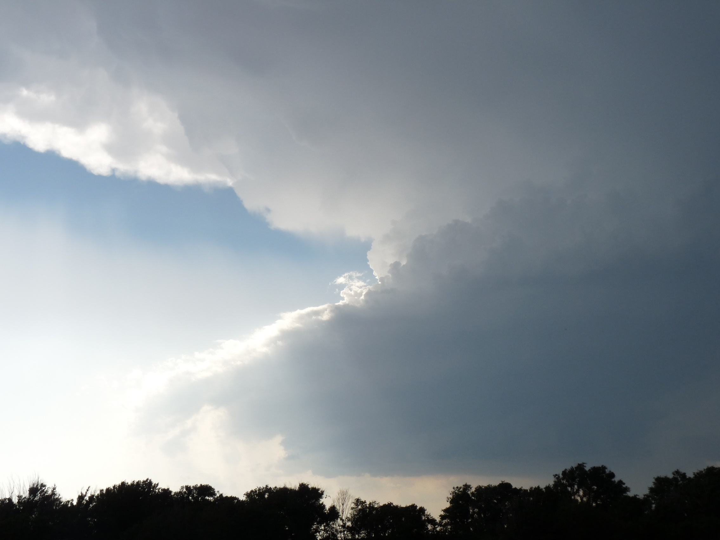
Process Studies of Clouds and Chemistry
Thunderstorm Effects on Composition
Analyzing DC3 observations with WRF-Chem modeling
Lightning (NO_{x})
Mary Barth
Removal via Precipitation
Aqueous-Phase Chemistry
Mary Barth, Ann Marie Carlton, Sara Lance
Goal: To design a coordinated investigation of the effect of clouds on tropospheric composition
Activities:
Pilot Study: CPOC (Lance poster)
Cloud Water Sampling
Box Model Intercomparison (Barth poster)
NCAR LES with Chemistry
PBL transport

Slide 6
AUTOXIDATION:
(Perrin et al., 1998; Orlando, 2007; Peeters et al., 2009; Crounse et al., 2011,2013; Ehn et al., 2014; Wang and Wang, 2016; Wang et al., 2017’ Barsanti et al., 2017; Praske et al., 2018 …etc.)
A unimolecular reaction involving H-atom transfer in an organic peroxy radical:
Leads to multiple functional groups in one generation

Slide 7
AUTOXIDATION:
(Perrin et al., 1998; Orlando, 2007; Peeters et al., 2009; Crounse et al., 2011, 2013; Ehn et al., 2014; Wang and Wang, 2016; Wang et al., 2017; Barsanti et al., 2017; Praske et al., 2018 …etc.)
A unimolecular reaction involving H-atom transfer in an organic peroxy radical:
Typically endothermic, thus strongly T-dependent; factor of 10 in rate for 25 K.
Reverse reaction usually MUCH faster than forward.
Often the first isomerization sets the stage for more.

Slide 8
AUTOXIDATION: (what goes around, might go around again and again)
RO₂ lifetime against bimolecular reactions for different [NO]:
10 ppt NO ⇒ 100 s 10 ppb NO ⇒ 0.4 s
Lots of time in the background atmosphere (minutes); as we lower NO_{x}, increasing amount of time (seconds) in urban / suburban locations. (Praske et al., 2018)
Lots of likely possibilities – biogenics, especially pristine conditions (Peeters, Crounse, Ehn)
But anthropogenic too! Alkane chemistry, ethers, alcohols, aldehydes, hydroperoxides, aromatics – any weak-ish C-H bonds in appropriate places.
What do we need to do (already happening) – Use combination of lab and theory to develop quantitative knowledge of rates of these processes (SARs) for incorporation into mechanisms.

Slide 9
ORGANIC NITRATES:
Formation and loss can control NO_{x} distributions and lifetimes (hence ozone) (e.g., Ayres et al., 2015; Romer et al., 2016; Ebben et al., 2017)
Permanent sinks or temporary reservoirs?
Peroxy Radical reactions with NO:
Still work to do, formation and loss, even for simple systems (alkanes, alkenes), but especially for functionalized peroxy radicals.

Slide 10
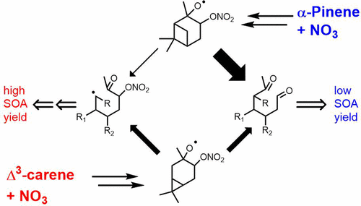
ORGANIC NITRATES:
NO₃ Reactions with Unsaturated species (Biogenics):
Many studies on NO₃ / monoterpene reactions, in particular as sources of SOA.
Ng et al., ACP 2017
Need to understand peroxy radical fate and chemistry, losses of nitrates by photoxidation, hydrolysis, etc., …
Lots of work being done here (Fry et al., 2014; Boyd et al., 2015, 2017; Slade et al., 2017; Faxon et al., 2018; Claflin and Ziemann, 2018…)
Kurten et al., 2017:
Subtle changes in structure ⇒ different behavior of an alkoxy species
⇒ v. different SOA yields.

Slide 11
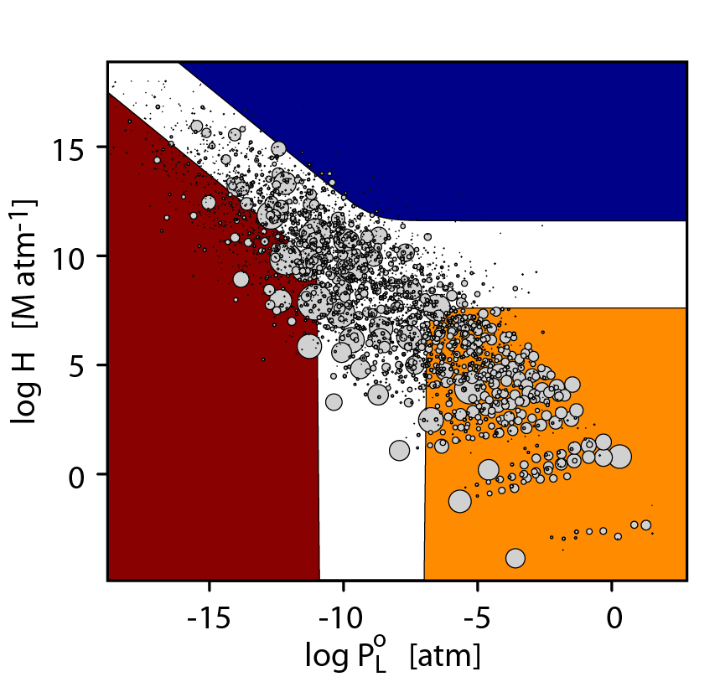
CHEMISTRY OF MULTI-FUNCTIONAL ORGANICS:
Chemistry of Dodecane in GECKO-A
Increased
Functionalization
= more uncertainty in lifetime, ‘site-of-attack’, outcome.

Slide 12
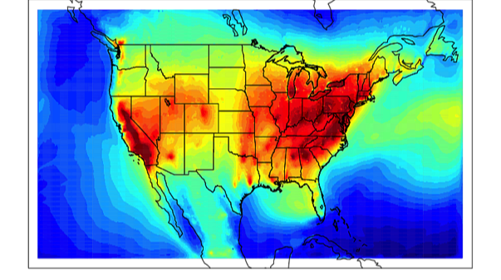
CHEMISTRY OF MULTI-FUNCTIONAL ORGANICS:
Can we judiciously select the most relevant compounds for study (rate coefficients and site-of-attack) so as to understand effects of multiple substituents, extend the utility of SARs, and develop predictive power for multifunctionals?
Chemistry of Dodecane in GECKO-A
⇔ ⇒
Increased
Functionalization
= more uncertainty in lifetime, ‘site-of-attack’, outcome.
NB: “Volatile chemical products”, too (McDonald et al., 2018; Khare and Gentner, 2018)

Slide 13
CHEMISTRY OF FURANS / OXYGENATED AROMATICS FROM BIOMASS BURNING:
Obviously, a large focus on biomass burning right now
WE-CAN about to happen, NSF C-130, E. Fischer (CSU).
FIREX-AQ – NASA/NOAA, Summer 2019
FIRELAB experiments (e.g., Stockwell et al., 2015; Hatch et al., 2017; Koss et al., 2018)
– hundreds of VOC identified / quantified
Loosely speaking: product of emission strength, reactivity, SOA potential and unknowns in the chemistry points to a series of furans and oxygenated aromatic species…
Lab studies needed – oxidative chemistry, SOA production, brown carbon
(Sangwan and Zhu, 2018; Finewax et al., 2018, …)

Slide 14
COULD HAVE DISCUSSED MANY OTHERS:
Criegee radical chemistry – lots of activity, driven by direct detection and potential importance as sulfate source (Mauldin et al., 2012; Welz et al., 2012; Nguyen et al., 2016; Taatjes, 2017; Enami et al., 2017; Vereecken et al., 2017, …).
Halogens – everything from Arctic, MBL in general, Hg chemistry, global tropospheric ozone, to urban regions.
Terpene Oxidation in general (OH/O₃) – reactive, SOA sources, lots of activity; field missions coming (COALA-BAIR). What level of detail do we require, how do we best achieve that?
HO_{x} budgets in multiple locations. Are we there yet? Missing processes? Urban ‘high-NO_{x} chemistry’?

Slide 16
Aircraft campaigns
GECKO-A ‘hyper-explicit’ mechanism generator
Earth System Models
Aircraft instruments
Fast GC/MS, CIMS
Lab-based process studies

