Slide 1
Atmospheric Chemistry Modelling at BSC
Oriol Jorba, Sara Basart, Jaime A. Benavides, Francesco Benincasa, Dene Bowdalo, Matthew L. Dawson, Enza Di Tomaso, Jerónimo Escribano, María Gonçalves, Marc Guevara, Martina Klose, Francesca Macchia, Gilbert Montané, Vincenzo Obiso, Miriam Olid, María Teresa Pay, Herve Petetin, Carles Tena, Carlos Pérez García-Pando
Atmospheric Composition Group
Earth Sciences Department
21-22/5/2019
MUSICA Kick-off Meeting, NCAR Foothills Lab, Boulder CO

Slide 2
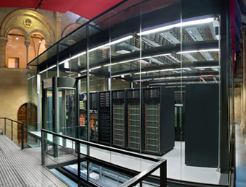
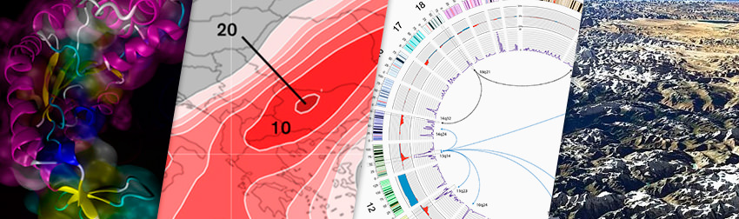





Barcelona Supercomputing Center
Centro Nacional de Supercomputación
Created in 2005
More than 600 employees
Objectives
Supercomputing services
to Spanish and
EU researchers
R&D in Computer,
Life, Earth and
Engineering Sciences
PhD programme,
technology transfer,
public engagement
Scientific Departments

Slide 3
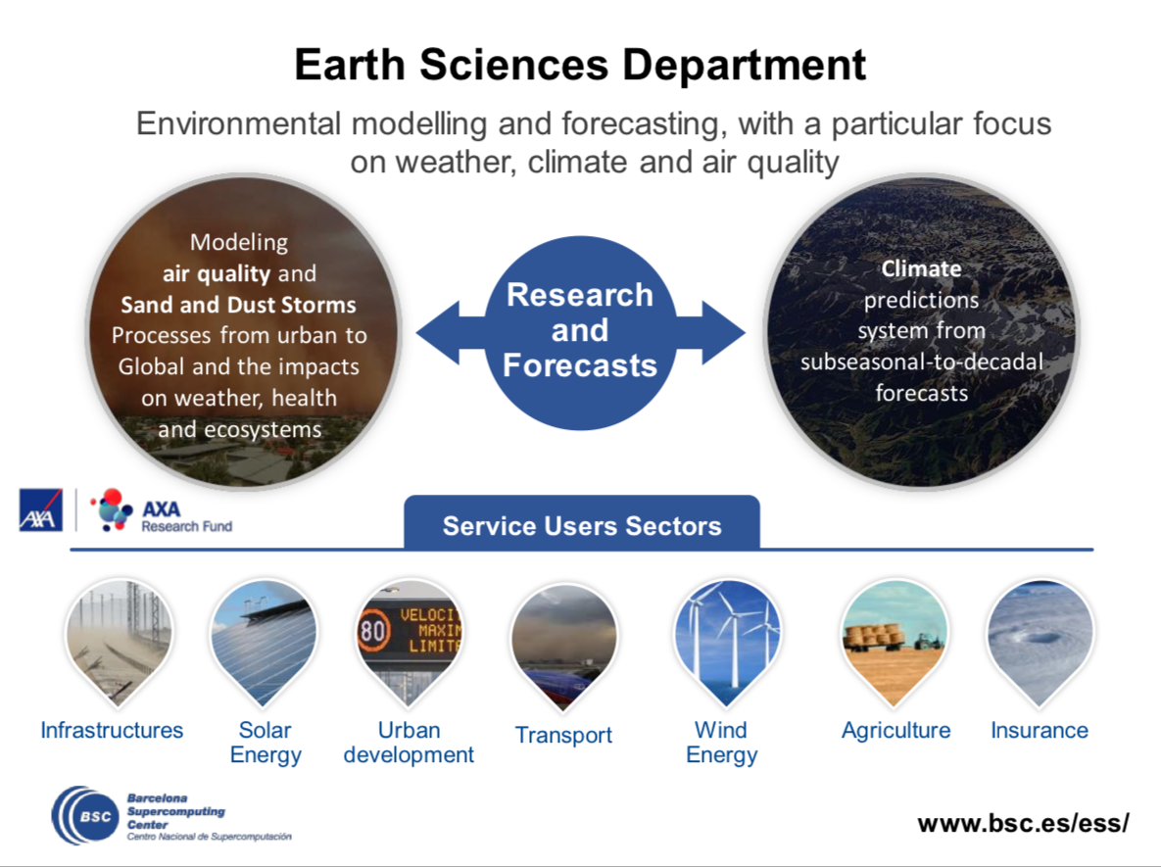
>100 people
Funding from H2020, COPERNICUS, private contracts, ESA, Spanish and regional governments
Notes:
Where MONARCH was born? The Earth Sciences Department @BSC
BSC-ES objective: has as main objective doing research on climate and atmospheric composition.
Tools: We maintain air quality forecasts and climate prediction systems both for research and services deployment.
Indeed, there is a third group in the Department doing the transition of our research outcomes to other economic sectors like in energy or urban development, the Earth System Services group.

Slide 4
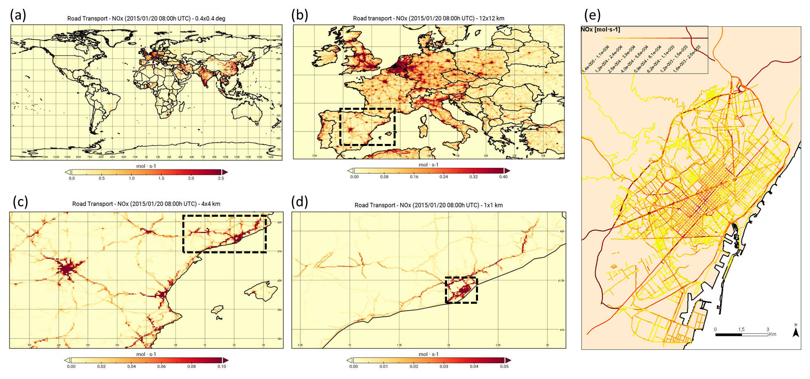
HERMESv3: emission model
A python-based, open source, parallel and multiscale emission modelling framework that processes and estimates gas and aerosol emissions for use in atmospheric chemistry models.

Slide 5
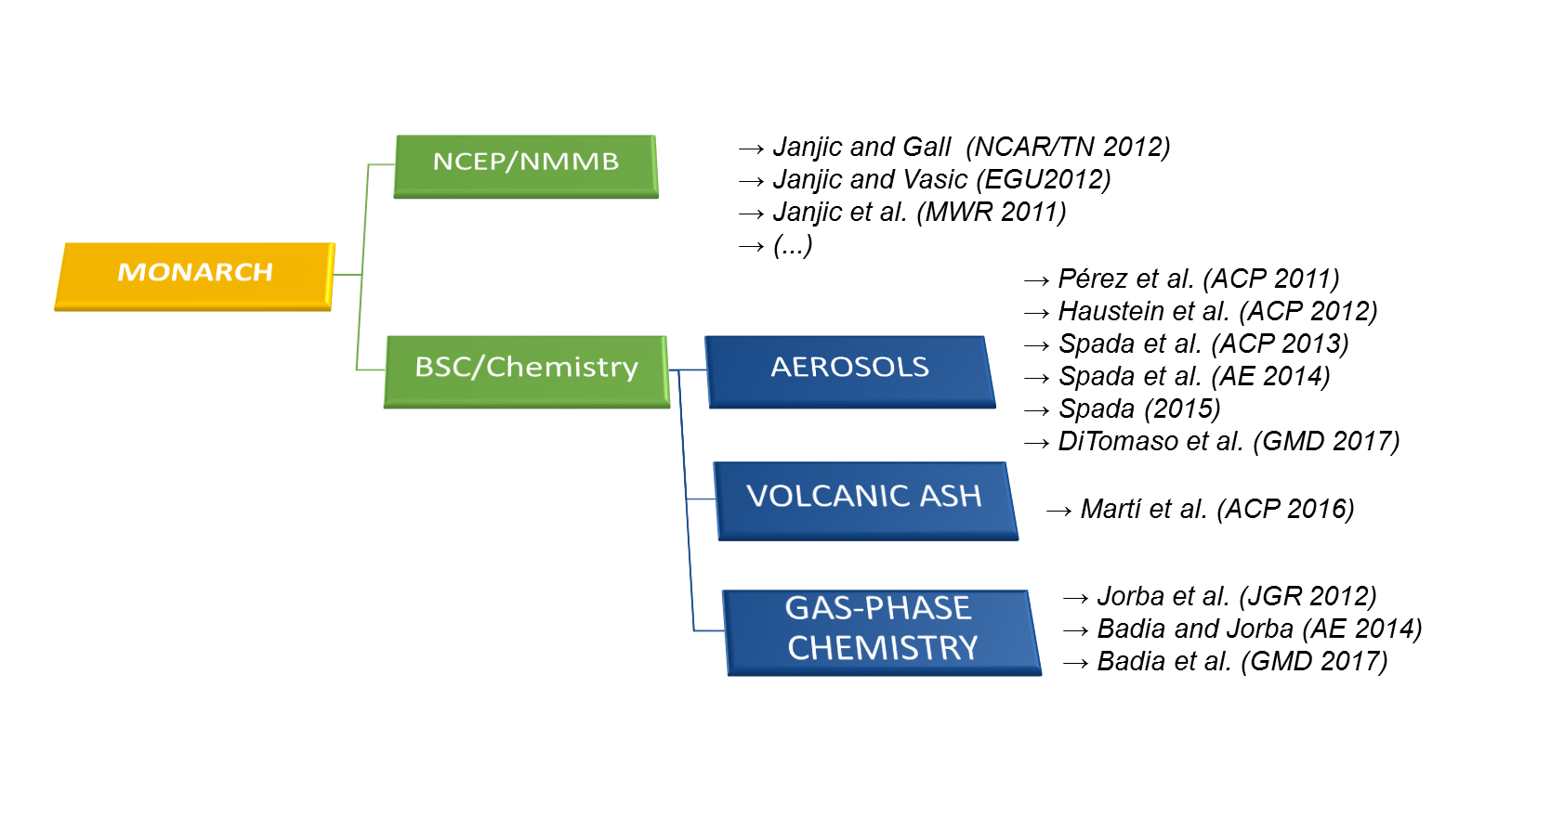
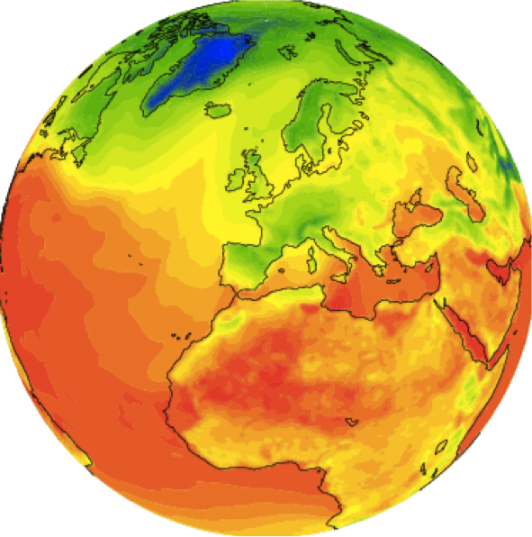
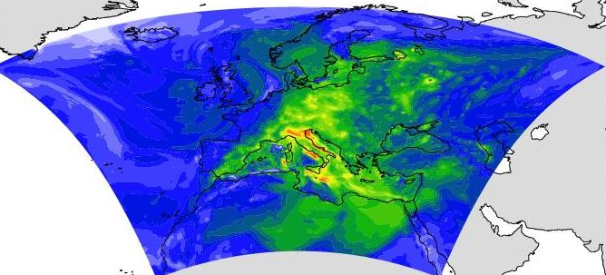
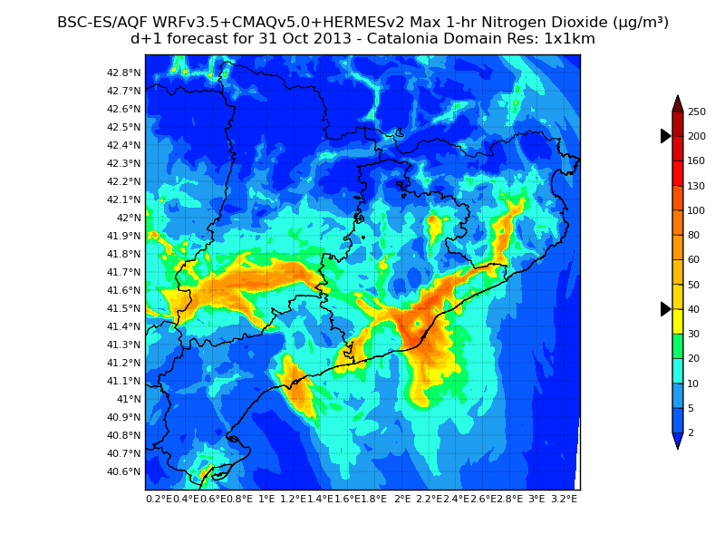
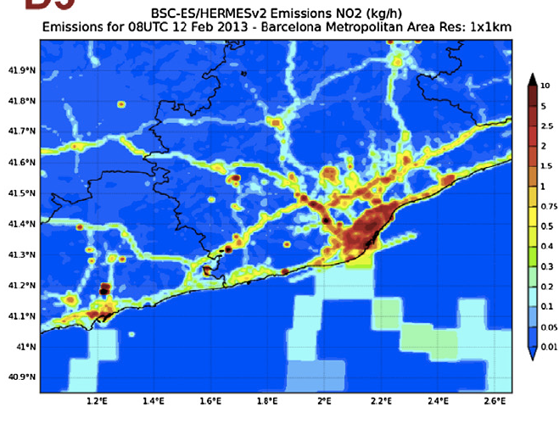

MONARCH: online weather-chemistry model
Fully on-line coupling: weather-chemistry feedback processes
In-house developed.
Multiscale: global to regional (up to 1km) scales (nesting capabilities)
Enhancement with a data assimilation system
Multiscale Model from Global to Local Scales
The AEROSOL module includes a dust module known as NMMB/BSC-Dust
Notes:
MONARCH is a fully on-line coupled meteorology – chemistry model with the option to solve feedback processes.
The meteorological driver is the NCEP NMMB
The chemistry and aerosol schemes are in-house implemented and developed.
Motivation:
(1) further development of mineral dust model dream (since 2006) towards to fully couple online meteo-chem system (since 2008),
(2) extend the area of application from regional to global scales.
It runs from global to regional domain up to 1km with telescoping nesting capability.
Data assimilation system for aerosols based on the EnKF approach.
5

Slide 6
Motivation—Chemistry and Related Modules
Host Model
photolysis
activity
model
activity
model
vapor
pressure
model
transport
gas-phase chemistry
KINETIC
inorganics
chemistry and partitioning
EQUILIBRIUM
organics chemistry and partitioning
EQUILIBRIUM
deposition
cloud
chemistry
emissions
aerosol
microphysics
changes model state
calculates rates
Aerosol Representation
support module
Notes:
Zooming out to chemistry-related modules adds to the complexity
Increase need for mapping between modules
Overlapping scope
Equilibrium & Kinetics approaches
Aerosol-related modules are tightly tied to aerosol representation used by the host model
Difficulty adding new reactions/species
What if you want to use your new scheme in a different model?

Slide 7
Approach—Integrated Chemistry Module
Host Model
Chemistry Module
Solver
chemistry API
solver API
model state
chemistry core
photolysis
deposition
transport
integrated
chemical
mechanism
emissions
changes model state
aerosol
microphysics
calculates rates
provides aerosol
properties
Aerosol Representation
PartMC Science Library
Notes:
Include emissions, gas- and aerosol-phase chemistry, photolysis, deposition, partitioning, and aerosol-phase chemistry
Chemistry module developed as part of the PartMC science software library.
Will be employed in PartMC, but can also be directly employed in other host models, like MONARCH.
(discussion not specifically focused on single-particle simulations)
Employ external solvers (right now SUNDIALS CVODE solver with the SuiteSparse sparse matrix for Jacobian data)
Will explore other solvers in the future

Slide 8
Chemistry Module – Overall Workflow
Change the chemical mechanism without recompiling
  Vary mechanism complexity based on conditions/location
  Compare mechanisms in real time
Use same mechanisms across models (MONARCH, PartMC, etc.) changing only Aerosol Representation JSON
{
"reactants" : {
"O3" : {} ,
"NO" : {}
},
"products" : {
"NO2" : {}
},
"type" : "ARRHENIUS",
"A" : 3.0E-12,
"B" : 0.0E+00,
"C" : -1500.0
}
{
"reactants" : {
"O3" : {} ,
"NO" : {}
},
"products" : {
"NO2" : {}
},
"type" : "ARRHENIUS",
"A" : 3.0E-12,
"B" : 0.0E+00,
"C" : -1500.0
}
{
"reactants" : {
"O3" : {} ,
"NO" : {}
},
"products" : {
"NO2" : {}
},
"type" : "ARRHENIUS",
"A" : 3.0E-12,
"B" : 0.0E+00,
"C" : -1500.0
}
{
"reactants" : {
"O3" : {} ,
"NO" : {}
},
"products" : {
"NO2" : {}
},
"type" : "ARRHENIUS",
"A" : 3.0E-12,
"B" : 0.0E+00,
"C" : -1500.0
}
{
"reactants" : {
"O3" : {} ,
"NO" : {}
},
"products" : {
"NO2" : {}
},
"type" : "ARRHENIUS",
"A" : 3.0E-12,
"B" : 0.0E+00,
"C" : -1500.0
}
{
"reactants" : {
"O3" : {} ,
"NO" : {}
},
"products" : {
"NO2" : {}
},
"type" : "ARRHENIUS",
"A" : 3.0E-12,
"B" : 0.0E+00,
"C" : -1500.0
}
Load input files into model objects
SIMPOLPhaseTransfer
State
TroeReaction
load()
initialize()
…
species_state[]
ArrheniusReaction
load()
initialize()
…
UNIFAC
load()
initialize()
…
Your favorite model
PDFITE
load()
initialize()
…
MassOnlyBinsModes
PartMC
advance
state
load()
initialize()
…
MONARCH
Solver
load()
initialize()
…
Condensed Data Structure
The PartMC library is available at: https://github.com/compdyn/partmc
Notes:
Summarize by example –
Experimentalist finds new chemical process
gas-phase reactions
Partitioning to aqueous aerosols
Acid dissociation
Aqueous reaction with dissolved species
Re-evaporation
Further reactions
Condensation to organic aerosols
Now they can do all this by modifying or creating a couple JSON files and run the same chemistry in a particle-resolved chamber model, a PartMC Lagrangian urban plume simulation and a global MONARCH simulations with a mixed binned/model aerosol scheme
No modifying source code
No recompiling the model
Just sit back and enjoy

Slide 9
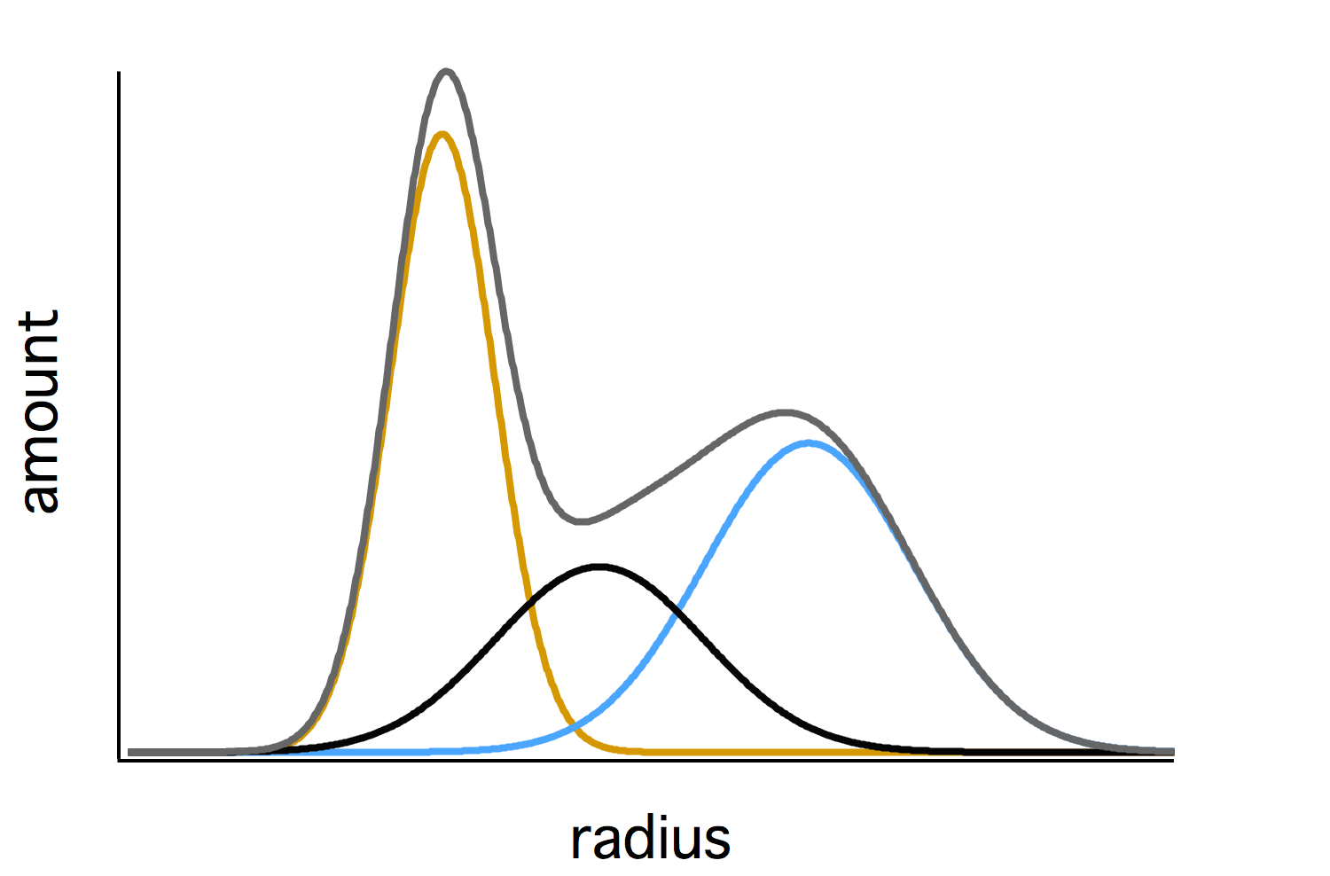
Aerosol Representation Abstraction – Approach
Model State
Modal
load()
initialize()
effective_radius()
number_concentration()
…
gas-phase species
BC
mode 1 – black carbon
O
mode 2 – organics
I
mode 3 – inorganics
INPUT
Modal
{
"name" : "Modal",
"type" : "AERO_REP_MODAL_BINNED_MASS",
"modes/bins" : {
"dust" : {
"type" : "BINNED",
"phases" : [ "dust" ],
"bins" : 8,
"minimum diameter" : 1.0e-7,
{
"name" : "inorganics",
"type" : "AERO_PHASE",
”species" : [
"PM_phob", "PM_phil", "ISOP-P1_aero",
"ISOP-P1_aero", "TERP-P1_aero", "TERP-P1_aero"
]
}
{
"name" : "black carbon",
"type" : "AERO_PHASE",
”species" : [
"PM_phob", "PM_phil", "ISOP-P1_aero",
"ISOP-P1_aero", "TERP-P1_aero", "TERP-P1_aero"
]
}
AerosolPhase
AerosolPhase
load()
initialize()
…
{
"name" : "organics",
"type" : "AERO_PHASE",
”species" : [
"PM_phob", "PM_phil", "ISOP-P1_aero",
"ISOP-P2_aero", "TERP-P1_aero", "TERP-P2_aero"
]
}
AerosolPhase
INPUT
load()
initialize()
…
load()
initialize()
…

Slide 10
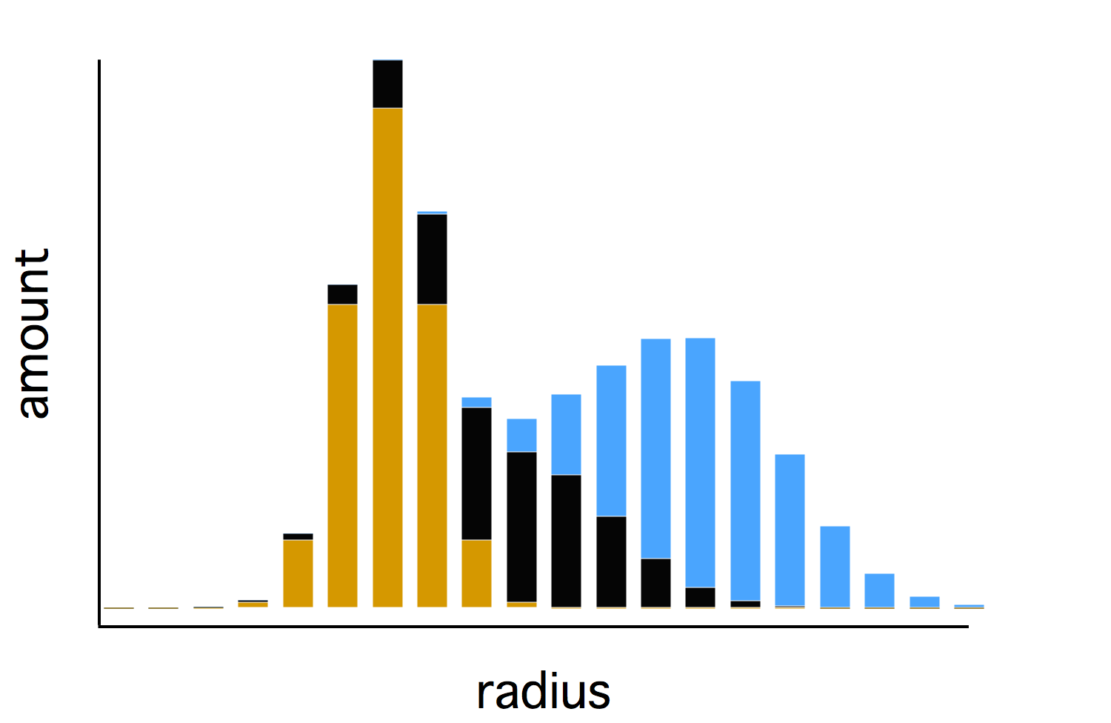
Aerosol Representation Abstraction – Approach
Model State
Binned
load()
initialize()
effective_radius()
number_concentration()
…
gas-phase species
BC
bin 1 – black carbon
O
bin 1 – organics
I
bin 1 – inorganics
INPUT
BC
bin 2 – black carbon
Binned
O
bin 2 – organics
I
bin 2 – inorganics
{
"name" : "Modal",
"type" : "AERO_REP_MODAL_BINNED_MASS",
"modes/bins" : {
"dust" : {
"type" : "BINNED",
"phases" : [ "dust" ],
"bins" : 8,
"minimum diameter" : 1.0e-7,
bin 3 – …
{
"name" : "inorganics",
"type" : "AERO_PHASE",
”species" : [
"PM_phob", "PM_phil", "ISOP-P1_aero",
"ISOP-P1_aero", "TERP-P1_aero", "TERP-P1_aero"
]
}
{
"name" : "black carbon",
"type" : "AERO_PHASE",
”species" : [
"PM_phob", "PM_phil", "ISOP-P1_aero",
"ISOP-P1_aero", "TERP-P1_aero", "TERP-P1_aero"
]
}
AerosolPhase
AerosolPhase
load()
initialize()
…
{
"name" : "organics",
"type" : "AERO_PHASE",
”species" : [
"PM_phob", "PM_phil", "ISOP-P1_aero",
"ISOP-P2_aero", "TERP-P1_aero", "TERP-P2_aero"
]
}
AerosolPhase
INPUT
load()
initialize()
…
load()
initialize()
…
Notes:
Chemistry modules – particularly inorganic and organic partitioning and chemistry – are often tightly tied to the aerosol representation used in the host model

Slide 11
Aerosol Representation Abstraction – Approach
Model State
ParticleResolved
load()
initialize()
effective_radius()
number_concentration()
…
gas-phase species
BC
particle 1 – black carbon
O
particle 1 – organics
I
particle 1 – inorganics
INPUT
BC
particle 2 – black carbon
Particle Resolved
O
particle 2 – organics
I
particle 2 – inorganics
{
"name" : "Modal",
"type" : "AERO_REP_MODAL_BINNED_MASS",
"modes/bins" : {
"dust" : {
"type" : "BINNED",
"phases" : [ "dust" ],
"bins" : 8,
"minimum diameter" : 1.0e-7,
particle 3 – …
{
"name" : "inorganics",
"type" : "AERO_PHASE",
”species" : [
"PM_phob", "PM_phil", "ISOP-P1_aero",
"ISOP-P1_aero", "TERP-P1_aero", "TERP-P1_aero"
]
}
{
"name" : "black carbon",
"type" : "AERO_PHASE",
”species" : [
"PM_phob", "PM_phil", "ISOP-P1_aero",
"ISOP-P1_aero", "TERP-P1_aero", "TERP-P1_aero"
]
}
AerosolPhase
AerosolPhase
load()
initialize()
…
{
"name" : "organics",
"type" : "AERO_PHASE",
”species" : [
"PM_phob", "PM_phil", "ISOP-P1_aero",
"ISOP-P2_aero", "TERP-P1_aero", "TERP-P2_aero"
]
}
AerosolPhase
INPUT
load()
initialize()
…
load()
initialize()
…
Notes:
Chemistry modules – particularly inorganic and organic partitioning and chemistry – are often tightly tied to the aerosol representation used in the host model

Slide 12
Porting to GPUs
Solving chemical mechanisms involve repeated calculations of contributions from hundreds or thousands of individual reactions
Approach: simultaneously solve for multiple grid cells by spreading reaction calculations across GPUs
Condensed Data Structure
GPUs
Solver
(CPU)
State
advance
state
species_state[]
Notes:
Describe porting to GPUs

Slide 13

Marenostrum IV
General-purpose block with Intel Xeon Platinum chips with a total of 165,888 processors.
Emerging technologies:
  A cluster of IBM POWER9 processors and NVIDIA Volta GPUs.
  A cluster of Intel Knights Hill (KNH) processors.
  A cluster of 64 bit ARMv8 processors in a prototype machine.

Slide 14




Acknowledgments
Spanish Ministry of Economy and Competitiveness (CGL2006-11879/CLI, CGL2008-02818/CLI, CGL2010-19652, CGL2013-46736-R1, CSD2007-0050, SEV-2011-00067)
European Research Council – H2020 ERC Consolidator Grant FRAGMENT
The Copernicus Atmosphere Monitoring Service (CAMS50, CAMS81) on behalf of the European Commission.
AXA Research Fund.
H2020 research and innovation programme under the Marie Sklodowska-Curie grant agreement No 747048.
Thank you!

Slide 15
JSON Configuration Files
Readily applied to science models
Industry standard – lots of free tools available
{
"type" : "SIMPOL_PHASE_TRANSFER",
"gas-phase species" : "ISOP-P1",
"aerosol phase" : "organic matter",
"aerosol-phase species" : "ISOP-P1_aero",
"B" : [ 3.81e3, -2.13e1, 0.0, 0.0 ]
}
{
"name" : "MONARCH mass-based",
"type" : "AERO_REP_MODAL_BINNED_MASS",
"modes/bins" : {
"dust" : {
"type" : "BINNED",
"phases" : [ "dust" ],
"bins" : 8,
"minimum diameter" : 1.0e-7,
"maximum diameter" : 1.0e-5,
"scale" : "LOG"
},
"organic matter" : {
"type" : "MODAL",
"phases" : [ "organic matter" ],
"shape" : "LOG_NORMAL",
"geometric mean diameter" : 2.12e-8,
"geometric standard deviation" : 2.24
}, …
{
"reactants" : {
"O3" : {} ,
"NO" : {}
},
"products" : {
"NO2" : {}
},
"type" : "ARRHENIUS",
"A" : 3.0E-12,
"B" : 0.0E+00,
"C" : -1500.0
}
{
"name" : "n-butanol/water activity",
"type" : "SUB_MODEL_UNIFAC",
"phases" : [ "n-butanol/water mixture"],
"functional groups" : {
"CH2(-OH)" : {
"main group" : "CHn(-OH)",
"volume param" : 0.6744,
"surface param" : 0.540
},
"CH2(hydrophobic tail)" : {
"main group" : "CHn(hydrophobic tail)",
"volume param" : 0.6744,
"surface param" : 0.540
}, …
Notes:
First step is a flexible means to configure the chemistry.
Must be able to describe complex chemical systems and be easy to work with.
JSON!

Slide 16
Object-Oriented Design
Chemistry Module
chemistry core
Reaction
AerosolRepresentation
load()
initialize()
calc_derivative()
calc_Jacoobian()
…
load()
initialize()
effective_radius()
number_concentration()
…
integrated
chemical
mechanism
SubModel
load()
initialize()
update()
…
Notes:
The second tool used to increase flexibility is object oriented model design
Three types of abstract classes are employed: reactions, sub models and aerosol representations
The way the model interacts with any extending class is the same.
- Permits rapid development of new reaction types, addition of new sub models, and deployment to host models with unique aerosol representations

