Slide 1
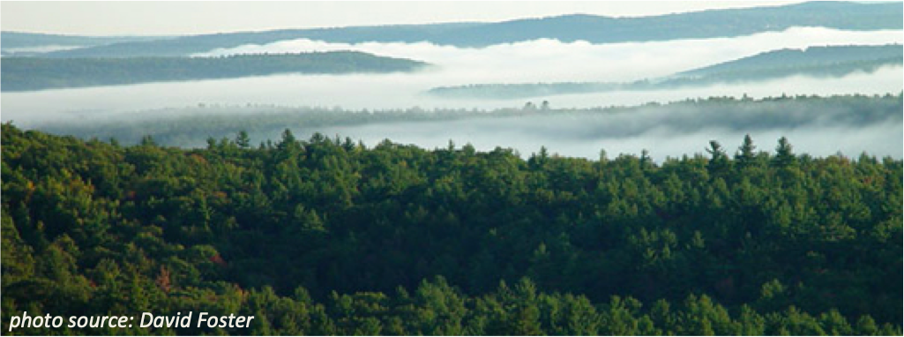
Towards a general framework for mechanistic modeling of ozone dry deposition
Olivia Clifton
Postdoctoral Fellow
Advanced Study Program
Acknowledgements: Arlene Fiore (Columbia/LDEO), Larry Horowitz (NOAA GFDL), Fabien Paulot (NOAA GFDL/Princeton), Sergey Malyshev (Princeton), Gus Correa (LDEO), Bill Massman (Forest Service), Bill Munger (Harvard), Elena Shevliakova (NOAA GFDL/Princeton), Meiyun Lin (NOAA GFDL/Princeton), Lee Murray (U. Rochestor)
Notes:
What I will talk about is relevant for dry deposition of other gases

Slide 2
Ozone dry deposition is an important but uncertain & overlooked sink of tropospheric ozone
O3
O3
O3
cuticle
Interrupts local-to-global carbon & water cycles [Sun et al., 2012; Lombardozzi et al., 2015], & influences climate [Sitch et al., 2007; Li et al., 2015]
O3
O3
ground
Substantial variations in stomatal & nonstomatal deposition pathways
Notes:
Both variations in stomatal + nonstomatal deposition pathways are important for the total ozone dry deposition

Slide 3
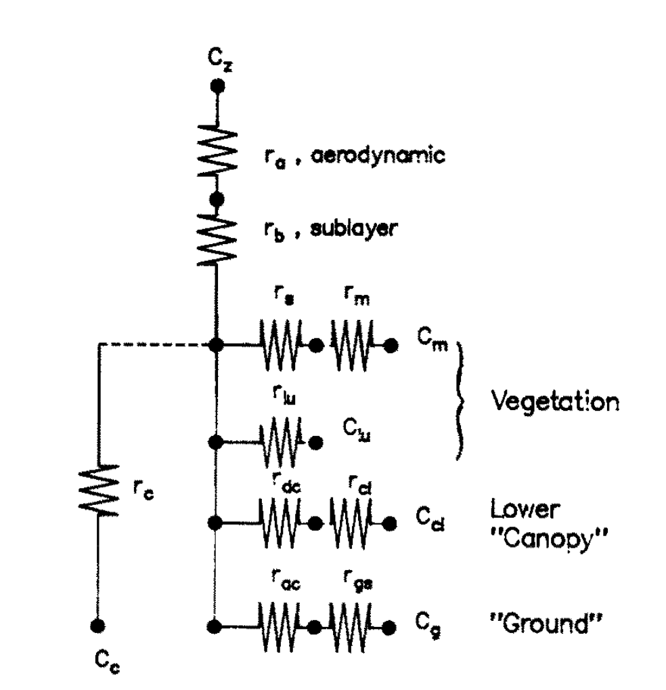
Dry deposition is typically modeled with a resistance network approach
Pros for general resistance approach
Good for modeling at all scales
Individual processes represented
Easily adaptable
Can be informed by observations
Wesely [1989]
Notes:
1) {Read title}
2) This is the resistance network approach for the Wesely 1989 scheme.
3) The Wesely scheme is widely used
4) {Go through network; Ra, Rb, deposition pathways}
5) {Click} In general, resistance network approaches have a lot of strengths
6) {Click, Go through bullets}

Slide 4
Most representations of processes within resistance frameworks are crude
High-frequency (e.g., hourly) modeling for months to centuries
Look-up table values for regional & seasonal average conditions
Very short-term observations (e.g., days or less)
forest
crop
water
grass
Baseline/climatological deposition velocity may not be captured well
Not much emphasis on representing variations (e.g., daily, interannual)
Notes:
IMO, the major limitation of current DD schemes is not the resistance network approach, rather the limited representation of processes
DD schemes strongly rely on look-up table values, or tuning parameters, to represent different processes
Very short-term observations were used to inform look-up table values for different land use types + seasons in the Wesely scheme
{CLICK} which is used in atm. chem. models to simulate changes over months to centuries.
{CLICK} Wesely emphasized that this scheme was supposed to represent regional & seasonal average conditions
But we don’t even know if “baseline” conditions are represented well

Slide 5
Sensitivity to look-up table values in Wesely scheme
GEOS-Chem 9-02 with 2006 GEOS-5 & land use type according to Geddes et al. [2016]
Stomata
Cuticle
Ground
Lower canopy
1.4
Coniferous
Deciduous
Tropical
Grass
Crops
Are the sensitivities to look-up table values realistic?
Is the magnitude of current look-up table values accurate?
1.2
Fractional change
1
0.8
Fractional change in annual mean ozone deposition velocity for grid boxes dominated by land use type shown for ±50% changes in look-up table value
Silva & Heald [2018]
Notes:
{Go through plot slowly; then describe some of sensitivities that this plot shows}

Slide 6
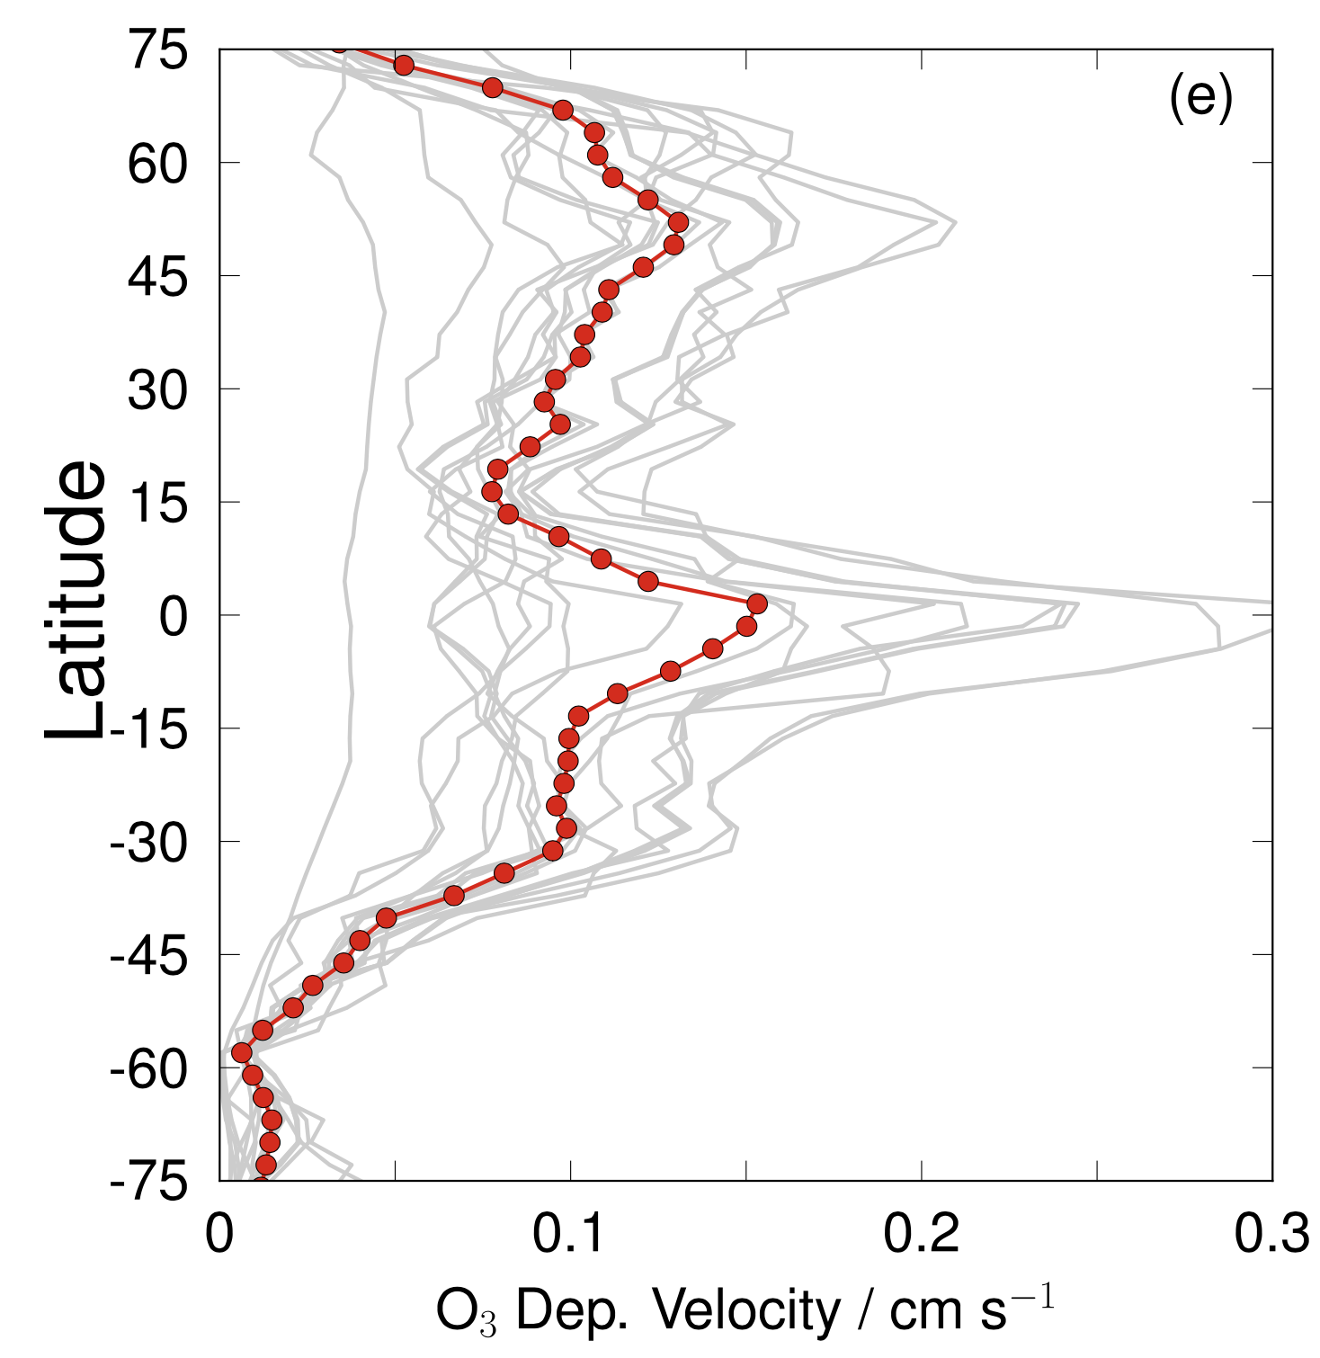
Ozone deposition velocity varies strongly across global chemistry-climate models
Annual averages from models used in TF HTAP comparison
All but two use schemes based on Wesely [1989]
Factor of 2-3 variation suggests strong model sensitivity to implementation (e.g., inputs)
Multimodel average
Individual model
ozone deposition velocity (cm s⁻¹)
Hardacre, Wild, & Emberson [2015]

Slide 7
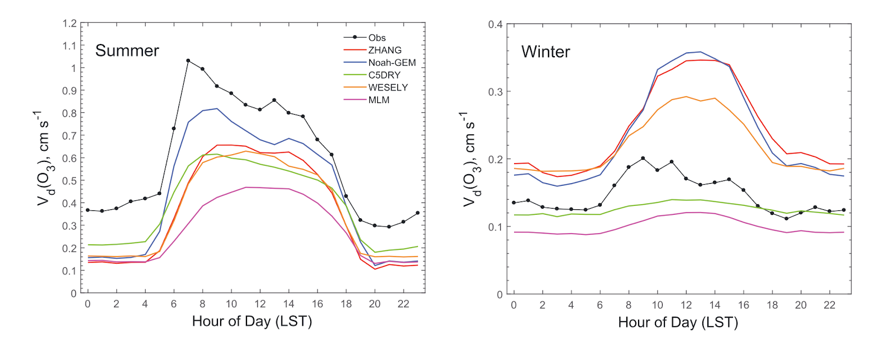
Ozone deposition velocity also varies across different schemes
Five dry deposition parameterizations driven by observations from Borden Forest
ozone deposition velocity (cm s⁻¹)
ozone deposition velocity (cm s⁻¹)
Wu, Schwede, et al. [2018]
Variation across schemes is the result of several processes
Most schemes have a high degree of empiricism
Notes:
{Talk through plot}
And Zhiyong finds that {click} …
I’d just like to mention here that like the Wesely scheme, most of the these schemes …. {CLICK}

Slide 8
Brazen empiricism in ozone dry deposition schemes hinders our ability to:
Attribute variability & trends in tropospheric ozone concentrations to specific processes
Project atmospheric composition, as well as air quality-climate-vegetation connections

Slide 9
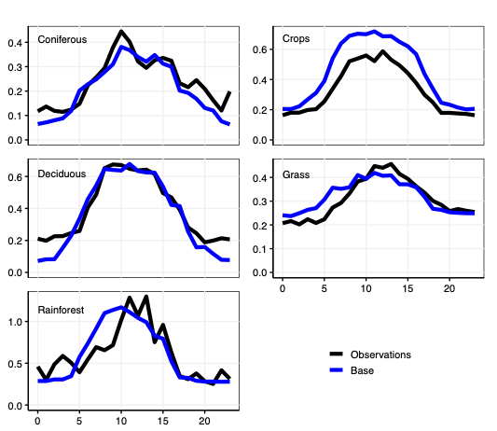
What are current schemes reasonably good at?
GEOS-Chem 9-02 with 2006 GEOS-5 & land use type according to Geddes et al. [2016]
ozone deposition velocity (cm s⁻¹)
Observations
GEOS-Chem, respective land use type
hour of the day
Silva & Heald [2018]
GEOS-Chem shows strength in simulating diel cycles
hour of the day
Notes:
Aggregate of many observations for a given land use type.
Sampled model at observational sites for respective land use type

Slide 10
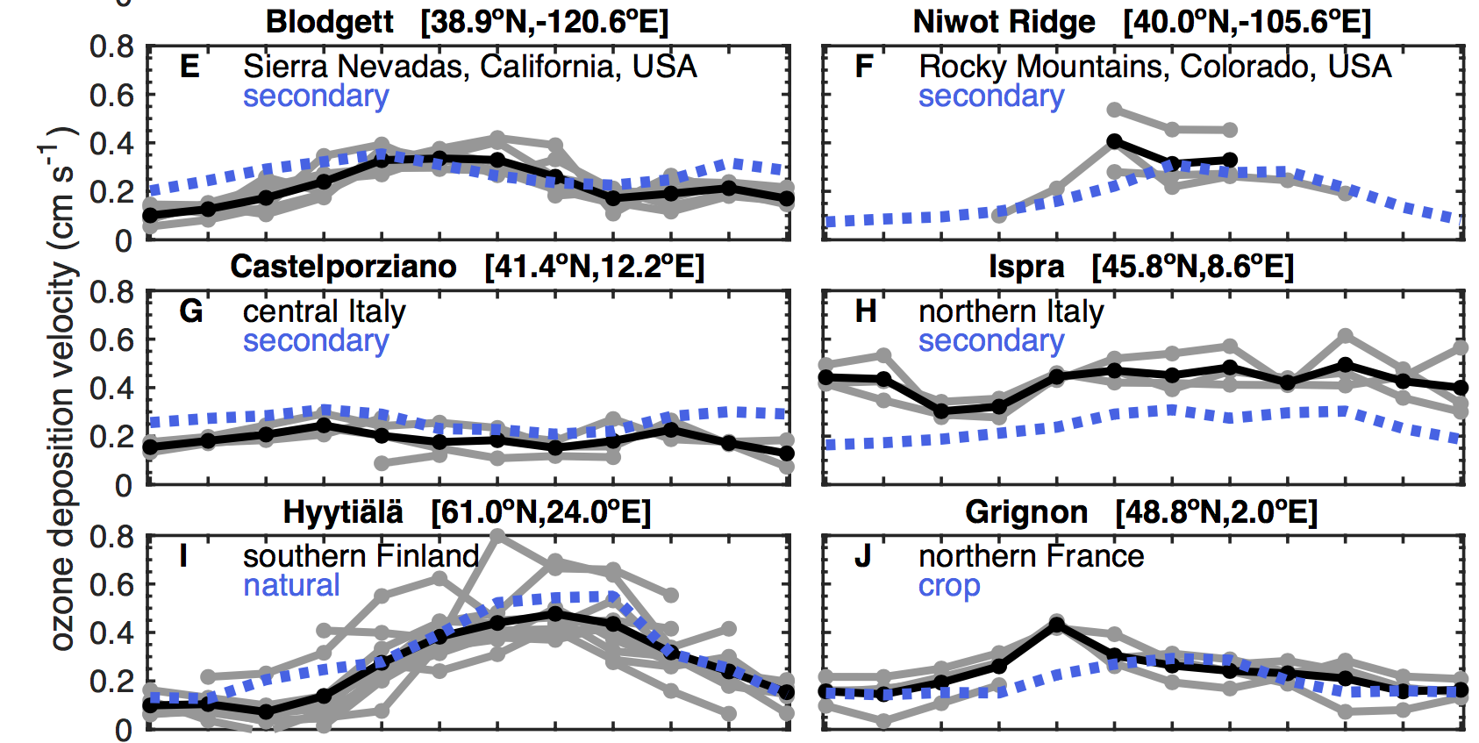
What are current schemes reasonably good at?
NOAA GFDL AM3 with new dry deposition scheme in underlying land model (Paulot et al., 2018; Clifton et al., in prep)
AM3 shows strength in simulating seasonality
ozone deposition velocity (cm s⁻¹)
Observations, multiyear average
Observations, single year
Clifton, Paulot, Fiore, Horowitz, et al., in prep
AM3, respective land use type
Notes:
{Emphasize that things may look good in some models, but it’s hard to tell if we are getting things right for the right reasons.}

Slide 11
Where are current schemes lacking?
Harvard Forest
Interannual variability
Long-term trends (??)
Changes with environmental conditions like surface wetness
Spatial heterogeneity
Spatially-extensive surfaces with low deposition velocities (e.g., snow, water)
ozone deposition velocity (cm s⁻¹)
ozone eddy covariance flux observations
ozone deposition velocity (cm s⁻¹)
GEOS-Chem
Wesely [1989] dry deposition scheme
Clifton et al. [2017]
Notes:
{After last bullet talk about how much of the research on ozone deposition focuses on the growing season when deposition velocities and ozone pollution tend to be high, but recent work suggests that deposition to snow and water may be important for large-scale pollution & the tropospheric ozone budget}

Slide 12
Better process understanding of deposition pathways than previously thought
e.g., resistance to removal of ozone by soil
Reactions with soil surfaces
Reactions with gases in soil
How easy is it for ozone to diffuse into soil
Bill Massman
Several inputs are uncertain at large scale
Clifton et al., review on ozone dry dep., in prep
Notes:
Coming back to the representation of processes, I think we have better understanding of depositional pathways than we previously thought or than modeled in current ozone dry deposition schemes
This is a new model for the resistance to .. derived for me by Bill Massman for our review on ozone dry deposition
{Go through terms}
I wont go through all of the variables here, but {CLICK} I’ll say that several of them are uncertain at the large scale.

Slide 13
What are the bottlenecks in creating an effective scheme?
Ability to represent relative variations in individual deposition pathways sufficiently
Lack of realistic inputs (either when using forcing data or underlying land surface model)
Clifton et al., review on ozone dry dep., in prep

