Slide 1
Air Quality Modeling at EPA – Global to Urban scales
Jonathan E. Pleim & AQ Model Development Team
Office of Research and Development
USEPA
MUSICA Kick-off Meeting, May 21 – 22, 2019

Slide 2
Atmospheric model development at EPA
Community Multiscale Air Quality (CMAQ) model is a comprehensive chemical transport model:
  gas, aerosol, aqueous chemistry
  photolysis including cloud and aerosol effects
  precipitation scavenging/wet deposition and convective cloud transport
  dry deposition and bidirectional surface flux
  dust, sea salt and biogenic emissions processes
WRF
  EPA added physics: ACM2, PX LSM, modified KF
WRF-CMAQ
  Two-way coupled w/ direct aerosol radiative feedback
MPAS
  EPA added physics: ACM2, PX LSM, modified KF
  Analysis FDDA
MPAS-CMAQ
  Two –way coupled on MPAS mesh

Slide 3
CMAQv5.3
Highlights of new version to be released in June 2019
  Chemistry mechanisms updated and consolidated. Complexity of chemical speciation
    reduced
  Photolysis and halogen updates - long-range transport of ozone
  Expanded cloud aqueous chemistry including SOA production
  Biogenic secondary organic aerosol production revised
  Water uptake to aerosol organic phase – applications to
    chemistry, mixing state, optics, etc.
  Updates dry deposition of gases and aerosols
  Improved bidirectional surface flux for NH₃

Slide 4
Aerosols: Organic Aerosol in CMAQv5.3 (AERO7)
PAHs
+ OH
+ OH/NO
pcSOG
pcVOC
long
alkanes
SVAVB1
AAVB1
pcSOA
+ OH
+ OH/HO₂
OOG
AAVB2
OOA
+OH
high-yield aromatics
SVAVB2
+ OH/NO
AAVB3
POA
POG
SVAVB3
AOLGA
low-yield aromatics
+ OH/NO
AAVB4
POC+NCOM
SVAVB4
cloud
water
+ OH/NO
RH
AORGH₂O
benzene
+OH, +O₃, +NO₃, +O³P
SVSQT
AORGC
sesquiterpenes
ASQT
AOLGB
AGLY
+OH, +O₃, +O³P
SVMT1, SVMT2
SVMT3, SVMT4
SVMT5, SVMT6
APIN monoterpenes
AMT1, AMT2
AMT3, AMT4
AMT5, AMT6
GLY MGLY
ANTHROPOGENIC EMISSIONS
AISO3
+OH, +O₃, +O³P
TERP monoterpenes
+NO₃
AMTNO₃
AMTHYD
BIOGENIC EMISSIONS
MTNO₃
VOCs
+OH, + NO₃
SV_ISO1 SV_ISO2
AISO1 AISO2
isoprene
EMISSIONS
EMISSIONS
EMISSIONS
IEPOX
aqueous aerosol
Notes:
Figure: Schematic of SOA in updated simulation. See Pye et al. 2017 for a description of the traditional and aqueous aerosol SOA systems. See Pye et al. 2015 for MTNO3 formation and hydrolysis. See Murphy et al. 2017 for a description of the semivolatile POA (POA, POG), oxidized POA vapors (OOA, OOG) and potential SOA from combustion sources (pcSOA) system. Species different from the default configuration are in red.
Improved consistency between SAPRC and CB SOA mechanisms
Monoterpene organic nitrate SOA from SAPRC07tic (Pye et al. 2015 ES&T) now available in CB6r3-aero7.
Included in aero6i and aero7i as well.
Reduced number of species required for primarily anthropogenic SOA (benzene, toluene, xylene, alkanes, PAHs/naphthalene) (all aero7/7i mechanisms)
Updated monoterpene photooxidation SOA (all aero7/7i mechanisms)
Uptake of water onto hydrophilic organics (all aero7/7i mechanisms)
Process analysis can now access contributions from individual aerosol microphysical processes (e.g. coagulation from Aitken to Accumulation mode, condensation to each mode, new particle formation, etc)

Slide 5
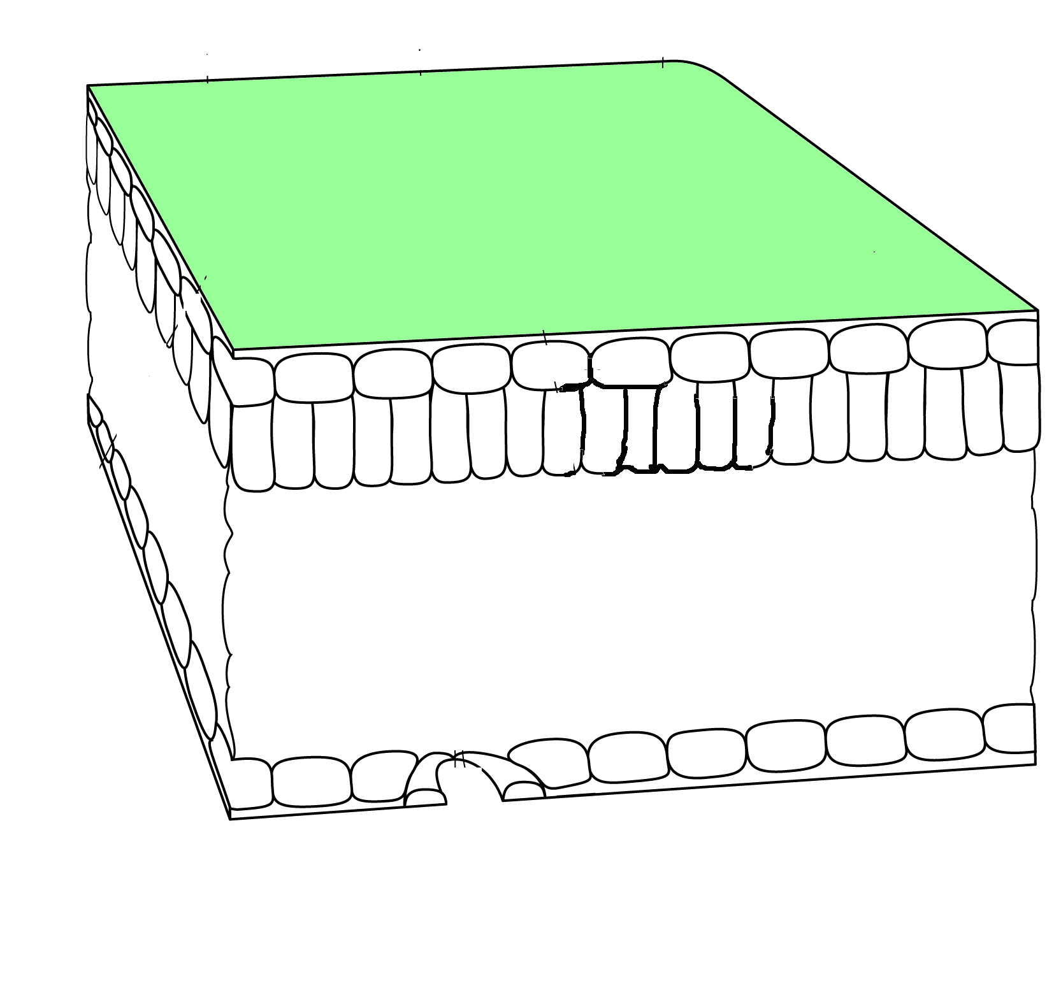
NH₃ Bidirectional surface flux
New NH₃ bidirectional flux in CMAQ is closely linked to EPIC agriculture model
The bidi model uses daily inputs from EPIC for soil ammonia content, soil pH, soil moisture CEC, porosity, and wilting point to calculate Γ_{g} and χ_{g}
χ_{a}
R_{a}
NH₃(ppb)
0.5R_{inc}
χ_{c}
R_{w}
0.5R_{inc}
R_{b}
CMAQ
R_{bg}
R_{b}
χ_{st}
R_{soil}
R_{st}
χ_{g}
CrIS
Schematic of bidi model
Monthly average NH₃ (ppb)
vs AMoN observations
June average NH₃ concentrations
Vs CrIS retrievals
Pleim et al 2019, JAMES submitted

Slide 6
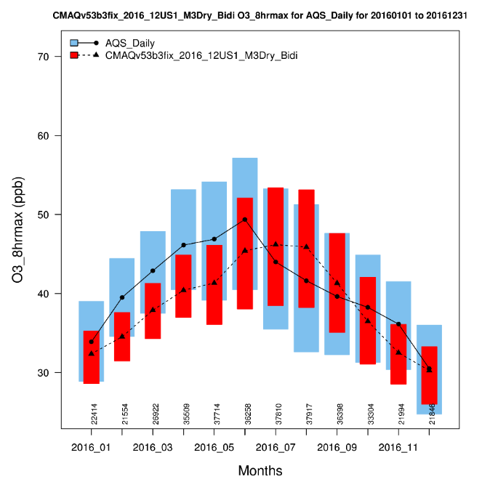
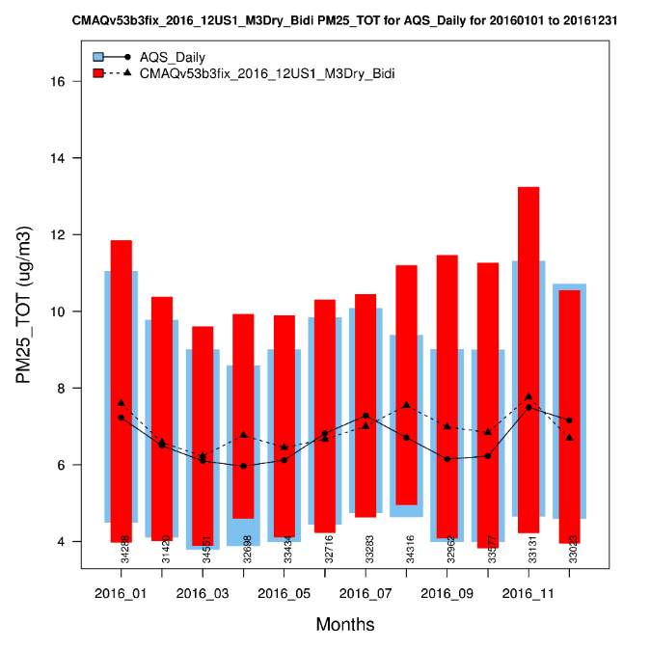
Model evaluation
EPA models are used for policy development and air quality regulation as well as research
  Must have scientific review and credibility (journal articles, peer reviews)
  Every new version is rigorously evaluated
Max 8-hr O₃
Max 8-hr O₃
PM2.5
PM2.5
CMAQv5.3 Mean bias
May – August, 2016

Slide 7
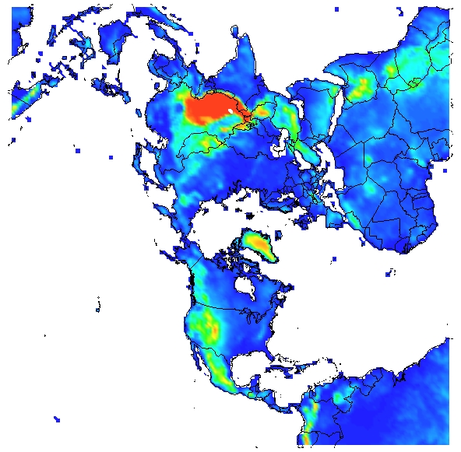
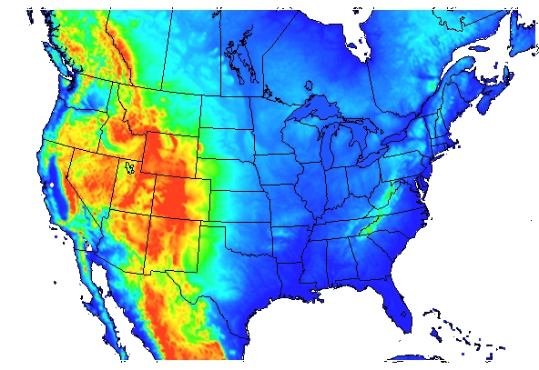
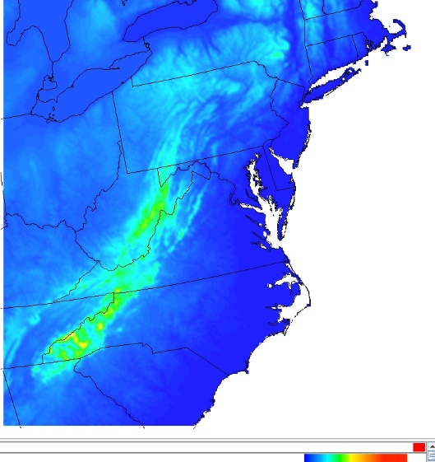
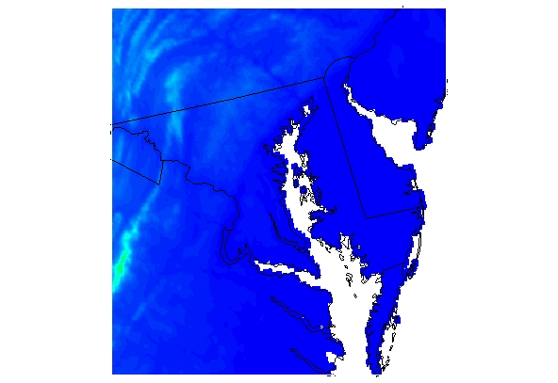
Drivers for global multiscale system
As AQ is cleaner in US, more comes from beyond our borders
  Current systems either rely on different global models for LBCs for regional AQ modeling or Multiple nesting from Hemispheric to regional and urban:
  Multi-step process, Many opportunities for user mistakes, Interpolation errors on boundaries, Resolution discontinuities, Map projection differences, No upscale feedback
ΔX = 108 km
ΔX = 12 km
ΔX = 4 km
ΔX = 1 km

Slide 8

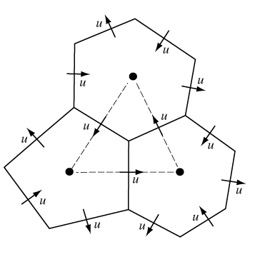
MPAS
MPAS with its capability for seamless refinement is ideally suited for global to local scale AQ modeling
MPAS uniform mesh (240 km)
MPAS non-uniform mesh (92km – 25km)
Refinement over CONUS

Slide 9
MPAS-CMAQ
Integrated meteorology and chemistry on global domain with seamless refinement to local scales
  Simple efficient interface
    Call CMAQ as module similar to WRF physics
    Two-way interaction including aerosol feedbacks
  Transport (adv, diffusion) of chemical species in MPAS
    Ensure mass conservation
    Consistency with met parameters
    Minimize numerical diffusion and dispersion
Three configurations of flexible systems:
  Online global variable grid: MPAS-CMAQ)
  Online regional (WRF-CMAQ and limited area MPAS-CMAQ)
  Offline regional (WRF + CMAQ)
Uses latest version of CMAQ from public EPA Git Repo (no changes needed)
Future coupling to other met models (FV3)
MPAS

Slide 10
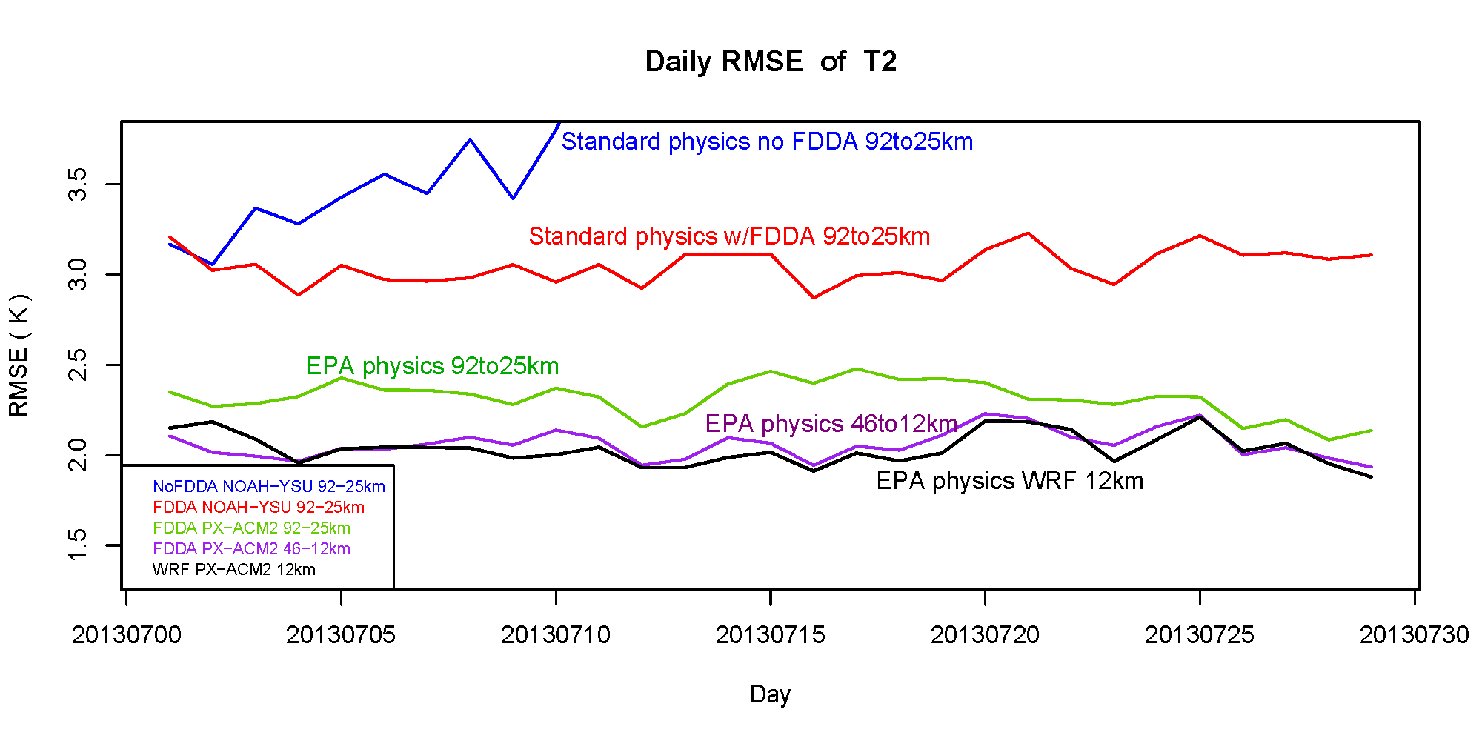
Testing EPA mods to MPAS
2-m Temperature Daily RMSE for CONUS
July 2013

Slide 11
MPAS w/ EPA physics & FDDA
July 2016 with 46km/12 km mesh resolution
EPA Physics – ACM2, PX LSM, modified KF
FDDA using 6-hrly GFS analyses at 0.25 deg resolution
Surface analyses for PX LSM soil nudging : 0.25-deg GFS with 12 km NAM blending over US
RMSE T-2m
RMSE WS-10m

Slide 12
Initial testing of MPAS-CMAQ
Max 8hr Ozone – July 11 – 31, 2013
Observed
MPAS Simulated
TOAR dataset includes ozone observations from many networks across the globe
Need more data for Asia (particularly China) and Africa

Slide 13
Conclusions
EPA AQ models are developed for policy development and regulatory planning as well as for air quality research
AQ models need to address issues relevant to implementation of policy goals:
  Improved capabilities for addressing local nonattainment issues
  Enable examination of US air pollution in context of changing global emissions
  Quantifying natural vs anthropogenic contributions
  Improved cross-media application capability
  Models must be state-of-the-science to withstand legal challenge
Expanding to global scale through coupling with MPAS is next step for serving both EPA’s mission and the research community
AMS 100the annual meeting session: Global to Local Scale Coupled Meteorology and Atmospheric Chemistry Modeling

Slide 14
Disclaimer
The views expressed in this presentation are those of the authors and do not necessarily reflect the views or policies of the U.S. EPA

Slide 15
New research on mechanistic approaches to monoterpene SOA formation
Monoterpene oxidation products dictate PM_{2.5} and new particle formation
Predicted decline in HOM peroxy radical production in Atlanta, GA and other sites
New particle formation rates by pathway (May-June)
Changes in monoterpene SOA due to the NO_{x}-oxidant-autoxidation couplings potentially responsible for a quarter of the recent downward trend in organic aerosol in the southeastern United States (Pye et al. 2019 PNAS)
Monoterpene oxidation products (ELVOC) are the dominant source of new particle number except where ammonia (NH₃) or amines (e.g. DMA) are abundant (Murphy et al. in prep)
Notes:
HOM peroxy radical is proxy for MT SOA production

Slide 16
Volatile chemical products important for urban air quality
OH Reactivity
Background corrected SOA
Ozone
CalNex 2010 CMAQ Modeling (Qin et al. in prep) Pasadena site
Modeling experiment to show that inclusion of more VOCs from VCPs improves SOA, ozone, and OH reactivity

