Slide 1
Emissions for MUSICA
Claire Granier
NOAA ESRL/Chemical Sciences Division and CIRES, University of Colorado
Boulder, CO, USA
and
Laboratoire d’Aérologie, Toulouse, France
With contributions from colleagues from
CAMS, GEIA and AMIGO

Slide 2
Discussed in this talk
What we know/don’t know/is available for:
Anthropogenic emissions
Natural emissions (biogenic, soils, oceans, volcanoes)
Emissions from fires

Slide 3
Global anthropogenic emissions - 1
Three most recent datasets
EDGAR v4.3.2 (JRC, Italy): 1970-2012, 0.1x0.1 degree, monthly averages
CEDS (PNNL, USA): 1750-2014, 0.5x0.5 degree
CAMS-GLOB-ANT: 2000-2019, 0.1x0.1 degree, monthly averages
= combination of EDGAR + CEDS + extrapolation
General problem for anthropogenic emissions inventories: no up-to-date emissions, because data on energy use/fuel consumption/traffic/etc. need a few years to be compiled by agencies
Regional emissions: many data exist for the USA, Canada, Europe, China, Africa and for a few countries in Latin America
Common issue: spatial distribution
All datasets provide emissions for each country
Gridding based on proxies which are not described and almost never public

Slide 4
Global anthropogenic emissions - 2
VOCs speciation:
Most inventories = emissions of total NMVOCs
Some models include a speciation, either based on reactivity, or just as a global percentage of total NMVOCs
Gridded speciations:
RETRO speciation: developed in 2000, never published, based on non-published EU data
Huang et al. 2017 (EDGAR group): 1970-2012 0.1x0.1 degree speciation
Particulate matter
Global inventories: EDGAR, CEDS and CAMS provide BC and OC emissions
Regional inventories (EPA, ENV. Canada, EMEP, CAMS-Regional, etc.) provide only PMs emissions without information on speciation
→ Difficult to use regional inventories to improve/evaluate global datasets

Slide 5
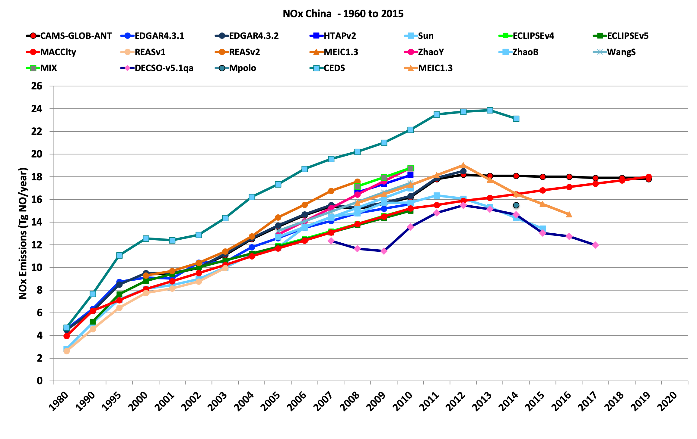
Global anthropogenic emissions - 3
Large differences between inventories. Systematic comparison under way
Very difficult to understand the differences: data used to calculate emissions are never public
Inverse modelling studies might help, but limited to NO2, CO and maybe SO2 and NH3
Need series of modelling studies to quantify the impact of emissions on model results.
Would it be possible to use machine learning techniques + the MUSICA model for quantifying the impact of emissions?
From Elguindi, Granier et al., Earth Future, to be submitted

Slide 6
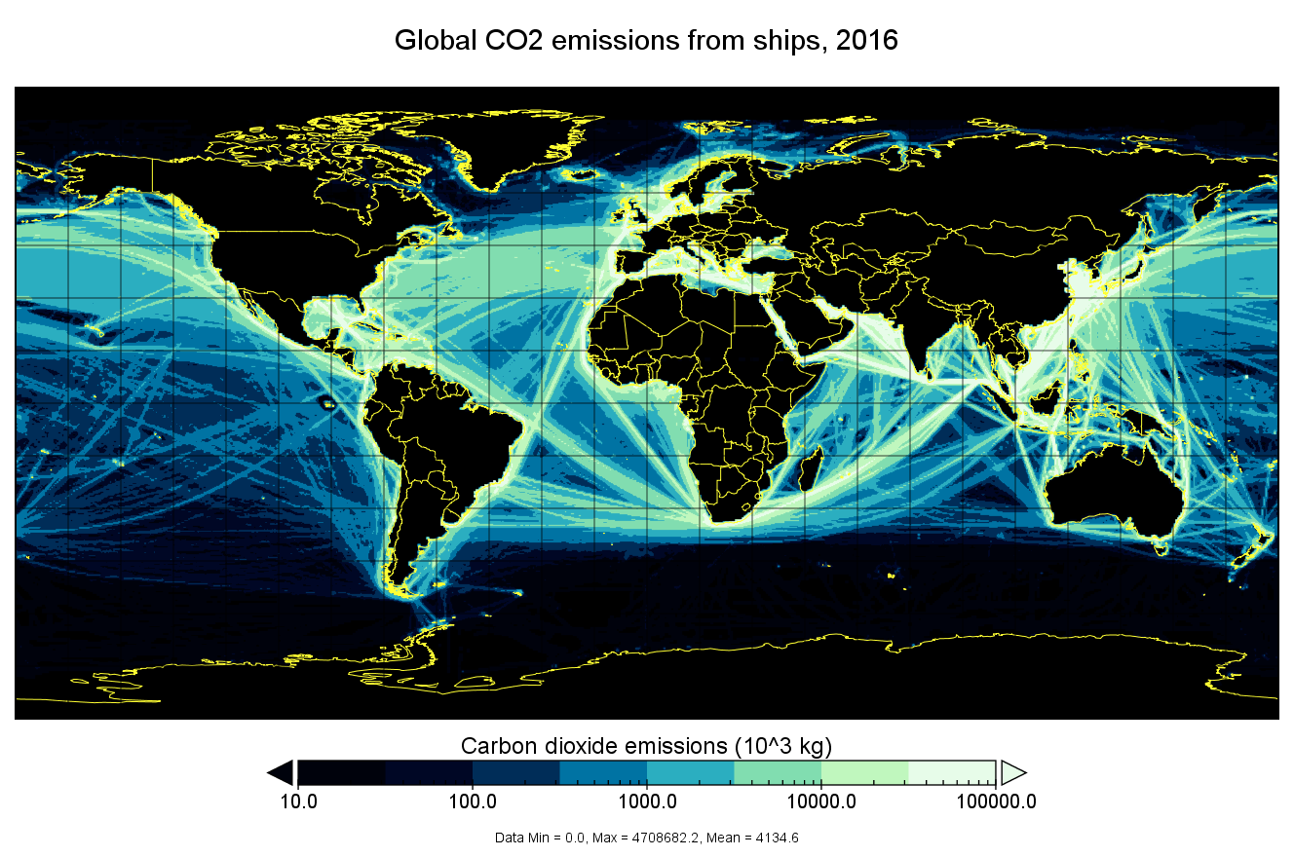
Global anthropogenic emissions – ships
With emissions from traffic decreasing in many countries, ship emissions are getting more and more important
A new dataset recently developed: CAMS-GLOB-SHIP
Dataset developed by the Finnish Meteorological Office (FMI)
Global and regional datasets based on realistic vessel traffic using AIS (Automatic Identification System) vessel transponder data
Emissions calculated using the Ship Traffic Emission Assessment Model (STEAM)
2000-2018, all species,
0.25 degree resolution
Temporal resolution: daily
Inland waterways under study
Emissions significantly higher than in previous inventories: needs testing

Slide 7
Temporal resolution of anthropogenic emissions
Emissions generally available as monthly averages, based on old temporal profiles
New developments at Barcelona Supercomputing Center + Lab. Aerologie
New monthly, daily and weekly temporal profiles are being developed, based on observations and data collected in different world countries
First version of the temporal profiles:
CAMS-GLOB-TEMPO
Old
Residential CO emissions 2014-2019
New

Slide 8
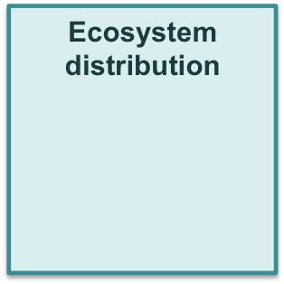
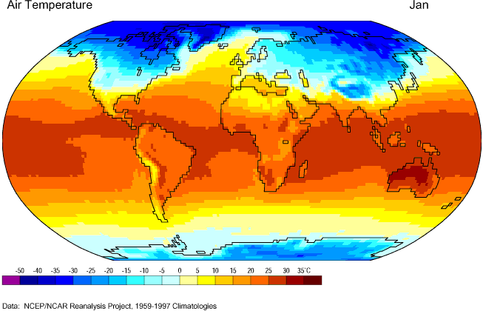
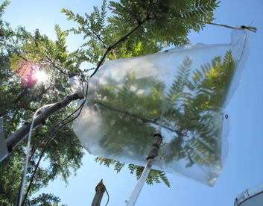
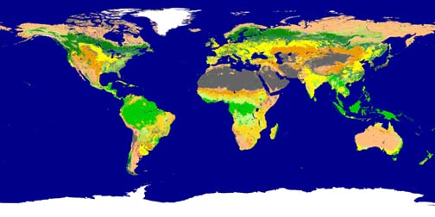
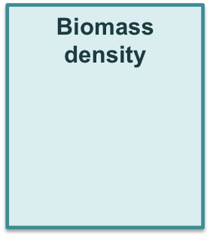
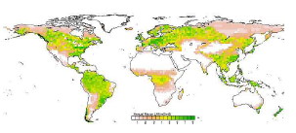
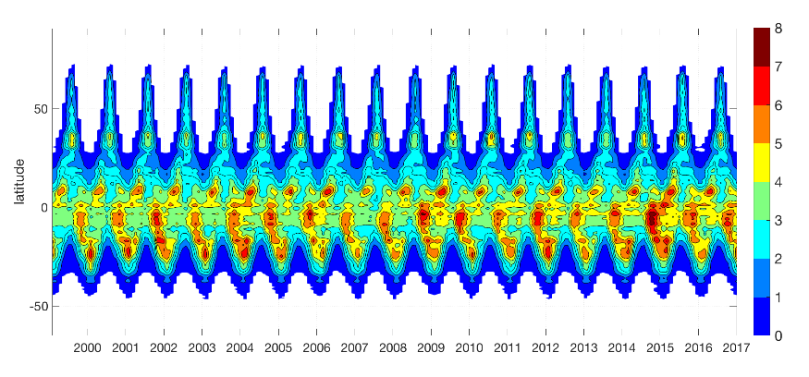
Biogenic emissions : BVOCs
Most groups use a version of the MEGAN model
Most recent version: CAMS-GLOB-BIO developed at the Charles University
in Prague (Czech Rep.) (Sindelarova et al., ACP, 2014)
List of modeled species
Isoprene; α-pinene; β-pinene
other monoterpenes
Sesquiterpenes; CO
hydrogen cyanide
Ethane; propane
butane and higher alkanes
Ethene; propene
butene and higher alkenes
Methanol; ethanol
Formaldehyde; acetaldehyde
other aldehydes
Acetone; other ketones
formic acid; acetic acid
toluene
time resolution: monthly means
spatial coverage: global
spatial resolution: 0.5° x 0.5°
Time period: 2000-2017
This BVOCs code can be implemented in
the MUSICA model

Slide 9
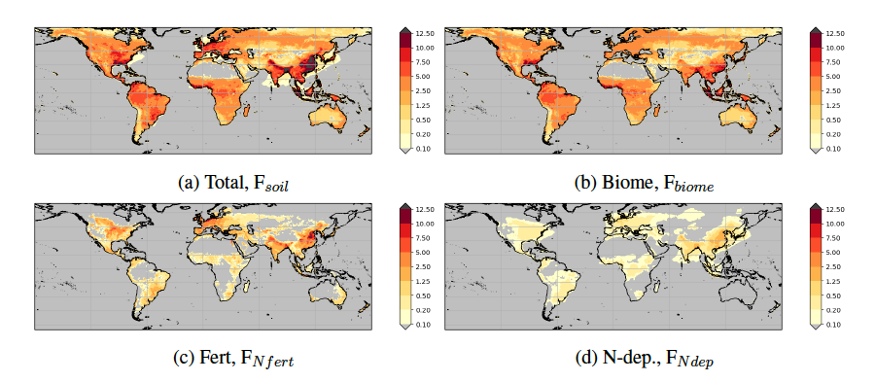
Soil NOx emissions
Different approaches have been tested, many based on Yienger and Levy (1995)
or on Hudman and al. (ACP, 2012)
A new version (also based on Yienger and Levy) has recently been developed by David Simpson and colleagues (Met Norway and Chalmers University in Sweden) ➔ CAMS-GLOB-SOIL
Total 2010 emissions (ng N/m2/s)
Biome emissions (ng N/m2/s)
Fertilizer emissions Deposition induced emissions
Somewhat higher (12.9 Tg NOx-N) than the Hudman et al. value (10.7 Tg) used in GEOS-Chem. Impact on NOx budget of these emissions needed

Slide 10
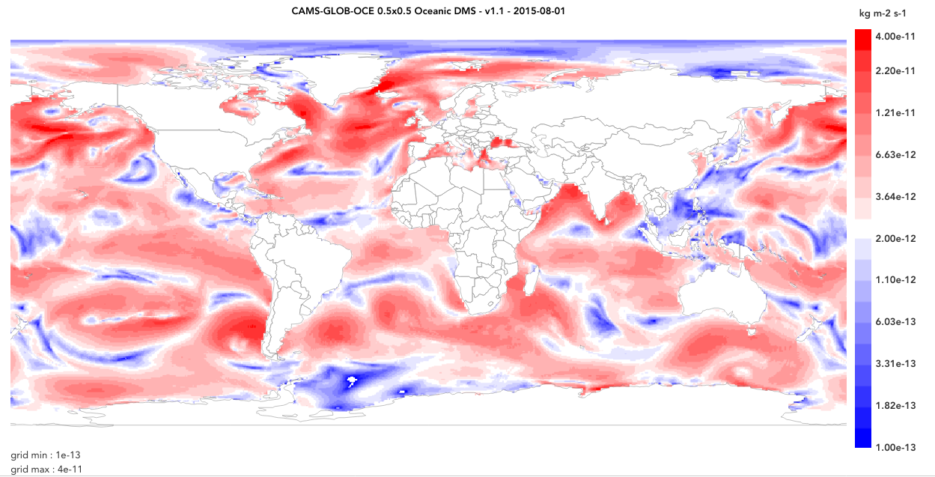
Oceanic emissions
A new dataset of emissions of DMS, OCS and halogens (CHBr₃, CH₃I, CH₂Br₂)
has been developed by Met Norway in Oslo and GEOMAR in Kiel
→ CAMS-GLOB-OCE
The emissions are based on a climatologies of DMS, OCS and
halogens concentrations in sea water measured in different oceans
+ ECMWF meteorology
Time period and spatial/temporal resolution:
DMS: 2000-2015, 0.5x0.5 degree, daily
OCS: average for 2002-2014, 1x1 degree, monthly
Halogens: 2000-2015, 0.5x0.5, daily
DMS emissions on Aug., 1st, 2015
Formulas and methodology could be implemented In MUSICA

Slide 11
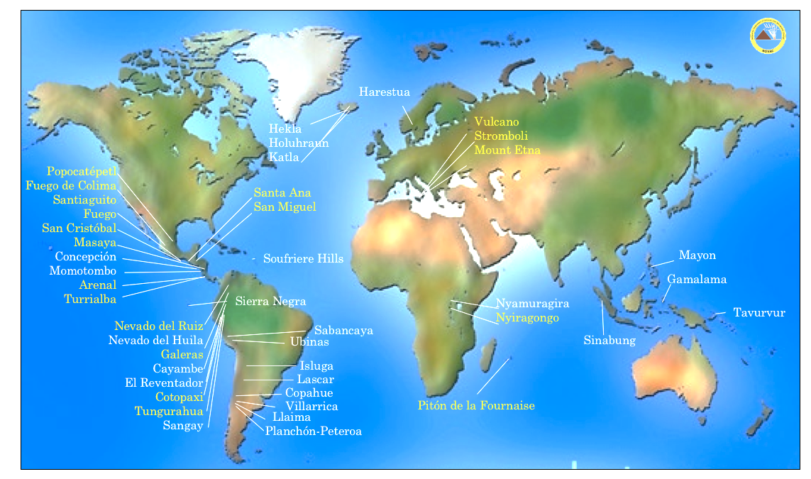
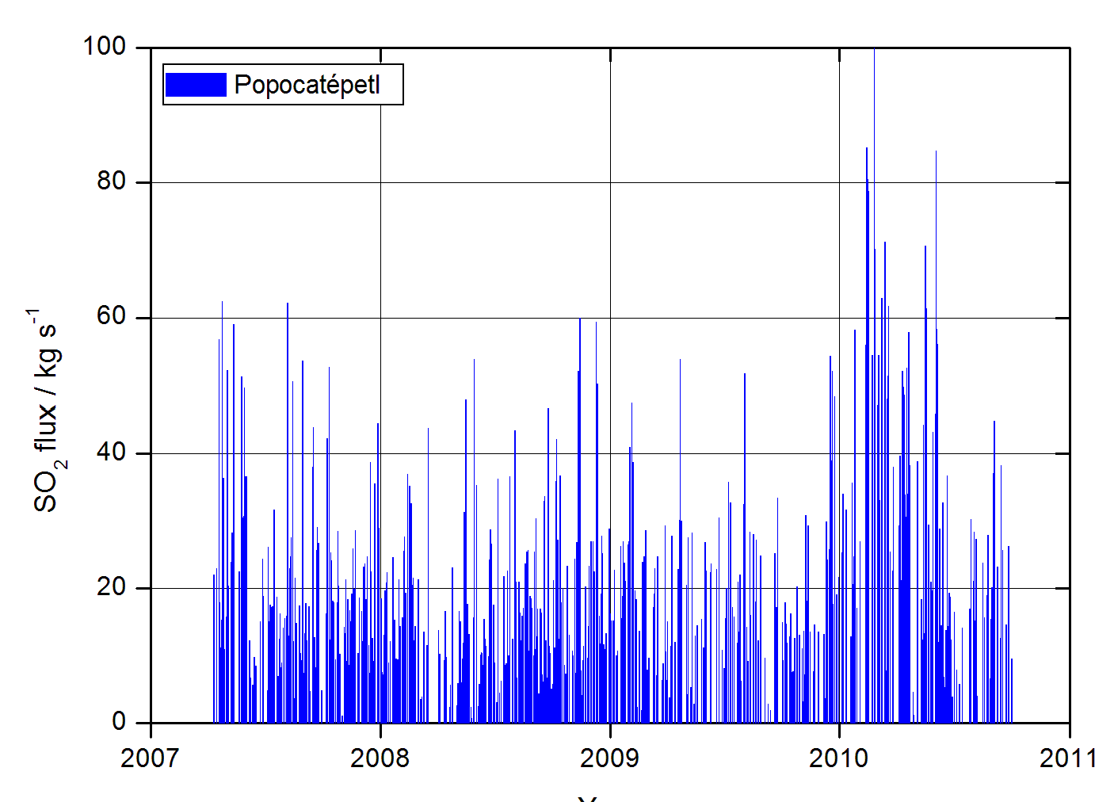
Continuously degassing volcanoes
Very old dataset available as the old “GEIA inventories”
New dataset based on the use of observations from the NOVAC network + ECMWF meteorology ➔ CAMS-GLOB-VOLC
1st version = 20 volcanoes, 2005-2010, daily averages
2007-2011 emissions from
Popocatépetl, Mexico

Slide 12
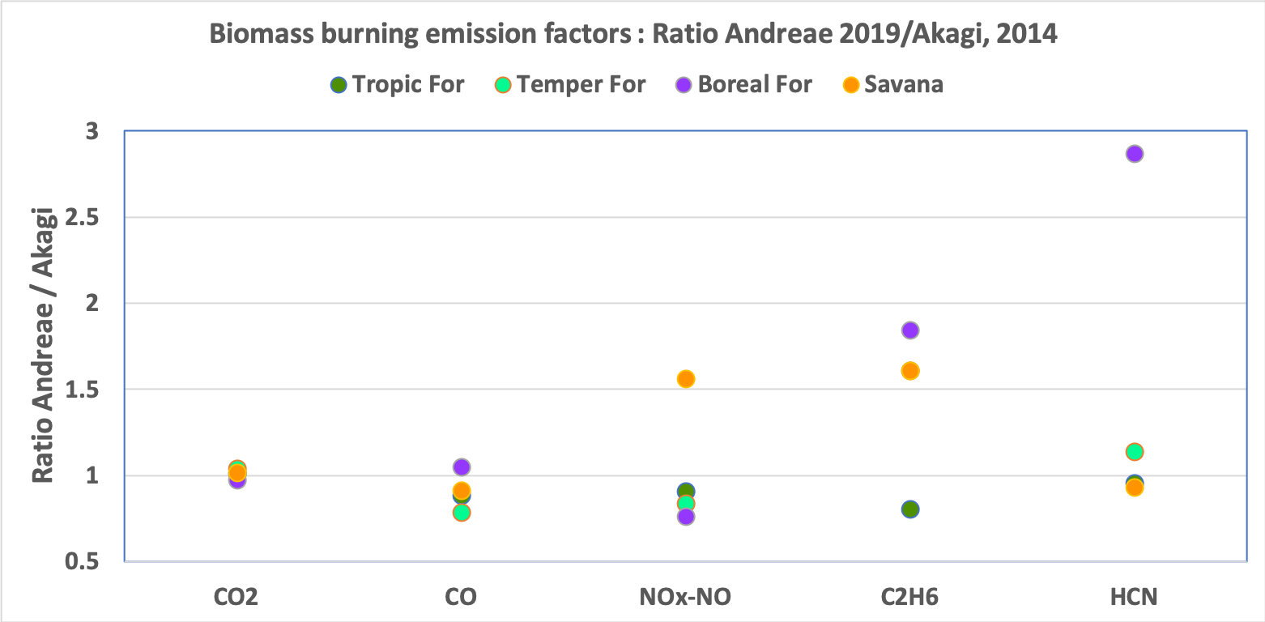
Emissions from fires
Many different fire emissions datasets developed over the past years, using:
Active fires
Burned areas
Fire radiative energy
Local data from forest services
These datasets used compilations of emission factors: Andreae and Merlet (GBC, 2001) - Akagi et al. (ACP, 2011); New compilation: Andreae (ACP, 2019)

Slide 13
Emissions from fires : common inventories
Commonly used fire inventories:
GFED v4, van der Werf et al. (ESSD, 2017), up to 2016, 0.25x0.25 degree
FINN, v1.5, Wiedinmyer et al. (GMD, 2011), up to 2018, 1x1 km²
GFAS, Kaiser et al. (BG, 2012), 0.1x0.1 degree, operational
Comparison using data in Shi et al. (Env. Poll., 206, 2015)
Regions in the plots: BO = Boreal; TE = Temperate; CE – Central; NA = North America; SA = South America, MIDE = Middle East, AF = Africa, AS = Asia)

Slide 14
Access to emissions datasets
All the CAMS-GLOB-xx mentioned will be publicly released in a few days
Reference: Granier et al., The Copernicus Atmospheric Monitoring Service global and regional emissions, ECMWF/CAMS report, DOI: 10.24380/d0bn-kx16, 2019.
Access to the datasets mentioned here (i.e. CAMS datasets, EDGAR, CEDS, GFED, GFAS, etc.)
ECCAD database = Emissions of atmospheric Compounds and Compilation of Ancillary Data
Website : eccad.aeris-data.fr
ECCAD = Detailed metadata with complete reference + User-friendly tools to visualize and analyse emissions + Download of emissions data + possibility of hosting data with restricted access while the data are being checked and analyzed

Slide 15
Partnerships for MUSICA
CAMS emission group (10 different institutes)
NOAA ESRL/CSD and ESRL/GMD
GEIA / IGAC: Global Emissions InitiAtive (inventories, evaluation of emissions, access to data, etc.) and its regional working groups (China, Latin America and Africa)
AMIGO / IGAC: Analysis of eMIssions using Observations (evaluation of inverse modelling products, consistency between satellite observations, surface observations, etc.)
+ Joint Research Center (Italy), Asia Center for Air Pollution (Japan), PAPILA project members (EU + Latin America institutions), and many others

Slide 16
Conclusions
Many datasets available for anthropogenic, natural and fire emissions
Anthropogenic emissions: up-to-date emissions are missing, extrapolation needed for the most recent years
Very large differences between datasets: origin of the differences difficult to identify because of the lack of access to ancillary data
Very few analysis of the impact of using different emissions in models. Systematic evaluations needed. Tuning of emissions could hide problems not related to emissions
Inverse modelling results could bring information, but currently limited to a few species. Tools to determine co-emitted species need to be developed
The ECCAD database gives access to (most) available data

