Slide 1
MUSICA Kick-Off Meeting
Welcome!
Atmospheric Chemistry Observations and Modeling Laboratory (ACOM)
May, 2019

Slide 2
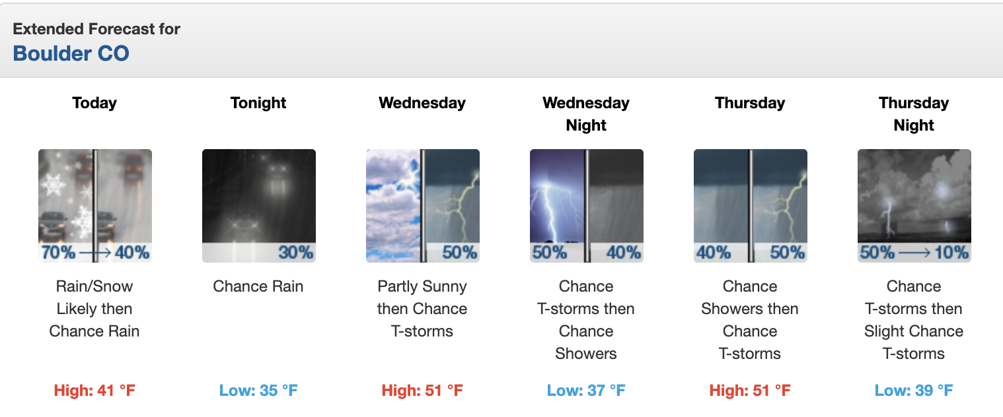
MUSICA Kick-Off Meeting
And Apologies
Atmospheric Chemistry Observations and Modeling Laboratory (ACOM)
May, 2019

Slide 3
Main Objective
Engage the participation of the community at an early stage in the development of a new unified model for the global to local prediction of air quality and investigations of the role of chemistry in weather and climate.

Slide 4
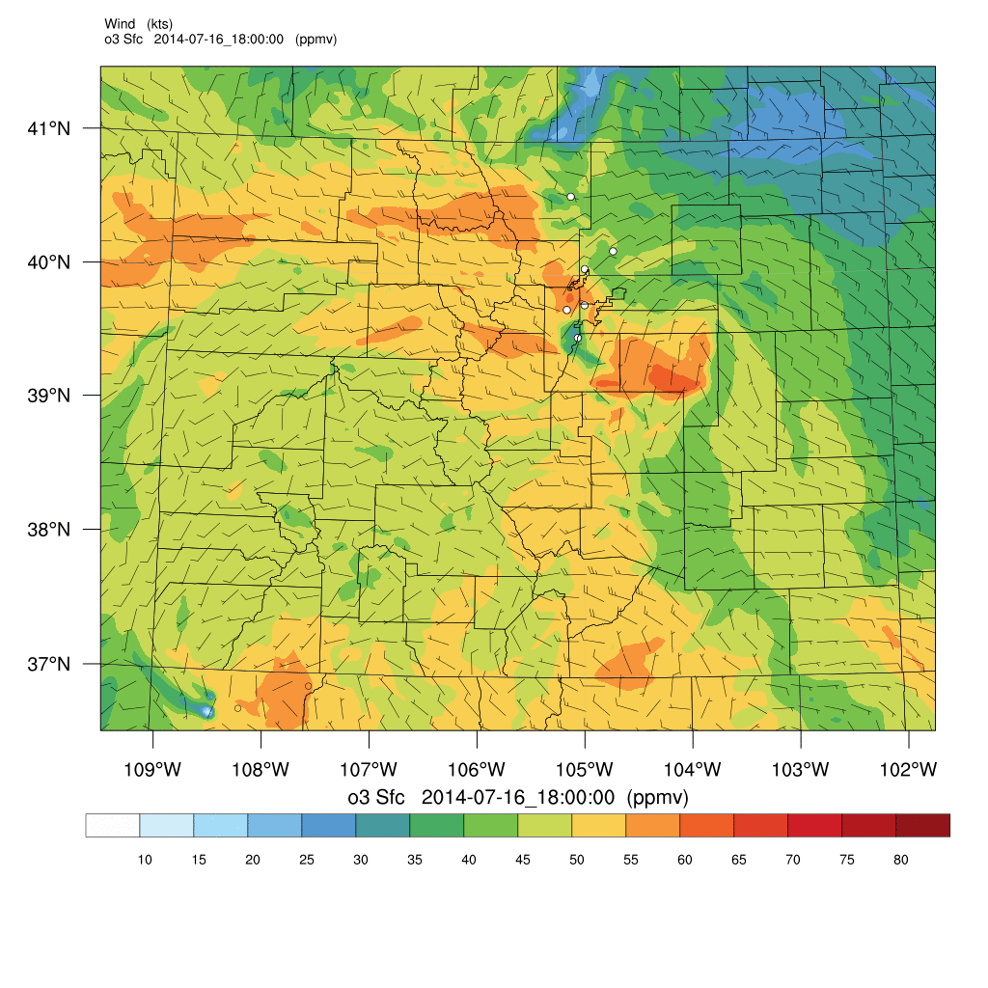
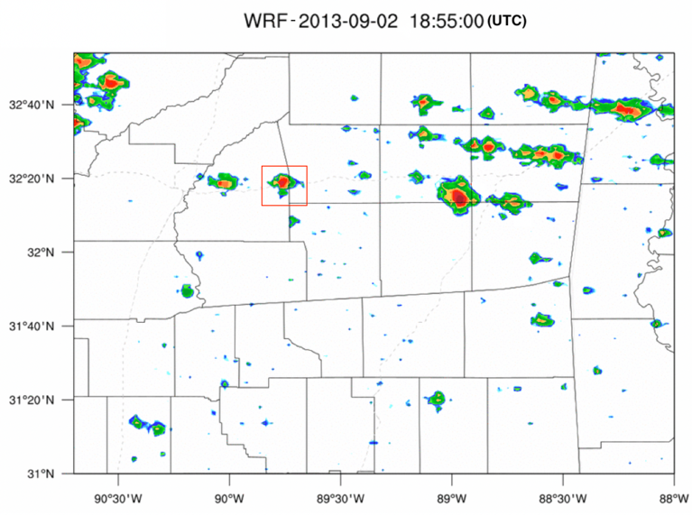
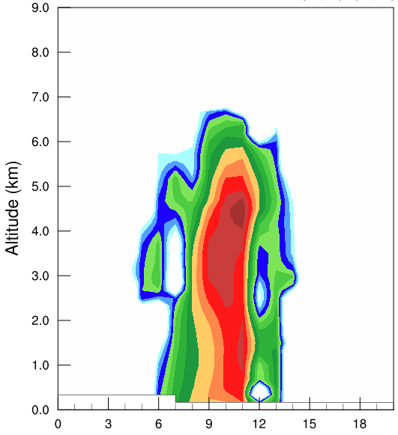
Different Models for Different Applications
Global Context
Connections of phenomenon across globe and the across all layers of the atmosphere
Impact of local area on regional and global scales
Regional Scale
Air quality
Process studies in local areas, e.g. urban air quality, thunderstorms and chemistry
WRF-Chem Surface Ozone
Colorado
Local Scale
Process studies, e.g. PBL chemistry, urban AQ
LES-Chem Organic Nitrate
WRF-Chem Radar Reflectivity

Slide 5
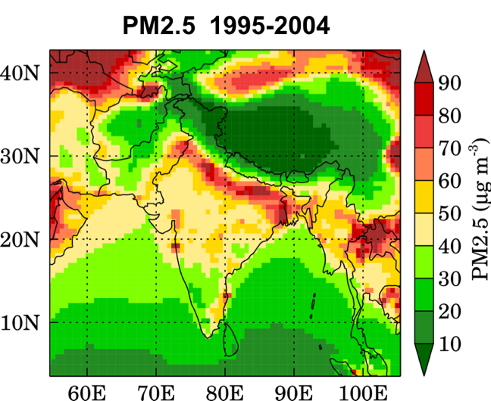
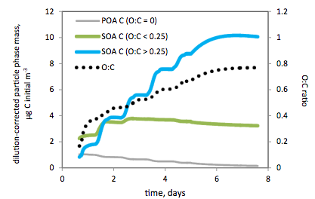
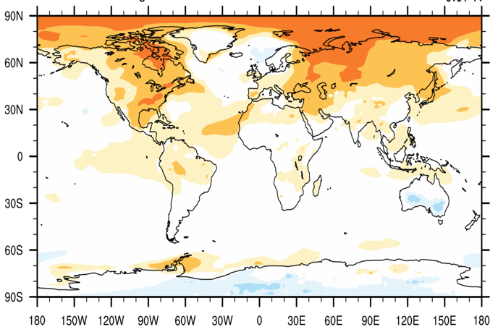
Understanding the Chemistry in Detail
Box model (BOXMOX)
NCAR LES with Chemistry
Examining the Urban/Cloud to Regional Scales
Weather Research and Forecasting model with Chemistry (WRF-Chem)
Global Scale Impacts of Atmospheric Chemistry
Community Atmosphere Model with Chemistry (CAM-chem)
Whole Atmosphere Community Climate Model (WACCM)
Troposphere Ultraviolet-Visible (TUV) radiation model
Generator of Explicit Chemistry and Kinetics of Organics in the Atmosphere (GECKO-A)

Slide 6
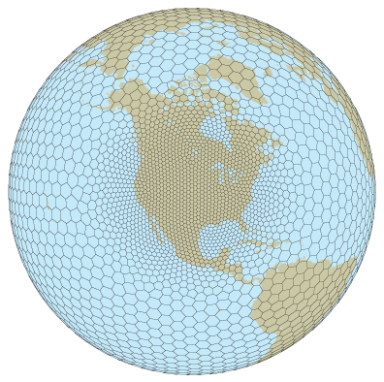
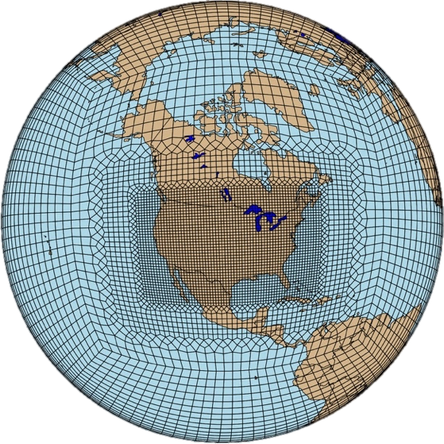
One modeling Infrastructure for All Applications
& Full Coupling Across All Scales
Future Modeling at ACOM
Within five years develop, jointly with the community, a computationally feasible global modeling framework that allows for simulation of large-scale atmospheric phenomena, while still resolving chemistry at emission and exposure relevant scales.
Model Independent Chemistry Module (MICM)
Multi-scale Infrastructure for Chemistry and Aerosols (MUSICA)

Slide 7
What to we want to achieve?
Engage the participation of the community at an early stage in the development of a new unified model for the global to local prediction of air quality and investigations of the role of chemistry in weather and climate
Establish partnerships on the development and identify overlap and collaborative opportunities with other model development initiatives
Determine the community expectations of a unified model brief the community on the future of chemistry modeling as part of NCAR’s integrated earth system model development plans.
Identify opportunities for scientific collaborations in the areas of chemical prediction and projection, assessing the impacts and risks of air pollution and development of mitigation strategies in a Whole Atmosphere Approach
Discuss the co-development of a framework for model evaluation, data assimilation and model diagnostics in conjunction with the development of MUSICA.
Expected Outcomes:
Input from the community on needs and development plans
Strategic Partnerships & collaborations
Formation of Working Groups
White Paper/Action Plan

Slide 8
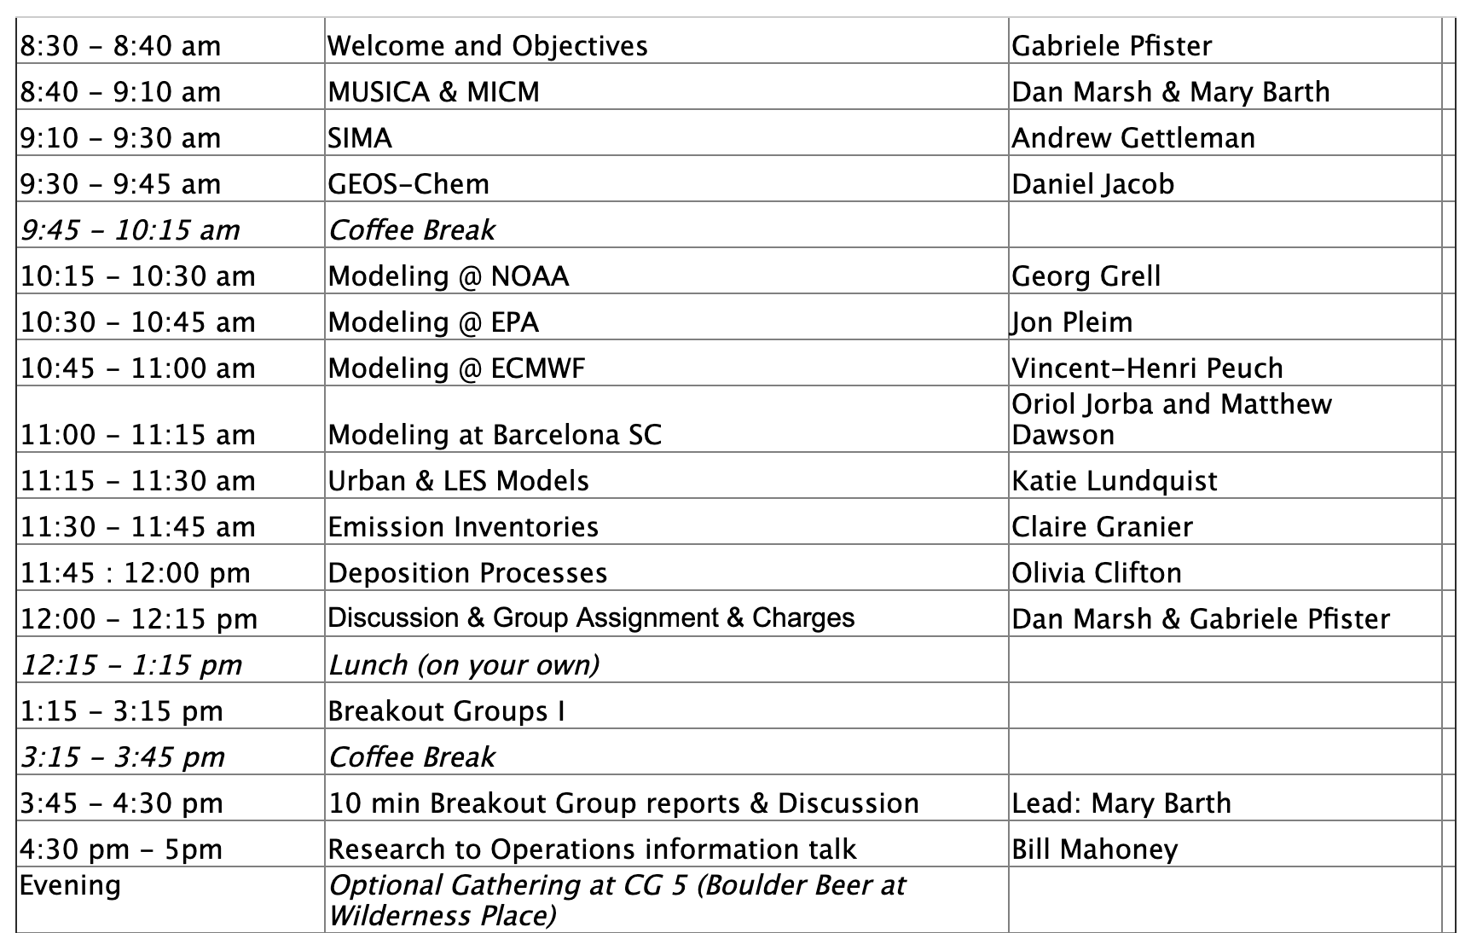
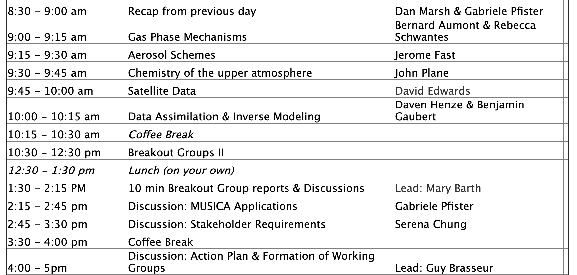
Tuesday
Wednesday
8:45 am: Welcome to NCAR
(Everette Joseph)

