Slide 1
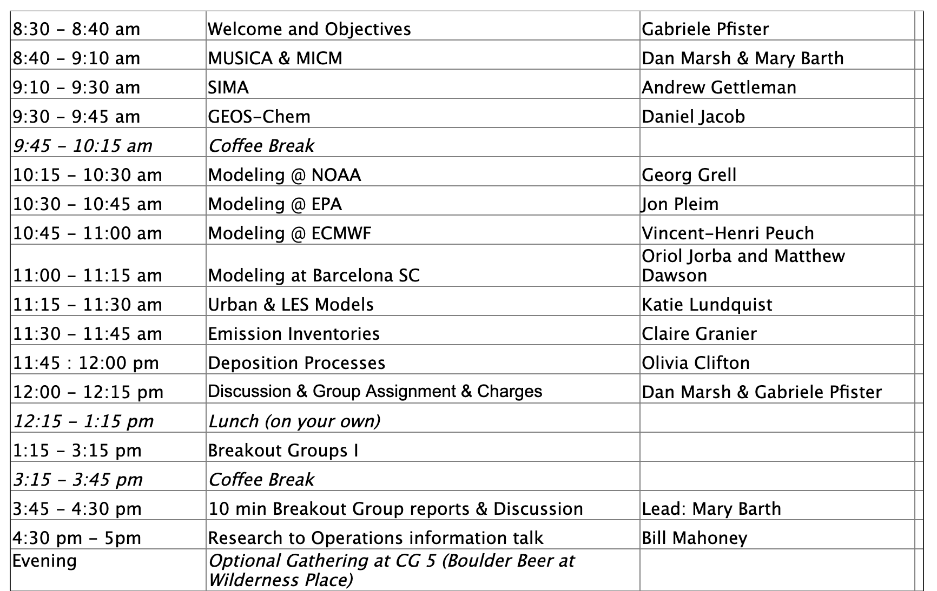
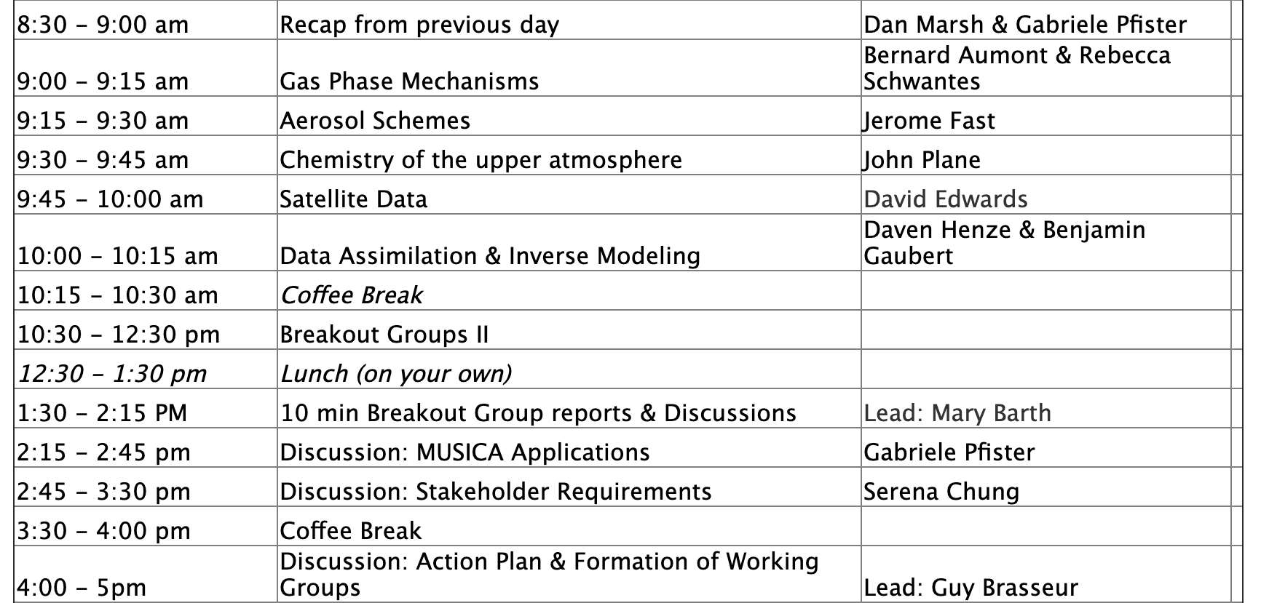
Tuesday
Wednesday

Slide 2
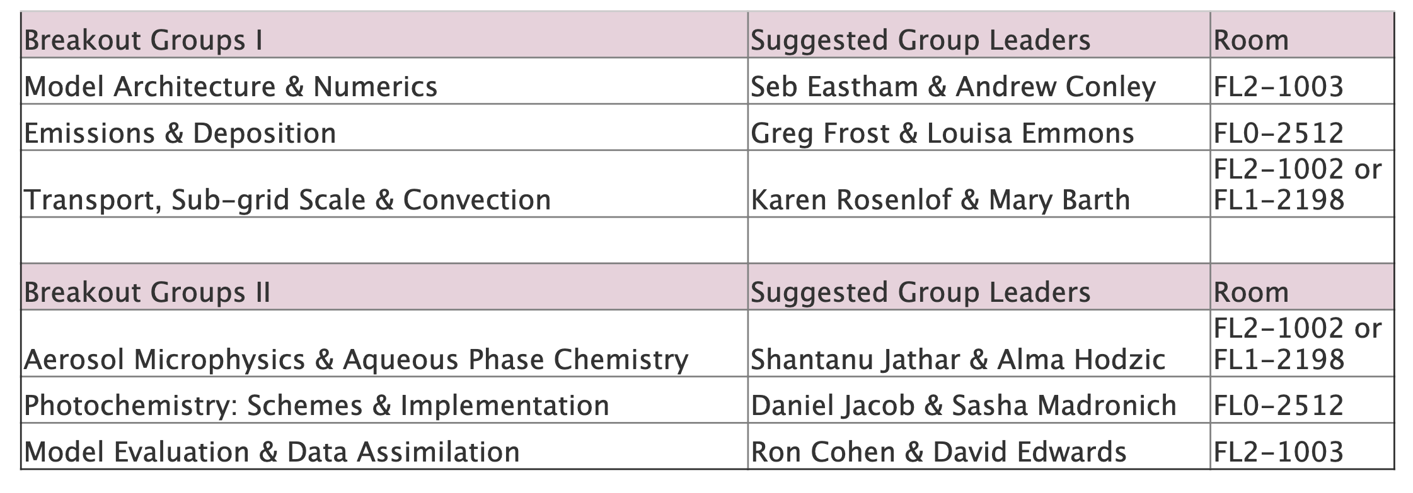
Breakout Groups

Slide 3
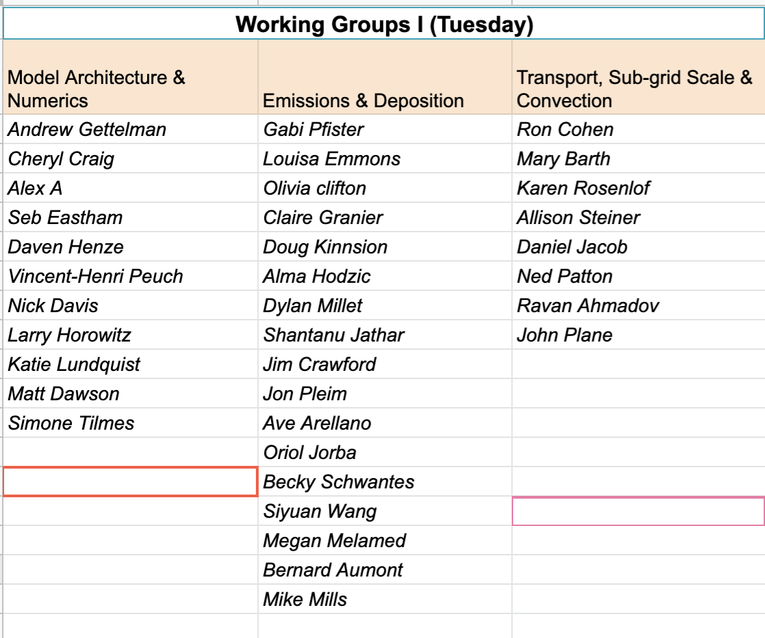

Slide 4
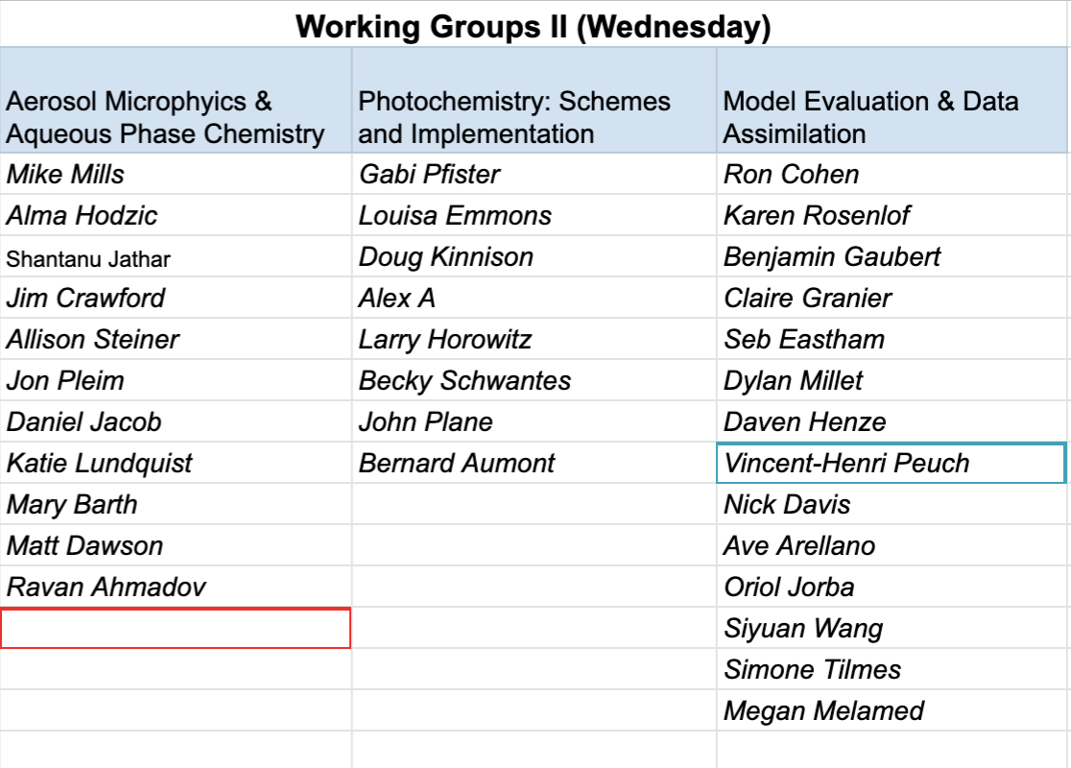

Slide 5
https://www2.acom.ucar.edu/workshop/musica-2019-agenda

Slide 6
Questions posed to the Breakout Groups:
Which working group(s) for MUSICA do you see evolving from your topics?
What are the scale-dependencies of your topic considering the range of applications from urban air quality to upper atmospheric research and timescales from days to centuries?
What are or could be the major obstacles to the proposed development plan for MUSICA?
Does the proposed realization of MUSICA address your research needs?
What new science can be addressed with the new modeling infrastructure?
What next major development steps for MUSICA are necessary to consider the processes in your topic?
What type of diagnostics should be part of the output?
Are there dependencies between your and other working groups to be considered?
What multi-lateral Strategic Partnerships should be established and what specific Deliverables will they include?
Please assign a rapporteur to report the group’s response to the above points.

