Slide 1
Research to Operations (R2O)
Science in Service to Society
Bill Mahoney
Director, Research Applications Laboratory
National Center for Atmospheric Research (NCAR)
21 May 2019

Slide 2
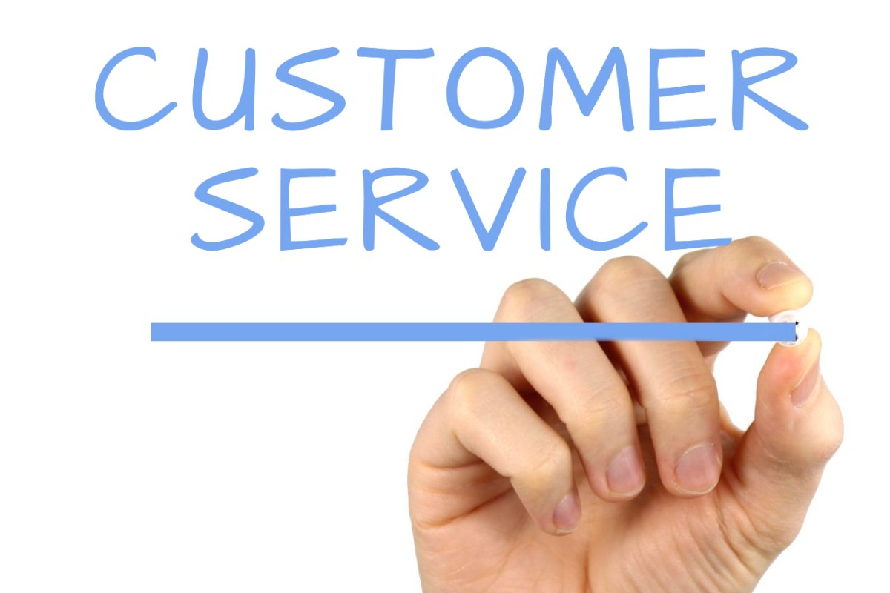
Talk Outline
What is R2O?
Non-traditional sponsors
Building sponsor relationships
Understanding users’ decision space
Project Components
Proposal writing framework

Slide 3
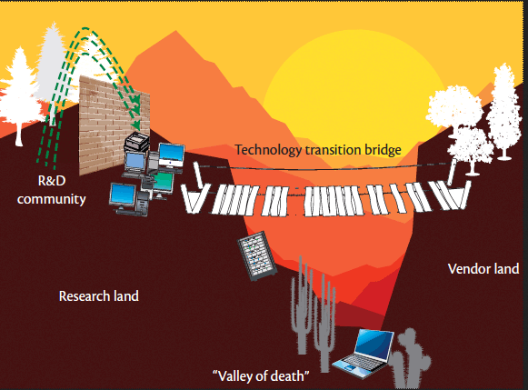
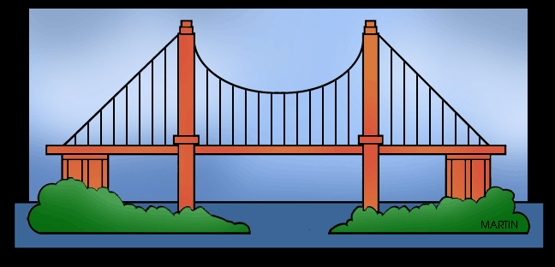
What is R2O (and O2R)?
The “Valley of Death” is where good research goes to die because of the complexity of the transition process and lack of funding opportunities.
R2O:
Bridging the Valleys of Death and Lost Opportunities

Slide 4
Research-to-Operations R&D Process
To reduce risk and ensure that end-user requirements are met throughout the project, systems should be developed using an iterative approach.
This is consistent with the overall philosophy that R&D staff are in a partnership with the sponsor and will work cooperatively to co-develop and evolve the system capabilities as the user requirements and science and technology evolve.

Slide 5
Evolutionary Development Process
Design
IOC System
User Requirements
Analysis
Deliver Final Capability
IOC
Coding & Implementation
Deliver
Researchers, developers, and sponsor co-develop capabilities iteratively to ensure the initial operational capability system meets user needs and expectations.
Final
Version
Develop a Version
Incorporate Feedback
Demonstrate Annually
Incorporate
Deliver
Customer
the
Feedback
Version
Elicit User Feedback
Elicit
Customer
Feedback

Slide 6
Traditional & Non-Traditional Research Sponsors
Typically, NCAR and most university researchers write proposals to perform research, develop technologies (e.g., models, sensor system).
The outputs are mostly publications, specifications, new technologies, etc.
Non-Traditional Sponsors are defined here as those that expect a usable outcome from their research investment – to support decision making.

Slide 7
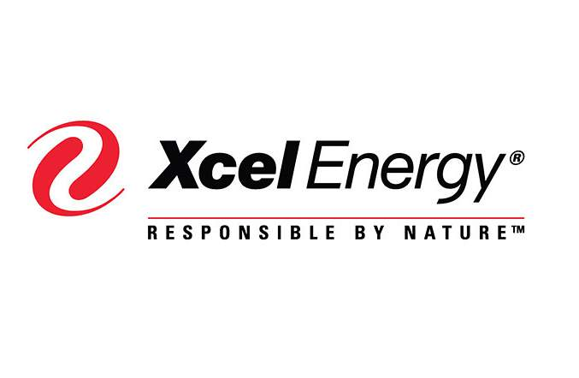
What is a Non-Traditional Sponsor?
Generally, not a science granting agency (e.g., NSF, NOAA, NASA)
Private sector
Foundation
Trust
Social Donor
International organization
World Bank

Slide 8
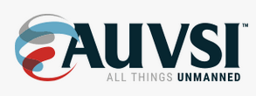
Relationship Building – Community Service
Being engaged in professional organizations can lead to funding opportunities
Expand out beyond your typical suite of colleagues (work with researchers, end users, public/private firms, etc.)
Go to conferences attended by sponsoring organizations
Be visible in the community (broadly defined)

Slide 9
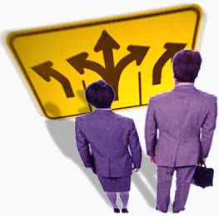
Relationship Building – Needs Assessment
Sponsors oftentimes don’t know exactly what they need to address their problems
You must develop a relationship of trust with the sponsor and users in any development process
Patiently listening to their needs is a critical first step
You need to understand their world!

Slide 10
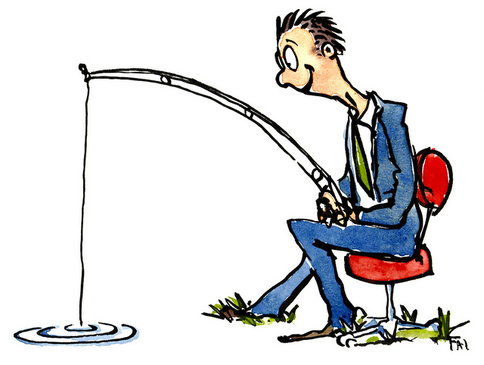
Relationship Building – Needs Assessment
For anticipated competitive proposals, be involved in educating the sponsors on what is scientifically and technically feasible
Spend time upfront in face-to-face meetings with program leads
Don’t use a hard sell approach
Be cooperative and informative
Respond to Requests for Information (RFIs)
Help the sponsor build the requirements, but take care not to disqualify yourself from bidding!
Look for R&D opportunities to help your sponsor succeed
Patience is a virtue
Capture Management - This is often a 2+ year process!

Slide 11
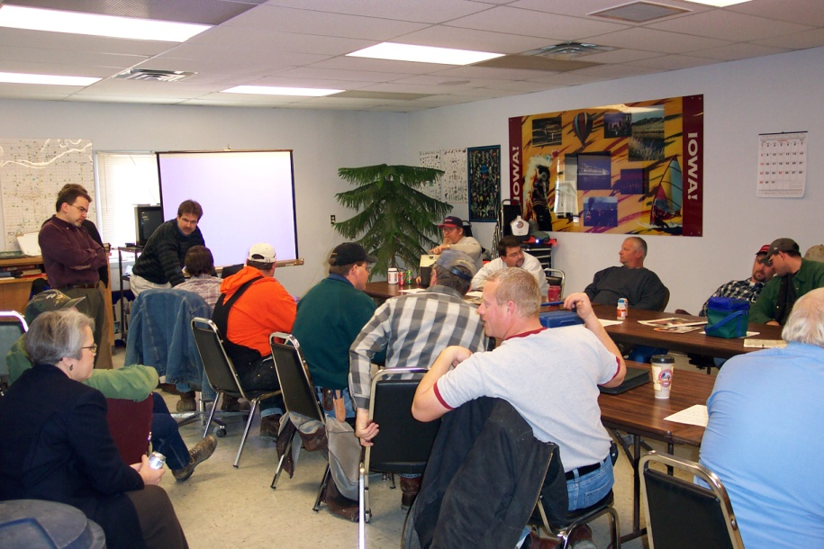
Analyzing the Sponsor’s Culture
Before one can consider developing or implementing a DSS, some important questions need to be asked to assess the client’s culture
What problem are you trying to solve?
What are the decision processes?
What is the organizational culture?
Are they ready for new capabilities?
Does automation intimidate?
Technology push or pull?
Top down or bottom’s up effort?
What job categories will be impacted?
Are there internal champions?
State DOT stakeholder meeting

Slide 12
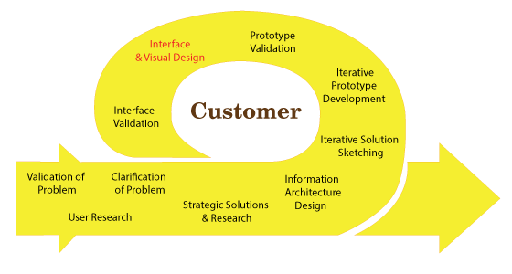
Proposal Writing Process
Typically, this is done iteratively with the sponsor
Co-develop appropriate expectations
Ensure the deliverables are catchable by the sponsor’s staff
Build-in training and capacity building
Include sufficient documentation
Include support after initial hand-off
Co-author publication(s)
Work on contract terms in parallel with SOW

Slide 13
Critical R2O Project Components
Shared expectations (technical and programmatic)!
User needs assessment(s)
Functional Requirements Document
Design Document(s)
Verification and Validation Strategy
Test Plans (FAT, SAT, RAT)
Technology Transfer Plan
Post implementation support
Ongoing science & technology infusion
Ensure the project advances our science!

Slide 14
Thank you
Bill Mahoney,
Director, Research Applications Laboratory, NCAR
mahoney@ucar.edu
Source unknown

