Slide 1
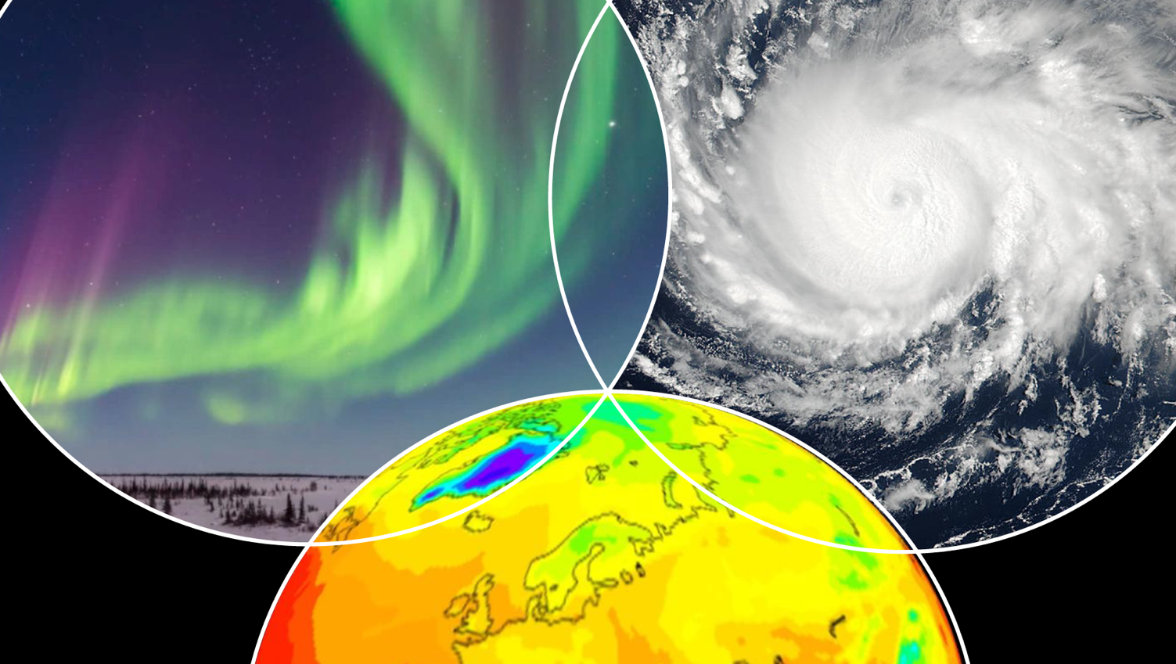
System for Integrated Modeling of the Atmosphere (SIMA)
May 21, 2019
A. Gettelman, B. Skamarock, M. Barth, H. Liu
On behalf of the SIMA Steering Group

Slide 2
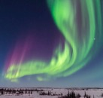
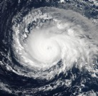
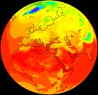
What is SIMA?
SIMA=an effort to unify NCAR community atmosphere modeling
Encompasses: Weather, Climate, Chemistry, Geospace
A configurable system: not ‘one model to rule them all’
Common atmospheric model components
Physical/Chemical Parameterizations, Dynamical cores
Common infrastructure (software framework) and methods
Develop infrastructure in current community models
Requires changes to things outside of the atmosphere (CIME, Data Assimilation, etc)
A Community working together towards frontier applications
Applications flow from diverse science goals
Exchanging knowledge and tools (diagnostics, best practices, evaluation)
MUSICA/MICM is part of SIMA

Slide 3
Outline: SIMA overview for MUSICA
What/who is SIMA?
Rationale and Vision
Frontier Science Goals
Progress
Examples
How MUSICA fits within SIMA
Summary

Slide 4
Who is SIMA?
Planning committee of ~20 NCAR staff
4 Working groups from Dynamical Cores to Diagnostics to Education
Over 50 NCAR staff involved in discussions over last year
Community outreach: 18 ‘champions’, 45 people engaged
Four co-leads (Weather, Climate, Chemistry, Geospace), two lab directors (Weather, Climate) for NCAR executive committee links
Includes MUSICA/MICM Group at NCAR

Slide 5
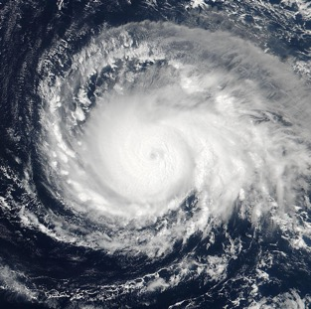
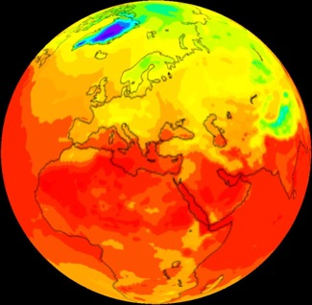
Current Community Atmosphere Models
Existing Applications
Weather (WRF & MPAS)
Geospace (TIE-GCM)
Chemistry (WRF-CHEM)
WACCM-X
Climate (CAM)
Chemistry (WACCM/CAM-CHEM)

Slide 6
SIMA Vision
Support Existing and Frontier Applications
Geospace
Weather
Chemistry (MUSICA)
Existing
Applications
Frontier Applications
Coupled Weather
Climate Extremes
Space Weather
Air Pollution
Climate
Chemistry (MUSICA)

Slide 7
System for Integrated Modeling-Atmosphere (SIMA)
SIMA is composed of common atmospheric model components & infrastructure
SIMA Frontier Applications
Coupled Weather
Climate Extremes
Space Weather
Air Pollution
Coupled Polar
Weather
Existing
Applications
SIMA Vision
Encompass Climate, Weather, Chemistry & Geospace
Prediction (Initialized and Forecast) capabilities
Complement & extend existing applications (CESM/WRF/MPAS)
Shared infrastructure for efficiency
Minimal set of components
‘Center Wide’ project including education, observations, computation
Geospace
Chemistry
Climate

Slide 8
SIMA Vision is Comprehensive: ‘Center Wide’
System for an Integrated Model of the Atmosphere (SIMA) Includes:
Dynamical Core(s): Support applications, and development (geospace)
Physical Parameterizations: Maintain ‘Suites’, aim for cross-scale physics
Chemistry & Geospace: Links to physical model + specialized modules
Prediction: Enable Data Assimilation, better initialization
Diagnostics/Obs: Community Diagnostics, Facility Instrument Simulators
Education/Training: Tutorials, Visitor Programs, Suite of simple models
Infrastructure: Robust infrastructure, usability from small to exascale, eliminate redundancy, consolidate and simplify around best practices
Computation: Co-evolution of software, workflow & facility hardware (NWSC)

Slide 9
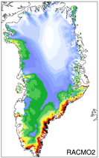
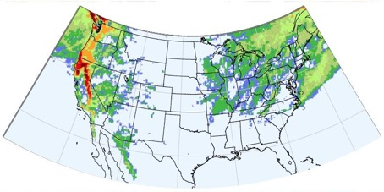
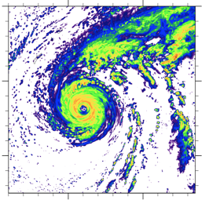
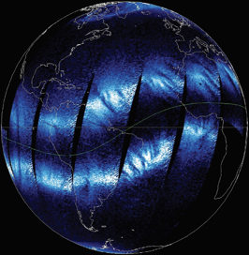
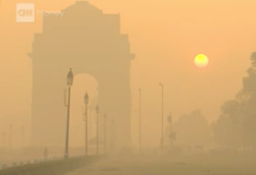
Frontier Science Goals
Map to specific applications
Polar
Coupled Simulations at the Weather Scale
Tropical cyclones, Extreme convection
Extreme weather under climate change
Extreme heat and precipitation, Hydrologic cycle extremes
Polar Processes and Prediction
Integrated Geospace modeling
Air composition/quality prediction and projections (MUSICA)
Hydrology Extremes
Tropical Cyclones
Air Quality
Space Weather

Slide 10
SIMA Frontier Applications (3yr targets)
Developed with community input
Prediction (initialized, assimilation) is implicit in many of these applications
Frontier | Target Application | Configuration
Weather | Tropical Cyclones | 3km refined mesh, coupled ocean, initialized
Climate | Hydrologic Extremes | 10km refined mesh hydrostatic climate simulations, 3km refined mesh non-hydrostatic initialized
Polar | Coupled Arctic System | 10km hydrostatic coupled Arctic refined mesh
Geospace | Space Weather | 25km global atmosphere to the ionosphere
Chemistry | Regional Composition | 10km hydrostatic refined mesh with chemistry
Interested? What are we missing? Let us know!

Slide 11
SIMA Progress/Timeline
Past, Present, Future
2018
Jan-February: Organized, developed science goals, requirements
March-May: Development of application examples, vision, outreach
June: Discussions with NSF, WRF/CESM Communities
July-Aug: Develop a ‘Roadmap’, Solicit Community Feedback
Sept-Oct: Roadmap available. More feedback (CESM/UCAR Members)
Oct-Dec: Refine SIMA plans/tasks, Start on Key Tasks
Jan-Feb 2019: SIMA Terms of Reference, CESM CAB presentation
2019-2021: Implementation: Phase 1 ≈ CY19, Phase 2 ≈ CY20, etc
Oct 2021: Target applications in SIMA framework (end of CY21)
‘Singletrack’
SIMA

Slide 12
SIMA Progress
(Status)
Common infrastructure
Unified physics interface (CPF) & repository for CAM, MPAS/WRF
Common development of Diagnostics/Evaluation tools
Common Dynamical cores
MPAS dynamical core in CESM-CAM
CAM-Data Assimilation capability (‘Pause-Resume’)
CIME/CAM infrastructure modifications
Better initialization, regridding, and assimilation
Good scaling at high resolution (e.g. 3km atmosphere)
More robust and flexible workflows for a hierarchy of models
Unified Chemistry (MICM/MUSICA)
Testing & developing physical parameterizations
(in process)
(starting)
(In process: Summer 2019 estimate for initial port)
(Final Stages)
(Not Started)
(Ongoing with Community)

Slide 13
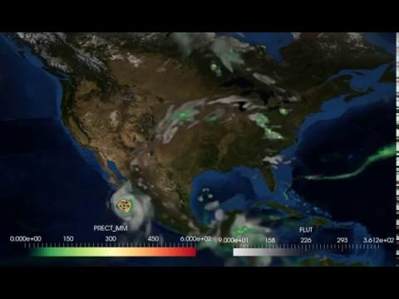
CESM2-14km refined mesh regional climate simulations
Gettelman, Callaghan (CGD), Zarzycki (PSU), Clyne (CISL)

Slide 14
Surface ozone: Refined Mesh (similar to climate) with Chemistry
Lacey, Schwantes & Tilmes, ACOM

Slide 15
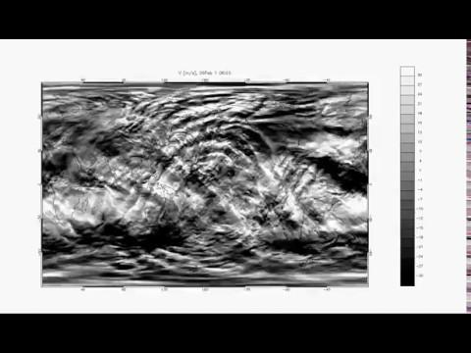
WACCM Meridional Wind at ~110km
Space Weather Driven by Terrestrial Weather
H. Liu, HAO
Notes:
WACCM with continuous Galerkin spectral finite element dynamical core.
Resolution: 0.25o(~25km) horizontal; 0.1 scale height (500-700m) vertical.
Scalable up to 10000+ cores on NSF NWSC/Yellowstone.
Motivations: Study dynamical coupling from planetary to mesoscales.
Study ionospheric variability and irregularity as driven by waves down to mesoscales.

Slide 16
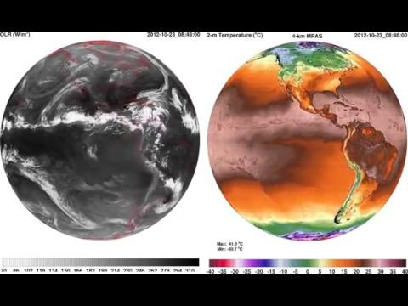
MPAS 4km Global Simulations
Falko Judt, MMM
Outgoing Longwave Radiation (OLR)
Surface Temperature
Notes:
global 4-km MPAS with the WRF "convection-permitting" physics suite:
Convection: Grell-Freitas
Microphysics: Thompson (non-aerosol aware)
Land surface: Noah
Boundary layer: MYNN
Surface layer: MYNN
Radiation, LW: RRTMG
Radiation, SW: RRTMG
Cloud fraction for radiation: Xu-Randall
Gravity wave drag by orography: YSU

Slide 17
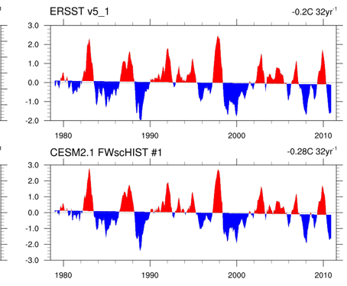
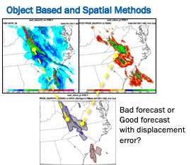
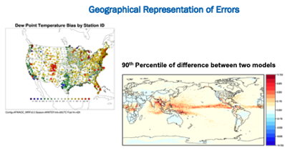
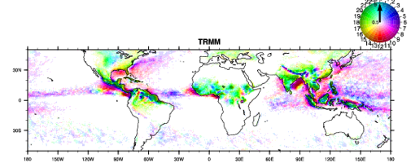
Unifying Diagnostics
Climate Variability
(Phillips, CGD)
Weather
(Jensen, RAL)
Climate/Chemistry
(Hannay, Tilmes, CGD/ACOM)
Atmos Processes
(Coleman, Chen, CGD)

Slide 18
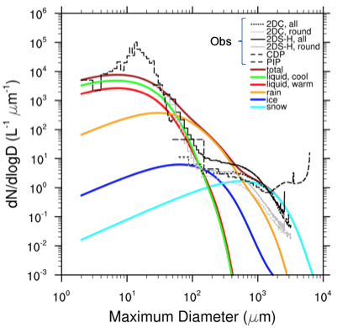
Bridging Models and Observations
SOCRATES & CAM6 size distributions
Simulate detailed observations from EOL facility cloud probes
Develop ‘simulators’ to simulate specific facility instruments (cloud probes, radar, lidar, chemistry) in SIMA system
C. Bardeen, ACOM

Slide 19
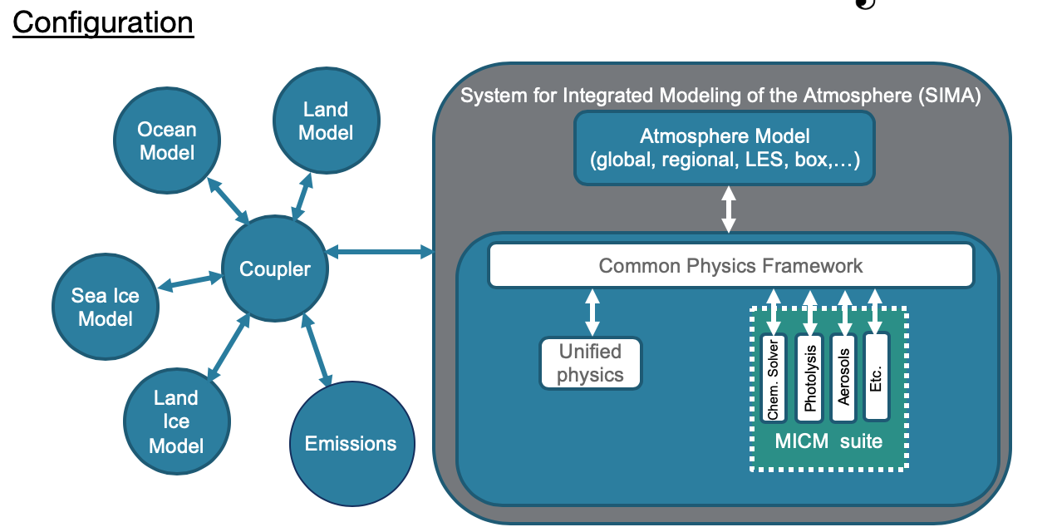
Code: SIMA and MUSICA
SIMA is an interoperable set of components for atmospheric modeling
SIMA works inside of a coupled Earth System Model (couplin on or not)
MUSICA is a set of SIMA components with chemistry
MICM are the chemistry components
MUSICA Configuration

Slide 20
People/Science: SIMA & MUSICA
MUSICA defines the vision for chemistry in SIMA
SIMA depends on MUSICA expertise
SIMA is infrastructure from which to configure models at different scales (Weather and Climate), and chemistry packages
SIMA is responsive to MUSICA needs
SIMA will hopefully bring a whole modeling system behind it (e.g. prediction)
SIMA is flexible: adjust chemistry, aerosols (MUSICA decides)
Details: ‘Atmospheric Chemistry & Aerosols’ are defined as parameterizations in the SIMA atmosphere model
Interface through a Common Physics Framework (API): same as NOAA
Can be at a high level (e.g.: wrap a whole chemistry model), or a low level (wrap and configure individual processes)

