Slide 1
Modeling @ECMWF
Vincent-Henri Peuch & the CAMS teams
MUSICA kick-off meeting, NCAR, Boulder
21-22 May 2019

Slide 2
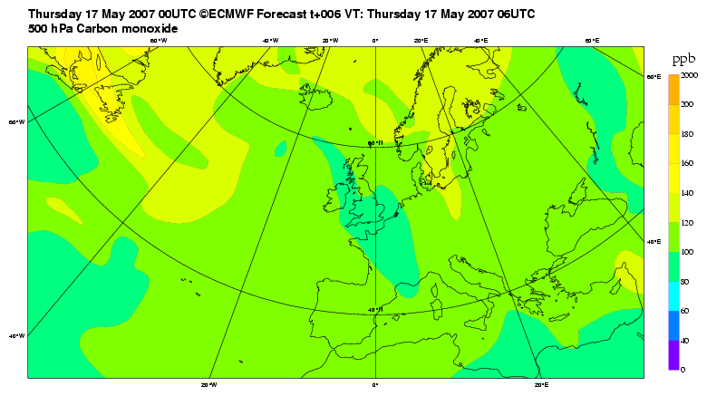
CONTEXT: CAMS
In end 2014, following a decade of R&D (GEMS, MACC, MACC-II, MACC-III), ECMWF has been entrusted with the management of the Copernicus Atmosphere Monitoring Service (CAMS), one of 6 thematic Services of theEU Space flagship programme Copernicus
12 years of continuous daily global atmospheric composition forecasts at ECMWF

Slide 3
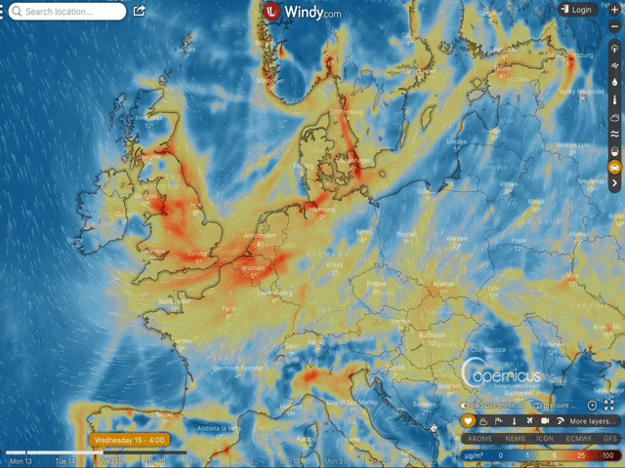
CAMS DAILY ANALYSES AND FORECASTS
Twice daily (based 00, 12) NRT global analyses and forecasts up to +120h, 40km resolution
Daily (based 00) NRT European analyses and forecasts up to +96h, 10 km resolution
Delayed mode (4 day behind) global analyses and forecasts of CO₂ and CH₄, 9km
CAMS regional forecasts seen in the highly successful Windy app and website (operational service starting next month).

Slide 4
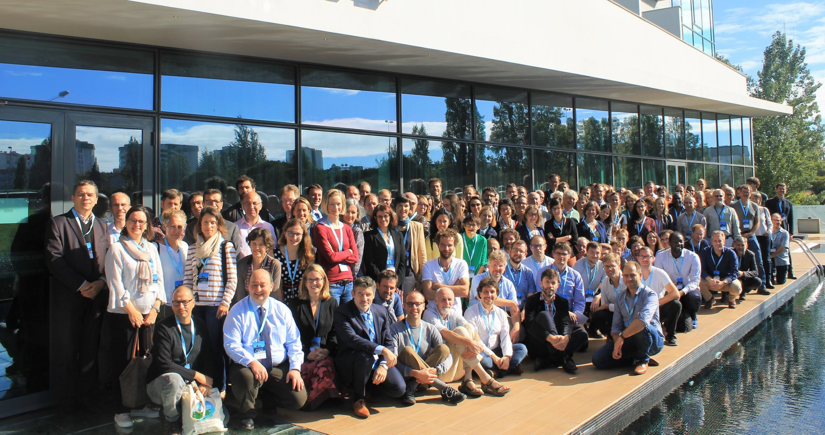
CAMS: a truly European effort
133 entities from 28 EU/ECMWF countries, 48 contracts

Slide 5
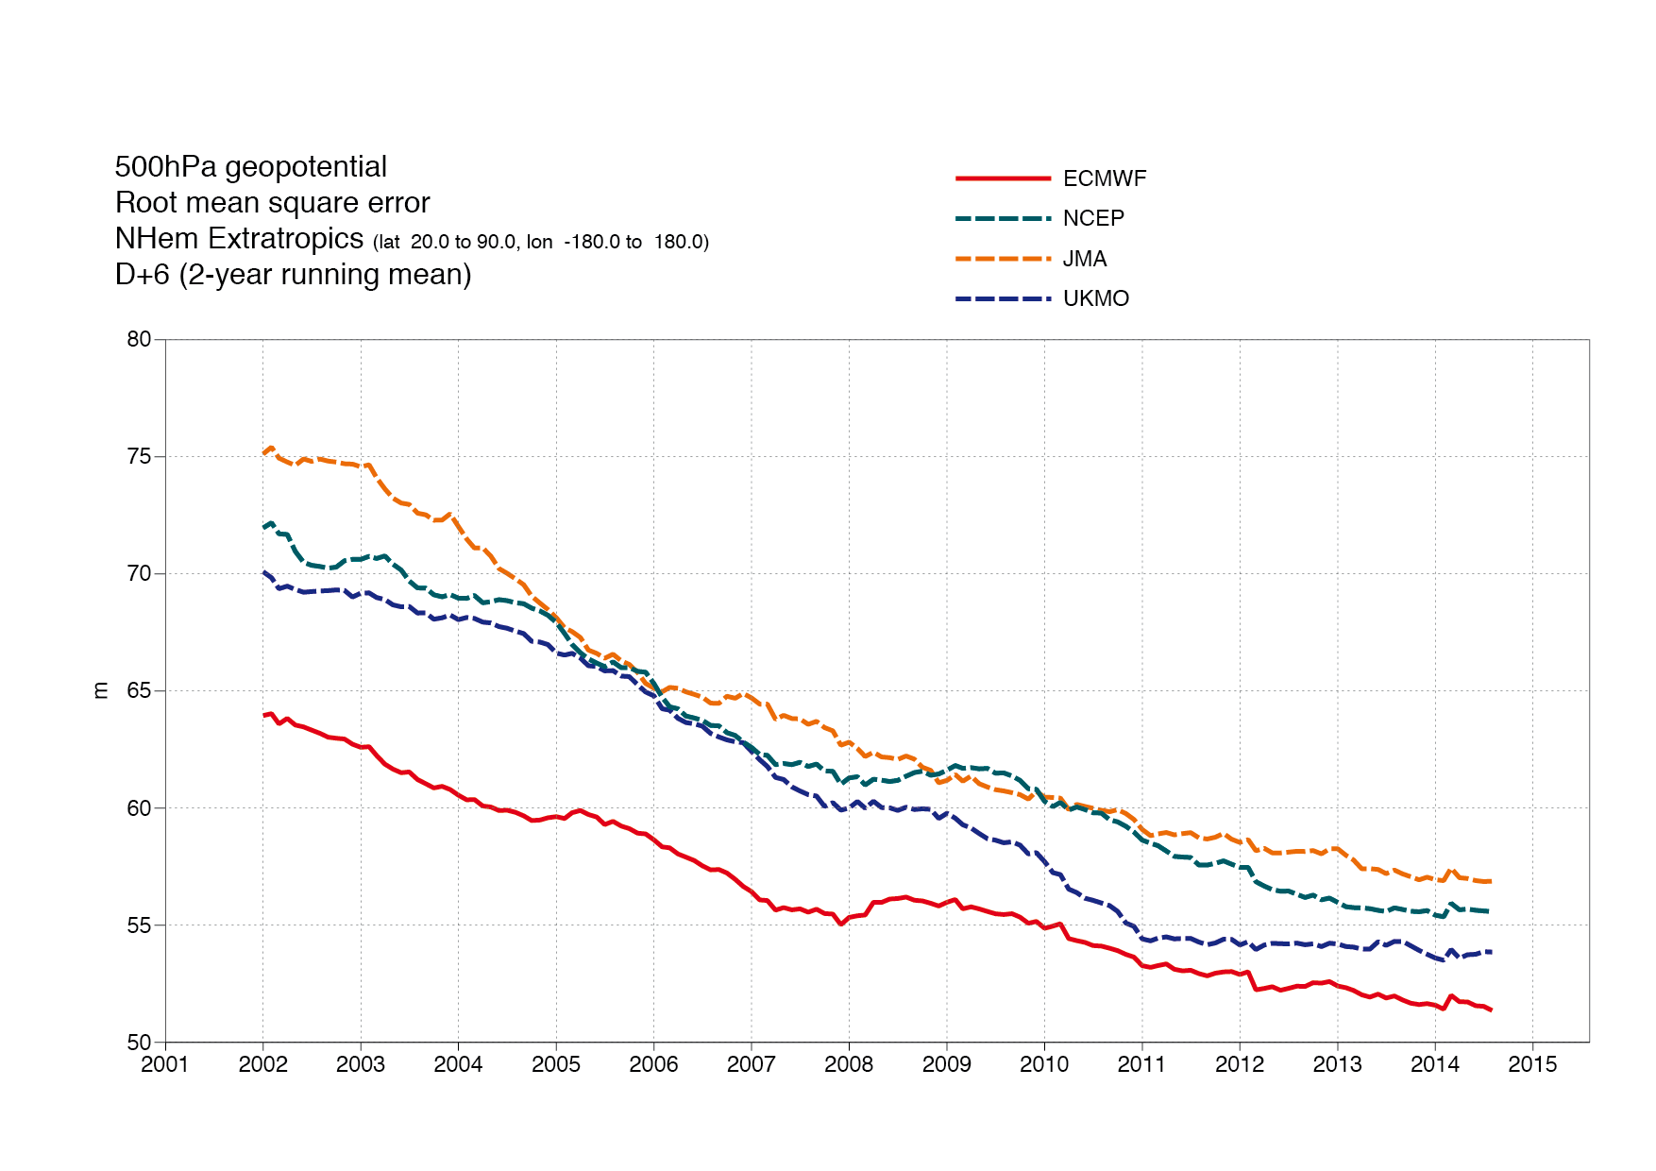
IFS: A VERY GOOD NWP AND DA SYSTEM
IFS (Integrated Forecasting System) is the tool behind ECMWF’s successful NWP
As part of ECMWF’s strategy, IFS is increasingly becoming an Earth-System Model, i.e. even more Integrated: surface, cryosphere… and composition

Slide 6
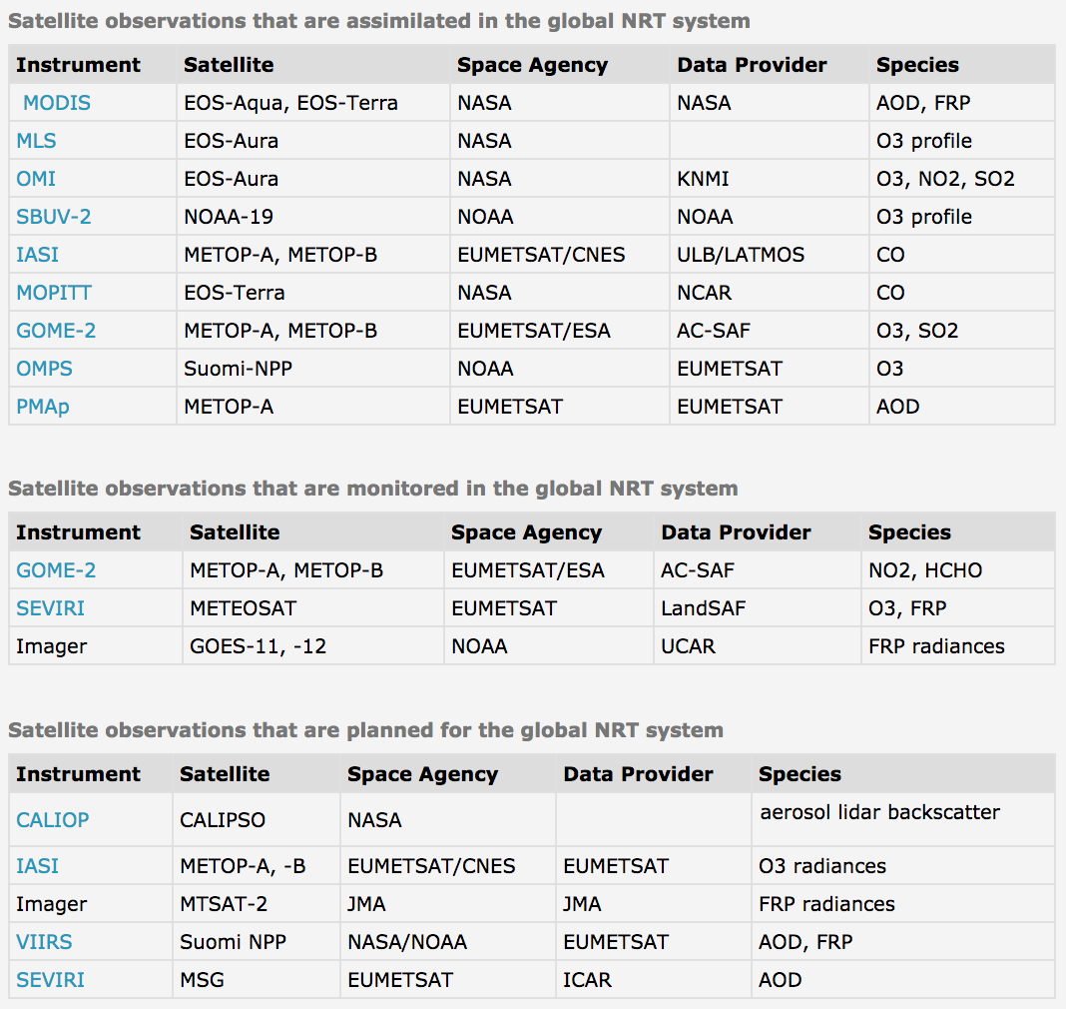
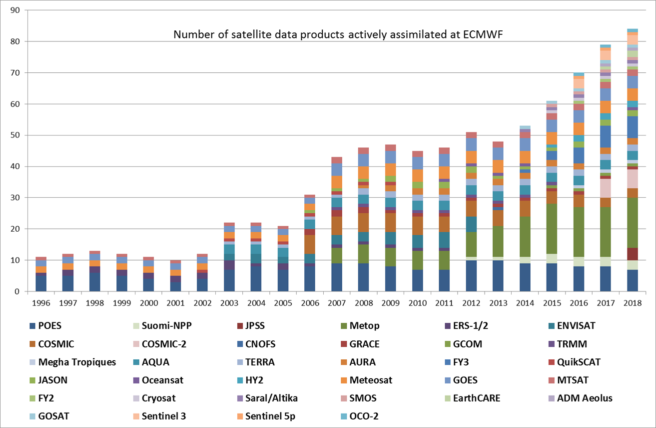
OVER 80 DATA STREAMS USED DAILY
https://atmosphere.copernicus.eu/cams-input-data
Notes:
This is a considerable effort: doing it once for Europe, fully operationally avoids duplication and/or degraded solutions

Slide 7
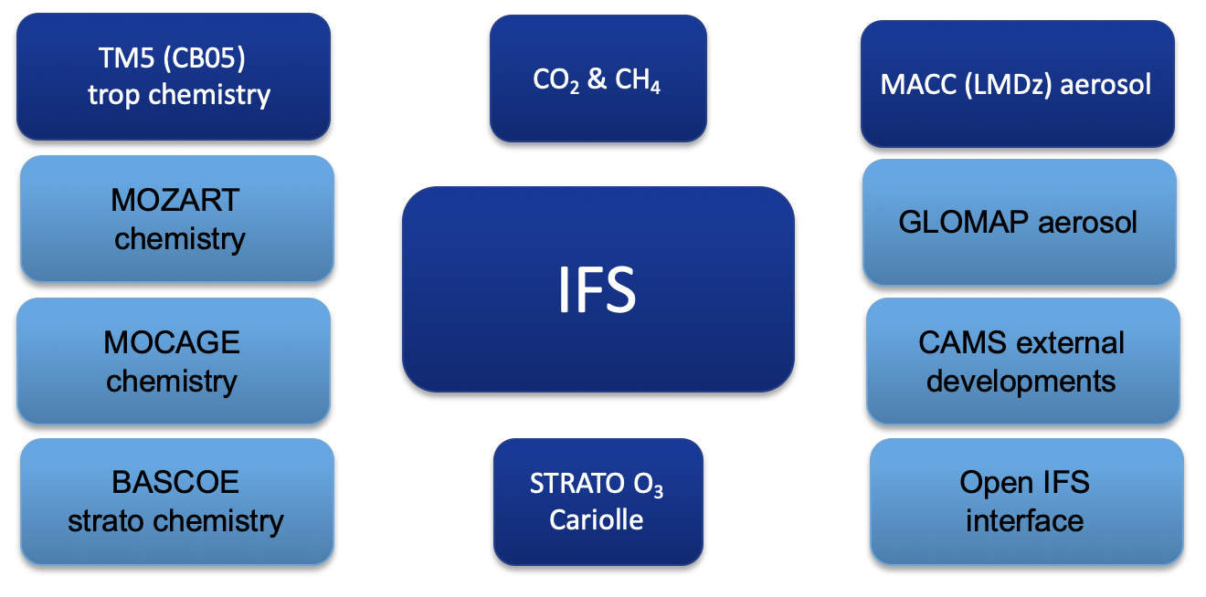
IFS: COMPOSITION CONFIGURATIONS
A. Inness et al., The CAMS reanalysis of atmospheric composition, ACP, https://doi.org/10.5194/acp-19-3515-2019, 2019.
A. Agusti-Panareda et al., Modelling CO₂ weather – why horizontal resolution matters?, ACP, https://doi.org/10.5194/acp-2019-177, 2019.
S. Rémy et al., Description and evaluation of the tropospheric aerosol scheme in the Integrated Forecasting System (IFS-AER, cycle 45R1) of ECMWF, GMDD, 2019 (submitted).
V. Huijnen et al., Quantifying uncertainties due to chemistry modelling – evaluation of tropospheric composition simulations in the CAMS model (cycle 43R1), GMD, https://doi.org/10.5194/gmd-12-1725-2019.
Upcoming upgrade (July)
Based on IFS Cy46r1
T511 (unchanged, ~40km)
L137 (was L60)
(GEOSCHEM)

Slide 8
THE CAMS REANALYSIS
The dataset covers the period 2003 to end 2017. This reanalysis is a marked improvement over our previous datasets (MACC reanalysis and CAMS interim reanalysis).
CAMSRA (2003-2016)
Evaluation of total column CO
bias
4.49 ± 5.04 | 2.99 ± 3.02 | -0.54 ± 2.95
CIRA (2003-2016)
Evaluation of Aerosol Optical Depth
bias
4.55 ± 4.50 | 7.30 ± 4.42 | 1.96 ± 5.06
MACCRA (2003-2012)
I. Inness

Slide 9
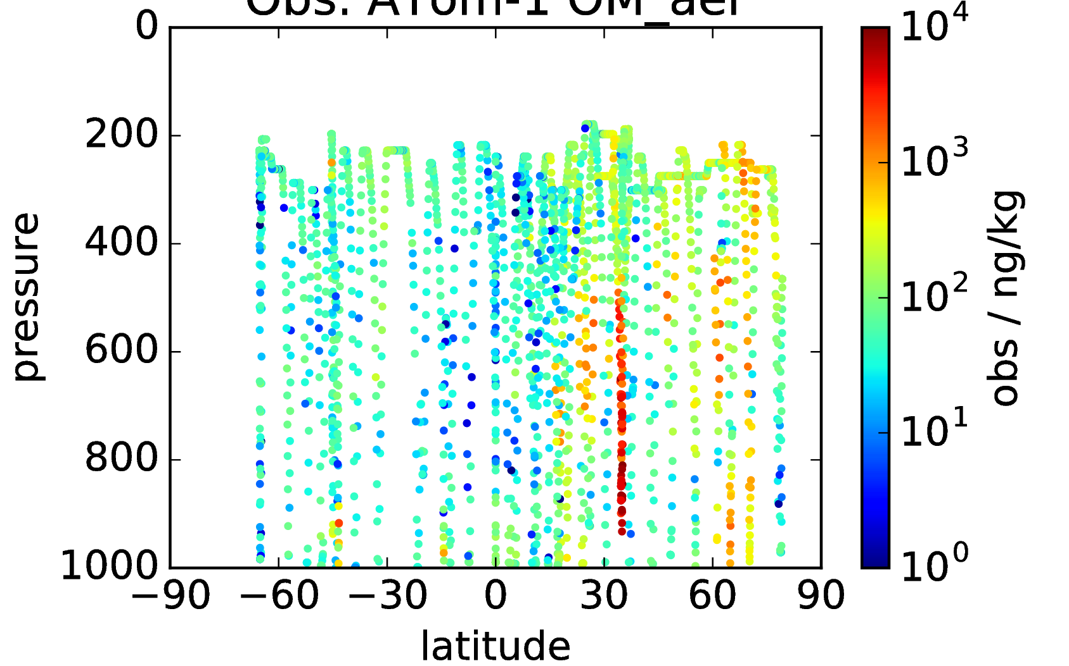
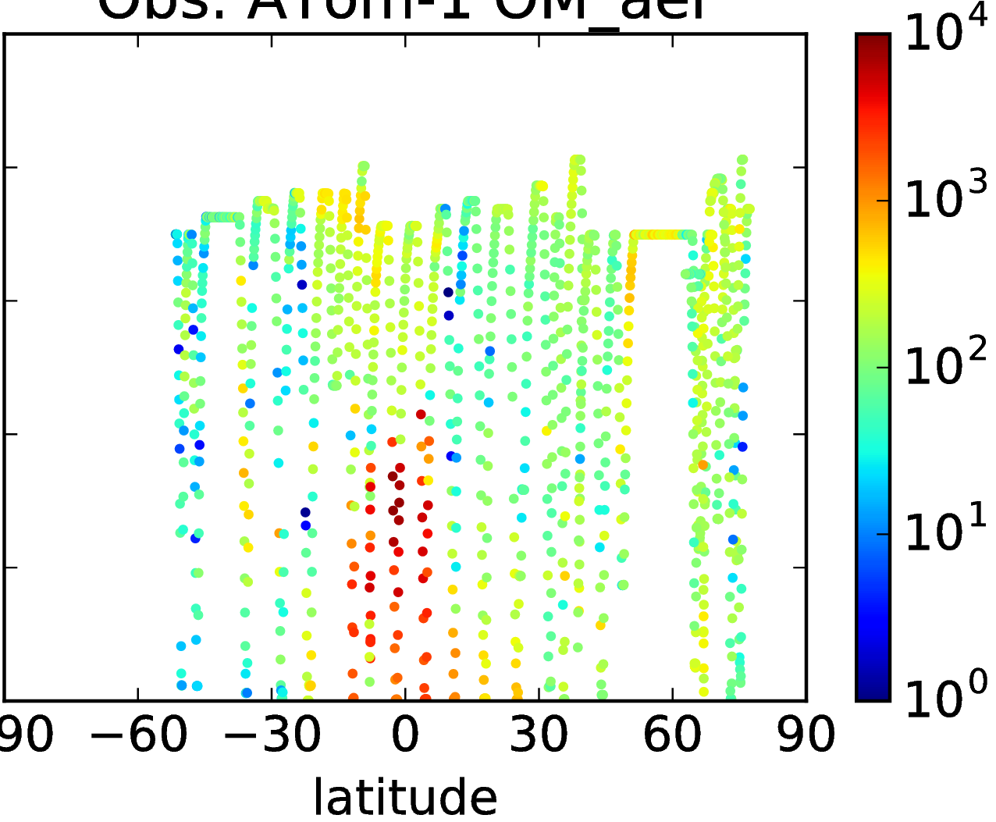
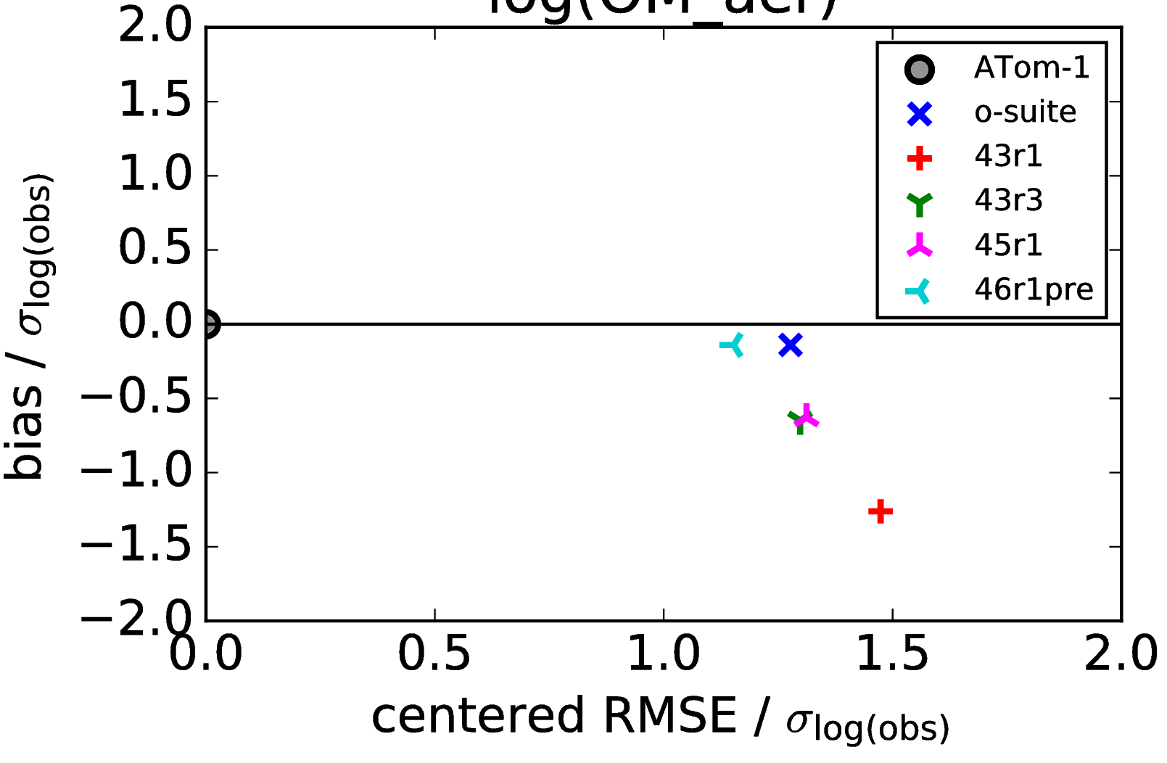
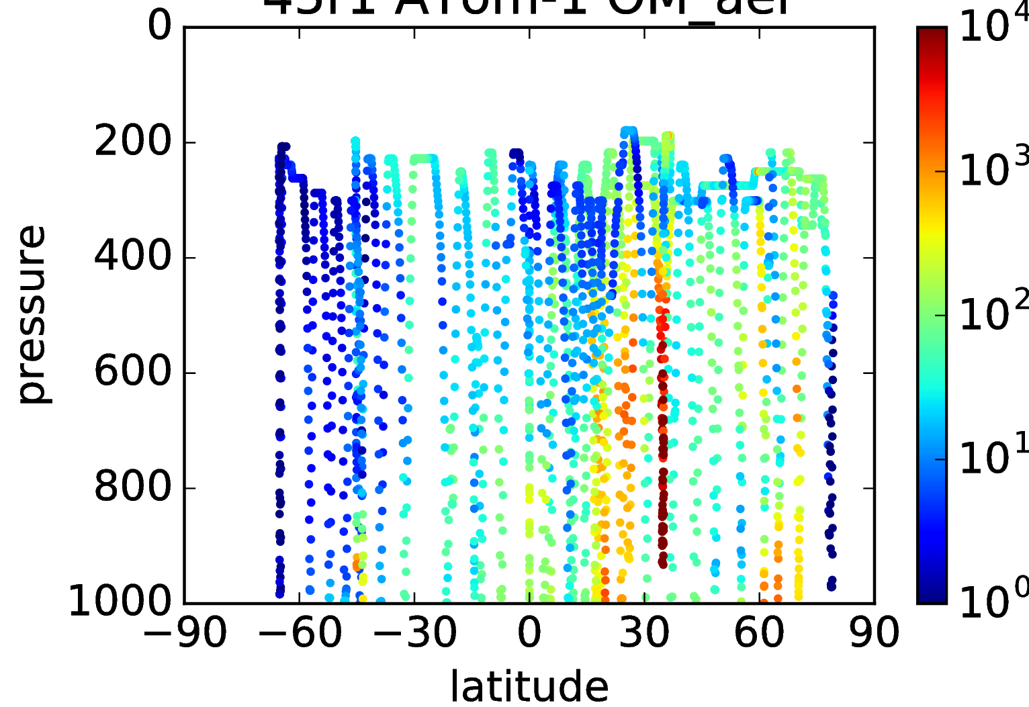
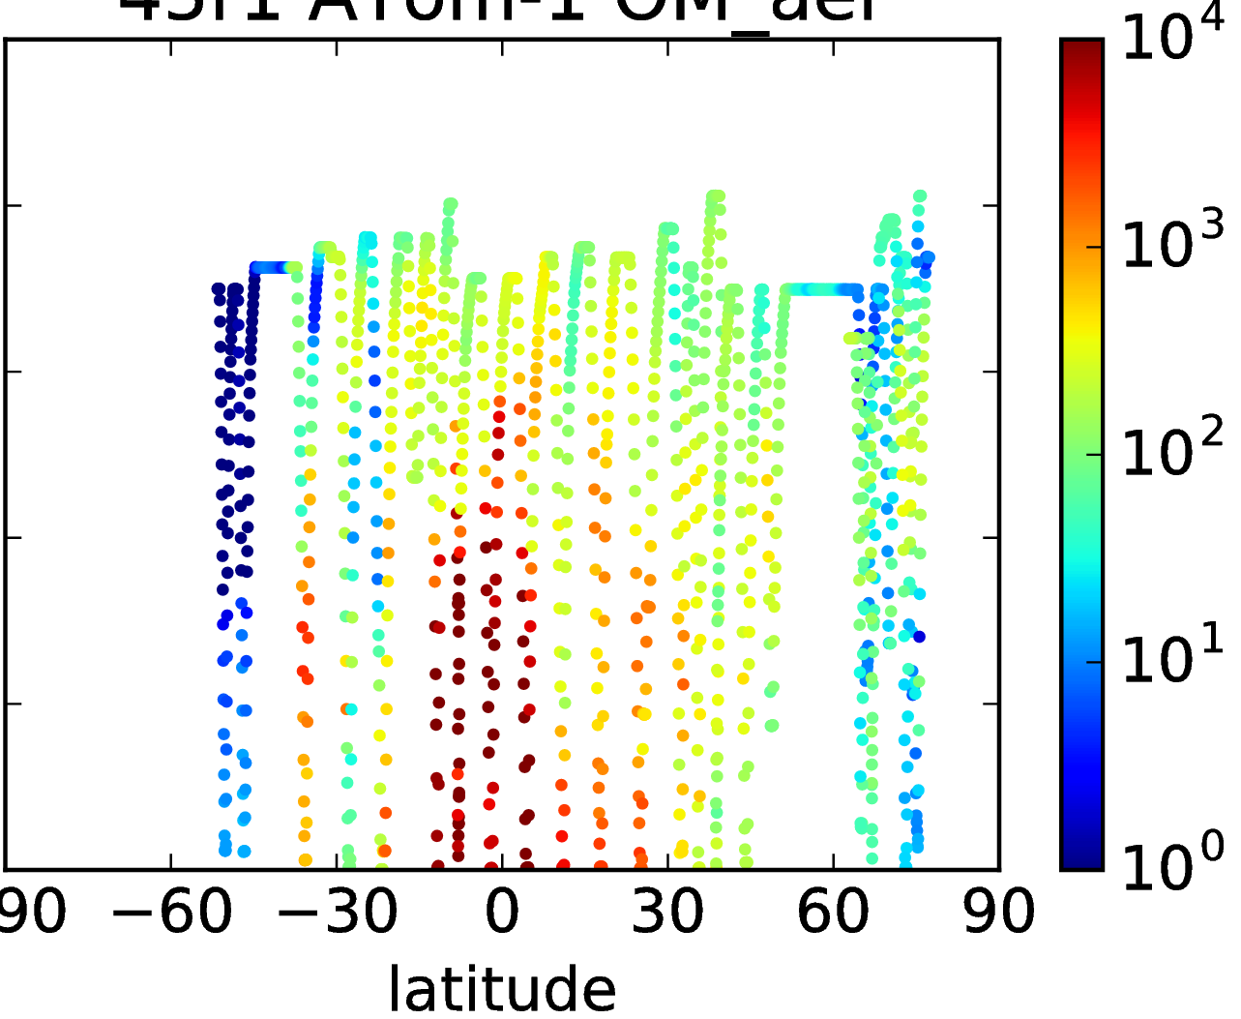
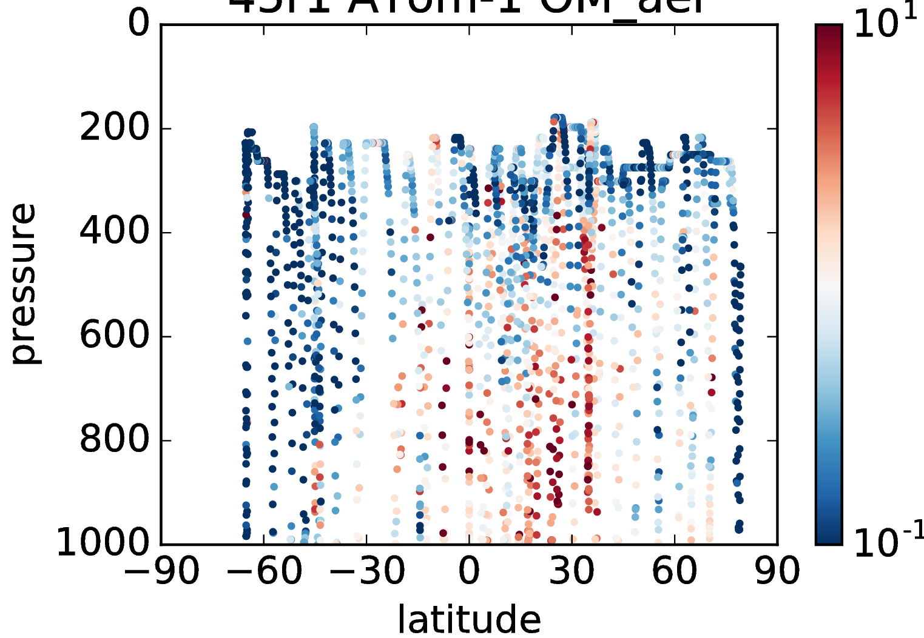
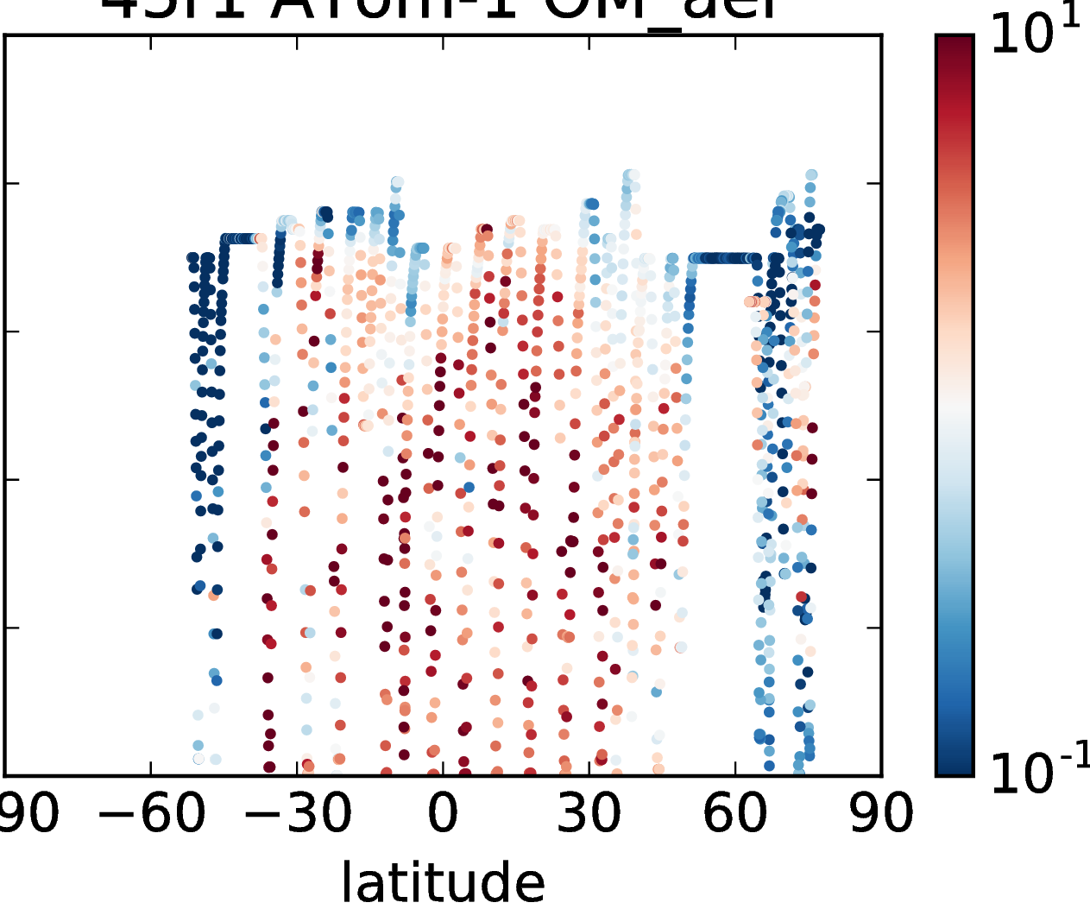
ORGANIC AEROSOL: IFS vs ATOM-1 (JUL/AUG 2016)
ATom-1 obs (HR-ToF-AMS)
Normalised bias & RMSE of log(OM MMR) across IFS cycles
Pacific
Atlantic
Organic aerosol mass mixing ratio / ng kg⁻¹
IFS 45r1
Pacific
Atlantic
o-suite at this time was older (41r1), and also assimilating MODIS AOD
IFS 45r1 / obs
Pacific
Atlantic
Improving from 43r1 to 46r1 in model-only mode
Ratio (model / obs)
Z. Kipling

Slide 10
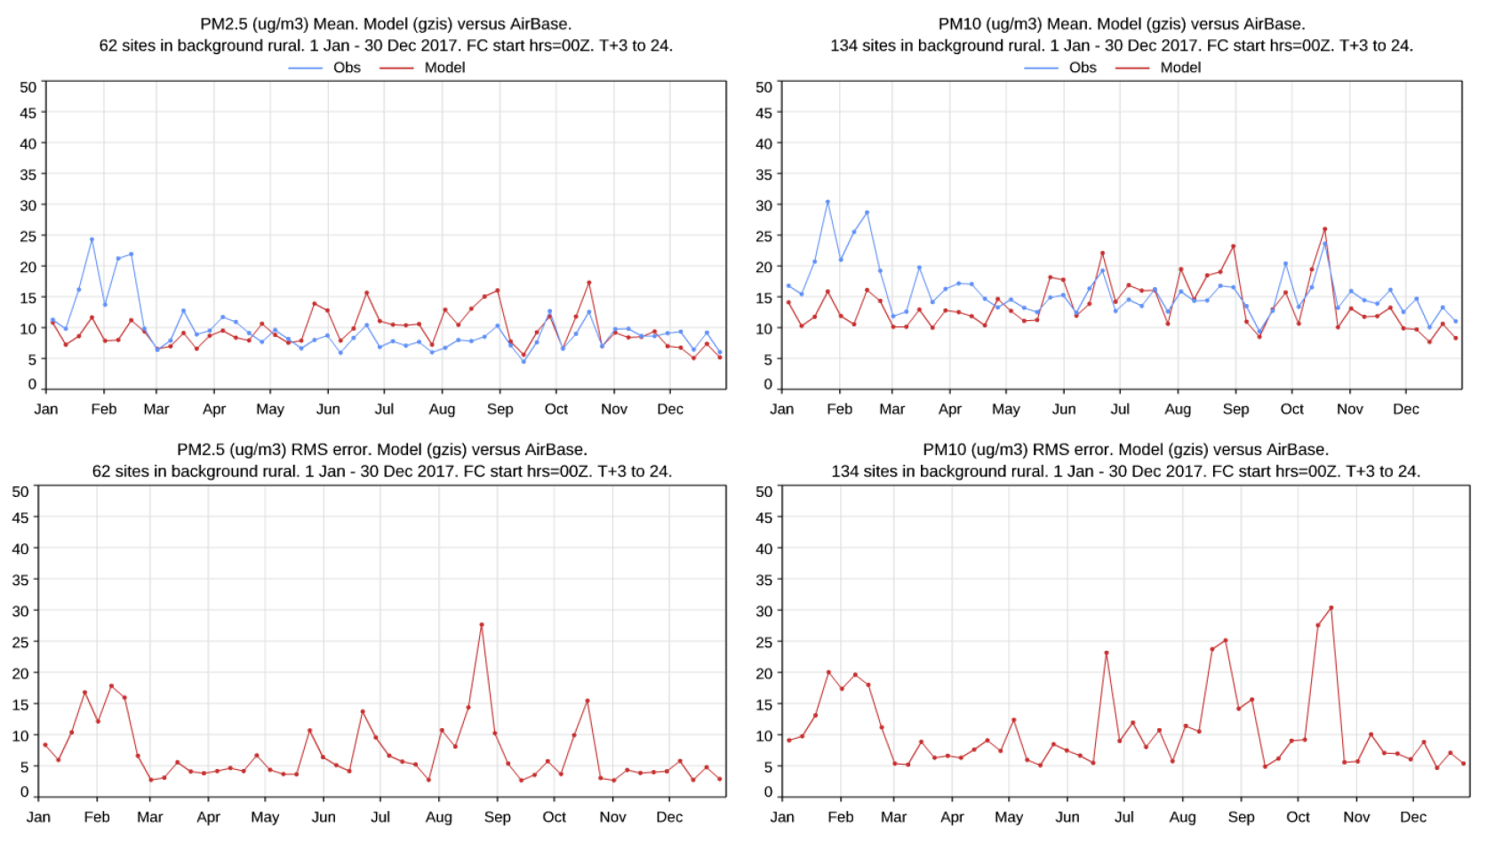
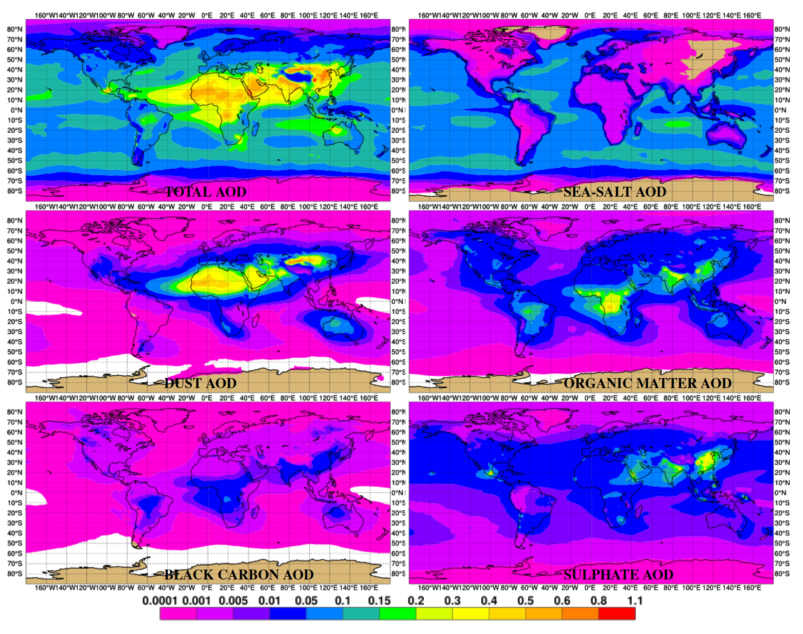
AEROSOL IN IFS: IFS-AER
Since Morcrette et al. (2009), many components have been reviewed, and two new species (nitrate and ammonium) were added in Cycle 45R1
In Cycle 46R1 dust production and wet scavenging have undergone a major upgrade.
On-going work on using SOA production rates provided by the gas chemistry scheme.
S. Rémy
2017

Slide 11
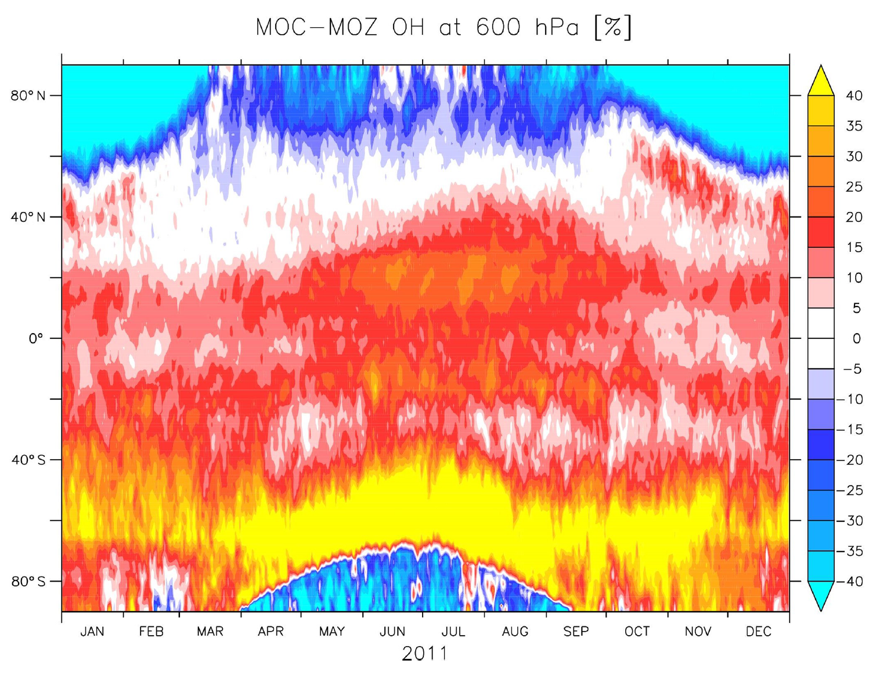
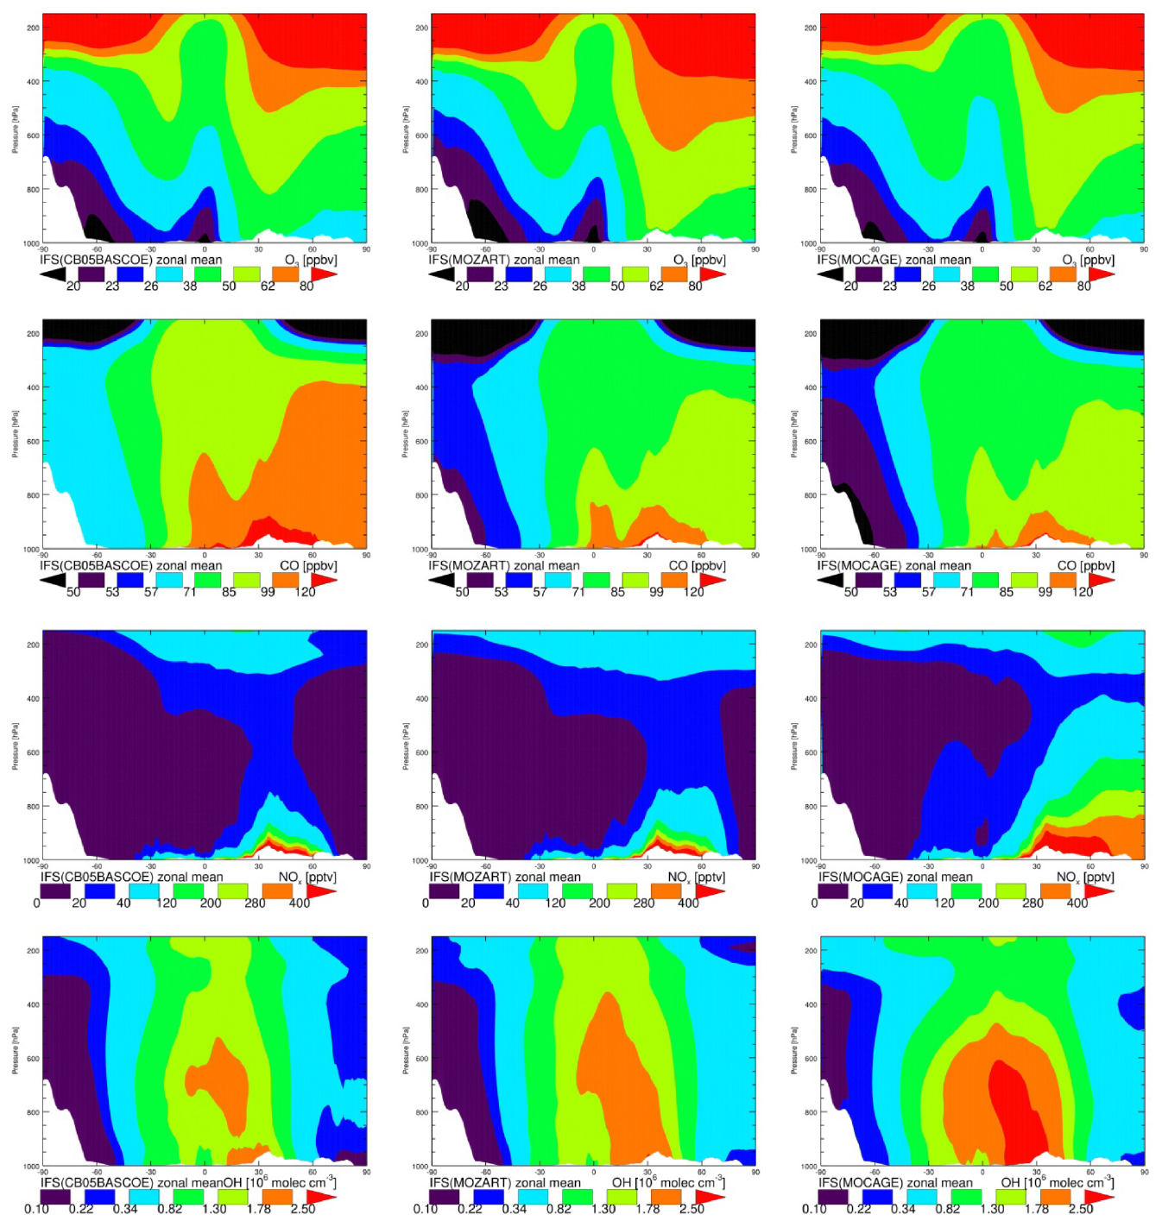
UNCERTAINTY DUE TO CHEMISTRY MODELING
IFS-CB05
IFS-MOZART
IFS-MOCAGE
O₃
CO
similar patterns and magnitudes for CO, O₃, CH₂O, C₂H₄ and C₂H₆.
O₃ (CO) are within 10 % (20 %) throughout the tropo
except for C₂H₆ and C₂H₄, all these trace gases are reproduced with an uncertainty-weighted bias well within 1σ against A/C observations
OH levels may vary by up to 50 % particularly at high latitudes, which may explain the larger spread for C₂H₄
larger discrepancies exist for NO₂, SO₂ and HNO₃ due to processes such as photolysis, heterogeneous chemistry and conversion to aerosol through gas- and aqueous-phase oxidation
aspects point to emissions uncertainties
NO_{x}
OH
V. Huijnen

Slide 12
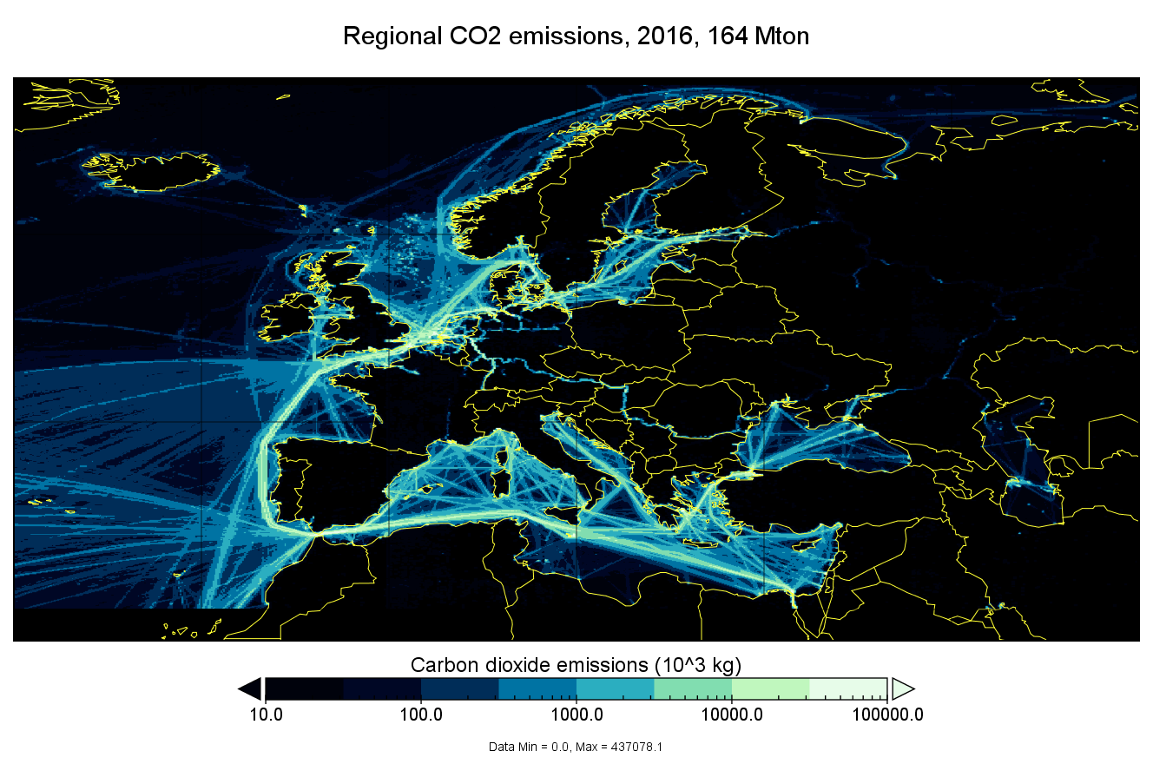
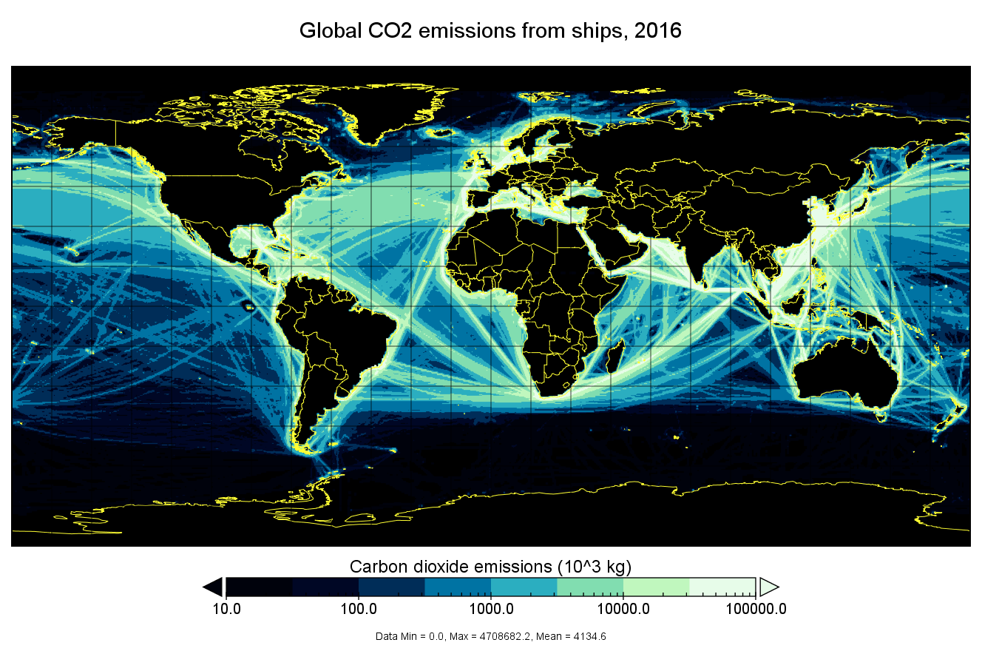
CAMS BOTTOM-UP EMISSIONS
Emissions are both an input to CAMS global and regional systems and a popular product. Entirely new datasets have been released covering 2003 to 2019 (extrapolation). Example: CO₂ emissions from shipping activities
(provider: FMI, Finland).
C. Granier

Slide 13
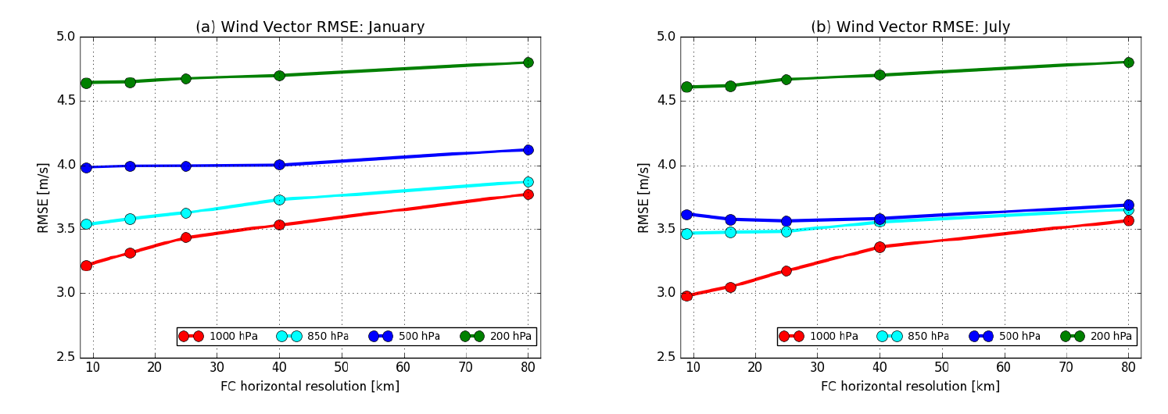
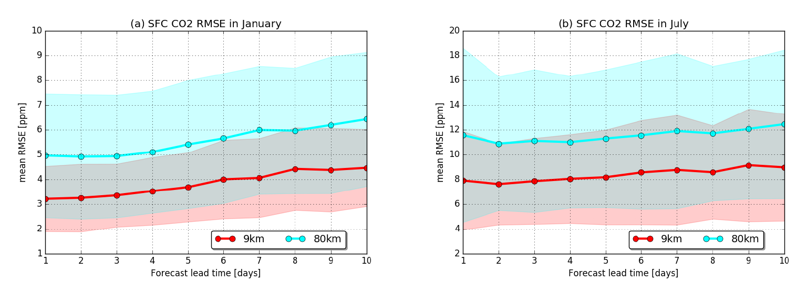
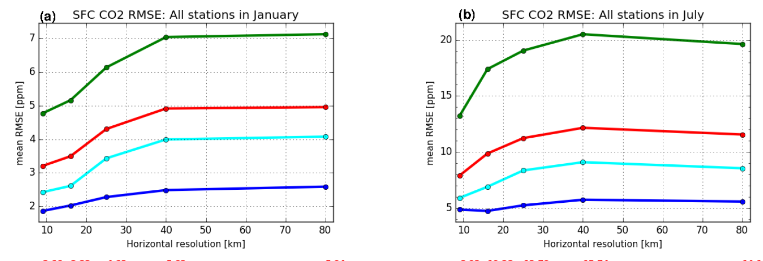
INFLUENCE OF RESOLUTION: CASE OF CO₂
Winds
9 km resolution instead of 80 km leads to a general improvement in the simulated variability of hourly near-surface and column-averaged atmospheric CO₂
higher horizontal resolution has a consistent positive impact on the error reduction at all forecast lead times, from day 1 to day 10
CO₂
A. Agusti-Panareda

Slide 14
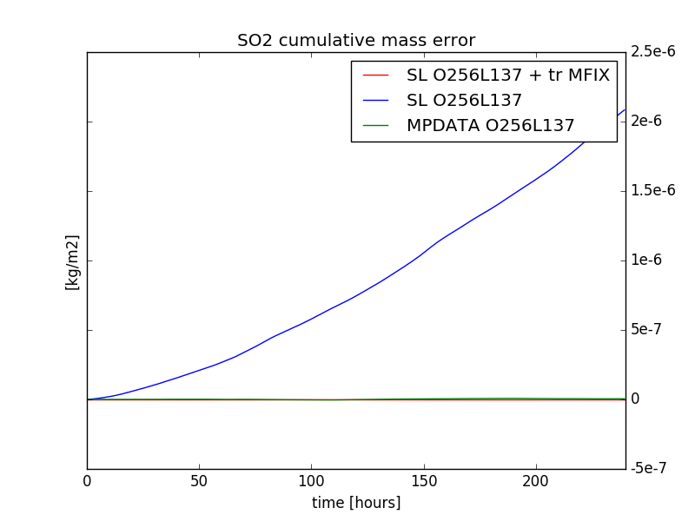
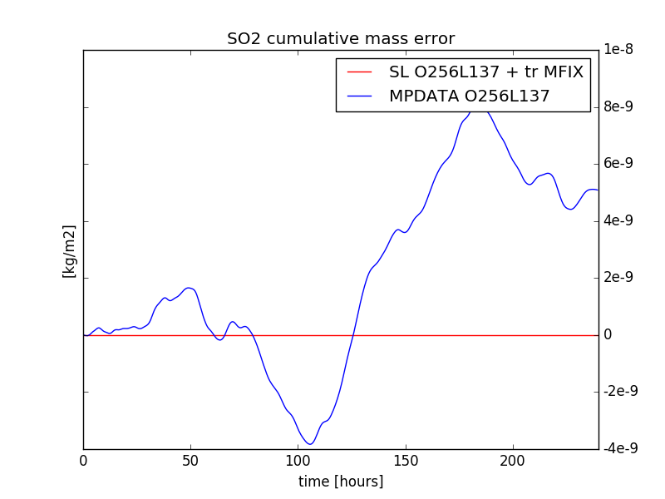
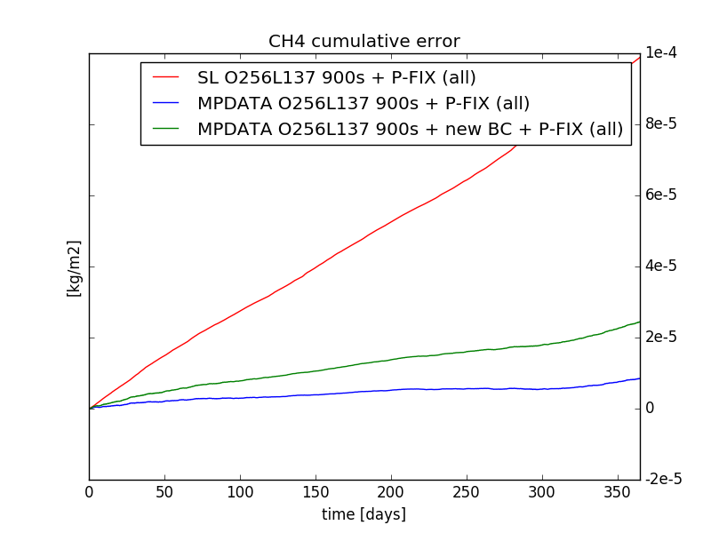
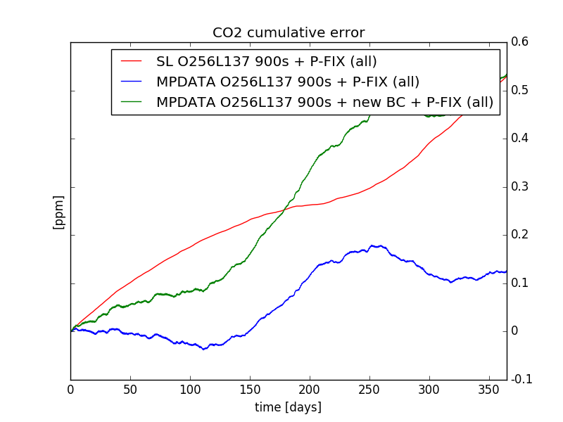
MASS CONSERVATION ISSUES
Plumes (e.g. volcanic…) = worst case
SL+fix
SL
Mass
conserving
Added complexity because of P_{surf} and moist air (rather than dry): adding dry-wet term to continuity equation requires non-trivial change to dynamics code)
Slow accumulation for GHG
M. Diamantakis

Slide 15
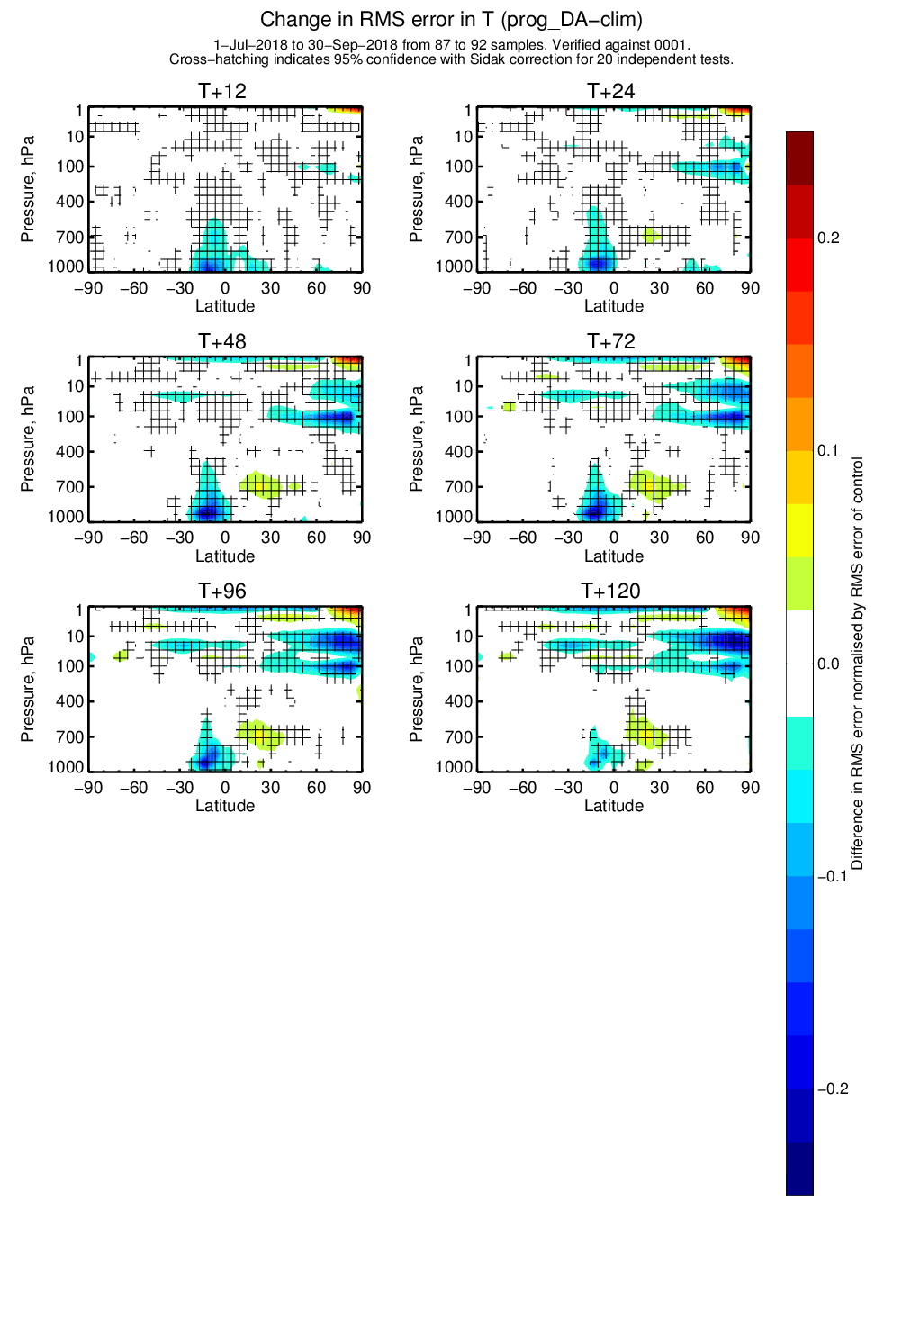
TESTING PROGNOSTICS AEROSOL AND OZONE
CAMS o-suite (TL511L137) uses prognostics aerosol and ozone in the radiation scheme since 45r1 (June 2018)
Control forecast run using CAMS based ozone and aerosol climatologies in the radiation scheme (as in NWP application of IFS, no aerosol background term)
Evaluation against own CAMS o-suite analysis
More testing of prognostic aerosols needed to find robust improvement in NWP scores
Prognostics stratospheric ozone had good impacts
Biomass burning imprint in improvements
J. Flemming

Slide 16
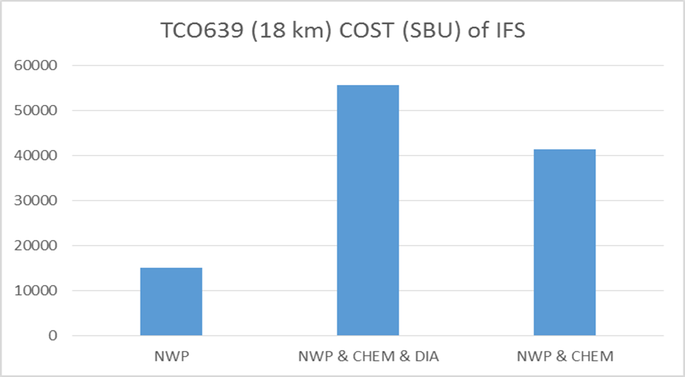
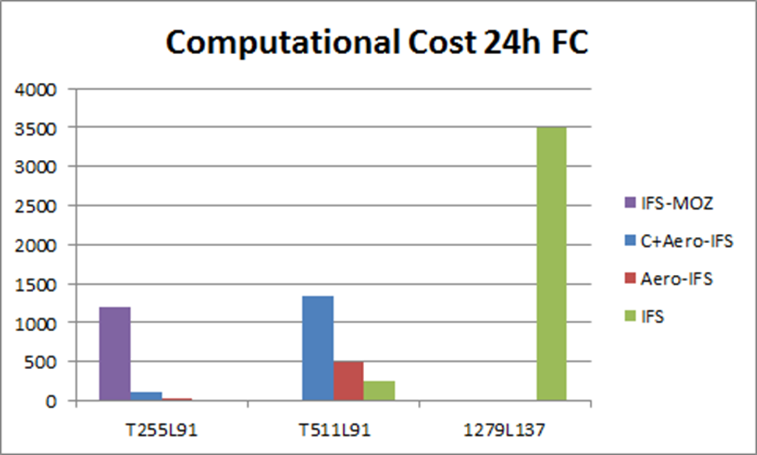
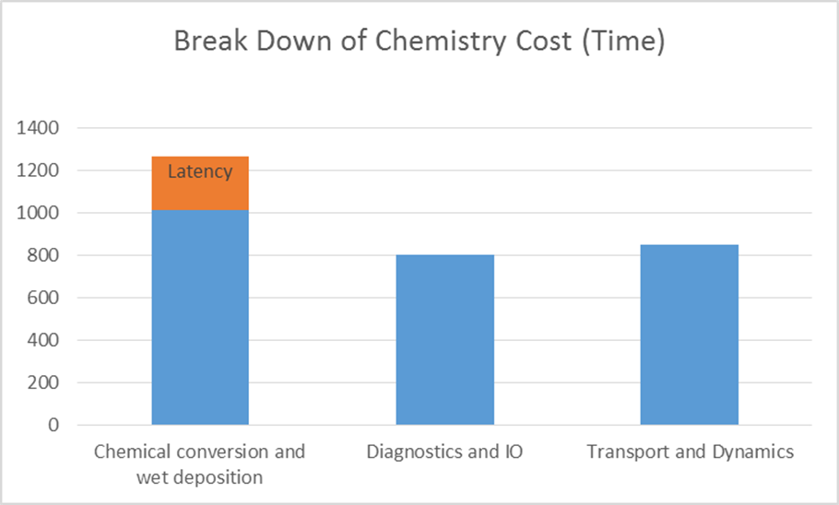
COMPUTING COSTS
x 4.0
x 2.5
“old” coupled system was extremely inefficient
80 km
40 km
16 km
J. Flemming

Slide 17
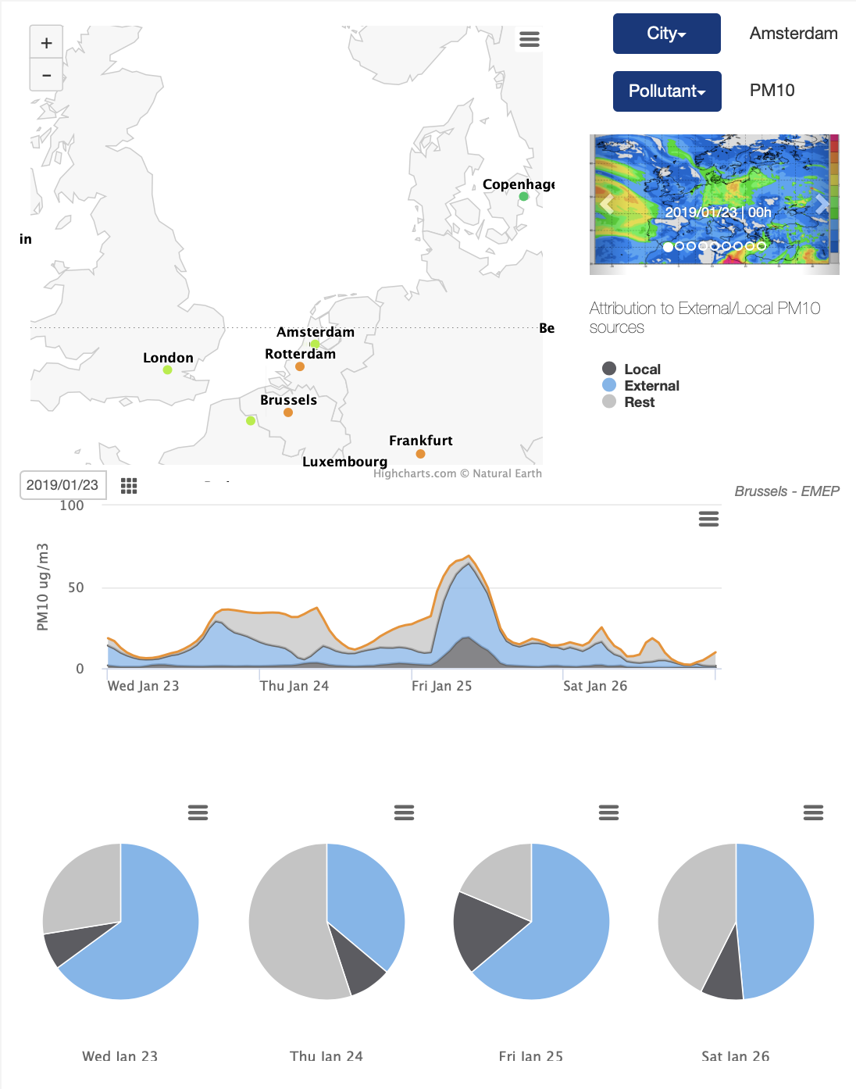
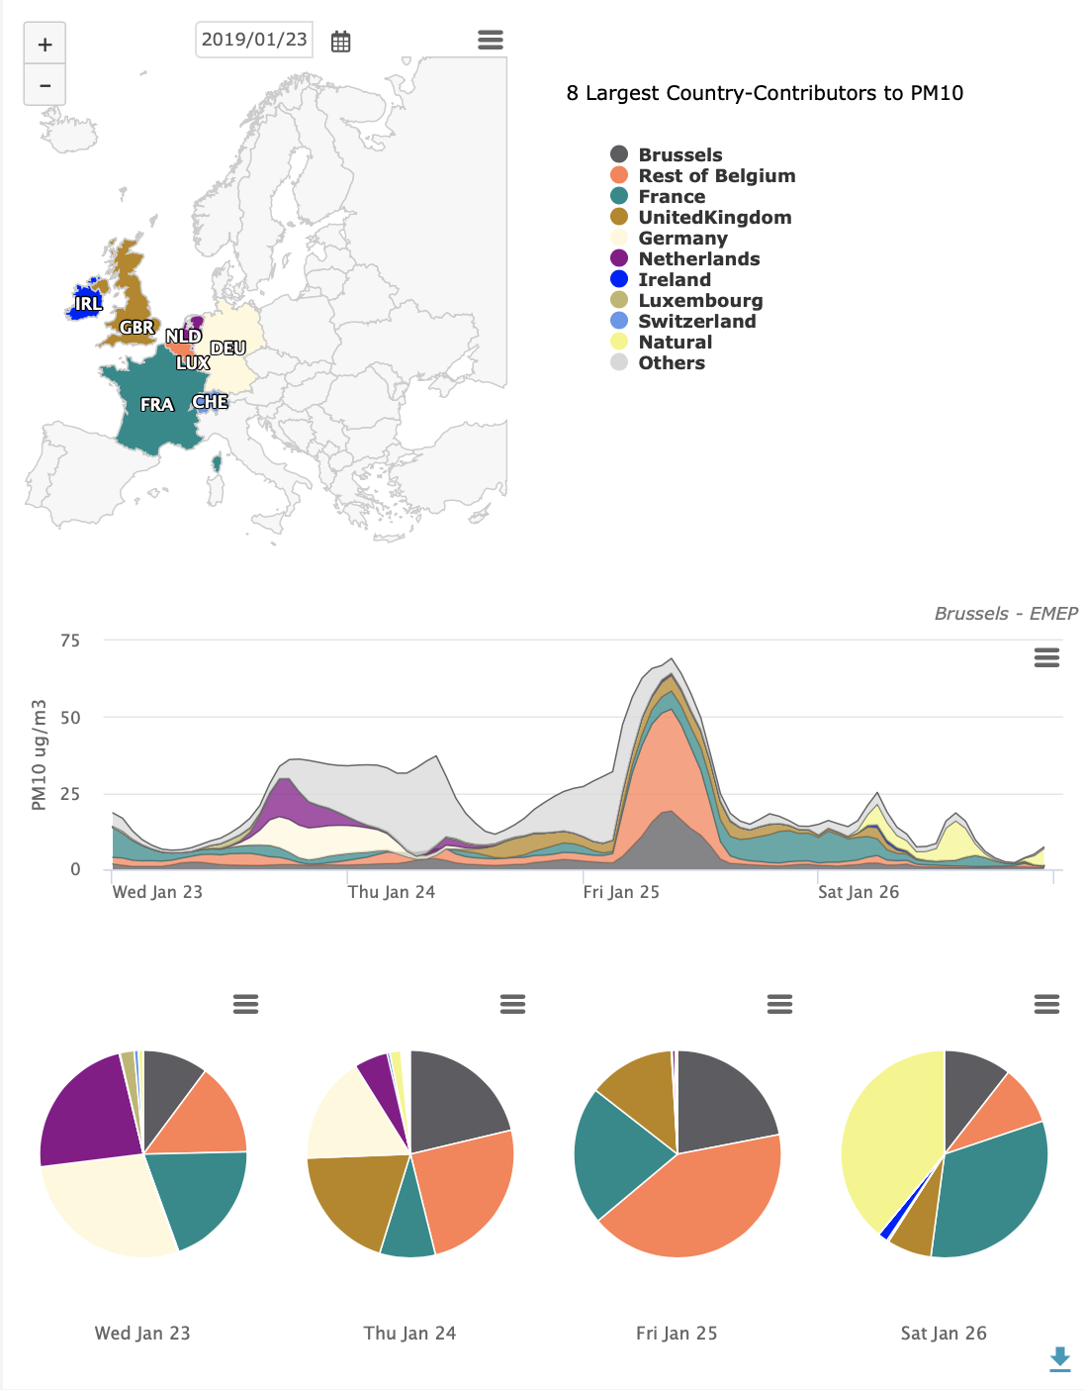
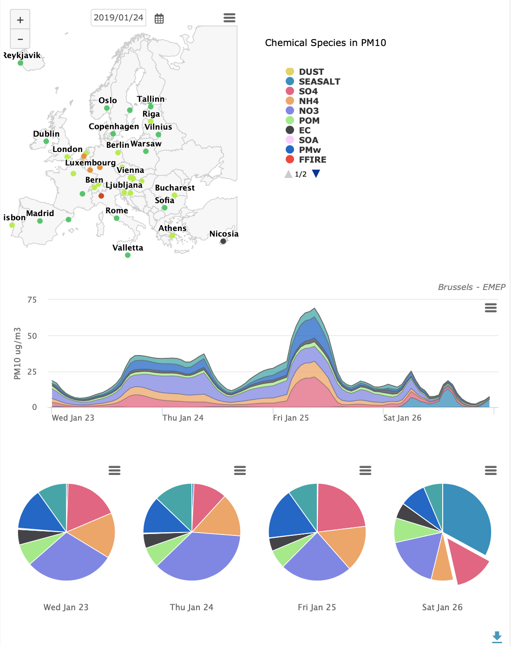
BEYOND FORECASTING: SCIENCE TO SERVICES
For the European capitals, daily analysis of local versus large scale contribution to air pollutant concentrations. Where does pollution come from? What is the chemical composition of PM?
Brussels
M. Schulz

Slide 18
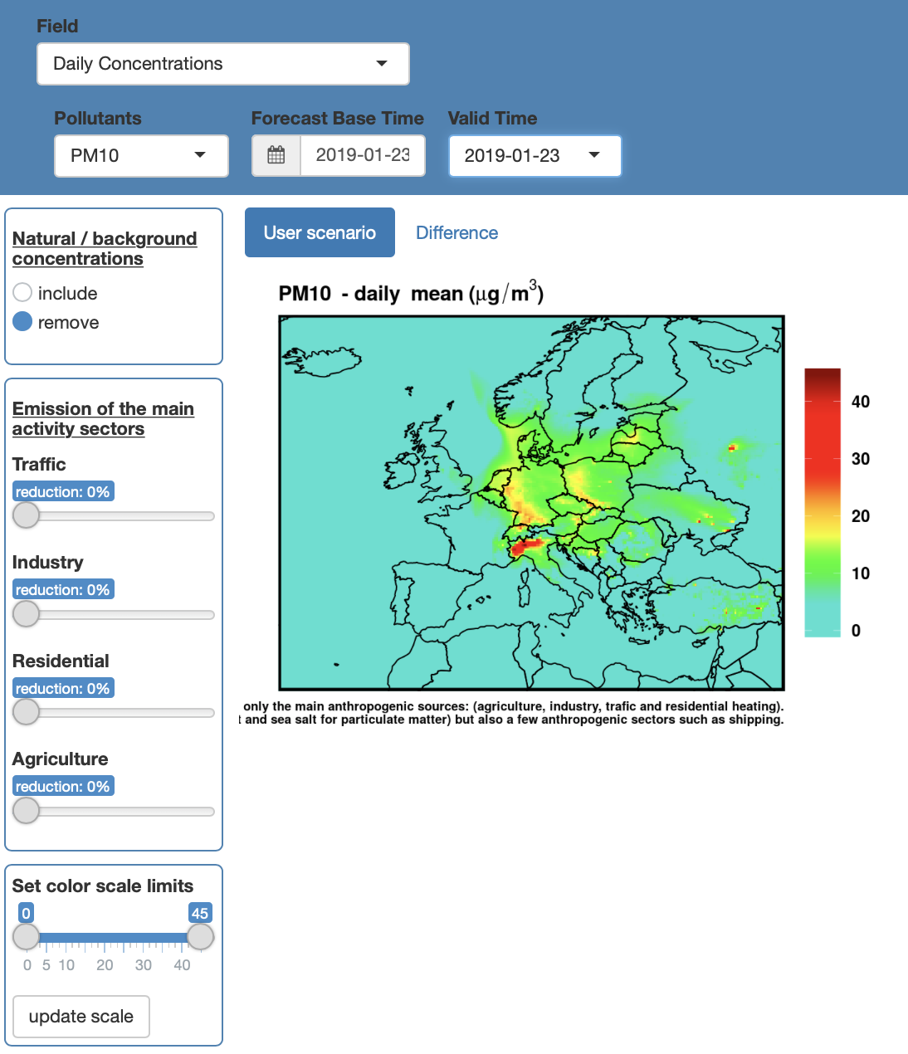
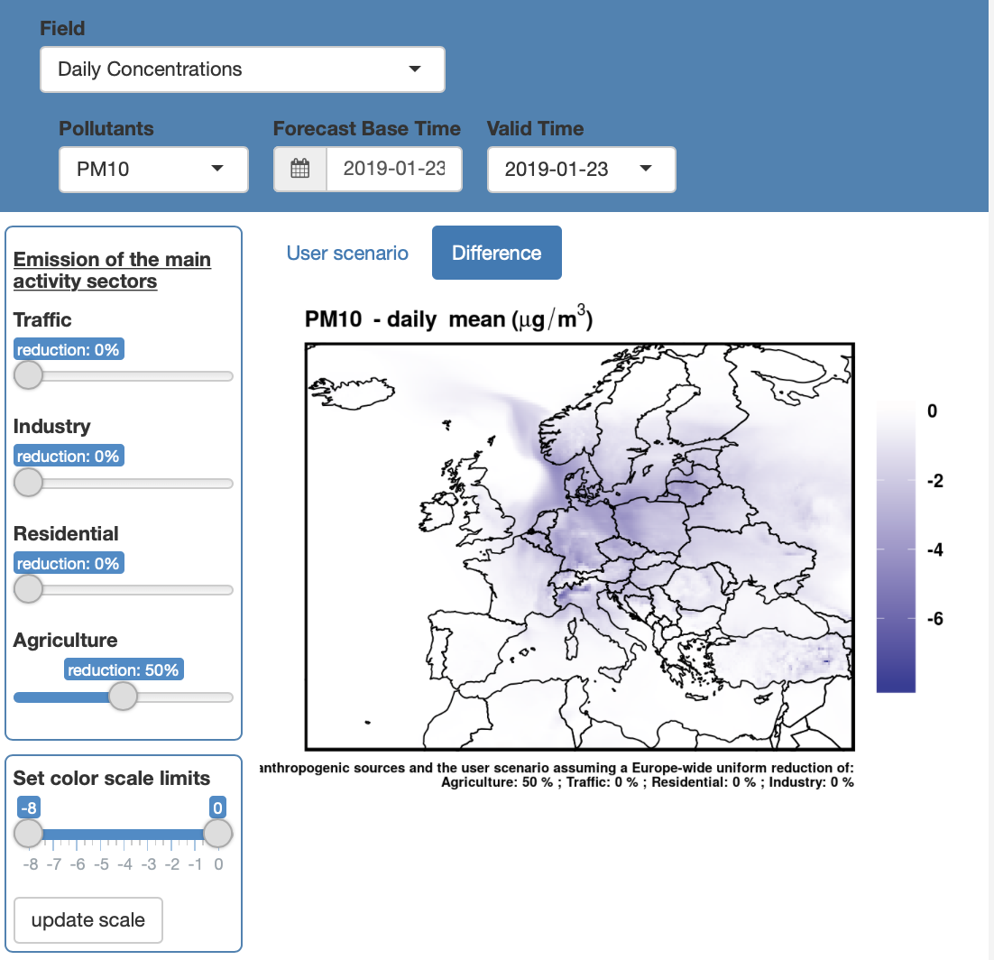
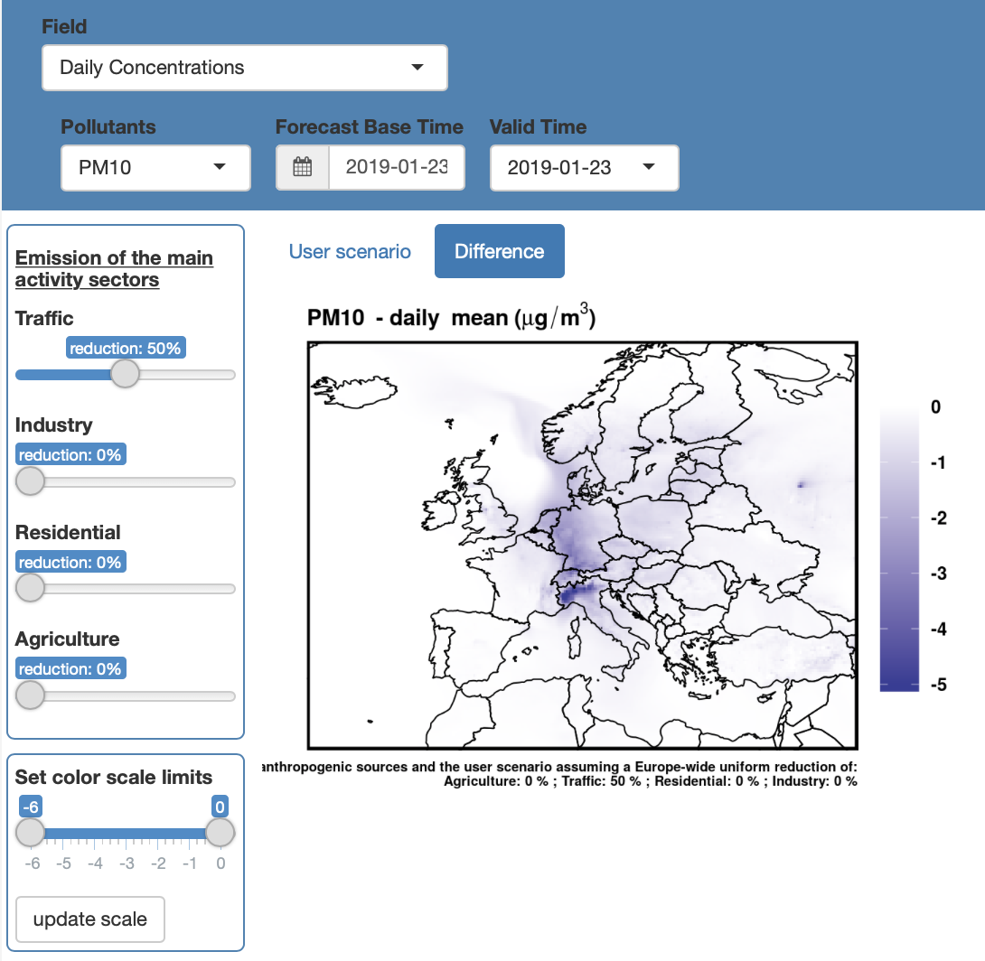
THE CAMS AIR CONTROL TOOLBOX
What happens today if emissions from agriculture are cut by 50%
What happens today if emissions from traffic are cut by 50%
Live! Using a surrogate model combining a dozen actual forecast runs.
A. Colette

Slide 19
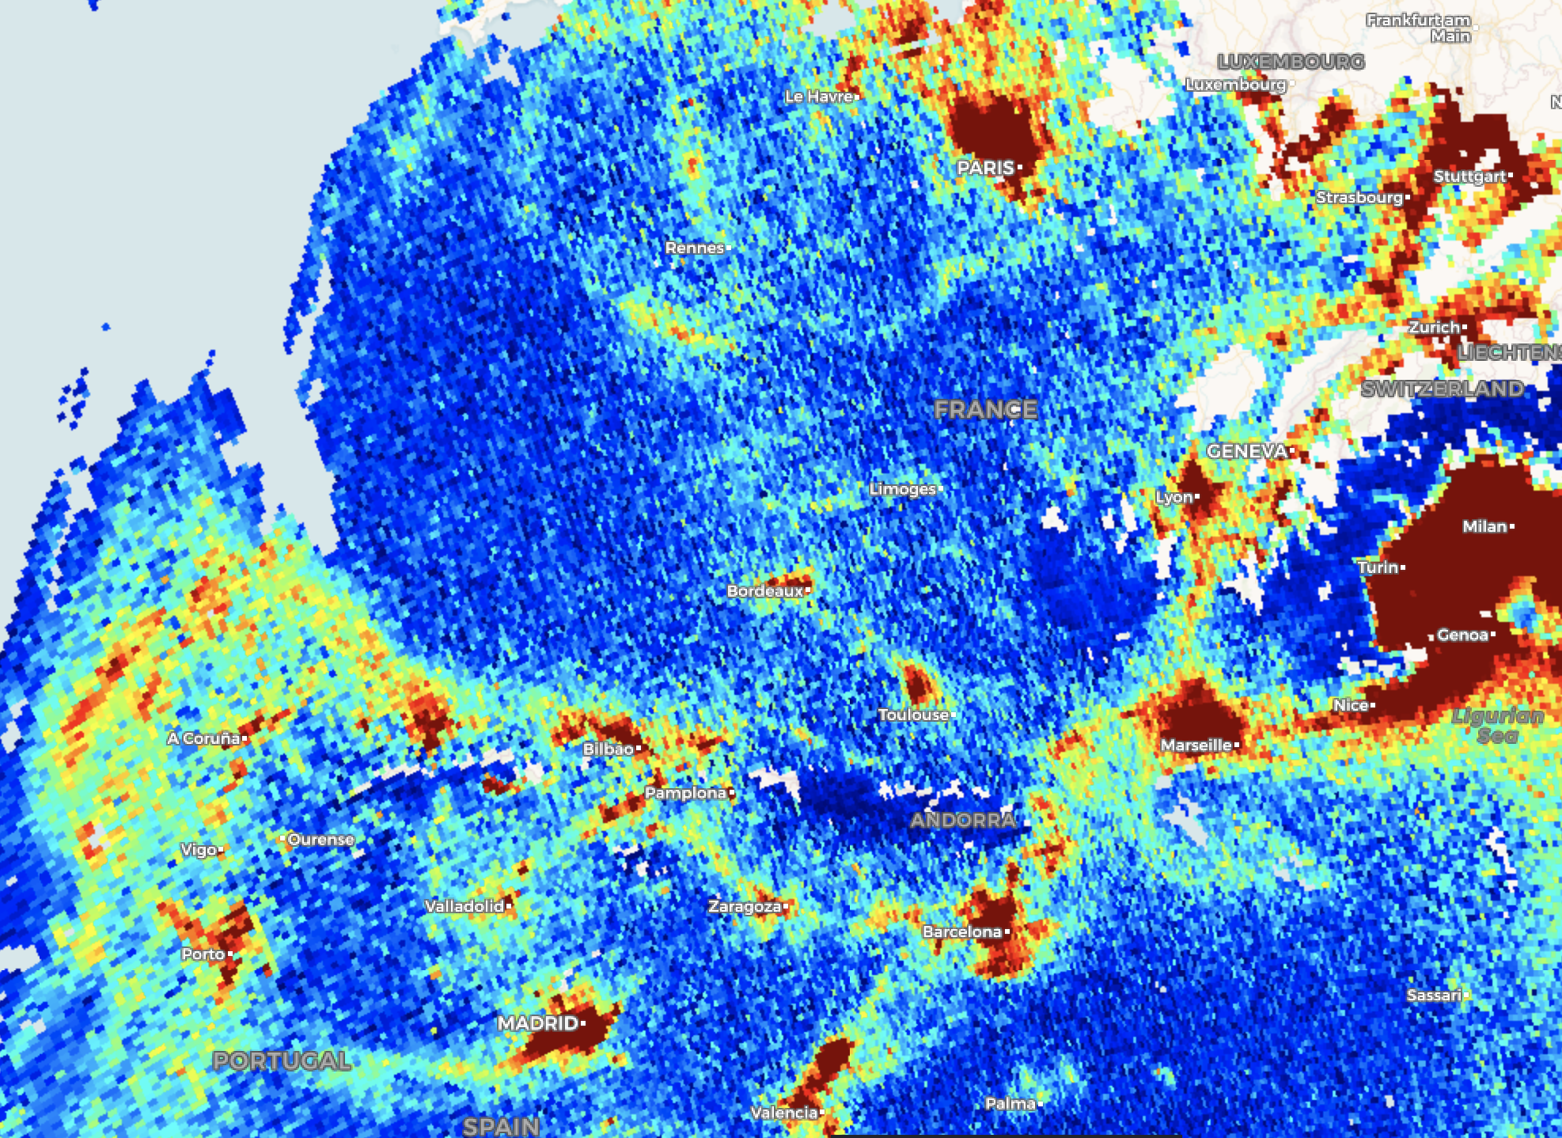
ANNO S-5P: BEFORE AND AFTER
S-5P is triggering unprecedented interest in the air quality community
And GEMS, TEMPO and S4 will combine high spatial and high temporal resolution
Example: 13/02/2019, tropospheric NO₂

Slide 20
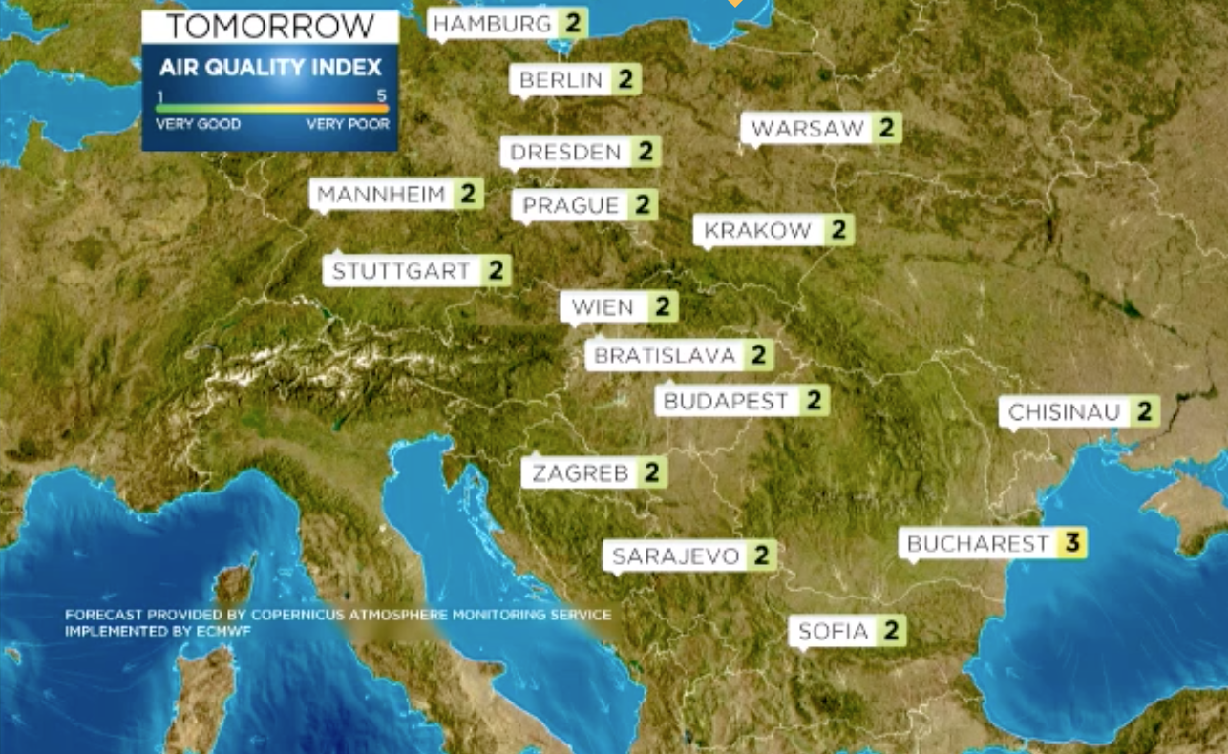
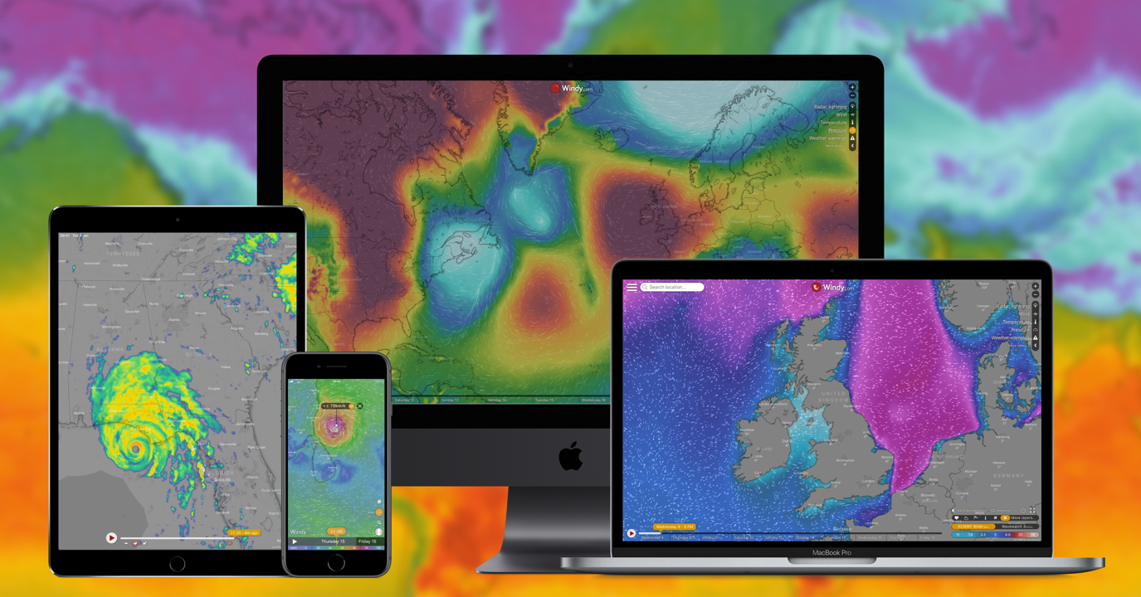
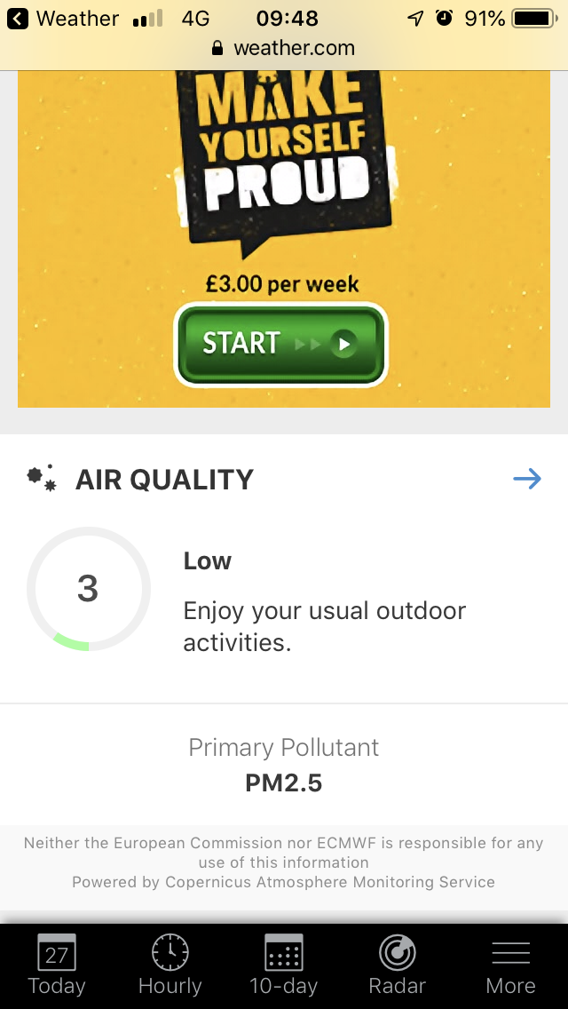
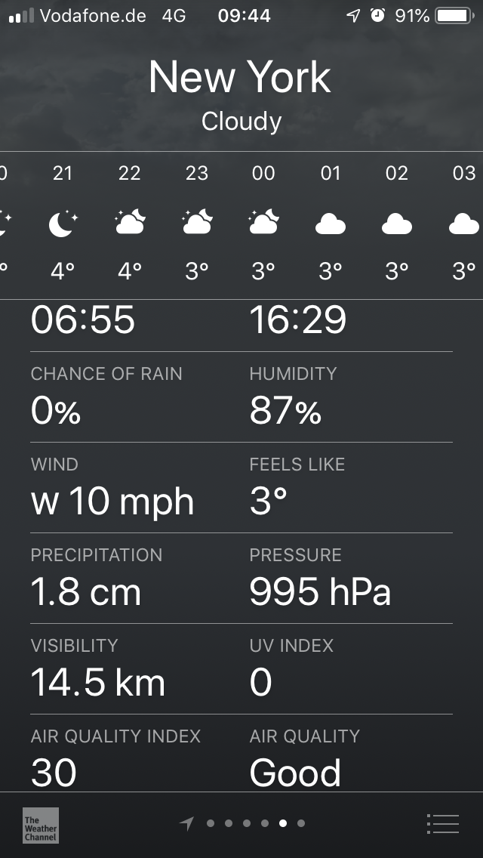
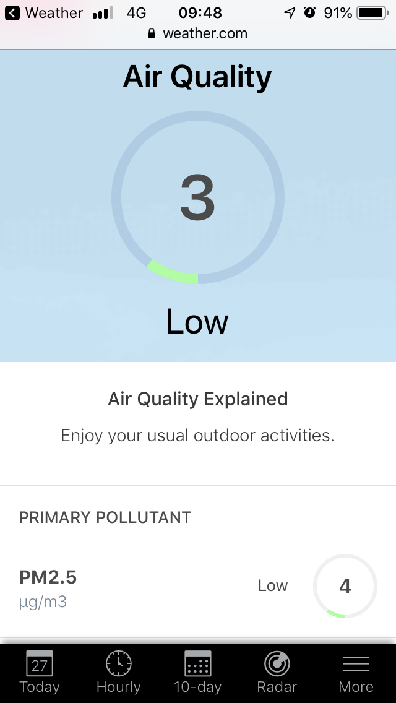
… NOW REACHING A GLOBAL COMMERCIAL AUDIENCE
Windy
Plume Labs
Breezometer

