Slide 1
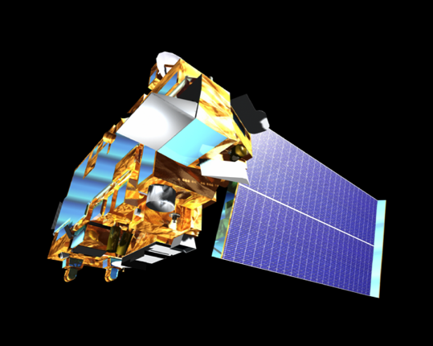



Satellite data
David P. Edwards
NCAR/ACOM
MUSICA Kick-Off Meeting, May 21-22, 2019
This material is based upon work supported by the National Center for Atmospheric Research, which is a major facility sponsored by the National Science Foundation under Cooperative Agreement No. 1852977.

Slide 2
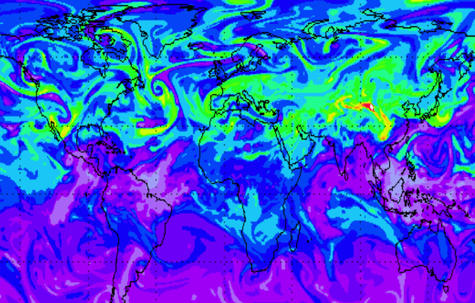

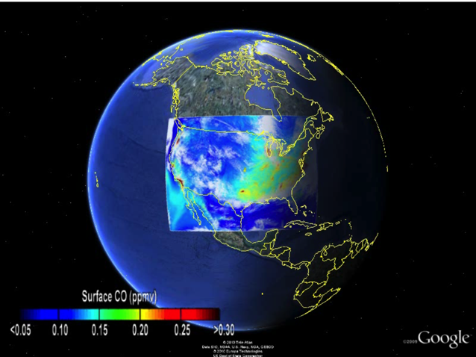
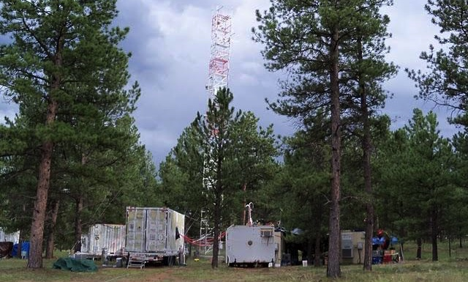
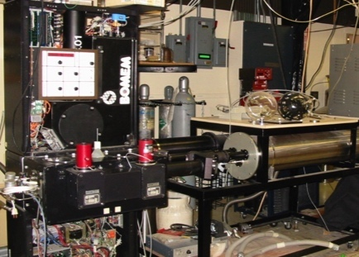
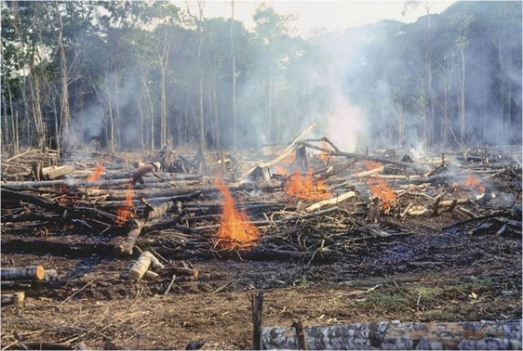
Predictive capability relies on the quantitative integration of observations and models spanning local-to-global scales
Remote sensing
Long term observations
Regional-global coverage
Large scale context for processes
Some limits on horizontal, vertical and temporal resolution
Global models
Aircraft campaigns
Regional models
In-situ observations
Lab studies
Process models

Slide 3

Over the last decade, low-Earth orbit (LEO) sensors have characterized tropospheric composition sources, transport, and variability on weekly to monthly and regional to global scales
Passive sensors observe columns, or partial columns, of AQ relevant species; active systems have high vertical information content but limited coverage
Now entering a new era of higher spatiotemporal resolution observations that will access local, regional and diurnal scales
Remote sensing of tropospheric composition
UV-VIS: GOME, SCIAMACHY, OMI, GOME-2, TROPOMI …
O₃, NO₂, HCHO, SO₂, BrO, aerosol + …
NIR: GOSAT, OCO-2, TanSat …
CO₂, CH₄, aerosol + ...
SWIR: SCIAMACHY, MOPITT, MODIS …
CO, CH₄, aerosol + …
TIR: MOPITT, AIRS, TES, IASI, CrIS …
CO, O₃, CH₄, HNO₃, NH₃ + …
… along with other Earth-system remote sensing information …
thermodynamic quantities, clouds, winds, surface properties, vegetation indices, fires parameters, SIF ...

Slide 4
Satellite data and models
Radiative transfer: An fundamental modeling component for remote sensing
Retrievals: Models provide a priori constraints
Satellite validation: Models give confidence in new observations
Data assimilation: Quantitative integration of model and measurement;
accounting for strengths and weaknesses of both components
Combining different observations: Models as a cross-scale transfer standard
Observations of emissions, transport and transformations: Updating model processes
Long-term data records: Informing seasonal and inter-annual variability and trends
Operations: Realistic initialization of AQ forecasts
Unobserved species: Constraints derived from species that can be observed
New observations: Identifying data requirements: OSSEs are increasingly important
Notes:
Proxy gases: CO for AOD
Formaldhype for VIOC

Slide 5
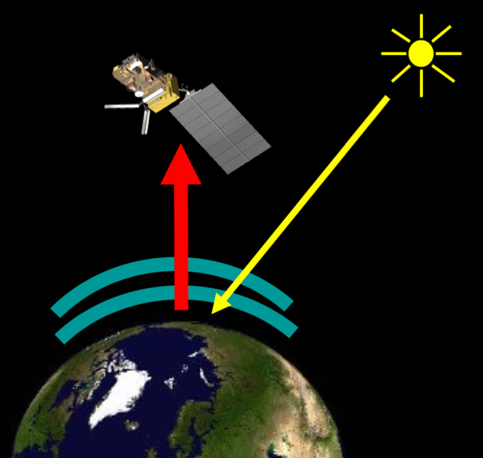
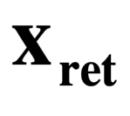
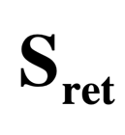
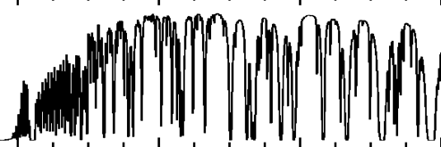
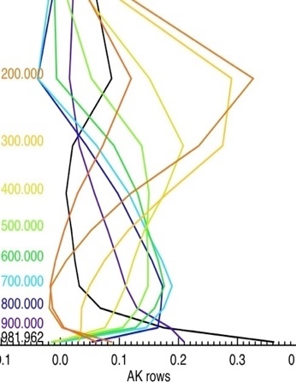
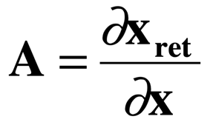
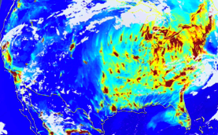
What we want:
Atmospheric trace gas profile
Measurements
The retrieval
& auxiliary obs:
Met. Fields
Cloud fields
Surface data
A cost function is minimized to obtain “optimal estimate” of , given the measurement & our prior knowledge of the atmosphere
What we think we already know:
The Physics of the Measurement:
Forward Model
Measurement
sensitivity
a priori data
Notes:
22/05/2019
5

Slide 6
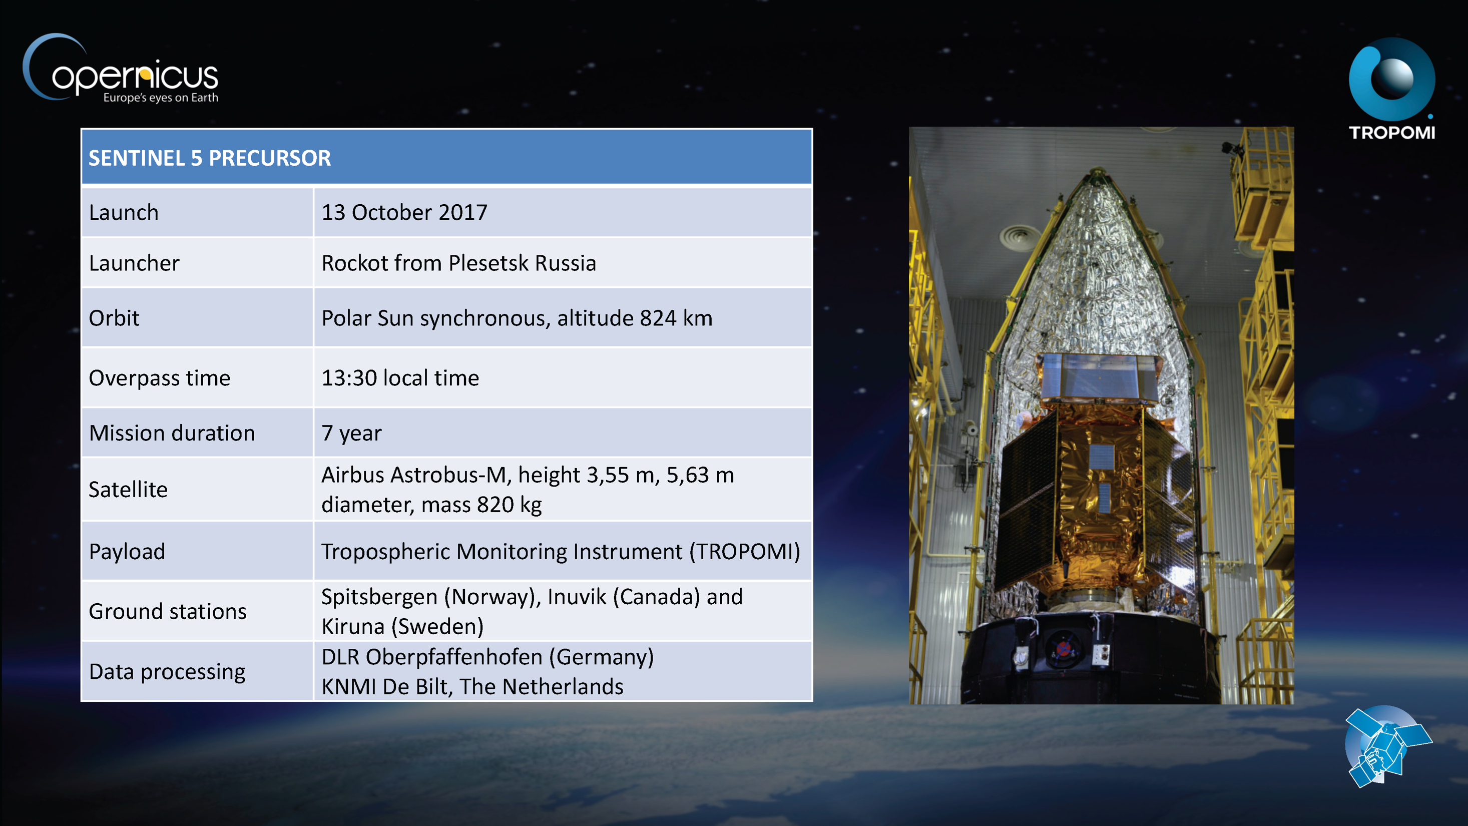
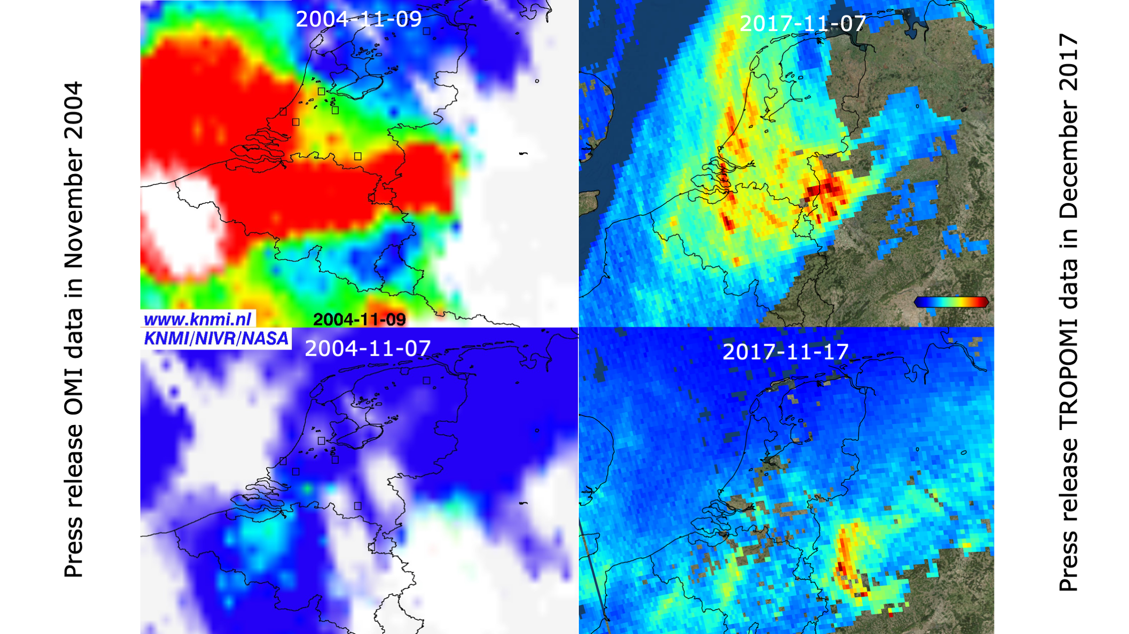
Following on from Aura/OMI, the S5-P TROPOMI mission …
TROPOMI and UV mission heritage
Pepjin Veefkind and Pieternel Levelt, KNMI

Slide 7
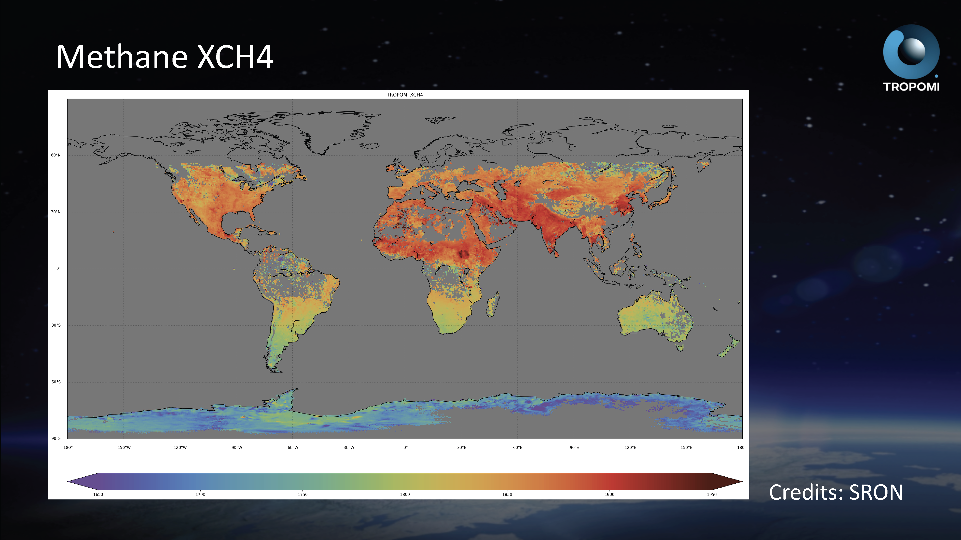
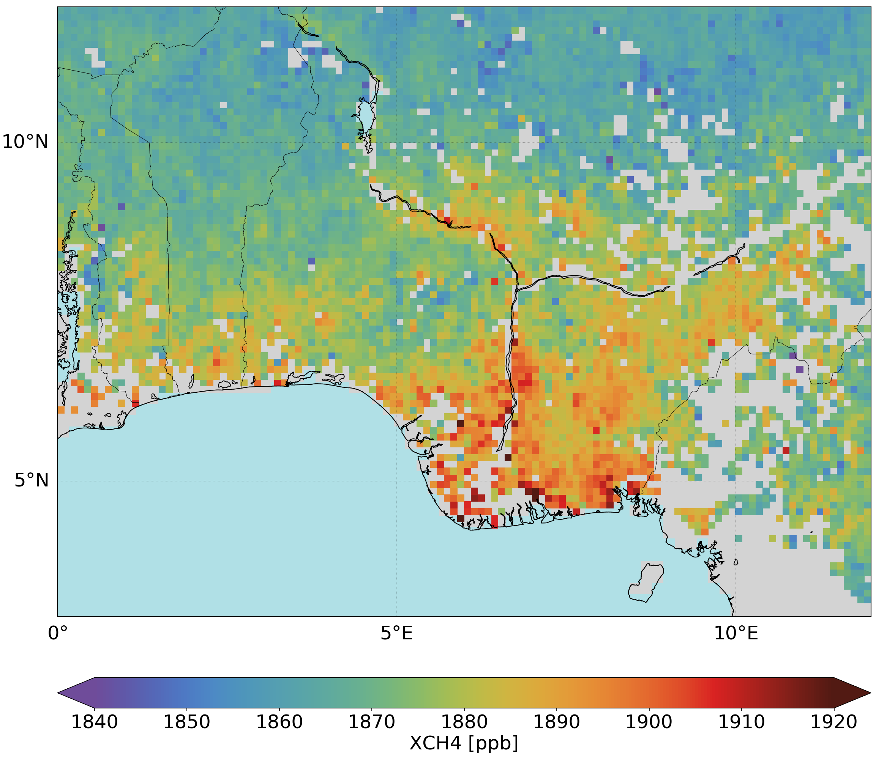
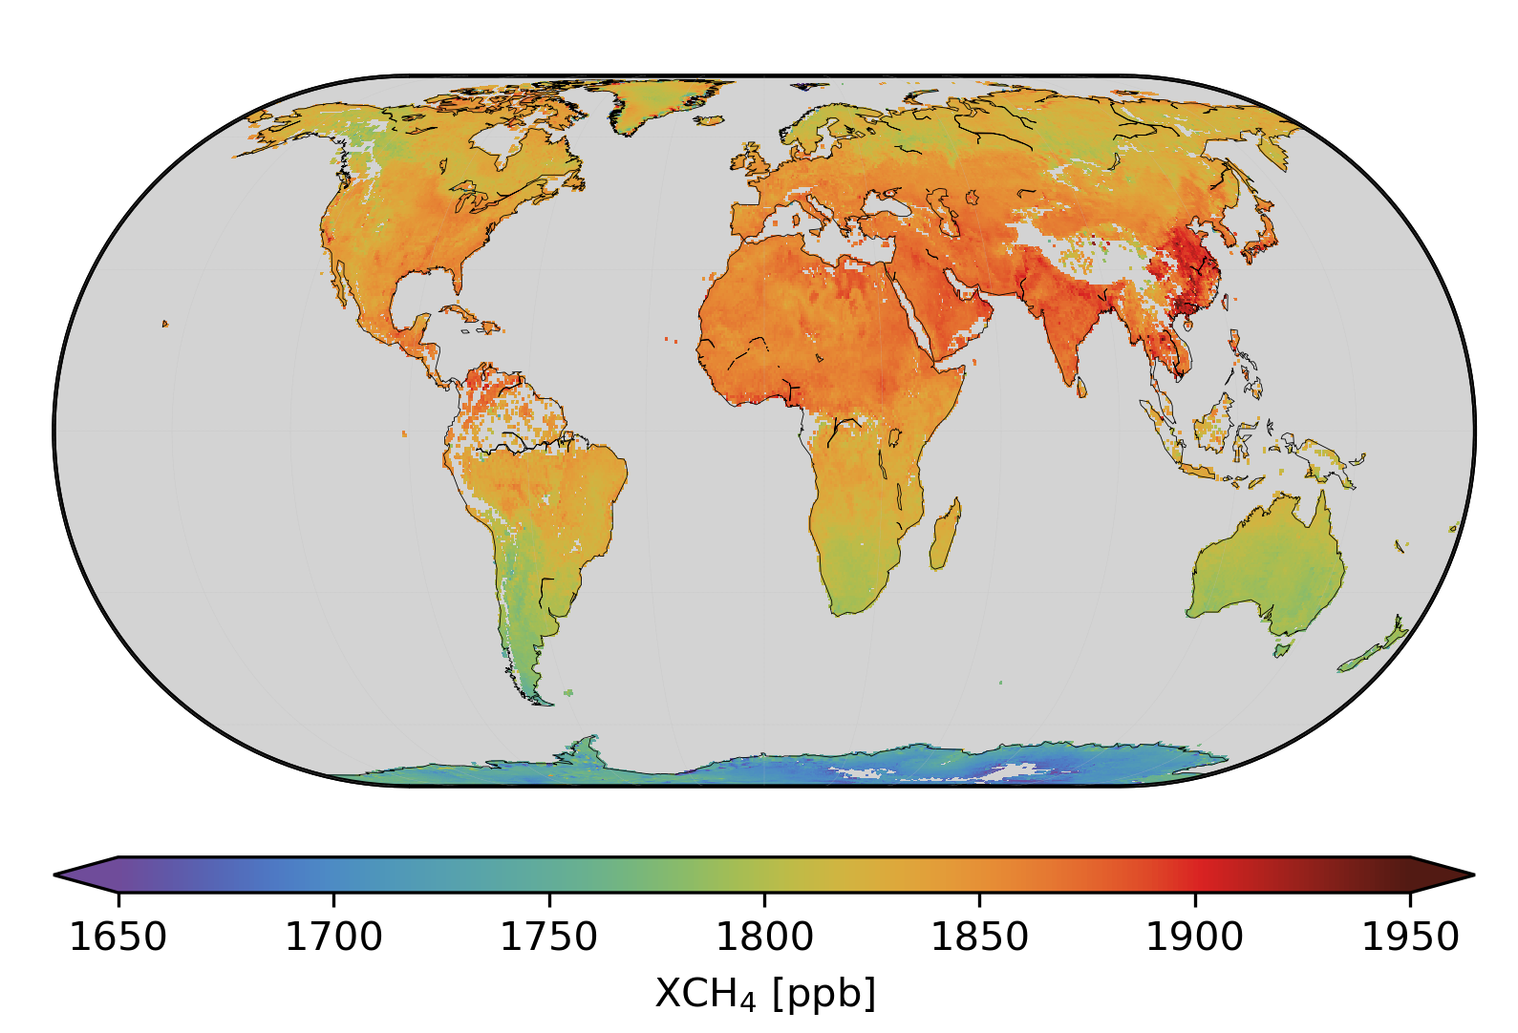
New capability:
XCH4 retrieved over wetlands in Nigeria between November 2018 - February 2019

Slide 8

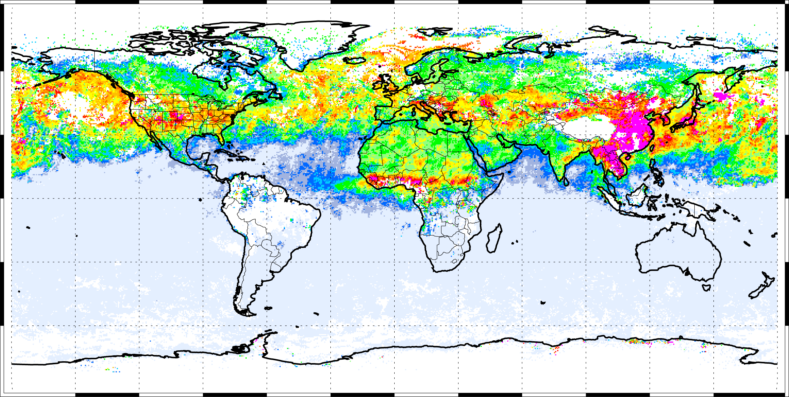
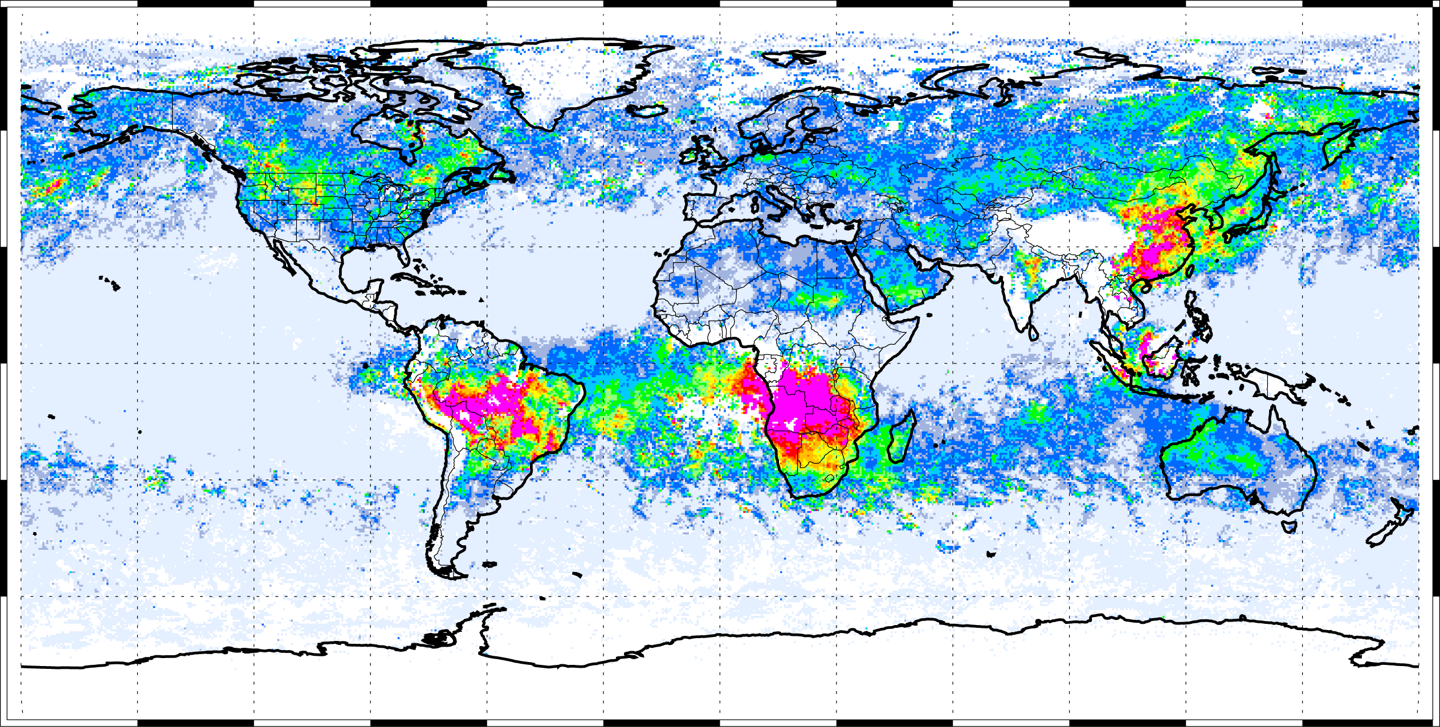
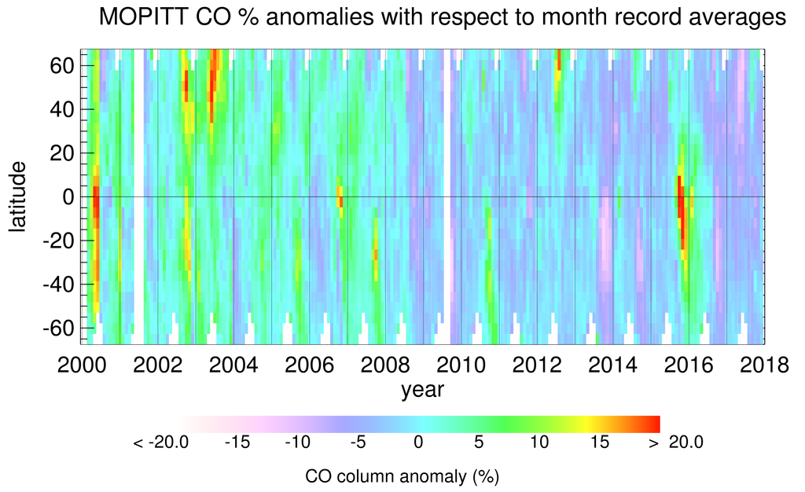
Seasonal & interannual variability: MOPITT CO example
Mar. 06
Sept. 06

Slide 9
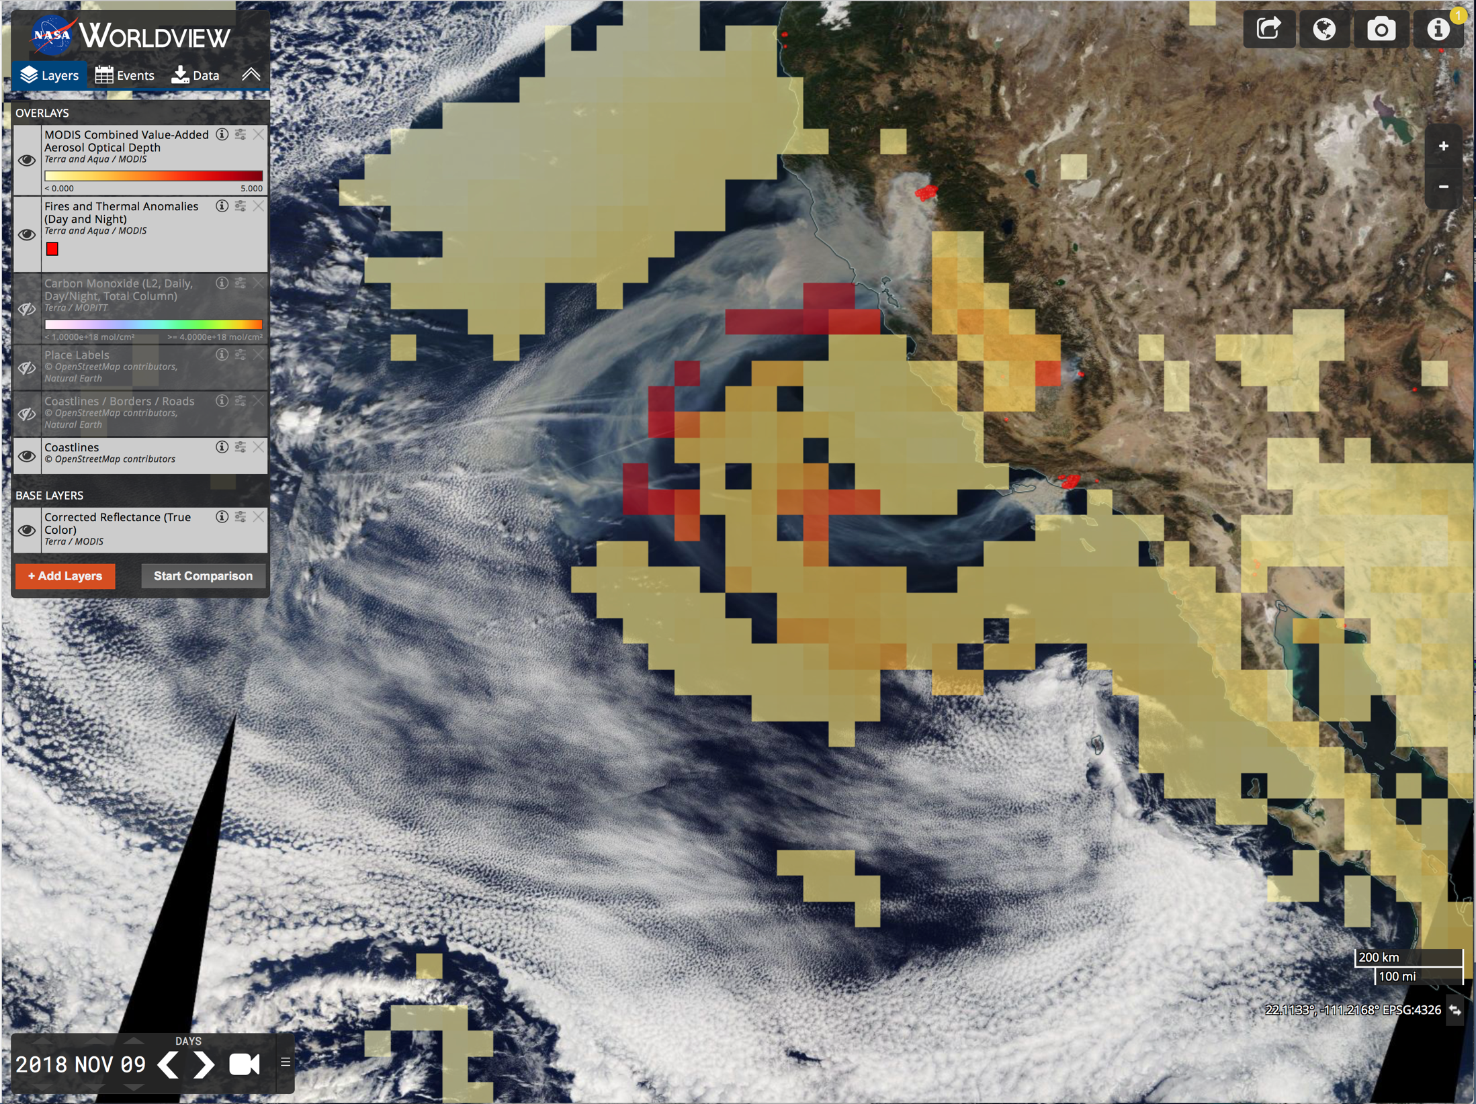
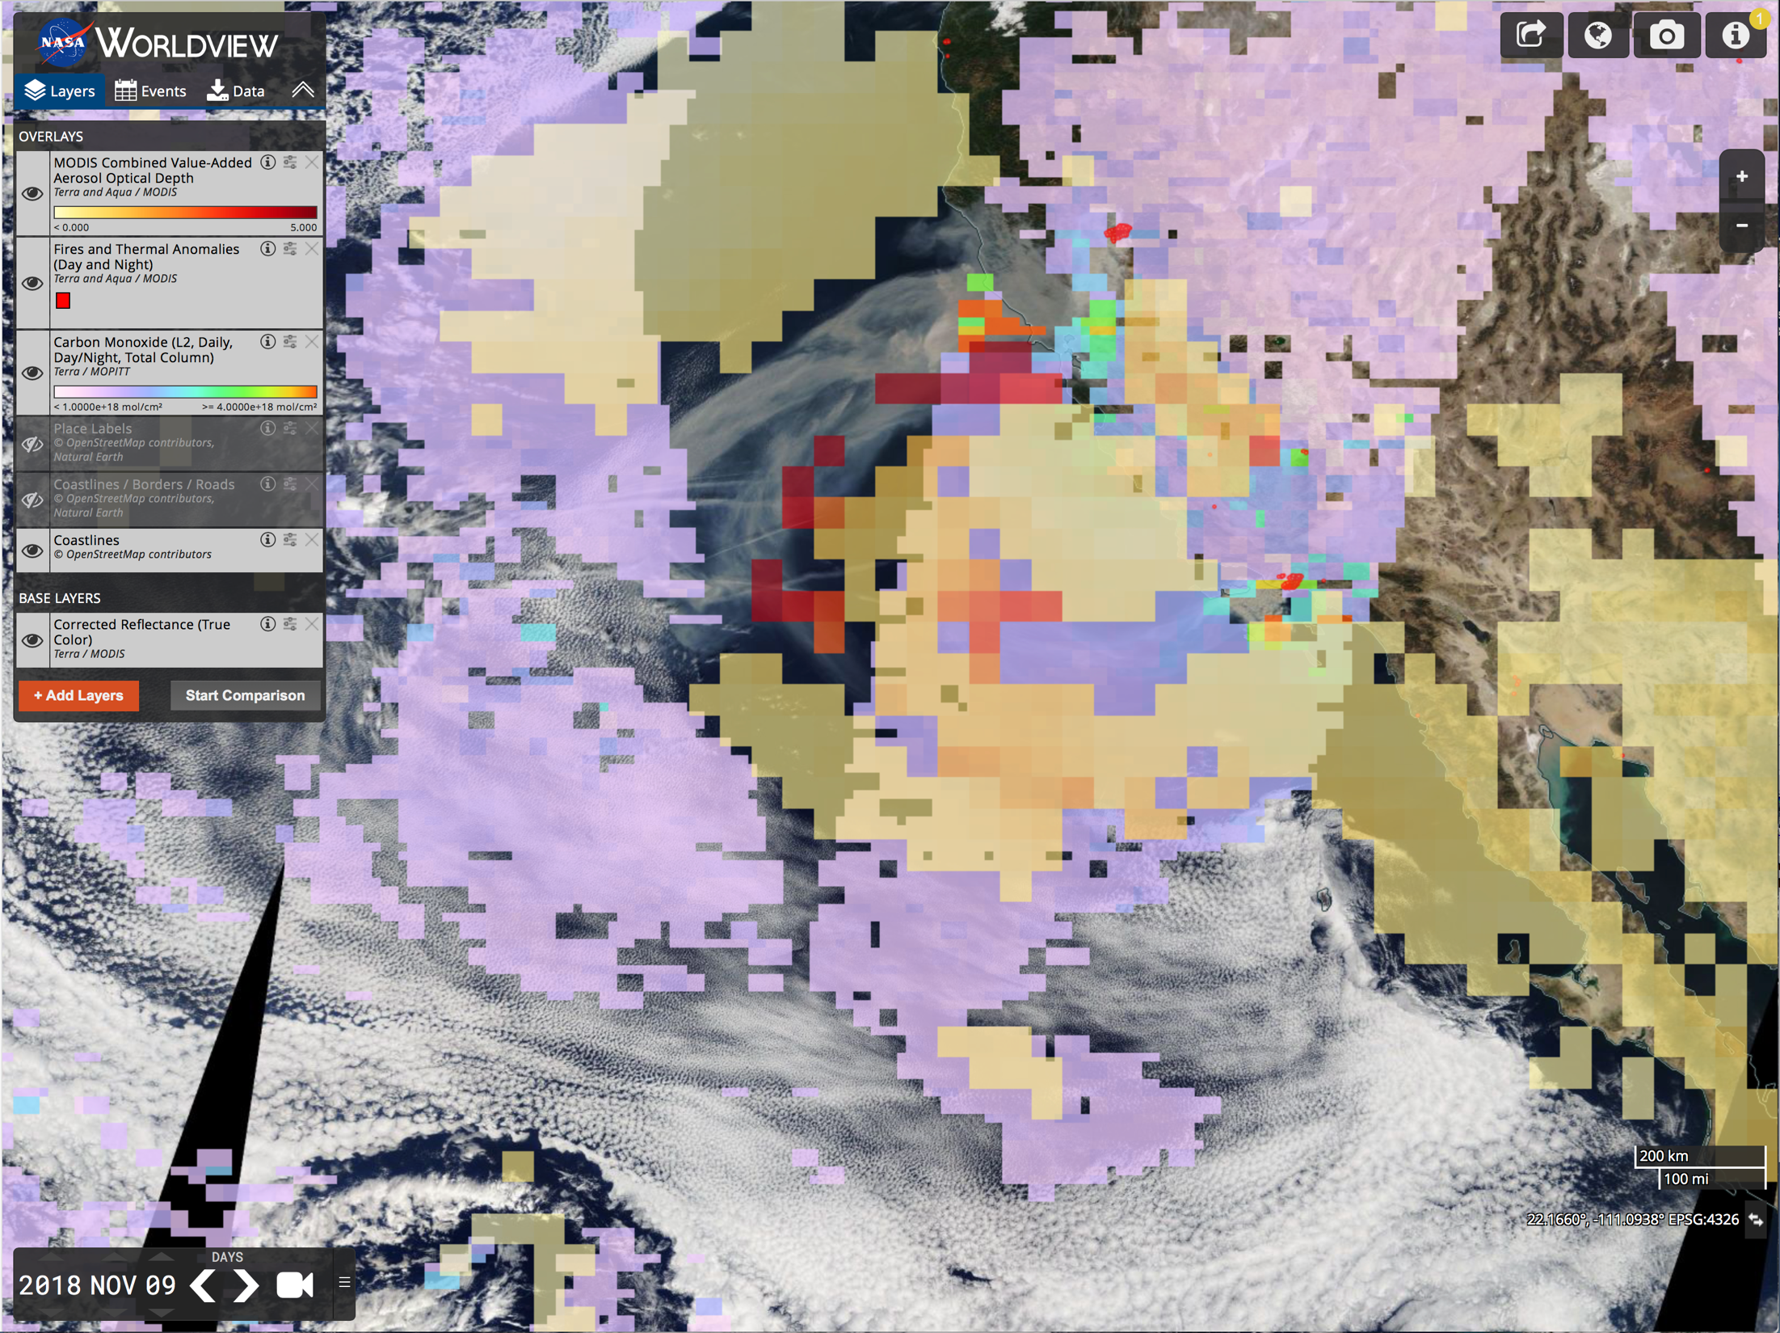
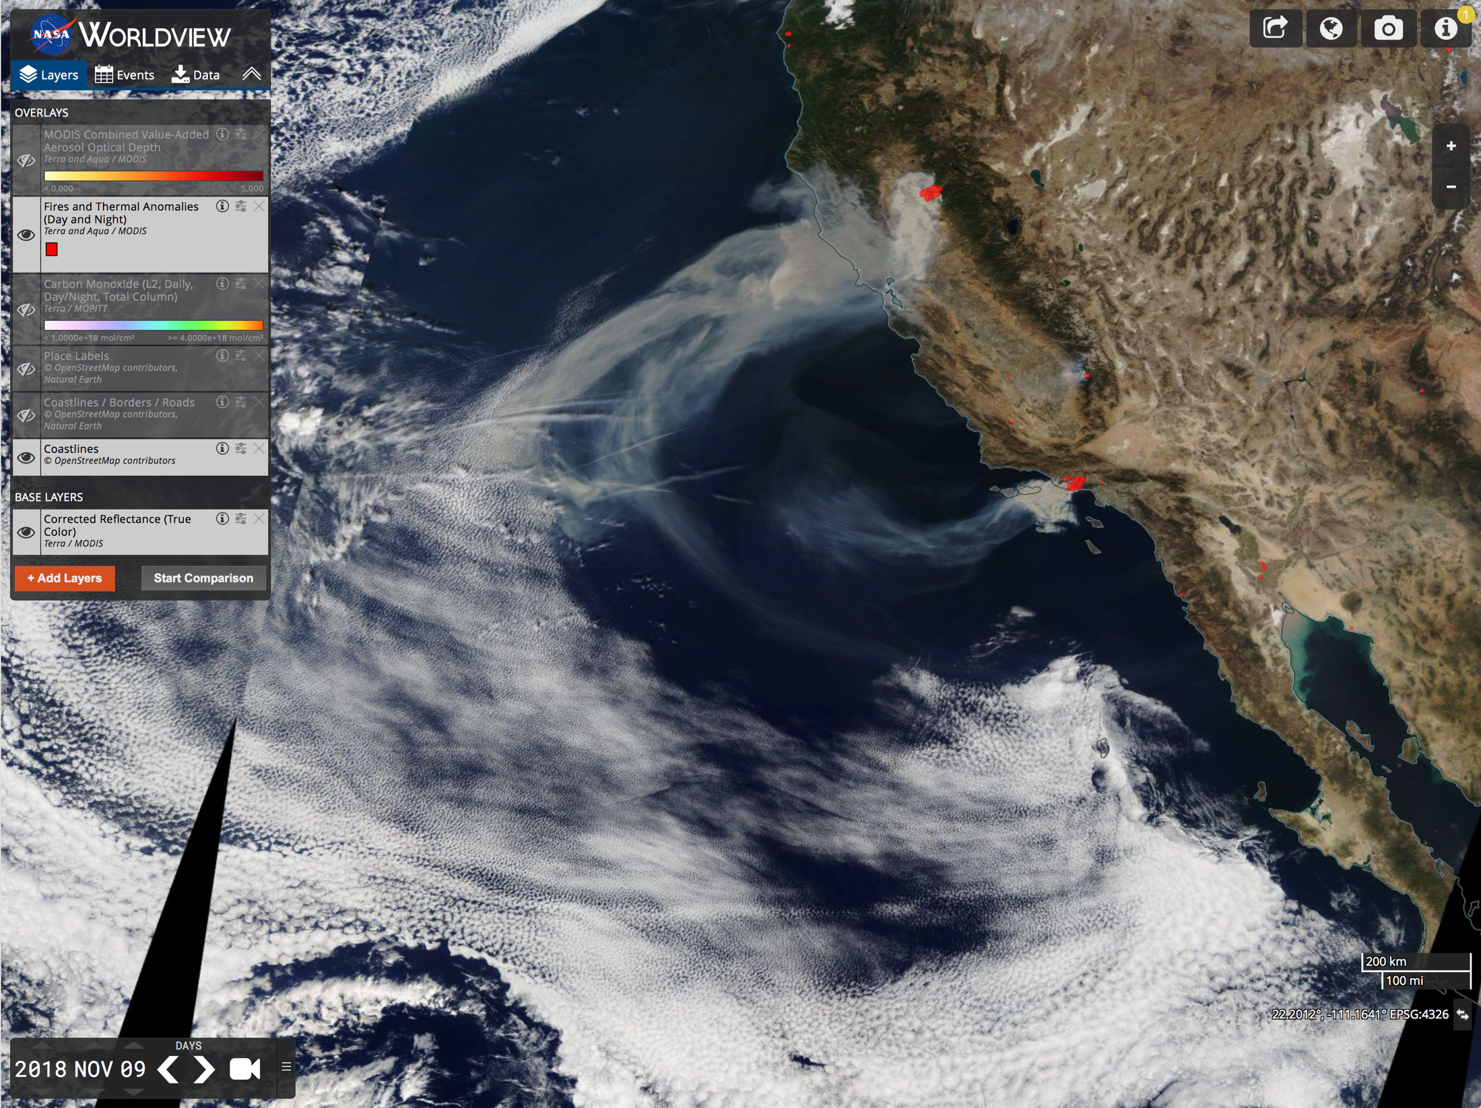
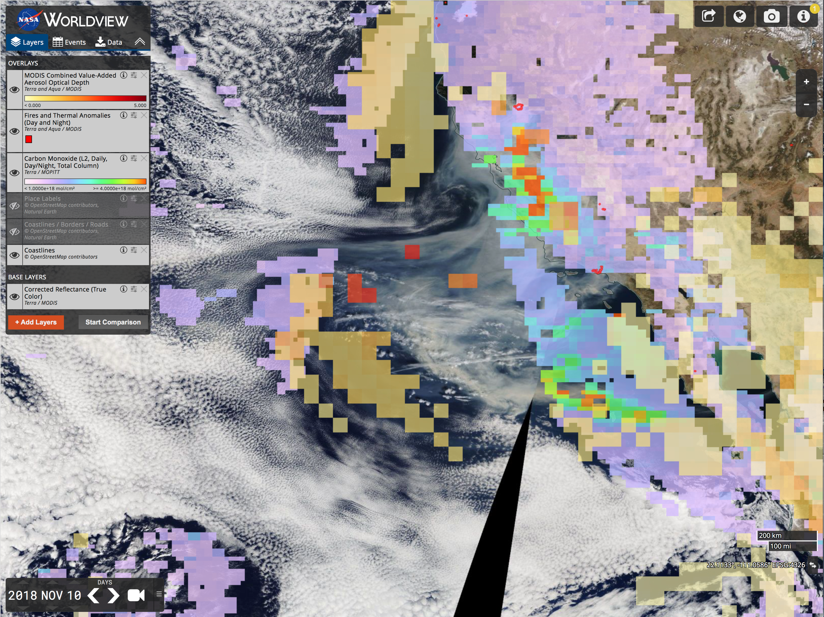
Data visualization: California fires example
Low-level CO plume near fire
Camp fire
Woolsey fire
Elevated CO plume down-wind

Slide 10
Source detection: IASI ammonia example
IASI long-term averaging of the very small NH₃ TIR signal, in combination with a new over-sampling technique, has identified fine horizontal scale source hotspots
Anthropogenic NH₃ emissions dominate natural, originating from agricultural, domestic and industrial activities
NH₃ impacts AQ, acidification and eutrophication of ecosystems, and climate change
Ammonia source areas and hotspot locations. IASI global 9-year NH₃ average (molec.cm⁻²) with identified hotspots, their associated flux estimates (black circles), and source areas (white rectangles)
Van Damme et al., Nature, 2018

Slide 11
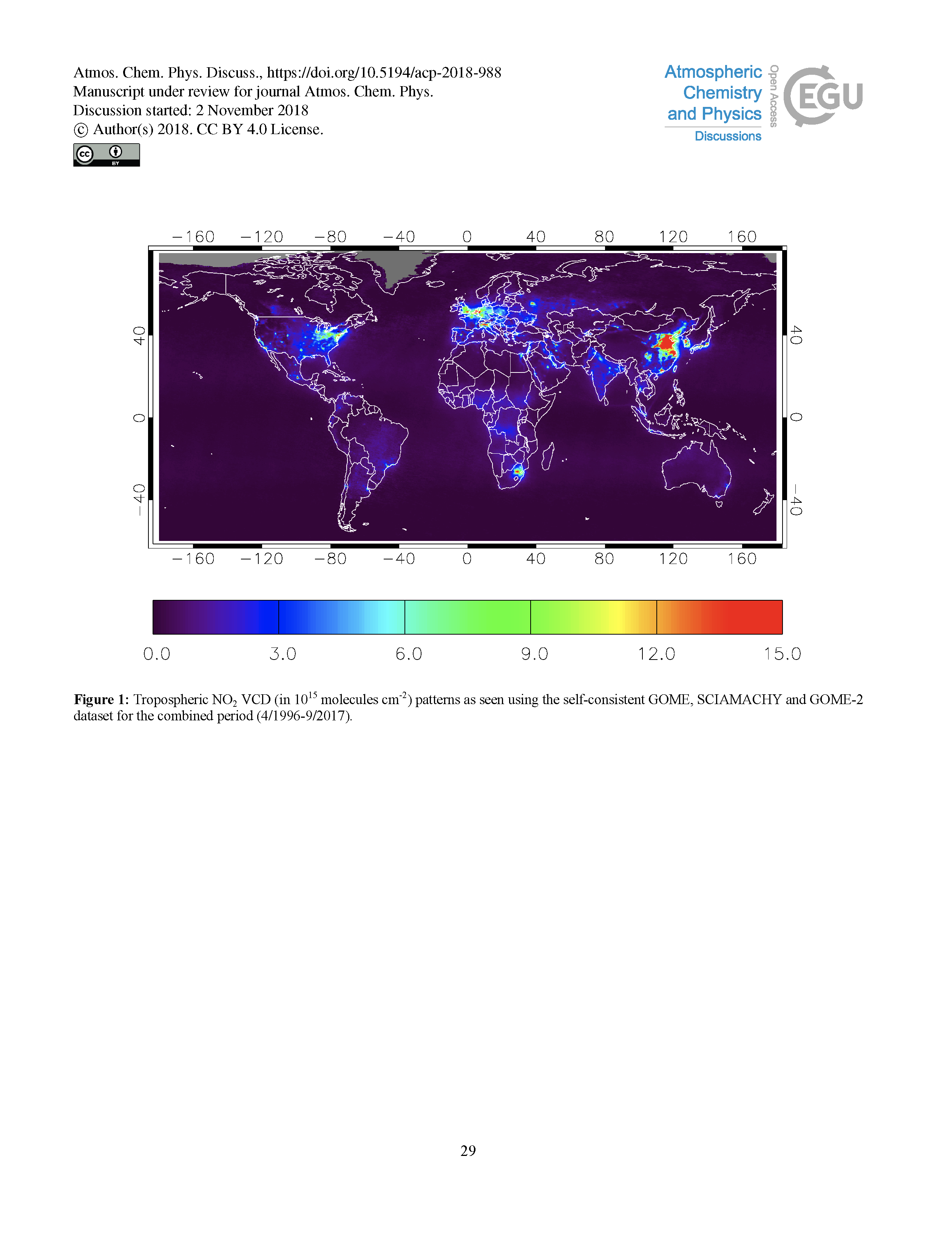
Trends: GOME, SCIAMACHY & GOME-2 NO₂ example
Long-term satellite datasets, often spanning multiple missions, allow an analysis of trends
NO₂ has received a lot of attention: highest concentrations over urban, industrialized and populated areas; ship tracks in the oceans
Tropospheric NO₂ has generally decreased over the last two decades in Europe, Japan and USA (~32-49% ), and increased over developing regions, China (~160%) and India (~33%)
Sensitive to environmental policies, recession, etc.; can cause trend changes or even a reversal
Tropospheric NO₂ VCD (10¹⁵ molec.cm⁻².yr⁻¹) using self-consistent GOME, SCIAMACHY & GOME-2 dataset for period (4/1996-9/2017
Trends of tropospheric NO₂ VCD (10¹⁵ molec.cm⁻².yr⁻¹) for the period 4/1996 - 9/2017
Georgoulias et al., acp, 2019

Slide 12
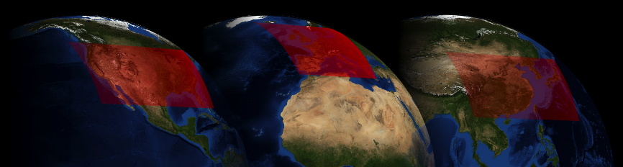



The upcoming GEO constellation
Several countries are planning to launch geostationary (GEO) satellites in the 2019-2022 timeframe for atmospheric composition measurements: KARI GEMS, NASA TEMPO & ESA Sentinel 4
These missions have UV-vis observational capabilities and similar Level-2 products, every hour at ~4 km spatial resolution
Common objectives, and harmonization through a constellation framework, provides the global perspective and an unprecedented capability to meet the needs of research and applications
The CEOS Atmospheric Composition Constellation activity is promoting collaboration through joint data processing and calibration approaches, modeling and assimilation
SENTINEL-4 + IRS
TEMPO
NOAA GOES
GEMS

Slide 13
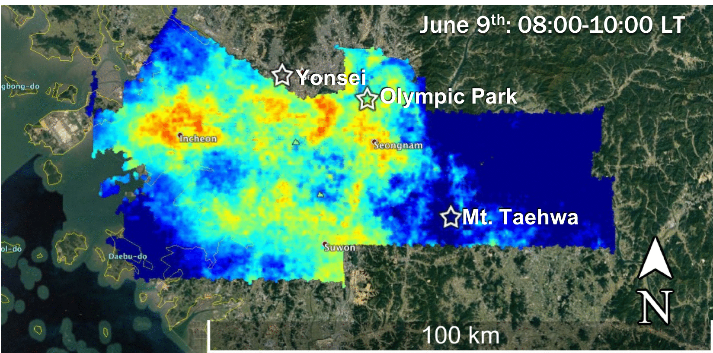
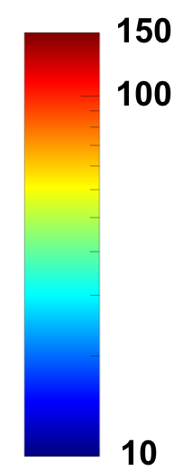

The GEO perspective
Hourly measurements at ~4 km spatial resolution will permit examination of diurnal processes and increase the probability of cloud-free observations
Sensors “stare” to acquire sufficient signal, improving retrievals, reducing need for data averaging
Similar measurement/model scales and continuous near-real-time data delivery will increase uptake of satellite data for regional AQ operations such as chemical weather forecasting and monitoring hazards such as wildfires
GeoTASO instrument aircraft measurements during KORUS-AQ in 2016 provide an indication of what will be possible from GEO
The NASA UC-12 aircraft ran raster patterns over Seoul several times in a single day allowing 2-D maps of several tropospheric trace gases top be derived
NO₂ Vertical Column (x10¹⁵ molec.cm⁻²)
Figure: Laura Judd, NASA LaRC;
GeoTASO PI & NO₂ retrieval: Scott Janz, NASA GSFC
Notes:
Late morning shows similar patterns to early morning, with much larger NO2 amounts. This indicates that active emissions are occurring during this period, and that the boundary layer is still relatively shallow, confining the emissions to low-lying areas.
By mid-afternoon, peak amounts are even larger and are distributed more uniformly across the region. The more uniform distribution is probably because the boundary layer is much deeper in mid-afternoon, allowing pollution to be less constrained by topography and to mix horizontally.
By late afternoon, peak concentrations are smaller but still quite large. The peak is still broadly distributed but has shifted more to the east.

Slide 14
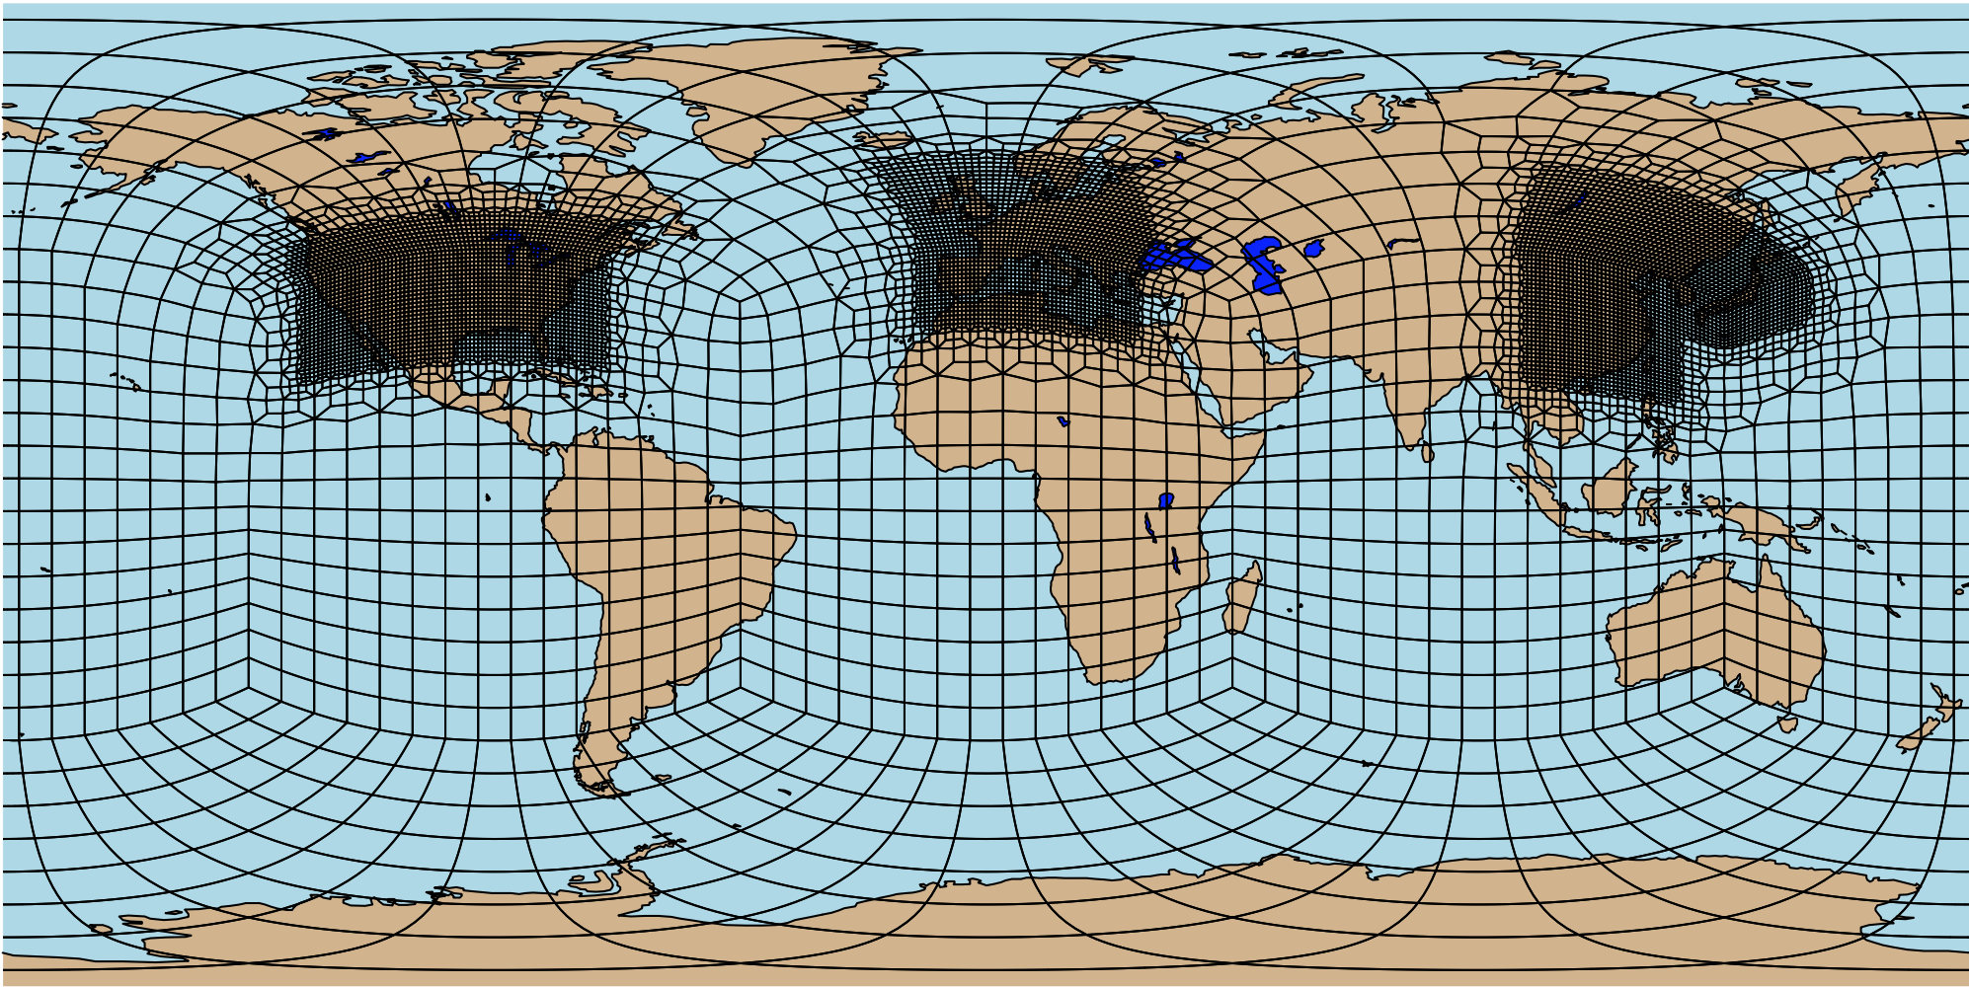
Next steps
Satellite observations would be complimented by a global modelling infrastructure with regional refinement to represent the AQ impact of transported pollution and fine-scale local processes
We are now entering a new era of higher spatiotemporal resolution satellite observations that will access local, regional and diurnal scales
TROPOMI represents a leap in capability; the upcoming GEOs will be game-changers
Application-specific smallsats are also coming, aiming for the 1 km scale
Satellite observations of atmospheric composition will match the resolutions needed for operations
– and start to challenge models, DA systems, data management and computing
A CAM-SE-RR grid for modeling the GEO constellation
Graphic: Forrest Lacey, NCAR

