Slide 1
multi-scale modeling infrastructure for Chemistry and Aerosols Data Assimilation and Inverse Modeling
Benjamin Gaubert & Daven Henze
MUSICA Kick-off Meeting 22 May 2019
Notes:
multi-scale modeling infrastructure for Chemistry and Aerosols

Slide 2
Science Application for DA
Ability to model systems that couple the atmospheric chemistry to other earth system model components including ocean, land, ionosphere.
Coupled Earth System Model for medium range forecast and seaming less Chemistry Climate application
Multiscale DA and prediction where a wide range of space and time scales are resolved in a single application.
Multiscale Coupled gas phase chemistry (CH₄-O₃-CO-NOx-OH)
Can simultaneously assimilate surface and satellite observations
Address weather, climate and atmospheric composition interactions
Atmospheric Chemistry and Aerosols and Cloud interactions, multi-phase Data Assimilation
MUSICA Kick-off Meeting 22 May 2019
Notes:
multi-scale modeling infrastructure for Chemistry and Aerosols

Slide 3
Science Application for DA
Parameter estimation including boundary conditions: source and sink estimation for constituents.
Using DA to study bias and improve MUSICA.
Production of reanalyses and reforecasts for the same problems as above.
Observing system simulation experiments (OSSEs), observing system experiments (OSEs).
Real-time prediction capability for field campaign and experiment support.
Health Impacts assessment.
Policy relevant, emission scenarios, coupling with urban scale modelling framework.
MUSICA Kick-off Meeting 22 May 2019
Notes:
multi-scale modeling infrastructure for Chemistry and Aerosols

Slide 4
CH₄-O₃-CO-NOx-OH chemical coupled system: Scale interaction
Assess Air Quality / Climate Change issues
The Future of Atmospheric Chemistry Research:
Remembering Yesterday, Understanding Today, Anticipating Tomorrow
“A key issue for atmospheric chemistry research is the global atmospheric oxidation capacity, especially associated with OH since it controls the lifetime of methane and other important greenhouse gases.”
National Academies of Sciences, Engineering, and Medicine. 2016. Washington, DC: The National Academies Press. https://doi.org/10.17226/23573.
“mechanistic global atmospheric chemistry transport models fail to even simulate the [hemispheric] partitioning of OH”
(Turner, Frankenberg and Kort, PNAS 2019).
MUSICA Kick-off Meeting 22 May 2019
Notes:
Gas Phase Chemical Data Assimilation: Motivation
At the same time, we need to consider that mechanistic global atmospheric chemistry transport models fail to even simulate the partitioning of OH
between the Northern and Southern Hemispheres
multi-scale modeling infrastructure for Chemistry and Aerosols (
I will present an overview of some recently published work and review in the field of gaseous phase chemical data assimilation.

Slide 5
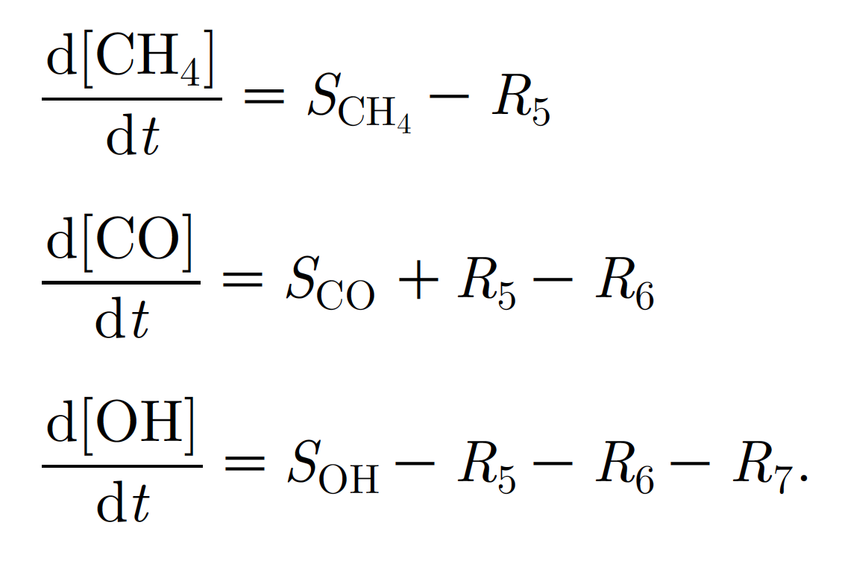
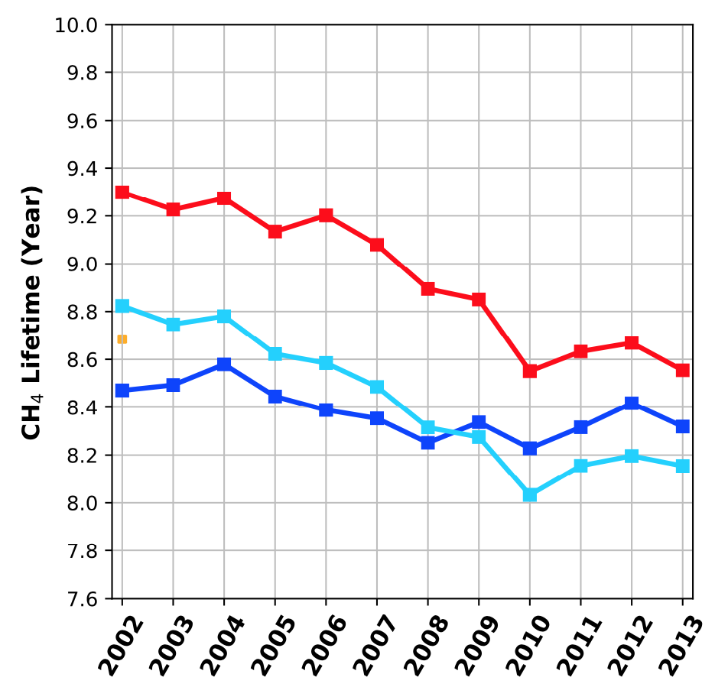
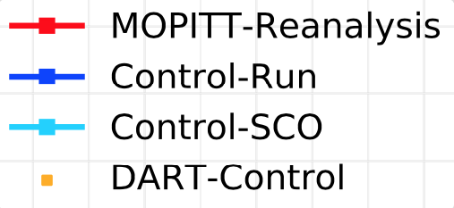
CH₄-O₃-CO-NOx-OH chemical coupled system
Time Scale
Annual
CH4
Monthly
M. Prather (2007): Lifetimes and time scales in atmospheric chemistry
CO
Weekly
O₃
Daily
CH2O
Hourly
NO_{x}
Seconds
OH
Spatial Scale
Point sources to
Urban (<10 km)
Regional
(<1000 km)
Continental
(<5000 km)
Global
Gaubert et al. 2017
MUSICA Kick-off Meeting 22 May 2019
Notes:
multi-scale modeling infrastructure for Chemistry and Aerosols

Slide 6
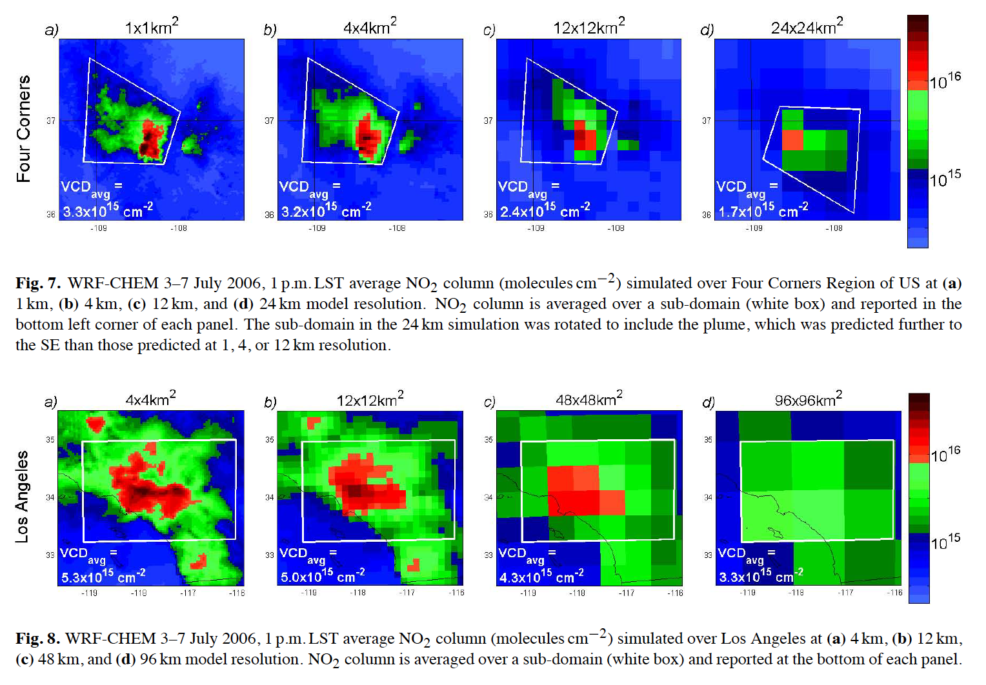
CH₄-O₃-CO-NOx-OH chemical coupled system
Time Scale
We find that resolution in the range of 4–12 km is sufficient to accurately model nonlinear effects in the NO₂ loss rate (Valin et al. 2011)
Annual
CH4
Monthly
MUlti-Scale Infrastructure for Chemistry & Aerosols
MUSICA
CO
Weekly
O₃
Daily
CH2O
Hourly
NO_{x}
Seconds
OH
Spatial Scale
Point sources to
Urban (<10 km)
Regional
(<1000 km)
Continental
(<5000 km)
Global
MUSICA Kick-off Meeting 22 May 2019
Notes:
multi-scale modeling infrastructure for Chemistry and Aerosols

Slide 7
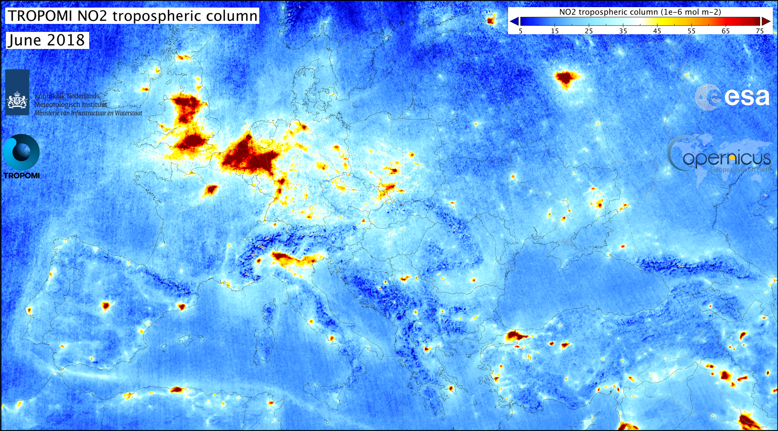
CH₄-O₃-CO-NOx-OH chemical coupled system
Time Scale
Annual
Monthly
MUlti-Scale Infrastructure for Chemistry & Aerosols
MUSICA
TROPOMI alone measures simultaneously
CH₄ O₃ CO NO₂ and CH₂O
Weekly
Daily
LEO only
Hourly
Already challenging our model resolution
Seconds
OH
Spatial Scale
Point sources to
Urban (<10 km)
Regional
(<1000 km)
Continental
(<5000 km)
Global
MUSICA Kick-off Meeting 22 May 2019
Notes:
multi-scale modeling infrastructure for Chemistry and Aerosols

Slide 8
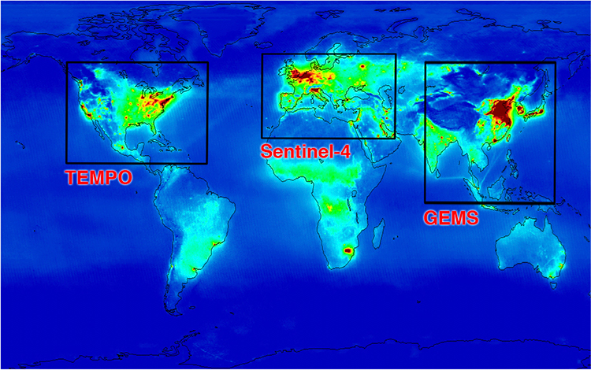
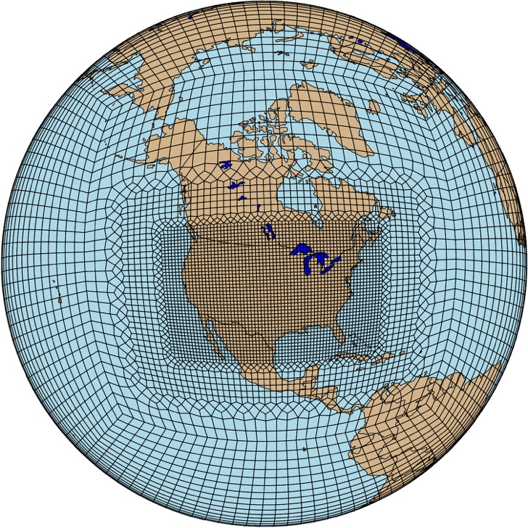
CH₄-O₃-CO-NOx-OH chemical coupled system
Time Scale
Annual
GEO & LEO
GEO only
© KNMI/IASB/ESA/SAO.
Monthly
MUlti-Scale Infrastructure for Chemistry & Aerosols
MUSICA
Weekly
TROPOMI
Daily
LEO only
TEMPO
Hourly
Seconds
OH
Spatial Scale
Point sources to
Urban (<10 km)
Regional
(<1000 km)
Continental
(<5000 km)
Global
Joint GEO and LEO DA
MUSICA Kick-off Meeting 22 May 2019
Notes:
multi-scale modeling infrastructure for Chemistry and Aerosols

Slide 9
Considerations for DA as a capability of MUSICA
DA is not a feature of MUSICA as much as MUSICA is a component of DA
Forward modeling system
(e.g. MUSICA)
Forward modeling system
Model adjoint
Forward modeling system
Forward modeling system
Forward modeling ensembles
Observation operators
DA solver
Model and observation error statistics
Parameter statistics
Observations
MUSICA Kick-off Meeting 22 May 2019
Notes:
multi-scale modeling infrastructure for Chemistry and Aerosols

Slide 10
An Examination of Data Assimilation Algorithms, Observations, and Applications in the Context of Next Generation Computing
Jeffrey Anderson, Michael Bell, Josh Hacker, Youssef Marzouk, Adrian Sandu, Chris Snyder, NCAR 2017
Priority Research Directions (4 of 6):
Impact of architectures / environment on DA methods
Impact of DA methods on architectures / environment
“There is evidence that DA systems make significantly sub-optimal use of current HPC because there is insufficient collaboration between computational scientists with deep knowledge of HPC systems and software, and DA and model developers.”
Handling of very large datasets:
Satellite data
Model diagnostics to align with the satellite data
Fundamental algorithmic advances:
interfaces / frameworks for DA exist (JEDI, OOPS, DART, GSI, WRFDA,…)
taking advantage of these will enhance R2O and O2R
keep in mind these are not always designed with chemistry in mind
MUSICA Kick-off Meeting 22 May 2019
Notes:
multi-scale modeling infrastructure for Chemistry and Aerosols

Slide 11
Discussion desirable for DA
Emissions estimation is a unique component of chemical DA systems, and the lessons learned / methods potentially differ from NWP
– potentially more to learn from inverse modeling / flux estimation community
Ensemble to represent model error
Multi-physic ensemble interest beyond the DA world
Stochastic perturbation of input parameters
Flexible model infrastructure, updating parameters on the fly
Ability to run forward and backward in time
4D-Variational and Particle Smoothers
Code differentiation, adjoint application
Fit within the JEDI effort ?
MUSICA Kick-off Meeting 22 May 2019
Notes:
multi-scale modeling infrastructure for Chemistry and Aerosols

