Slide 1

Chemistry at the edge of space
School of Chemistry
FACULTY OF MATHEMATICS and PHYSICAL SCIENCES
Chemistry of the upper atmosphere
John Plane
University of Leeds, UK

Slide 2
Talk outline
Quick introduction to the MLT
The meteoric metal layers and vertical transport
The O₃ – O deficit problem
The HO_{x} dilemma
The CO₂ problem
Energetic particle precipitation

Slide 3
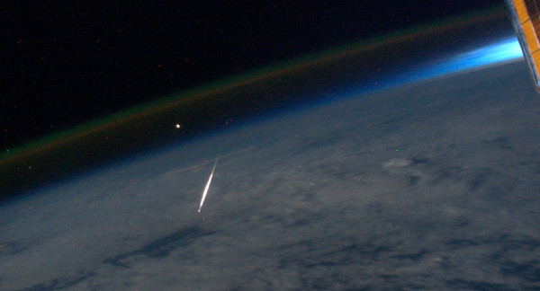
A Perseid meteor, noctilucent cloud and airglow layer
Photograph by Ron Garan on the ISS

Slide 4
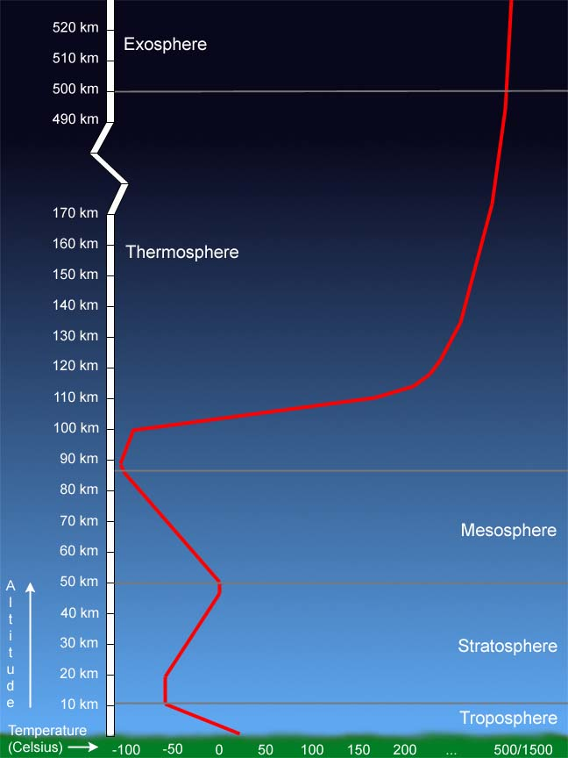
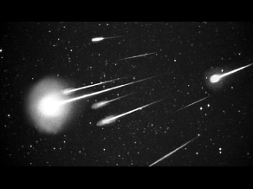
Unusual chemistry
Energetic particle precipitation
X-rays
EUV
VUV
Reactions involving highly excited electronic states of N, N₂, O and O₂
Atomic O becomes more abundant than O₂, representing a huge store of chemical potential energy
Chemical potential energy ⇒ airglow
Highly reactive species such as Na and K atoms at significant concentrations
Plasma controls the atmospheric lifetimes of v. long-lived gases e.g. SF₆
Cosmic dust
Ions electrons
H₂
NO_{x}
O
Fe, Mg, Si, Na
MSPs
H₂O
from CH₄
Long-lived GHGs (SF₆, NF₃)

Slide 5
Energy balance in the MLT
Solar energy
Chemical potential energy (radicals and ions)
Molecular kinetic energy
Internal excitation of atoms and molecules
Radiative loss in the IR/visible
Gravity wave breaking
Inputs from the sun and the lower atmosphere are balanced by radiative cooling.

Slide 6
Where is the “top” of the atmosphere?
Above the turbopause around 105 km, the mean free path of molecules approaches 1 m.
Bulk motion is no longer possible and eddy diffusion is overtaken by molecular diffusion.
At this point gravitational separation of molecules starts to occur e.g. the mixing ratio of CO₂ decreases because its mass is 44 compared with 28 for N₂.

Slide 7
January
July
The high latitude MLT is very cold during summer, so not a radiative effect! Cooling caused by adiabatic expansion of rising air over the summer pole
Plane et al., Chem. Rev. 2015

Slide 8
Temperature trends in the mesosphere
(50 – 80 km)
Mid-latitudes
Rocketsonde data + OHP Rayleigh lidar
Cooling of ~2-3 K per decade
Data from Beig et al (2003)

Slide 9
Diurnal variation as a function of the height of the
(a) O density (10¹⁰ atom cm⁻³)
(b) H density (10⁷ atom cm⁻³)
(c) O₃ density (10⁹ molecules cm⁻³)
50º N (2004-2011), from the WACCM model
Plane et al., Chem. Rev. 2015
Above 82 km, the time-constants for the third-order reactions
O + O₂ (+ M) → O₃
and H + O₂ (+ M) → HO₂
are longer than 12 hours.
Hence, little diurnal variation of atomic O and H
O measurements made by rocket-borne resonance fluorescence instruments during summer (68N)
Murray and Plane, ACP 2004

Slide 10
Airglow emissions
Airglow emission layers in the MLT region, produced by chemiluminscent reactions.
These are all fuelled by atomic O descending from the lower thermosphere

Slide 11
Formation of layers of metal atoms in the MLT
E region ionization
Ions
Meteoric ablation
100 km
Reducing atmosphere
Atoms
85 km
Highly reactive H and O atoms
Oxidizing atmosphere
Compounds
Sodium forms NaHCO₃ Magnesium forms Mg(OH)₂
Iron forms FeOH Silicon forms Si(OH)₄
→ METEORIC SMOKE

Slide 12
Global models of the metal atom layers
Wuhan, China (30º N)
South Pole (90º S)
Lidar-Fe
Lidar-Fe
Whole Atmosphere Community Climate Model (WACCM) with Fe chemistry
WACCM-Fe
WACCM-Fe
Good agreement with the annual column density variation, peak height and width of both layers at mid-latitudes
Poor agreement at high latitudes – Fe remains too long above 80 km and is concentrated by convergence over the winter polar vortex
Feng et al., JGR 2013

Slide 13
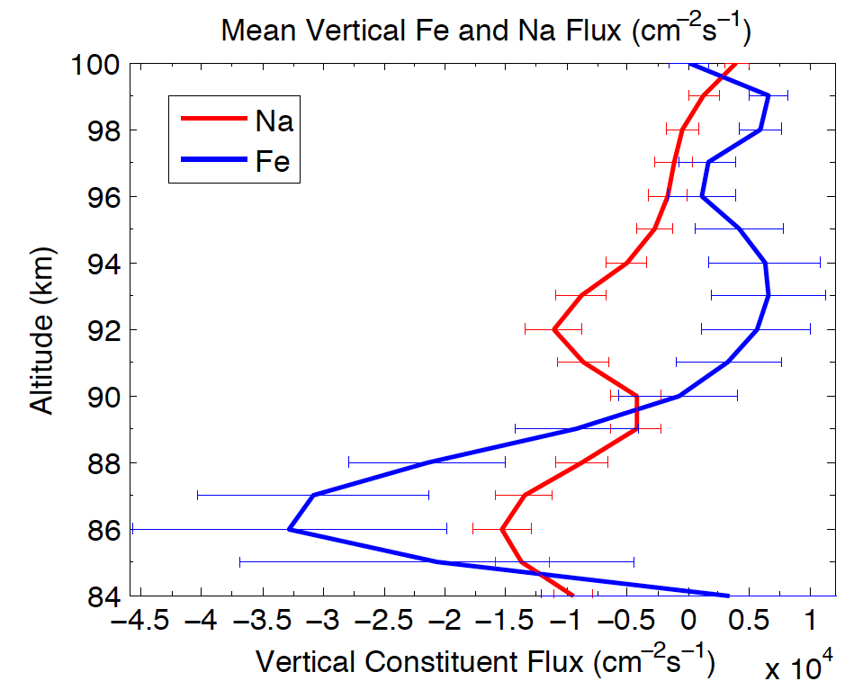
Vertical flux of Na and Fe atoms
The vertical flux of atomic Na can be calculated by using a lidar which simultaneously measures the Na concentration and vertical wind speed:
vertical flux of atomic Na measured at 87.5 km by lidar over a year (Gardner et al., JGR 2014)
global Na flux above 87.5 km = 0.3 ± 0.06 t d⁻¹
Vertical fluxes of Na and Fe measured at Table Mt. CO for 6 weeks (Huang et al., GRL 2015)
the ratio of Fe/Na is 2.36 ± 1.0
global Fe flux above 87.5 km = 2.3 ± 1.0 t d⁻¹

Slide 14
Estimates of the Fe input rate
Factor of 50 discrepancy!
¹ Feng et al., JGR 2013
² Janches et al., ApJ 2014
³ Nesvorny et al., ApJ 2015
⁴ Huang et al., GRL 2015
⁵ Dhomse et al., GRL 2013

Slide 15

Wave-driven transport of chemically active species in the MLT
The vertical flux of Fe atoms measured at Table Mt. CO, compared with the modelled flux when K_{wave} and ${\overline{w}}_{Chem}$ are included, or transport is only by K_{zz} and K_{mole}.
Gardner, JGR 2018

Slide 16
Meteoric smoke particles - modelling
January
July
Zonal average plots of the MSP concentration, mass density, and effective radius for the simulation with 7.8 t d⁻¹ ablated mass.
The data are an average of the last 7 years of a 10 year simulation using WACCM coupled to the CARMA aerosol microphysics model.
The effective radius is calculated as the ratio of the third and second moments of the dust size distribution.
Bardeen et al., JGR 2008

Slide 17
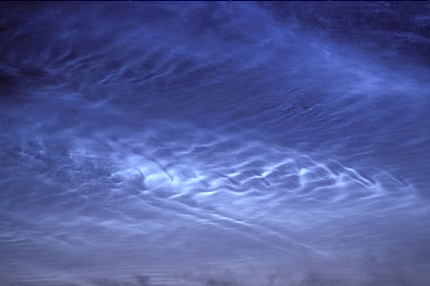
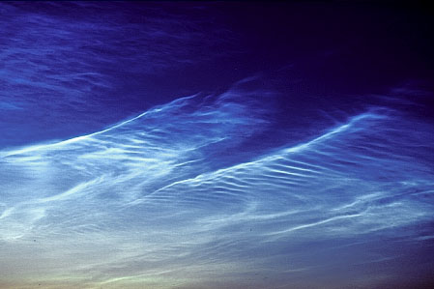
Noctilucent Clouds
Water-ice clouds which occur between 82 and 86 km
Most likely ice nuclei are meteoric smoke particles
Not reported before 1885
Almost certainly an early warning of changing climate

Slide 18
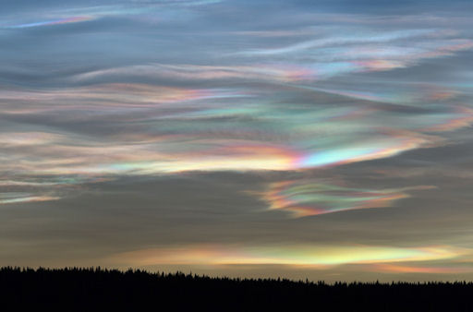
Polar Stratospheric Clouds
These “nacreous” clouds form during winter in the lower stratosphere and activate chlorine which then destroys ozone in the following spring.
HNO₃-H₂SO₄-H₂O droplets freeze at temperatures above 194 K, much higher than the freezing point of the pure ternary solutions.
Meteoric smoke or meteoritic fragments may provide the ice nucleation cores.

Slide 19
Pathways of two kinds of meteoric material through the atmosphere
Processes are shown which lead to formation of Meteoric Smoke Particles (MSPs) and Meteoric Fragments (MFs), either of which could heterogeneously nucleate Nitric Acid Trihydrate (NAT) in polar stratospheric clouds.
James et al., ACP 2018

Slide 20
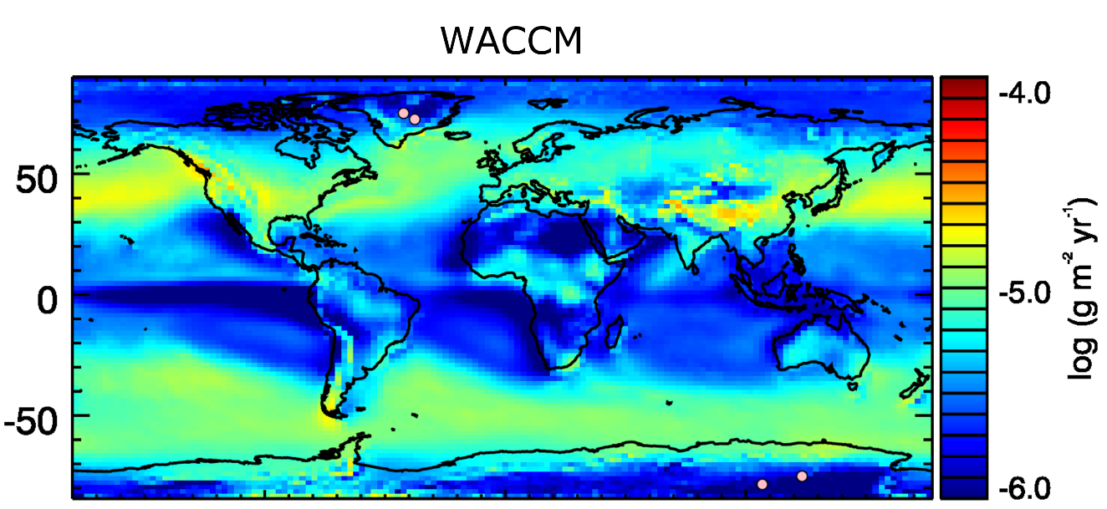
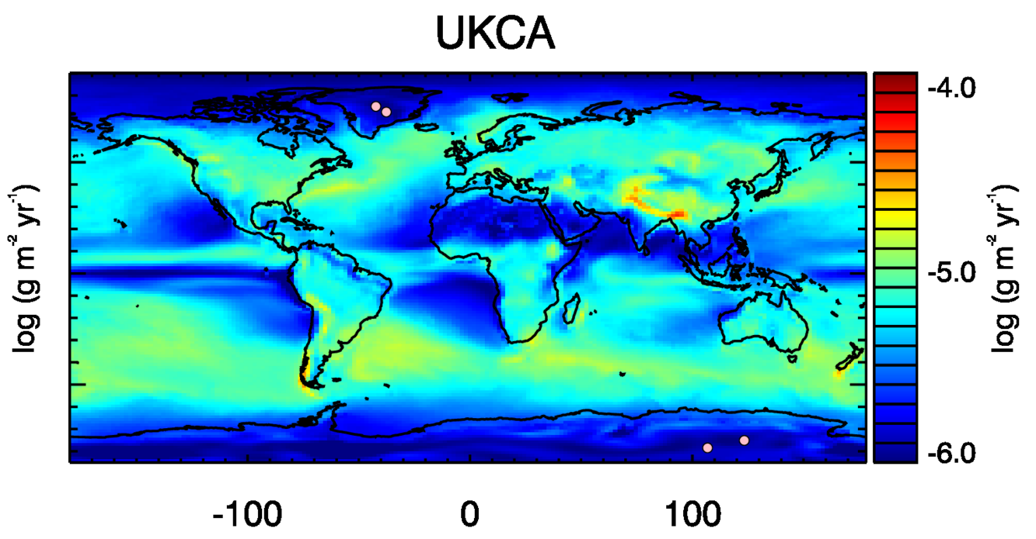
Deposition of Meteoric Smoke Particles
Maps of modelled MSP deposition flux averaged over 2005 – 2014
Pink circles indicate the ice core locations at GRIP and EPICA/Vostok
WACCM is coupled to the CARMA sectional aerosol microphysics model
The UKCA model – with the GLOMAP modal aerosol microphysics model – shows somewhat similar results
Measured MSP deposition rate is 30-33 time higher in Greenland, 11-13 times higher in Antarctica
UKCA
50
0
-50
Brooke et al., JGR 2018

Slide 21
The Atomic O – O₃ deficit problem
Derived zonal mean O₃ mixing ratios (ppmv), based on SABER data for years 2002 – 2005
SABER = Sounding of the Atmosphere using Broadband Emission Radiometry, an instrument on the TIMED satellite
Huang et al., JGR 2008

Slide 22
The Atomic O – O₃ deficit problem
O is produced in the thermosphere above 120 km where photo-dissociation of O₂ is at a maximum
dynamical processes, including molecular diffusion and wave effects, transport O downward into the upper mesosphere, where it is chemically removed below 95 km, primarily through a series of exothermic reactions leading to the formation of mesospheric O₃ layer and the OH airglow layer (OH*)
O transport therefore represents a transfer of chemical potential energy from the thermosphere to the mesosphere, and O is central to the chemistry and radiative balance of the MLT
the O, O₃ and OH profiles, as well as the brightness of concomitant airglow emissions, are related to the speed of O transport, with faster transport corresponding to higher densities and brighter airglow

Slide 23
The Atomic O – O₃ deficit problem
Measured/modelled ratio of the night-time concentration of a) O and b) O₃, as a function of height and month.
Conditions: 35N, averaged from 2011-2014.
Measurements from SABER
Model data from WACCM
Even though the chemistry of O and O₃ is well understood, global models significantly underestimate the observed mesospheric densities of these species

Slide 24
Atomic O is removed principally by two reaction sequences:
O + O₂ (+M) → O₃ M = third body (N₂ and O₂) (1)
H + O₃ → OH + O₂ (2)
O + OH → H + O₂ (3)
________________
Net: O + O → O₂
H + O₂ (+M) → HO₂ (4)
O + HO₂ → OH + O₂ (5)
O + OH → H + O₂ (6)
________________
Net: O + O → O₂
The reaction H + HO₂ → H₂ + O₂ converts H into H₂ (7)

Slide 25
The HOx dilemma
Despite the apparent simplicity of HO_{x} chemistry, models struggle to provide a consistent picture of OH/HO₂ in both the stratosphere and mesosphere using the same set of rate coefficients.
These plots compare daytime latitude-month plots of HO₂ for 2005 at 0.014 hPa (~80 km).
Top panel: WACCM-SD
Middle panel: the MLS averaging kernels are applied to the SD-WACCM data set to fairly compare the two.
Bottom panel: MLS measurements (MLS = Microwave Limb Sounder)
WACCM lower by up to 80%
HO₂ at 80 km – measurements vs. model
Millán et al., ACP 2015

Slide 26
The HOx dilemma
HO₂ mixing ratio (ppbv) measured by the Microwave Limb Sounder (MLS)
HO₂ mixing ratio (ppbv) predicted by WACCM-SD
Zonal average, January 2005

Slide 27
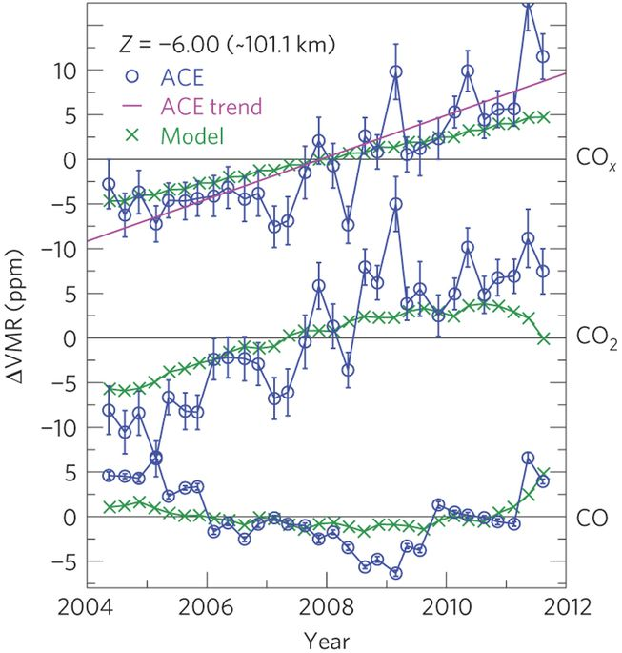
CO₂ and CO above 80 km
Residual VMRs of CO, CO2 and COx = CO + CO₂, after removal of seasonal-latitudinal effects.
Results are shown at around 101 km:
ACE-FTS (blue circles)
NCAR TIEGCM global mean model results (green crosses)
The solid pink line is the linear trend from a least-squares fit of the ACE-FTS CO_{x} residuals.
The CO_{x} vmr increase of 24 ppm per decade is 50% faster than predicted by TIMED-GCM
Emmert et al., Nat. Geo. 2012

Slide 28
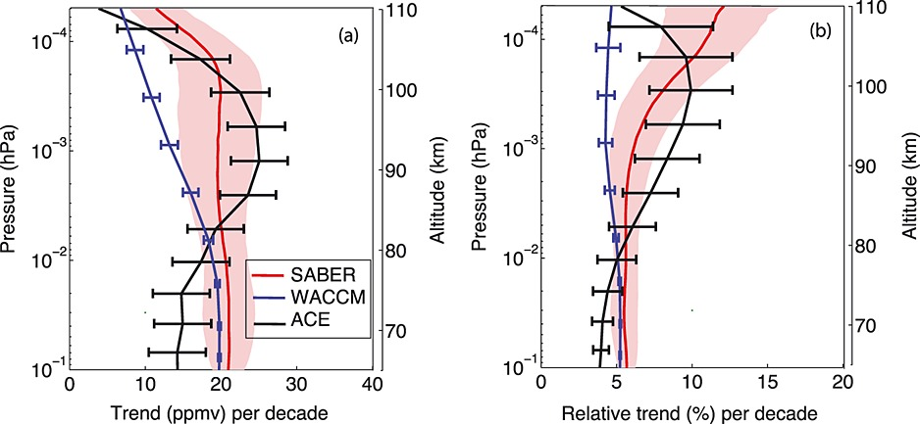
CO₂ above 80 km
CO₂ data show a trend of ~5% per decade at ~80 km and below
above 80 km, the SABER CO₂ trend is larger, reaching ~12% per decade at 110 km, consistent with ACE-FTS
the observed rate of increase of CO₂ above 80 km is >50% larger than can be explained by chemistry-climate models
Yue et al., GRL 2015

Slide 29
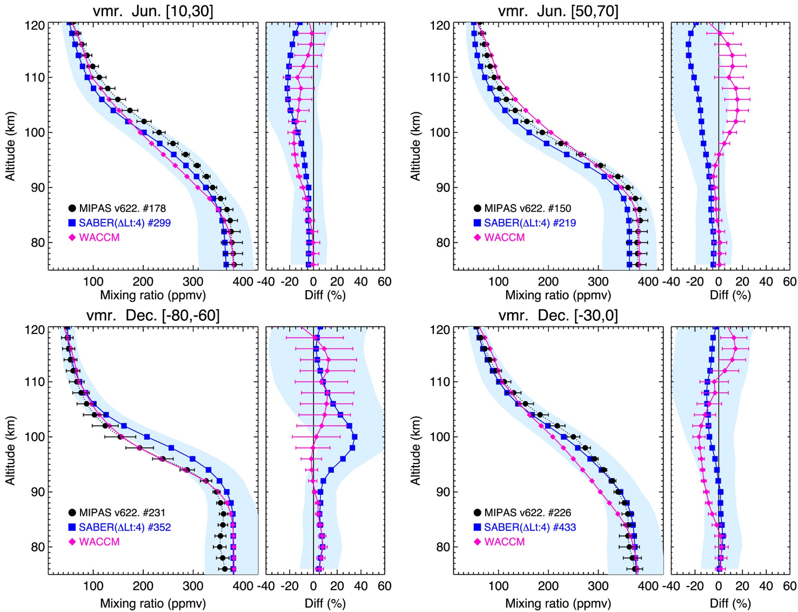
CO₂ above 80 km
Better agreement of WACCM with satellite measurements when the Prandtl number is reduced from 4 to 2, which increases K_{zz} (Garcia et al., JGR 2014)
Solstice conditions
Poor agreement in NH polar summer (50°N–70°N for June).
Otherwise, good agreement for SH polar summer (80°S–60°S for December) and the tropics (10°N–30°N for June and 30°S–0 for December)
The combined errors of SABER and MIPAS are blue shaded areas
López-Puertas et al., 2017

Slide 30
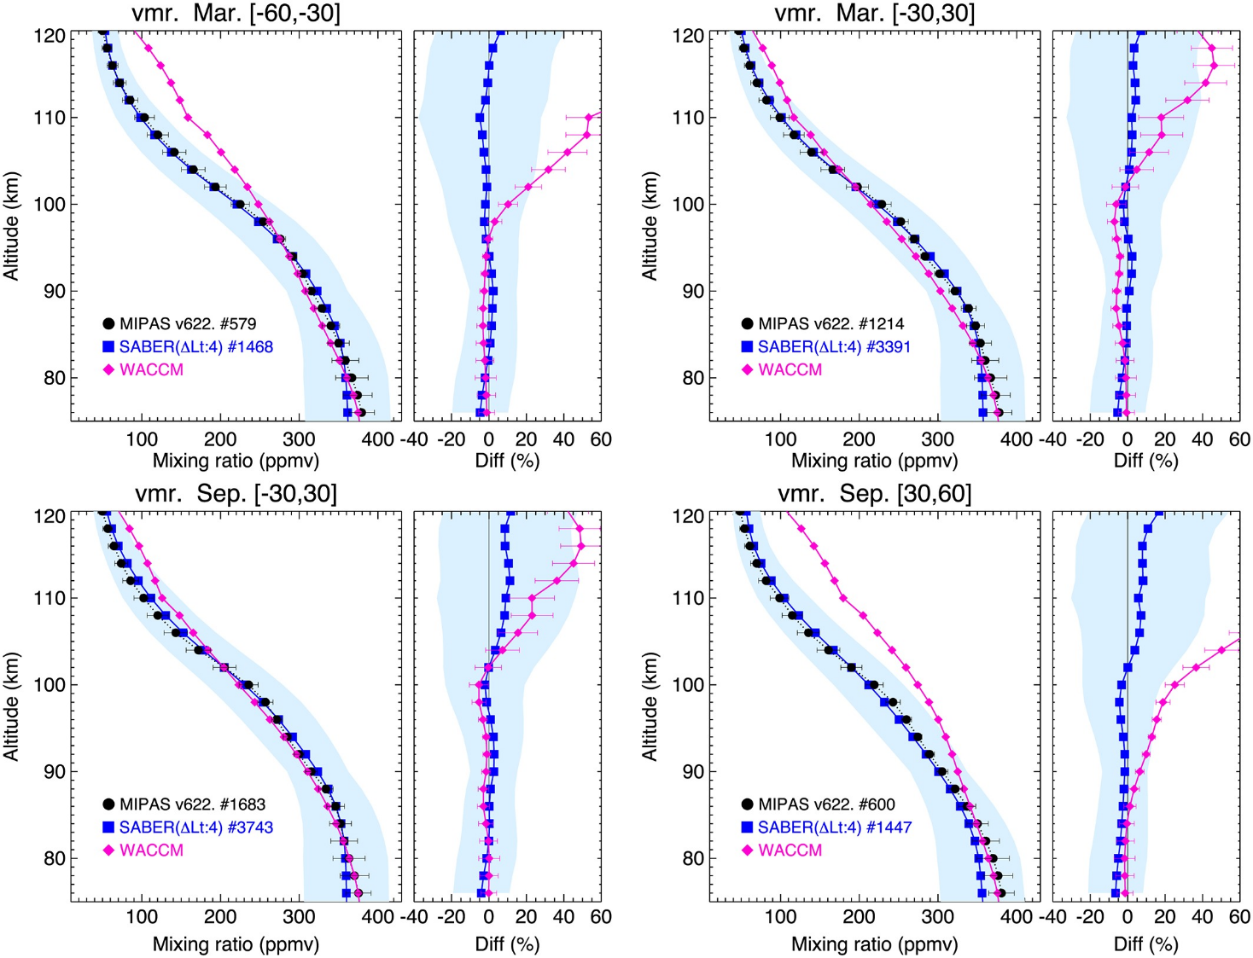
CO₂ above 80 km
Better agreement of WACCM with satellite measurements when the Prandtl number is reduced from 4 to 2, which increases K_{zz} (Garcia et al., JGR 2014)
Equinox conditions
Midlatitudes (30°–60°) and the tropics (30°S–30°N).
Combined errors of SABER and MIPAS are the blue shaded areas.
Poor agreement at mid to high latitudes
López-Puertas et al., 2017

Slide 31
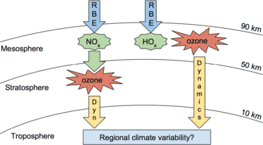
Energetic particle precipitation
Baker et al., SSR 2016

Slide 32
Example: the January 2005 Solar Proton Event
Daily average ion pair production rates (# cm⁻³ s⁻¹) for protons with energy 1–300 MeV) as a function
of time for 15–22 January 2005.
Jackman et al., ACP 2012

Slide 33
SPE in January 2005 – model predictions
60 – 90º N
Decrease in O₃ by over 40%
Increase in NO_{x} by a factor of 10
Increase in OH by a factor of 10
Increase in HNO₃ by a factor of 40
Compares well with satellite observations
Andersson et al., JGR 2016; Kovacs et al., GMD 2016

Slide 34
Surface temperature anomalies appear to propagate downwards through dynamical coupling mechanisms
Meteorological reanalysis data
Note these anomalies are regional, not zonal in extent
Seppälä et al., JGR 2009

Slide 35
Summary
Clear evidence that vertical transport in the MLT is significantly underestimated in chemistry-climate models, by a factor of 5 – 10
This should reconcile the injection rate of metals such as Na and Fe, inferred from a multiplicity of evidence, with the modelled meteoric metal layer densities
Vertical transport may also help to resolve the “O₃ deficit”, the “HO_{x} dilemma”, and the CO₂ problem
The impacts of meteoric smoke particles and the tropospheric climatic effects of EPP are important examples of whole atmosphere coupling

Slide 36



Wave-driven transport of chemically active species in the MLT
The effective vertical transport velocity of a species is defined as its vertical flux divided by its mean density. When the chemical production of a species C is slow compared to the periods of the dominant gravity waves, its total vertical transport velocity induced by molecular diffusion, eddy mixing and wave effects, is given by (Gardner, JGR 2018):
$${\overline{w}}_{Trans}$$
K_{Tot}, K_{Mole}, K_{zz} and K_{Wave} are the total, molecular, eddy and wave diffusivities
${\overline{w}}_{Chem}$ is the chemical transport velocity
where
[C] = density of C
[M] = atmospheric density
T = temperature
p = pressure
$\overline{w^{′}T′}$ = sensible heat flux
$\overline{w^{′}p′}$ = wave energy flux
Γ_{ad} = adiabatic lapse rate
g =gravitational acceleration
N = buoyancy frequency
and

Slide 37
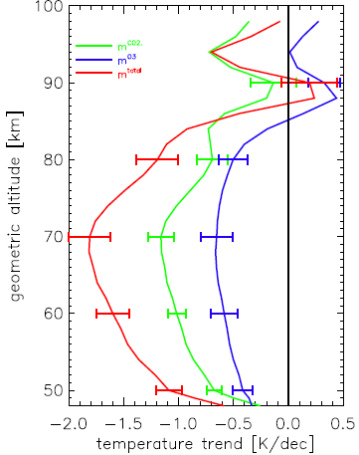
Climate change in the middle atmosphere
Older data sets (pre-2000) show a larger cooling in the middle atmosphere, mainly caused by ozone depletion
The more recent cooling is driven by increases of greenhouse gases CO₂ and CH₄
Models capture these trends well. This is the LIMA model from the IAP, Kühlungsborn
Lübken et al., JGR 2013
Beig, JGR 2011

