Slide 1
MUSICA Kick-Off Meeting
Day 2
Atmospheric Chemistry Observations and Modeling Laboratory (ACOM)
May, 2019

Slide 2
Main Objective
Engage the participation of the community at an early stage in the development of a new unified model for the global to local prediction of air quality and investigations of the role of chemistry in weather and climate.
Expected Outcomes:
Input from the community on needs and development plans
Strategic Partnerships & collaborations
Formation of Working Groups
White Paper/Action Plan

Slide 3
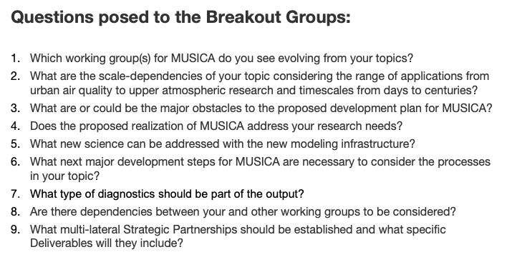

Slide 4
WG: Model Architecture and Numerics
Potential WGs: - User Experience (incl. portability, compatibility, user support & documentation) - Infrastructure
Governance needs to reflect user engagement. Longevity of WGs depends on engagement.
Define and document component interfaces
Ensure ease of installation and use
Desirable to have evaluation infrastructure
Could infrastructure prevent science (e.g. adjoint feasible?)
Strategic Partnerships with developers and users: representatives from ENTIRE community (HPC and low-resource, operational + research, ...)

Slide 5
WG: Emission and Deposition
Potential WGs: - Emission Inventory Implementation and Assessment (&) Dry Deposition - Wet deposition - Boundary layer processes - Forecasting for emissions
Plenty room for emission improvements (magnitude, speciation, characteristics, ...). Employ new methodologies (machine learning, integrate GIS information,...)
Constraining emissions where you know the influence on non-emission related processes - modularity is beneficial
Multiple options are good but need for standard well tested configurations
Emission tool: Leverage existing work
Source apportionment diagnostics, Online processing of diagnostics
Who are the people (decision makers/managers) to engage with to get collaboration going on model development across agencies?

Slide 6
WG: Sub-grid scale and convective transport
Potential Working Groups:
Chemical transport (resolved, convective, subgrid mixing)
Urban transport and chemistry
Cloud processing of aerosols and trace gases (scavenging, aerosol-cloud interactions, etc.)
Several scale dependencies noted
Transport in the ’grey zone’ (urban scales) will require special attention
Need to re-consider vertical resolution – what is optimal at each resolution?
Transition for parameterized to resolved gravity waves
Transition from using a cloud fraction to cloud resolving
Wet scavenging, lightning-NOx, aerosol-cloud effects, photolysis
Need to modify chemistry rates due to segregation

Slide 7
Quick Observations
WGs need to be consolidated (aim for 4-5 initial WGs)
How does that coordinate development activity? Steering committee?
Need to clarify our Stakeholders
Discussion on how to form governance structure (and how it interacts with formation of SIMA governance)

