Slide 2
MUSICA (Science) Applications
Kick-Off Meeting
May, 2019
Notes:
NOTE: Background image can be used as is or changed for a particular presentation in the “Slide Master” button found under the “View” tab.

Slide 3
Will MUSICA support current science applications?
AQ Forecasting (2-5 days) on regional/local scale (3-12 km)
Source Attribution Studies (emission sectors, long-range transport, …)
Future Projection of AQ (~12 km or coarser)
Chemistry Climate Simulations (>0.25 deg)
Field campaign design, forecasts and analysis
Usefulness and Validation of Satellite Data
Data Assimilation (Initialization, Re-analysis, …) & Inverse Modeling (Adjoint?)
Fundamental Processes: Understanding Processes Affecting Atmospheric Composition and Impacts (Whole Atmosphere)
LES/urban scales: urban AQ, complex terrain, emergency response of hazardous release

Slide 4
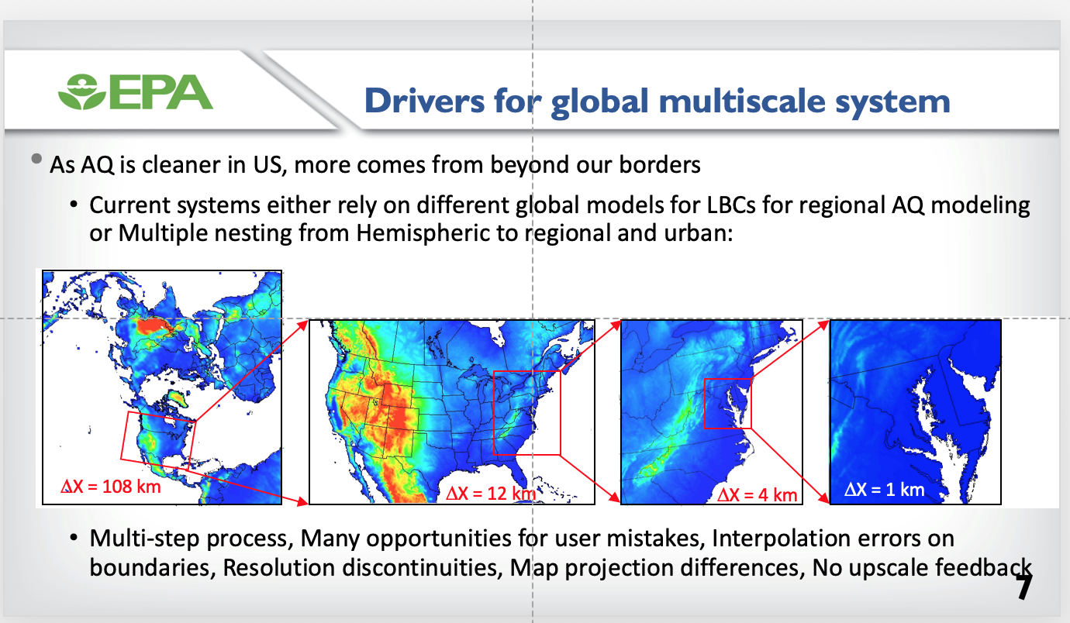
From Jon Pleim

Slide 5
What new science will MUSICA allow?
Unification & Modularization

Slide 6
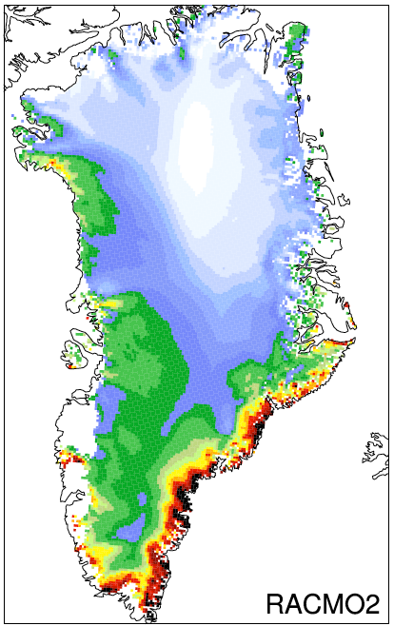
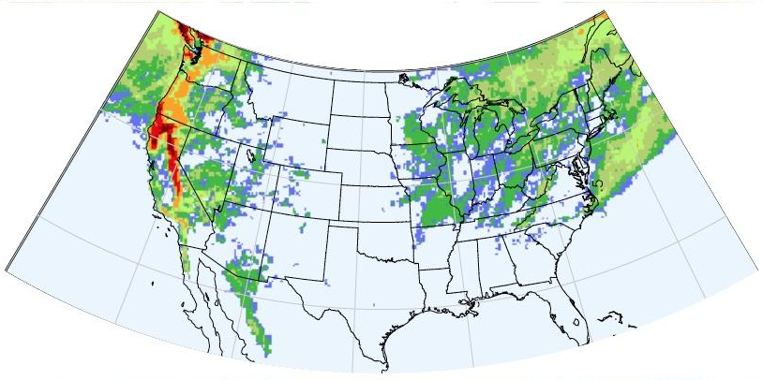
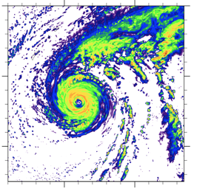

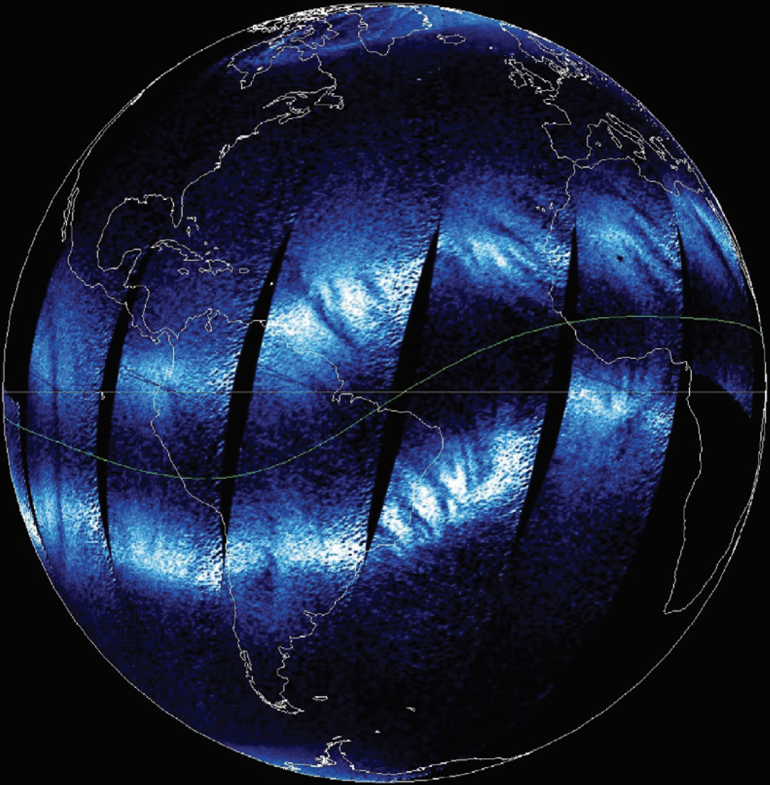
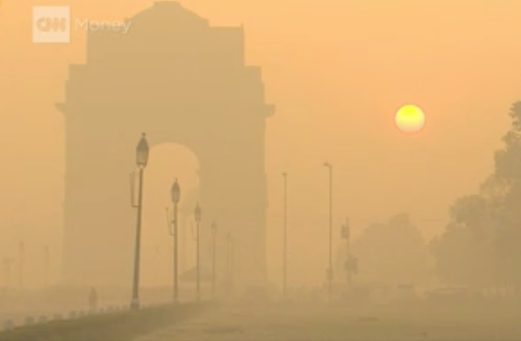
Frontier Science Goals
Map to specific applications
Polar
Coupled Simulations at the Weather Scale
  Tropical cyclones, Extreme convection
Extreme weather under climate change
  Extreme heat and precipitation, Hydrologic cycle extremes
Polar Processes and Prediction
Integrated Geospace modeling
Air composition/quality prediction and projections (MUSICA)
Hydrology Extremes
Tropical Cyclones
Air Quality
Space Weather
From Andrew Gettelman

Slide 7
From Dan Marsh

Slide 8
Coupling and transport in the UTLS Asian monsoon
Notes:
Zooming into monsoon regions to represent the emissions, convection, and convective transport of trace gases and aerosols requires cloud-resolving grids (< 5 km horizontally). Yet the impact of the convection in the UT reaches the regional to continental scale. → Model for Prediction Across Scales (MPAS) hooked with gas and aerosol chemistry would be ideal for addressing this topic.
Left figure: Daily maps of PV in PV units (1PVU =10−6Km2kg−1s−1) on the 360K level between 9 and 19 June of the year 2006.

Slide 9
New science with MUSICA
Quantify relative contributions of transported pollution versus local emissions on air quality in a specific location; conversely, quantify the impact of a particular local source on larger-scale regional and global atmospheric composition.
Understand impact of venting of surface emissions into the free troposphere where long-range transport more readily occurs.
Teleconnections - Prediction of the seasonal to interannual variability of composition driven by large-scale climate patterns. E.g. occurrence of El Niño leads to drought conditions in the tropics and subsequently, large fires with high pollutant emissions.
Coupling between the troposphere and upper atmosphere (current underrepresentation in transport)
Modular framework – quantify bias of individual processes, e.g. ability to switch from complex and comprehensive chemical mechanisms for looking at urban air quality issues (100s of chemical species) to less comprehensive, computationally efficient mechanisms.
Quantifying the impacts of extreme events such as heat waves and wildfires on local and distant atmospheric composition. For example, understanding the radiative effect of aerosols lofted to the stratosphere by pyro-convection.
Support assessment and research for geostationary satellite constellations
Others ……
Can we explore in advance the degree to which MUSICA might improve over current capabilities?

