Slide 1
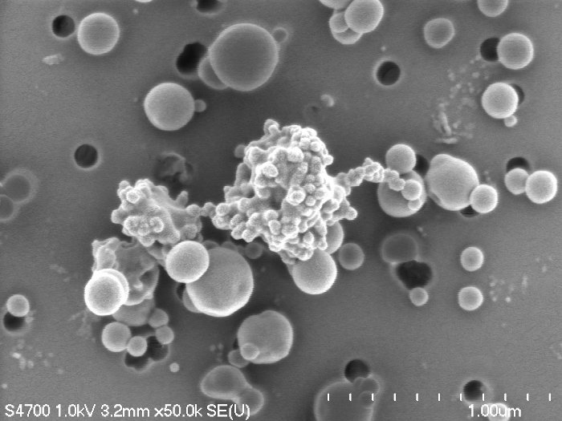
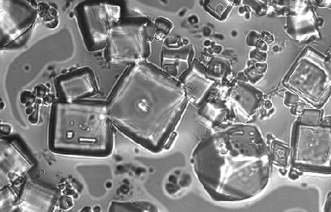
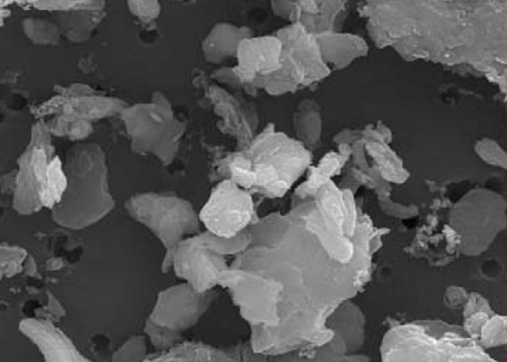
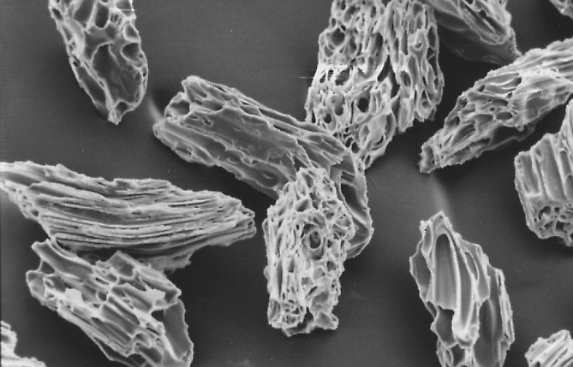
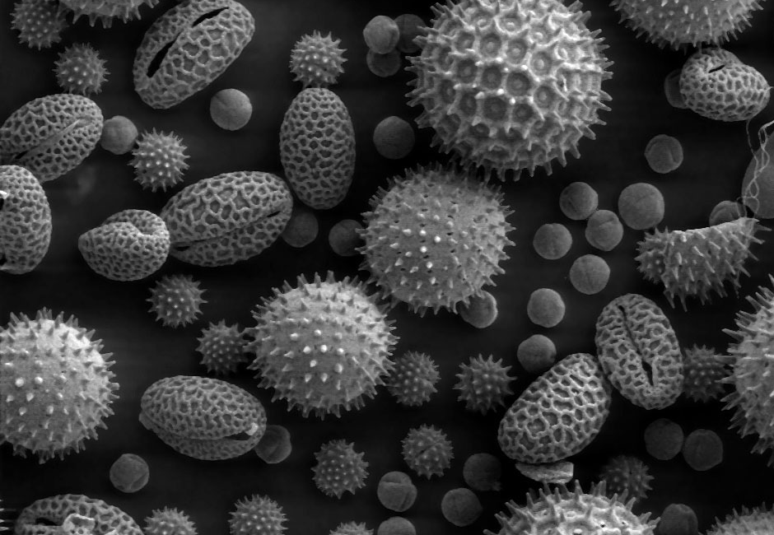
How Models Represent Aerosols
sea-salt
mineral dust
fly ash
soot and tar balls
Jerome Fast
secondary species
pollen
Notes:
About the Image: Glass Lab Equipment
Glass lab equipment on a table at the regional American Chemical Society meeting
https://www.flickr.com/photos/pnnl/41280037010/in/album-72157692716565760/

Slide 2



Overall Processes
Trace Gas Chemistry
Nucleation
Dry Deposition
Formation
Aerosol Growth and Chemical Aging
Removal
Emissions
Wet Scavenging
optical, CCN, IN properties
Biogeochemistry
Meteorology
Overarching Issue of Representing Aerosol Properties (Number, Size, Composition, Mixing State, Morphology)

Slide 3
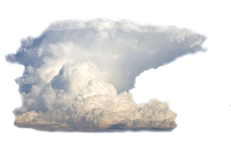
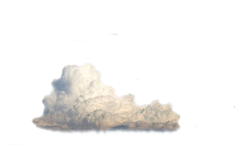


Representations
There are 4 basic approaches used to represent the aerosol number and mass size distributions in models:
Bulk
Modal
Sectional
Explicit
Assumptions
Complexity
moments:
1) mass,
2) mass & number,
3) mass, number, & surface area
Assumptions in each approach will affect 1) radiation via aerosol optical properties and 2) clouds via cloud condensation nuclei (CCN) and ice nuclei (IN), and 3) human health assessments since smaller particles penetrate deeper into the lungs.

Slide 4
Bulk Approach
Only total mass of aerosol compounds are represented
No information on particle number or size – need to assume size distribution for radiative transfer and response of cloud properties to aerosols
Most numerically efficient of all the approaches (fewest number of species to keep track of)
16-year Mean Surface Concentration
from Ginoux et al. EMS, 2004

Slide 5
Modal Approach
Represents the size by a discrete number of log-normal distributions
Number of modes usually hard-coded into the model
Modes smoother than observed distributions
Numerical efficient – suitable for AQ and climate models
1000
100
10
1
observed distribution
another mode needed for nanoparticles
another mode needed for coarser particles
Aiken mode
Example: MAM in CESM
Liu et al. GMD, 2016
4 modes by default
particle number dN/dD (cm⁻³ nm⁻¹)
Accumulation mode
Coarse
mode
1 10 100 1000
particle diameter, D (nm)

Slide 6
Sectional Approach
Represents the size distribution by a discrete number of size bins
More flexible than modal approach – better represents size
Need a large number of bins to represent observed distributions
Numerical more expensive - suitable for AQ models and research studies
1000
100
10
1
need more bins to represent entire size distribution
Example: MOSAIC in WRF-Chem
Zaveri et al. JGR, 2008
4 or 8 bins by default but can be configured to any #
particle number dN/dD (cm⁻³ nm⁻¹)
from Lupascu et al. ACP, 2015
20 bins
1 10 100 1000
particle diameter, D (nm)

Slide 7
Explicit Approach
Represents the size distribution by explicitly simulating each particle in a population of particles. Need to simulate thousands of particles.
More flexible than both modal and sectional approaches
Numerical most expensive - suitable for research studies (e.g. box modeling)
1000
100
10
1
model can represent the continuum of the size distribution
Example: PartMC-MOSAIC
Riemer et al. JGR, 2010 Zaveri et al. JGR, 2010
particle number dN/dD (cm⁻³ nm⁻¹)
1 10 100 1000
particle diameter, D (nm)

Slide 8

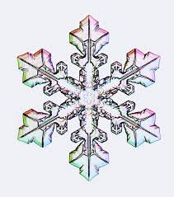
Complexity as a Function of Species
Like meteorological and trace gas species, prognostic aerosol species are a function space and time, i.e. aerosol(i,j,k) at 2 time intervals
But they also have properties that need to be accounted for:
Composition: e.g. SO₄, NO₃, NH₄, OM, Cl / Na (sea-salt), OIN (dust), H₂O
Size: separate species for number of bins or sections
Phase: Interstitial or cloud borne
OM is particularly complicated because of the many processes responsible for SOA. It is desirable to keep track of OM from primary, biogenic, biomass burning, and anthropogenic sources as well as subclasses of those sources.
Dust can be speciated into different mineral types (e.g. illite, kaolinite, quartz, calcite) which is important for
1) Radiative Effects
2) Heterogeneous chemistry
3) Ice nuclei
4) Biogeochemical cycle
from Shrivastava et al. (2019)

Slide 9
Complexity Tied to Clouds
Need additional species to handle phase:
Meteorological models either explicitly “resolve” clouds (microphysics) or account for “unresolved” clouds (convection), requiring different assumptions
Cloud-aerosol interaction treatments hardwired to specific microphysics and/or convection parameterizations, but more flexible coupling is needed and the representations of cloud-aerosol interactions needs to be scale-aware
activation
resuspension
interstitial cloud-borne interstitial
so4_a01 so4_cw01 so4_a01
so4_a02 so4_cw02 so4_a02
… … …
no3_a01 no3_cw01 no3_a01
no3_a02 no3_cw02 no3_a02
… … …
num_a01 num_cw01 num_a01
num_a02 num_cw02 num_a02
“growing cloud”
cldfra - cldfra_old > 0
“shrinking cloud”
cldfra_old > cldfra
Include separate “ice-borne” species?

Slide 10
Complexity Tied to Mixing State
Most aerosol models (excluding explicit models) assume aerosols are an internal mixture
In reality, aerosol populations are far more complex. Accounting for mixing state may not be important for particulate loading. But some studies on the direct and indirect effects of aerosols show that an internal mixing assumption can lead to significant errors (> 10%) in aerosol optical properties and CCN calculations.
internally mixed mode
10.00
diameter (μm)
An Overly Simplistic Depiction, Where Color = Composition
diameter (μm)
external mixture
intermediate
complete internal mixture

Slide 11
Observations of Mixing State
Even when composition as a function of size is available from “traditional” AMS data, it provide little information about the mixing state
Single particle measurements now provide a means of evaluating predictions of mixing state, but there are still technical issues of comparing observed and simulated quantities.
boundary layer
Single Particle Data Lumped into Classes
interstitial within cloud
free troposphere
cloud borne
relative intensity
200 300 400 500 600 d_{va} (nm)
ferry
~1200 ft
below
~2000 ft
CVI
~3500 ft
above ~5000 ft
CVI
~3800 ft
below
~2800 ft
below
~2000 ft
interstitial
~4000 ft
below ~2800 ft
below
~1500 ft

Slide 12
Treating Mixing State
Modal models often include an additional primary carbon mode to represent microphysical aging of carbonaceous aerosols. Freshly emitted POM and BC are put into the primary carbon mode (externally mixed), which is assumed to be hygrophobic. Then, once a certain number of monolayers of SO₄ or SOA are formed, that POM and BC are moved into the accumulation mode (interally mixed) which is more hygrophillic.
A few treatments of mixing state have been proposed for sectional models
divide aerosol population into discrete bins by BC mass fraction, f_{BC}, and/or hygroscopicity (κ)
1.0
BC Mass Fraction
kappa (κ) or
hygroscopicity
κ = 0.1
0
Dry Diameter
0
0.7
f_{BC}= 0.3
Ching et al. (2016) found that 2 f_{BC} x 2 κ bins may be sufficient, but for 8 size bins that increases number of species needed by a factor of 4

Slide 13
Aerosol Code Complexity
Many arrays are needed to account for a range of aerosol properties
Can this be simplified?
Let the user select complexity based on how many species to include, how to treat the size distribution, whether to include cloud-aerosol interactions, and whether to treat or ignore mixing state, etc.
space
# of modes or size bins
# of mixing state bins
aerosol(i, j, k, n_comp, n_bin, n_phase, n_ms)
# of aerosol species
# phases: 1 = interstitial, 2 = cloud, 3 = ice
for SOA, this might include volatility bins
some computational inefficiency since some arrays may be zero or frequently zero, e.g. modal models exclude dust in aiken mode, BC in coarse mode, etc.

Slide 14
Aerosol Code Expense
Many treatments /options available for each process – but they may not all be compatible with different representations of the size distribution
most computationally expensive part, excluding transport of aerosol arrays
Trace Gas Chemistry
Nucleation
Dry Deposition
Formation
Aerosol Growth and Chemical Aging
Removal
Emissions
Wet Scavenging
optical, CCN, IN properties
Meteorology

Slide 15
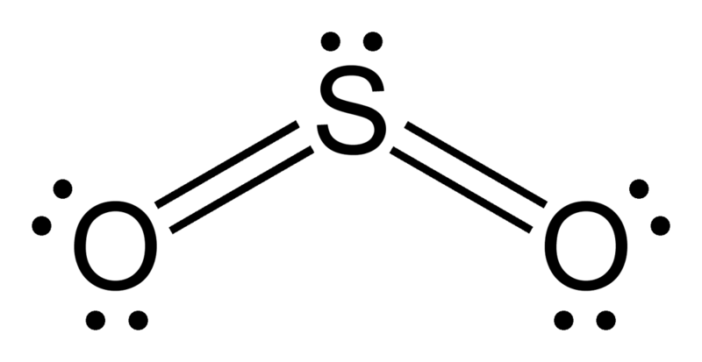
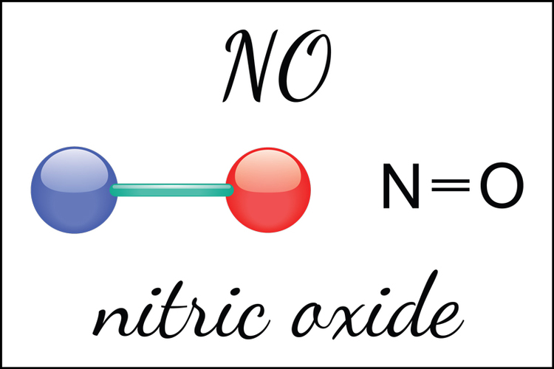
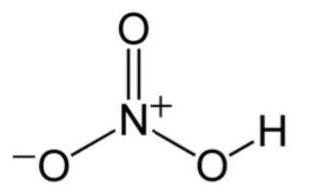
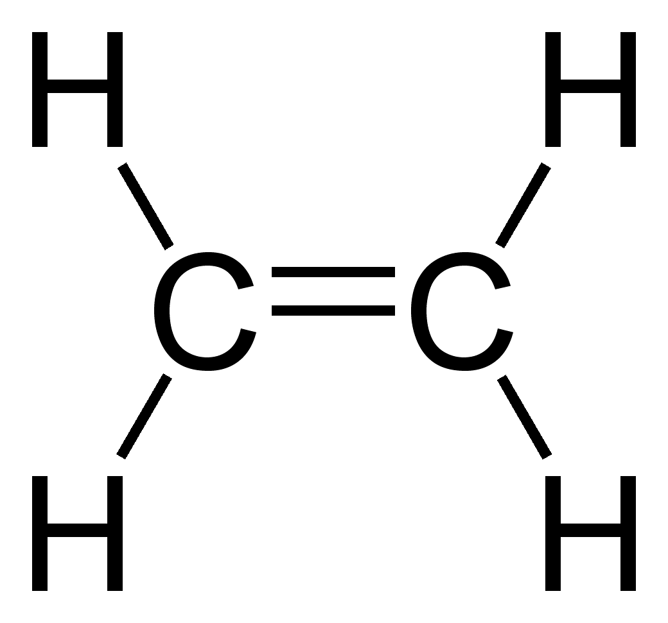
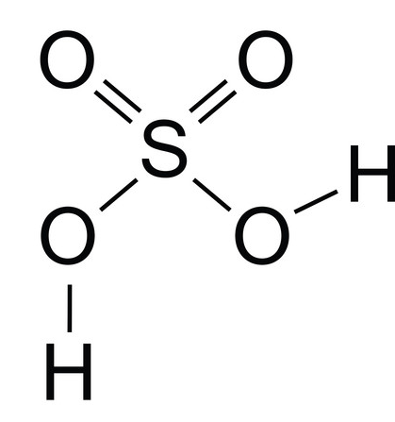
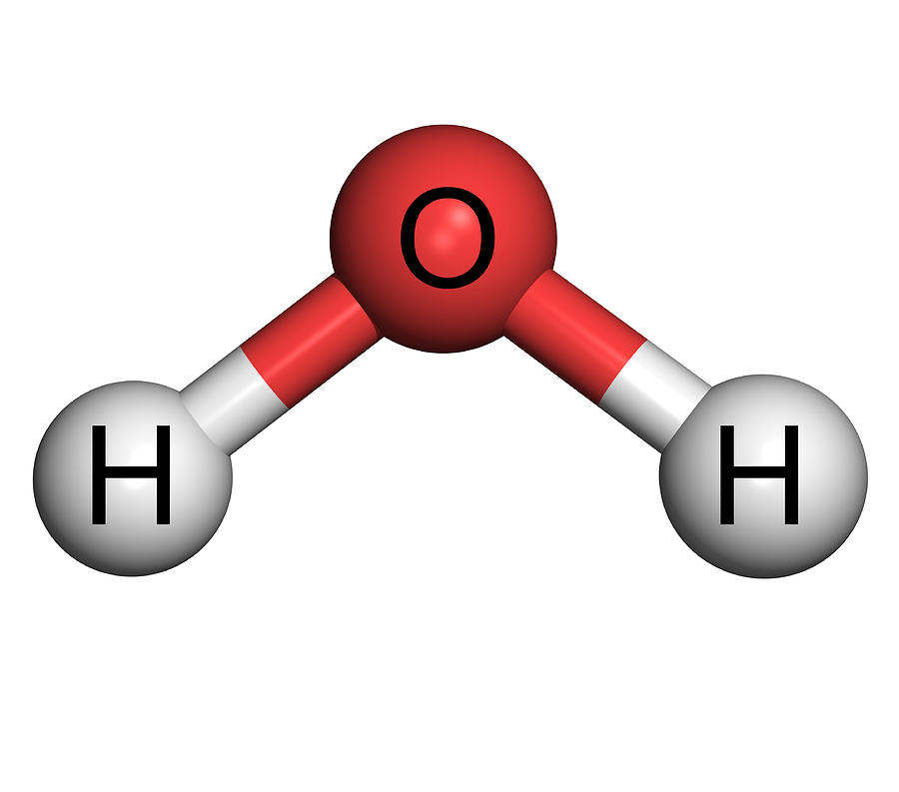
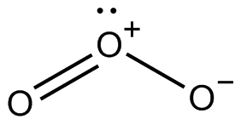
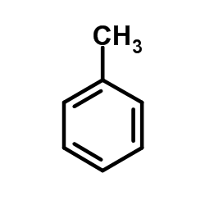
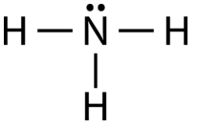
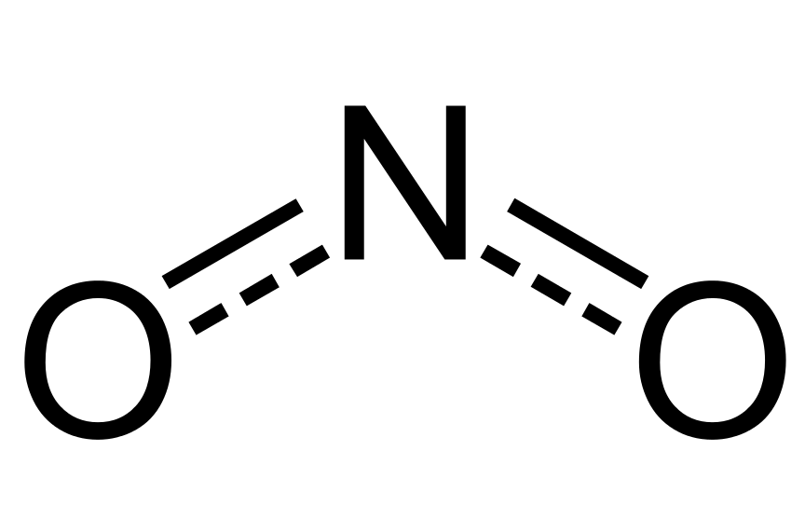
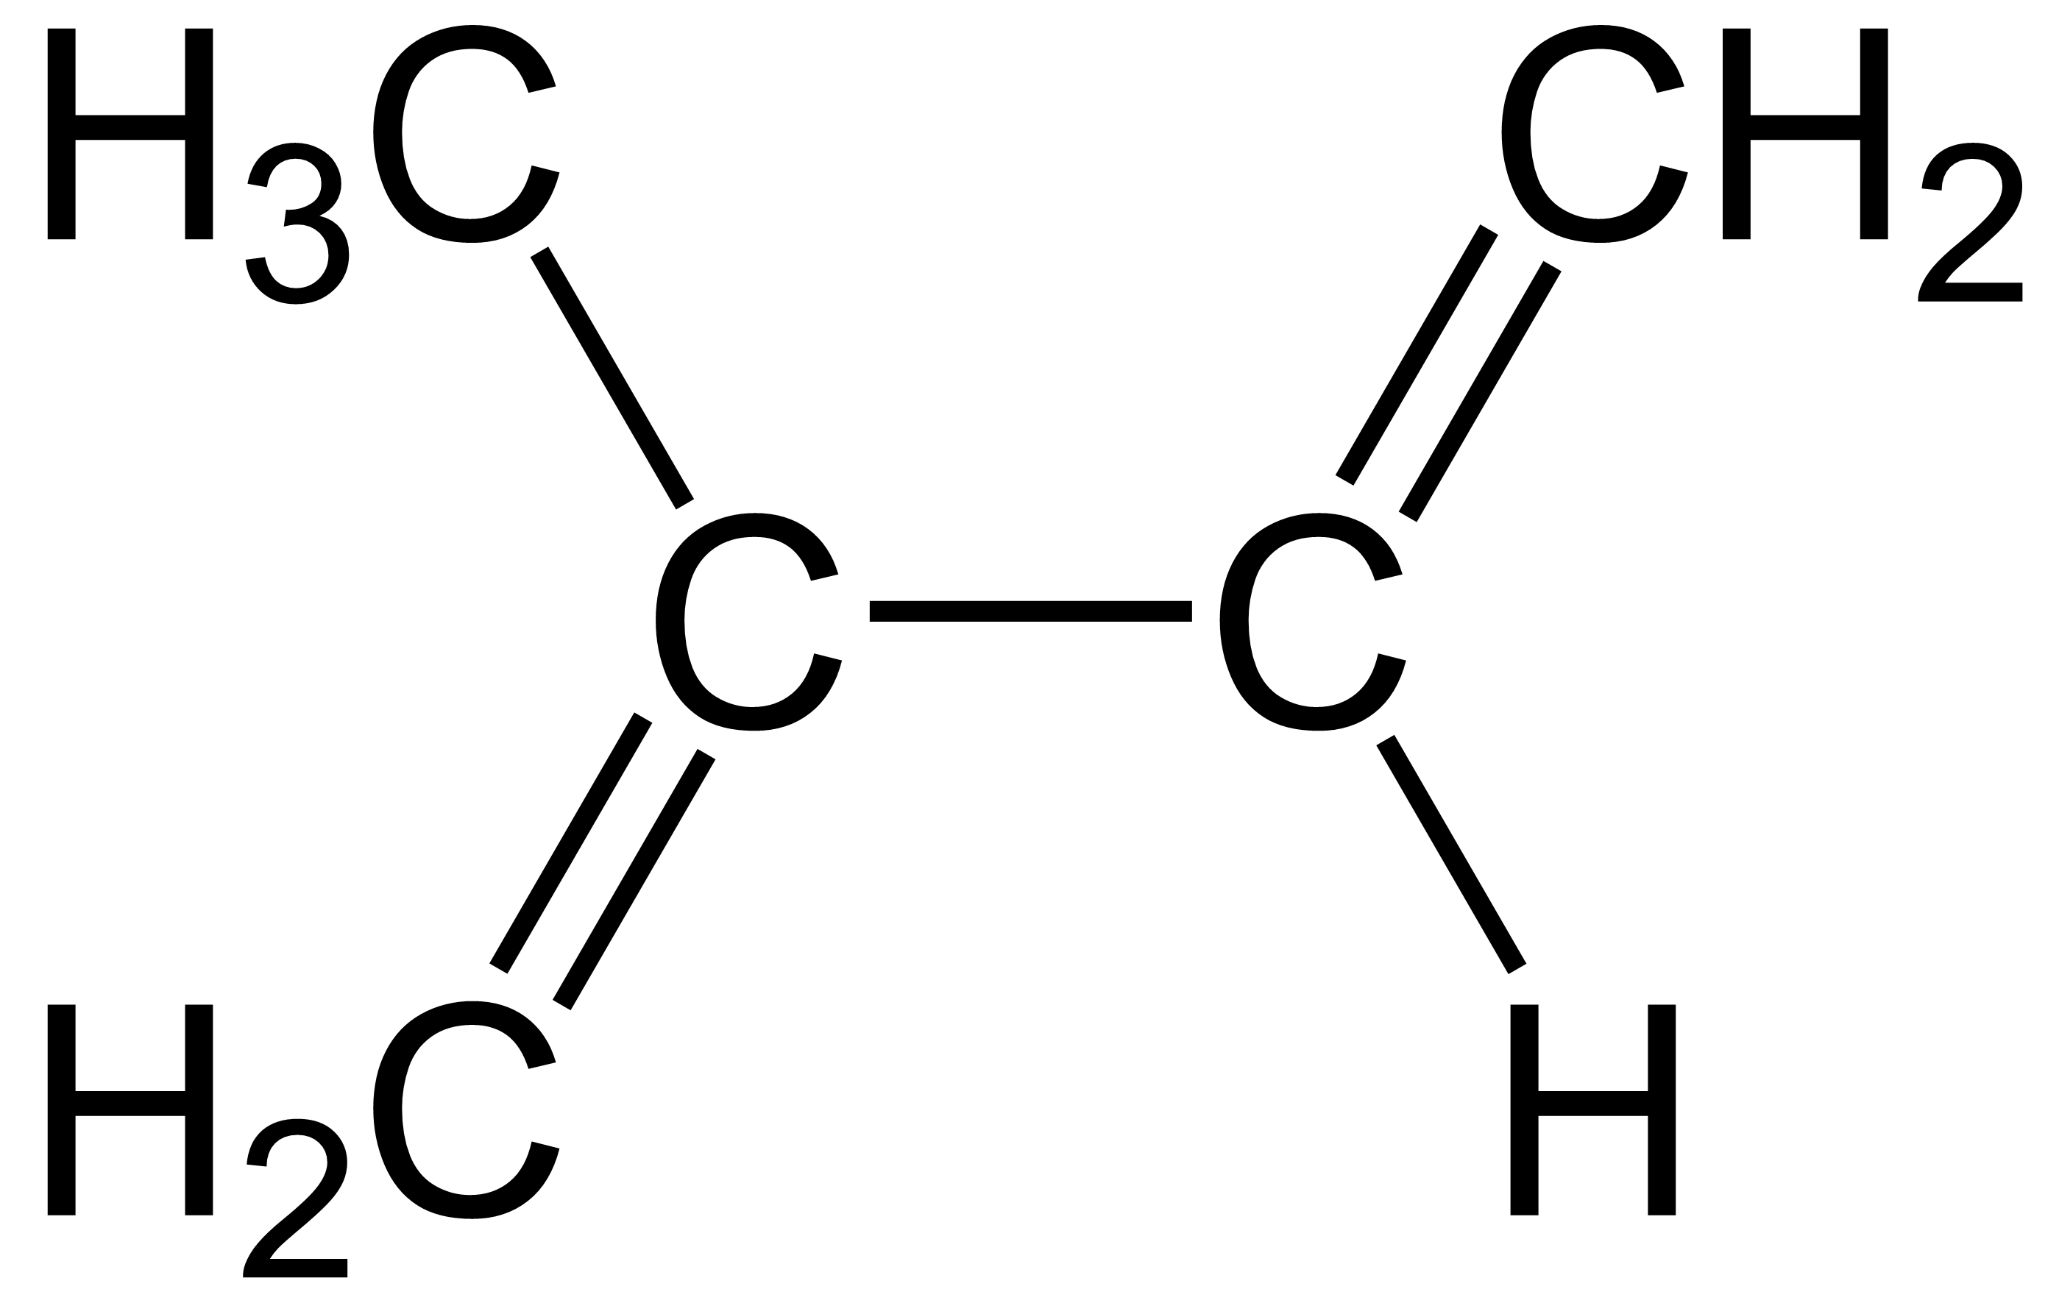
Aerosol Growth and Chemical Aging
All aerosol models have numerical methods to treat growth, gas-to-particle partitioning, aerosol chemistry
Thermodynamic Module
HNO₃
organics
HCl
thermodynamic assumption
H₂SO₄
NH₃
set of species and reactions treated
tied to complexity of trace gas chemsitry
OH-
H+
NH₄+
Cl-
salts
BC
Org
Na+
multicomponent activity coefficients
NO₃-
Ca²+
temperature & RH dependence
SO₄-
Org
H₂O
water activity
oligomer
solid-liquid phase transitions
before
numerical methods to solve ODEs
after
Model complexity varies greatly due to # of species and reactions treated, and assumptions
Equilibrium: Assumes that volatile species in the gas and particle phase are in equilibrium.
Dynamic: Observational and theoretical studies demonstrate that equilibrium assumption is not always valid for typical atmospheric conditions.
Hybrid: Combination of equilibrium & dynamic
SOA often calculated separately using volatility basis set (VBS) approach
+ lots more …

Slide 16
Inter-Operable Thermodynamics
Model Size Distribution
Sectional Size Distribution
MOSAIC
same code serving difference approaches
diameter (μm)
diameter (μm)
Thermodynamic Module
HNO₃
organics
HCl
thermodynamic assumption
H₂SO₄
NH₃
set of species and reactions treated
OH-
H+
NH₄+
Cl-
salts
BC
Org
Na+
multicomponent activity coefficients
NO₃-
10.00
Ca²+
temperature & RH dependence
SO₄-
Org
H₂O
water activity
oligomer
solid-liquid phase transitions
numerical methods to solve ODEs

Slide 17
Other Ways to Deal with Expense
Some groups propose to solve chemistry/aerosols on a coarser grid than meteorology, analogous to atmosphere, ocean, cryosphere, and land models having different grids linked through a “coupler”. There is a desire to simulate clouds accurately, but will sacrifice spatial variability of chemistry/aerosols to reduce computational expense.
chemistry
atmosphere
“Superparameterization” also being adapted to solve aerosol processes
ECPP: Explicit Clouds, Parameterized Pollutants
ECEP: Explicit Clouds, Explicit Pollutants
Lin et al, 2018
Embed 2-D “cloud-resolving” grid within a climate model grid cell

Slide 18
What Will MUSICA Become?
modular
modular
modular
Nucleation
Dry Deposition
Formation
Aerosol Growth and Chemical Aging
Removal
Emissions
Wet Scavenging
modular
modular
OR
aerosol model A
aerosol model B
aerosol model C
aerosol model D
aerosol model E

Slide 19

Choices, Choices, Choices
What is the problem being addressed by the aerosol model?
What level of complexity in size distribution is needed?
How many aerosol (and trace gases) species are needed?
What is the domain extent, spatial resolution, and the time period needed to represent the processes of interest?
Do I need to include aerosol-radiation-cloud-precipitation feedbacks?
How much disk space can I afford?
How long am I willing to wait for one simulation to finish? Am I a patient person?
Inevitably, there is always a trade off between spatial resolution, simulation length, level of model complexity, and your sanity.

