Slide 1
Organic trace gases in the extratropical UTLS during START08
E. Atlas, R. Lueb, X. Zhu, L. Pope (UM)
F. Moore, D. Hurst, J. Elkins, R. Gao (NOAA)
L. Pan, S. Tilmes, B. Hall, B. Stephens, A. Weinheimer, F. Flocke, I. Pollack, W. Zheng, D. Knapp, T. Campos, S. Schauffler, R. Hendershot (NCAR)
S. Wofsy, B. Daube, R. Jimenez, S. Park, E. Kort (Harvard)
K. Bowman, C. Homeyer (TAMU)
Acknowledgements: Funding by National Science Foundation; Support of pilots, staff, and management of NCAR Research Aviation Facility.

Slide 2
A large suite of trace gases were measured during START08…
Ozone
Water vapor
Carbon Monoxide
Carbon Dioxide
Nitrous Oxide
Methane
Reactive Odd Nitrogen (NO_{Y}) /Nitric Oxide
Organic trace gases:
Whole Air Sampler (AWAS)
In-situ GC/ECD and GC/MS (PANTHER/UCATS)

Slide 3
…with a variety of interesting properties
Hydrocarbons, halocarbons, sulfur and nitrogen containing VOC (>50 gases)
Greenhouse gases
Different source emission characteristics
Mid latitude pollution/Biogenic emission and uptake/Biomass burning
Gradients with latitude/altitude
Different chemical lifetimes
Known temporal trends in the atmosphere (e.g. HCFCs, HFCs, CO₂,SF₆)

Slide 4
Scientific objectives
Tracer correlations
Mixing scales for gases of different lifetimes/loss processes
Characterization of trace gas compositions for different mixing regimes/source regions
Use of tracers to estimate age spectra
Age of air relationships
Sources of reactive halogen (Br) to the LS
Examination of specific cases
Tropospheric intrusions/RF01 + RF14

Slide 5
Ozone: CO correlations
RF03: Extratropical
UTLS Survey
RF04: Stratospheric Intrusion
RF01: Tropospheric
Intrusion

Slide 6
Ozone:tracer correlations
CH₃CCl₃
~ 5 yr.
CHCl₃
~ 0.5 yr
C₃H₈
~.06 yr
C₂Cl₄
~.25 yr

Slide 7
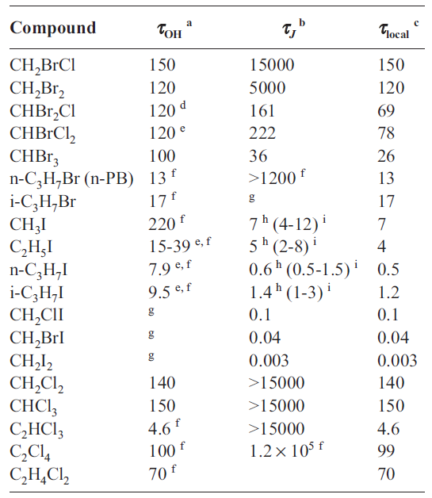
Local photochemical lifetimes (days) of VSL halocarbons in the UT/LS
From WMO Ozone Assessment, Chapter 2, Ko and Poulet

Slide 8
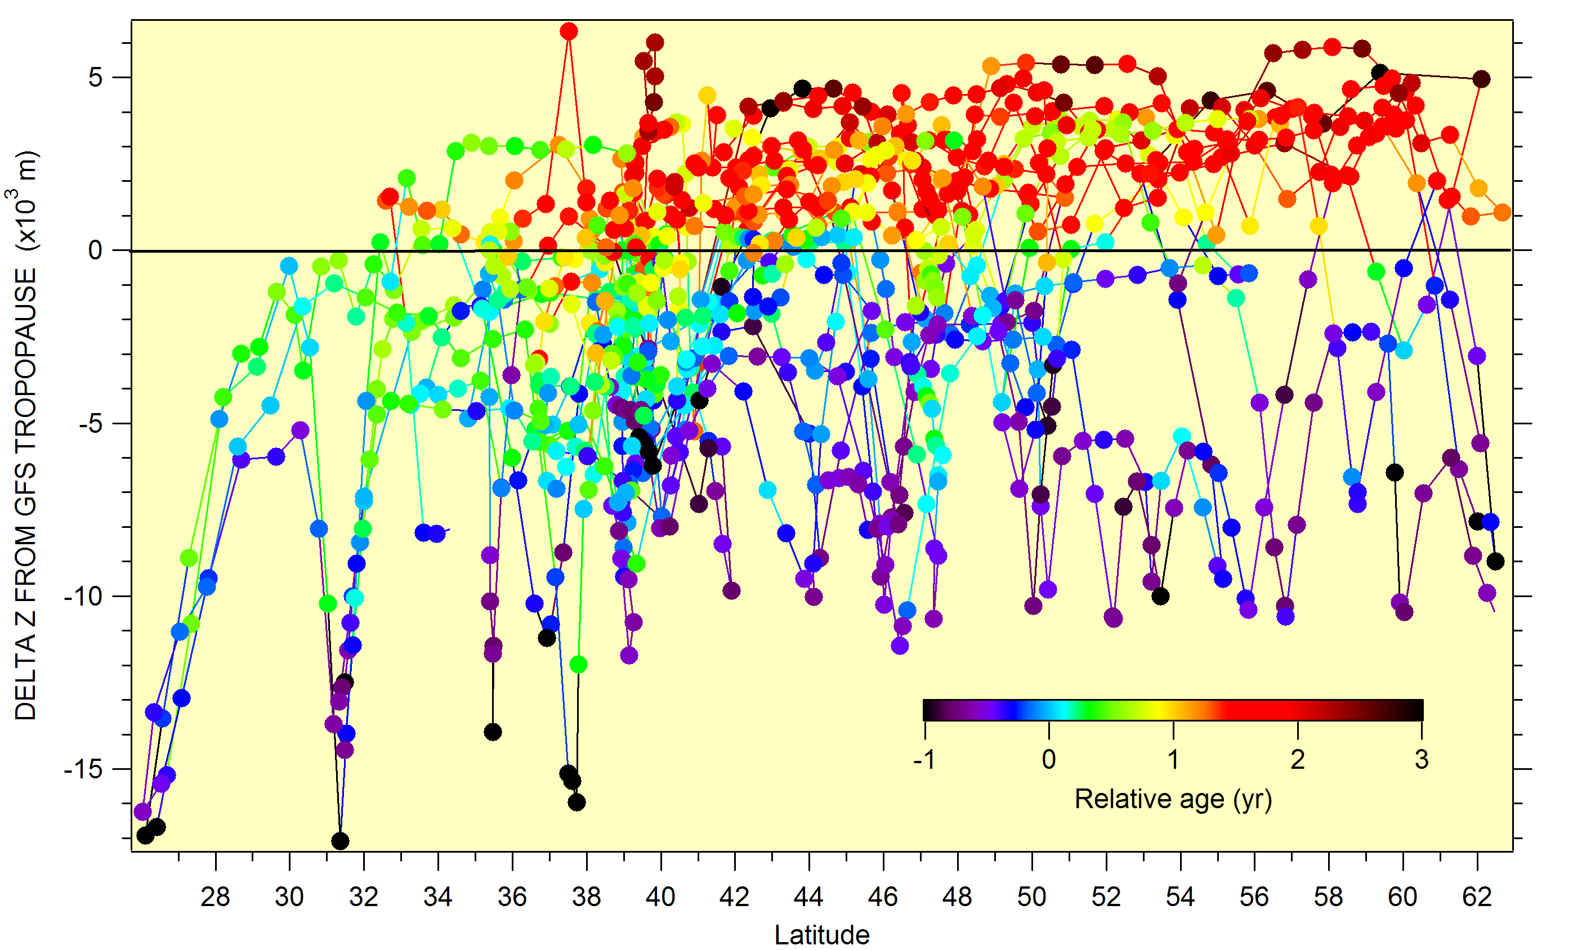
Sample coverage (relative to tropopause): ~ 35% of samples within 2 km of trop.

Slide 9
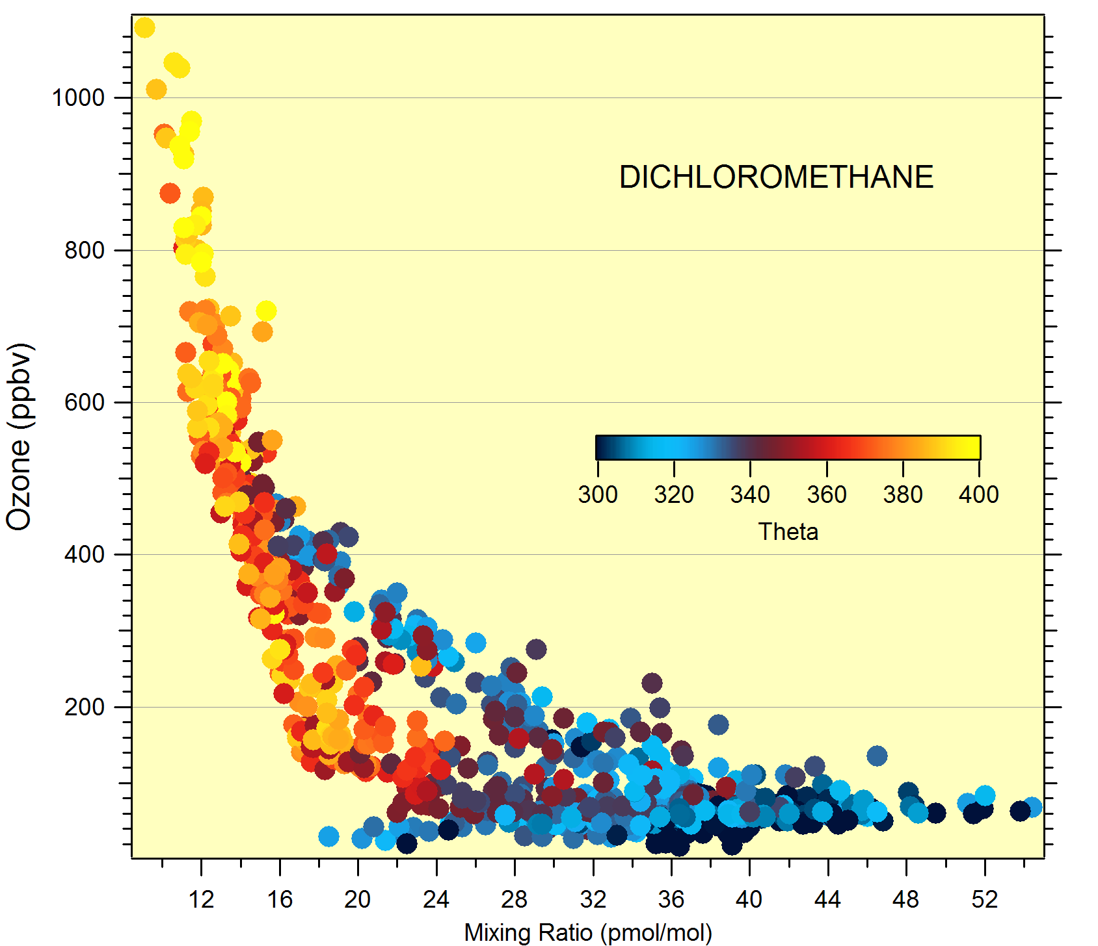
CH2Cl2:O3 correlation STARTo8

Slide 10
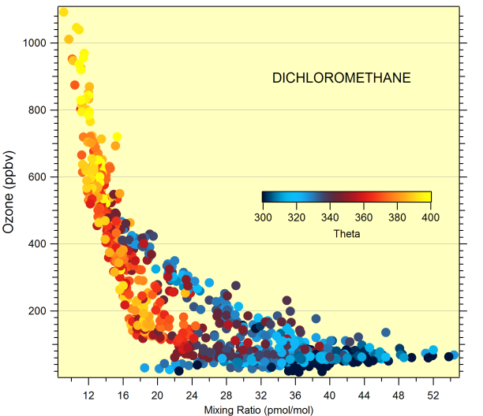
Mixing pathways and tracer correlation
Tropics
Stratosphere
Pole
Sub tropical Jet
High theta branch
Stratospheric Intrusion
(Tropopause fold)
Tropopause
Low theta branch
Troposphere

Slide 11
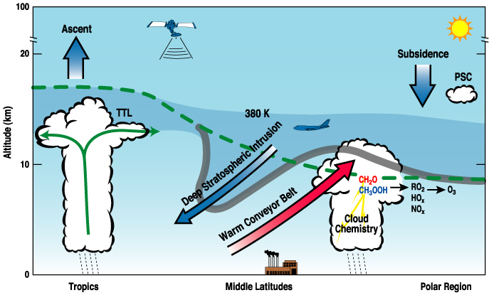
Processes affecting extratropical UT/LS: Tropics to pole
Processes coupling dynamics, chemistry and cloud microphysics in the UTLS region
Gravity wave generation and breaking
Mixing on top of the STJ
Long range transport
Convective transport
Based on figure by Randel and Pan, SPARC Newsletter no.22

Slide 12
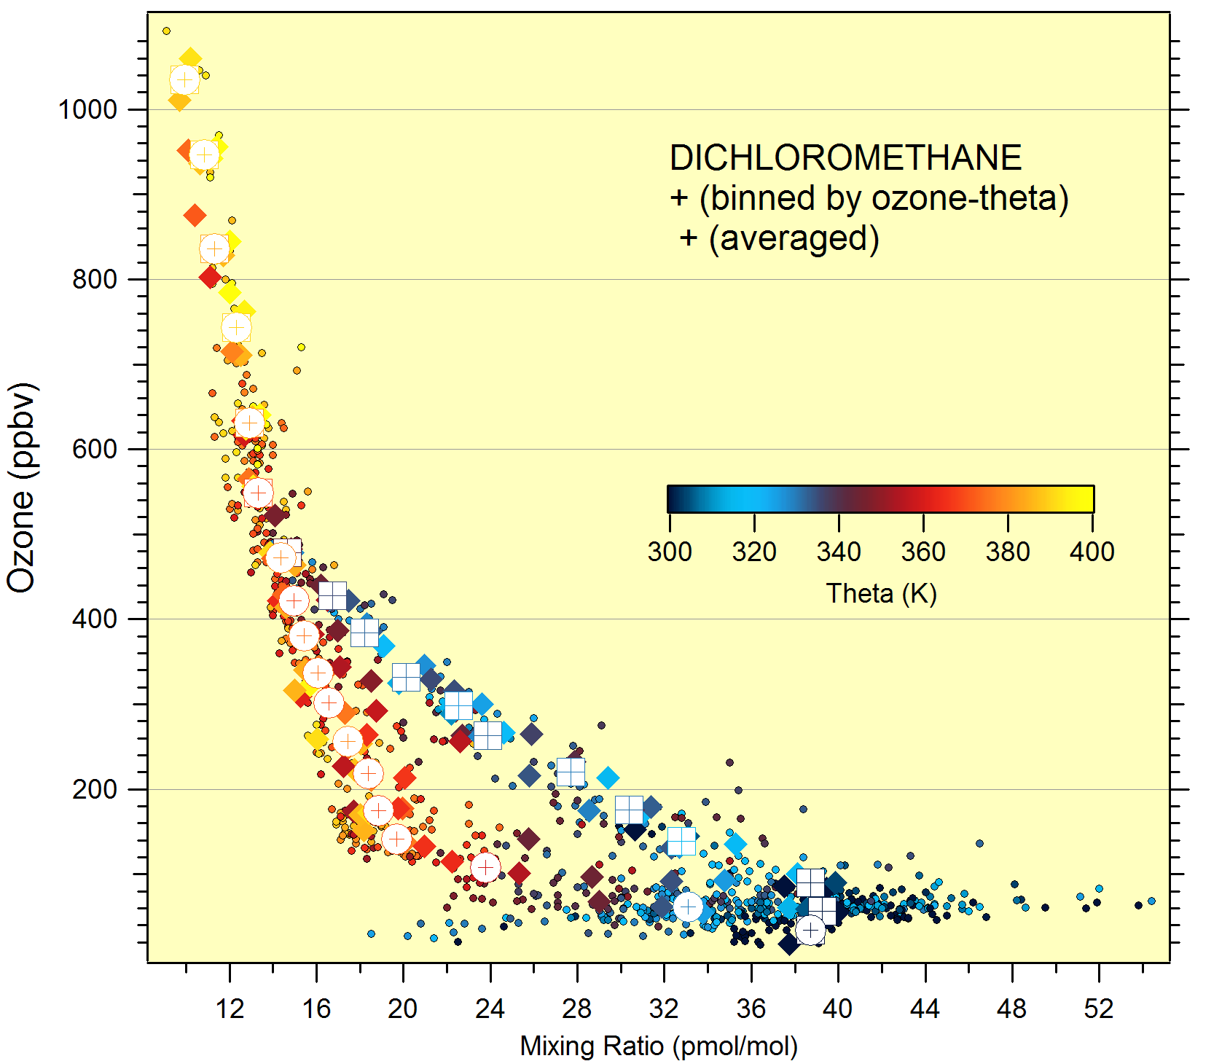
Ozone: CH2Cl2 (binned by O3:Θ)

Slide 13
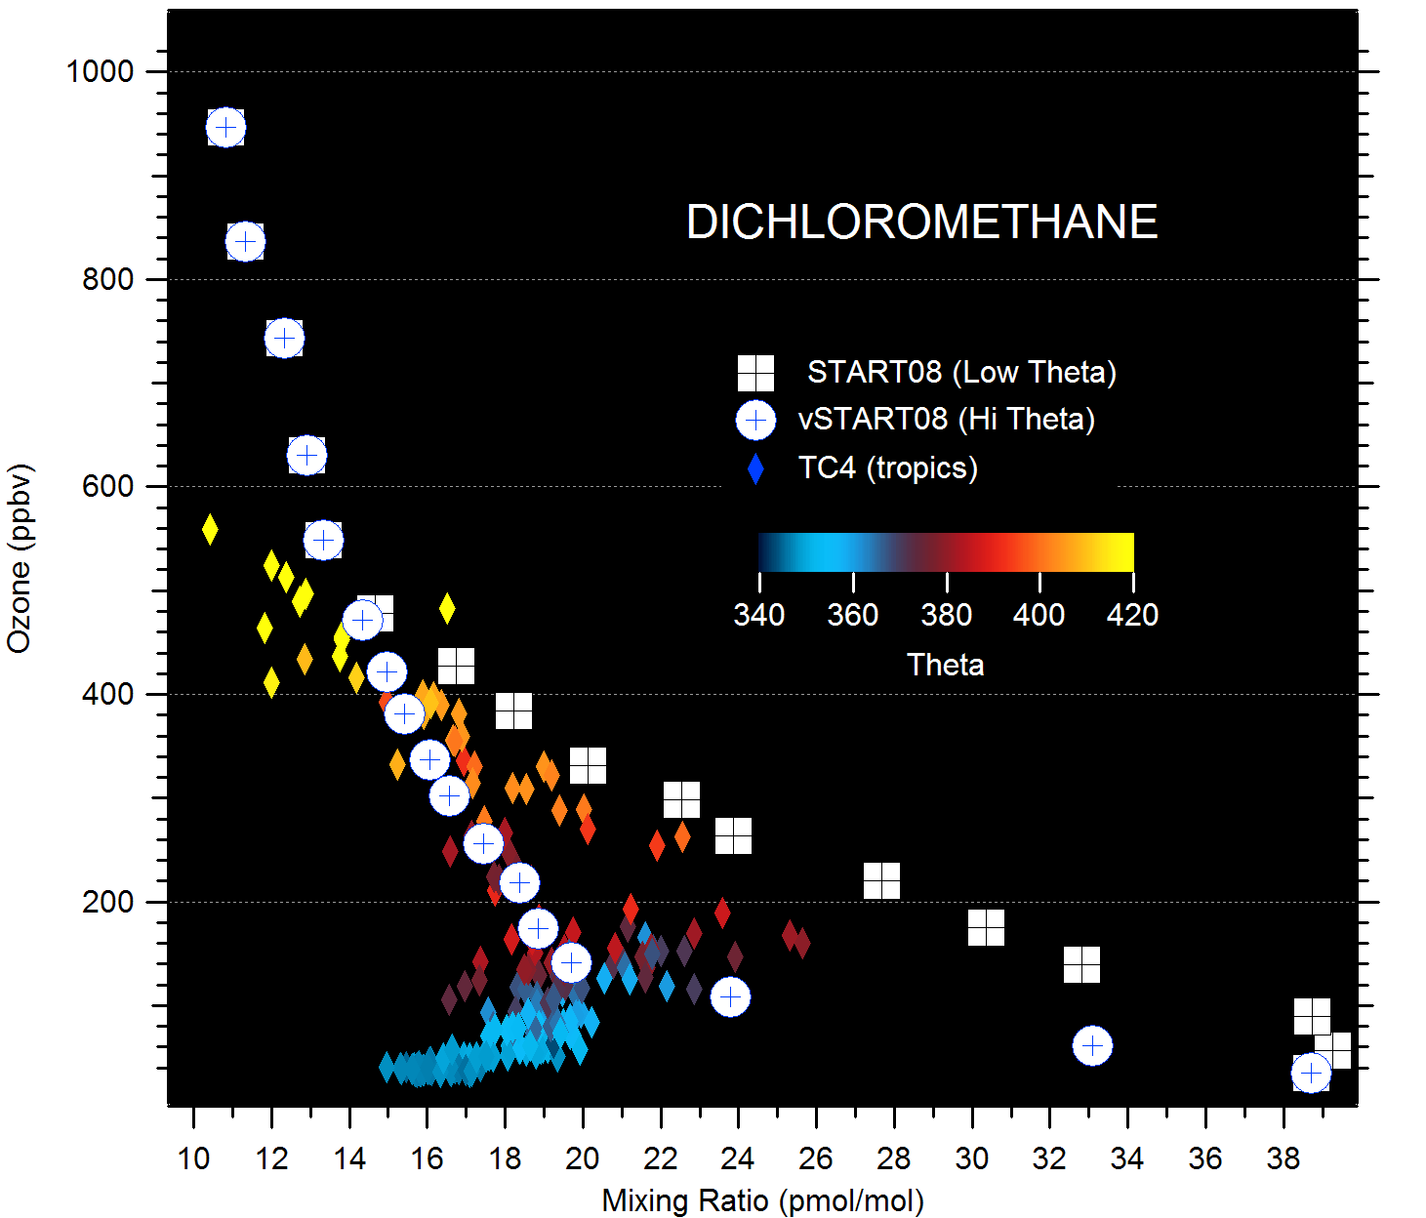
CH2Cl2: O3 START08 & TC4

Slide 14
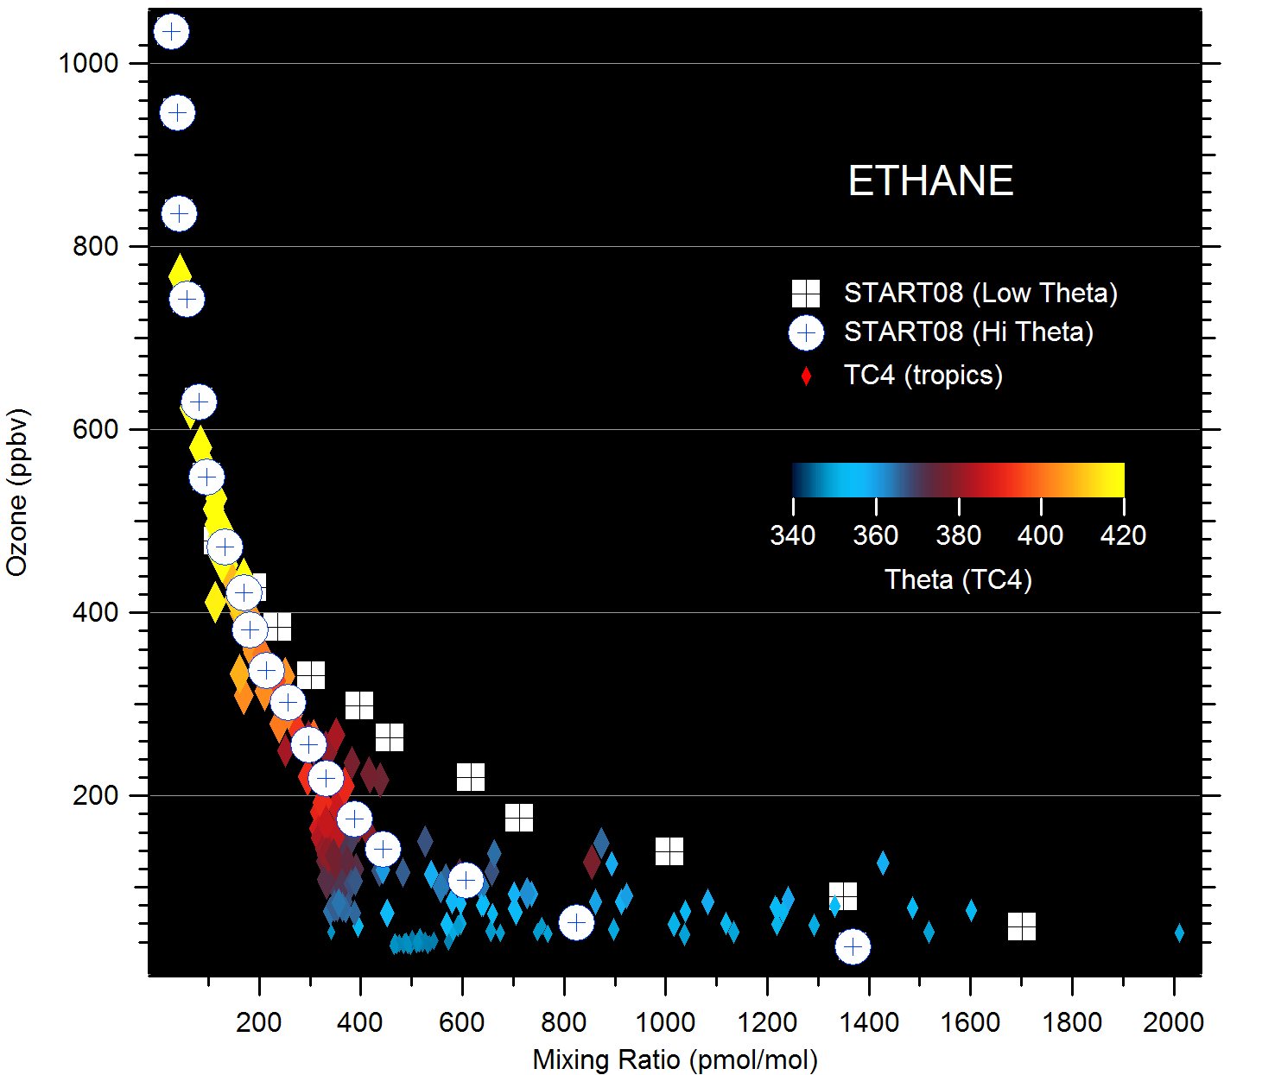
Ethane: O3 START08 & TC4

Slide 15
Case Study: RF01 tropospheric intrusion
Evaluate trace gas signature of high-theta, low ozone air mass observed at 14 km, near 50 N latitude:
Stratospheric age-of-air tracers
SF₆, CO2
Comparison to HCFC, HFC trends
Examination of shorter-lifetime, reactive gases
Comparison to potential source region

Slide 16
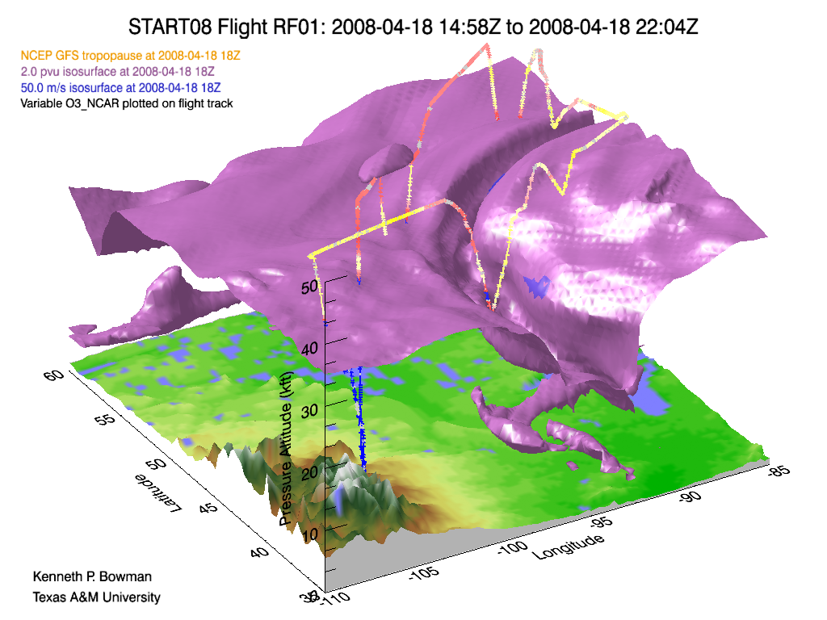
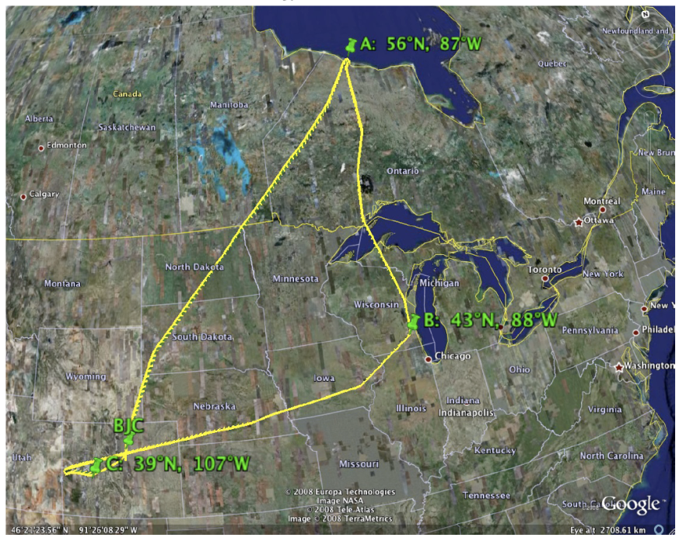

START08: RF01

Slide 17
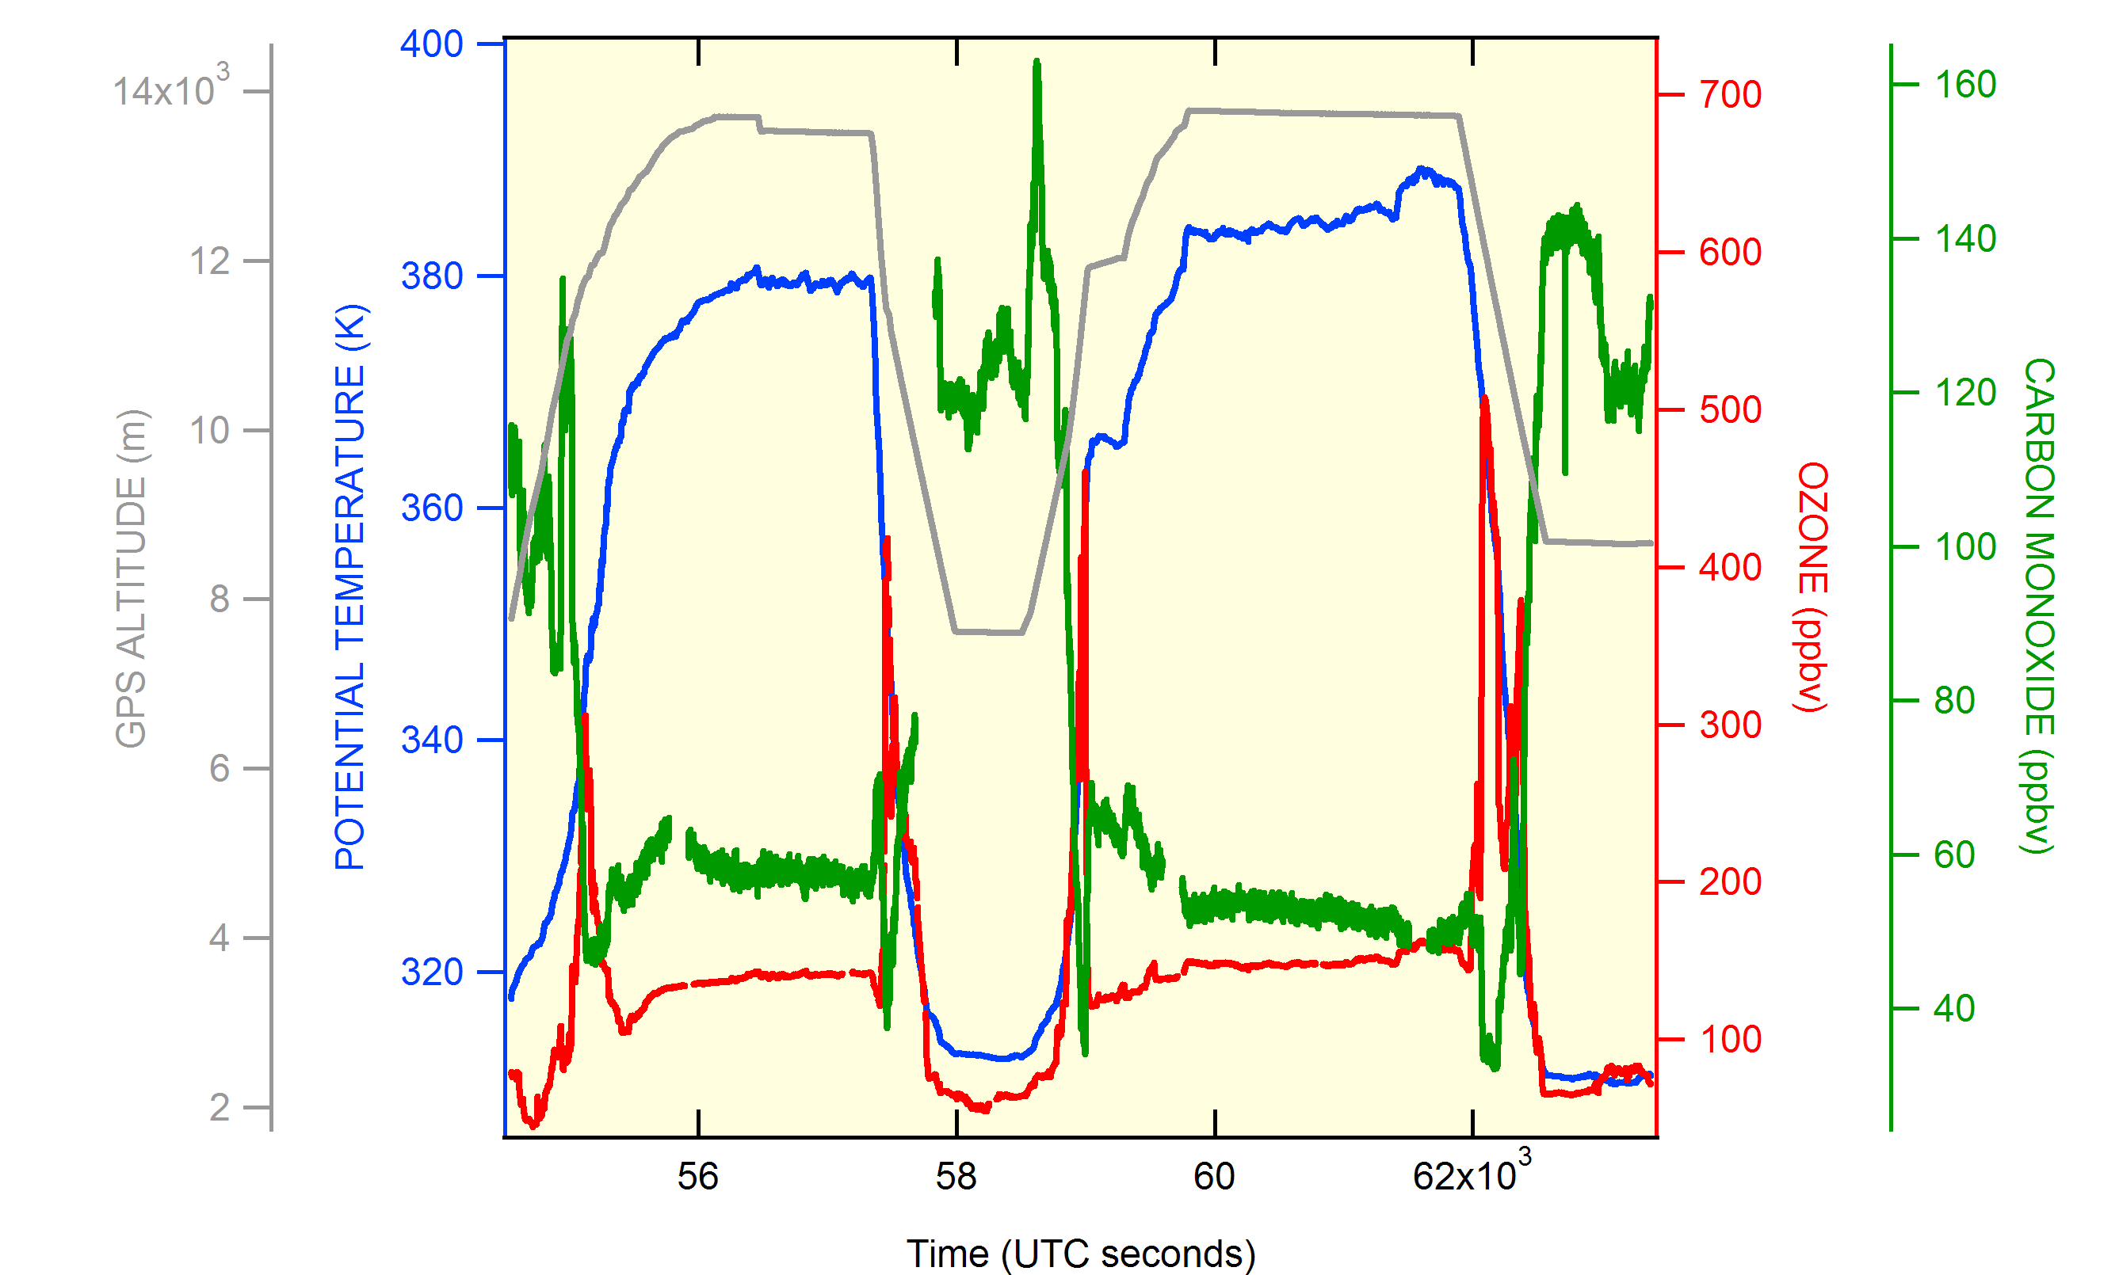
Tropospheric intrusion: RF01

Slide 18
Tropospheric tracers
Compound | Lifetime | Trend /year (global – NOAA) | Mixing ratio (std. dev) in tropospheric intrusion
Sulfur Hexafluoride | >600 yr | .3 ppt/yr (5 %) | 6.3 (.03) pptv
Carbon Dioxide | - | ~ 2 ppm/yr (0.5%) | 384.7 (.2) ppmv
HCFC 141b | 9.3 yr | 0.6 ppt/yr (3%) | 18.4 (0.1) pptv
HCFC 142b | 17.9 yr | 1.0 ppt/yr (5%) | 17.1* (0.3) pptv
HCFC 22 | 12.0 yr | 7.4 ppt/yr (4%) | 184 (1) pptv
HFC 134a | 14.0 yr | 4.3 ppt/yr (9%) | 44.2 (1.0) pptv
Ethane | ~100 day | - | 376 (23) pptv
Propane | ~ 20 day | - | 14 (5) pptv
Ethyne | ~ 35 day | - | 52 (3) pptv
n-Butane | ~ 10 day | - | 3.1 (0.4) pptv
Dibromomethane | ~120 day | - | 0.87 (0.01) pptv
Bromoform | ~ 26 day | - | 0.15 (.02) pptv
Isopropyl nitrate | ~ 8 day | - | 0.35 (.04) pptv

Slide 19
SF₆ atmospheric trend
Jan. – mid Feb.
DATA FROM NOAA ESRL

Slide 20
CO2 : Atmospheric trend
mid to late February

Slide 21
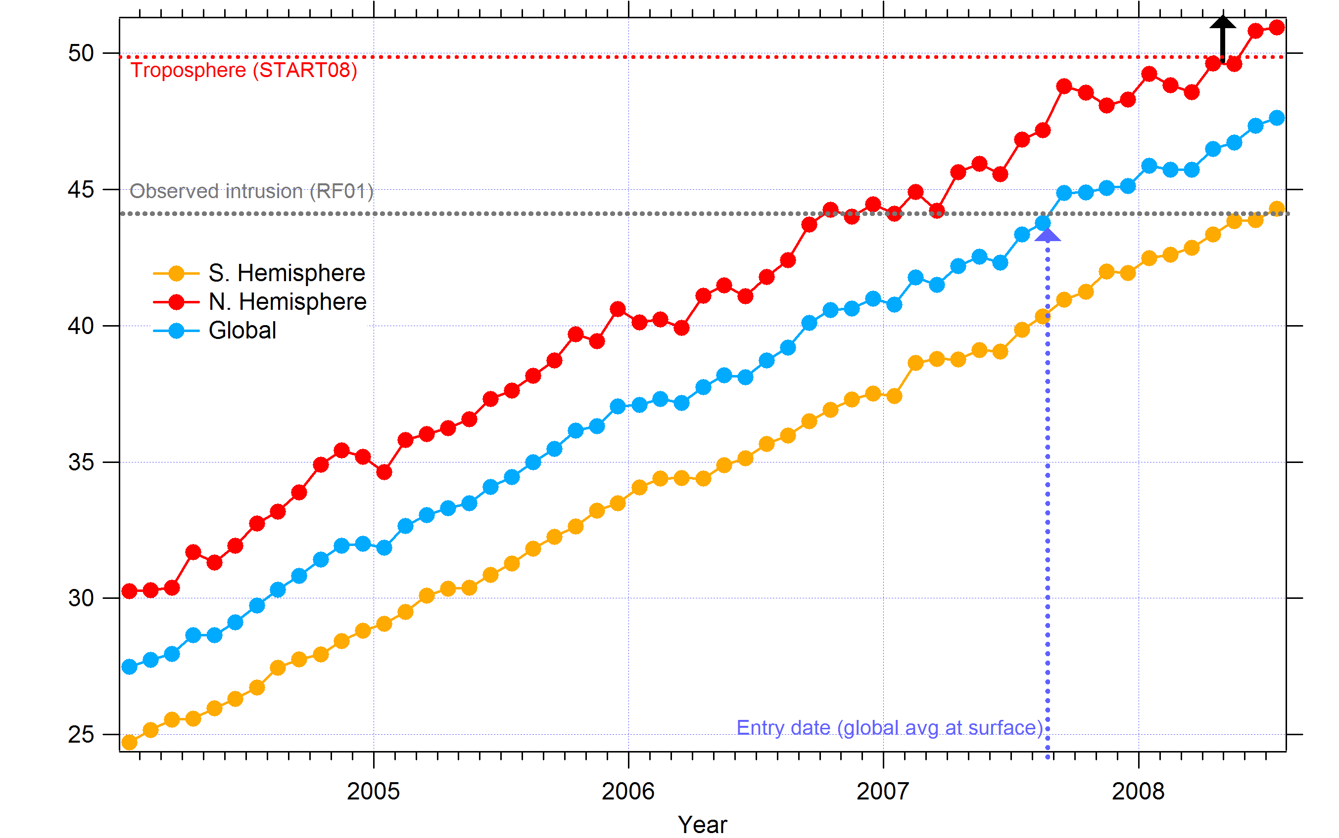
HFC-134a : Atmospheric Trend
HFC-134a (pptv)
Aug.-Sept.,2007

Slide 22
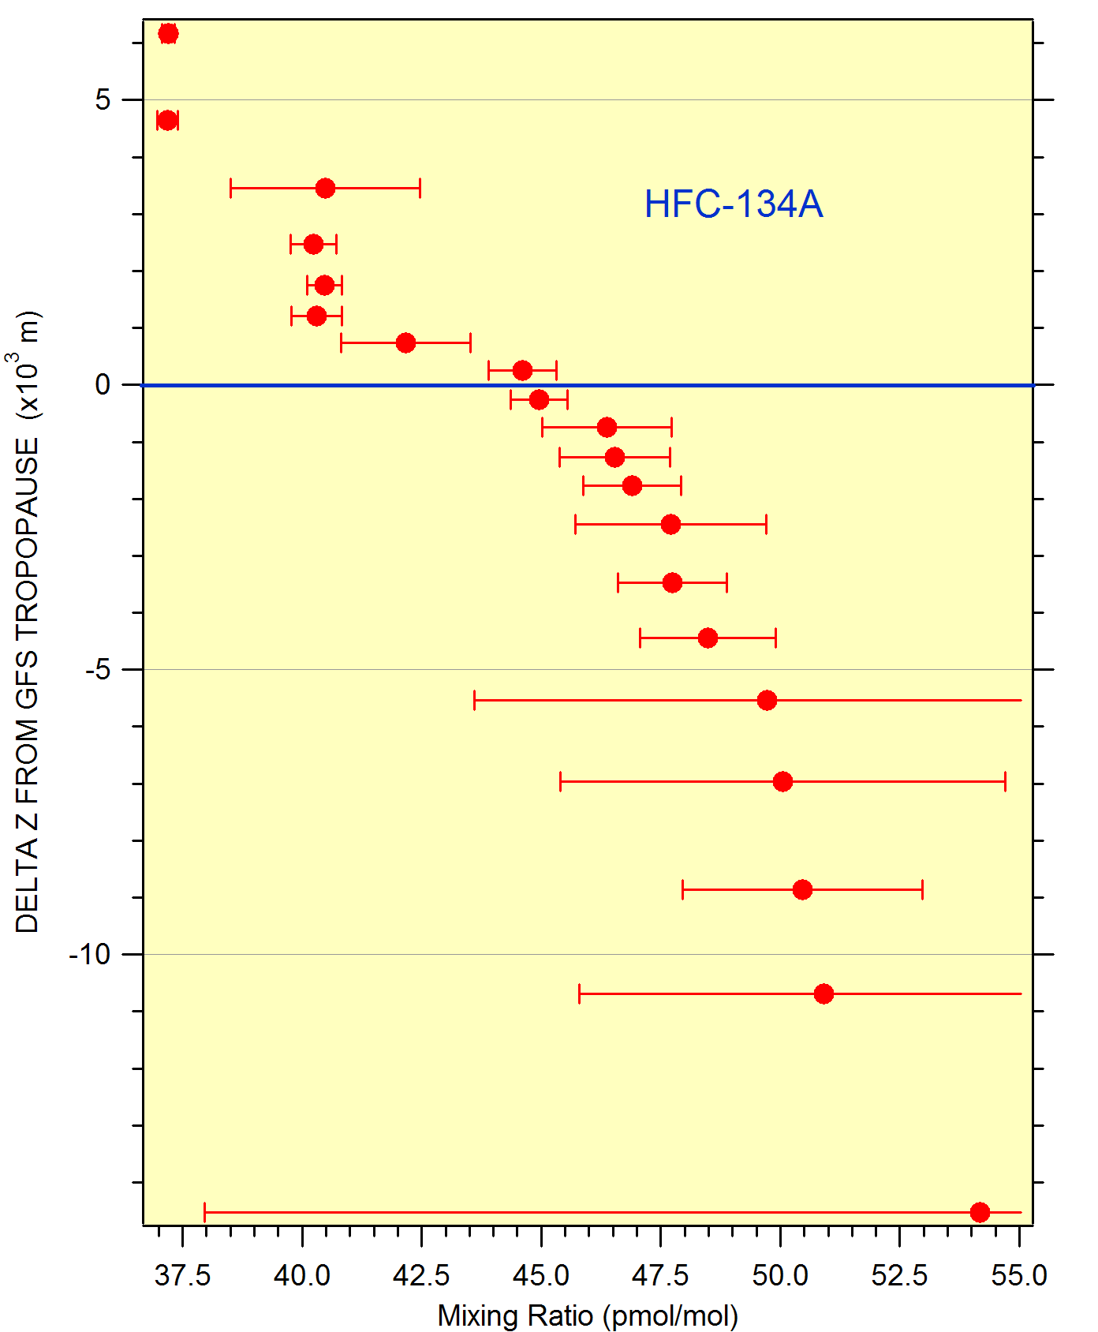
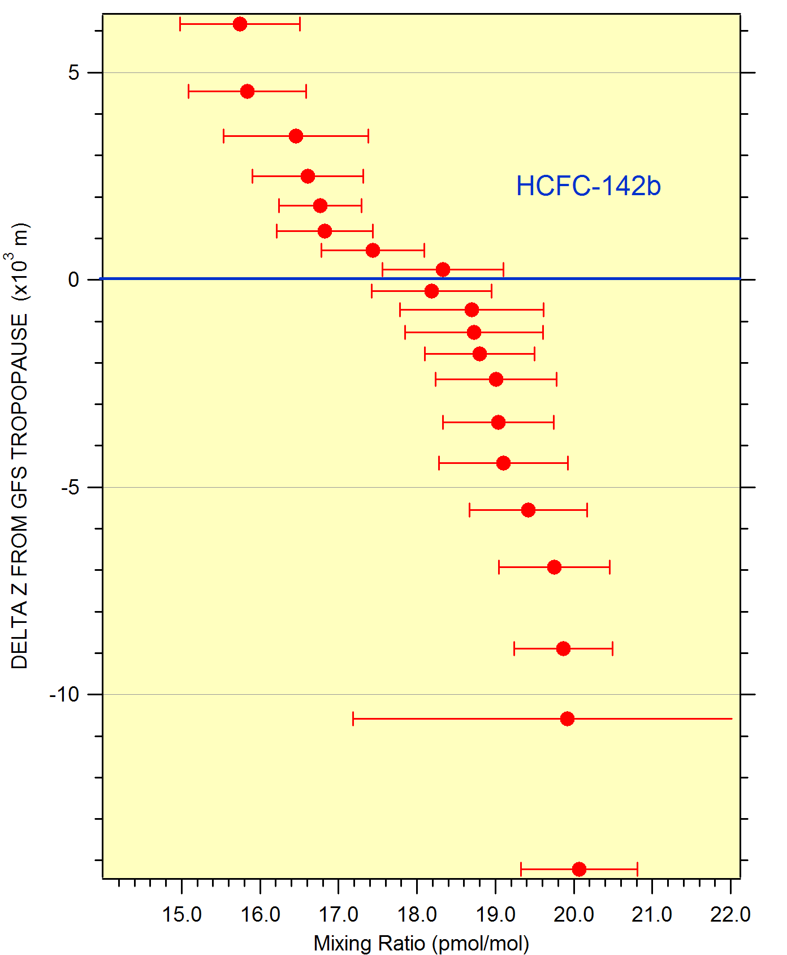
Vertical distributions: HCFC’s
90%
93%

Slide 23
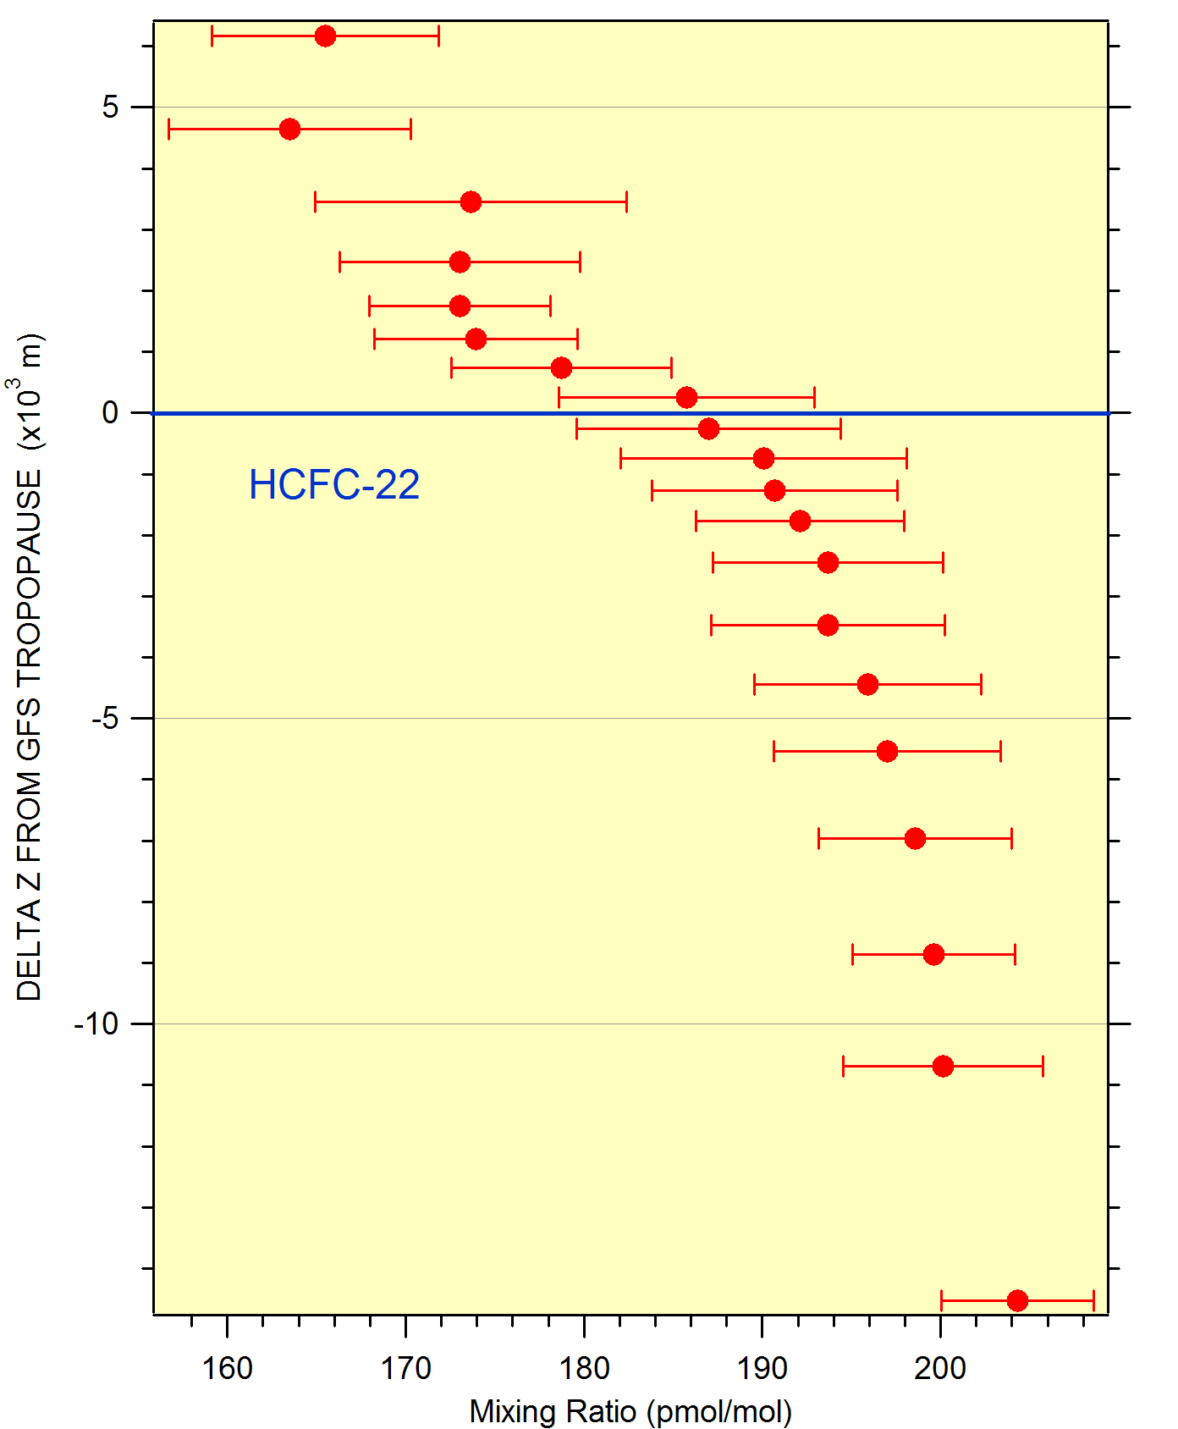
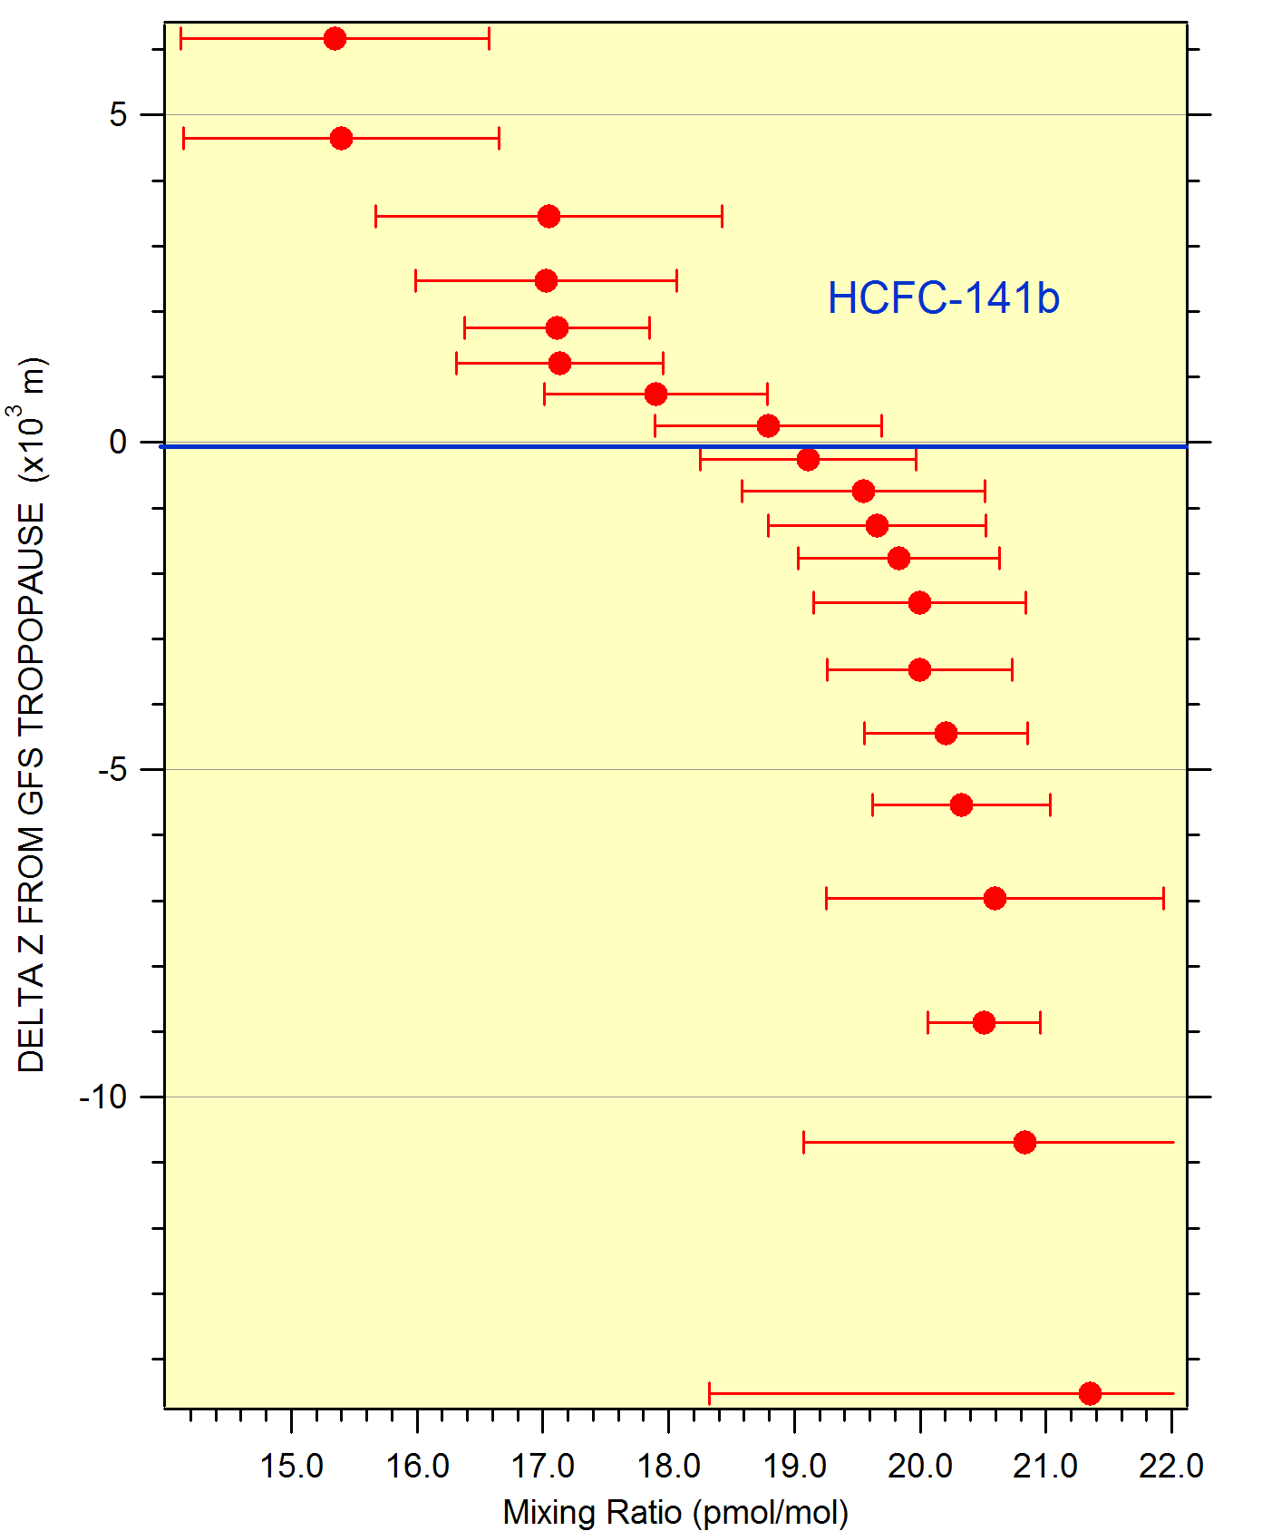
Vertical distributions: HCFC’s
93%
92%

Slide 24
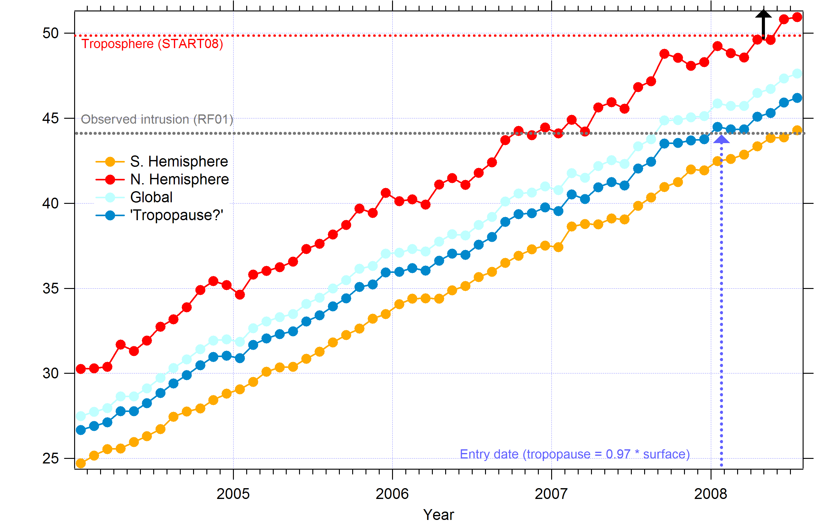
HFC-134a : Atmospheric Trend
Tropical tropopause estimate = 97% Global Surface Average
Feb. - March

Slide 25
Age of air: corrections for altitude gradient
Compound | “Age” based on Global Mean Surface | Based on trop = 95% surface | 96 % surface | 97% surface | 98% surface
HCFC 22 | August, 2007 |  |  | April – May, 2008 | Feb-March, 2008
HCFC 141b | Nov. – Dec., 2006 |  | May – June, 2008 | Feb. – April, 2008 | Oct. – Nov., 2007
HCFC 142b | June - July, 2007 | April – May, 2008 | Jan. – Feb., 2008 | Oct.– Dec., 2007
HFC 134a | Aug. – Sept., 2007 | April – May, 2008 | March – April, 2008 | Feb – March, 2008

Slide 26
Shorter lived trace gases:
Compound | RF01 Intrusion Layer | TTL (Costa Rica, January)
Ethane | 376 ± 23 | 323 ± 55
Propane | 14 ± 5 | 17 ± 16
Ethyne | 52 ± 3 | 35 ± 10
n-Butane | 3.1 ± 0.4 | 4.1 ± 6.7
Isopropyl nitrate | 0.35 ± .04 | .08 ± .25
Dibromomethane | 0.87 ± .01 | 0.57 ± .20
Bromoform | 0.15 ± .02 | 0.10 ± 0.15
Carbon Monoxide | 51 ± 2 | 53 ± 5
Ozone | 158 ± 13 | 86 ± 22

Slide 27
Ozone:θ correlation
RF01, RF08, RF14, RF17

Slide 28
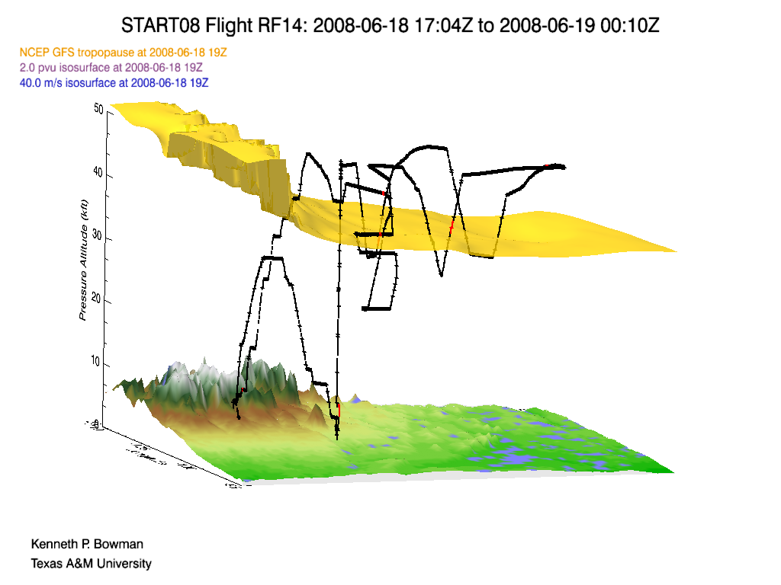
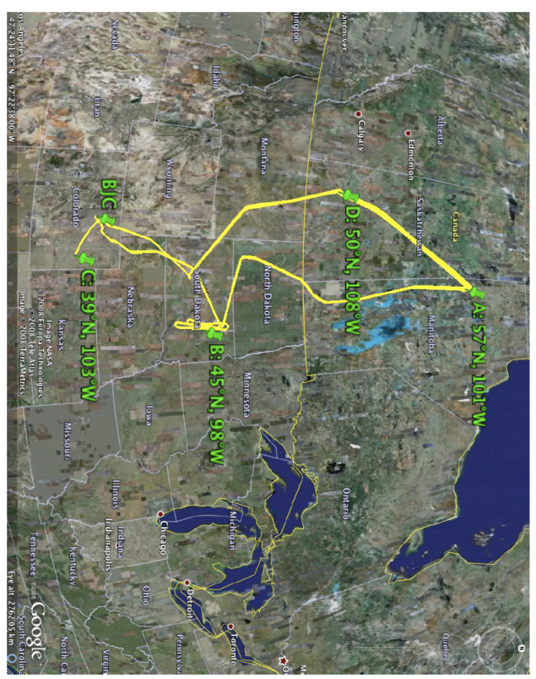
START08: RF14

Slide 29
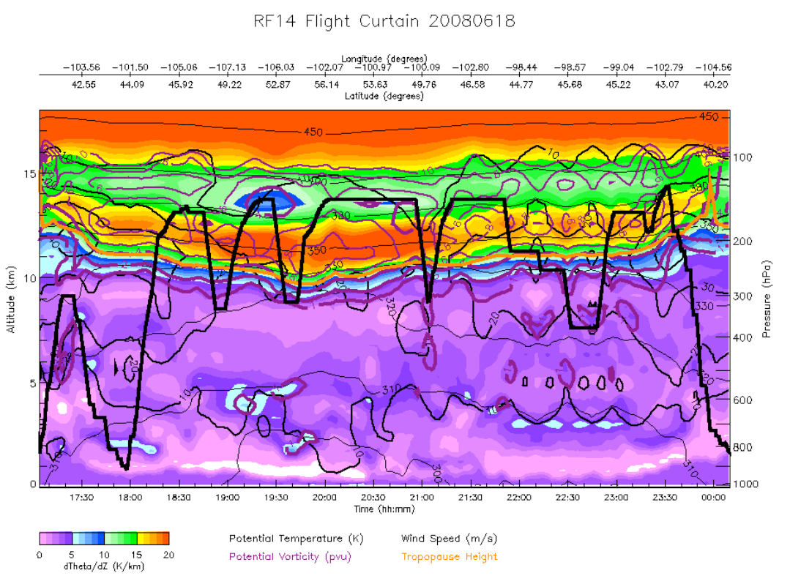
RF14: Flight curtain (dѲ/dz)

Slide 30
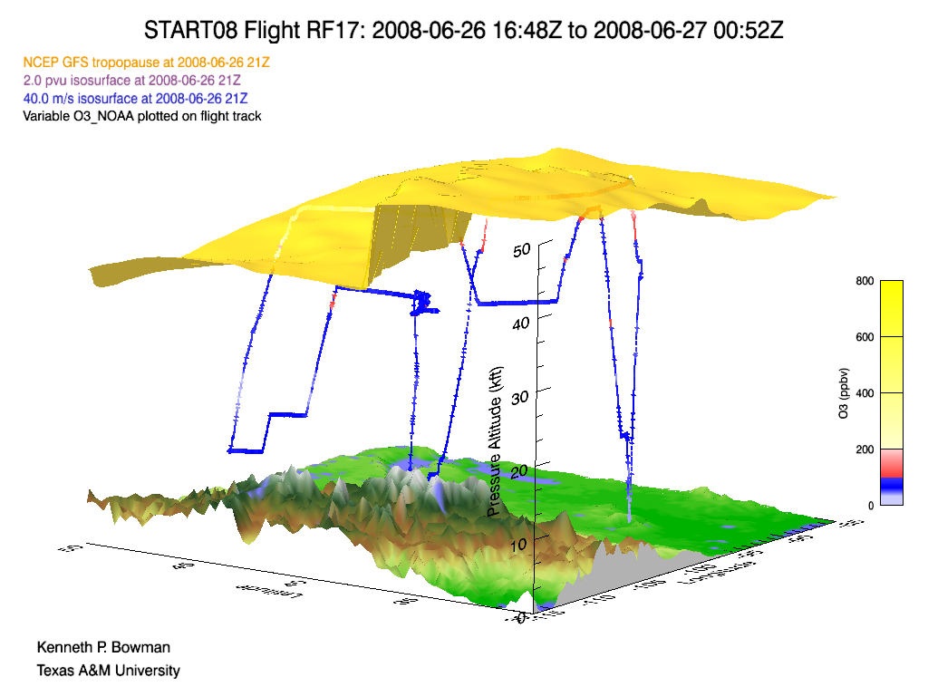
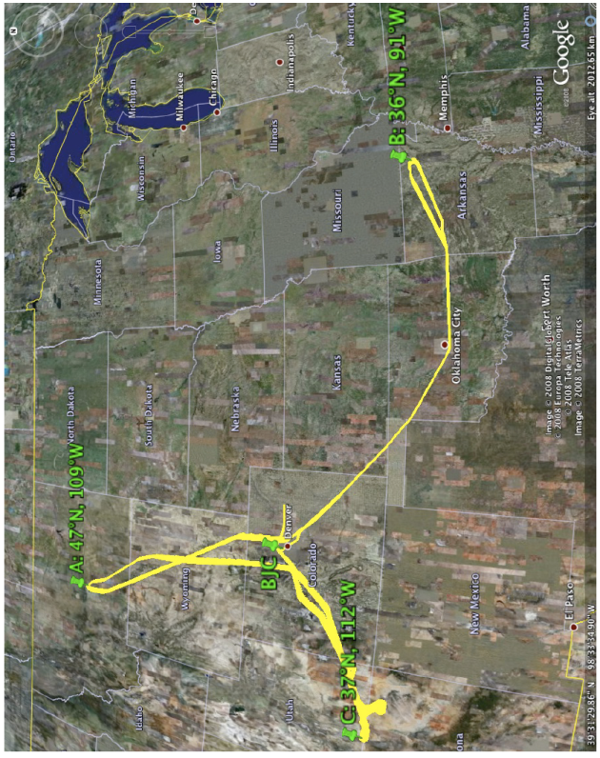
START08: RF17

Slide 31
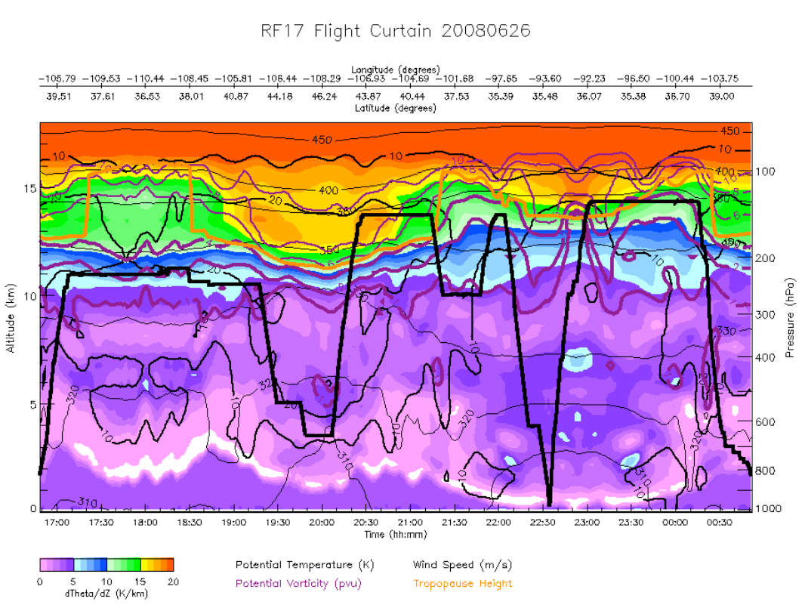
RF17: Flight curtain (dѲ/dz)

Slide 32
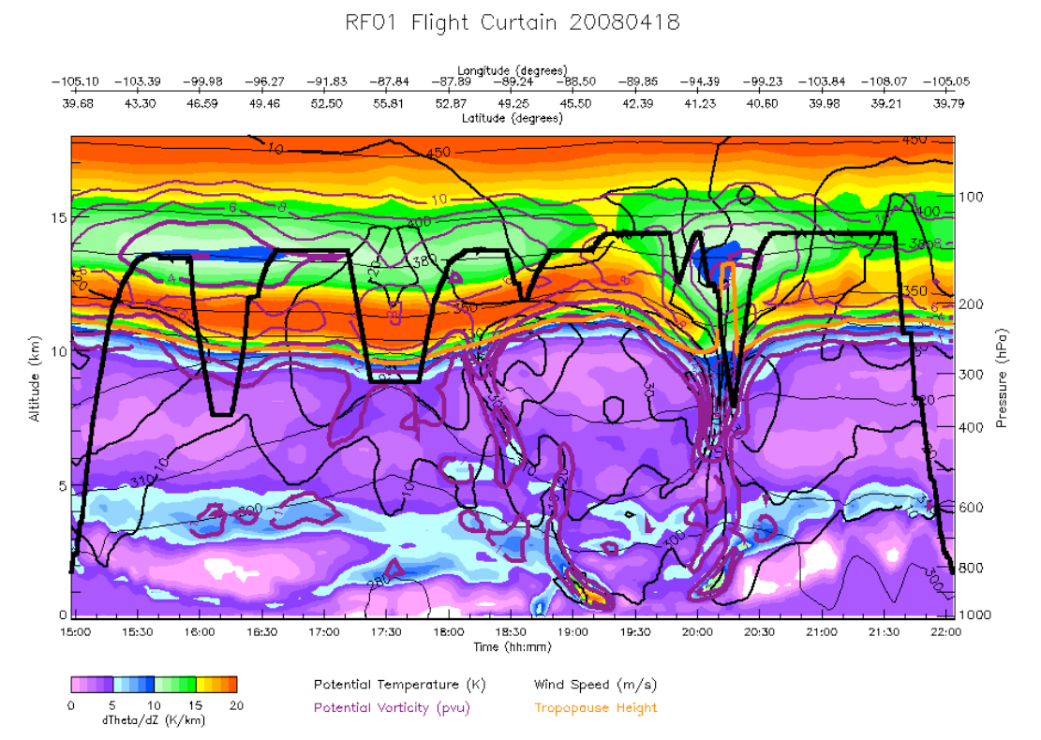
RF01: Flight curtain (dѲ/dz)

Slide 33
Shorter lived trace gases:
Compound | RF01 Intrusion Layer | RF14 Intrusion Layer | RF17 UT/near tropopause | TTL (Costa Rica, January)
Ethane | 376 ± 23 | 374 ± 15 | 375 ± 37 | 323 ± 55
Propane | 14 ± 5 | 16 ± 2 | 19 ± 9 | 17 ± 16
Ethyne | 52 ± 3 | 37 ± 3 | 42 ± 6 | 35 ± 10
n-Butane | 3.1 ± 0.4 | 3.0 ± 0.8 | 2.8 ± 2.7 | 4.1 ± 6.7
Isopropyl nitrate | 0.35 ± .04 | 0.20 ± .08 | 0.37 ± .12 | .08 ± .25
Dibromomethane | 0.87 ± .01 | 0.75 ± .02 | 0.74 ± .06 | 0.57 ± .20
Bromoform | 0.15 ± .02 | 0.10 ± .02 | 0.16 ± .09 | 0.10 ± 0.15
Carbon Monoxide | 51 ± 2 | 47 ± 1 | 51 ± 4 | 53 ± 5
Carbon Dioxide | 384.7 ± 0.2 | 386.1 ± 0.2 | 386.6 ± 0.8
Ozone | 158 ± 13 | 162 ± 15 | 200 ± 44 | 86 ± 22

Slide 34
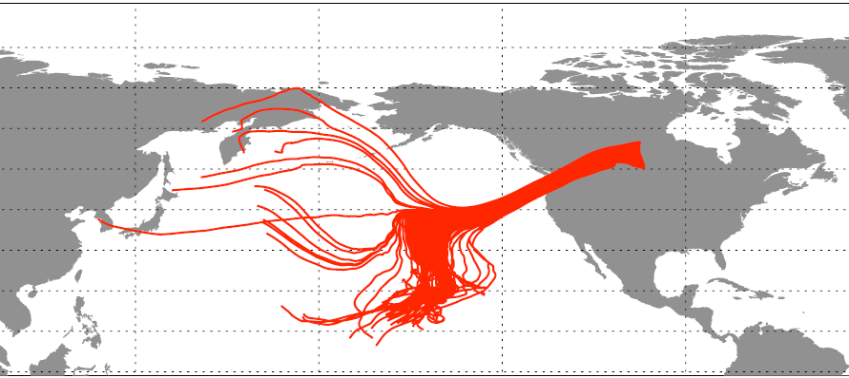
Air mass back trajectories: RF14 (19:37 – 20:57 Z & >13 km)

Slide 35
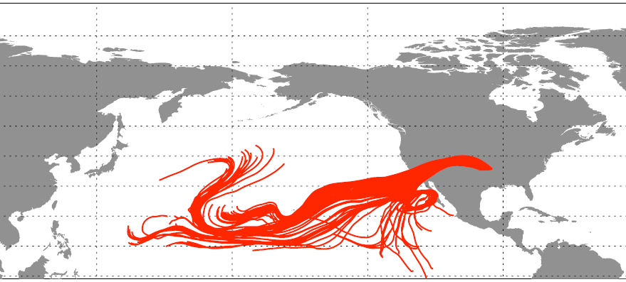
Air mass back trajectories: RF17 (23:10 – 00:13 Z)

Slide 36
Summary
Comprehensive suite of trace gases with range of source region/reactivity were measured during START08.
Case study of tropospheric intrusion:
Different trace gases consistent with meteorological analysis of source/timing.
“Age of air” in intrusion about 2 – 3 months
Short-lived tracers (days to months) present at levels similar to TTL and UT (tropical origin).

Slide 37
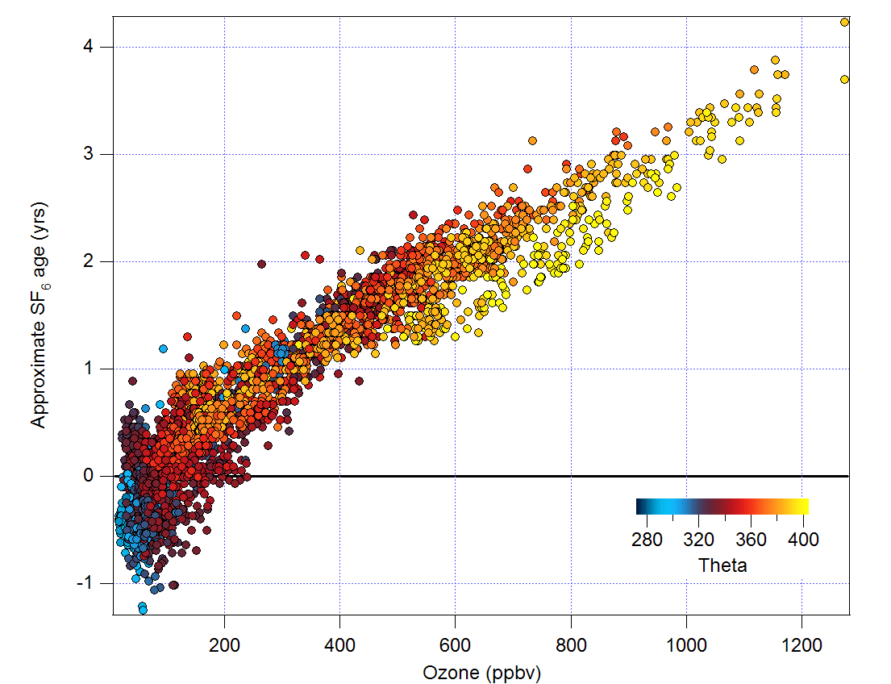
Ozone: age correlation from SF₆

Slide 38
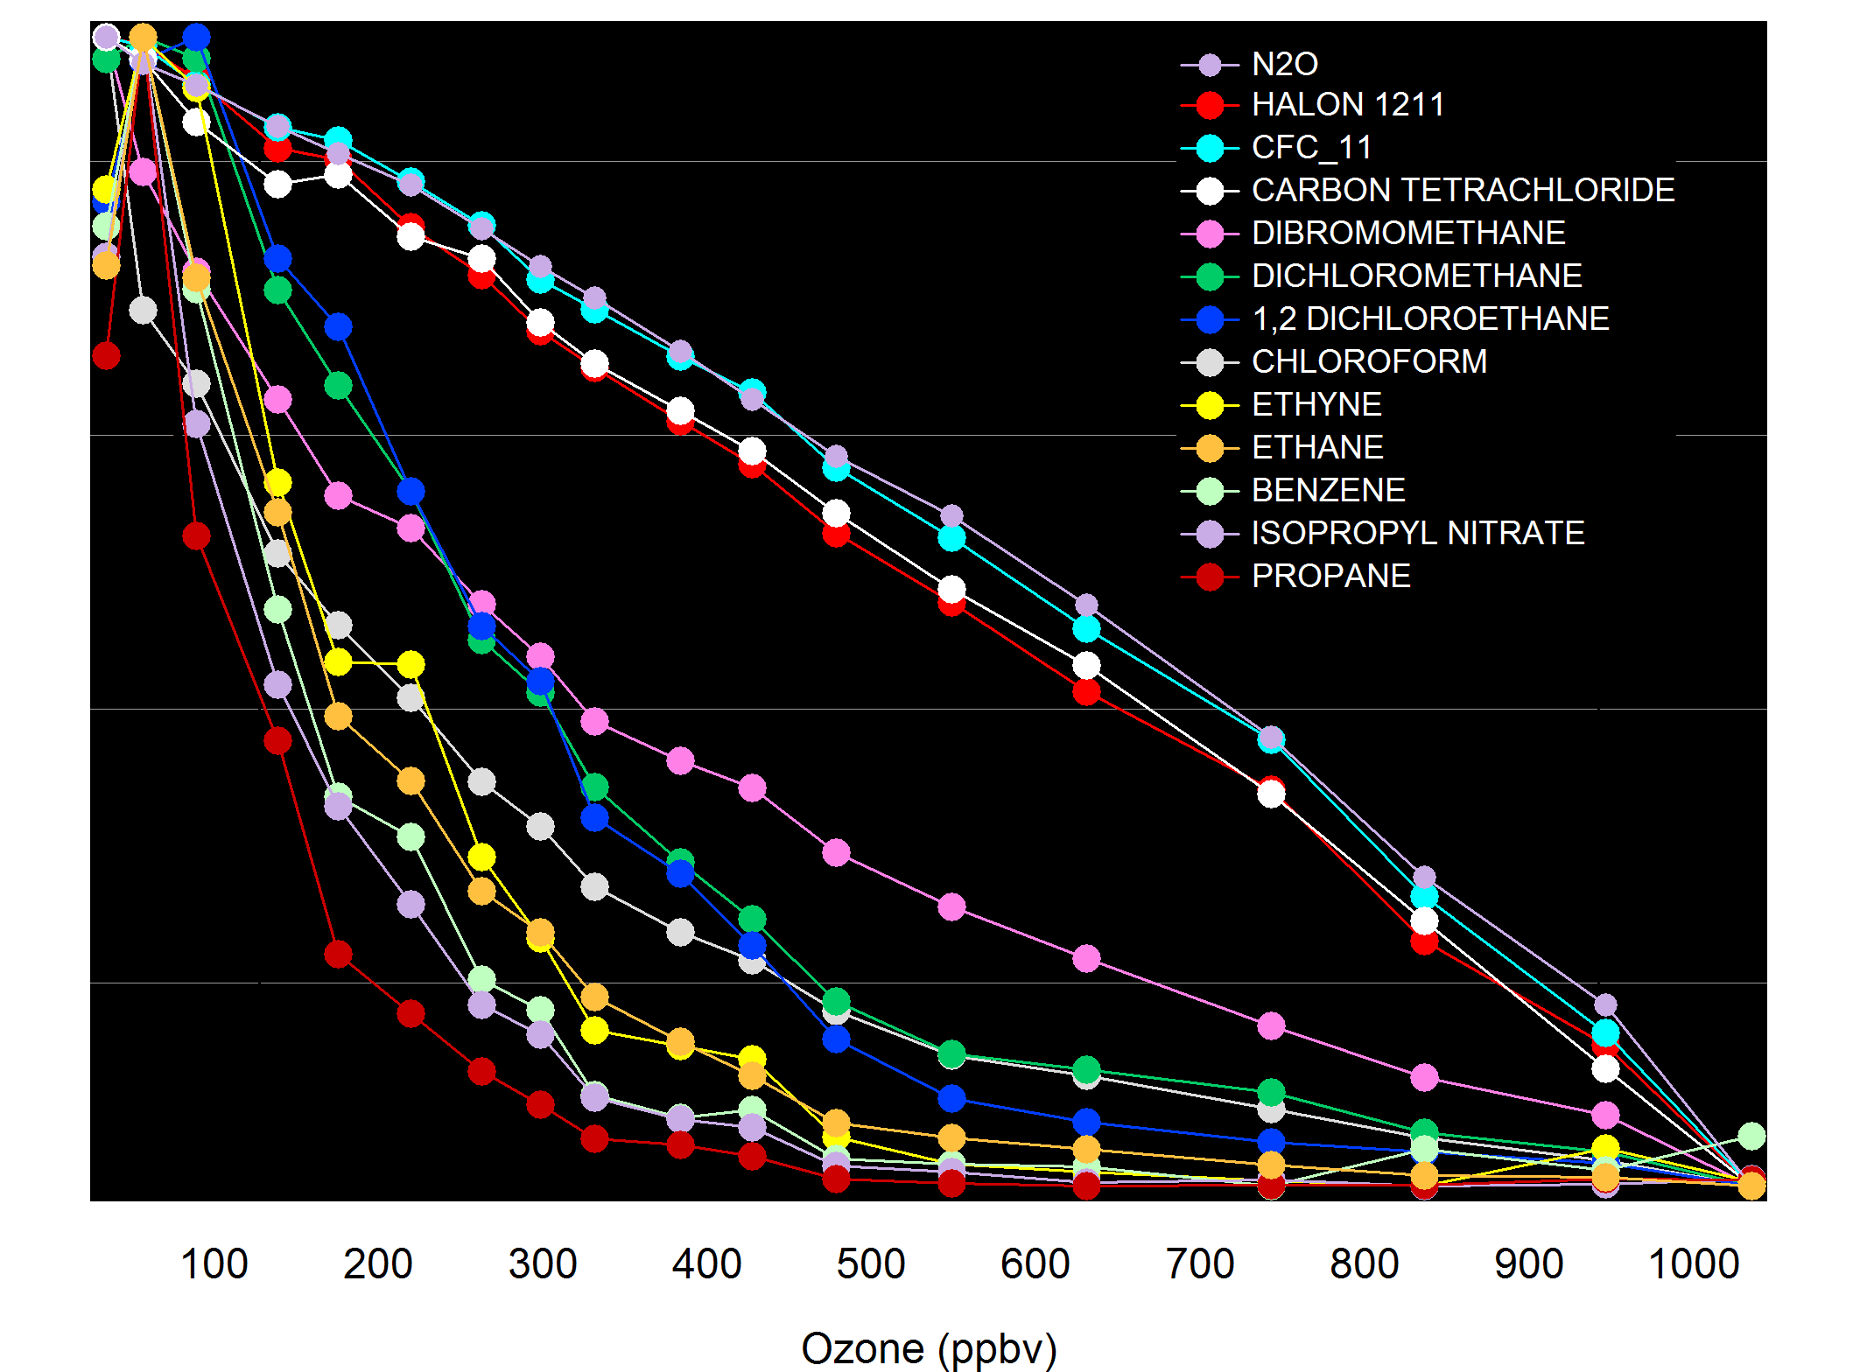
Tracer : O3 correlations Low theta
Troposphere
(max)
Stratosphere
(min)

Slide 39
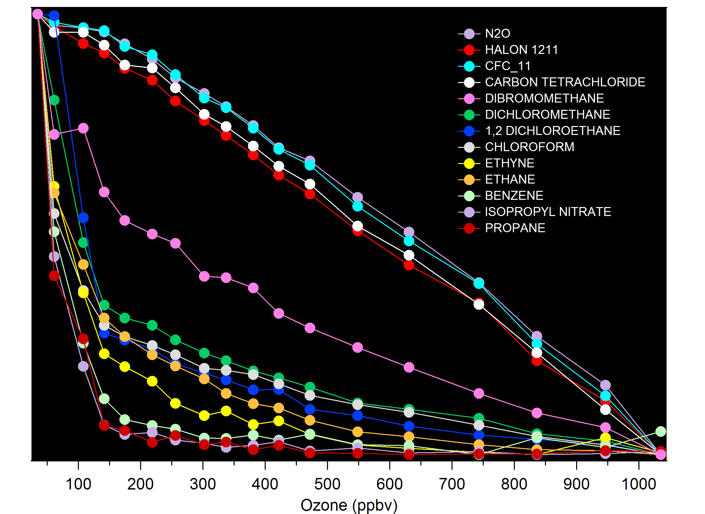
Tracer : O3 correlations High theta
Troposphere
(max)
Stratosphere
(min)

