Slide 1
Transport timescales and source regions of UTLS air from START08
E. Ray, F. Moore and K. Rosenlof
NOAA/ESRL and CU/CIRES
Thanks to UCATS and PANTHER instrument teams, L. Pan, K. Bowman, G. Dutton, J. Pittman
Notes:
I’ve taken HIPPO out of the title because I didn’t have time to get to it unfortunately.

Slide 2
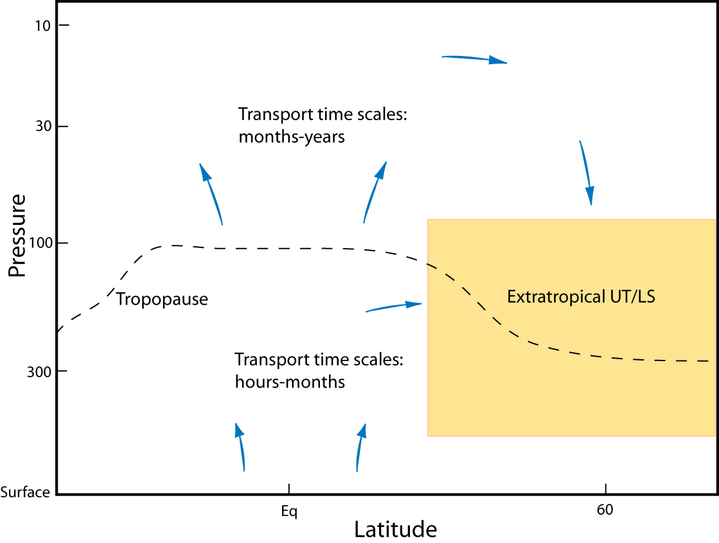
Introduction
UT/LS region is a complex mixture of air transported over many different time scales and from different regions.
“High paths”
Goal of this work:
Use in situ trace gas measurements from START08 and surface stations to determine transport time scales and source regions of air in the extratropical UT/LS.
“Low paths”
START08 flights
NOAA GMD surface measurements
Notes:
General transport features of the UTLS are known but the details are still uncertain, mostly because of a lack of measurements in the region. START08 is arguably the best UTLS in situ data set from a single campaign to date.

Slide 3
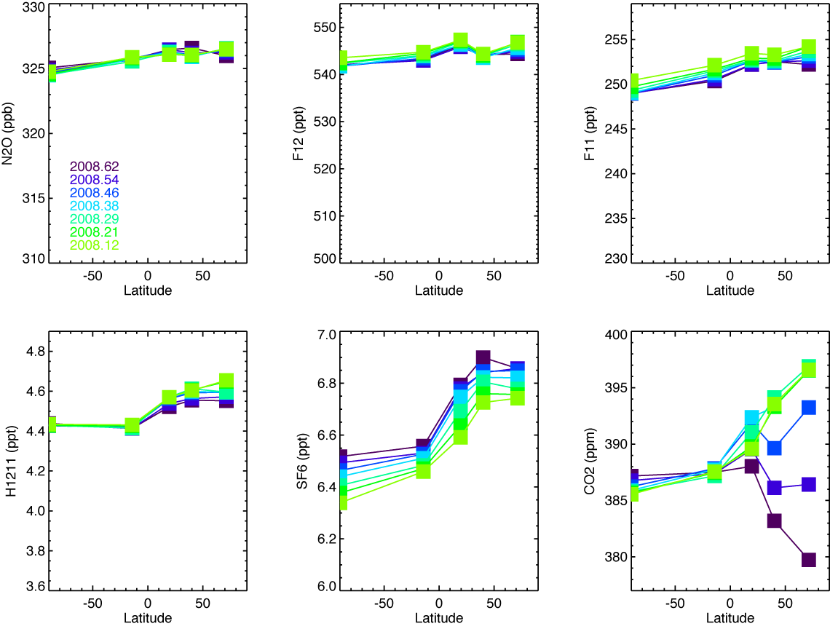
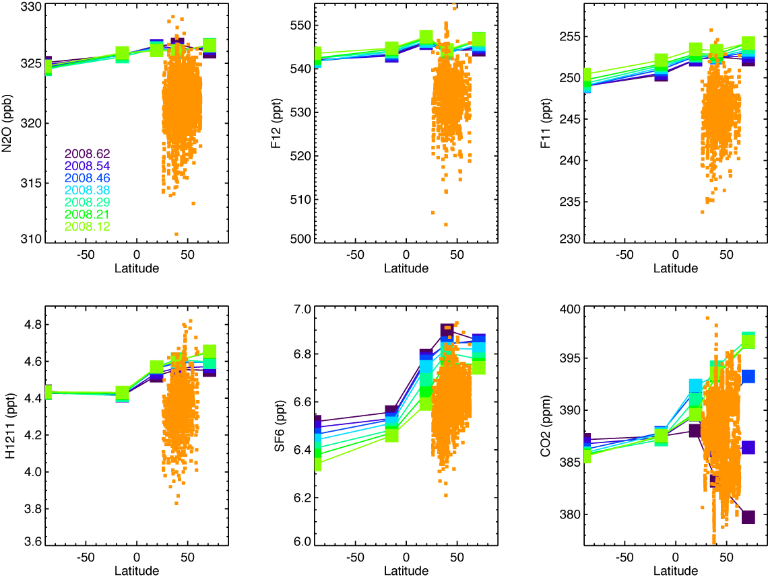
In Situ Surface Observations
N₂O
F12
F11
START08 trop data
“Age” tracers –
can determine transport time scales and surface latitude origins, once “high path” part has been removed.
Photolytic tracers –
sensitive to where the air has been - “high path” tracers
h1211
SF₆
CO₂
Notes:
The difference between START08 trop values and surface values for the photolytic species tells you where the air has been in the strat. The difference for the age tracers tells you how long the air has taken to reach the UTLS from the surface and latitudinal origin. We can use the photolytic differences to remove the part of the age tracer difference due to stratospheric transport so we can determine UTLS transport.

Slide 4
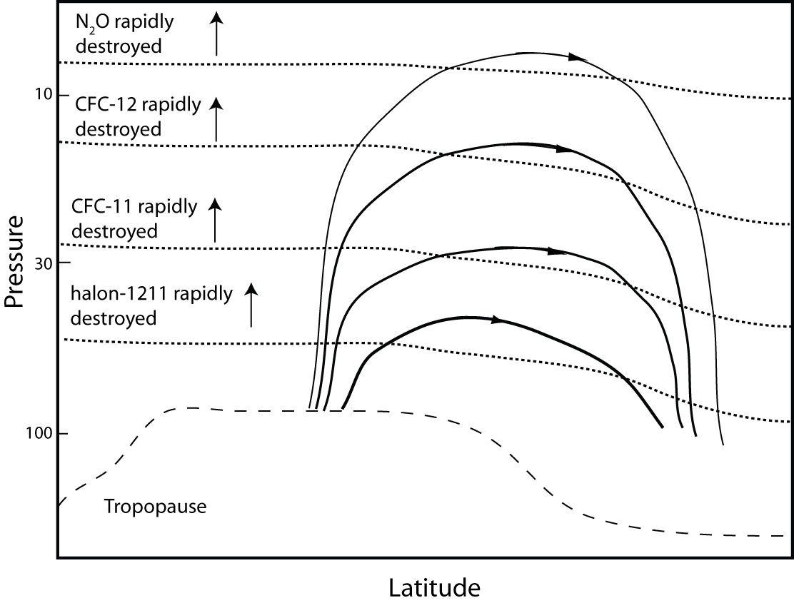
Photolytic Tracers and the Stratospheric Circulation
Near complete loss
Local Transport Time (≈ months)
Negligible loss
The photolytic tracers are sensitive to changes in the maximum path height of an air parcel and each tracer is sensitive to a different height.

Slide 5
Stratospheric Fractions From Photolytic Tracer Correlations
Any decrease in a photolytic tracer is due to mixing from above the cutoff level, where the mixing ratio is zero, with surface values.
Cutoff level
Define the fraction of air from above F11 cutoff level by:
START08 LS
START08 UT
NOAA Surface

Slide 6
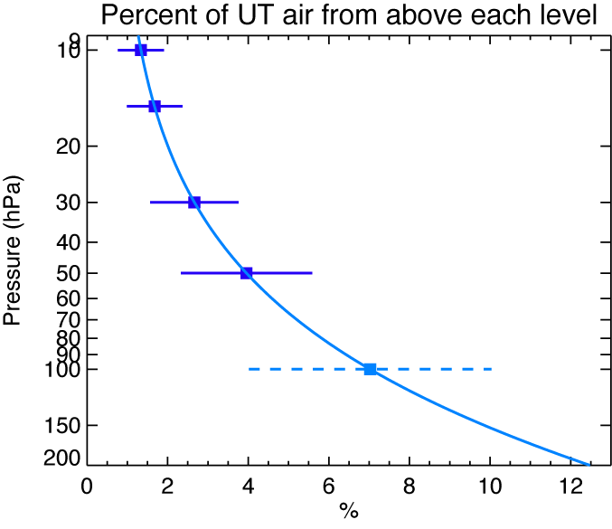
Stratospheric Fraction Profiles
N₂O cutoff
F12 cutoff
F11 cutoff
H1211 cutoff
Extratropical UT air contains a mixture of 4-10% air from above 100 hPa and 0.5-2% from above 10 hPa.

Slide 7
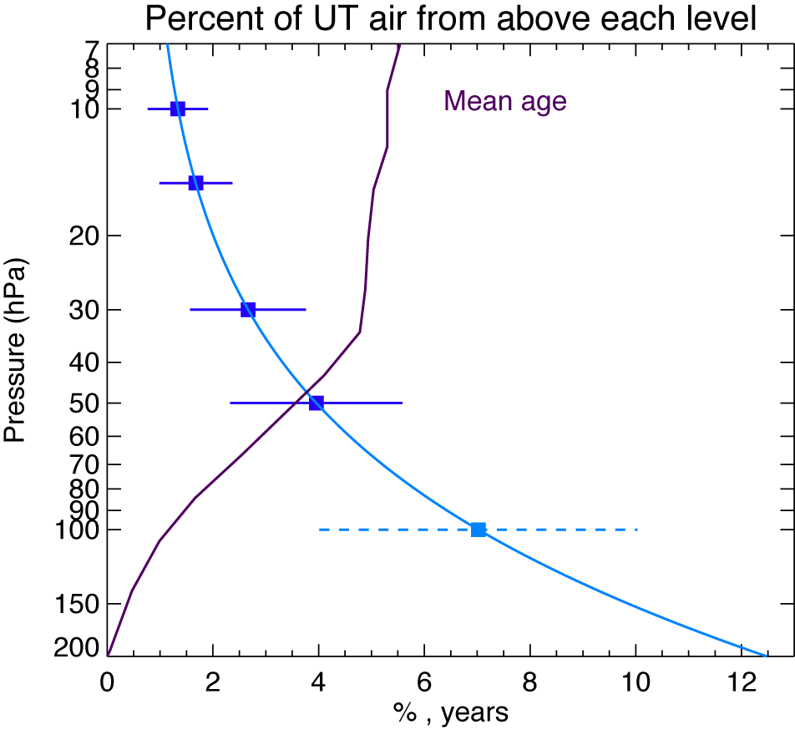
Removing “High Path” Part of UTLS Age Tracers
(Engel et al., 2009)
where
i = cutoff level in pressure
χ_{Γ(i)} = mixing ratio of tracer with mean age Γ(i).
F(i) = fraction of air from above level i
From χ_{UTLS} we can compute transport times and surface latitude origins for the part of the air in the UTLS that did not go above 100 hPa.

Slide 8
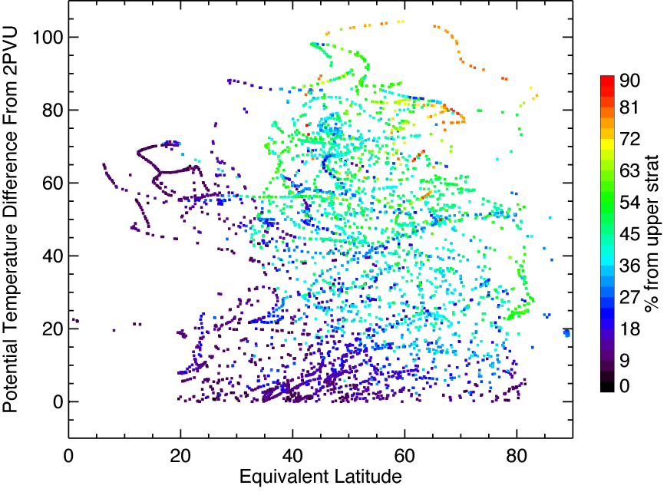
“Low Path” Transport Time From Surface to LMS
Low upper strat fractions from trop intrusions have transport times at least several months shorter than average at this level – “shortcut” to LMS.
8
4
Approximate Altitude Diff (km)
Region with a minimum of low transport times coincident with the level of the jet core.
Shortest transport times in ExTL.
0
The transport time is calculated from the time difference between the flight date and the date where χ_{surface}(lat=0) = χ_{UTLS}. Average values up to 70 K are consistent with Boenisch et al, 2009. Values are cutoff at a minimum of 1 month by adjusting the surface latitude origin.

Slide 9
Surface Latitude Origins of Transport Times < 1 Month
More NH surface influence on ExTL – consistent with more local troposphere mixing into ExTL.

Slide 10
Surface Latitude Origins of Tropospheric Part of UT Air
Primarily subtropical influence from the surface on the extratropical UT.
Surface latitude origin distribution closely matches the Elat distribution.
Method loses sensitivity north of 40N due to lack of SF₆ surface gradient.

Slide 11
Conclusions
START08 dataset is unique and valuable for studying the origins of air transported into the extratropical UTLS.
The combination of photolytic and age tracers allows a detailed description of the composition of UTLS air including pathways, time scales and surface latitudinal origins.
Profiles of stratospheric fractions in UTLS could be a useful diagnostic for model transport evaluation.
More to come by including CO₂ and other tracers and especially the HIPPO dataset.

