Slide 1
On the Use of Equivalent Latitude (& q) in UTLS Studies
Laura Pan
With contributions from:
Bill Hall, Simone Tilmes, Doug Kinnison (NCAR)
Dalon Stone, Cameron Homeyer, Ken Bowman (TAMU)

Slide 2
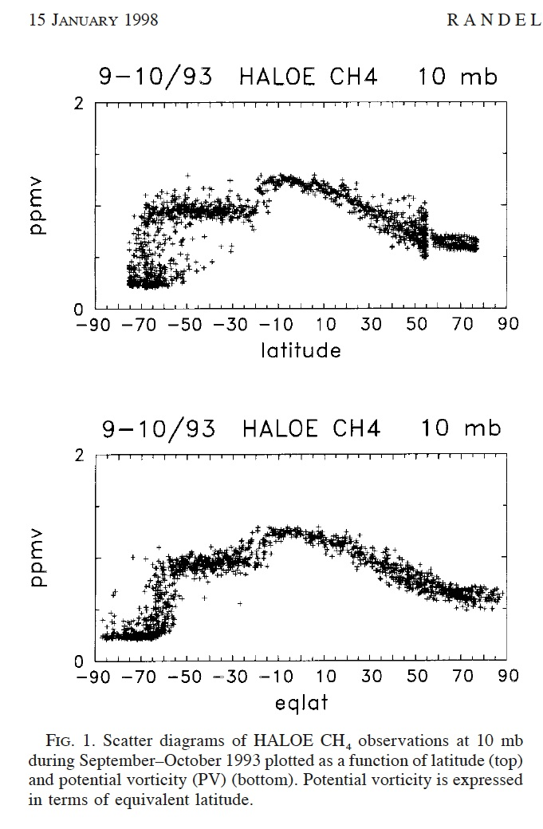
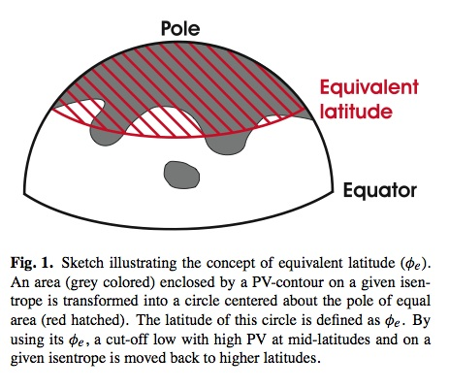
What is the (PV based) equivalent latitude?
Schematic from Hegglin et al., 2006

Slide 3
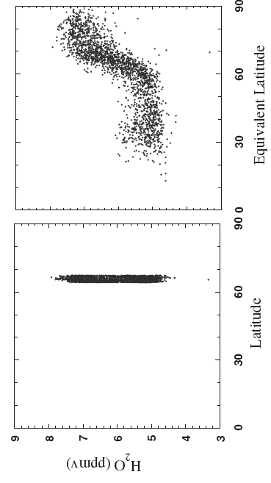
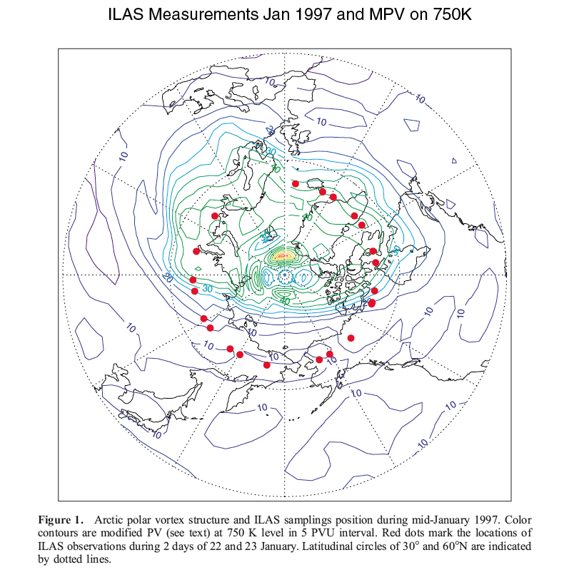
EqL in polar stratospheric studies:
An example from (Pan et al., 2002), ILAS water vapor data analysis
contrast of water vapor outside and inside of polar vortex is revealed when EqL is used.

Slide 4
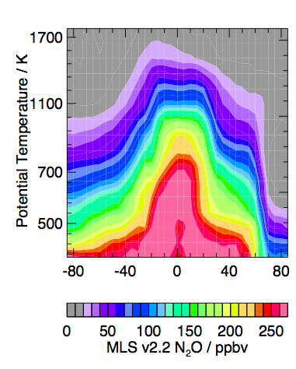
Typical stratospheric tracer EqL-q zonal mean (Gloria Manney, 2007)
MLS,
10-16 March 2005

Slide 5
General Questions
How similar are the tropopause and the polar vortex edge?
To what extent is the EqL a useful tracer or a coordinate variable in the UTLS region?
What are the limitations of using the EqL to perform zonal averages or for integrating models and observations, or to compile trace gas climatologies in this region?

Slide 6
Approaches:
Evaluate q as vertical coordinates in the UTLS region
Examine the behavior of Eql as a 3D variable (for 0-20 km or 250-450 K, common range of research aircraft)
Compare the morphology of the chemical tracers (ozone and CO) and Eql on selected q surfaces
Examine the tracer compactness in Lat/Eql on selected q surfaces
Data used:
NCEP/GFS 1x1 degree data
WACCM run nudged with GOES5 (1.9x2.5 degree)

Slide 7
Behaviors of the isentropes in the UTLS
Stratosphere: > 15 K/km, Troposphere: < 5 K/km
Theta Lapse Rate, 060215, Lon = 240, GFS/FNL
∆q = 20 K ~ 1 km strat. ~ 4 km trop.

Slide 8
EqL as a 3D variable in the UTLS

Slide 15
Conclusions
Unlike the polar vortex edge, the tropopause is a boundary of the two regions, in one of them (troposphere) PV non-conservative processes are often significant
Theta as vertical coordinates emphasize the stratosphere, do not provide good representation of tropospheric structures
Eql as coordinates for integrating trace gas measurements provide a good air mass identification in near the tropopause, but do not work well in the tropics and polar region
Eql/q coordinates do not work well in general for the tropospheric air mass

