Slide 1
III. Challenges
Deriving integrative results of ExUTLS chemical observations
Diagnosing the key processes that maintain and control the chemical structure
Reconciling physical models and definitions of the extratropical tropopause

Slide 2
Challenges (1): Deriving integrative results of ExUTLS chemical observations
How/what do we use the aircraft observations to quantify?
Fine structure? STE? Transport barriers and pathways?
What are the “right” quantities to be used as effective metrics for evaluations and constraints of CCMs?
“flux” “budget” and “age spectra”, tracer correlations
What are the effective coordinates for integrating UTLS observations?
Eql-q, Trop rel Alt., wind speed/jet

Slide 3
The use of tracer correlations
Hintsa et al., 1998

Slide 4
Marcy et al., 2004

Slide 5
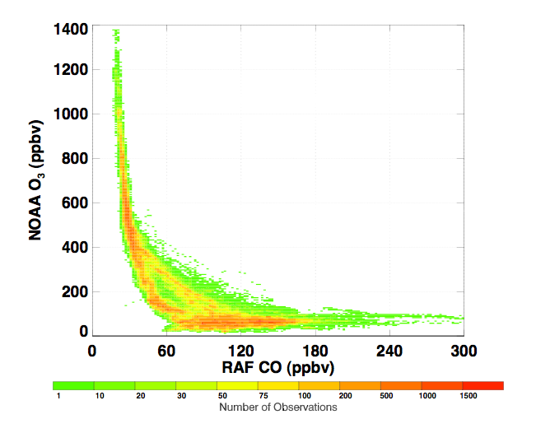
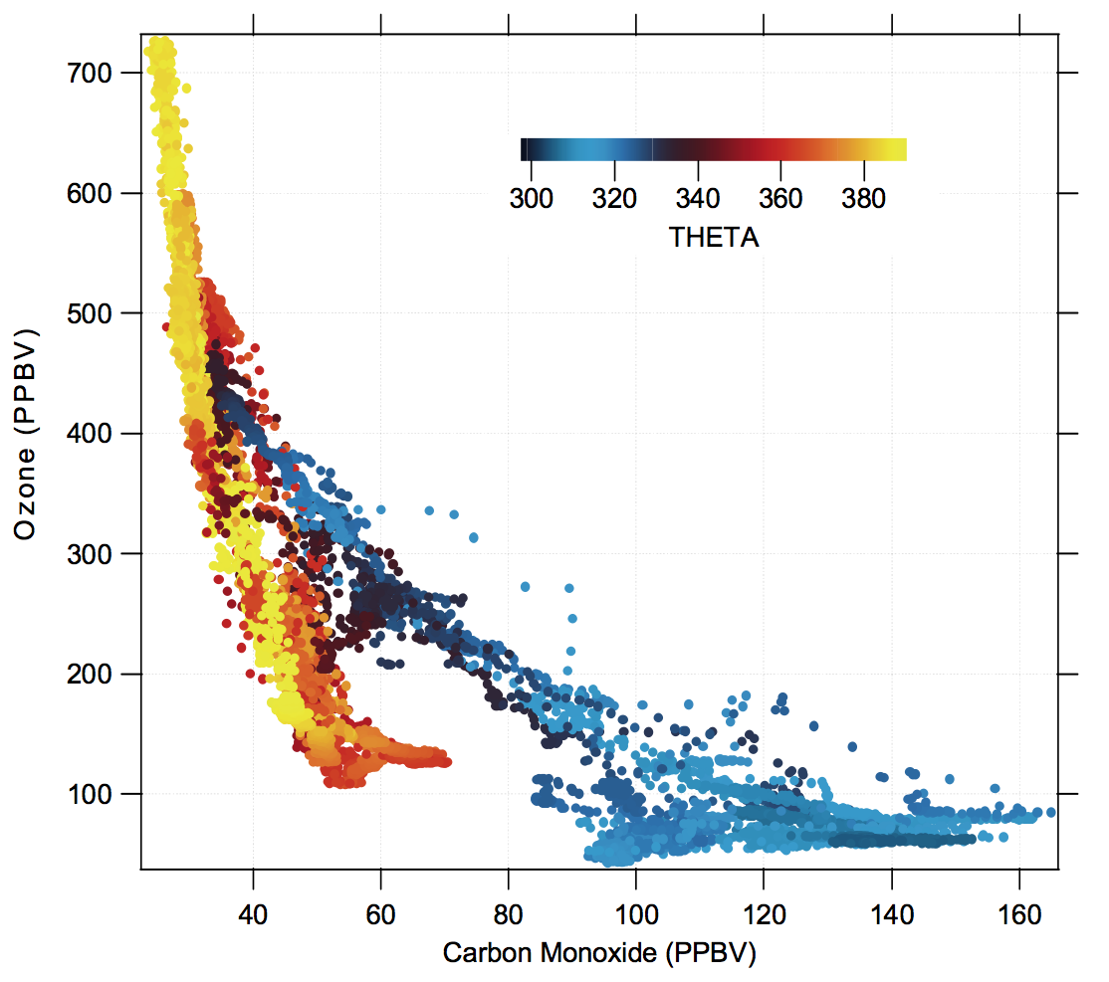
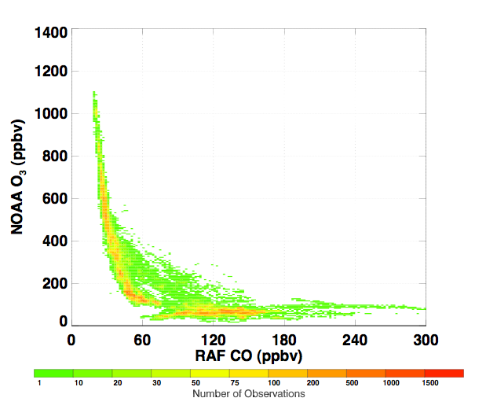
Integrative tracer correlations
All
Pittman et al., in progress
RF01
RF01,08,09,14
Atlas et al.,
Vogel et al., in progress
O3-CO relationship for tropospheric intrusions

Slide 6
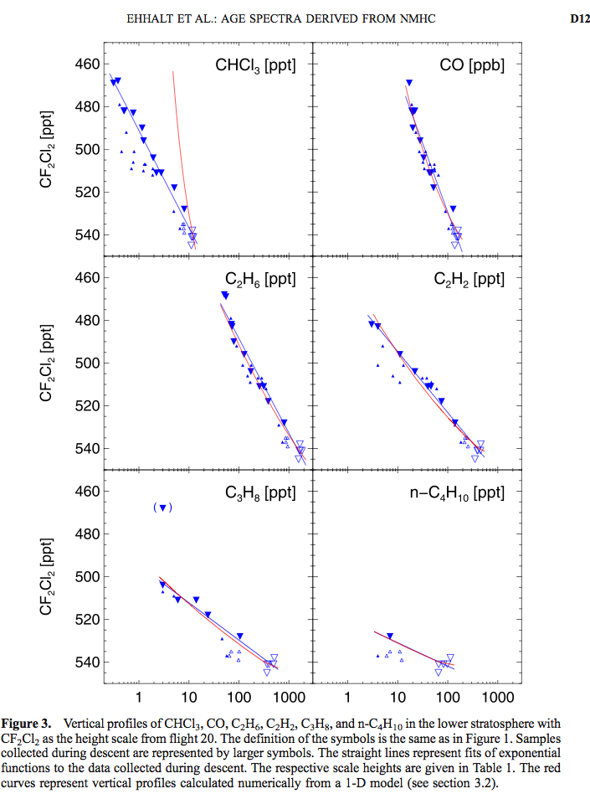
Age and age spectrum
Information from tracers of different lifetimes
Age spectrum derived using NMHC, Ehhalt et al., 2007
Ray et al., Tuesday
Atlas et al., Wednesday

Slide 7
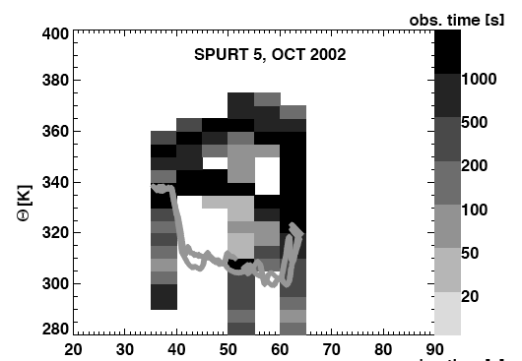
Examples of using EqL in the UTLS region for compiling tracer climatology: [Hoor et al., 2004]
Coordinates for integrating data:

Slide 8
Coordinates for integrating data:
Profiles in tropopause referenced Rel. Alt
Tilmes et al., submitted

Slide 9
Dynamical coordinates: wind field/Jet streams:
Brioude et al., 2004
Combine Jet and Rel Alt, in progress:
Tilmes et al., Manney et al.,
Ray et al., 2004

Slide 10
Challenges (2): diagnosing the key processes that maintain and control the chemical structure
How do we identify the roles and interactions of multi-scale dynamical processes (i.e., planetary, synoptic, meso-scale including convection and GW)?
Are small scale processes important?
How do we identify, model and quantify mixing?

Slide 11
Stone et al., in progress
Vogel et al.,
Konopka et al, Tuesday

Slide 12
DTP and TIL: are they results of the same process?

Slide 13
Challenges (3): Physical models and Definitions of the extratropical tropopause (ExTP)
How do we best characterize the ExTP as a transport boundary?
How do we reconcile the multiple existing conceptual models/definitions of the ExTP?
What processes control the occurrence and spatial extent of multiple tropopauses?

Slide 14
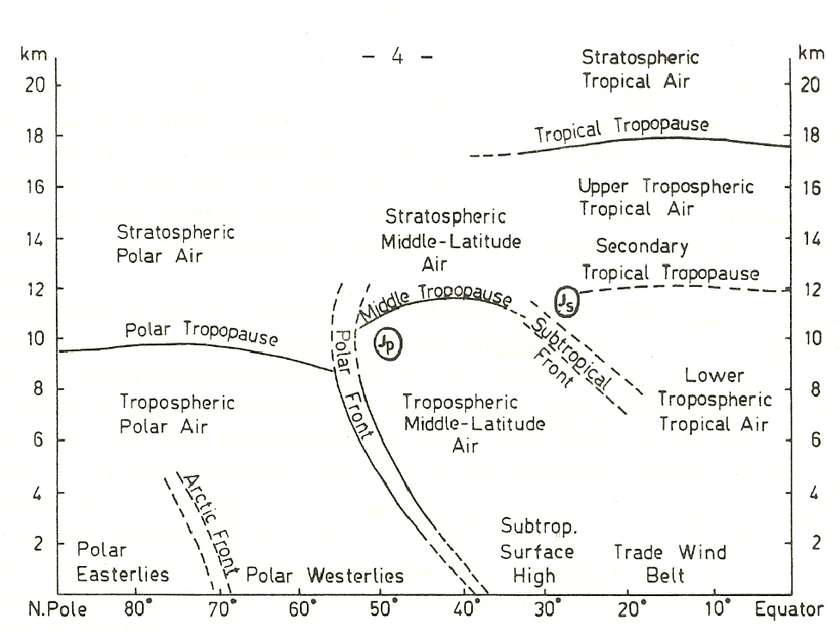
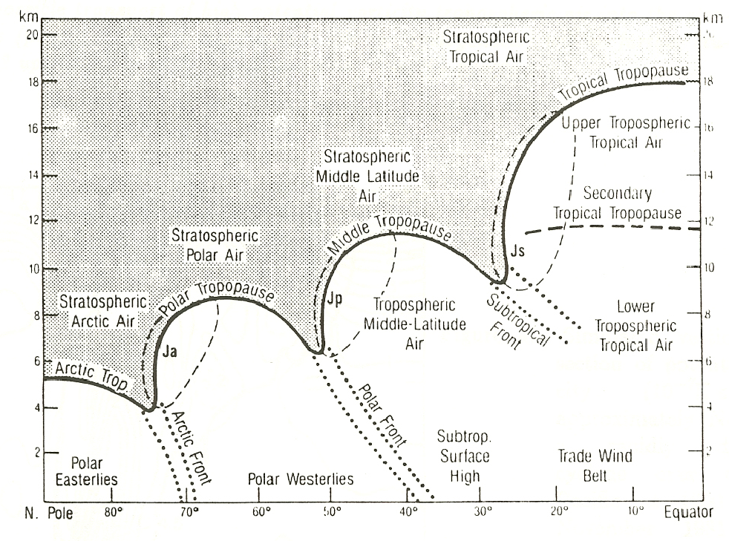
The Dichotomy of the Tropopause Definitions
“The Thermal Tropopause”
“The Dynamical Tropopause”
Palmen & Newton, 1969
Shapiro & Keyser, 1990
(WMO, 1957)
(Reed, 1955, Danielsen, 1968; Shapiro, 1980; WMO, 1986; Holton et al., 1995;…)

Slide 15
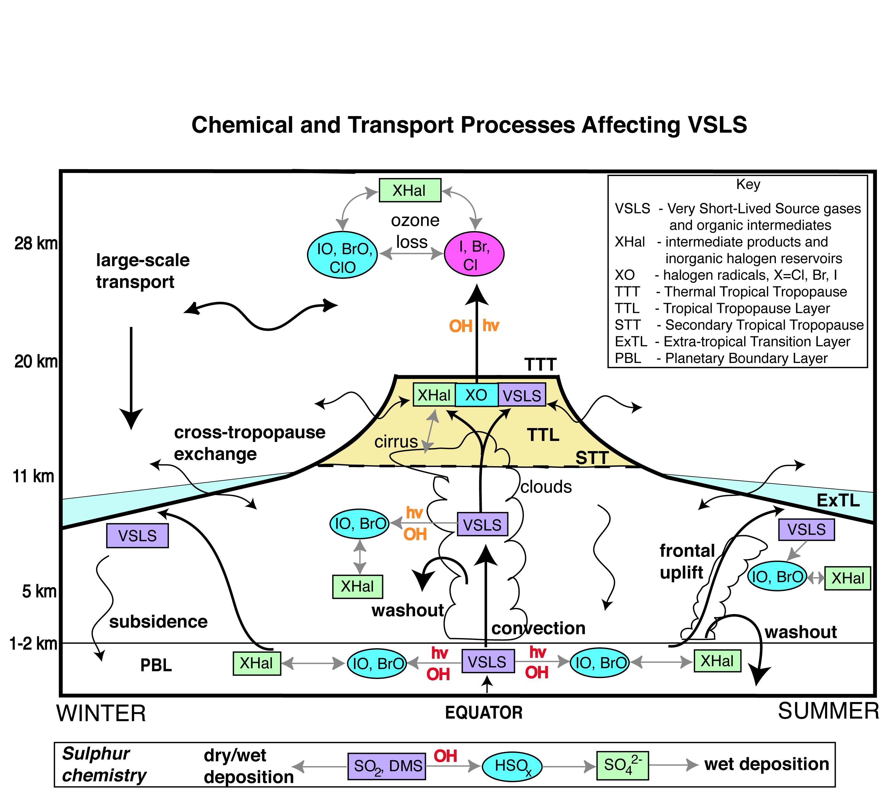
Extratropical Transition Layer - ExTL?
Adapted from Chapter 2 WMO (2002), Law, Cox & Haynes

Slide 16
Chemical Tropopause using tracer correlations?
Zahn, 2003

Slide 17
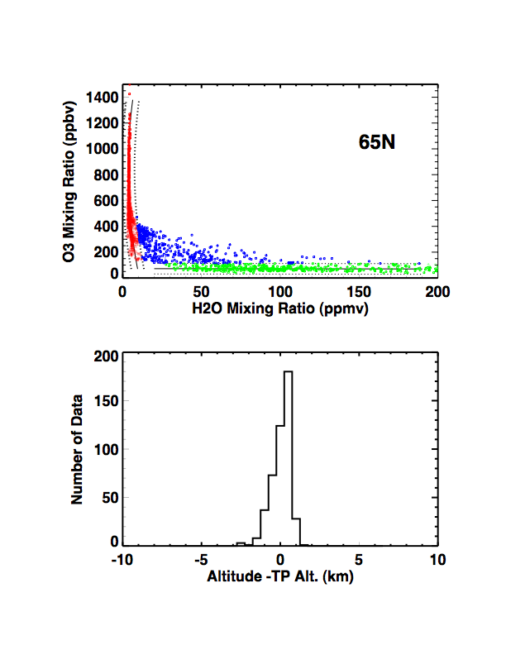
Statistical “Chemopause” or ExTL
Pan et al., 2007

Slide 18
ExTL vs TTL
Tropics: Two physical boundaries
Birner, 2006
Gettelman and Foster, 2002
Extratropics: one physical boundary

Slide 19
ExTL vs TTL – existence of multiple horizontal boundaries

Slide 20
Expectations to the workshop
Emerging pictures -> Conceptual framework?
From Mainz workshop 2005: “well defined terminology” “STE=STT/TST”, “ExTL”
Broader picture: How is the extratropical UTLS coupled to the tropical UTLS? The processes near the subtropical break?

