Slide 1
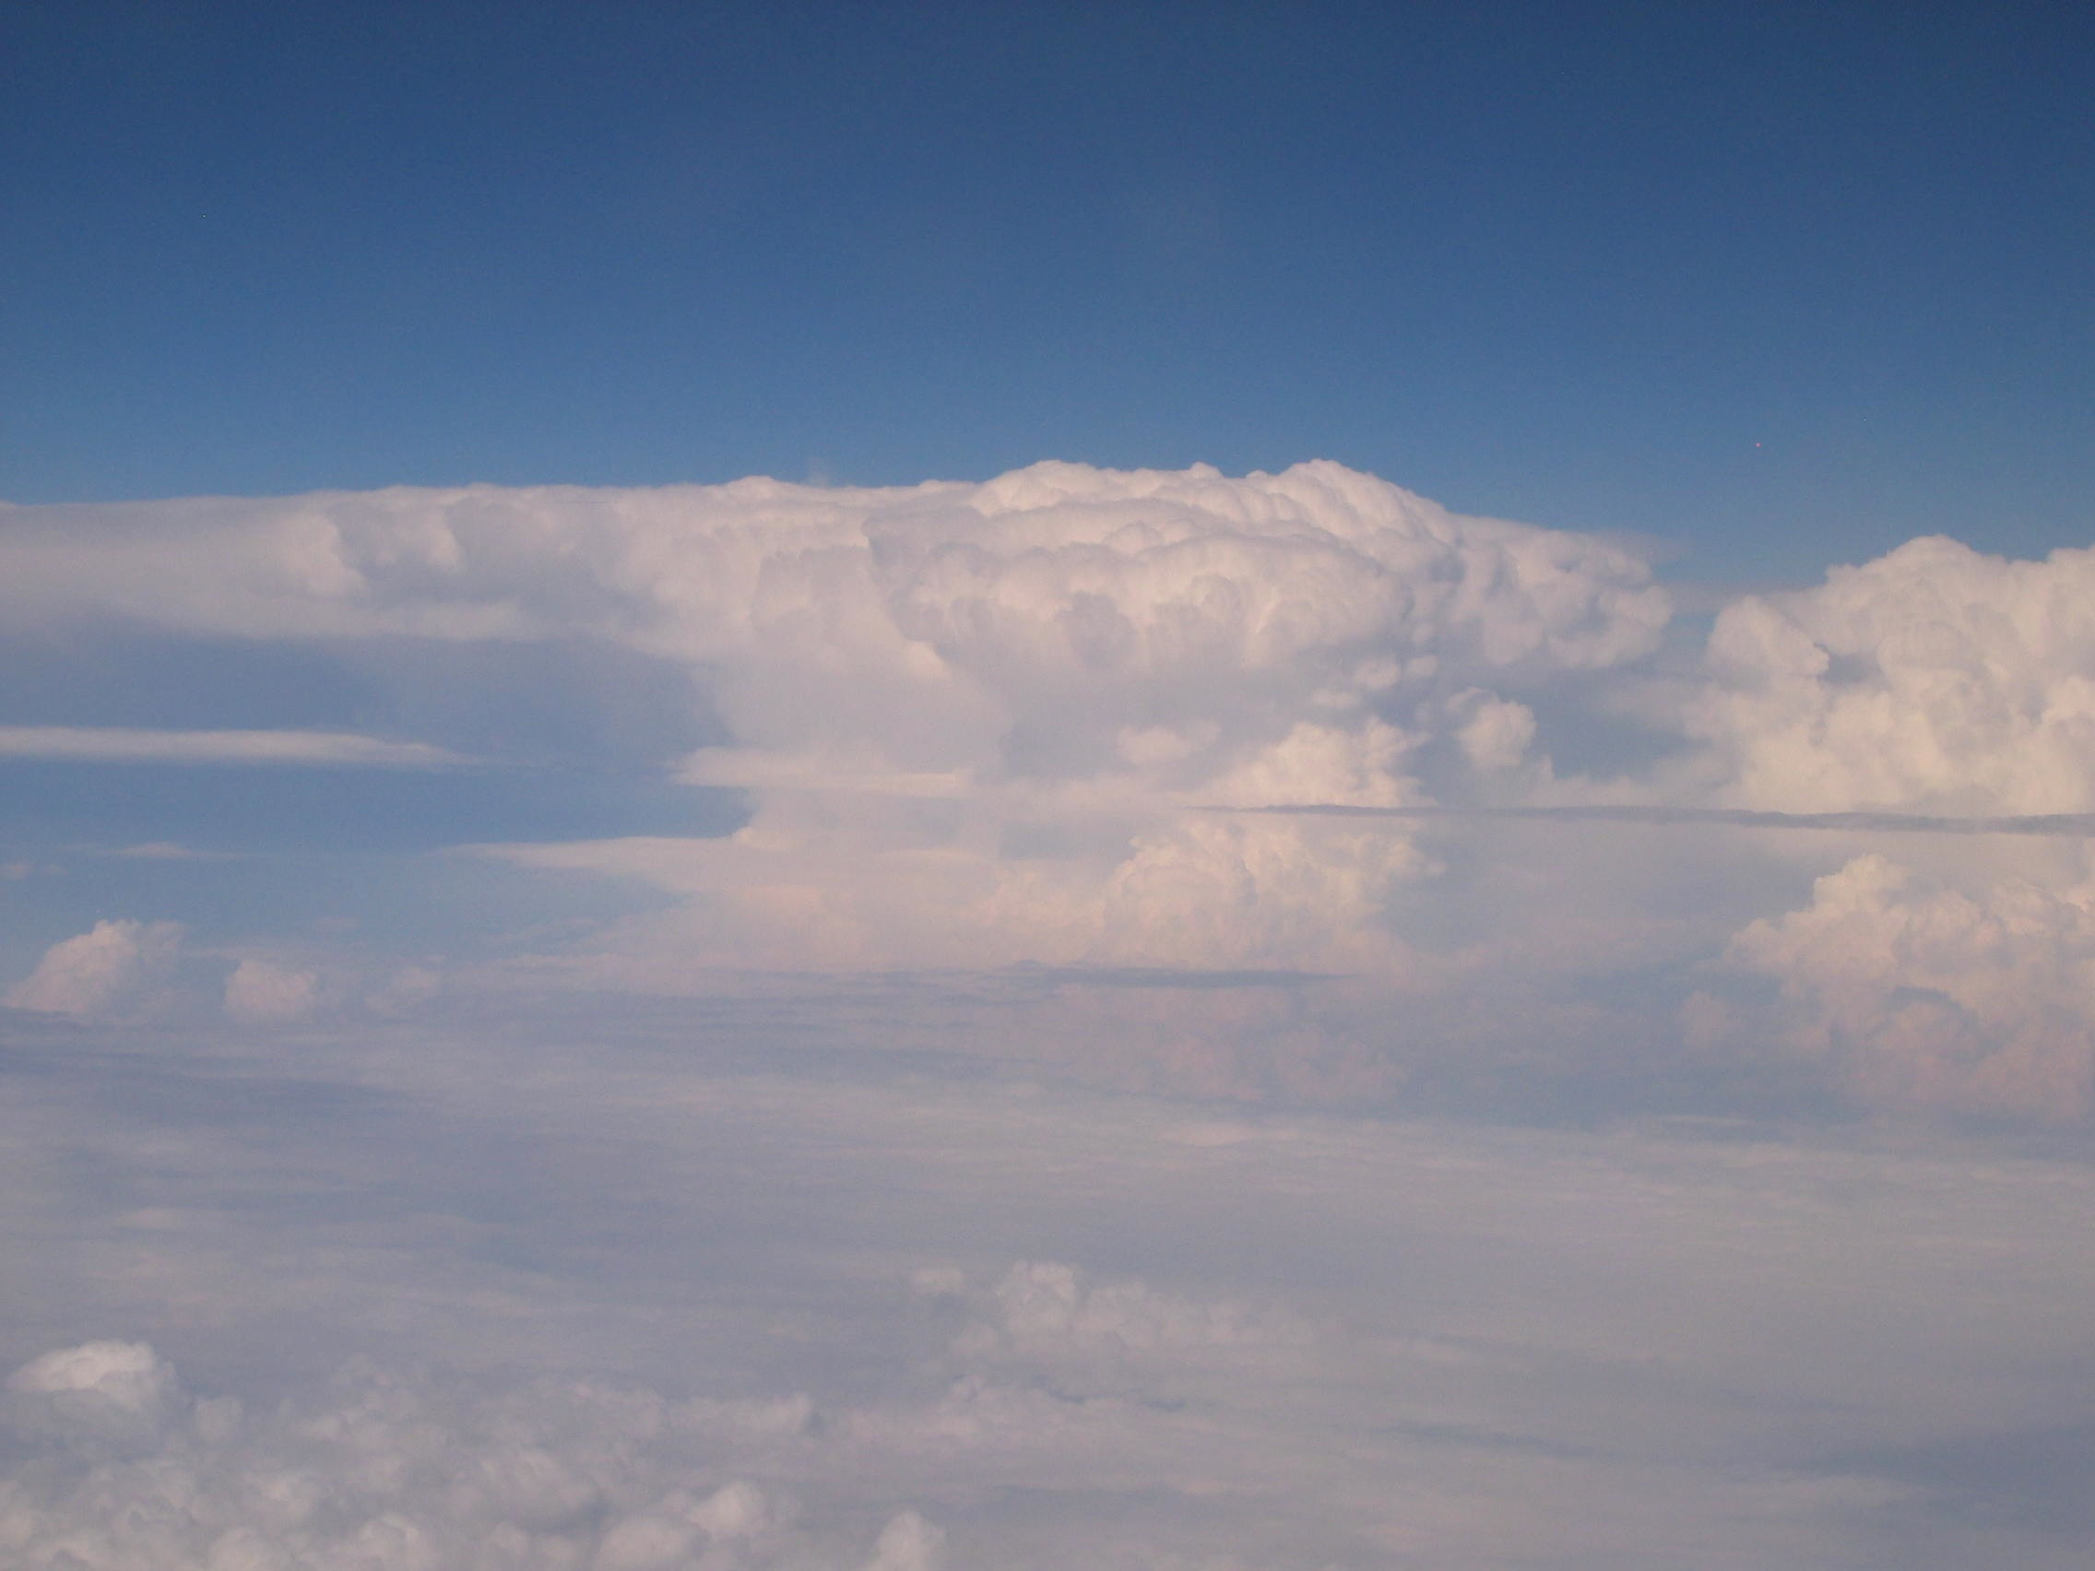
Stratosphere-Troposphere Analyses of Regional Transport Experiment 2008 (START08) Overview
Laura L. Pan (NCAR), Elliot Atlas (U. Miami), Kenneth P. Bowman (TAMU), Steve Wofsy (Harvard), Fuqing Zhang (PSU)
RF14, June 18, 2008

Slide 2
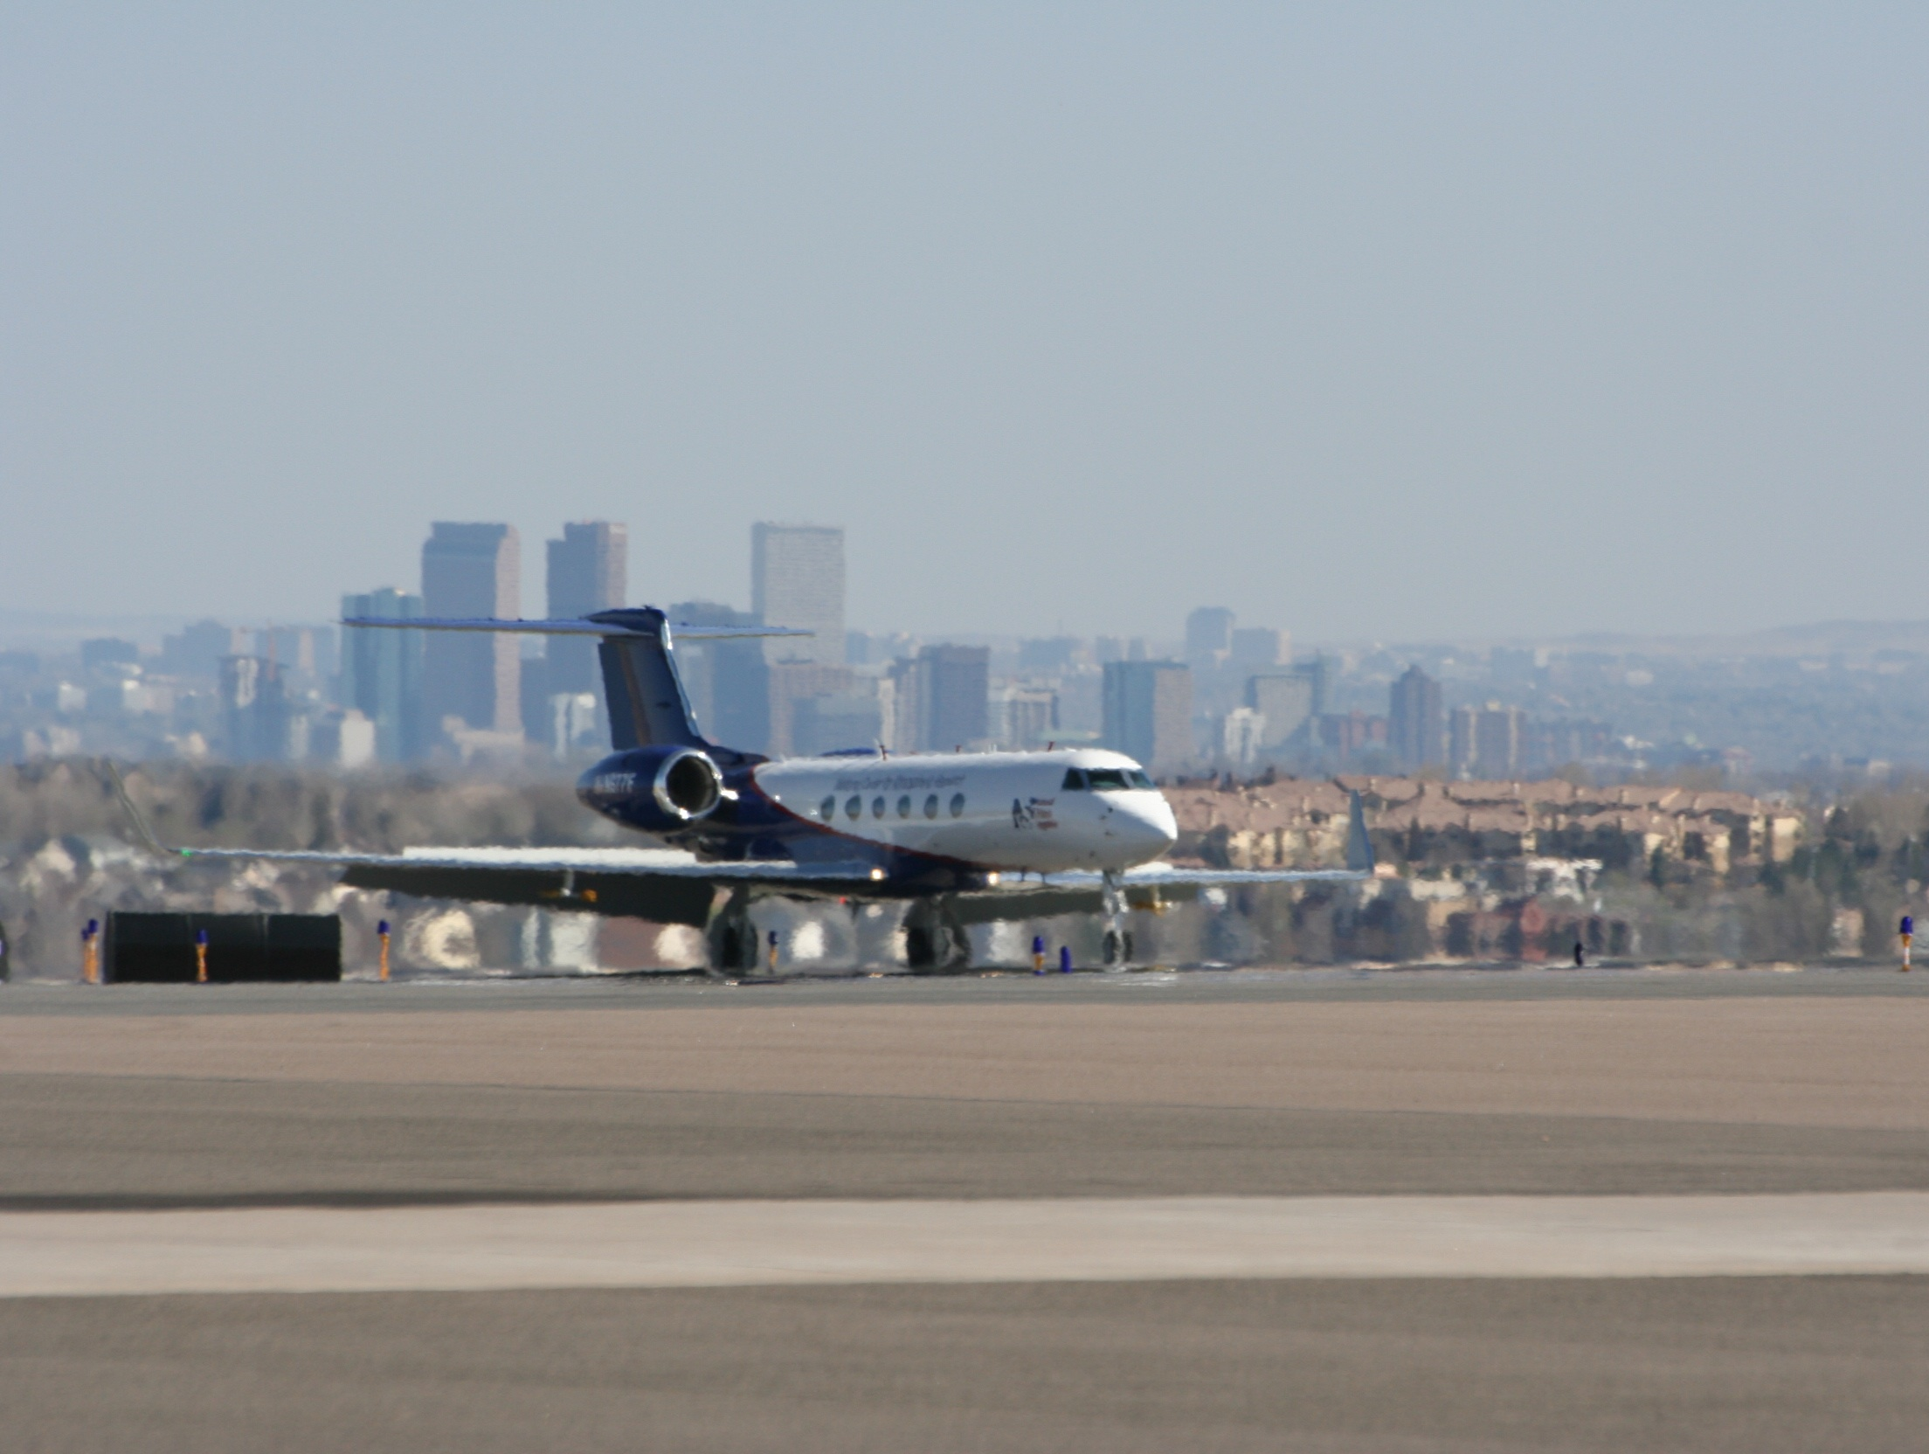
START08 Field Campaign
April - June, 2008 operated from the Jeffco airport (Broomfield Colorado), using Gulfstream-V (GV, aka HIAPER)
Participated by NCAR, TAMU, Univ. Miami, Univ. Colorado, Harvard U., and NOAA
Joint operation with the PreHIPPO project
Total 150 GV flight hours given, 123 flown in six flight weeks
Principal Investigators:
START08: Laura Pan, Elliot Atlas (Miami U), Kenneth Bowman (TAMU)
HIPPO: Steve Wofsy (Harvard)
RF01 Takeoff, April 18, 2008

Slide 3
START08 Science Goals
Provide key chemical transport information for the new generation of chemistry-climate models
Map major transport pathways that couple the UT and LS
Characterize the behavior of the extratropical tropopause as a transport boundary using chemical tracers

Slide 4
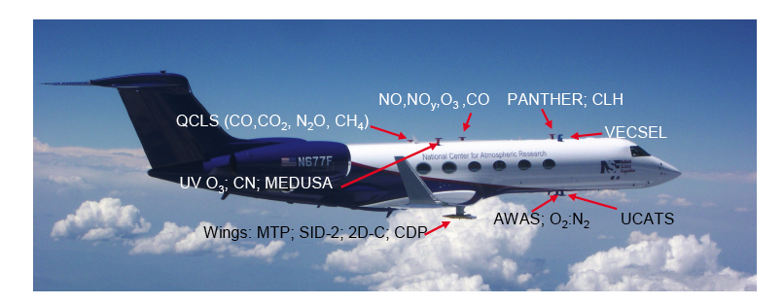
Breaking New Ground in GV Payload Complexity
AWAS (Advanced Whole Air Sampler) [HAIS/U Miami]
QCLS airborne laser spectrometers (CH₄, N₂O, CO, CO₂) [HAIS/Harvard],
AO2 (Continuous O₂/N₂ ratio) [NCAR/EOL],
Fast O₃ and NO/NOy [NCAR/ACD],
MTP (T profile, tropopause) [HAIS/JPL],
TDL-Total Water [CU]
SID2 (small ice detector) [HAIS],
VCSEL (H₂O) [HAIS],
TDL-H₂O, VUV CO [NCAR/RAF],
UV Ozone (NOAA),
PANTHER-UCATS gas chromatographs [NOAA] (CO, CH₄, N₂O, H₂, PAN, halocarbons, COS), with ozone and MayCom H₂O.

Slide 5
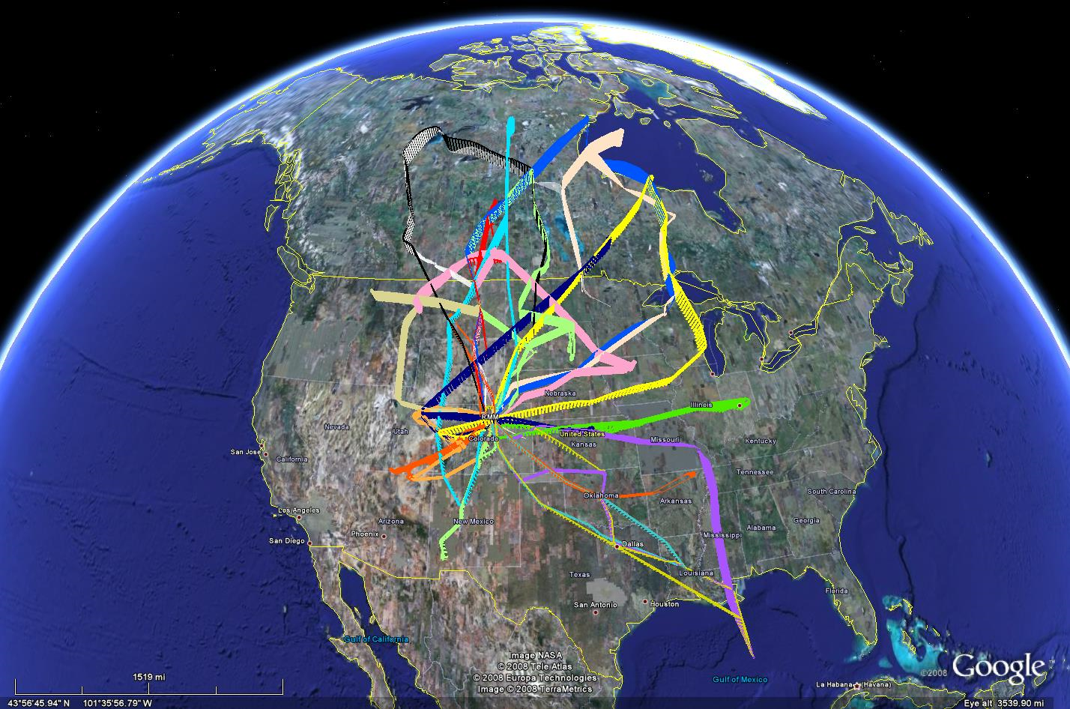
Flight Tracks of START08/PreHIPPO (18 flights)
Phase I: April 18-May 16, Phase II: June 16-27

Slide 6
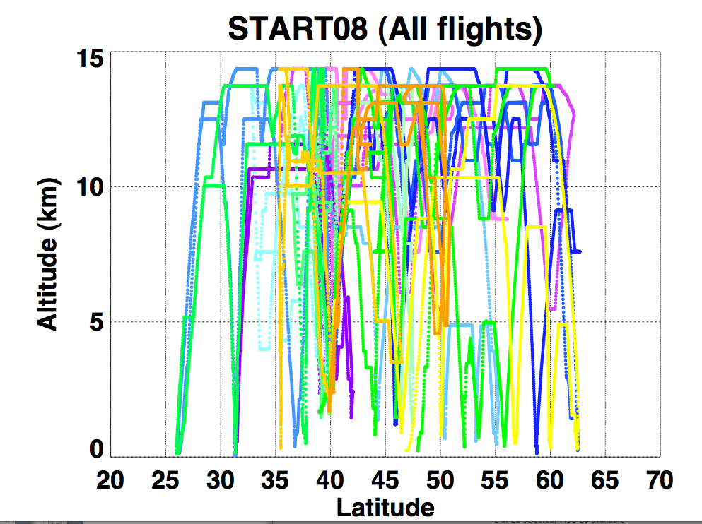

Slide 7
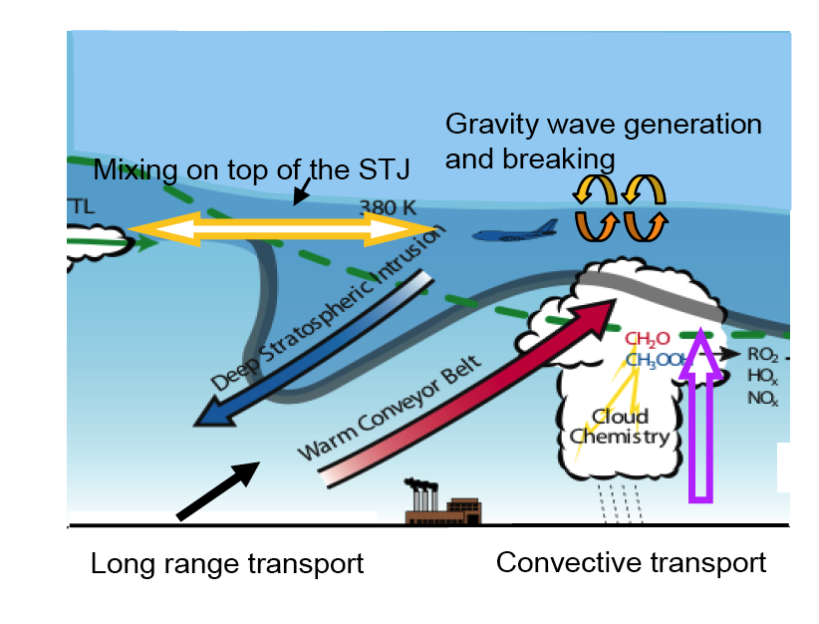
Sampling Strategy: Targeting Major Transport Pathways in the Ex-UTLS
Extratropical UT/LS Survey (including cirrus clouds) (RF 03, 09, 14, 17, 18)
Stratospheric Intrusion (Tropopause Fold) (RF 04, 06, 11, 12)
Tropospheric Intrusion
(RF 01, 07, 08, 09, 14)
Convective Influence (RF 08, 13, 14, 18)
5. Gravity Wave (RF 02)
6. HIPPO (RF 05, 07, 08, 10, 13, 15, 16)

Slide 8
Science Questions Targeted by the Flights
Behavior of the extratropical tropopause (ExT):
From the chemical transport point of view, does the ExT behave as a surface or a layer? ExTL?
How do we define or identify this boundary/layer?
Does the secondary tropopause have a physical meaning?
Quantifying STE:
What are the observables for quantifying STE?
How do we quantify STE and the transport pathway using tracers and tracer correlations?
How do we relate chemical tracer behaviors to dynamical variables
How do we characterize the age of air in the ExUTLS using tracers of a range of lifetimes
Role of convective transport and GW in UTLS composition
What is the role of multi-scale UTLS dynamics in midlatitude cloud microphysics?

Slide 9
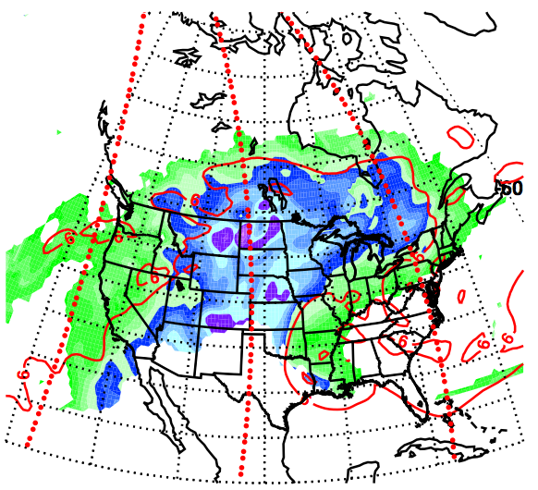
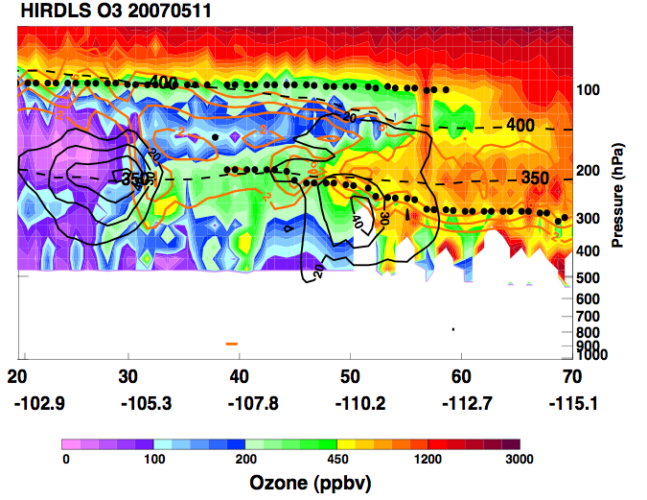
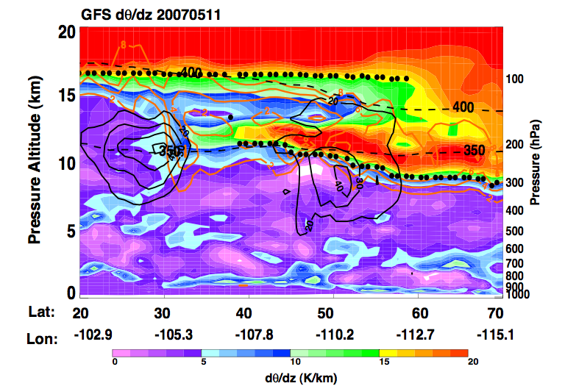
Diagnostic and forecast for intrusion of tropospheric air above the subtropical jet
HIRDLS O₃ and GFS dq/dz, May 11, 2007
Pan et al., 2009
Notes:
9

Slide 10
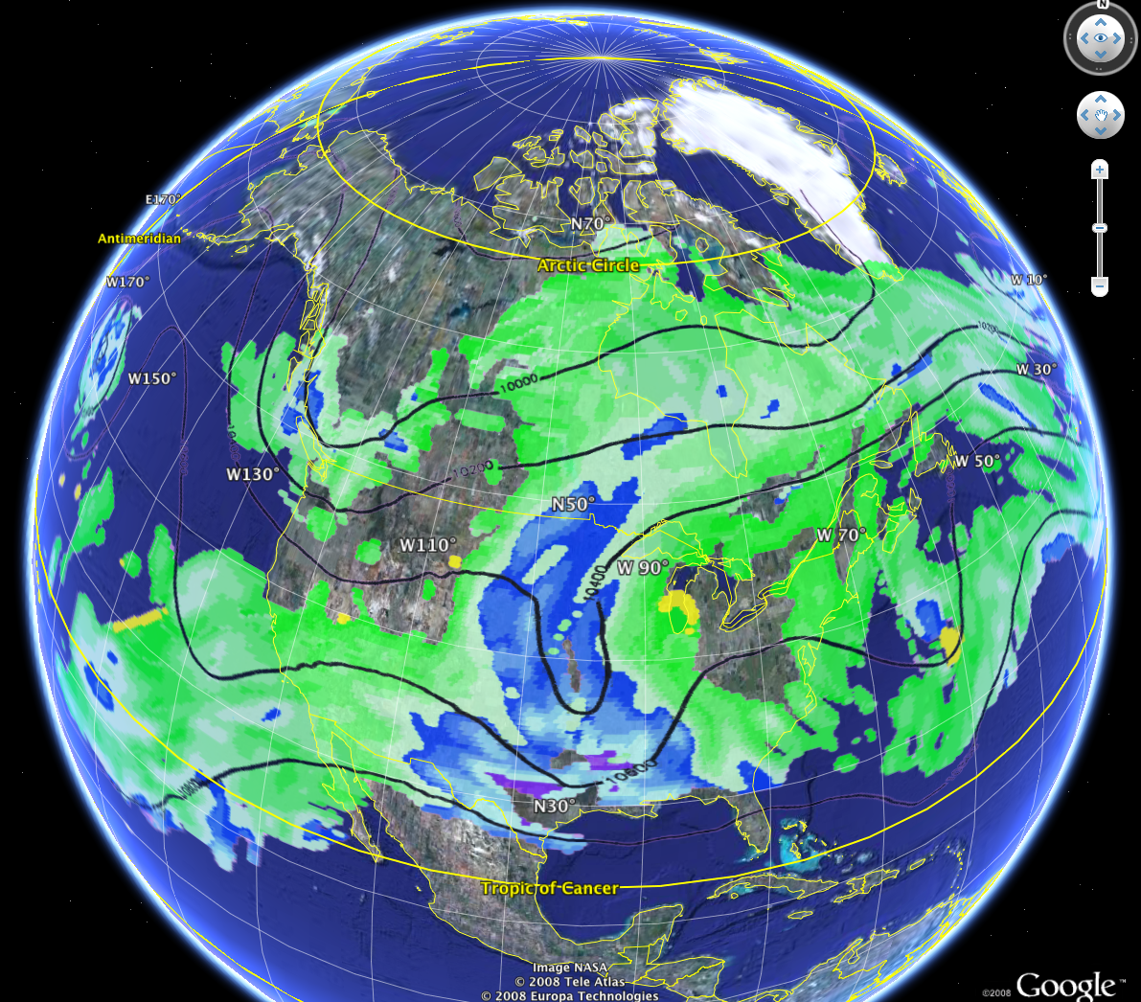
Tropospheric Intrusion
associated with the double tropopause
RF01, April 18, 2008

Slide 11
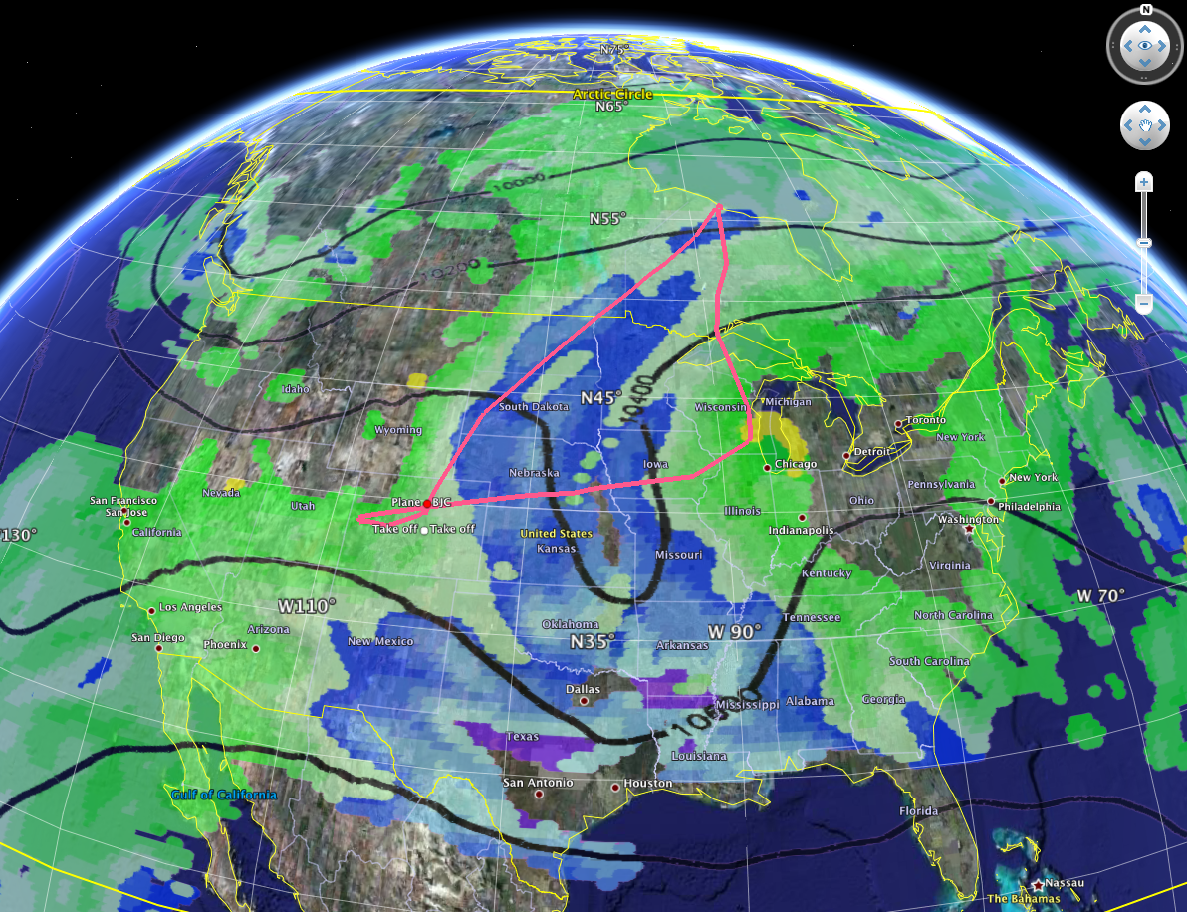
Tropospheric Intrusion
associated with the double tropopause
RF01, April 18, 2008

Slide 12
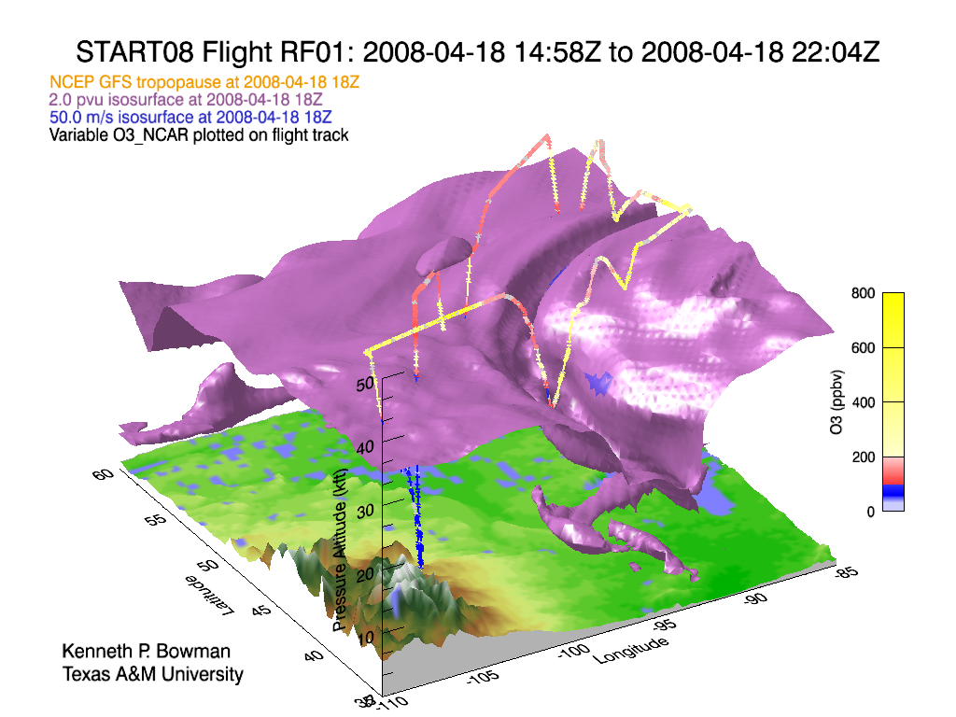
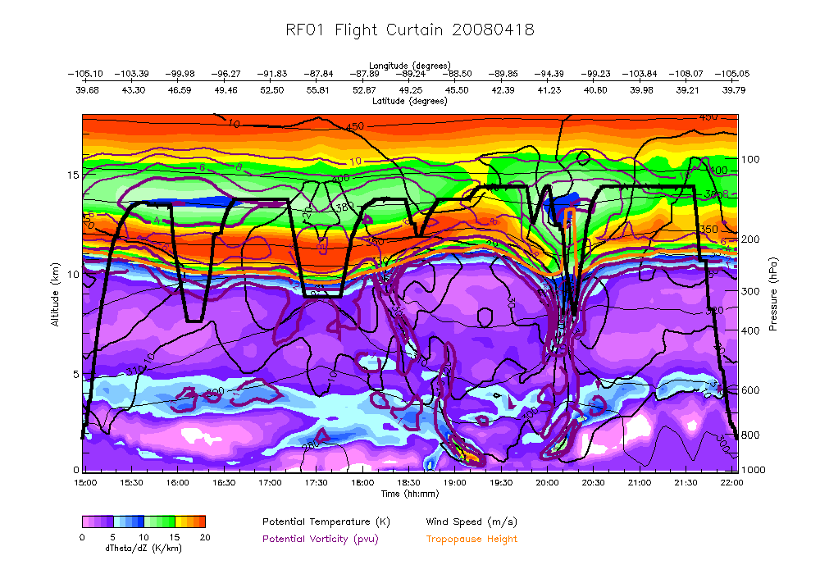
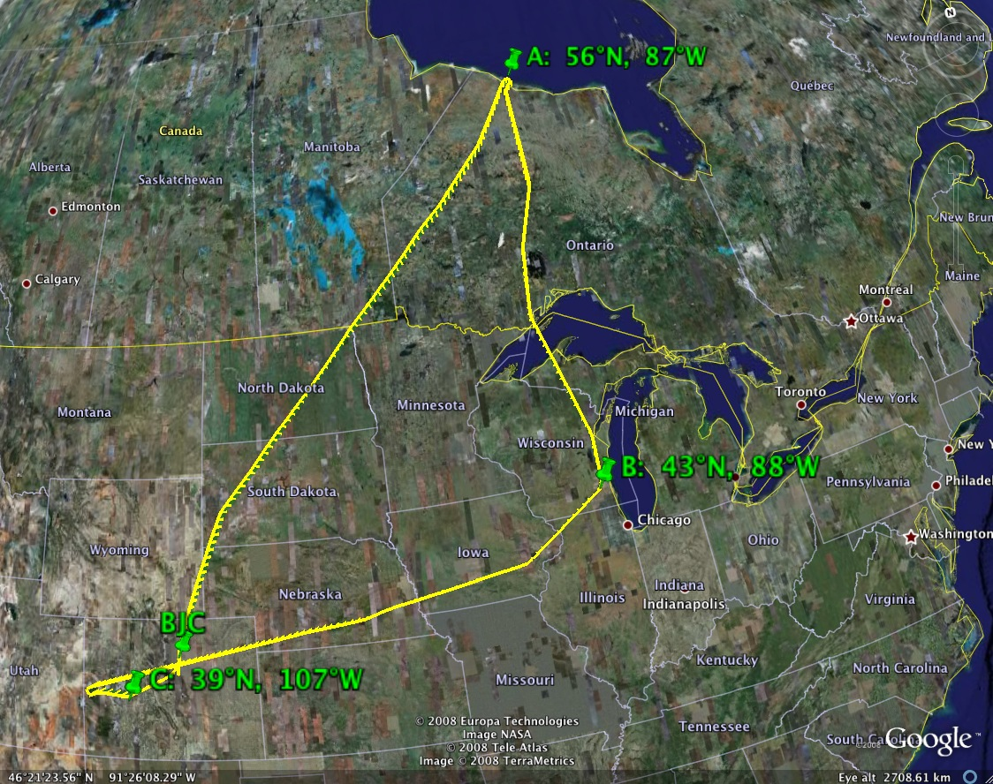
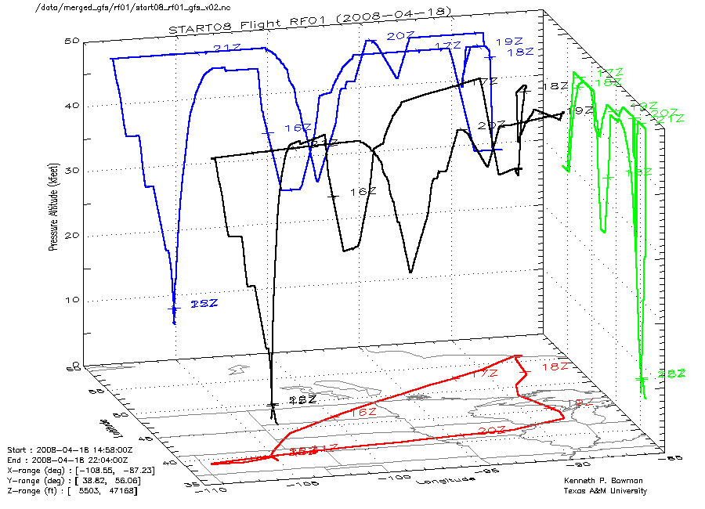

Slide 13
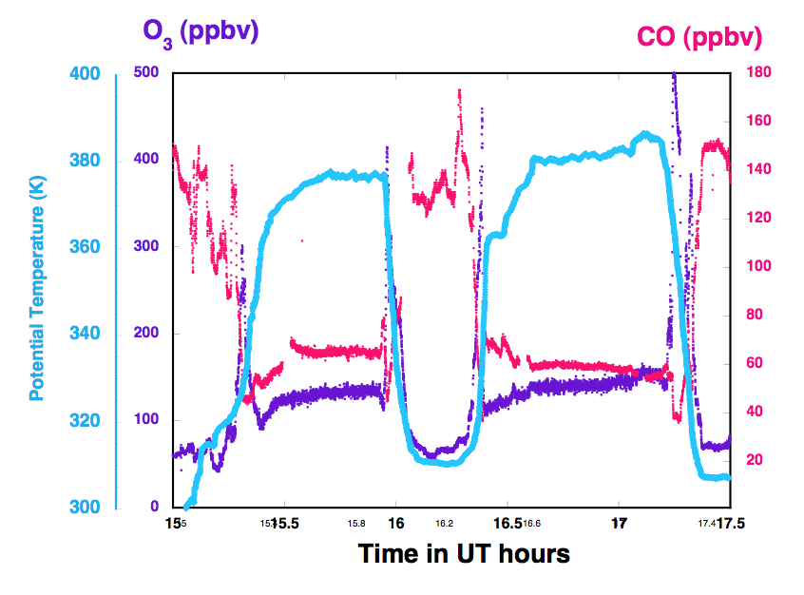
RF01, April 18, 2008
Sandwiched stratosphere?
Latitudes: > 50° N
PT: ~ 380 K
PV: < 4 pvu
O3: <150 ppbv
CO: ~ 50 ppbv

Slide 14
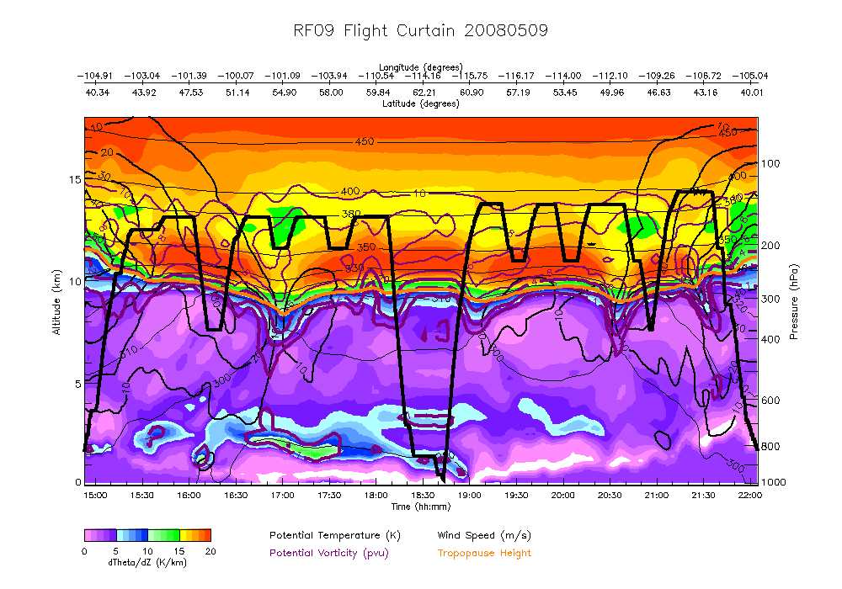
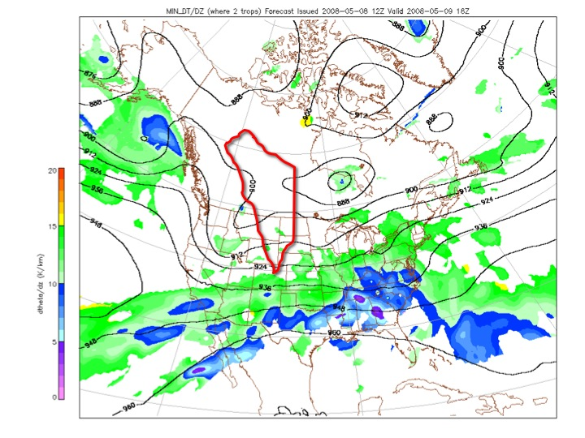
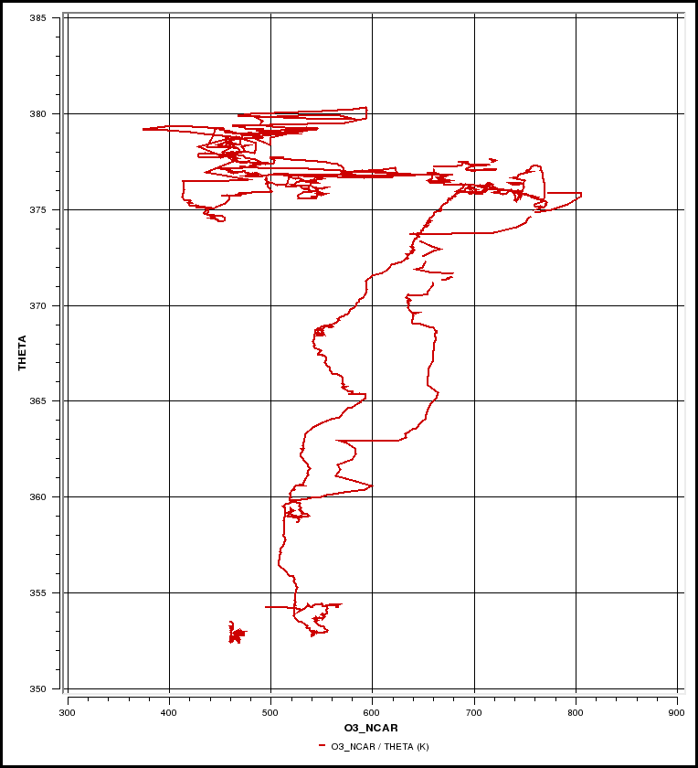
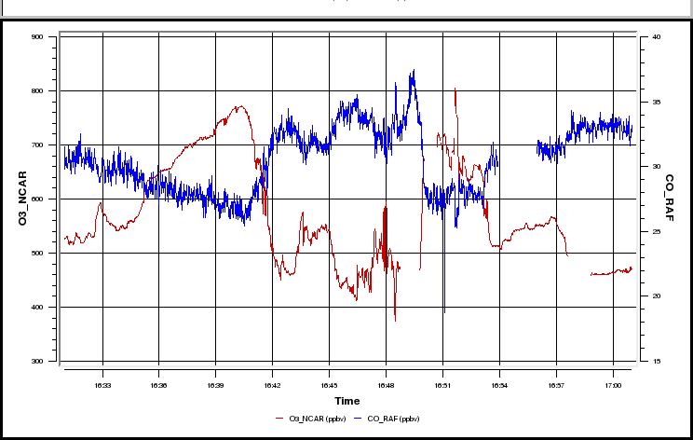
Proof of irreversibility
RF09, May 9, 2008
380
370
Potential Temperature (K)
400
Ozone (ppbv)
800

Slide 15
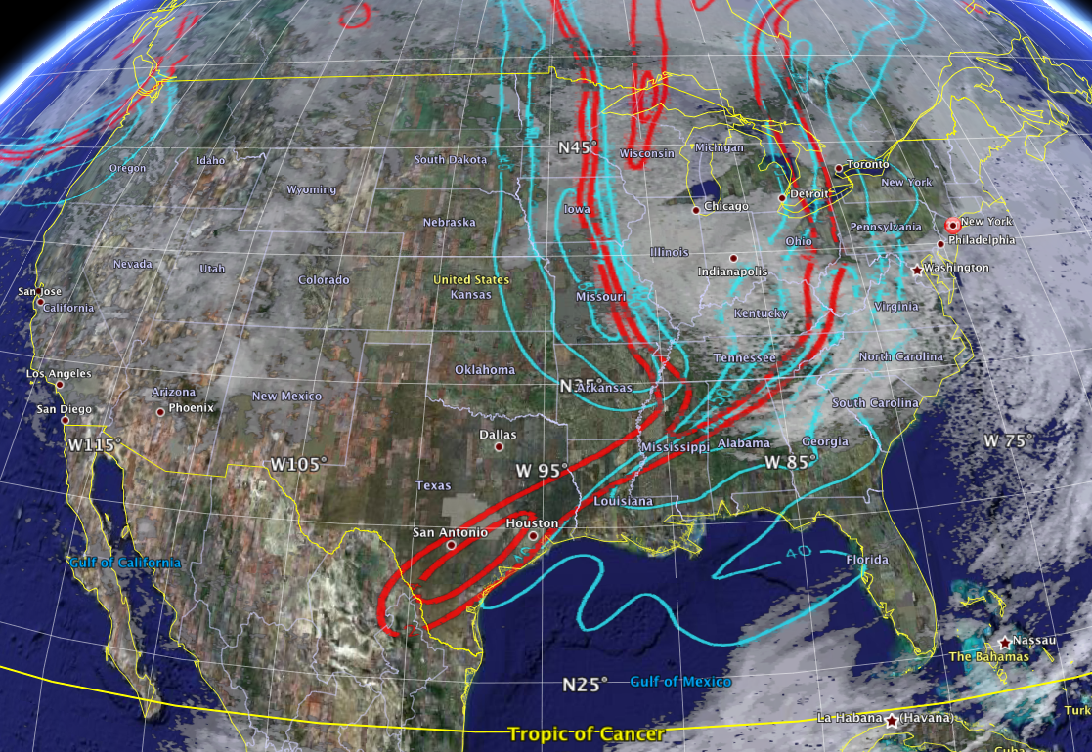
Stratospheric Intrusion
“Tropopause fold”
RF04, April 28, 2008
300 hPa PV (2,4 pvu) and wind

Slide 16
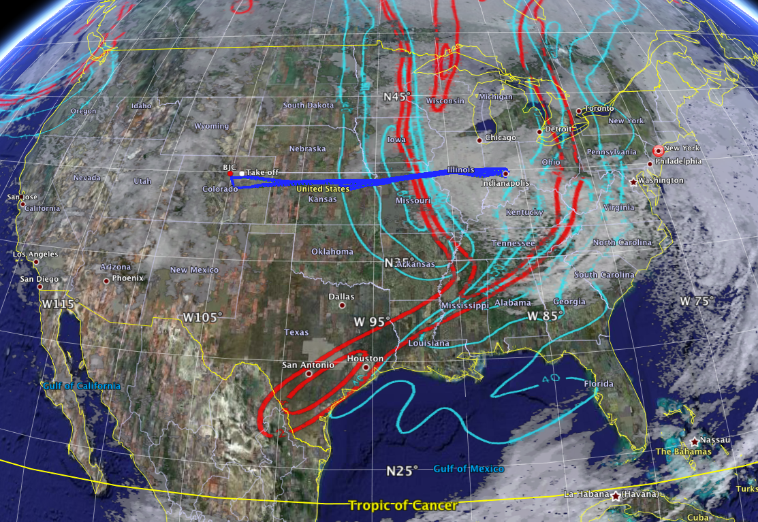
Stratospheric Intrusion
“Tropopause fold”
RF04, April 28, 2008
300 hPa PV (2,4 pvu) and wind

Slide 17
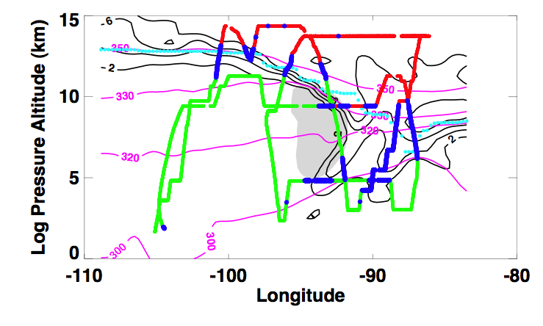
“Flat” vs. “Structured” Tropopause
RF04, April 28, 2008
mixed
Strat.
Trop.

Slide 19
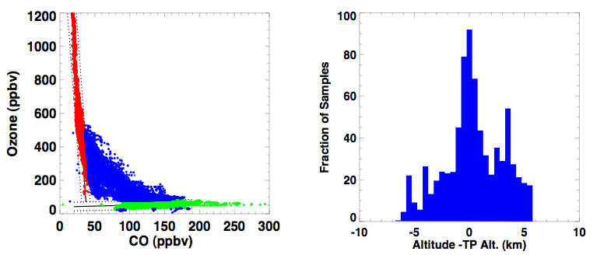
Tracer Correlation – Mixing - ExTL, and Transport Pathways
Vertical profiles from 12 flights April-May, the thermal tropopause is determined from the T profile of GV in situ measurements
secondary TP.
Primary TP.
Stratospheric
mixed
Trop.

Slide 20
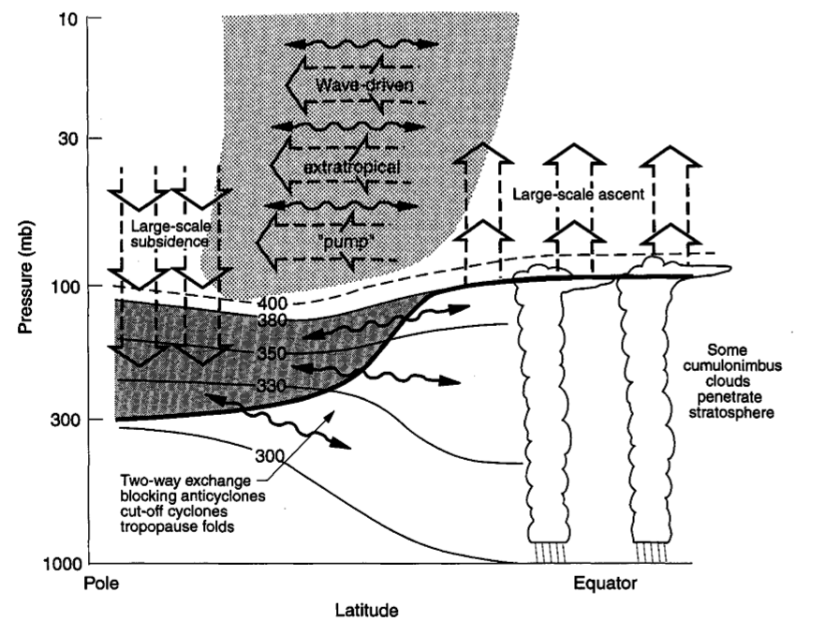
New content for the STE classic
Holton et al., 1995

Slide 21
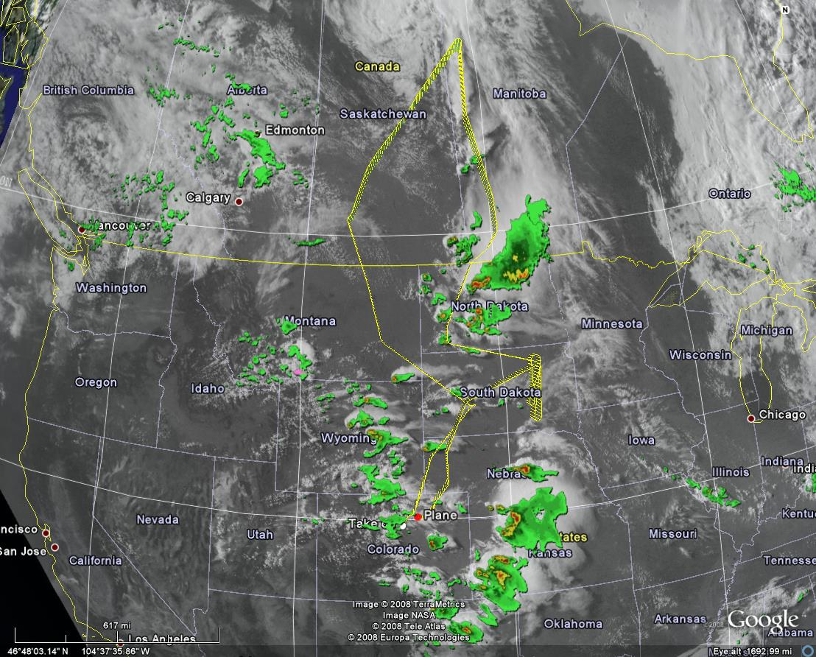
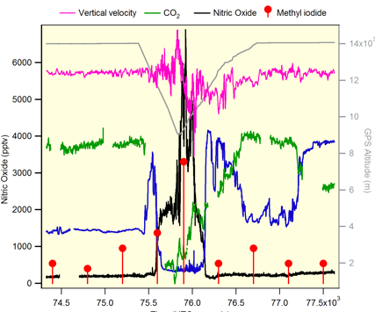
Convective transport and lightning NOx- RF14, June 18, 2008
~8 ppbv NOy
~6ppbv NO
Notes:
Flight track of RF14 in Google Earth with satellite vis and radar. The image was captured in a later time so the positions of the storms are shifted. The GV measurerments for a ~ 10 min. near Canadian border north of ND, enroute to Minot is shown in the figure. Collocated GV altitude (purple, 43K-29K dip), NO and Noy enhancement (red and orange) shows the effect of lightnng. Drop in ozone (blue) indicate the airmass is tropospheric.

Slide 22
Convective transport and lightning NOx-
RF14, June 18, 2008
NO ~ 7 ppbv

Slide 23
Research Activities and Expected Results
Climate relevant UTLS processes
Transport and mixing,
Behavior of the tropopause,
UTLS chemical gradients and Age Spectra
Modeling chemistry-climate interaction
diagnostics for CCM
quantifying mixing – Lagrangian vs. Eulerian
Design for future campaigns
GV as a powerful tool for UTLS studies
Targeting thunderstorms use GV over continental US with IFR
Satellite data evaluation
MLS, OMI, AIRS, IASI, ACE…

Slide 24
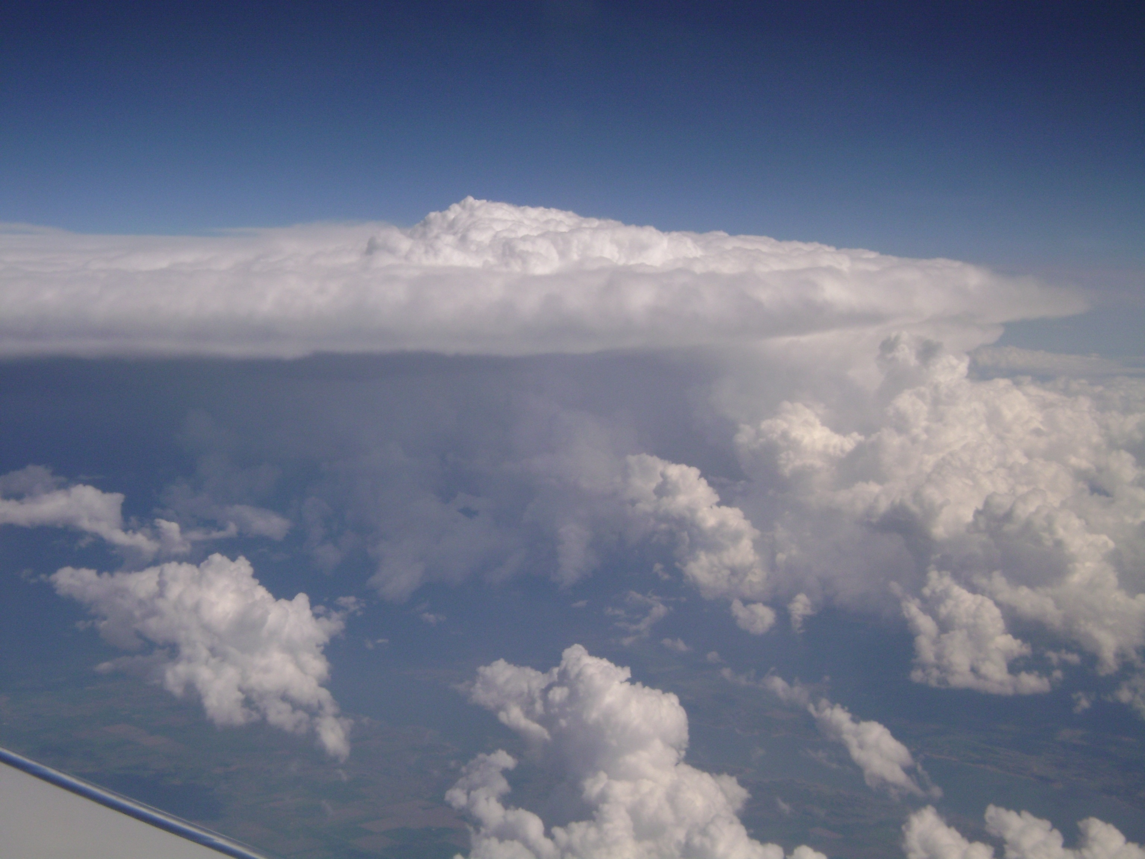
Thank You !
Data is now available:
http://www.acd.ucar.edu/start/
Overview article is in press at BAMS online:
Pan LL, Bowman KP, Atlas EL, Wofsy SC, Zhang F, et al. (2009) The Stratosphere–Troposphere Analyses of Regional Transport 2008 (START08) Experiment. Bulletin of the American Meteorological Society: In Press
RF18, June 27, 2008

