Slide 1
Model evolution of a START08 observed tropospheric intrusion
Dalon Stone, Kenneth Bowman, Cameron Homeyer
- Texas A&M
Laura Pan, Simone Tilmes, Doug Kinnison - NCAR
Elliot Atlas - U. of Miami
START08 Project Team
UTLS Workshop, NCAR
2009-10-20
Notes:
Thank START08 Project team members

Slide 2
START08 Field Campaign
Stratosphere-Troposphere Analyses of Regional Transport (START08)
April - June 2008, 18 flights
NSF/NCAR Gulfstream V (GV) Aircraft
Measured numerous chemical and microphysical species in the extra-tropical upper troposphere and lower stratosphere (UTLS)

Slide 3
Models Used
- Whole Atmosphere Community Climate Model (WACCM)
NCAR climate model with numerous chemical species and free running dynamics
2.5° x ~1.9° horizontal resolution, interpolated to GFS pressure grid with 47 vertical levels, ~1 km native resolution in the UTLS
3 hour output from April to July 2008
Particular simulation used 10% nudging to meteorological fields from Goddard Earth Observing System (GEOS-5) analyses
- Global Forecast System (GFS)
National Centers for Environmental Prediction (NCEP) global model used for synoptic-scale weather forecasts
0.3° x 0.3° high horizontal resolution, 47 vertical levels with ~0.5 km resolution in the UTLS
6 hour analyses from April to July 2008
ss

Slide 4
Primary Goals
To compare WACCM model output to in situ START08 observations with tracer correlations and vertical profiles
Compare WACCM with GFS analyses to verify existence of dynamical transport features and multiple tropopause (MT) events within the met fields
Use START08 data and GFS analyses to validate WACCM’s ability to simulate intrusion-like characteristics
Use WACCM as a diagnostic tool to study the spatial and temporal evolution of a mid-latitude tropospheric intrusion

Slide 5
RF01 flight summary

Slide 6
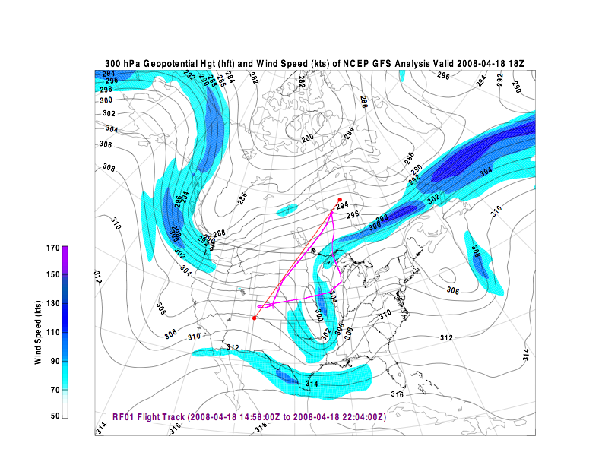
RF01 Flight Track
Notes:
Point out northern leg where intrusion was observed
Deep amplitude trough over midwest
Red line is where cross section is taken in next plot

Slide 7
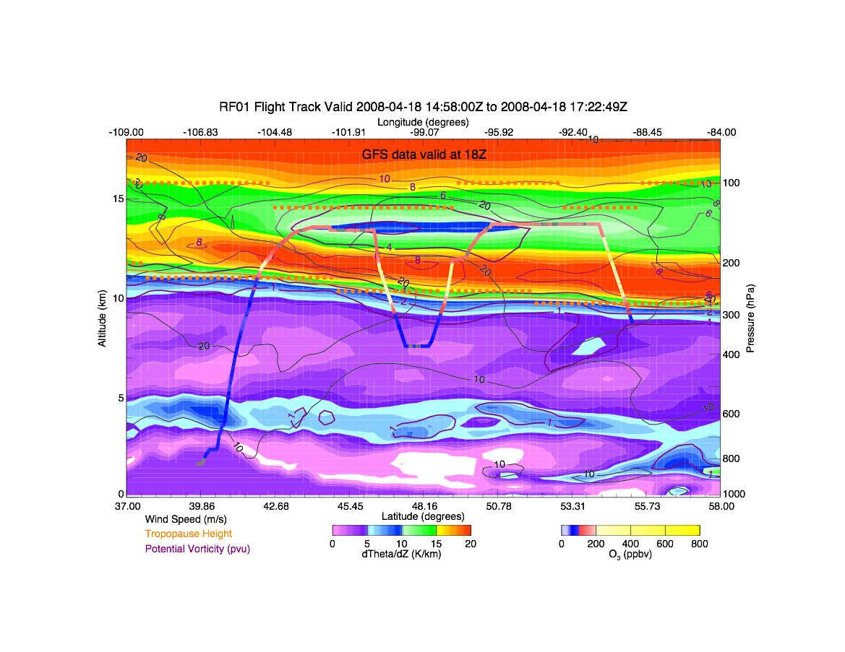
RF01 Static Stability
Sandwich layer
Low stability
High stability
Notes:
Aircraft track through high- and low-stability air
Ozone color coded on track
Aircraft reached the center of the low-stability layer

Slide 8
Tracer comparisons with RF01 observations

Slide 9
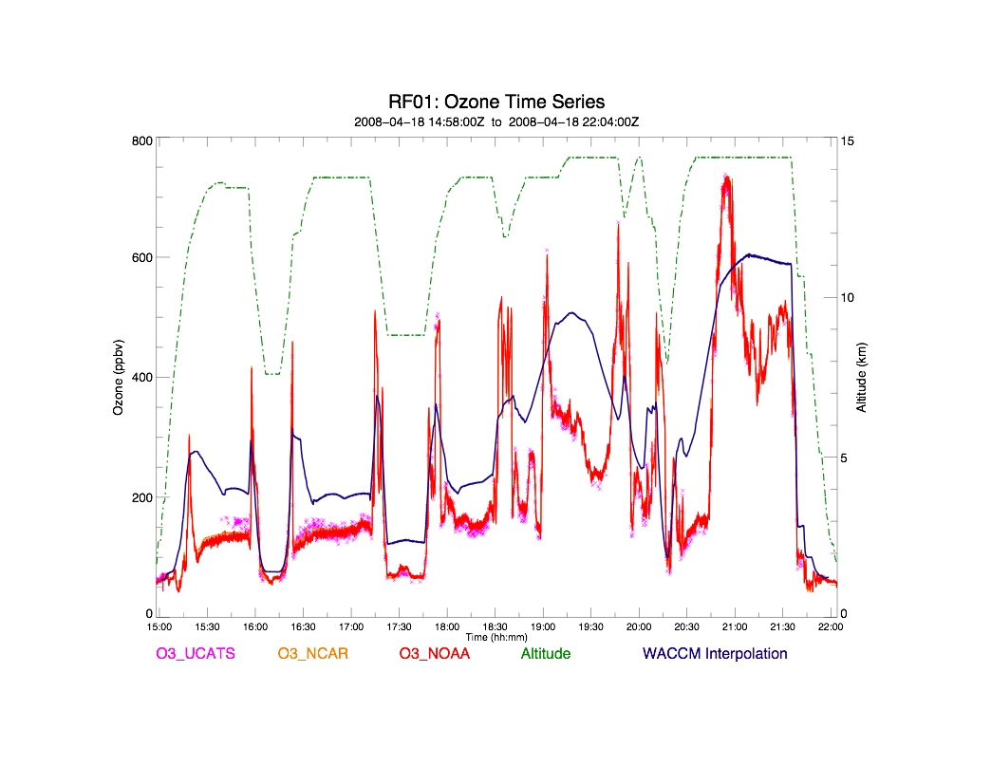
RF01 Tracer Comparison
Flight through intrusion
Sandwich layer
Lifetime: ~ 1 - 2 months
Notes:
Explain observations vs. WACCM interpolation with flight track altitude
Point out difference in intrusion layer
WACCM shows some mixing issues, core of ~200 ppbv, also horizontal resolution issue

Slide 10
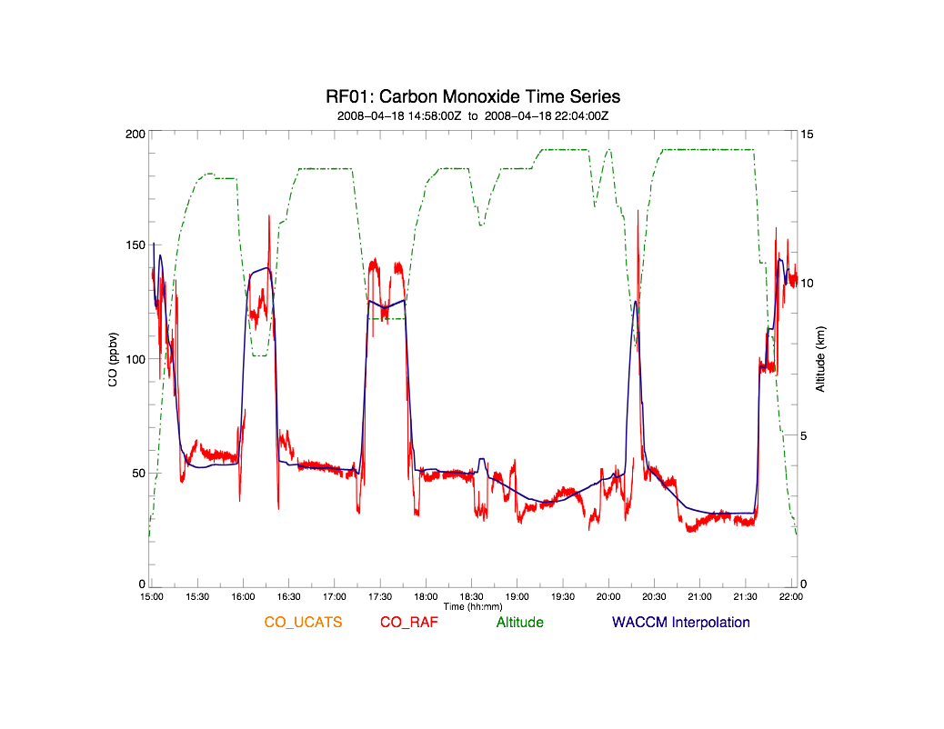
RF01 Tracer Comparison
Sandwich layer
Lifetime: ~ 3 months
Notes:
Point out tropospheric tracer profile
Absolute differences are better, but no evidence of intrusion in model
Could be tropical upper tropospheric air, which is relatively clean of CO

Slide 11
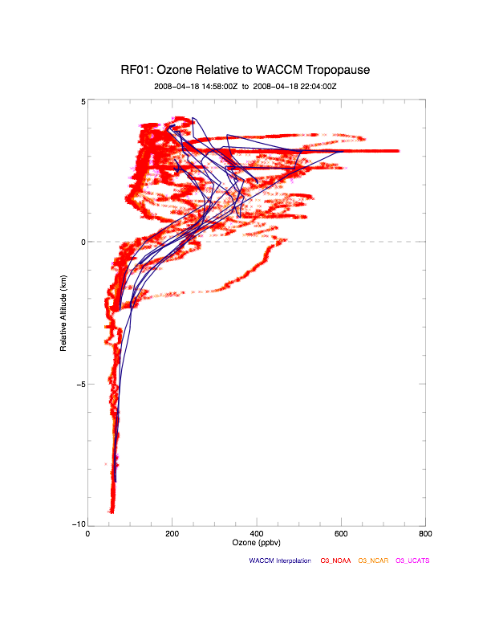
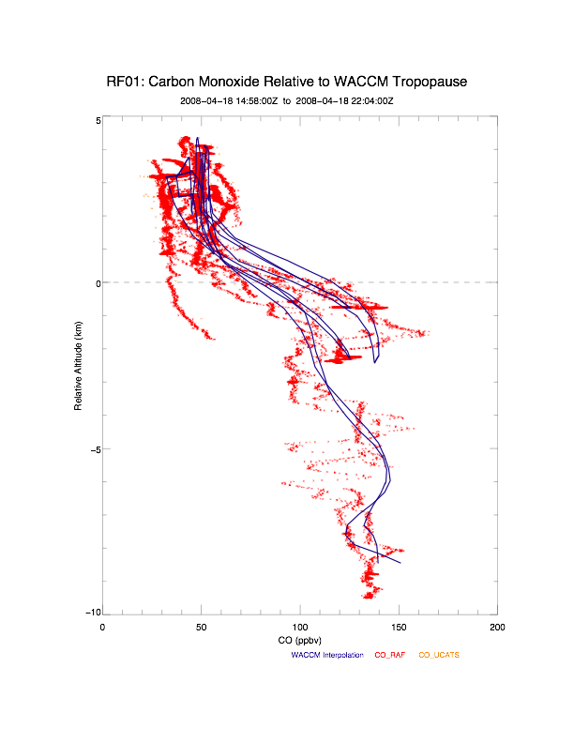
RF01 Tracer Comparison
Intrusion points
Notes:
WACCM ozone profile shows intrusion, but underestimates magnitude
CO profile is closer to observations, but no intrusion

Slide 12
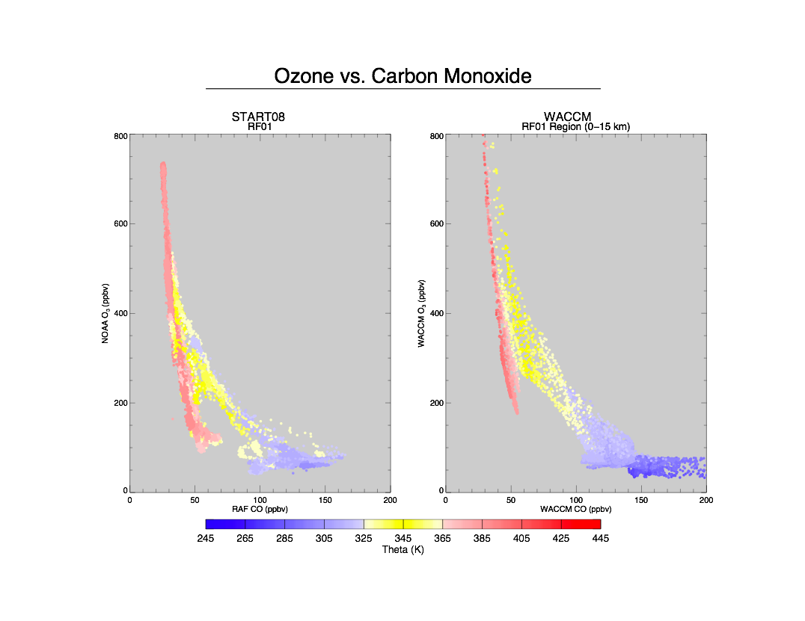
Flight RF01
Intrusion branch
Notes:
Explain WACCM sampling in flight region, intrusion level between 13-14 km (~380K)
Explain color scale
Point out magnitudes of intrusion

Slide 13
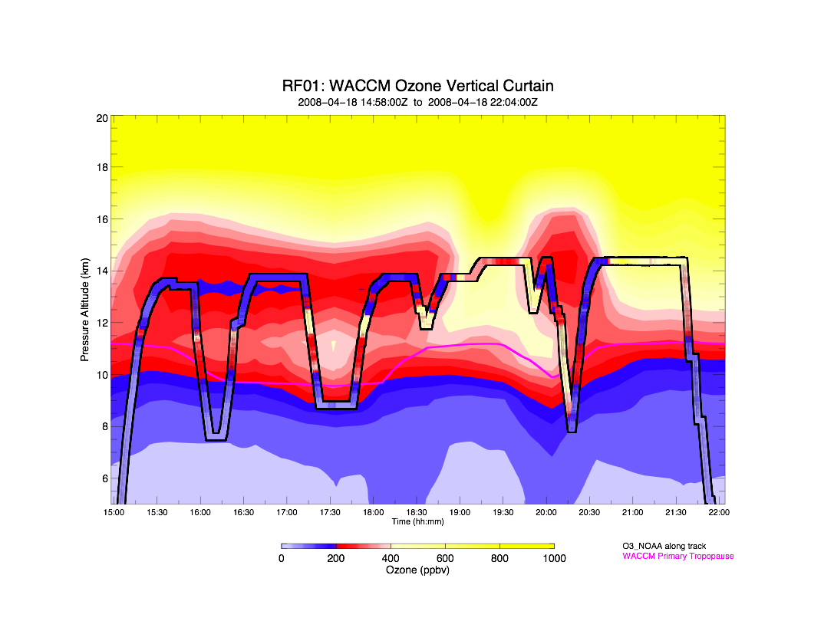
RF01 Tracer Comparison
Notes:
Explain curtain plot, color scale
Point out core of model
Sandwich layer is lower in model, points to resolution issue

Slide 14
Spatial and vertical extent of intrusion
Notes:
Now we want to validate WACCM’s ability to resolve transport in UTLS region

Slide 15
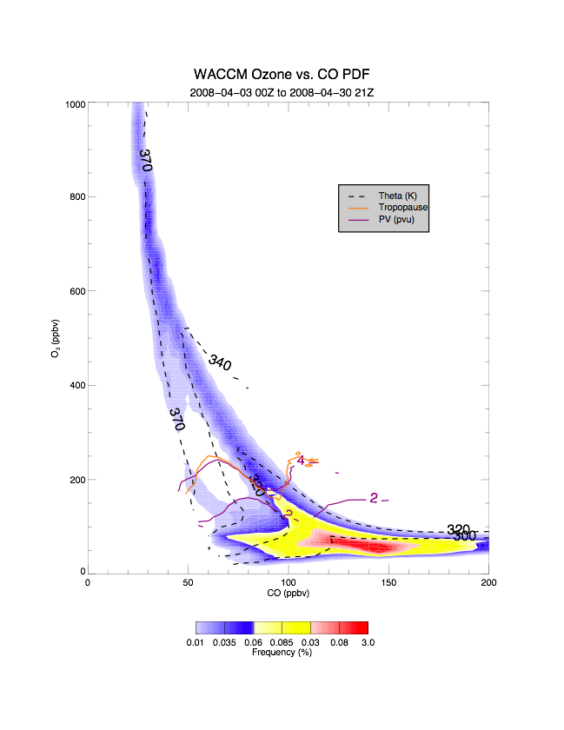
WACCM Ozone vs. CO
Criterion...
a). < 390 K
b). > 25˚ N.
Stratospheric intrusion
Tropospheric intrusion
Notes:
Explain elements of plot
Point out intrusion branches
Explain that bins were averaged to get theta, pv, trop contours, actual distribution could be much more spread out
High sampling will validate these values in tracer space

Slide 16
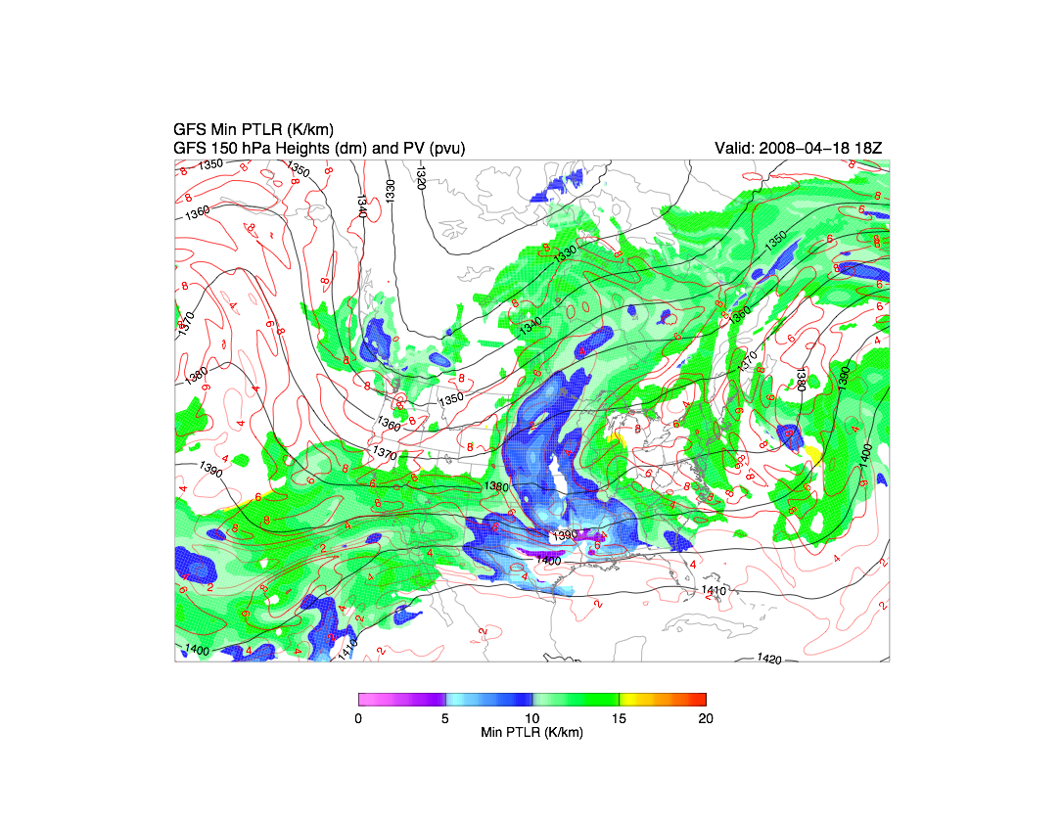
GFS Double Tropopause
Notes:
Explain min dtheta/dz values, only present where 2 trops
Used high resolution thermal tropopause algorithm

Slide 17
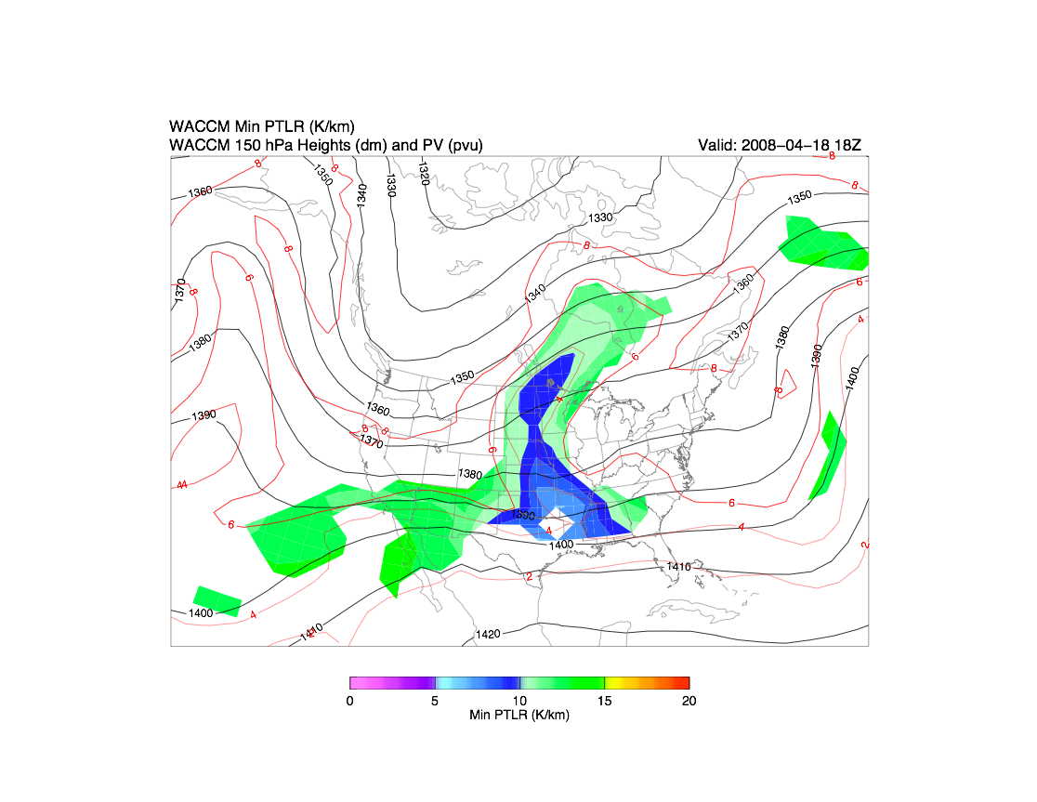
WACCM Double Tropopause
Notes:
Same algorithm applied to WACCM
Vertical resolution limits MT identification, but spatial structure is comparable to GFS
We want to look at longitude cross sections in intrusion and non-intrusion regions to verify MT existence

Slide 18
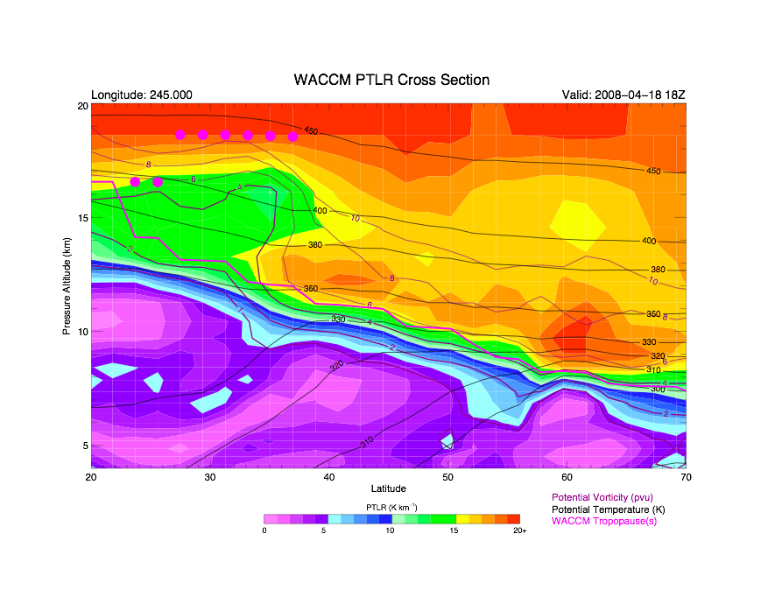
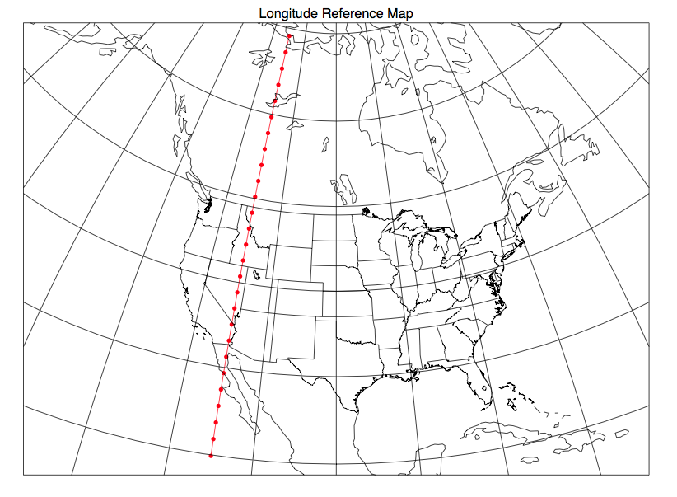
WACCM Stability Section

Slide 19
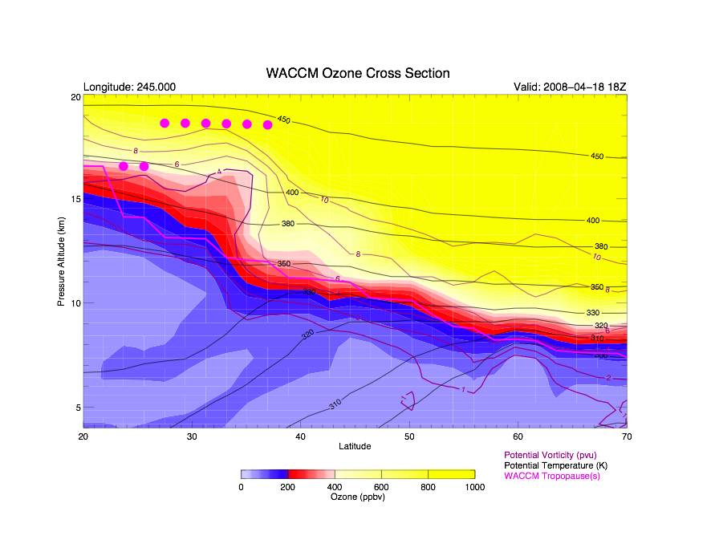
WACCM Ozone Section

Slide 20
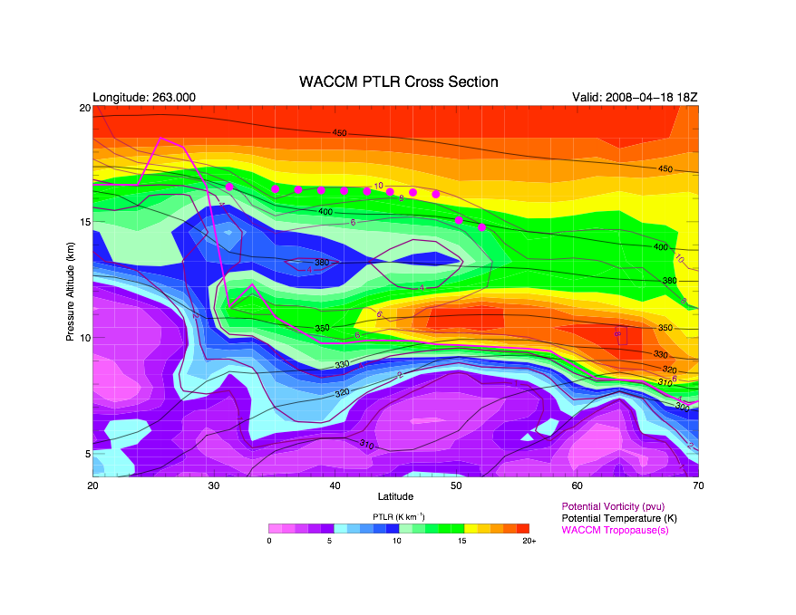
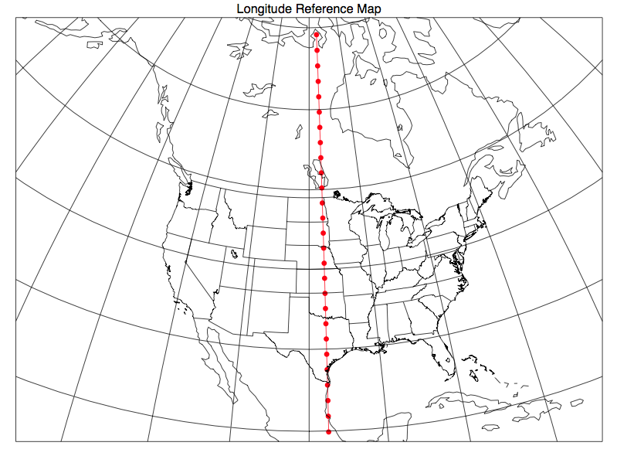
WACCM Stability Section

Slide 21
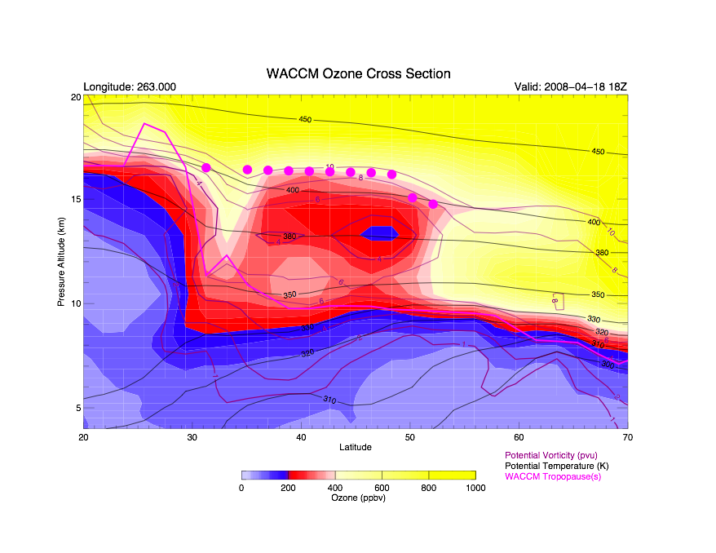
WACCM Ozone Section

Slide 22
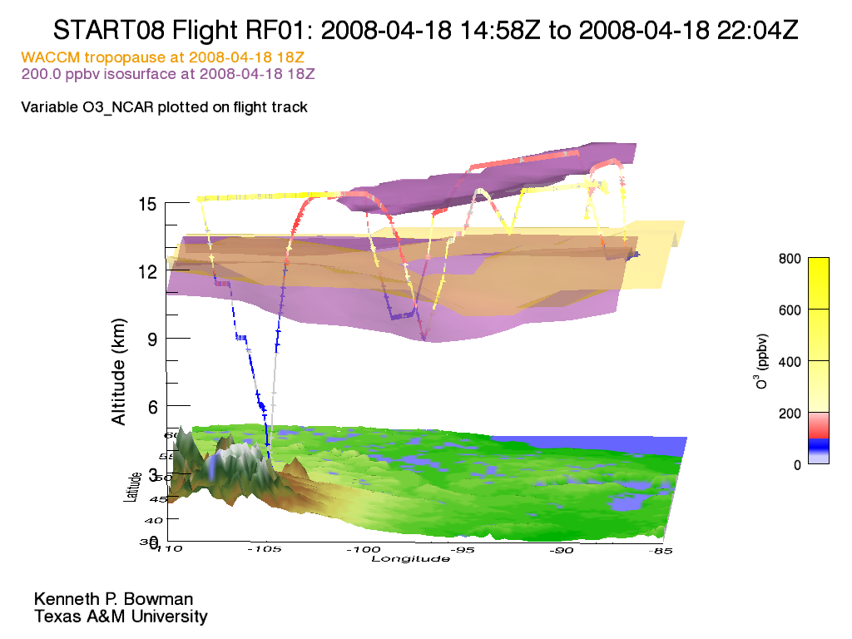
Intrusion in 3-D
Core of intrusion layer
Low observed ozone
WACCM tropopause
Notes:
Explain color scale
Explain that core is shallow but completely cut off from tropospheric source, so intrusion event is likely to have not been recent
Could explain the diffusion we see in WACCM

Slide 23
Model evolution of RF01 tropospheric intrusion

Slide 24
WACCM 380 K Ozone
Notes:
Explain that ozone and pv was interpolated to 380 K surface
Explain color scale, movie is a week before RF01, 10 days following observations
WACCM is diffusive but still approximately isentropic wave-breaking

Slide 25
WACCM Min Critical Ozone
Typical Ozone Profile in Intrusion Layer
Plotted value (core of intrusion)
17 km
> 20% decrease
< 4 km
Altitude (km)
Tropopause
Ozone (ppbv)
Notes:
We want to look at ozone profiles to identify model intrusions globally
Looked at profiles in intrusion, applied algorithm globally
Movie for the same temporal scale

Slide 26
Summary and Future Work
WACCM nudged met fields capture synoptic-scale dynamical processes (e.g., wave breaking) that are associated with tropospheric intrusions and MT events
Mixing and/or diffusion time scales within the intrusion appear to be shorter than START08 observations suggest
START08 observations provide a high-resolution data set to further validate WACCM output
Model ozone lapse rates are used to identify the spatial extent of tropospheric intrusions
Mapping these regions will provide a tool to study the spatial and temporal evolution of tropospheric intrusions in the future

