Slide 1
The Extratropical UTLS:
Observations, Concepts and Future Directions

Slide 2
Thanks to our sponsors!

Slide 3
Background / objectives for this workshop:
Synthesize key observations from aircraft, satellites, ....
- research aircraft: START08, SPURT, NASA, others
- in-service aircraft: MOZAIC, CARIBIC, CONTRAIL
- many satellite and ground-based data sets
Current state of UTLS modeling (process, regional and global models)
- what observed aspects are not well simulated?
Highlight key uncertainties in understanding
Identify specific future research needs (observations and models)

Slide 4
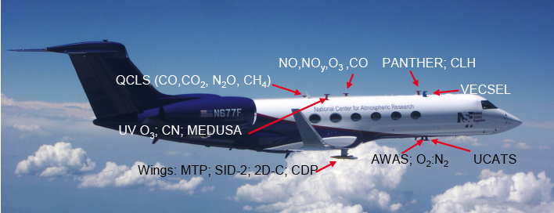
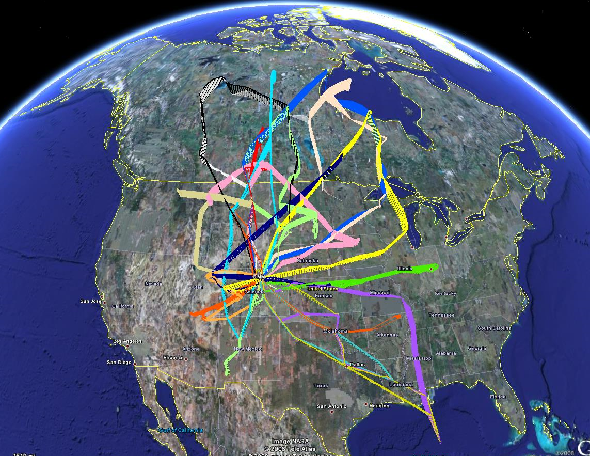
START08/PreHIPPO April-June 2008
> 120 hours of measurements
> 1000 whole air samples

Slide 5
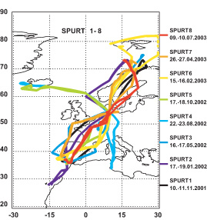
SPURT Oct 2001- Sept 2003
observations for
all seasons
CO in PV-theta coordinates

Slide 6
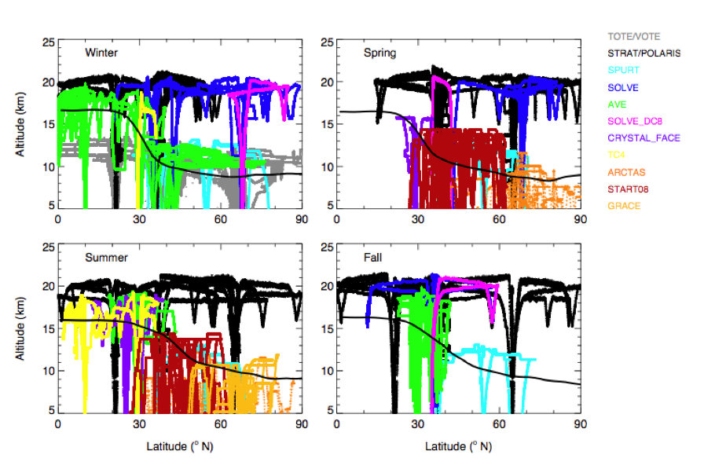
Sampling from research aircraft
Tilmes, Pan et al, 2009

Slide 7
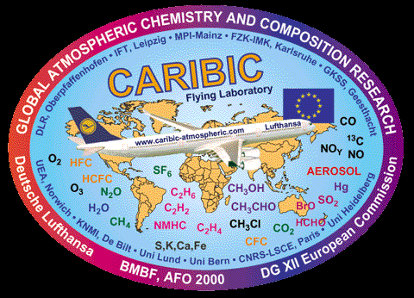
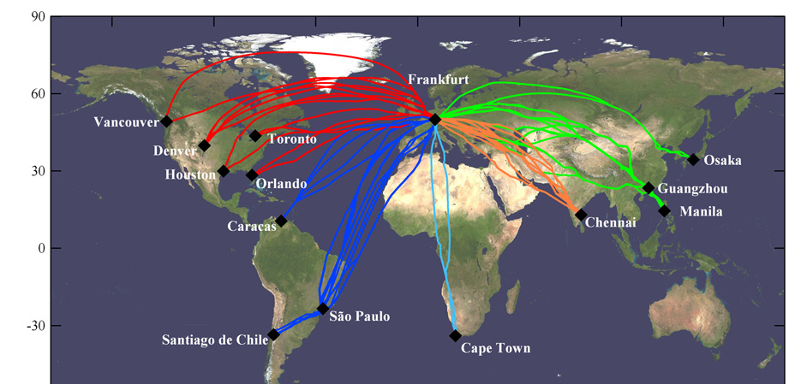
CARIBIC
measurements since 2004

Slide 8
> 28,000 flights !

Slide 9
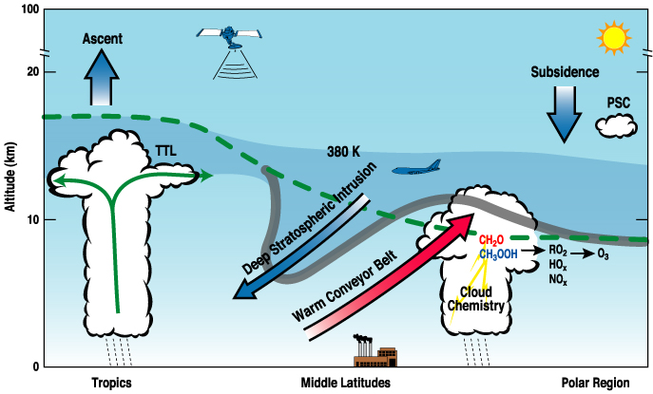
Key transport pathways and processes
influencing the UTLS
Mixing on top of the STJ
Jet

Slide 10
Hot topics:
tropopause inversion layer
multiple tropopauses – tropospheric intrusions
chemical structure of ExTL (including short-lived species)
spatial structure of ExTL transport/mixing
Asian monsoon anticyclone
influence of deep convection
variability and trends in UTLS composition
global tropopause trends / widening of the tropics

Slide 11
The tropopause inversion layer
Birner, 2002, 2006
average vertical structure from high-resolution radiosondes near 45º N,
calculated using ground-based and tropopause-based coordinates
temp
stability
tropopause-
based
coordinate
sharp
maximum
in N²
ground-based
coordinate

Slide 12
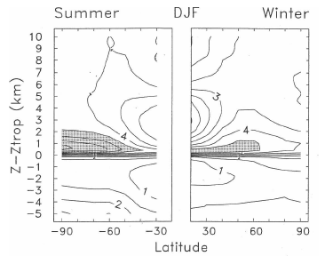
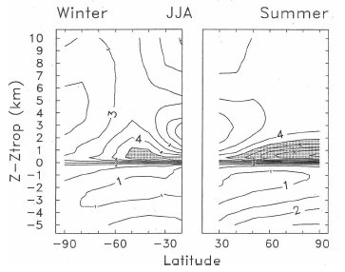
Climatology of TIL from GPS data
N² in tropopause
coordinates
DJF
JJA
summer polar
maximum

Slide 13
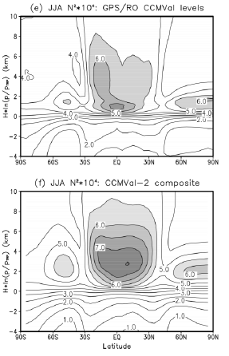
Observed and modeled
global TIL structure
(tropopause coordinates)
GPS observations
(subsampled like model)
model results
Results from CCMval
Chapter 7

Slide 14
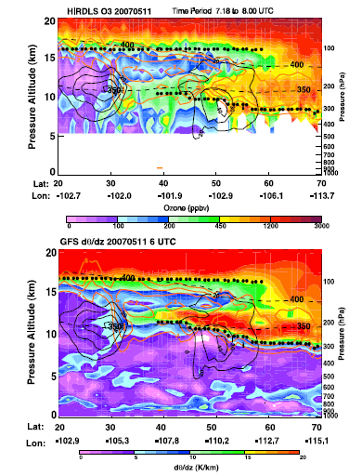
Multiple tropopauses and tropospheric intrusions
Pan et al, JGR, 2009
HIRDLS
ozone
double tropopause
linked to
intrusion above
subtropical jet
static
stability

Slide 15
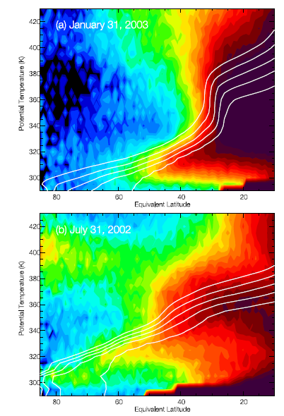
fraction of trajectories
originating equatorward
of 10º
Jet
transport
above
subtropical jet
Jet

Slide 16
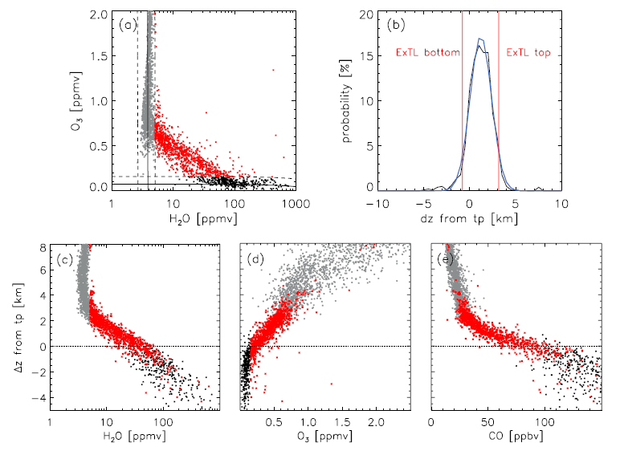
Chemical structure of the ExTL (Hegglin et al, JGR, 2009)
ACE
satellite
data
mixing
layer
using tracer
correlations
to define
mixing layer
H₂O
CO
O₃
tropopause
PV=3.5

Slide 17
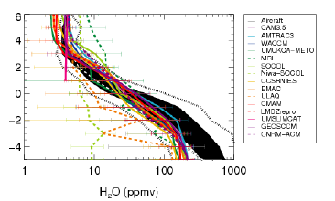
Water vapor mixing layer
model-observations
comparison from
CCMval Chapter 7
Distance from
tropopause (km)
aircraft
data

Slide 18
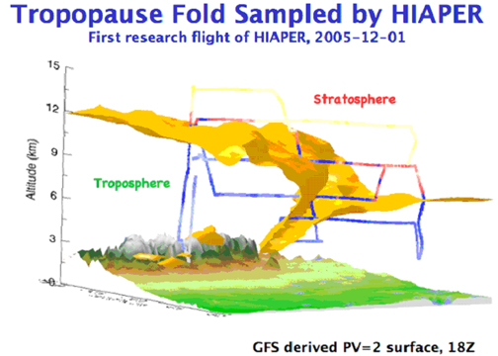
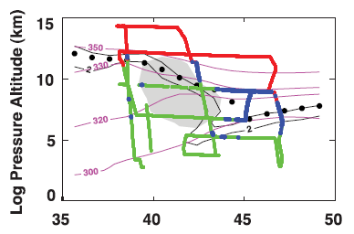
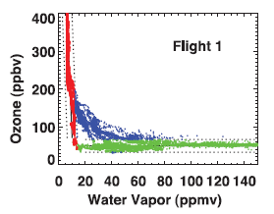
Synoptic spatial structure of transport and mixing
Pan et al, JGR, 2008
Jet
mixing on cyclonic
side of jet

Slide 19
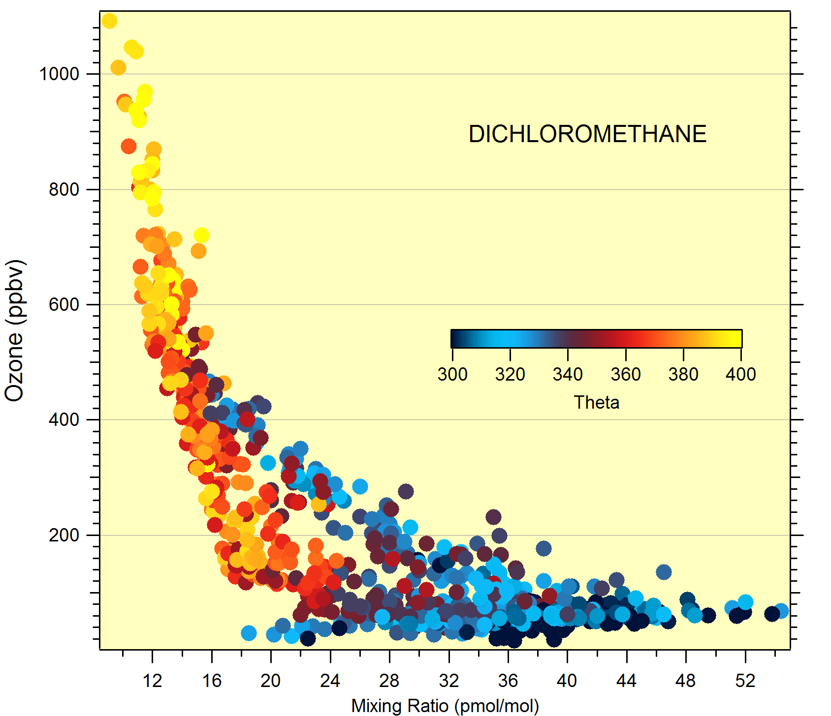
CH₂Cl₂ vs. O₃ correlation START08
from Elliot Atlas

Slide 20
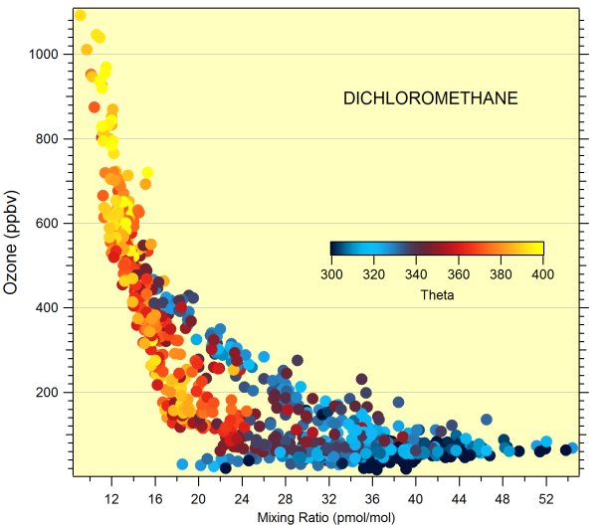
Mixing pathways and tracer correlation
Tropics
Pole
Jet

Slide 21
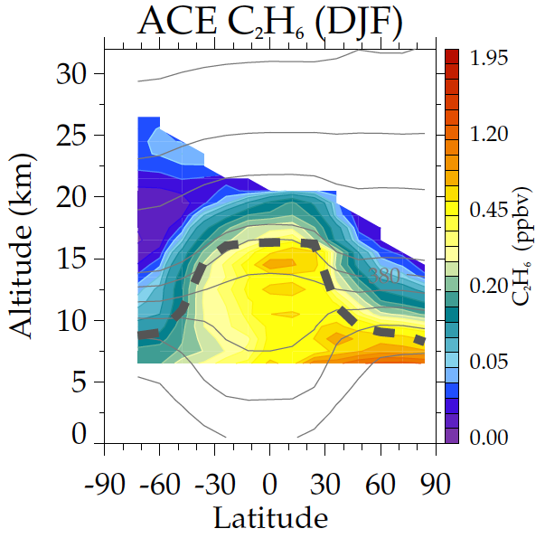
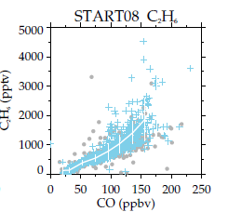
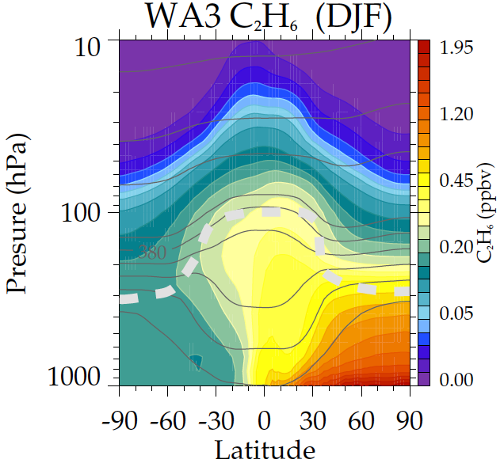
UTLS hydrocarbons: merging aircraft, satellites and modeling
WAS aircraft vs. ACE satellite
ACE
WACCM
from Mijeong Park

Slide 22
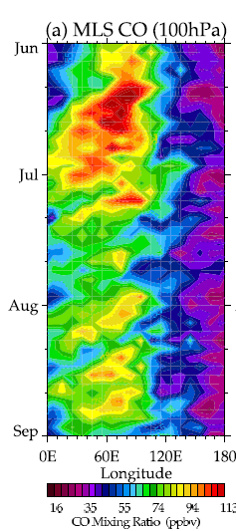
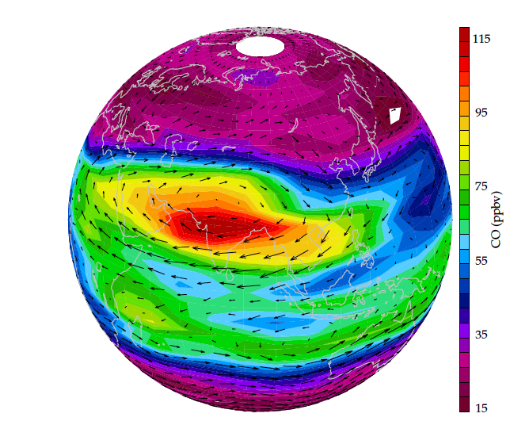
Asian monsoon anticyclone:
strong dynamical and chemical influence on summer UTLS
MLS 100 hPa
carbon monoxide
variability
linked to
monsoon
convection
Park et al, JGR, 2008, 2009

Slide 23
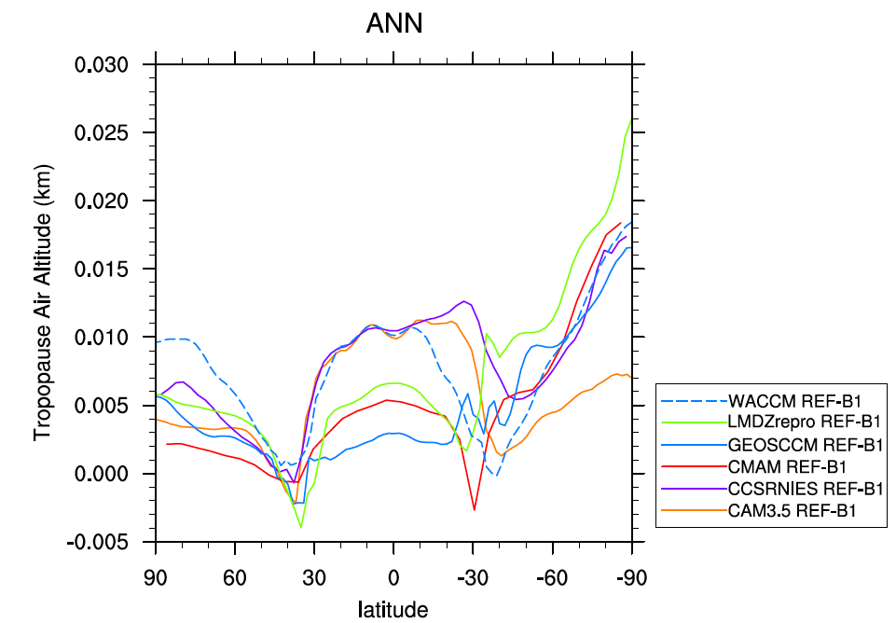
Tropopause Height Trends (1979-2005)
CCMval REFB1 model results
Observations
0.1 km/decade
Thanks to
Andrew Gettelman
Seidel and Randel, JGR, 2006

Slide 24
global tropopause trends / widening of the tropics
20
15
Height (km)‏
J
J
10
5
0
-90
-60
-30
0
30
60
90
Latitude

Slide 25
Metrics for width of the tropics:
ozone gradient
across subtropics
number of days with tropopause > 15 km
20
jet stream
separation
15
Height (km)‏
J
J
10
5
0
-90
-60
-30
0
30
60
90
Latitude
Hadley cell
boundary
(w=0)
downwelling
latitude
(OLR max)

Slide 26
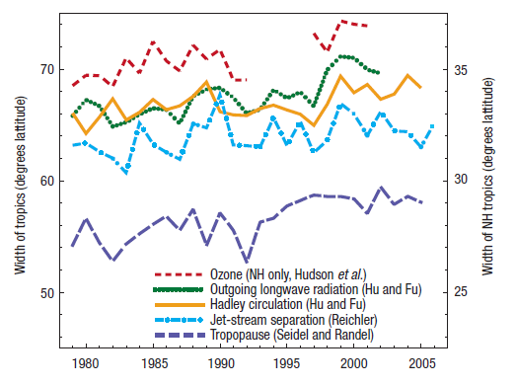
global tropopause trends / widening of the tropics
net change:
2 º- 4º
Seidel et al, Nature Geo., 2008
Question: how relevant is the stratosphere?

Slide 27
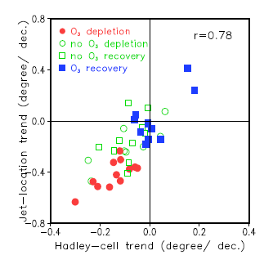
Influence of ozone on SH tropical widening (Son et al, GRL, 2009)
IPCC AR4
model results
Ozone depletion leads to larger poleward
shift of SH jet and Hadley cell

Slide 28
Workshop format:
Overview talks, contributed talks and posters
Dynamical structure
Chemical structure
Transport and STE
Chemistry and microphysics
Long-term variability
Future missions
Rapporteur groups for each Session. Will lead a discussion
of key points each morning.

Slide 29
Output of the Workshop:
Synthesis of key results from each session (what’s new?)
What are critical uncertainties?
Identify current gaps and future research priorities
-> Article for SPARC Newsletter

Slide 30
Posters:
Please put up your poster before or during lunch today.
Poster viewing / discussions:
Monday (extended lunch / poster time 12:00 – 2:30)
Tuesday (reception / poster time 5:30 – 7:00)

Slide 31
Width of the ExTL mixing layer (Hegglin et al, JGR, 2009)
Based on H₂O
Based on CO
thermal
tropopause

Slide 32
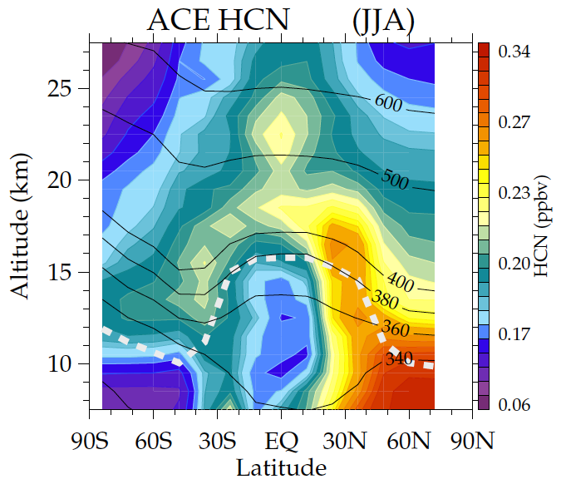
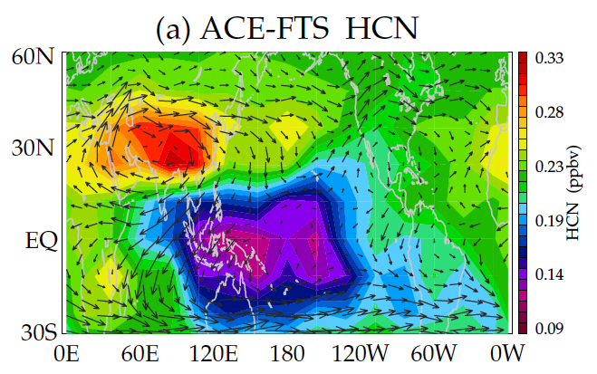
Asian monsoon anticyclone as a pathway to the stratosphere
HCN observations from
ACE-FTS satellite
June-August climatology
monsoon
maximum
tropical
minimum
transport to
stratosphere
via monsoon
minimum for air with
recent ocean contact

