Slide 1
Seasonal variability of UTLS hydrocarbons observed from ACE and comparisons with WACCM
Mijeong Park, William J. Randel, Louisa K. Emmons, and Douglas E. Kinnison
National Center for Atmospheric Research
UTLS Workshop, Boulder, Oct. 19-22, 2009

Slide 2
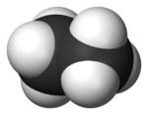
Hydrocarbons – UTLS?
sources
sinks
lifetime
CO
OH
2 months
Biomass Burning
1.5 months
C₂H₆
OH
OH, O(¹D)
~4 years (free atmosphere)
3 months (ocean contact)
HCN
ocean
Useful as tracers in the UTLS
Global satellite measurements (ACE-FTS)
Chemistry transport model (WACCM3)
Notes:
So, why hydrocarbons in the UTLS are interesting. The species shown in this table, carbon monoxide, ethane and hydrogen cyanide, first of all, they have common sources of biomass burning and also common sinks of reactions with hydroxyl radical in the troposphere. And the lifetimes are 2 month for CO and 1.5 month for ethane. And for HCN, the lifetime is 3 months in the troposphere but it has much longer lifetime in the free atmosphere something like 4 years. And also another interesting fact about HCN is that it has significant sinks with the contact with ocean surface.
Since the chemical lifetimes are much longer than the transport time scales, those hydrocarbons are usual as tracers in the UTLS region. Sometimes we see evidences of big biomass burning in the UTLS region.
In this talk, I’ll be using global satellite measurements from ACE-FTS and WACCM3 chemistry transport model simulations.

Slide 3
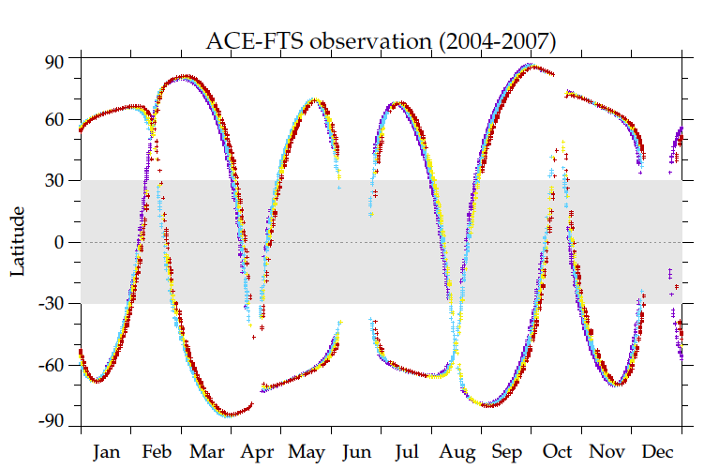
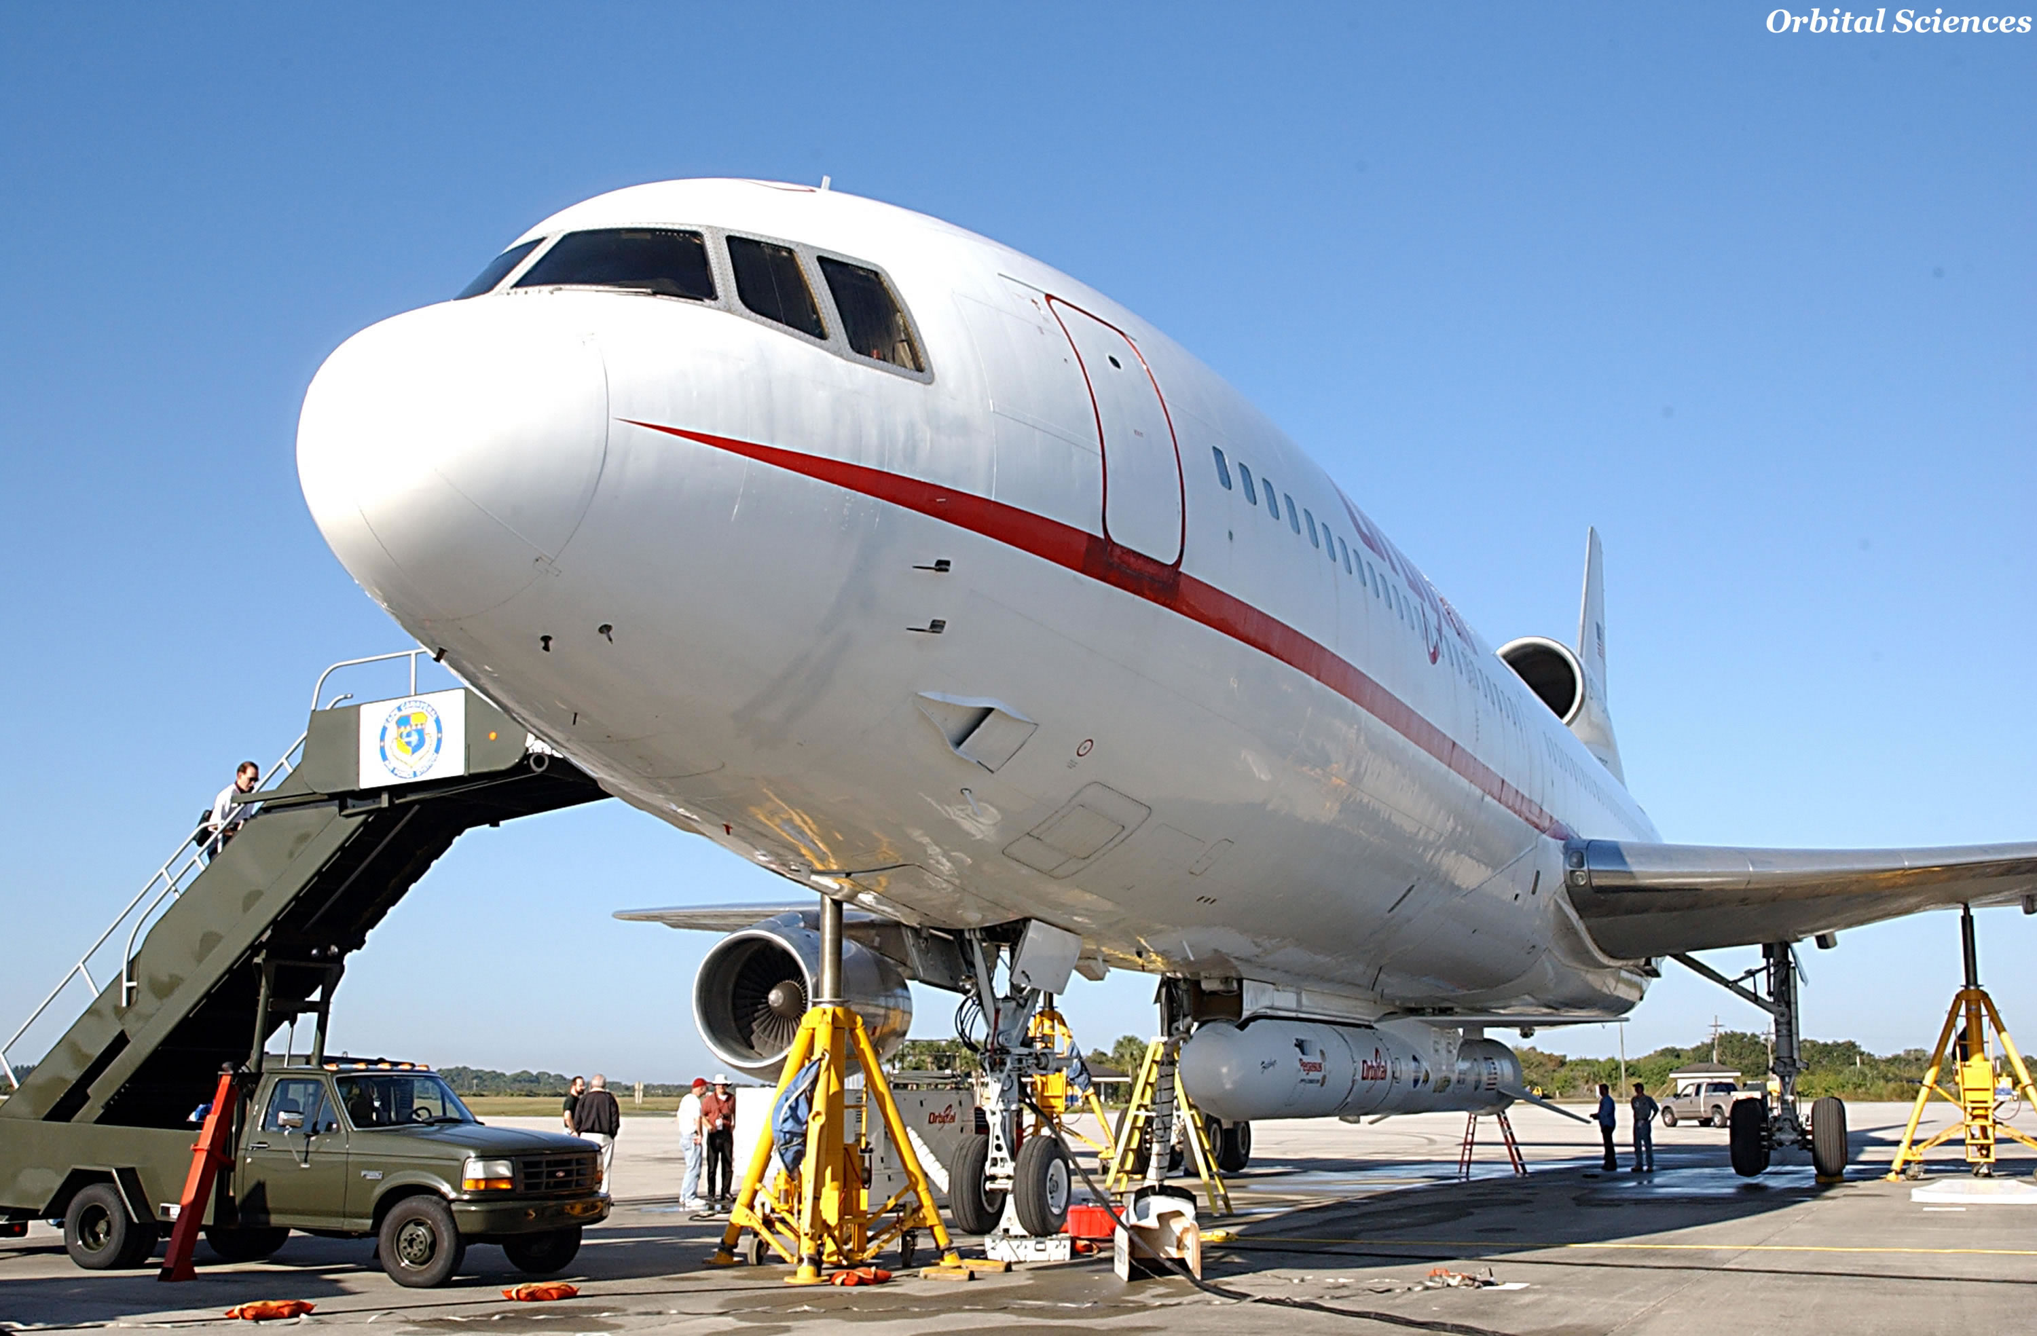
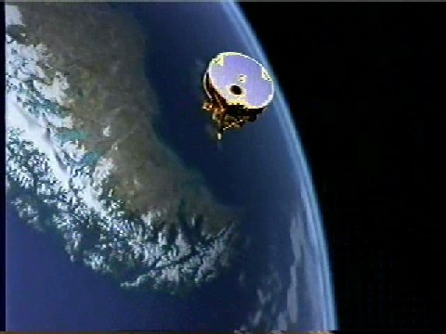
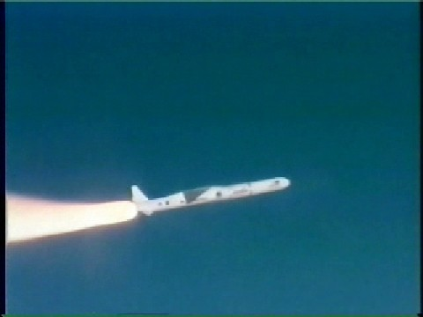
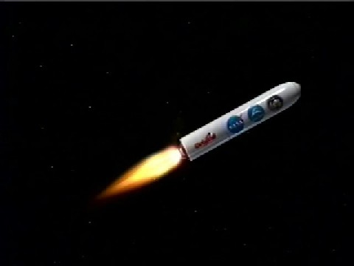
ACE-FTS
Atmospheric Chemistry Experiment Fourier Transform Spectrometer (ACE-FTS) is a high spectral resolution infrared Fourier Transform Spectrometer on SCISAT-1
ACE-FTS measures atmospheric absorption spectra (750-4400cm⁻¹) using solar occultation technique
CO, HCN, C₂H₆, C₂H₂, OCS, CH₃Cl, O₃, HNO₃, HCl,…
ACE-FTS Observations
FEB
APR
AUG
OCT
Tropical sampling ~ 4 times/year
Notes:
ACE-FTS. ACE-FTS is a high spectral resolution infrared Fourier Transform Spectrometer on SCISAT. ACE measures atmospheric absorption spectra over broad region using solar occultation technique. Since ACE is targeted to the polar region, sampling over tropics is somewhat limited. So, from this latitude and time progression of ACE observations, the tropical sampling is mostly available in Feb, Apr, Aug and Oct only 4 times per year. So the seasonal averages of ACE shown in this study are more closer to the monthly averages of those months.

Slide 4
Model Description
Whole Atmosphere Community Climate Model, version 3 (WACCM3)
Driven with GEOS5.1 analyzed meteorological fields
Period: 2004 – 2007 (4 years)
Resolution: 1.9°x2.5° (lat x lon); 88 levels (surface - 150 km)
Includes detailed tropospheric chemistry mechanism (125 species)
Emissions specific to each year
Notes:
We used WACCM3 simulations, which is driven with GEOS5 analyzed met fields for the period of 2004 to 2007. The model resolution is 1.9 degree by 2.5 degree in horizontal and it has 88 levels in the vertical. It includes detailed tropospheric chemistry mechanism for 125 species and the emissions are specific to each year.
GEOS-5 Met. Fields (U, V, T, etc…).
Advantage: Allows direct comparisons with aircraft campaigns and satellite observations.

Slide 5
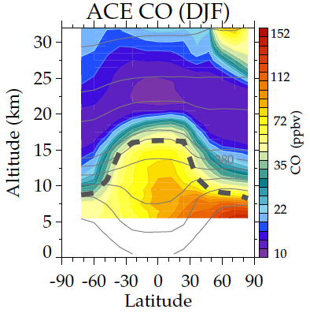
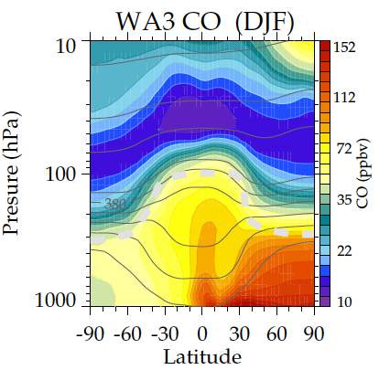
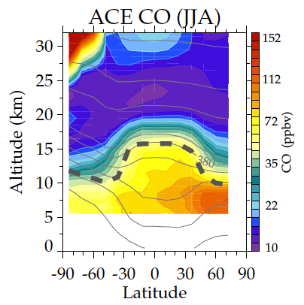
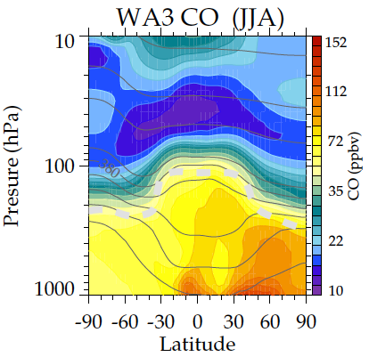
Carbon Monoxide (CO)
ACE CO
WACCM3 CO
Good agreement between ACE and WACCM3
DJF
min
max
ACE CO
WACCM3 CO
JJA
min
max
tropopause
Zonal mean climatology (4 years of data)
Notes:
Now, I’ll be showing some comparisons of ACE and WACCM3 seasonal variations. These are zonal mean climatologies of CO for Northern winter (DJF) and summer (JJA) from ACE (oh the left) and WACCM3 (on the right). The latitudes covers the globe and the altitude range is zero to 32 km, which is close to the surface to 10 hPa in pressure and the dashed line is the thermal tropopause. Overall, there is pretty good agreement between ACE and WACCM climatology. CO maximum is located in the Northern hemisphere troposphere and the minimum is located between 20-25 km due to chemical loss at this altitude.

Slide 6
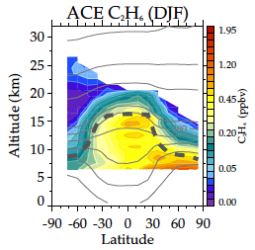
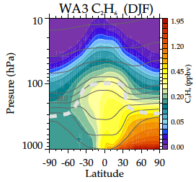
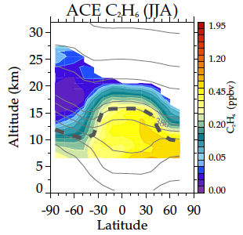
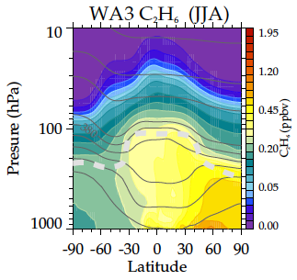
Ethane (C₂H₆)
ACE C₂H₆
WACCM3 C₂H₆
DJF
Overall agreement, but WACCM3 is higher in the lower stratosphere
(convection?)
ACE C₂H₆
WACCM3 C₂H₆
JJA
Zonal mean climatology
Notes:
And ethane. There is overall agreement between ACE and WACCM except WACCM is higher in the lower stratosphere, which might has an implication that convection in the model can be too strong.

Slide 7
CO – Horizontal Map
DJF
JJA
ACE CO 13.5 km
ACE CO 13.5 km
max
WACCM3 CO 147 hPa
WACCM3 CO 147 hPa
max
max (Africa, America, Maritime continent)
max (Asian Monsoon)
Notes:
Now, these are the seasonal comparisons at 13.5 km, near 147 hPa, for CO during winter (on the left hand side) and summer (on the right hand side). Top palel is the ACE and the bottom panel is the model. There are very good agreements between ACE and WACCM. The CO maxima are located over Africa, America and maritime continent during winter and over the Asian monsoon anticyclone during summer.

Slide 8
C₂H₆ – Horizontal Map
DJF
JJA
ACE C₂H₆ 13.5 km
ACE C₂H₆ 13.5 km
max
WACCM3 C₂H₆ 147 hPa
WACCM3 C₂H₆ 147 hPa
max
Reasonable agreement except higher noise in ACE
Notes:
And ethane has similar distributions with CO at this altitude and also has reasonable agreement between ACE and WACCM. So the maxima are located near the convection during winter over the Asian monsoon anticyclone during summer. And ACE has a little bit higher noise esp. in winter.

Slide 9
HCN – Horizontal Map
tropical minimum:
air with recent
ocean contact
DJF
JJA
ACE HCN 13.5 km
ACE HCN 13.5 km
max
min
WACCM3 HCN 147 hPa
WACCM3 HCN 147 hPa
max (Africa – DJF, Asian Monsoon – JJA)
min (ocean)
Notes:
HCN shows good agreement between ACE and WACCM and also has some similarity with CO. For example there is a maximum over Africa during winter and a maximum over the Asian monsoon anticyclone in summer. And there are minima over ocean both in winter and summer, which are very different from any other chemical species’ distributions.

Slide 10
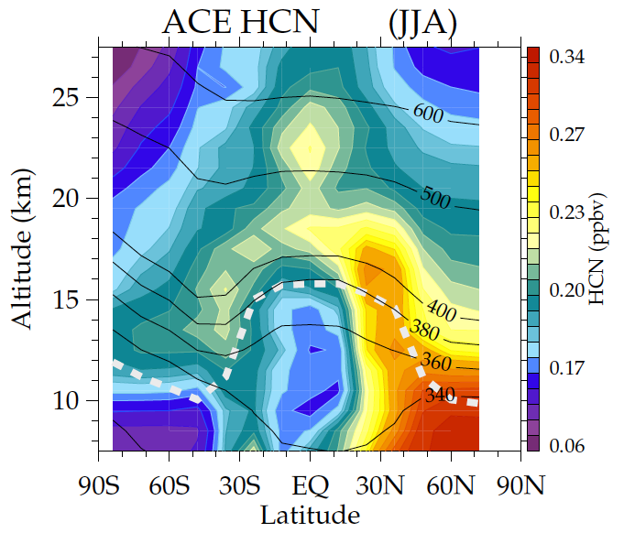
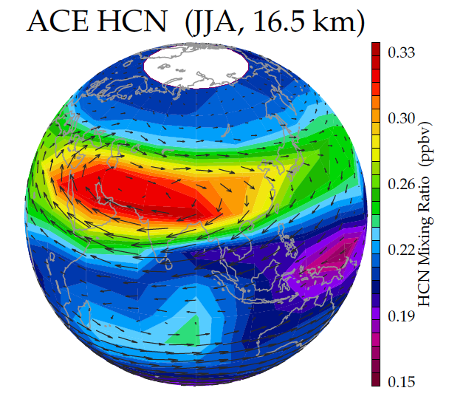
Asian monsoon anticyclone as a pathway to the stratosphere
ACE HCN Climatology
(JJA, 16.5 km)
ACE HCN (JJA)
monsoon
maximum
tropical min
transport to
stratosphere
via monsoon
minimum for air with
recent ocean contact

Slide 11
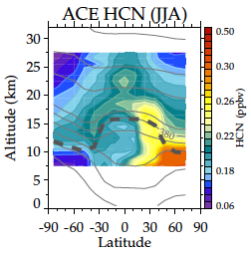
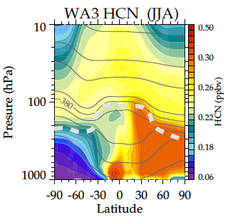
Hydrogen Cyanide (HCN)
(Summer, JJA)
ACE HCN (JJA)
WACCM3 HCN (JJA)
Similar structure, but higher values in WACCM3

Slide 12
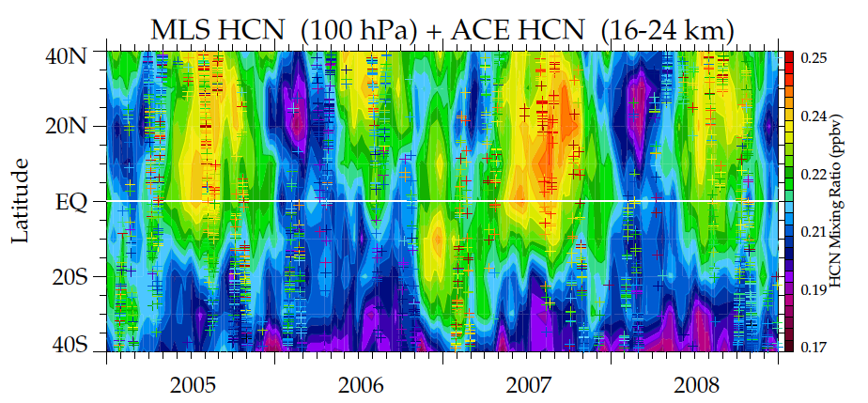
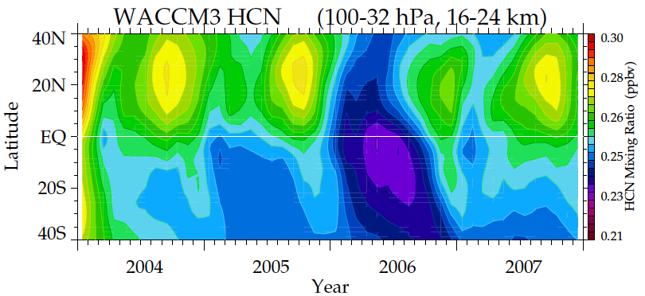
MLS HCN - Time vs. Lat
MLS HCN (100 hPa) + ACE HCN (16-24 km)
WACCM3 HCN (16-24 km) 2004-2007
Maxima in NH summer subtropics, linked to Asian summer monsoon
Notes:
As we’ve seen earlier, HCN has little annual cycle but strong interannual variability in the tropical UTLS region. These are the time variations of HCN near 100 hPa from MLS, ACE and WACCM. ACE and WACCM3 HCN is vertically averaged between 16-24 km following the 7 km vertical resolution of MLS HCN at this pressure level. On the top panel, MLS is shown as colors and ACE is shown as the pluses. The maximum HCN is shown mostly in NH summer over the Asian monsoon region. And there reasonable agreement with ACE and WACCM showing some interannual variability. For example, 2005 and 2007 show higher mixing ratio at the tropics. Since HCN has the minimum in the tropical upper troposphere, the HCN maximum over Asian monsoon anticyclone can contribute transport pathways from troposphere into the stratosphere.

Slide 13
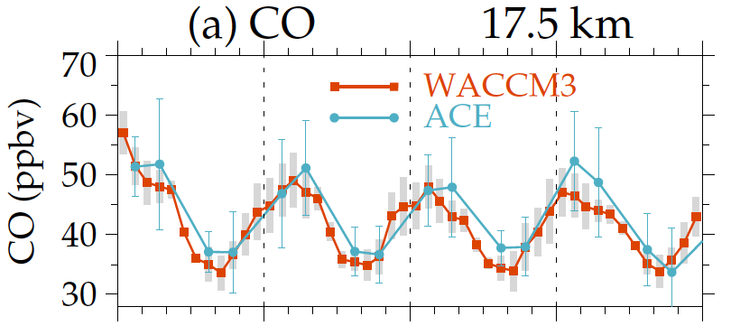
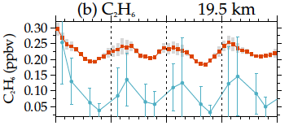
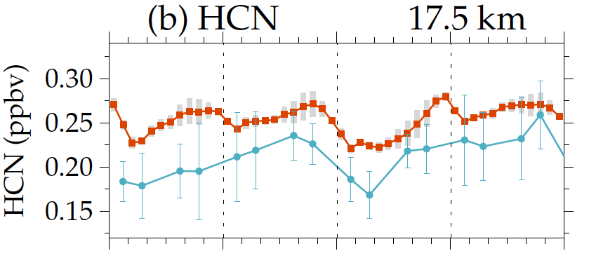
Time Series (15°S-15°N)
CO 17.5 km
annual cycle – right above the tropopause
WACCM3 has very good agreement with ACE
C₂H₆ 19.5 km
annual cycle
HCN 17.5 km
interannual variability
(2 year cycle?)
Notes:
Now, I’m going to show some comparisons of the seasonal cycle in the tropical lower stratosphere. These are the monthly average time series of CO, ethane and HCN averaged over 15S-15N latitude from 2004-2007. CO has a dominant annual cycle right above the tropical tropopause, in altitude range between 16-19 km. And the model has very good agreement with ACE. Ethane also has a strong seasonal cycle in the lower stratosphere. WACCM is a little bit higher than ACE and ACE seems to have bigger error bars at this altitude. And HCN has stronger interannual variability, which is close to 2 year cycle instead of an annual cycle at this altitude and in the lower stratosphere.

Slide 14
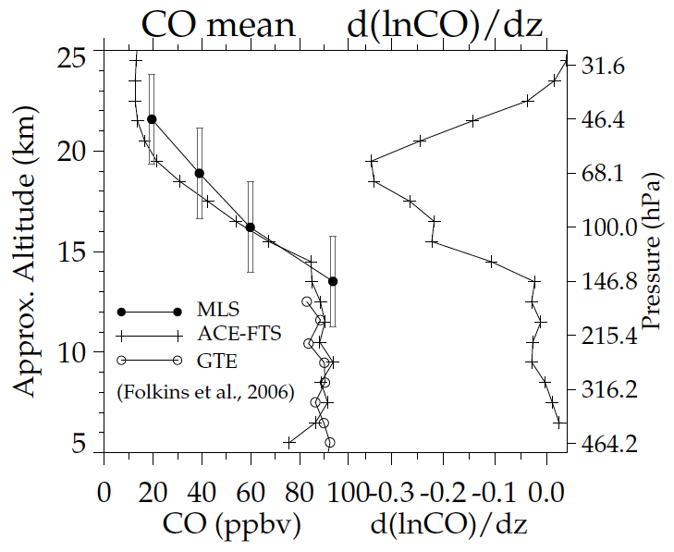
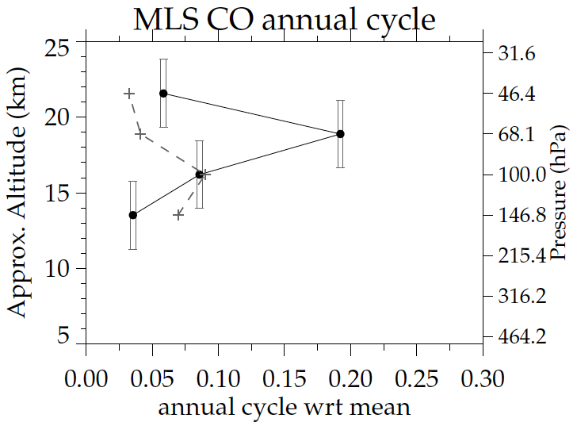
Annual Cycle - UTLS
MLS CO
mean d(lnCO)/dz
CO Annual Cycle Amp
Randel et al. (2007)
CO annual cycle - driven by the seasonal variation in upwelling acting on the strong background vertical gradient in CO
Notes:
Then, why there is a strong annual cycle in CO right above the tropical tropopause? These are the vertical profiles related to the MLS CO shown in Randel et al. (2007). On the left side is the average CO profiles at the tropics showing abrupt decrease in CO due to chemical loss near 15 km. And this shows the vertical gradient of CO, which has a maximum at 68 hPa. On the right is the normalized CO annual cycle amplitude. The maximum annual cycle amplitude at 68 hPa is primarily driven by the seasonal variation in upwelling acting on the strong background vertical gradient in CO .

Slide 15
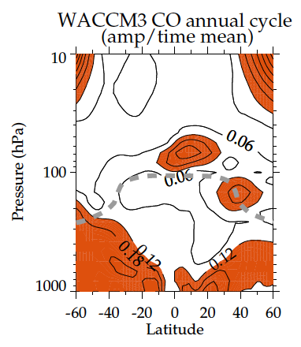
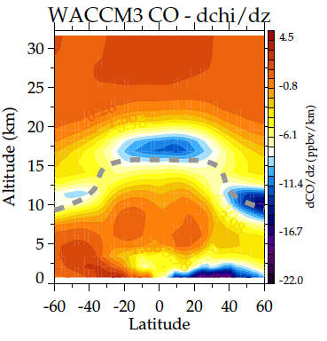
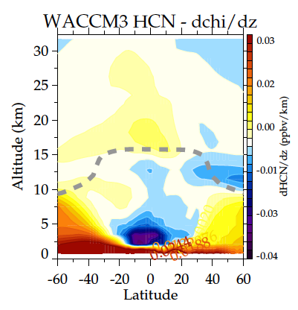
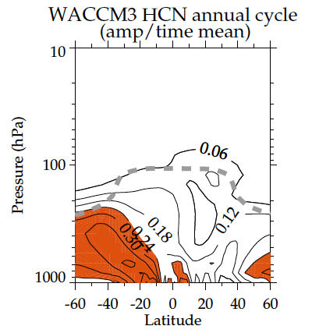
CO & HCN – annual cycle?
dCO/dz
CO Annual Cycle
CO
strong vertical gradient
strong annual cycle
dHCN/dz
HCN Annual Cycle
HCN
WACCM3
climatology
normalized annual cycle amplitude
vertical gradient
Notes:
This is again the same quantities from the previous plot showing zonal mean cross sections of CO vertical gradient and annual cycle amplitude. There is a strong vertical gradient right above the tropopause in the tropics and colocated is the strong annual cycle amplitude of CO. And HCN has a different pictures. There is no strong gradient near the tropical tropopause and the annual cycle amplitude is insignificant.

Slide 16
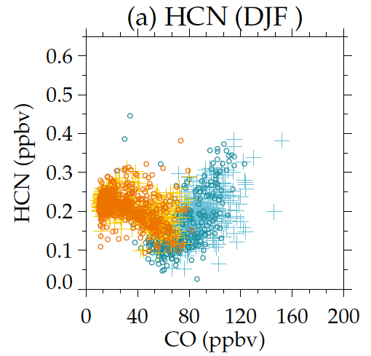
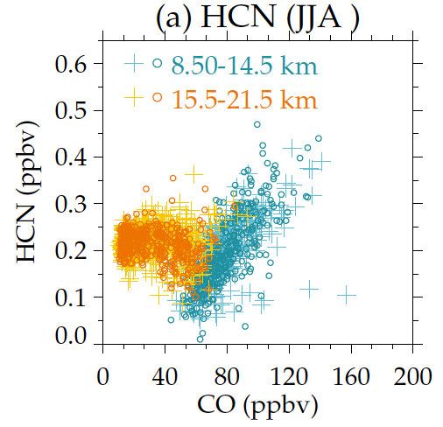
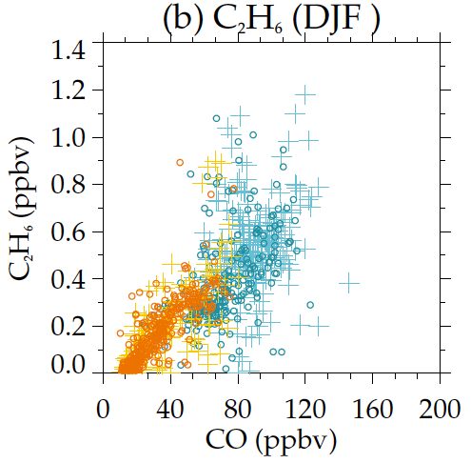
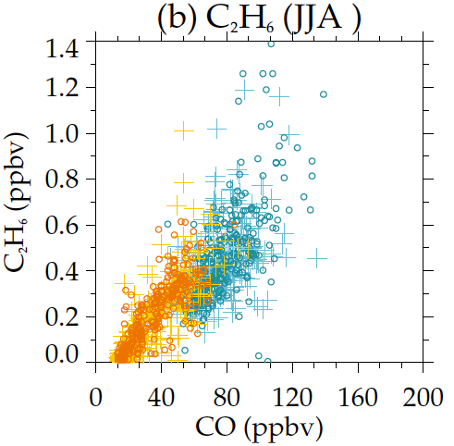
Tracer-tracer Correlations
high altitude (15.5-21.5 km)
DJF
JJA
low altitude (8.5-14.5 km)
HCN
no correlation
C₂H₆
high correlation (annual cycle)
Notes:
So the differences of seasonal cycles in different tracers can be seen in the tracer-tracer correlations. The upper panel shows the scatter plots of HCN vs. CO and the bottom panel shows the scatter plots of ethane vs. CO, both for winter (on the left) and summer (on the right). The orange color means high altitude, between 15 to 21 km, and the green means lower altitude, between 8-14 km. The tight correlation at the low altitude for different species in both seasons mean they have more common sources. However, the tight correlation between ethane and CO at high altitude means there is strong annual cycle at this altitude and the lack of correlation in HCN vs CO correlations in high altitude means HCN doesn’t have a strong annual cycle.

Slide 17
Summary
Seasonal variability of hydrocarbons in the tropical UTLS is analyzed using the ACE-FTS observations and WACCM3.
WACCM3 simulates seasonal cycles in the UTLS reasonably well.
Strong annual cycle is observed for the chemical tracers with strong vertical gradient (CO and C₂H₆) right above the tropical tropopause.
HCN is a unique tracer with minimum in tropical upper troposphere. Transport to stratosphere through Asian summer monsoon circulation.

Slide 18
HCN Chemistry
Production Processes (i.e., Emissions)…
HCN emissions were estimated by scaling CO emissions from biomass burning and biofuel combustion using HCN/CO = 0.012 mol/mol.
Biofuel combustion emissions are constant year-round (primarily domestic heating and cooking).
Biomass burning emissions are monthly averages over 1997-2006 from the GFED-v2 inventory [Van der Werf et al., ACP, 2006].
Loss Processes…
HCN + OH => products. [Strekowski et al, 2001]
HCN + O(¹D) => products [Strekowski et al, 2001]
Wet deposition in the troposphere.
Dry deposition over ocean surface.

Slide 19
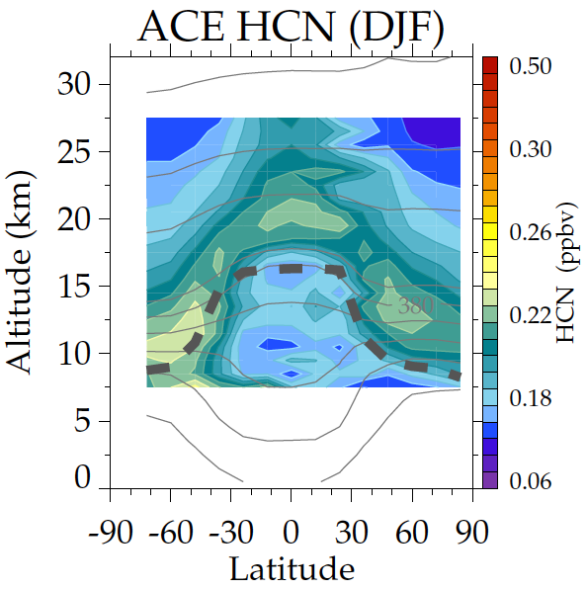
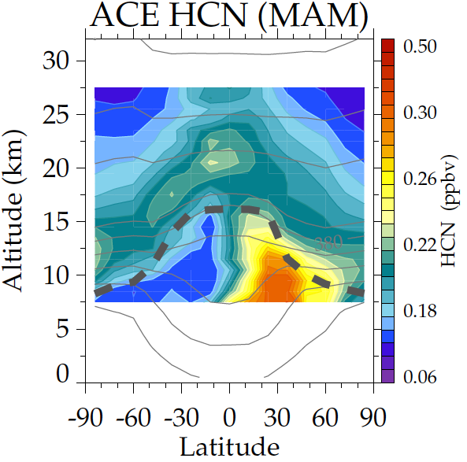
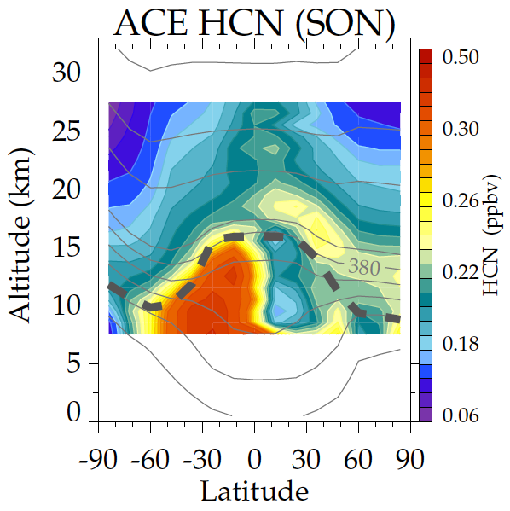
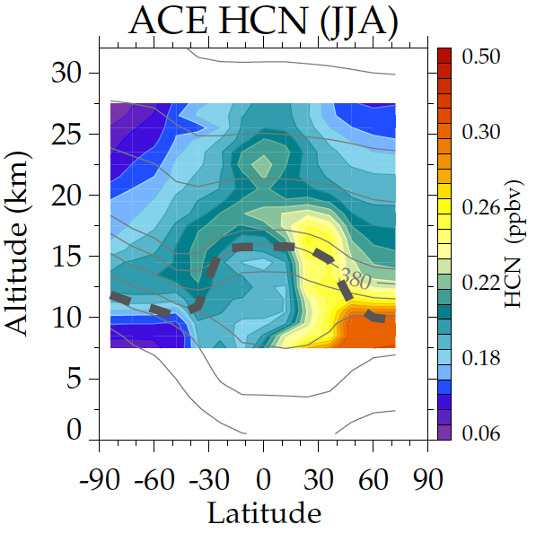
Seasonal cycle
of HCN
from ACE-FTS
HCN source: biomass burning
HCN lifetime: ~4 years in
free atmosphere,
but sink from
contact with ocean

