Slide 1
The lower tropospheric ozone increase over the eastern edge of the
Indochina Peninsula revealed by ozonesondes at Hanoi, Vietnam
Shin-Ya OGINO, Masatomo FUJIWARA, Masato I. NODZU,
Masato SHIOTANI, Fumio HASEBE,
Jun MATSUMOTO, Gia Hiep HOANG

Slide 2
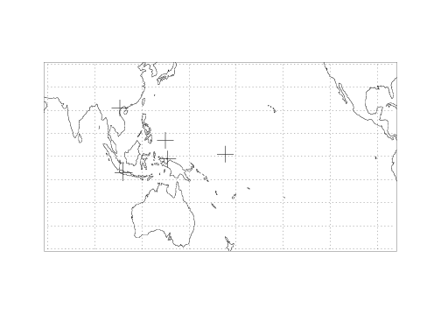
Background
Hanoi, Vietnam (20N, 105E)
Tropospheric ozone
  controls the air quality by producing OH radical
  a pollutant in the lower atmosphere.
  It is important to describe the three-dimensional distribution and its temporal variation of ozone in order to understand the air pollution and atmospheric variability.
Ozonesondes at Hanoi
  Since September 2004
  once- or twice-monthly regular ozonesonde
  SOWER (Soundings of Ozone and Water in the Equatorial Region)
  SHADOZ (Southern Hemisphere ADditional OZonesondes).

Slide 3
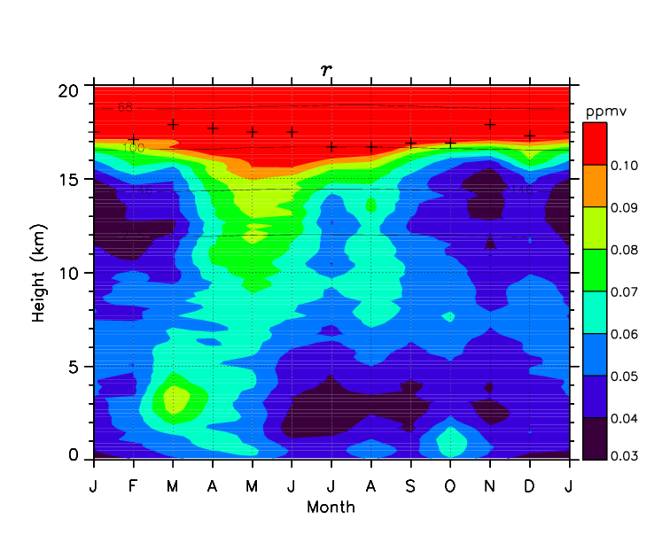
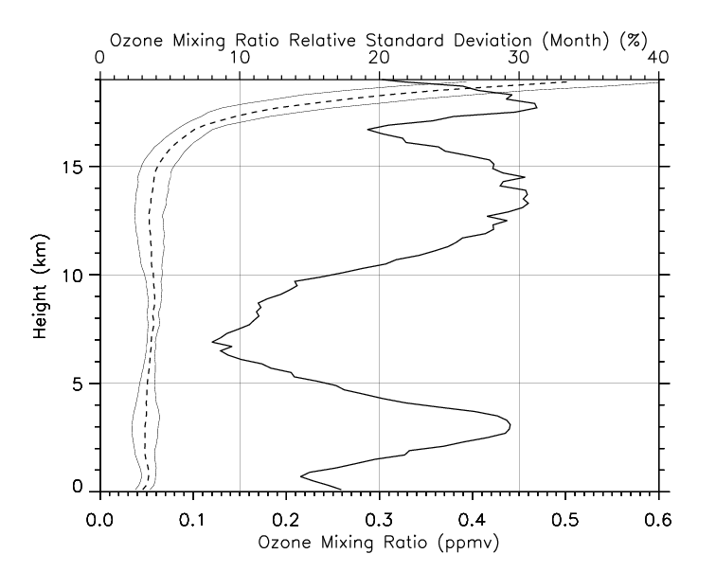
7-year mean seasonal variation of ozone mixing ratio
Ogino et al., 2013 (JGR)
1) UTLS region: Minimum in winter
2) Ozone increase in pre-monsoon season

Slide 4
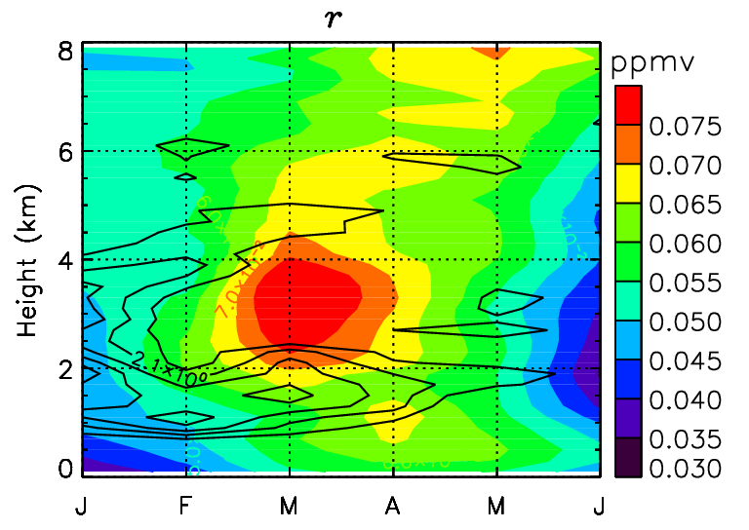
Ozone increase in pre-monsoon season
Ozone （Color shade）
Stability (Black contour)
Ozone increase appears
  at 〜3 km in March
  between double stable layers at 〜2 and 〜5 km. (c.f., Nodzu et al., 2006, J. Clim.)
This implies that the high-ozone air mass around 3 km height is separated from the other regions by these stable layers.

Slide 5
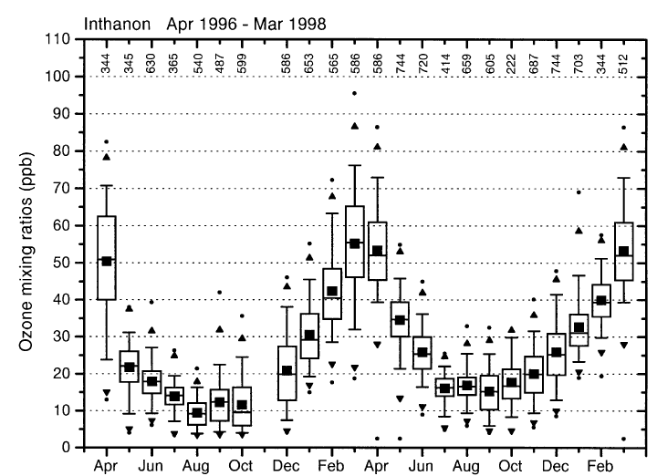
Ozone increase in pre-monsoon season
Source of ozone
  Biomass burning?
    Surface ozone increase in March in Thailand (Pochanart et al.,2001）
  Why is the ozone max at Hanoi at 3 km ?
  Transportation process should be clarified.
Ozone （Color shade）
Stability (Black contour)
Surf. Ozone in Thailand (Pochanart et al.,2001）

Slide 6
Ozone increase in pre-monsoon season
Objective
  clarify the transportation process and the mechanism of the ozone increase
Method
  backward trajectories
  meteorological fields
Data used
  Ozonesondes at Hanoi
  Operational radiosondes at Hanoi
  NCEP Reanalysis 2
Ozone （Color shade）
Stability (Black contour)
Surf. Ozone in Thailand (Pochanart et al.,2001）

Slide 7
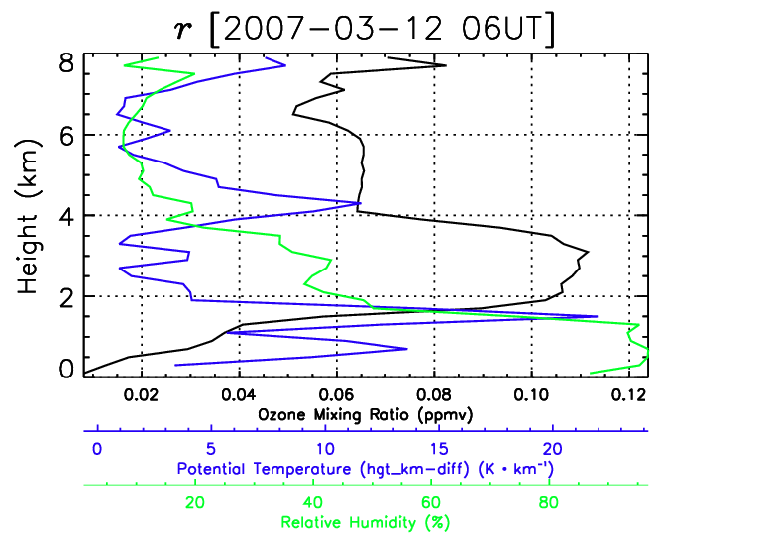
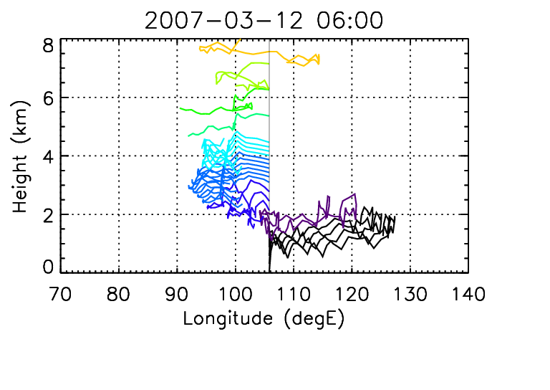
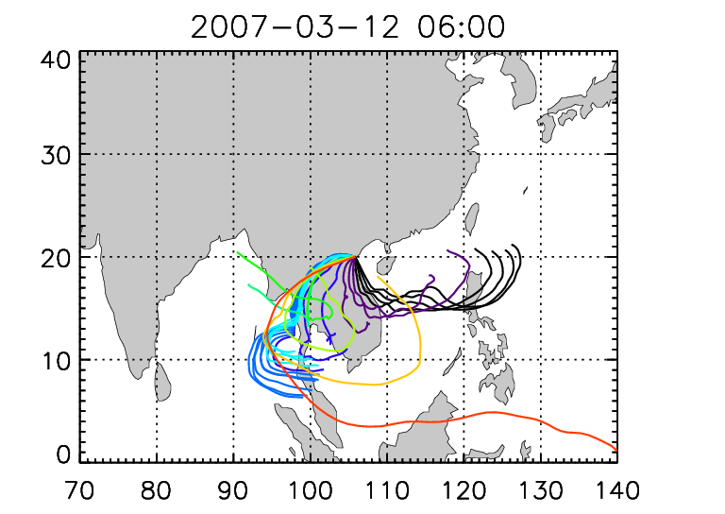
Trajectory analysis for the typical case of ozone increase in 2-4 km on Mar 12, 2007
5-day trajectories
Y-Z section
5-day trajectories
X-Y section
0-2 km: from the ocean in the east
2-4 km: from the land in the west or the southwest

Slide 8
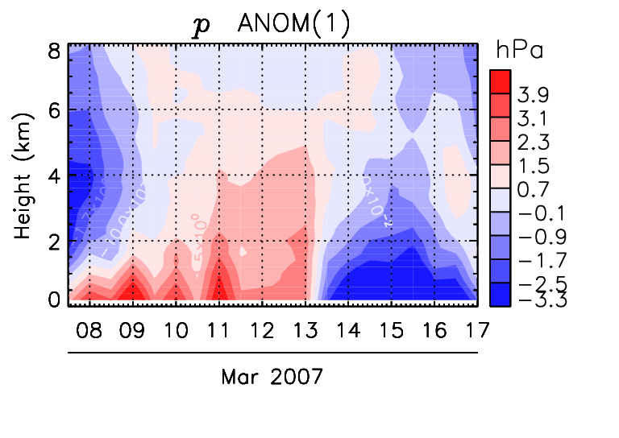
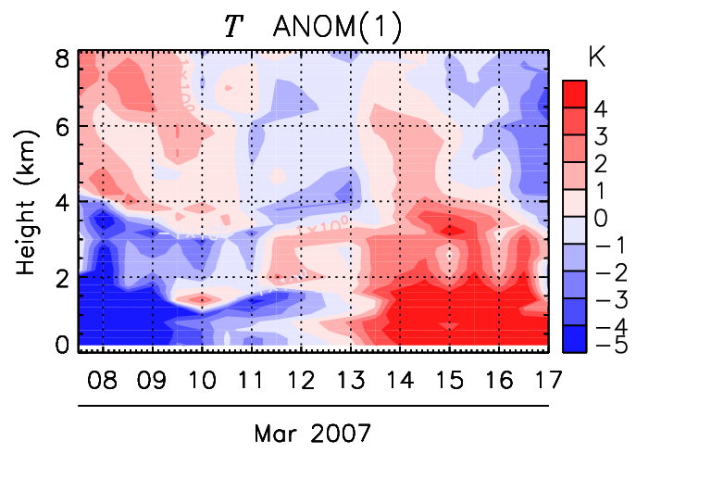
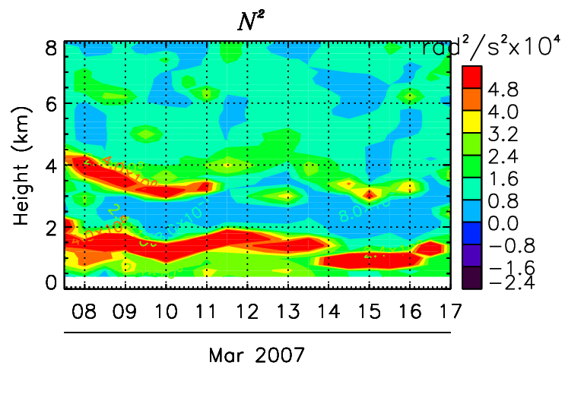
Pressure, temperature and stability
5 days before and after the typical case
High pressure and cold anomaly before and during the ozonesonde observation.
Clear double stable layers

Slide 9
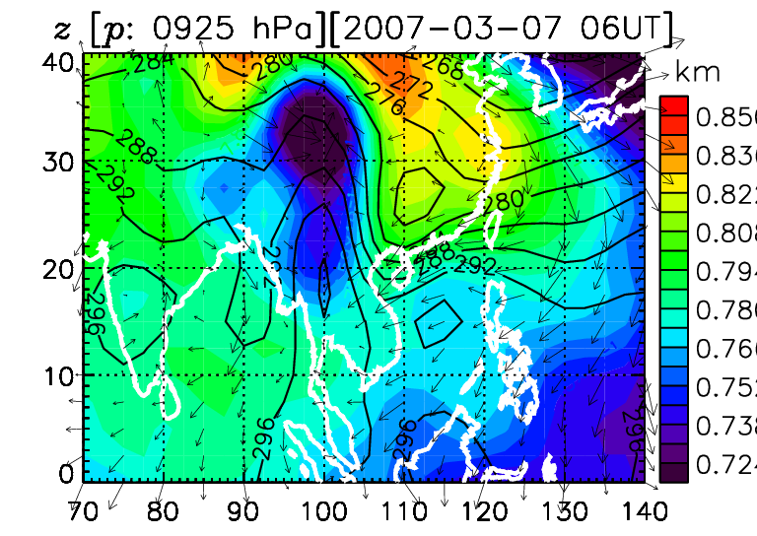
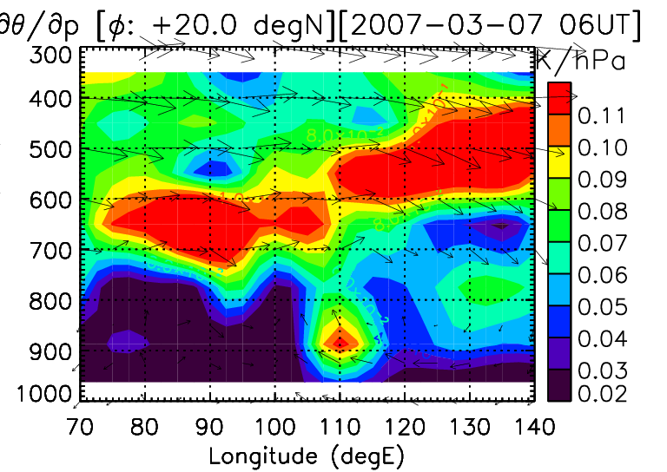
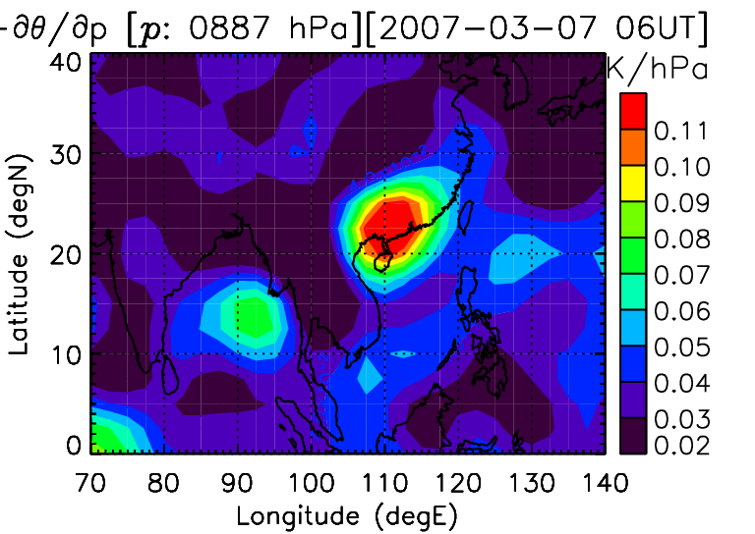
Horizontal and vertical structure
X-z section of stability at 20N
Z@925hPa (shade) and
T@925 hPa (contour)
Typical cold surge near surface
Stable layer just above cold surge intrusion
Vertical structure of stability
  Lower stable layer: near Hanoi
  Upper stable layer: broad extent
Stability just above 925hPa

Slide 10
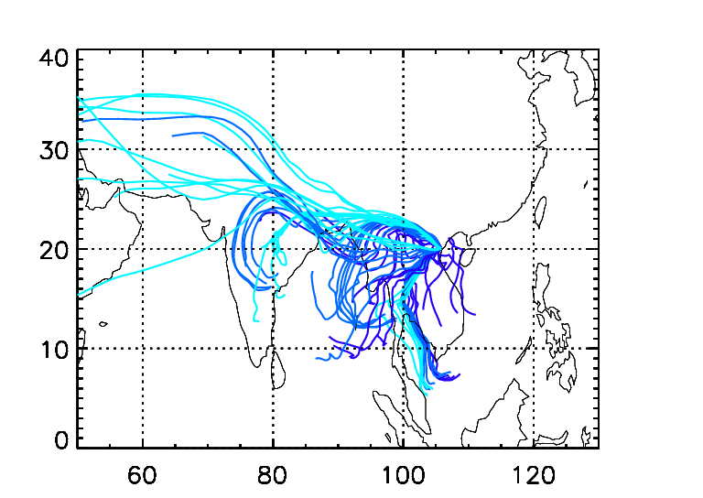
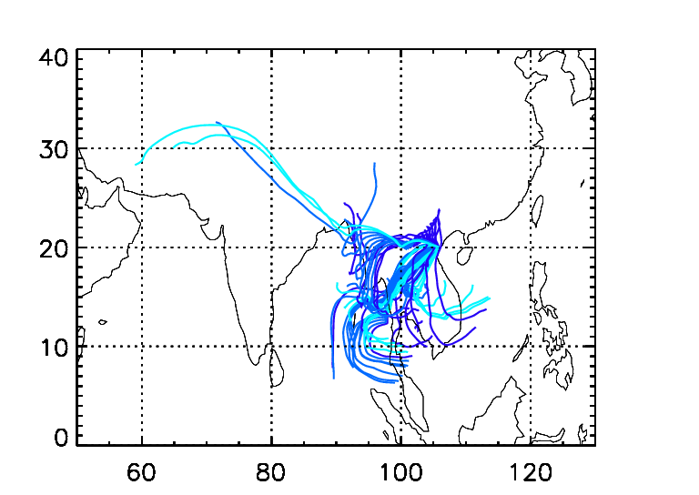
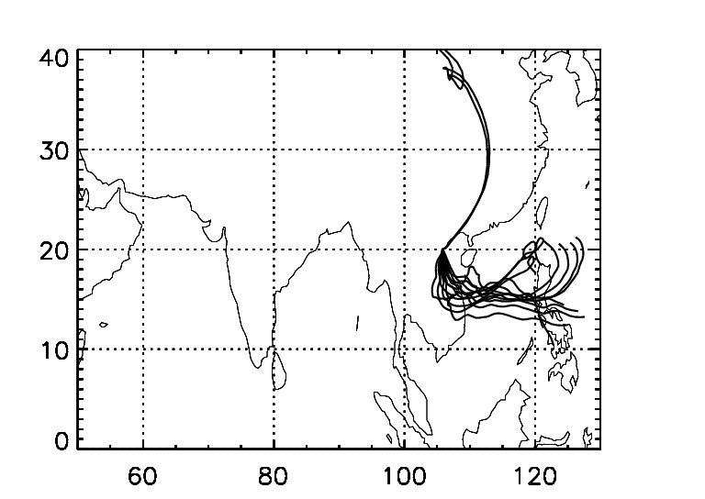
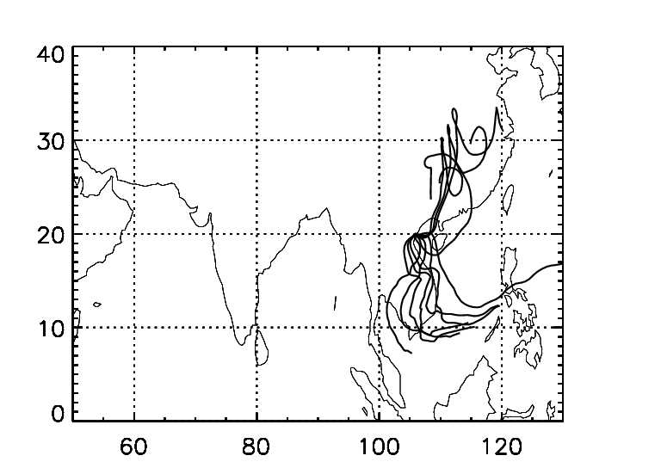
2-5 km
Low O3
High O3
0-1 km
Low O3
High O3

Slide 11
Schematic view
Unstable over the land
Shallow convections below the upper stable layer.
Polluted air well-mixed up to the upper stable layer.
The well-mixed air is advected by westerly flow, but when a cold surge is dominant, the lower level advection is blocked and the air only above the lower stable layer can reach the eastern side of Peninsula.
Upper stable layer 〜 5 km
Well mixed
Polluted air
Lower stable layer
〜 2 km
Cold surge
West
East
Indian
Sub-continent
Indochina
Peninsula
Hanoi
This system is only established from February to April, because the land heating is not strong enough in January, and the rainy season starts in May.
Ozone transport and distribution in this season is characterized not only by the seasonality of biomass burning but also by the monsoon transition from dry to rainy season.

