Slide 1
The Impact of the Asian Summer Monsoon and Typhoons on the UT/LS Chemical Composition Implications from ACCLIP Dry-Run Efforts Using the Chemistry Models and Satellite Measurements
Qing Liang¹, Doug Kinnison²
and many others (Laura Pan, Mian Chin, Leslie Lait, Eric Fleming, Juying Warner, Paul Newman, Ren Smith, Shawn Honomichl, Elliot Atlas, the CAMS team)
¹NASA Goddard Space Flight Center
² NCAR

Slide 2
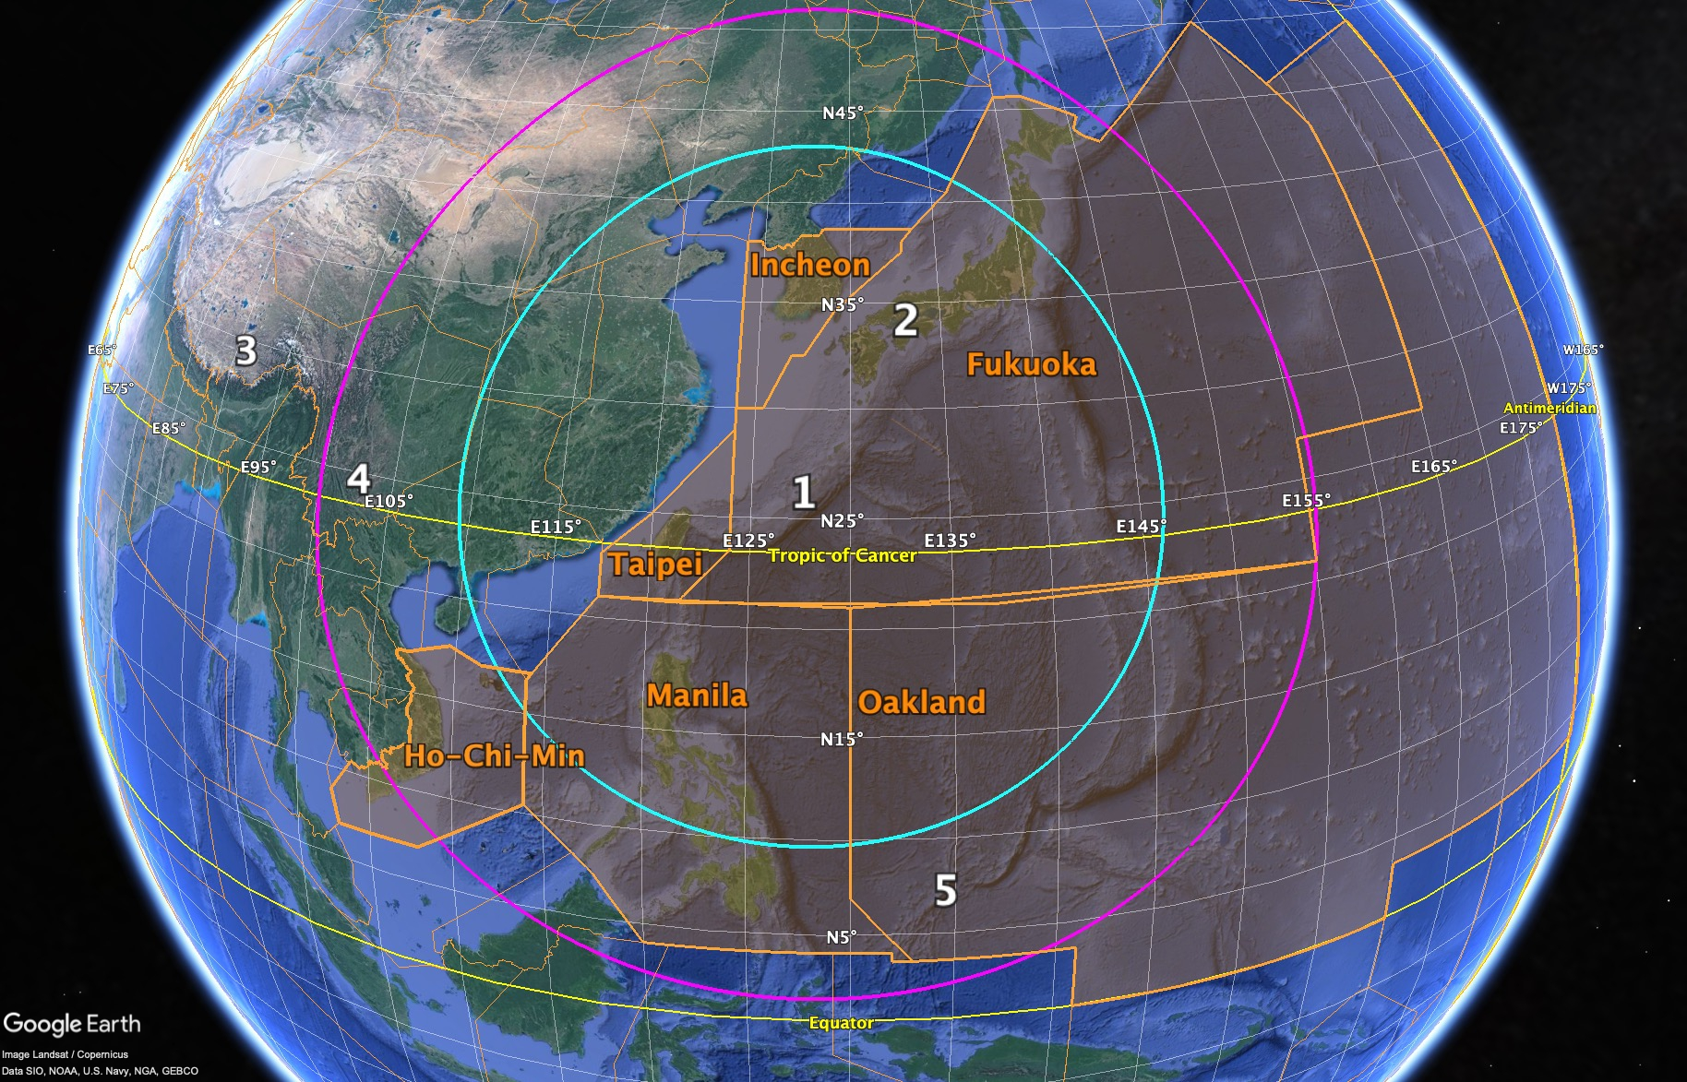
The Asian summer monsoon Chemical and Climate Impact Project (ACCLIP)
Chemistry in the ASM outflow
Budget of long-lived and short-lived chlorinated and brominated ozone depleting substances and their replacements
CFC-11 emissions from Asia
HCFCs, HFCs
Manmade very-short-lived chlorinated gases (VSLS-Cl), e.g. CH₂Cl₂
Natural very-short-lived brominated gases (VSLS-Br)
Ozone photochemistry and budget
→ Transport and chemistry of NMHC and OVOCs
→ NOx (lightning/combustion)
→ UT/LS ozone production and transport
Chemistry-climate interaction
Short-lived climate pollutants
Aerosol precursors and aerosol formation and transport
Airborne measurements: The NSF/NCAR research aircraft Gulfstream V (GV), the NASA research aircraft WB-57, and balloon borne ground-based measurements of profiles of aerosol and water vapor to complement the airborne studies.
Planned measurements include :
O₃, NO, NO₂, H₂O
CO, CO₂, CH₄, organic trace gases
Black carbon, SO₂ (and others by CIMS), aerosol composition (MS), aerosol size distribution
Cloud particles, and thermal profiles (MTP).
For more ACCLIP information please see Laura Pan’s presentation from this session.

Slide 3
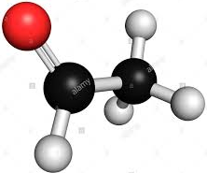
How can ACCLIP address the chemical impact of Asian Summer Monsoon on the UT/LS ozone and aerosol photochemistry?
VOC sources
OH
CO
HO₂
OH
Direct emissions
Anthropogenic combustion
Biomass burning
Terrestrial and ocean biogenic sources
HOx, NOx, RO₂
→ Net O₃ production
OH, hv
OH, hv
NO
NO₂
HCHO
In situ VOCs oxidation
Alkanes
Alkenes
Isoprene
Aromatics
Precursors & oxidants
(OH, H₂O₂, HNO₃)
→ aerosol formation
hv
CH₃C(O)O₂
hv
OH
PAN
CH₄ oxidation
CH₃CHO

Slide 4
ACCLIP forecast and flight planning: Three Global Chemistry-Transport Models
1st Dry run: 3-model dry run to monitor July-August 2019 + one-week B57 dry run test
2nd Dry run: 3-model dry run monitoring effort for July-August 2020
Field mission planned for July-August 2021
Model System | Res. | Chemistry | Aerosol
NCAR WACCM-SD / GEOS5 | 1-deg, 88L (110L), surf to 140km | Interactive 240 species | MAM4 (modal)
NASA GEOS | 0.25 deg, 72L, surf to 80 km | Specified Oxidants (OH, H₂O₂, NO₃ from GMI) | GOCART (Bulk)
ECMWF CAMS (Assimilation) | 40km, up to 80km T511 137L | CB05 | Bulk Scheme

Slide 5
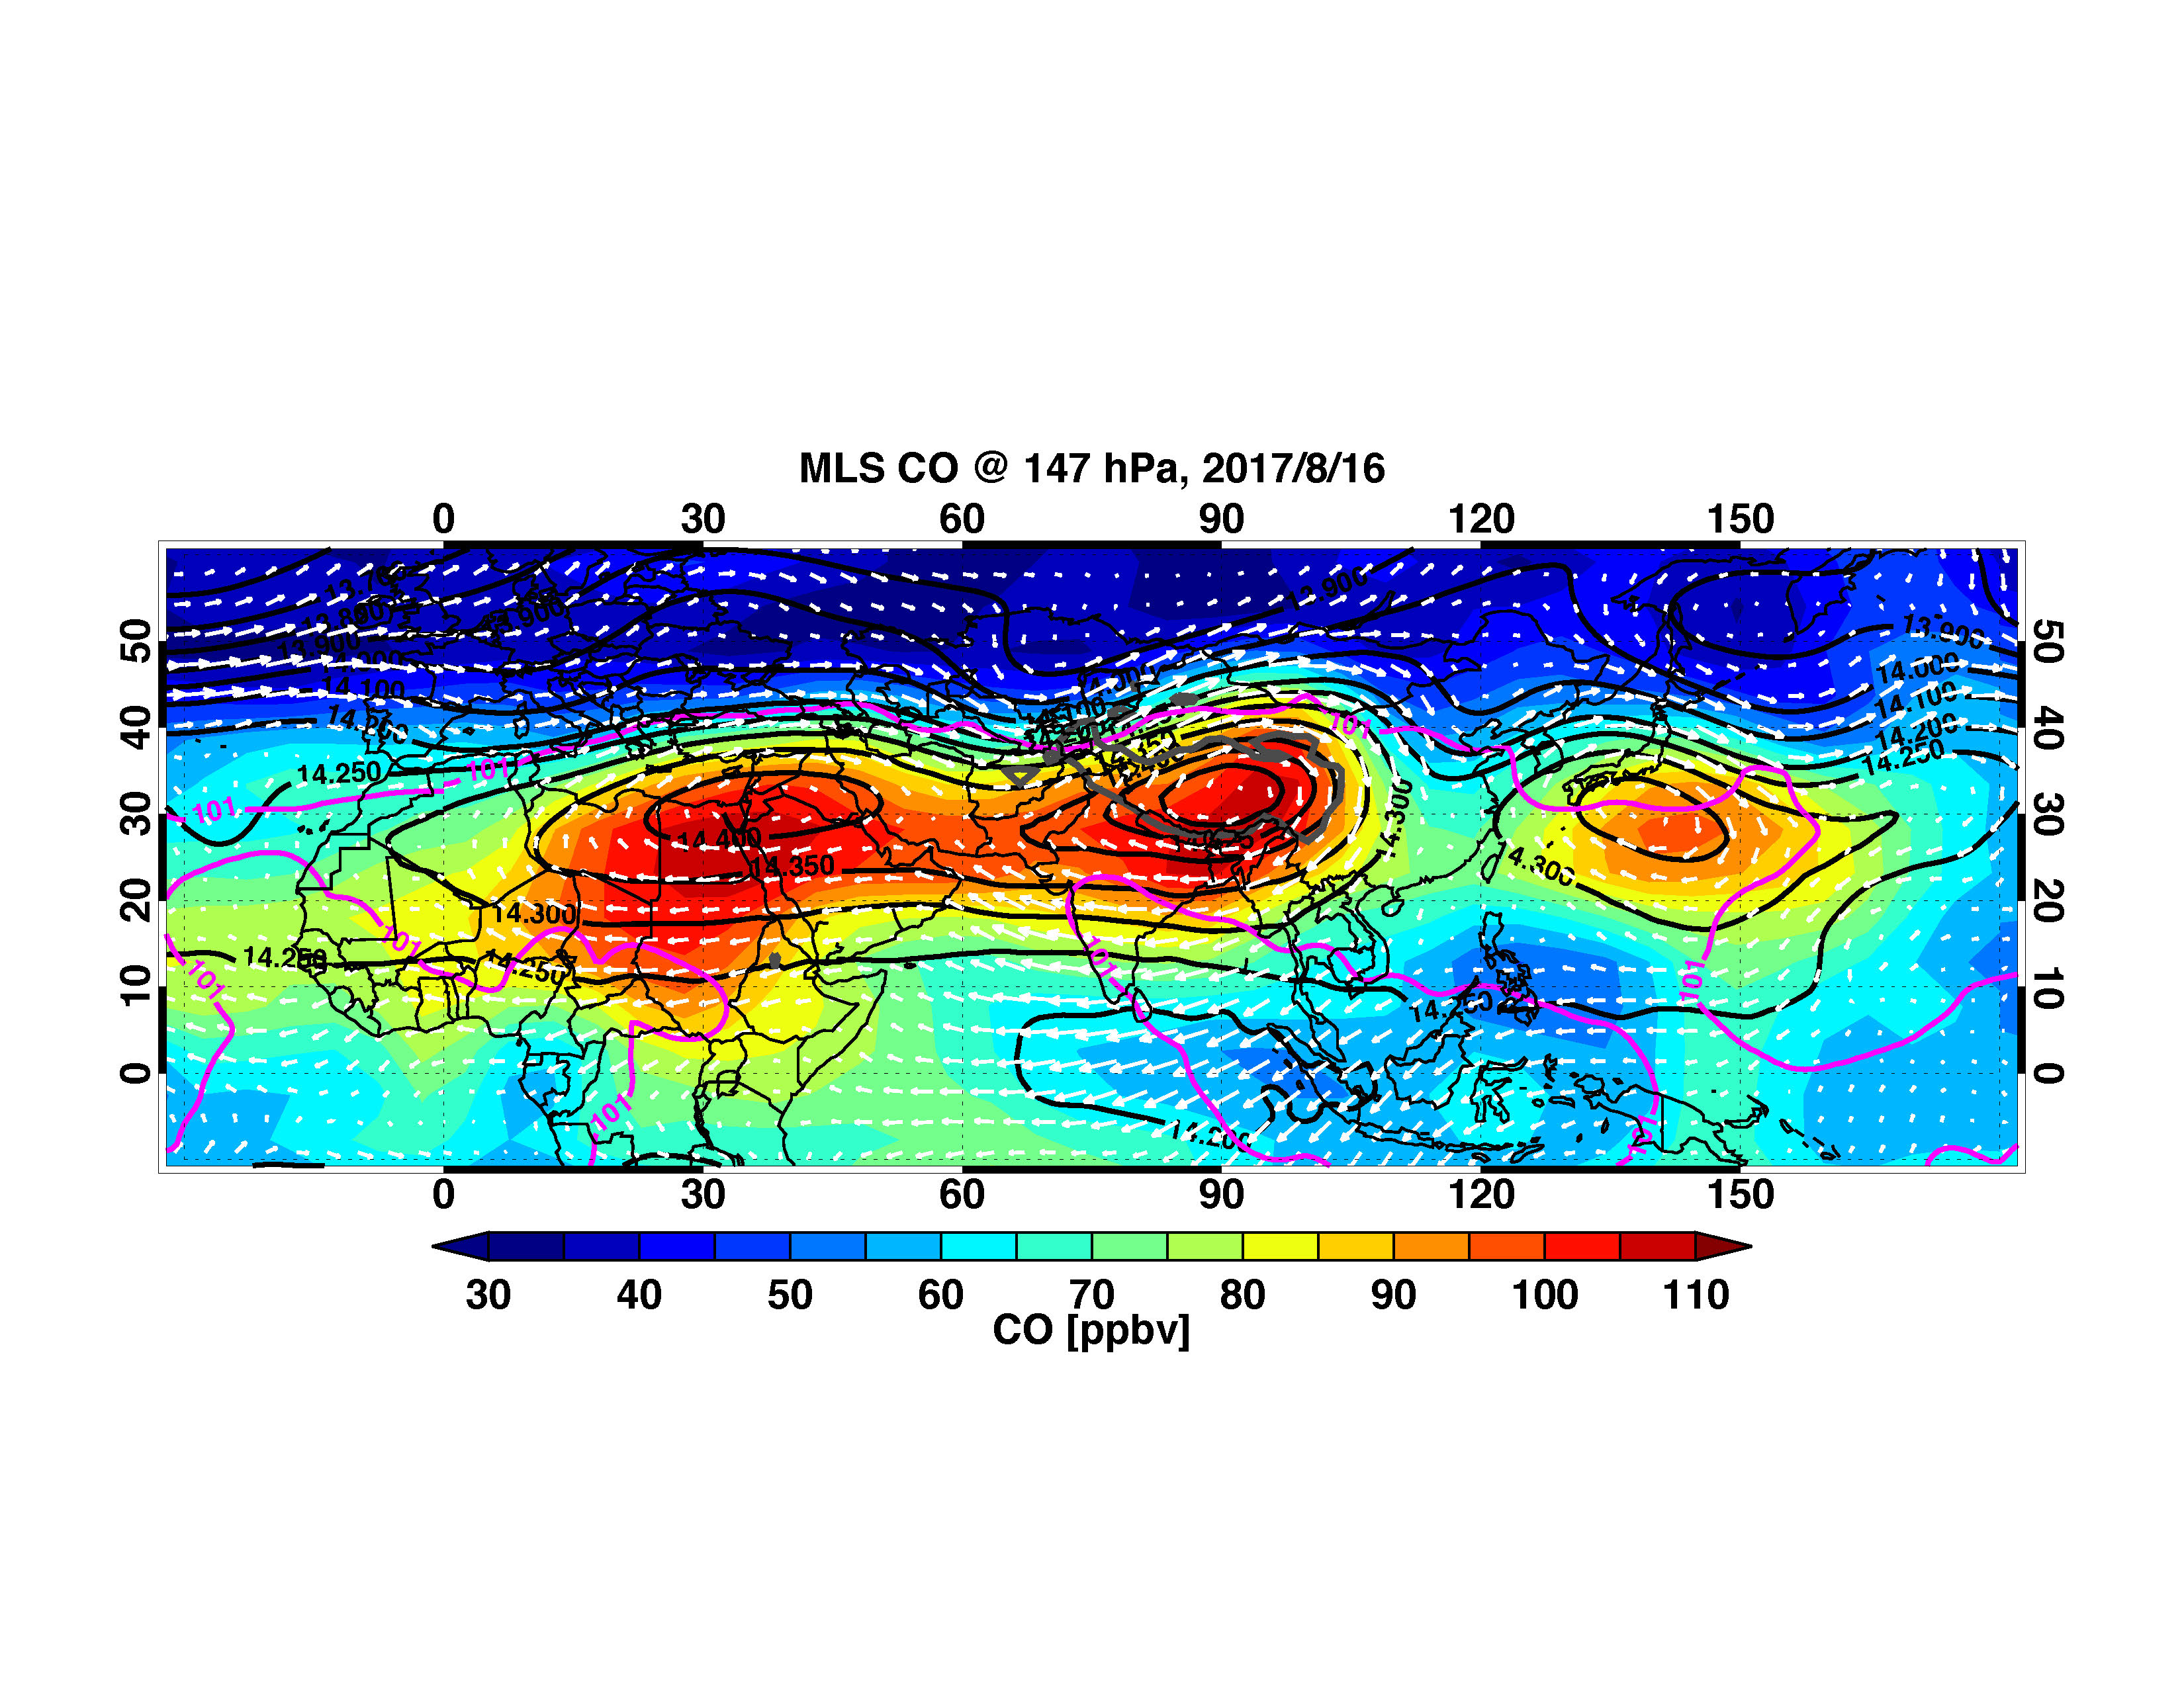
CO in the Asian Summer Monsoon
Iranian Plateau mode
Tibetan Plateau mode
Western Pacific mode
From Laura Pan

Slide 6
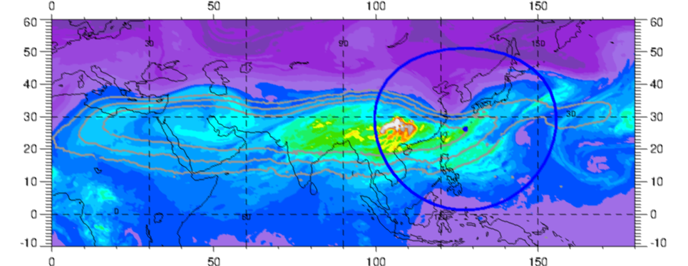
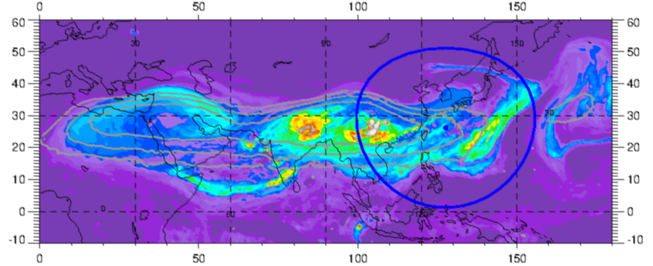
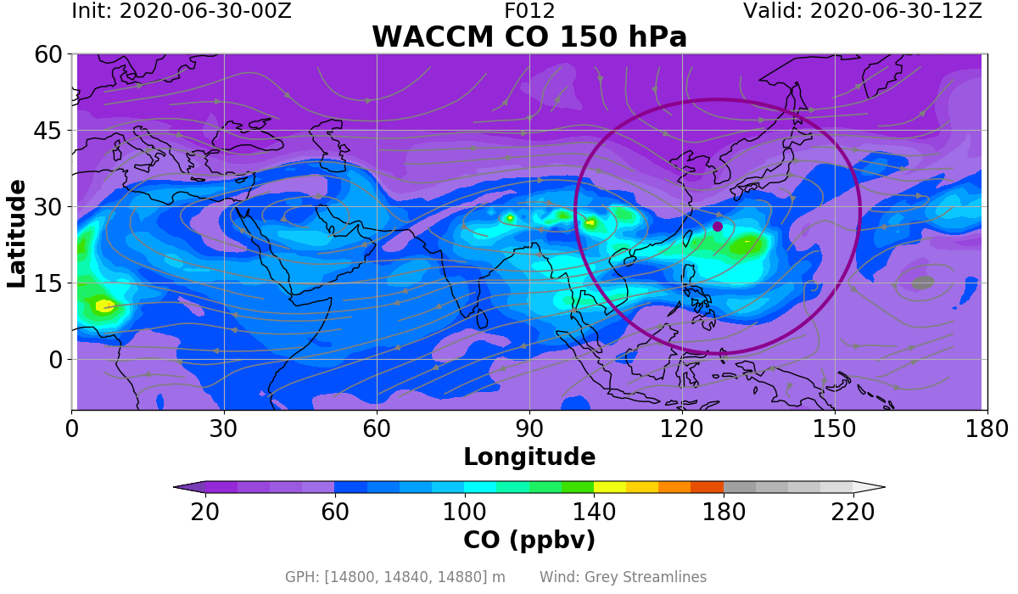
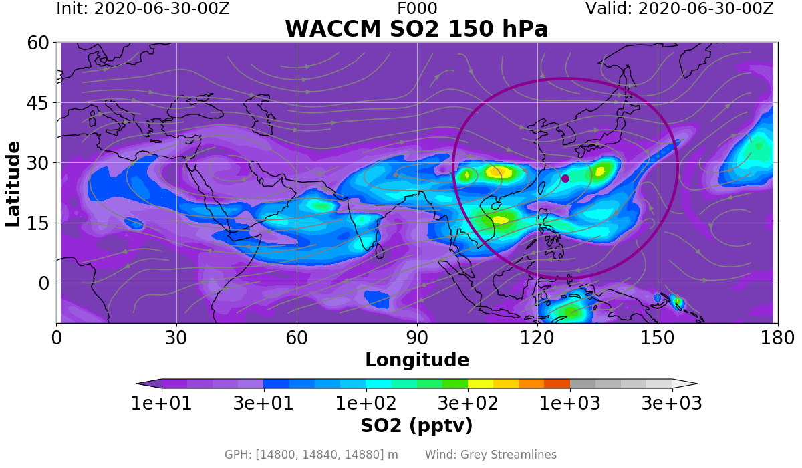
NCAR Field catalogue to archive all model and satellite plots http://catalog.eol.ucar.edu/acclip_2019/
CO @150hPa (2020/06/30 12Z)
SO₂ @150hPa (2020/06/30 12Z)
GEOS
GEOS
CAMS
CAMS
WACCM
WACCM

Slide 7
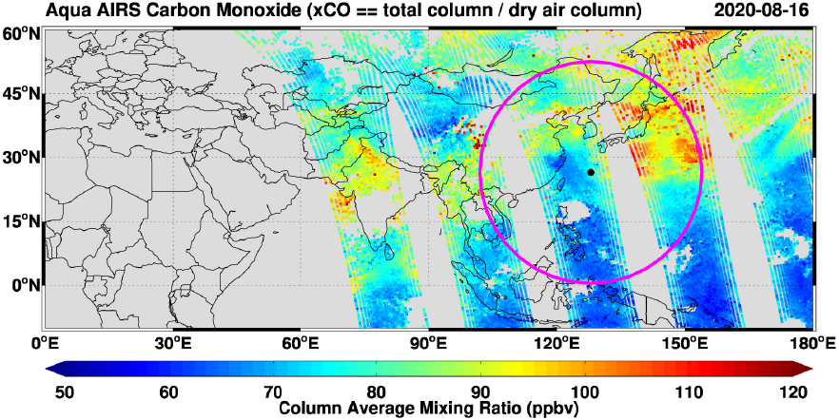
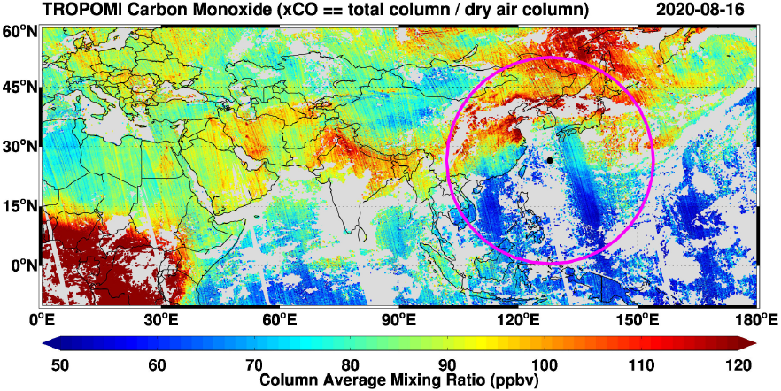
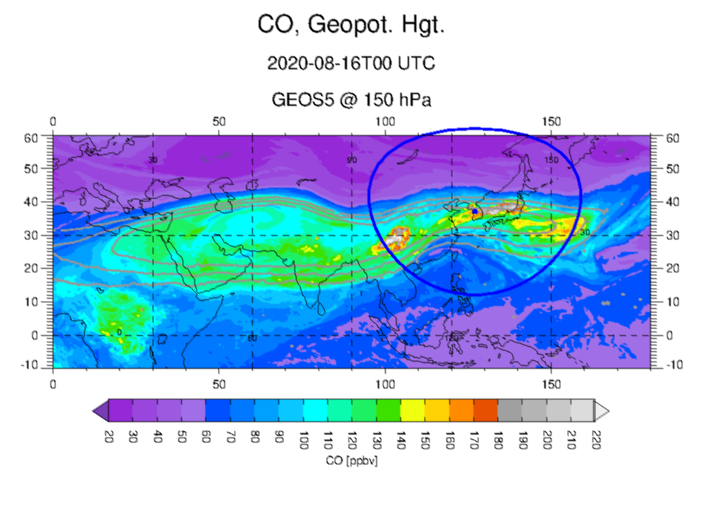
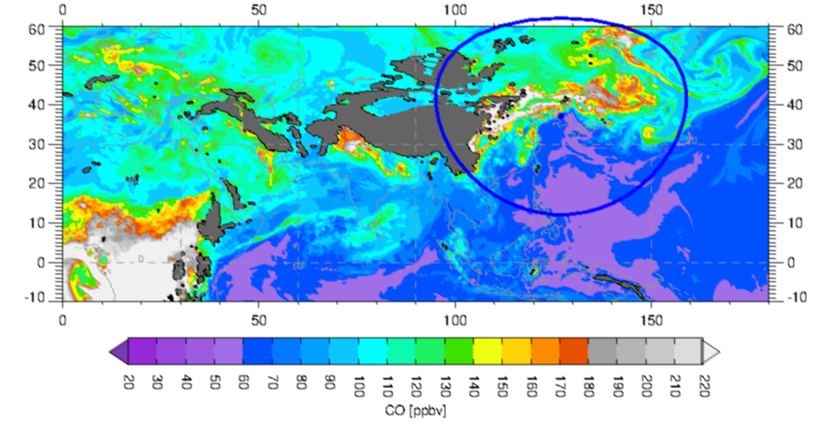
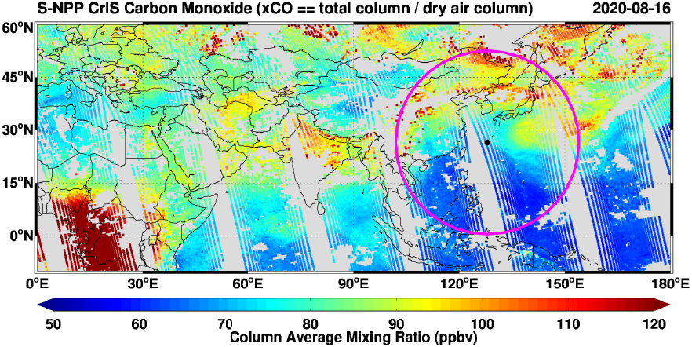
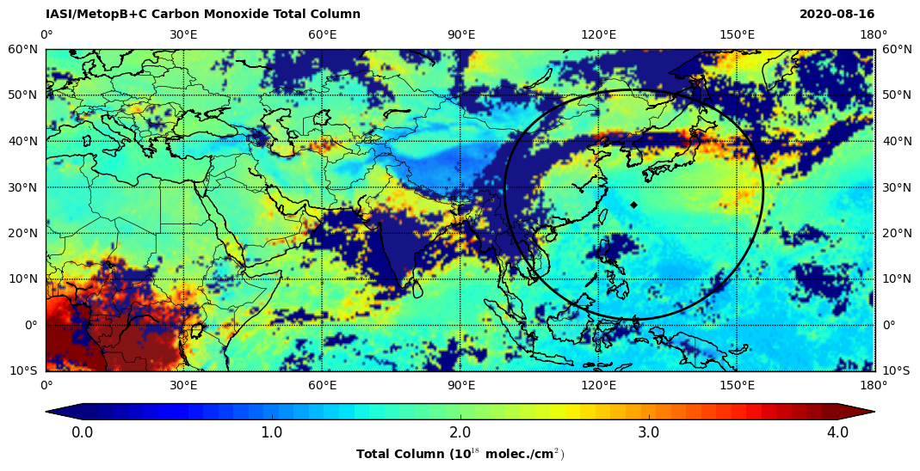
Satellite CO Nadir Measurements for ACCLIP
August 16, 2020, two shedding events
Model
AIRS
TROPOMI
GEOS CO at 150 hPa – Aug 16 00Z
1
2
CrIS
IASI
GEOS CO at 850 hPa – Aug 16 00Z

Slide 8
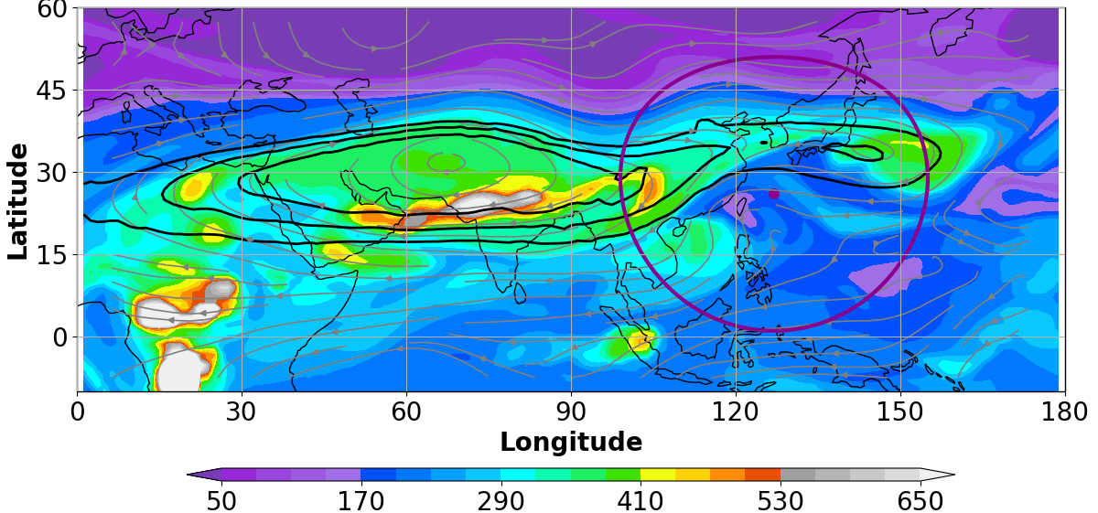
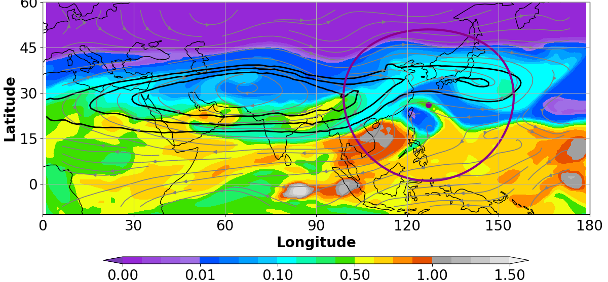
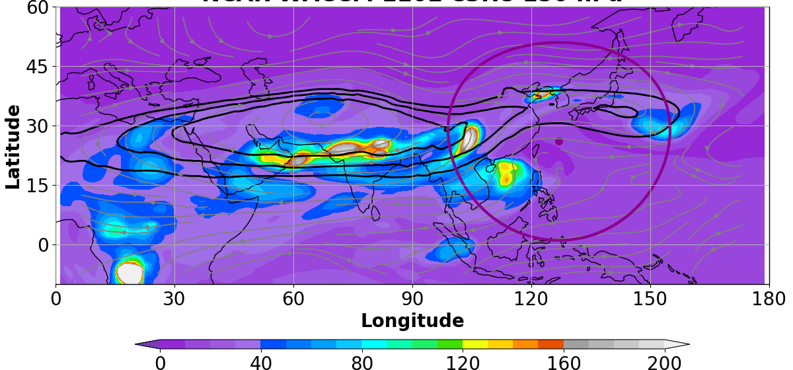
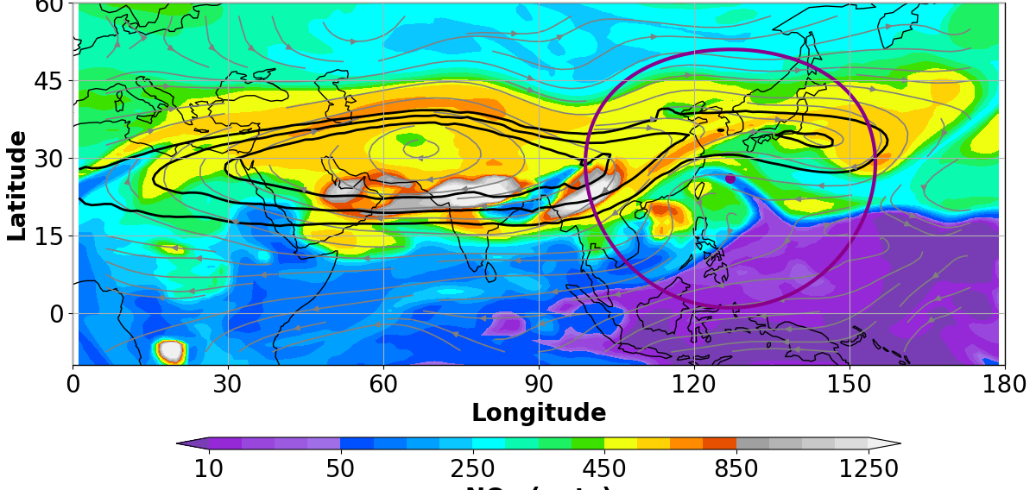
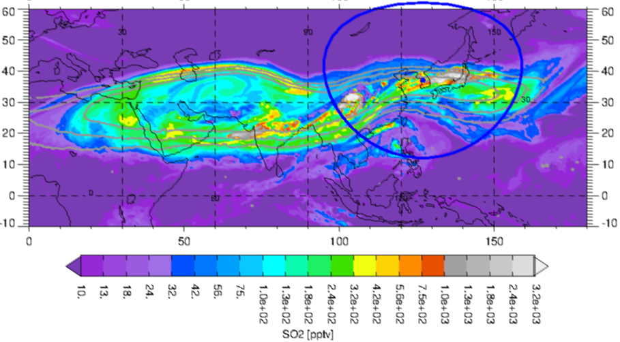
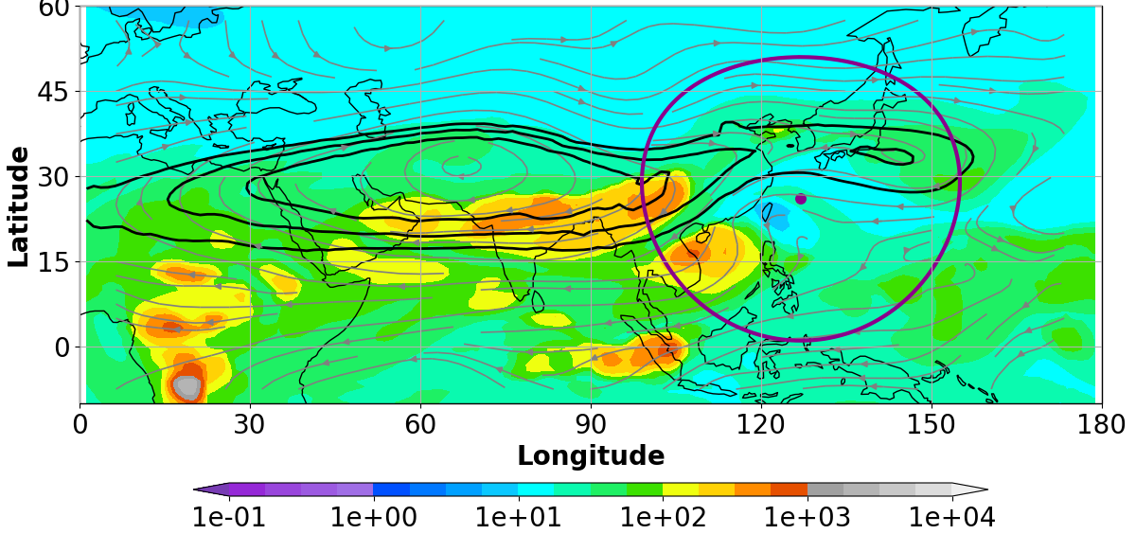
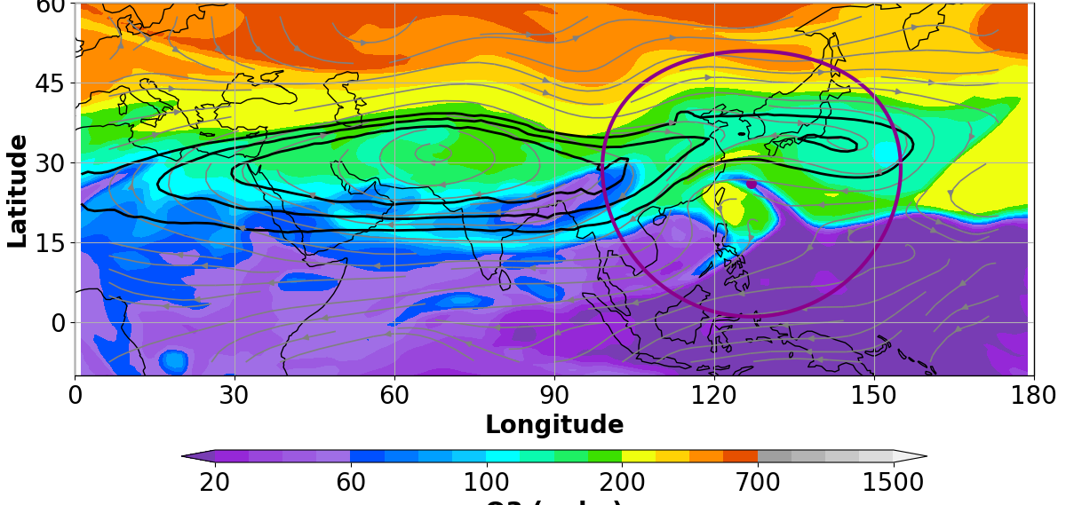
An example of photochemistry within ASM shedding event
Aug 16 00Z: 150 hPa
Chemical composition
WACCM C₂H₆
WACCM CHBr₃ - marine tracer
GEOS CO
Marine air
WACCM C₃H₈ – a very-short-lived VOC
WACCM NO_{x}
GEOS SO₂
Strat. air
WACCM HCHO – VOC oxidation product
WACCM O₃
Surface to UT/LS ASM transport of very-short-lived surface pollutants and ocean-originated gases and mixed with air of stratospheric origin.

Slide 9
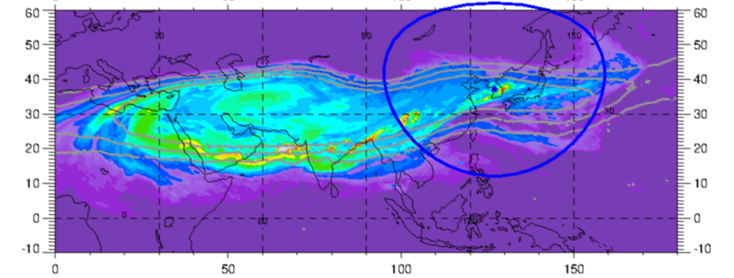
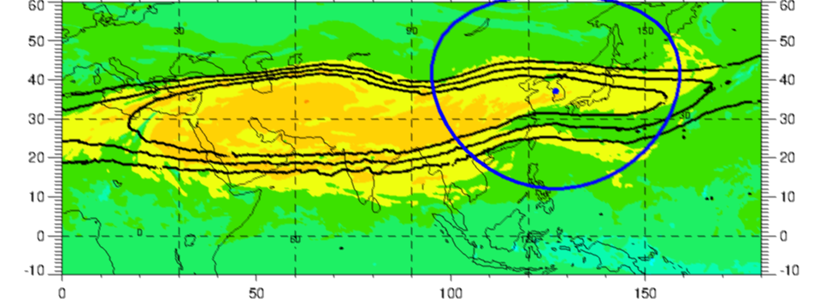
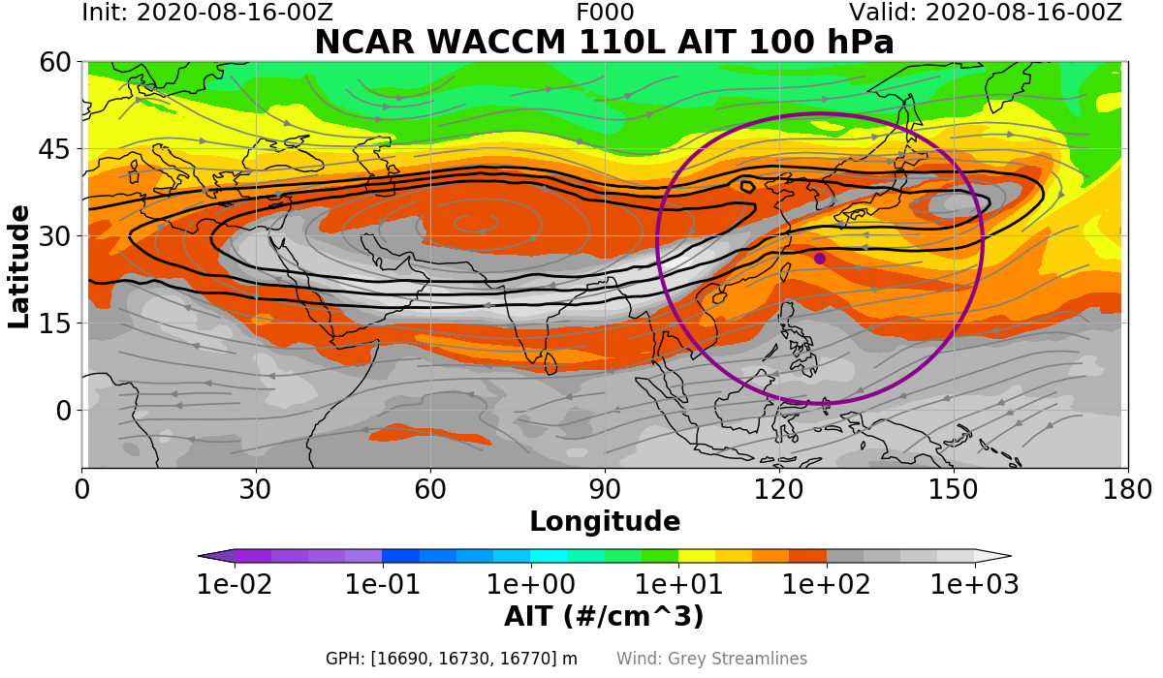
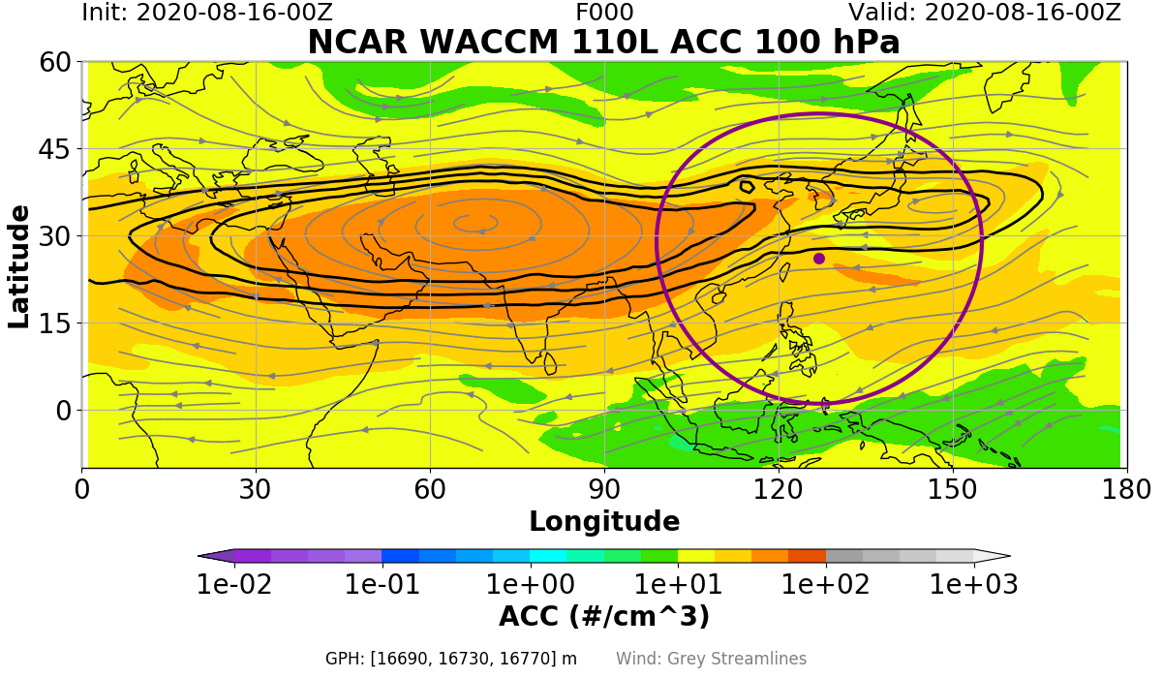
Aerosol composition within the Aug-16-2020 ASM shedding events at 100hPa
GEOS SO₂
GEOS SO₄⁼
Younger shedding event:
Higher SO₂/SO₄⁼; higher AIT/ACC
Older shedding event:
Higher SO₄/SO₂; higher ACC/AIT
WACCM AIT
WACCM ACC

Slide 10
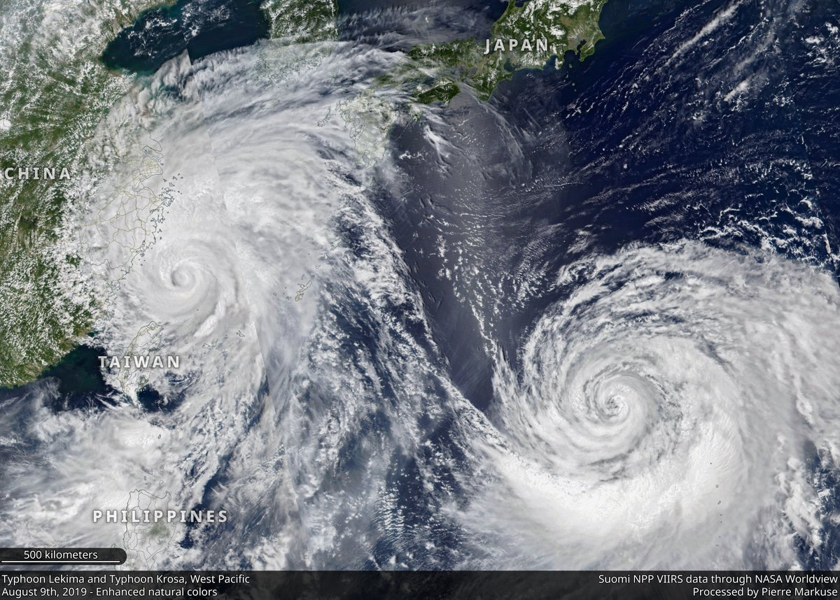
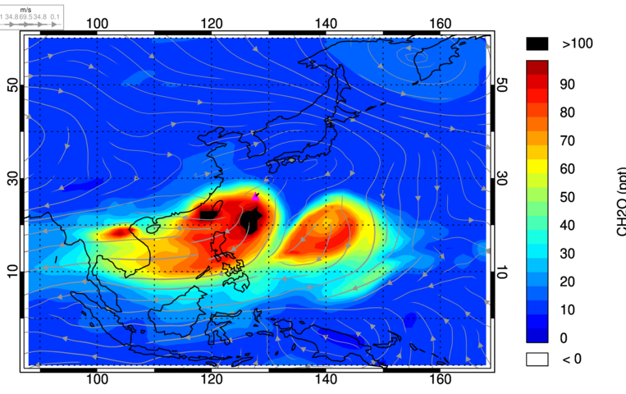
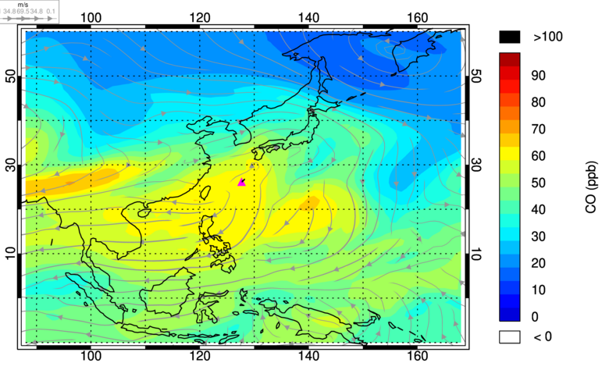
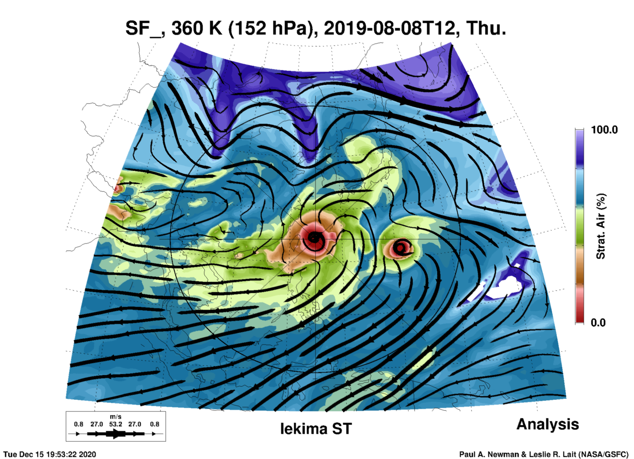
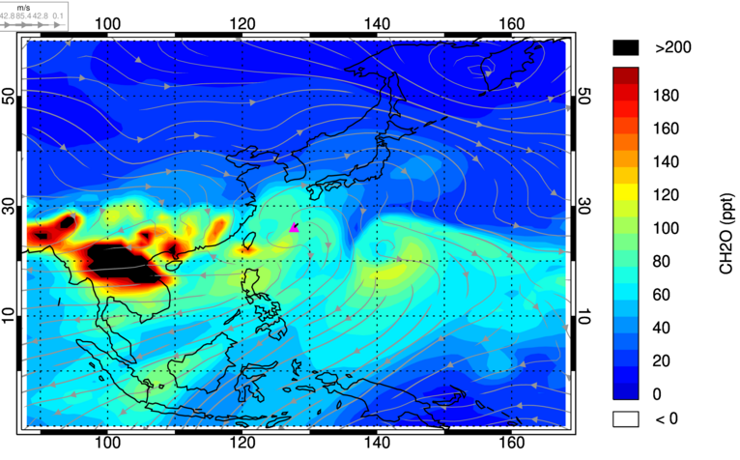
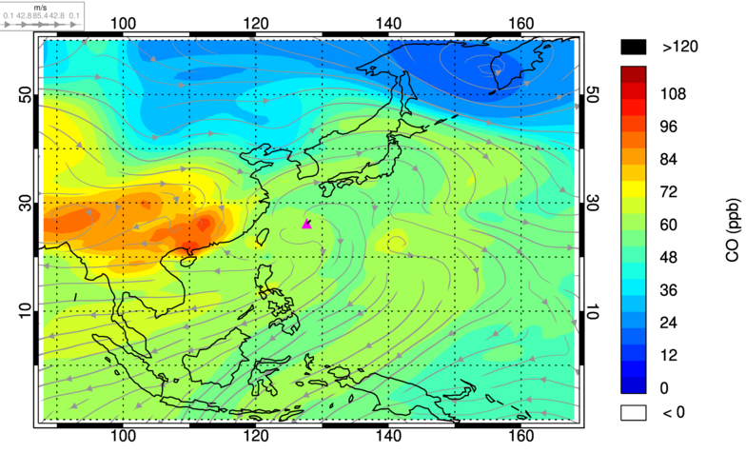
Enhanced UT/LS HCHO abundance within Typhoons
Lekima and Krosa, Aug 8th 2019
Two typhoons observed by Suomi NPP
(Aug 8, 2019)
Highly elevated H₂O leads to enhanced OH and subsequent CH₄ and VOC oxidation to form HCHO and CO within typhoon centers.
GEOS HCHO at 100hPa
GEOS CO at 100hPa
Lekima
Krosa
Typhoon Lekima
Typhoon Krosa
GEOS HCHO at 150hPa
GEOS CO at 150hPa
Air mass fraction proxy that tracks air of stratospheric origin (purple/blue) or convection (red/brown)

Slide 11
Summary messages from the ACCLIP 2019-2020 model forecast dry-run exercises
Frequent ASM shedding events on weekly basis as predicted by the 3 forecast models and confirmed by satellite observations
Within the ASM shedding events, there are highly elevated levels of CO, very short-lived VOCs, aerosol precursors, as well VOC oxidation products and secondary aerosols
The ASM shedding events sampled during the 2019-2020 dry run activities vary greatly in terms of transport time from the surface (a couple of days – a couple of weeks), their surface origins (China, SE Asia, India, marine air), chemical composition and evolution
Typhoon appears as an effective meteorological mechanism, in addition to ASM, in changing the chemical composition in the UT/LS as highly elevated H₂O within typhoon centers leads to enhanced OH and subsequent CH₄ and VOC oxidation to form HCHO

