Slide 1
Chemistry Café and the Model Independent Chemistry Module (MICM)
Mary Barth (ACOM/MMM)
Andrew Conley (ACOM)
Jean-François Lamarque (CGD)
Dan Marsh (ACOM/HAO)
and other significant contributors
National Center for Atmospheric Research

Slide 2
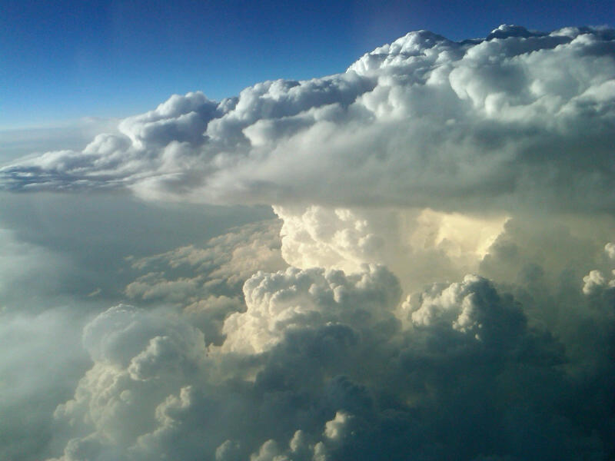
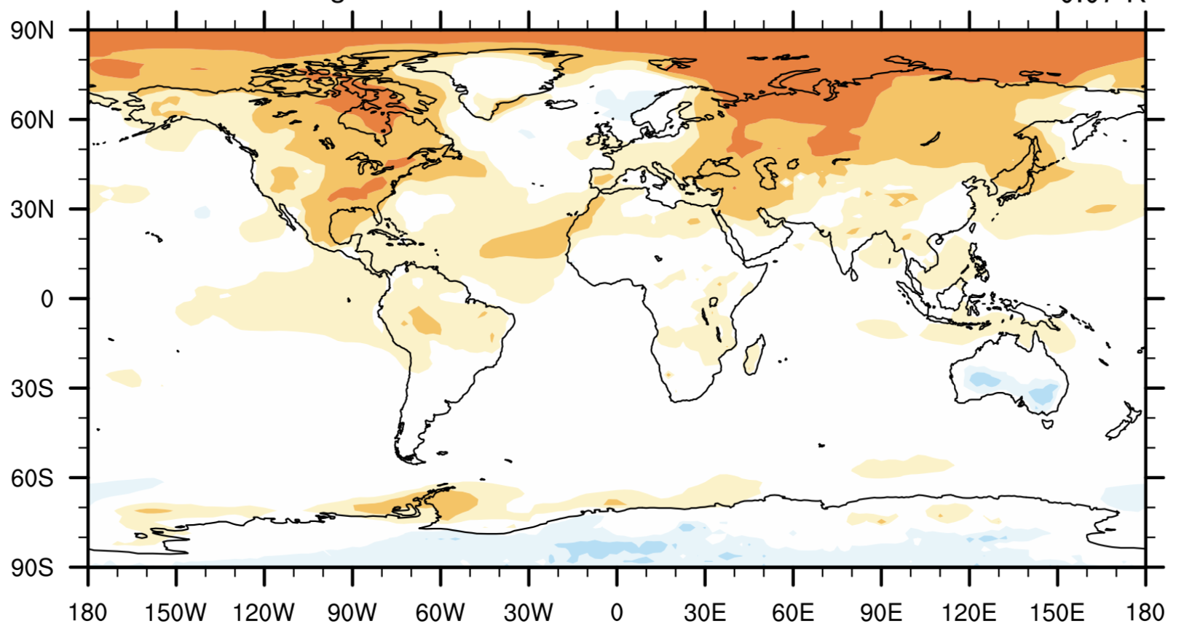
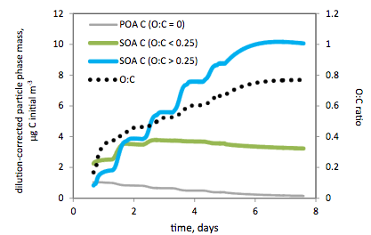
Atmospheric Chemistry Modeling Studies
Chemical Weather
Understanding Processes Affecting Atmospheric Composition, Impacts
Chemical Climate
Prediction of ozone along a trajectory from Denver westward into mountains
Surface Temperature Response
to US SO2 emissions
GECKO-A simulation of SOA production in an urban environment
Notes:
Science we do in NCAR/ACOM

Slide 3
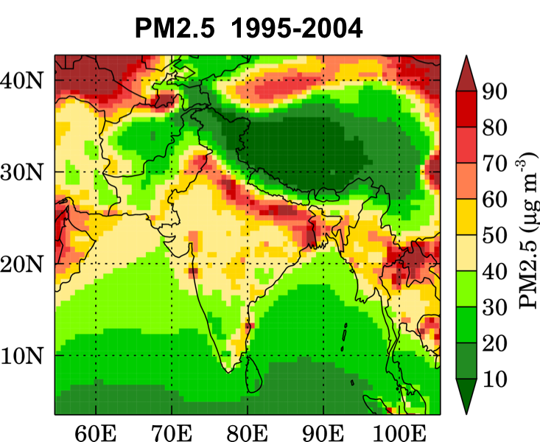
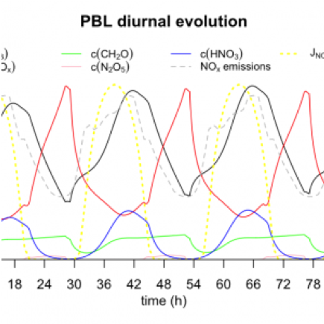
Current Atmospheric Chemistry Modeling at NCAR
Examining the Urban/Cloud to Regional Scales
Weather Research and Forecasting model coupled with Chemistry
Understanding the Chemistry in Detail
Generator of Explicit Chemistry and Kinetics of Organics in the Atmosphere (GECKO-A)
BOXMOX = box model with chemistry as represented in many 3-d chemistry transport models
Global Scale Impacts of Atmospheric Chemistry
Community Atmosphere Model with Chemistry
Whole Atmosphere Community Climate Model
Notes:
Many models we have in NCAR/ACOM, supporting many scales.
Forecasts for field campaigns, studies of air quality, process studies, connections to climate.

Slide 4
Model-Independent Chemistry Module (MICM)
Same infrastructure for box models, regional-scale models, and global models
Chemistry Café:
Versioned, traceable data storage
Atmosphere Model (e.g. Singletrack)
Reactions and Reaction Rates
Properties of Trace Gases
Data for Photolysis Rates
Common Physics Framework (CPF)
Developed
Under Construction
Kinetics
Definitions
Solve Chemistry
ODE
Other
Chemistry/Physics
Packages
Code Generator
Any CPF-compliant chemistry mechanism here
Notes:
MICM is gas-phase chemistry implemented with CPF.
Flexible gas-phase chemistry specifications.
Currently the database is being used by CESM, WRF, BOXMOX. Unified the gas-phase kinetics.
MICM provides flexibility, traceability to the 300-500 reactions and species

Slide 5
Chemistry Café Migration to MICM/MUSICA
WRF
KPP
Chemistry Cafe
Tag
Preprocessor Input Files
CAM-Chem
MozartPP
Constituent Properties
Reaction Kinetics
Mechanisms (Tags)
Versioning
Data Sources
CESM, WRF
BOXMOX, LaTeX
> node get_tag.js 145
Configured
Mechanisms
>node config_PP.js 145
Tag_145.json
Mechanism.F90
ODE_solver.F90
Constituent_Information.F90
CPF configuration
Notes:
Chemistry Café: Database and Web Interface to chemical mechanisms. All mechanisms are updated (JPL 16)
MICM/MUSICA: micro-services, filestreams/files
KPP and Mozart are a combination of compiled code, shell scripts, unix services

Slide 6
Example of JSON files
"molecules": [
{
"moleculename": "Cl",
"transport": ”No",
"molecular_weight": "35.4",
} ,
{} ,
{}
]
"photolysis": [
{
"rate": ”j_cl2",
"reactants": [
"CL2"
],
"products": [
{
"coefficient": "2",
"molecule": "CL"
}
} , {} , {}, …
]
"reactions": [
{
"rate": ”Troe(…)",
"reactants": [
"CL",
"CL"
],
"products": [
{
"coefficient": 1,
"molecule": "CL2"
}
]
}, {}, {},…
]
Tag_145.json
Notes:
JSON is like XML, but parsers are more standard and flexible.
User can provide JSON definition of mechanism rather than using the Café

Slide 7
Every Chemistry Mechanism will have a Tag and generate [Fortran] Code
Versioning Information
Preprocessor Version
Tag Comments
Person Creating Tag
…
Fortran Files that Plug into CPF
Constituent_Information:
Transported
Henry’s Law Coefficients …
Kinetics to define ODEs
ODE_solver
Configured
Mechanisms
Mechanism.F90
ODE_solver.F90
Constituent_Information.F90
CPF configuration
Kinetics
Definitions
Solve Chemistry
ODE
Code Generator
Notes:
Kinetics data type defining
User can provide JSON definition of mechanism rather than using the Café

Slide 8
Constituent_information_type{ } [Fortran]
Standard name - character string
Description - character string
Transported – T/F
Diffused [eddy, molecular, major species]
Convected T/F
Chemistry-Suite-Units: [dryMMR, wetVMR, …]
Wet removed – T/F [ Or pointer to function ]
Dry deposited – T/F [ Or pointer to function ]
Used for radiative heating rates - T/F [ Or name in radiation?]
…
Notes:
Kinetics data type defining
User can provide JSON definition of mechanism rather than using the Café

Slide 9
Model-Independent Chemistry Module (MICM)
Same infrastructure for box models, regional-scale models, and global models
Chemistry Café:
Versioned, traceable data storage
Atmosphere Model (e.g. Singletrack)
Reactions and Reaction Rates
Properties of Trace Gases
Data for Photolysis Rates
Common Physics Framework (CPF)
Developed
Under Construction
Kinetics
Definitions
Solve Chemistry
ODE
Other
Chemistry/Physics
Packages
Code Generator
Any CPF-compliant chemistry mechanism here
Notes:
MICM is gas-phase chemistry implemented with CPF.
Flexible gas-phase chemistry specifications.
Currently the database is being used by CESM, WRF, BOXMOX. Unified the gas-phase kinetics.
MICM provides flexibility, traceability to the 300-500 reactions and species

Slide 10
Model-Independent Chemistry Module
Year 1:
Standalone gas-phase chemistry implementing CPF (e.g., box model)
Community input on initial prototype
Year 2:
Connect to the atmosphere model, e.g.,
Transport
Deposition
Add aerosols – community involvement
Add heterogeneous and aqueous chemistry

Slide 11
Future Atmospheric Chemistry Modeling at NCAR
Atmosphere Model (Singletrack)
Ensures physical and transport processes affecting trace gases and aerosols are properly represented in physics routines, e.g.,
Convective parameterization includes convective transport and wet deposition of trace gases and aerosols
Cloud physics includes wet deposition of trace gases and aerosols
PBL parameterization includes vertical mixing of trace gases and aerosols
Scale-Aware / Scale-independent
Need to support such studies
Cloud Physics, Radiation,
Transport
Unified Model for
Chemical Weather
Chemical Climate
Process Studies
Common Physics Framework
Model-Independent Chemistry Model
(MICM)
Notes:
MICM hooks with atmosphere model and physics schemes.
Physical/transport processes affecting chemistry are done in physics.
Other chemistry schemes can be hooked into CPF.

Slide 12
Chemistry Café and Model Independent Chemistry Module
MICM will take the database of chemical reactions, produce the computer code to solve the ODEs, and be compliant with the common physics framework to allow solutions from box models to regional and global models
MICM will create an interface flexible enough to be incorporated in any atmosphere model
MICM will provide a framework for developers (inside and outside NCAR) to test and incorporate updated/new approaches or methods
Modular aspect of MICM will enable community developers to focus on improving a single aspect of chemistry

