Slide 1
Updating Chemical Mechanisms in Models (e.g., CESM)
Becky Schwantes
July 30, 2018
GEOS-Chem / NCAR Models Workshop

Slide 2
Current Tropospheric Chemical Mechanisms in CESM
Configuration / Compset | Model Top | Chemical Mechanism | Chemical Description
CAM-Chem | 40 km | TS1 | Troposphere and stratosphere
WACCM | 150 km | TSMLT1 | Troposphere, stratosphere, mesosphere, and lower thermosphere chemistry
TS1/TSMLT1 is an updated version of the MOZART-4 mechanism described in Emmons et al. 2010
Speciated aromatics
Updated isoprene and terpenes oxidation
More speciated organic nitrates for improve comparison between models and observations
Updated JPL rate constants (2015, No. 18)
Gas-phase isoprene and terpene organic nitrate uptake to aerosols as done in GEOS-Chem described in Fisher et al. 2016.

Slide 3
TS1 Chemistry Degree of Simplification
Base: 187 Transported species
34 Non-transported species
528 Reactions

Slide 4
Future Development
Future Updates to TS1 / TSMLT1 Chemical Mechanism:
Isoprene and terpene chemistry
More speciation of alkane chemistry
Improved halogen chemistry
Improved chemistry related to precursors from fires (in coordination with upcoming campaigns)
Tagged NO_{x} Scheme
Nitrate Aerosol Scheme - MOSAIC (Model for Simulating Aerosol Interactions and Chemistry) is being coupled with MAM4 in the CAM model (University of Wyoming, PNNL).
Notes:
Rearrange this structure of this

Slide 5
Upcoming Updates to Isoprene and Terpene Oxidation
Base: 187 Transported species
34 Non-transported species
528 Reactions
Isoprene (NO₃, O₃, + OH)
Terpene (NO₃, O₃, + OH)
+ 13 Non-transported Species
+ 21 Transported Species
+ 117 Reactions
+ ~12% time to run
+ 19 Non-transported Species
+ 15 Transported Species
+ 101 Reactions
+ ~14% time to run
Isoprene + OH
Terpene + OH

Slide 6
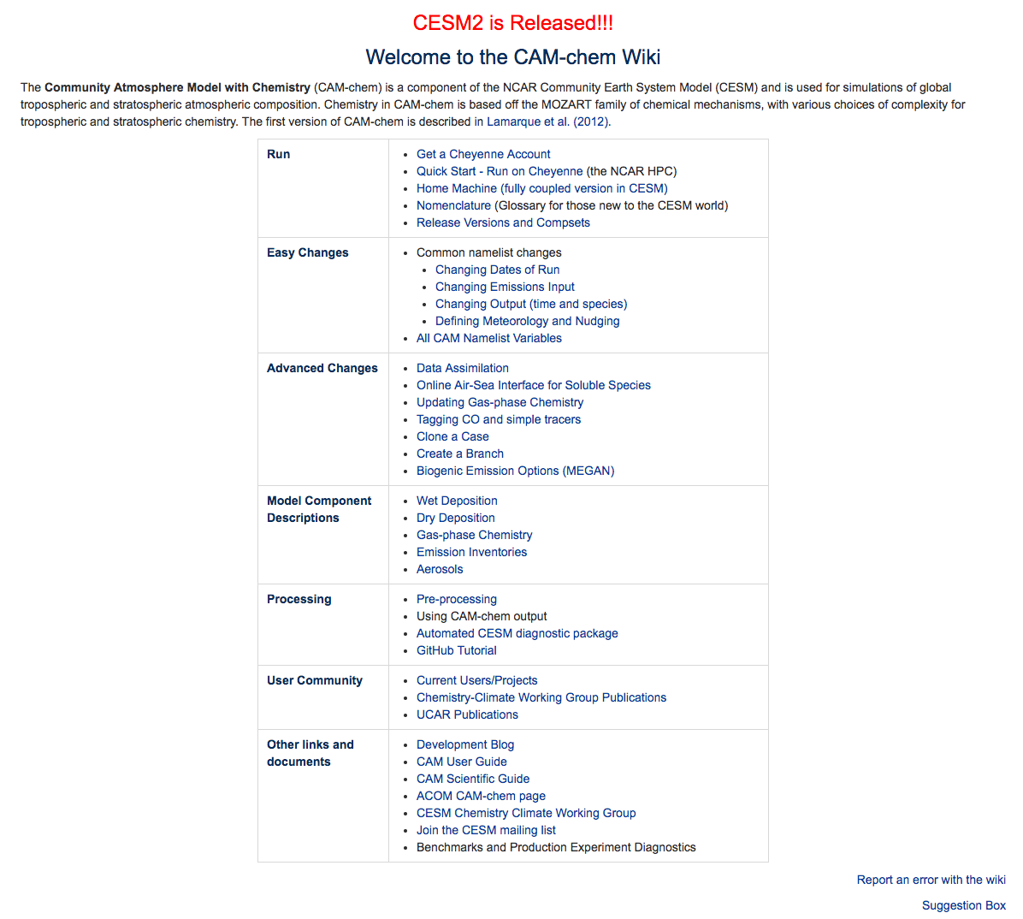
Adding Gas-Phase Chemistry
https://wiki.ucar.edu/display/camchem/Home
We have recently created a CAM-Chem wiki to explain how to run CAM-Chem including detailed descriptions of how to update chemistry
Updating/adding gas-phase chemistry is relatively easy in CESM
As discussed earlier today, future updates (e.g., Chem Café, MICM) will make this process even easier.

Slide 7

Very Simplified Schematic of Chemistry in CESM
CAM (Community Atmosphere Model)
O₃
Wet-deposition
hv
NO_{x}
Aerosols
To incorporate gas-phase chemistry:
Chemical processing
Photolysis
Wet/dry deposition
Aerosol uptake
Emissions
OH
Biogenic Emissions
Dry-deposition
CLM (Community Land Model)

Slide 8
Adding Gas-Phase Chemistry
Convert your chemical mechanism to an input file (ASCII) that the CESM chemical preprocessor can read.
Solution
ALKNIT -> C5H11ONO2,
Not-Transported
ALKO2,
Implicit
ALKNIT
Photolysis
[jalknit->,jch3ooh] ALKNIT + hv -> NO2 + 0.4*CH3CHO + 0.1*CH2O + 0.25*CH3COCH3 + HO2 + 0.8*MEK
Chemical Reactions
[ALKNIT_OH] ALKNIT + OH -> 0.4*CH2O + 0.8*CH3CHO + 0.8*CH3COCH3 + NO2 ; 1.6e-12
[ALKOOH_OH] ALKOOH + OH -> ALKO2 ; 3.8e-12, 200
[tag_CH3CO3_NO2] CH3CO3 + NO2 + M -> PAN + M ; 9.7e-29, 5.6, 9.3e-12, 1.5, 0.6
[usr_PAN_M] PAN + M -> CH3CO3 + NO2 + M

Slide 9
Adding Gas-Phase Chemistry
Add unique chemical reaction formats into mo_usrrxt.f90 file.
CESM is set-up such that code changes are put in a specific folder within your case directory such that accounting for code changes is simple and trackable.
!-----------------------------------------------------------------
! ... pan + m --> ch3co3 + no2 + m (JPL15-10)
!-----------------------------------------------------------------
call comp_exp( exp_fac, -14000._r8*tinv, ncol )
if( usr_PAN_M_ndx > 0 ) then
if( tag_CH3CO3_NO2_ndx > 0 ) then
rxt(:,k,usr_PAN_M_ndx) = rxt(:,k,tag_CH3CO3_NO2_ndx) * 1.111e28_r8 * exp_fac(:)
else
rxt(:,k,usr_PAN_M_ndx) = 0._r8
end if
end if

Slide 10
Adding Gas-Phase Chemistry
Photolysis Reactions
Photolysis reactions in CESM are derived from a look-up table based on TUV.
New photolysis reactions can be mapped to a rate in the look-up table with an optional multiplication factor.
[jalknit->,jch3ooh] ALKNIT + hv -> NO2 + 0.4*CH3CHO + 0.1*CH2O + 0.25*CH3COCH3 + HO2 + 0.8*MEK
[jalkooh->,jch3ooh] ALKOOH + hv -> 0.4*CH3CHO + 0.1*CH2O + 0.25*CH3COCH3 + 0.9*HO2 + 0.8*MEK + OH
[jbepomuc->,.10*jno2] BEPOMUC + hv -> BIGALD1 + 1.5*HO2 + 1.5*CO
[jbigald->,0.2*jno2] BIGALD + hv -> 0.45*CO + 0.13*GLYOXAL + 0.56*HO2 + 0.13*CH3CO3 + 0.18*CH3COCHO

Slide 11
Adding Gas-Phase Chemistry
Update henry’s law constants that are used for wet/dry deposition in seq_drydep_mod.F90
There are several arrays containing: 1) species names, 2) reactivity factors (f₀), 3) henry's law constants, and 4) molecular weights.
Update gamma values for gas-phase compound aerosol uptake in mo_usrrxt.f90 file
real(r8), parameter :: gamma_isopnita = 0.005_r8 ! from Fisher et al., ACP, 2016
c_isopnita = 1.20e3_r8 * sqrt_t(i) ! mean molecular speed of isopnita
!-------------------------------------------------------------------------
! ... ISOPNITA -> HNO3 (on tropospheric aerosol surfaces except dust and seasalt)
!-------------------------------------------------------------------------
if( usr_ISOPNITA_aer_ndx > 0 ) then
rxt(i,k,usr_ISOPNITA_aer_ndx) = hetrxtrate( sfc, dm_aer, dg, c_isopnita, gamma_isopnita )
end if

Slide 12
Adding Gas-Phase Chemistry
Adjust the namelist to include new tracers. Many changes within CESM can be made through the namelist, which does not require code manipulation or recompiling.
Output new species
New species mapping of emissions files
New species mapping of biogenic emissions from MEGAN
fincl1 = 'CFC11STAR', 'AODDUST', 'AODDUST2', 'T', 'U', 'V', 'O3', 'OH',
'NO3', 'HO2', 'LNO_COL_PROD', 'NO2_CLXF', 'SFNO', 'SFNH3', 'BRO', 'CH3CL’,…
…
'BIGALK -> /glade/p/cesmdata/cseg/inputdata/atm/cam/chem/emis/CMIP6_emissions_1750_2015/emissions-cmip6_BIGALK_anthro_surface_1750-2015_0.9x1.25_c20170608.nc',
'BIGALK -> /glade/p/cesmdata/cseg/inputdata/atm/cam/chem/emis/CMIP6_emissions_1750_2015/emissions-cmip6_BIGALK_bb_surface_1750-2015_0.9x1.25_c20170322.nc’,
…
megan_specifier = 'ISOP = isoprene',
'MTERP = pinene_a + carene_3 + thujene_a + 2met_styrene + cymene_p + cymene_o + terpinolene + bornene + fenchene_a + ocimene_al + pinene_b + sabinene + camphene + limonene + phellandrene_a + terpinene_g + terpinene_a + phellandrene_b + myrcene + ocimene_t_b + ocimene_c_b’,…

Slide 13
Adjusting VBS Schemes for SOA Formation
The VBS chemical scheme is in the same input file as the gas-phase chemical reactions.
There are 5 volatility bins for oxidized VOCs in the default mechanism (SOAG0, SOAG1, SOAG2, SOAG3, SOAG4).
[ISOP_NO3_vbs] ISOP + NO3 -> ISOP + NO3 + 0.059024*SOAG3 + 0.025024*SOAG4 ; 3.03e-12, -446
[ISOP_O3_vbs] ISOP + O3 -> ISOP + O3 + 0.0033*SOAG3 ; 1.05e-14, -2000
[ISOP_OH_vbs] ISOP + OH -> ISOP + OH + 0.0031*SOAG0 + 0.0035*SOAG1 + 0.0003*SOAG2 + 0.0271*SOAG3 + 0.0474*SOAG4 ; 2.54e-11, 410

Slide 14
Conclusion
We are constantly updating and improving chemistry in CESM and we welcome collaboration.
Comparisons of CESM and GEOS-Chem chemical mechanisms would be beneficial.
Updating/adding gas-phase chemistry and adjusting vbs schemes is relatively easy in CESM.
We have recently created a CAM-Chem wiki to explain how to run CAM-Chem including detailed descriptions of how to update chemistry (https://wiki.ucar.edu/display/camchem/Home)
We can provide guidance and help with errors.

Slide 15
Extra Slides

Slide 16
Modal Aerosol Module-4 (MAM4)
(Liu et al., Geosci. Model Dev., 2016)

Slide 17
Default VBS Scheme
Secondary Organic Aerosol
Semi-volatile compounds split into Volatility Bins
soa1_a1, soa1_a2
soa2_a1, soa2_a2
soa3_a1, soa3_a2
soa4_a1, soa4_a2
soa5_a1, soa5_a2
(Aitken and accumulation)
OH
hv
Partitioning based on Volatility
SOAG0
SOAG1
SOAG2
SOAG3
SOAG4
SVOC
IVOC
OH
soa1_c1, soa1_c2
soa2_c1, soa2_c2
soa3_c1, soa3_c2
soa4_c1, soa4_c2
soa5_c1, soa5_c2
(in cloud)
OH, O₃, NO₃
Wet/Dry
Deposition
(Hodzic et al., 2016)
Wet/Dry
Deposition

