Slide 1
GEOS-Chem Adjoint Model
07/30/2018
>100 registered users at more than 23 institutions
Daven K. Henze, CU Boulder, Adjoint Model Scientist
Jun Wang, U Iowa, Adjoint and Data Assimilation WG Co-Chair
Yanko Davila, CU Boulder, Adjoint Model Code Support

Slide 2
An adjoint model...
...efficiently calculates derivatives of a scalar model response with respect to all model parameters (emissions, rate constants, ...)
resolved at the native model resolution.

Slide 3
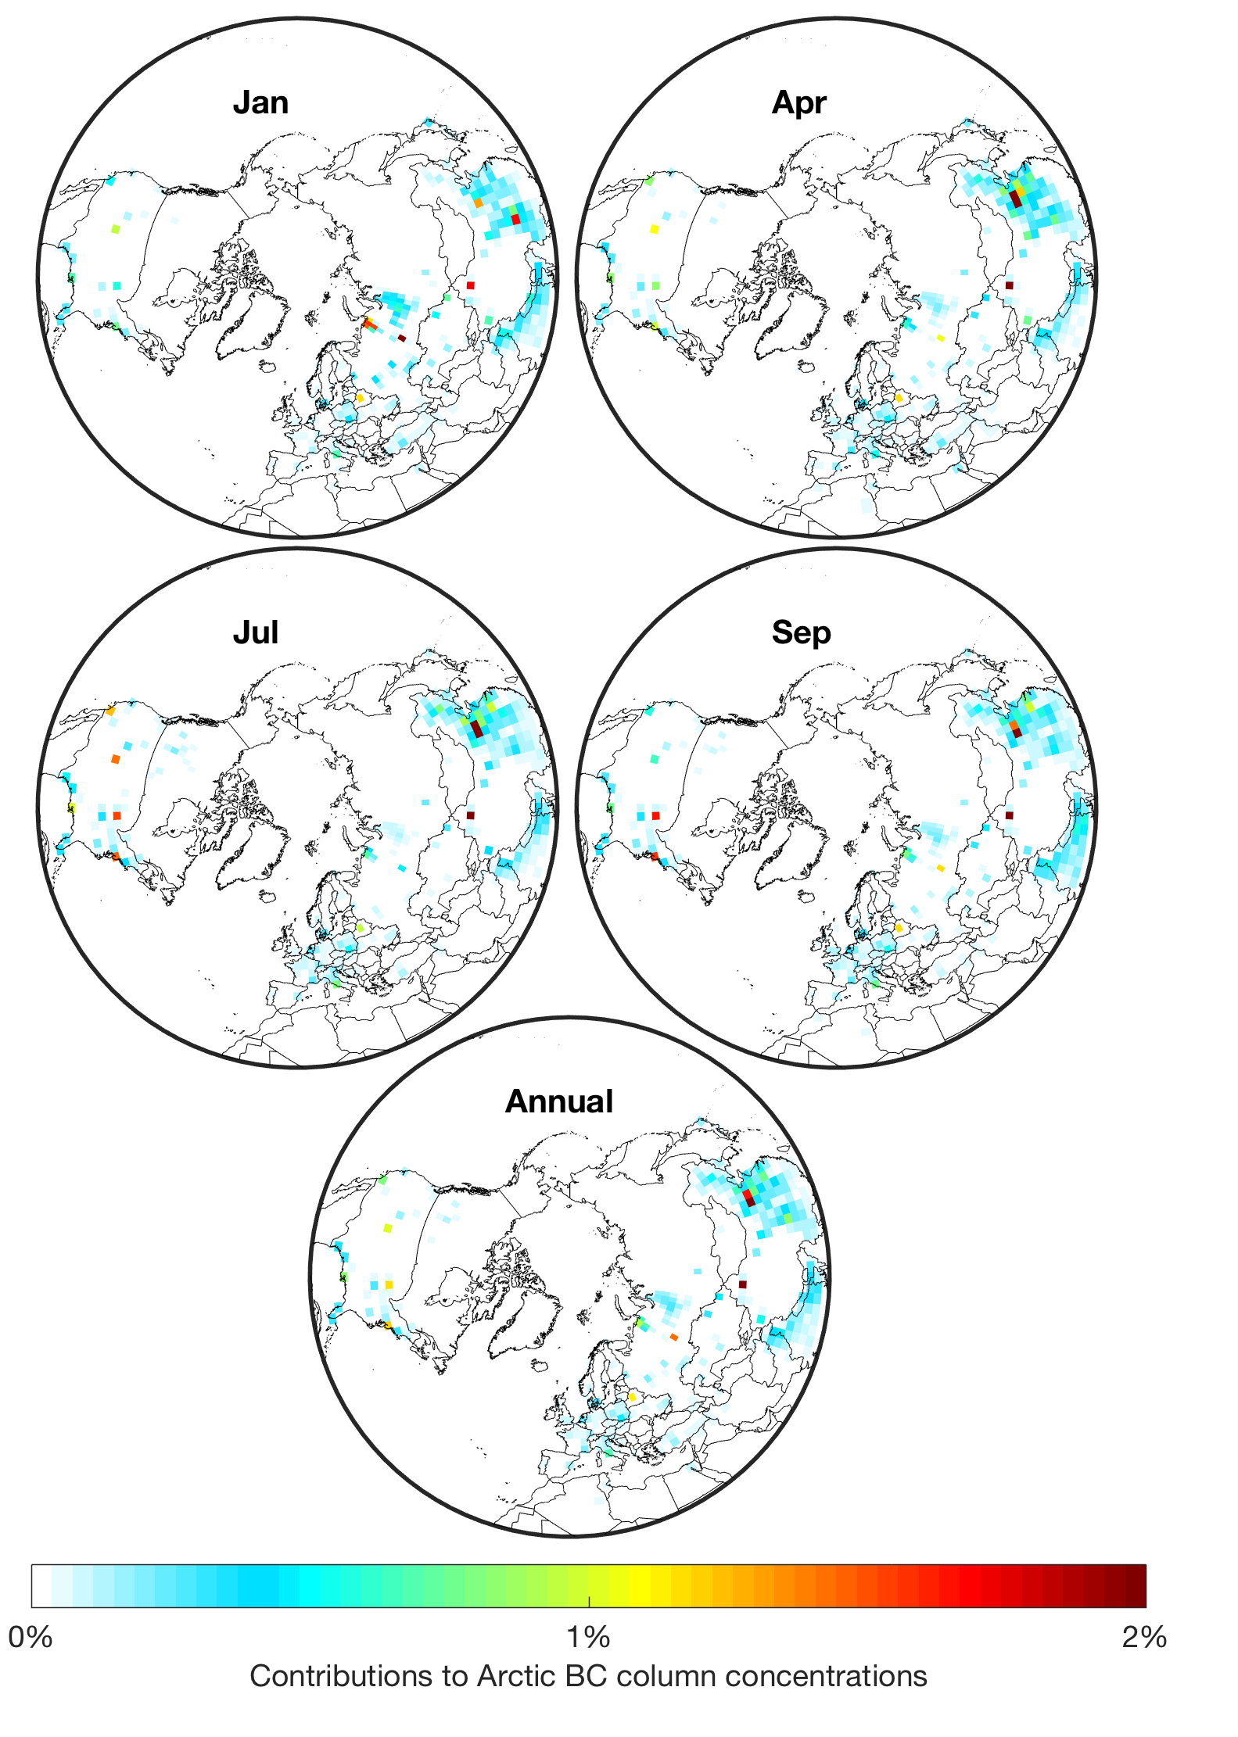
An adjoint model...
...efficiently calculates derivatives of a scalar model response with respect to all model parameters (emissions, rate constants, ...)
resolved at the native model resolution. Used for:
Source attribution
Contributions to annual Arctic BC column concentrations (Xu et al., 2017)

Slide 4
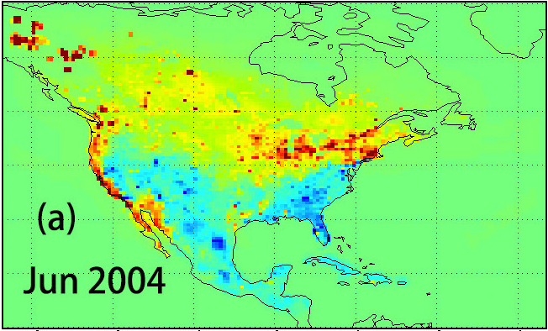
An adjoint model...
...efficiently calculates derivatives of a scalar model response with respect to all model parameters (emissions, rate constants, ...)
resolved at the native model resolution. Used for:
Source attribution
Inverse modeling / 4D-Var
Parameters
Optimization
J ~ [model – obs]²
adjoint:
dJ/dparameters
post
prior
Contributions to annual Arctic BC column concentrations (Xu et al., 2017)
CO emissions constrained using MOPITT (Jiang et al., 2015)

Slide 5
adjoint code: details
Consider model state vector x = [w,y,z], model M:
Forward
Adjoint
IF ( W > a )
W = Y ** 2
ELSE
W = Y * Z
END
IF ( W > a)
Y_ADJ = 2 * Y * W_ADJ
ELSE
Y_ADJ = Z * W_ADJ
Z_ADJ = Y * W_ADJ
END
Notes:
{\bf \lambda}^{k} = \left [ \frac{\partial(M({\bf x}^k))}{\partial {\bf x}^k} \right ]^T {\bf \lambda}^{k+1}

Slide 6
Potential applications of GC adjoint within NCAR models
CESM2:
  Chemical sensitivity analysis under a range of climates or meteorologies (e.g., global premature moralities/kg NOx emitted in any grid-box under present vs warmer climate)
  4D-Var inverse modeling with state-of-science treatment of non-atm components (land surface, ocean, snow/ice,…)

Slide 7
Potential applications of GC adjoint within NCAR models
CESM2:
  Chemical sensitivity analysis under a range of climates or meteorologies (e.g., global premature moralities/kg NOx emitted in any grid-box under present vs warmer climate)
  4D-Var inverse modeling with state-of-science treatment of non-atm components (land surface, ocean, snow-ice,…)
CESM2 / WRF: Better characterization of model-error use of different physics for 4D-Var inverse modeling and DA
  Model error is a critical term in inverse modeling and DA
  Can be tuned (Bousserez et al., in prep) or optimized (weak-constraint 4D-Var, Stanevich et al., submitted), which is elegant in theory but difficult in practice.
  Previously w/GEOS-Chem it has been roughly estimated using e.g. GEOS4 vs GEOS5 meteorology
    not a robust ensemble, and GC not supporting older met
    in contrast, with WRF we’ve used 156 model configs to estimate model error contribution to R (Guerrette et al., 2015)
Notes:
J({\bf x}) = (H({\bf x}) - {\bf y})^T {\bf R}^{-1} (H({\bf x}) - {\bf y}) + ({\bf x} - {\bf x}_b)^T {\bf B}^{-1} ({\bf x} - {\bf x}_b)

Slide 8
Potential applications of GC adjoint within NCAR models
WRF-Chem: Hi-resolution regional 4D-Var data-assimilation and inverse modeling (ignoring impacts of chemistry on dynamics)
  Would need to implement driver for running in reverse (sensitivity analysis) and solver for inversion/DA

Slide 9
Adjoint model within an inverse model
Inverse Model
Optimization
(L-BFGS)
Improved
Estimate
Parameter Estimate
Gradients
(sensitivities)
Forward Model
Adjoint Model
t₀
t_{f}
t_{f}
t₀
Predictions,
Adjoint Forcing,
y = observations, B,R = uncertainties

Slide 10
Potential applications of GC adjoint within NCAR models
WRF-Chem: Hi-resolution regional 4D-Var data-assimilation and inverse modeling (ignoring impacts of chemistry on dynamics)
  Would need to implement driver for running in reverse (sensitivity analysis) and solver for inversion/DA
WRFPLUS-Chem, WRFDA-Chem [Guerrette & Henze 2015; 2017]: DA and inverse modeling that accounts for feedback of chemistry on dynamic (or chem as a tracer for dynamics)
  expand beyond current state (just GOCART aerosols and sulfate chemistry)
    Full chemistry
    Inert GHGs
Other?

Slide 11
How adjoint code is made
Adjoint models can be made in several ways:
Application of automatic differentiation algorithms to forward model code
  TAPENADE: widely used generic tool
Manually applying the algorithms embedded in AD software to the forward model source code line-by-line
  Can generate code that is sleeker than AD-generated
Deriving the adjoint of discrete numerical algorithms
  This is how the KPP-generated adjoint works for chemistry
Deriving the adjoint of the continuous physics equations, and then discretize and solve these
  This is how the adjoint works for xy transport
→ Any modification to the forward model requires a commensurate update to the adjoint code

Slide 12
An adjoint model...
...runs “backwards” in time
From a software engineering standpoint, this means that the forward model needs to be able to be run in reverse time.
Adjoint model can be somewhat invasive to the forward model, as this may require changes to the standard forward model driver
Notes:
RF(NO_x) = \frac{\partial RE(O_3)}{\partial NO_x} + \frac{\partial RE(CH_4)}{\partial NO_x} + \frac{\partial RE(PM)}{\partial NOx}+\dots

Slide 13
GEOS-Chem adjoint model
- adjoint model is a separate code, with separate code versions
- single exec for forward model, adjoint model, and DA solver (pros and cons of this approach), iterations with shell script
- based on the forward model code with periodic updates, patches, and major overhalls (from v5 to v6, to v7, to v8… now working on v11 / GCHP)
- code managed through gitlab hosted at adjoint.colorado.edu
- adjoint model code support from Yanko Davila
- community model w/policies and procudures for updating similar to GEOS-Chem forward model

Slide 14
Adjoint code updates
Code update cycle
Adjoint models often lag forward models
Sometimes that is ok or even preferable for DA, for which adjoint is often simpler / coarser than full forward model (e.g., operational NWP centers)

Slide 15
GEOS-Chem adjoint code status (v35m)
From v8-02-1 forward model code base
adjoint of all code excluding:
  SOA, aerosol microphysics packages
  non-local PBL mixing
  GEOS-FP / MERRA2 convection
pulled all model updates and bug fixes up through v10
  excluding those that pertain to non-supported parts of the forward code
Fullchem, gly-chem, UCX, plus offline simulations for CH4, CO2, N2O, BC, dust, CO
Implemented features not yet standardized in forward model
  N2O
  NH3 bidirectional exchange and diurnal variability

Slide 16
Adjoint code benchmarking
Inverse modeling test using psuedo observations (i.e. an inversion where ”observations” are based on a model simulation with known emissions)
Sensitivity test (default d(Ox)/d(NOx)) through comparison of finite difference to adjoint sensitivities (w/xy-transport disabled)
Results from each version published on wiki
These tests are valuable but not exhaustive
  Puedo inversions and FD tests are built-in simulation modes that can be used by any user
Notes:
]

Slide 17
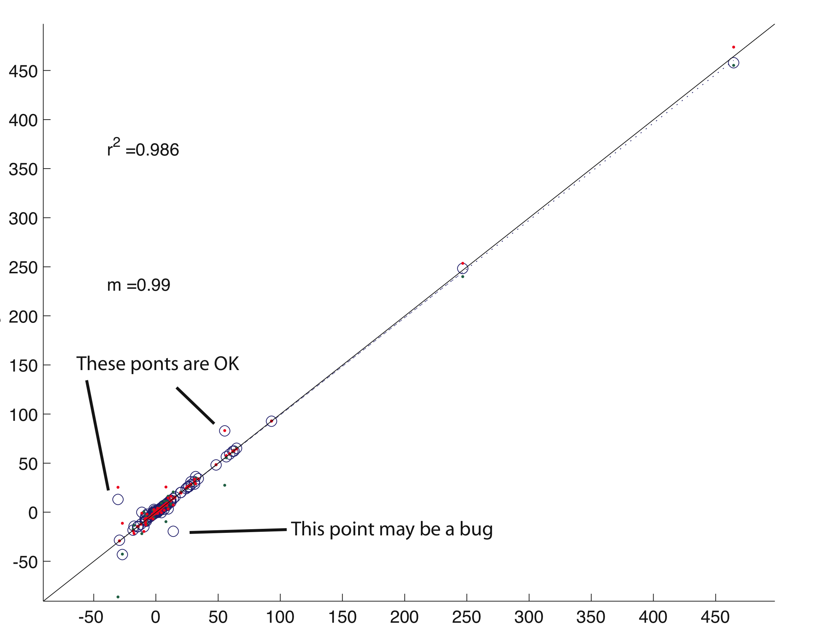
Validating code (IDL/matlab scripts provided)
Finite Difference
Adjoint

Slide 18
How adjoint code is made: checkpointing
Storage of forward model variables to disk or in memory for use within the adjoint (i.e., checkpointing) required at code junctures and nonlinearities
Forward
Adjoint
IF ( W > a )
W = Y ** 2
ELSE
W = Y * Z
END
IF ( W > a)
Y_ADJ = 2 * Y * W_ADJ
ELSE
Y_ADJ = Z * W_ADJ
Z_ADJ = Y * W_ADJ
END
Note: checkpointing requires altering the forward model
Notes:
{\bf \lambda}^{k} = \left [ \frac{\partial(M({\bf x}^k))}{\partial {\bf x}^k} \right ]^T {\bf \lambda}^{k+1}

Slide 19
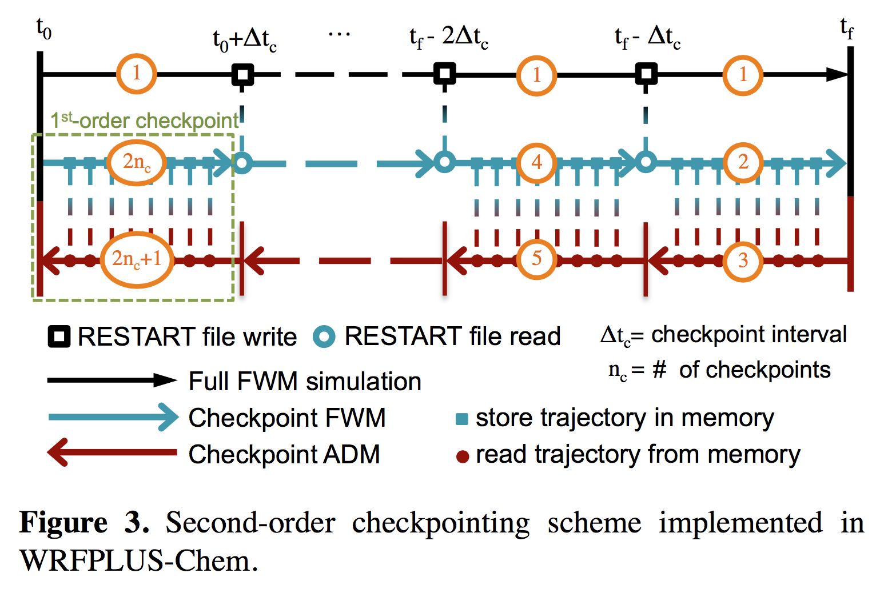
Checkpionting details
∆t chem,external
∆t chem, KPP, internal
Checkpt
Checkpt
Guerrette & Henze, 2015

Slide 20
Adjoint model: hardware requirements
Requirements:
- checkpointing: data written during fwd, read during adjoint
- forward model slower than standard owing to heavy i/o
- memory usage ~x4 of standard forward model
- adjoint requires x2-4 of standard forward CPU time
Examples (on dual hex-core Xeon 2.6 GHz):
- fwd+adj full chem, global 2x2.5, 1 month
- 400 GB checkpoint files
- 30 hours w/busy NFS scratch
- 9 hrs w/local SS scratch
- fwd+adj of offline CO2, global 2x2.5, 1 month
- 2.5 GB checkpoint files
- 2 hours

Slide 21
GEOS-Chem adjoint future
Updating to use GCHP and HEMCO the current development challenges
  Starting w/CO2 simulation, for which the adjoint is trivial
  Challenge is running GCHP in reverse time
Incorporation into online models
  WRFPLUS-Chem
  GEOS-5 has an adjoint
Incorporation into generic DA toolkits being championed by NWP community
  JEDI
  OOPS

Slide 22
Find out more…
Visit us at:
http://wiki.seas.harvard.edu/geos-chem/index.php/GEOS-Chem_Adjoint (wiki)
- manuals, instructions, publications
- code features
- current version overviews
- benchmarks
http://adjoint.colorado.edu:8080 (code GitLab)
- code distribution
https://trello.com/b/GTfHT38L/geos-chem-adjoint (pipeline)
- code development cycle / pipeline
GEOS-Chem adjoint code support:
- yanko.davila@colorado.edu

Slide 23
extra slides
Notes:
RF(NO_x) = \frac{\partial RE(O_3)}{\partial NO_x} + \frac{\partial RE(CH_4)}{\partial NO_x} + \frac{\partial RE(PM)}{\partial NOx}+\dots

Slide 24
Adjoint model: current and new features
Standardized code: v35l, maintained / distributed via GIT
Code base : v8-02-01 with relevant fixes / updates up to v10
Meteorology: GEOS-4, GEOS-5, GEOS-FP, MERRA2
Simulations : full chem; gly-chem, offline CO, O_{x}, CO_{2,} CH_{4,} BC, Dust, N₂O
Resolution : 4x5, 2x2.5, 0.5 x 0.667, 0.25 x 0.3125
Processes: all main forward model process excluding:
- non-local pbl mixing scheme
- aerosol microphysics
- feedback of aerosols on photolysis or heterogeneous chemistry
- UCX (in progress), HEMCO
Species: forward full chemistry model species excluding:
- SOA, SO4s, NITs, Br
Model update cycle slowed while waiting for GCHP / FlexChem…
Notes:
RF(NO_x) = \frac{\partial RE(O_3)}{\partial NO_x} + \frac{\partial RE(CH_4)}{\partial NO_x} + \frac{\partial RE(PM)}{\partial NOx}+\dots

Slide 25
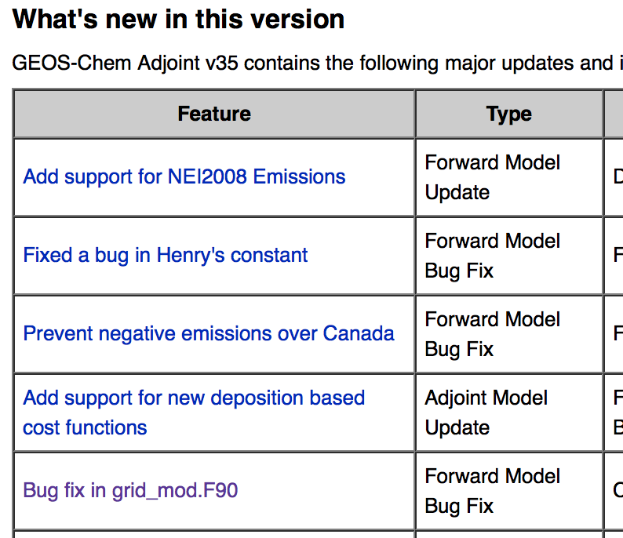
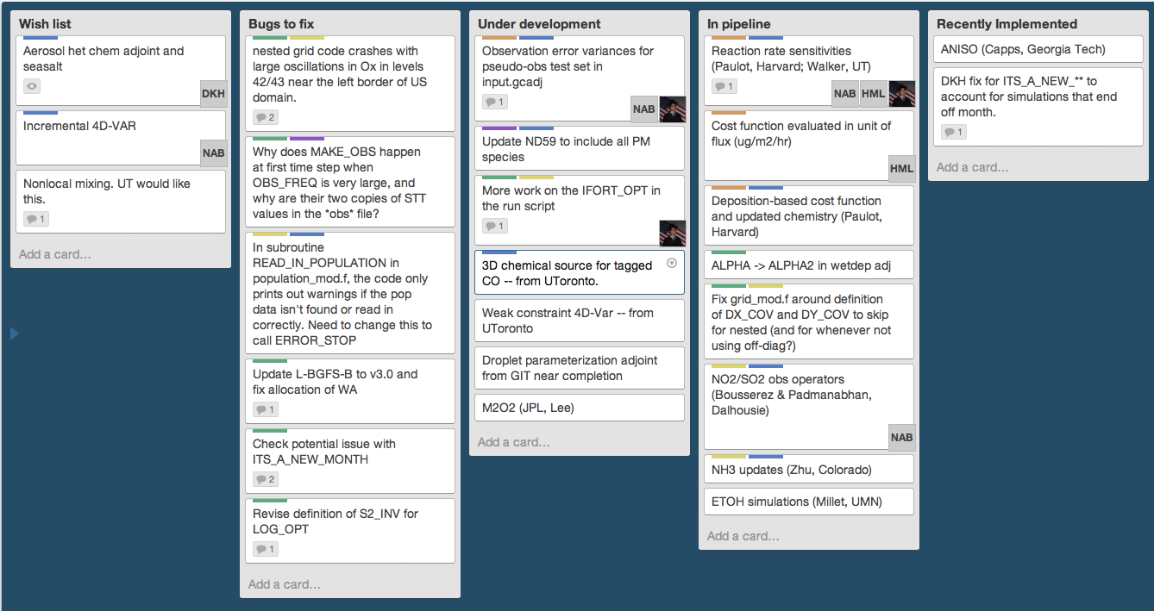
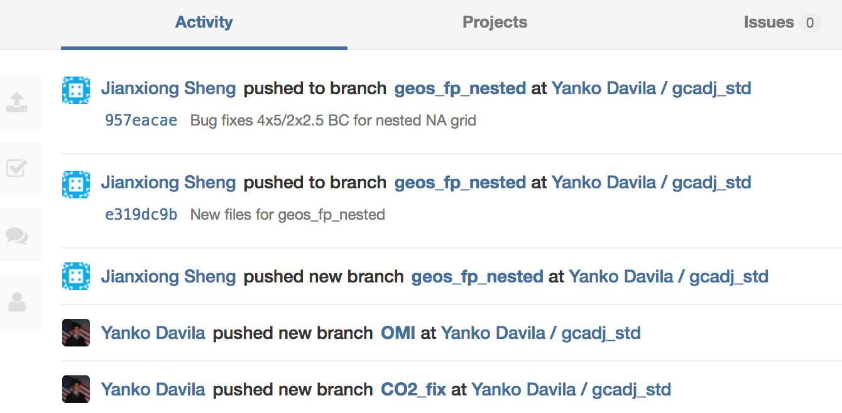
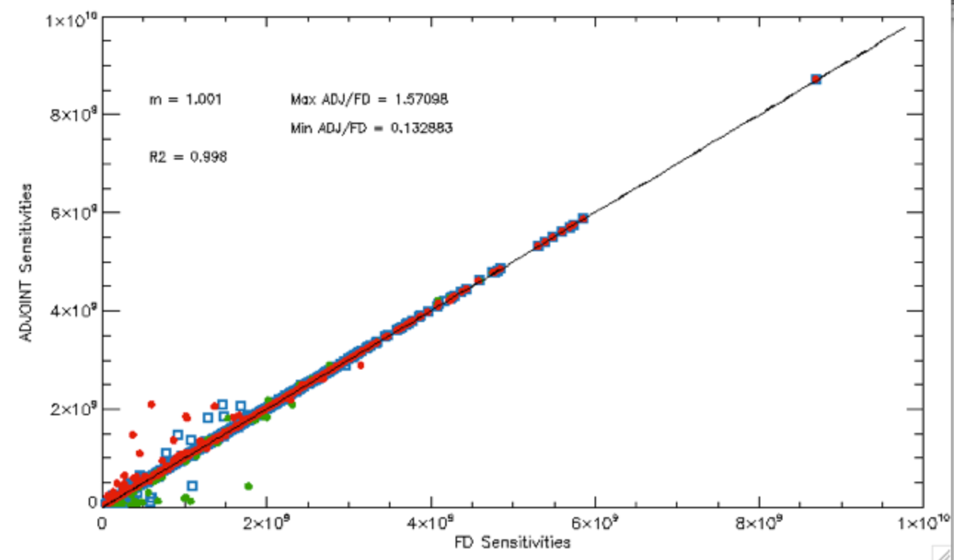
Adjoint model: tracking activities
See GC adjoint wiki page, GitLab and Trello for details:
http://wiki.seas.harvard.edu/geos-chem/index.php/GEOS-Chem_Adjoint (wiki)
http://adjoint.colorado.edu:8080 (code GitLab)
https://trello.com/b/GTfHT38L/geos-chem-adjoint (pipeline)
Benchmarking: finite difference vs adjoint
Notes:
RF(NO_x) = \frac{\partial RE(O_3)}{\partial NO_x} + \frac{\partial RE(CH_4)}{\partial NO_x} + \frac{\partial RE(PM)}{\partial NOx}+\dots

Slide 26
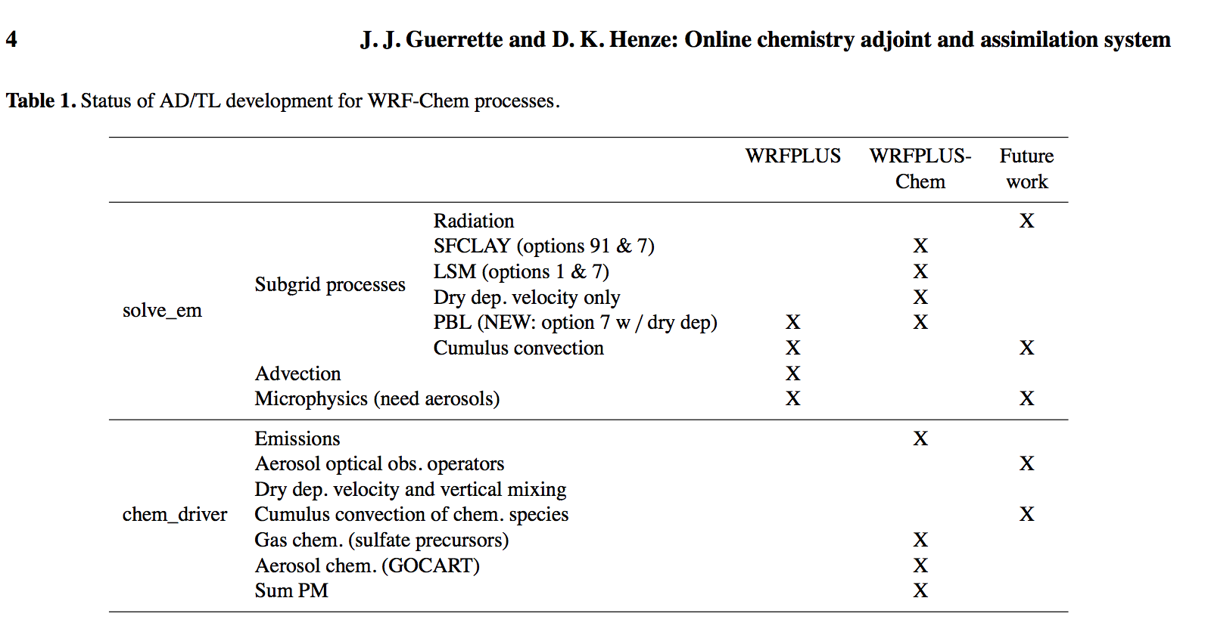
WRFPLUS-Chem
Notes:
RF(NO_x) = \frac{\partial RE(O_3)}{\partial NO_x} + \frac{\partial RE(CH_4)}{\partial NO_x} + \frac{\partial RE(PM)}{\partial NOx}+\dots

Slide 27













Discrete adjoint code example
Forward Run
Adjoint Run
Let

Slide 28





An adjoint model...
...efficiently calculates gradients of a scalar model response with respect to all model parameters (emissions, rate constants, ...)
at the native model resolution.
Forward Model (source-oriented)
Adjoint Model (receptor-oriented)
Sensitivity of all model concentrations to one model source
Sensitivity of model concentration in specific location to many model sources
Forward
Perturbation at source region at t₀
Concentration at the receptor at t_{n}
adjoint
area of
possible origin at t₀
Changes of concentration at t_{n}
cost scales with # of sources
cost scales with # of receptors
Notes:
RF(NO_x) = \frac{\partial RE(O_3)}{\partial NO_x} + \frac{\partial RE(CH_4)}{\partial NO_x} + \frac{\partial RE(PM)}{\partial NOx}+\dots

Slide 29
Recent and current applications:
Source attribution
Climate
- Aerosol Radiative forcing and Temperature (Lacey, CU Boulder)
- Ozone and CH₄ RF (Walker, JPL)
- CCN (Capps, Drexel)
- BC in the Arctic (Qi, UCLA; Xu, Dalhousie)
Air quality
- Background O₃ (JPL)
- PM_{2.5} source attribution (Zhang, Peking)
- PM_{2.5} health impacts (Dedoussi, MIT; Zhang, Tsinghua; Lee, Dalhousie; Lacey, CU Boulder; Koplitz, Harvard)
- O₃ health impacts (Henze, CU Boulder)
- NO_{x} sensitivity to emissions (Bowman, JPL)
- GC adjoint vs HTAP multi-model source-receptor relationships (Davila, Henze, CU Boulder)
Ecosystem impacts
O₃ vegetative exposure and crop loss (Lapina, CU Boulder)
N deposition (Lee, CU Boulder; Zhao, Peking)
Blue = person presenting this topic at IGC8
Notes:
RF(NO_x) = \frac{\partial RE(O_3)}{\partial NO_x} + \frac{\partial RE(CH_4)}{\partial NO_x} + \frac{\partial RE(PM)}{\partial NOx}+\dots

Slide 30
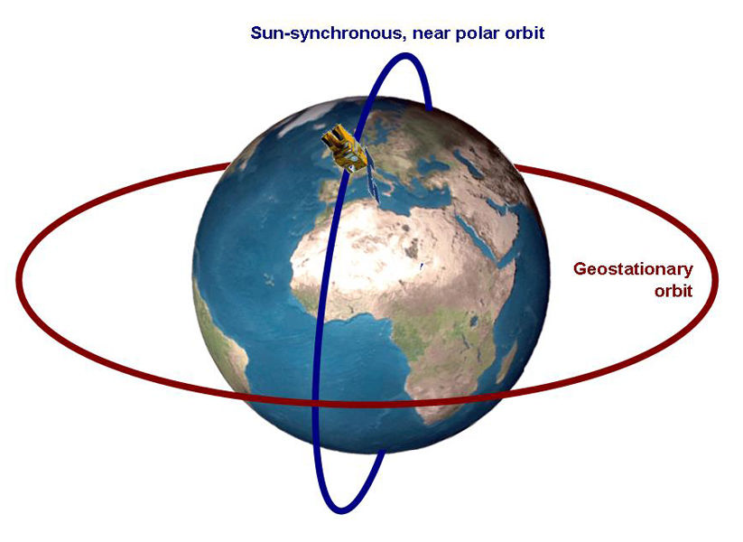
Recent and current applications:
4D-Var inverse modeling and data assimilation
Aerosol and aerosol precursor emissions
- Aerosol with MODIS, CALIPSO (Wang, UI; Lee, Dalhousie; Chen, CNRS)
- NH₃ with TES (Zhang, Peking)
- SO2 and NO₂ with OMI (Wang, UI; Qu, CU Boulder; Cooper, Dalhousie)
Greenhouse gases
- CH₄ (Turner, Harvard/UCB; Bousserez, CU Boulder; Stanevich, UT; Tan, Purdue)
- CO₂ (Liu, Lee, Bowman, JPL; Deng, Jones, UT)
- N₂O (Wells, U. Minnesota)
Reactive gas-phase species
- CO from MOPITT (He, UT)
- Isoprene from OMI HCHO (Kaiser, Harvard)
- NMVOCs (Cao, Peking U.)
- CO, NO₂ and O₃ (Miyazaki, JAMSTEC/JPL; Zhang, UT)
Satellite design
- GEO-CAPE (Bousserez; CU Boulder)
- CLARREO (Wang, UI)
Kaminski & Heimann, 2001
Peylin et al., 2001
Method advancement and comparisons
- Weak constraint 4D-Var (He, Stanevich, UT)
- UQ and model reduction (Bousserez, CU Boulder)
- Grid-scale vs optimal aggregation (Turner, Harvard;
Wells, U Minn)
- 4D-Var and EnKF (Miyazaki, JAMSTEC/JPL; Liu, JPL)
- Mass balance vs 4D-Var (Qu, CU Boulder; Cooper, Dalhousie)
- Verification of top-down CO₂ flux constraints (Liu, JPL)
Notes:
RF(NO_x) = \frac{\partial RE(O_3)}{\partial NO_x} + \frac{\partial RE(CH_4)}{\partial NO_x} + \frac{\partial RE(PM)}{\partial NOx}+\dots

Slide 31
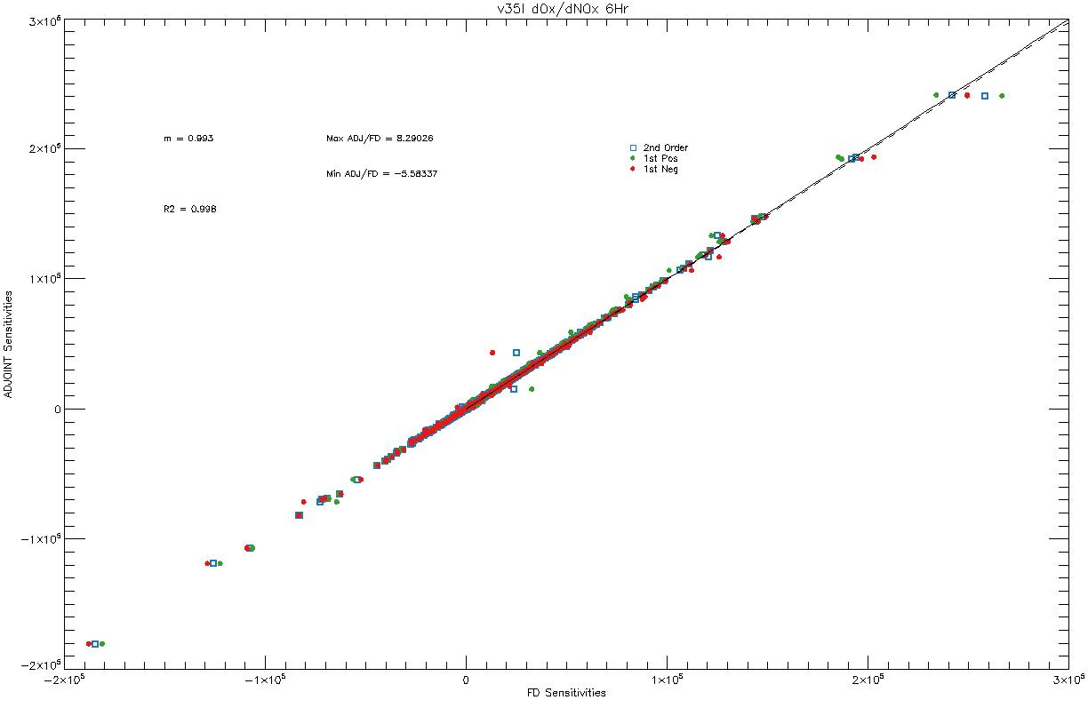
2nd order (centered) FD = J(s+0.1) – J(s-0.1) / 0.2
1st order (+10%) FD = J(s+0.1)/J(s)
1st order (-10%) FD = J(s-0.1)/J(s)
m = 0.993
R² = 0.998
Adjoint sensitivities
Finite Difference sensitivities

Slide 32
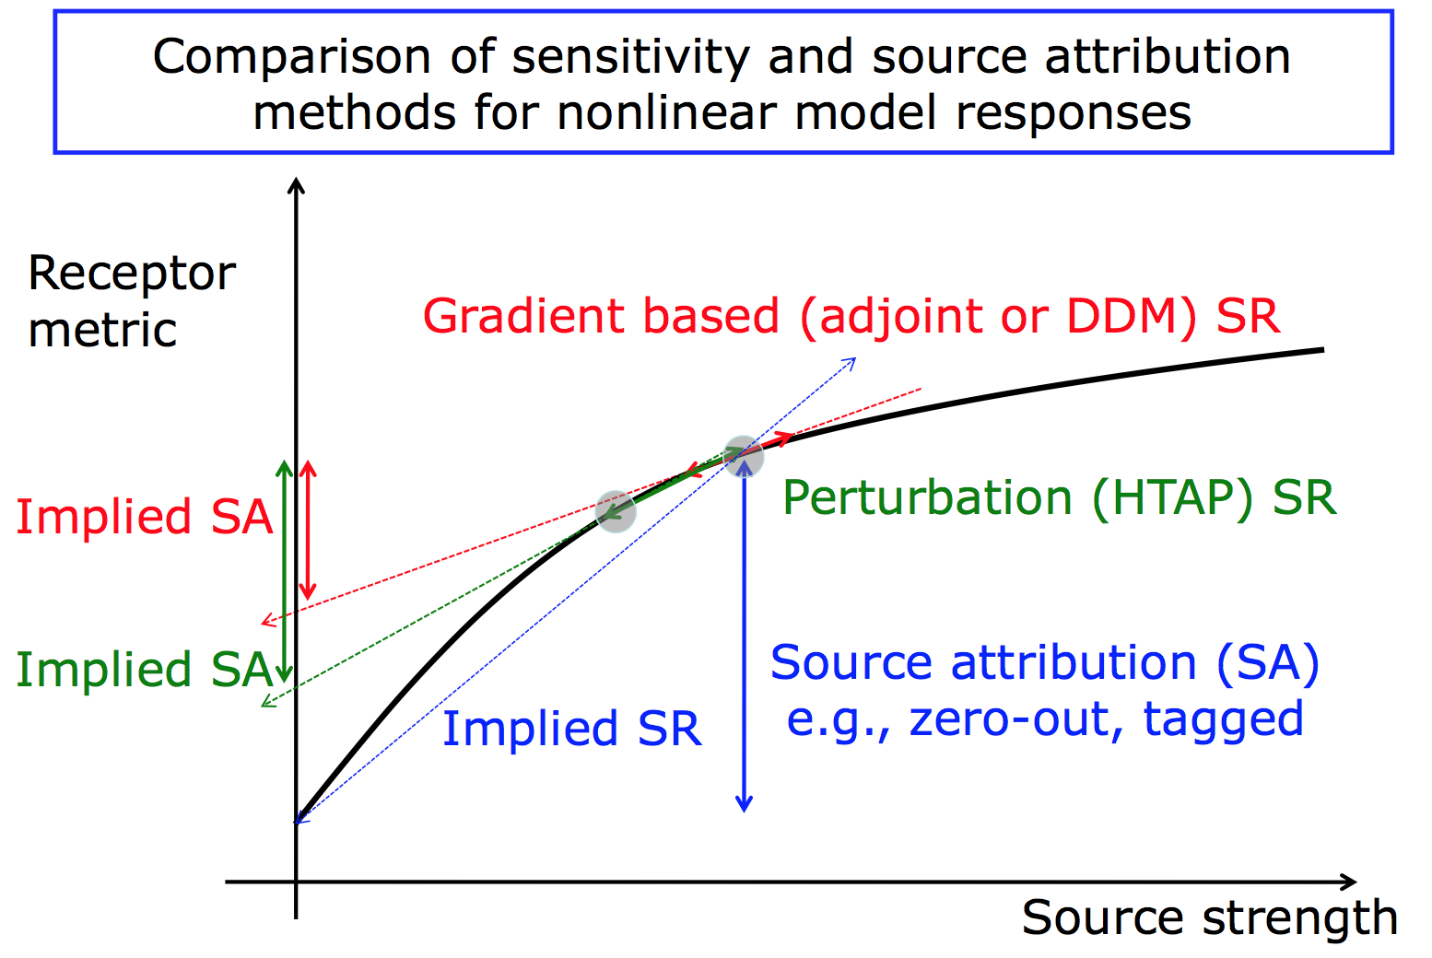

Slide 33
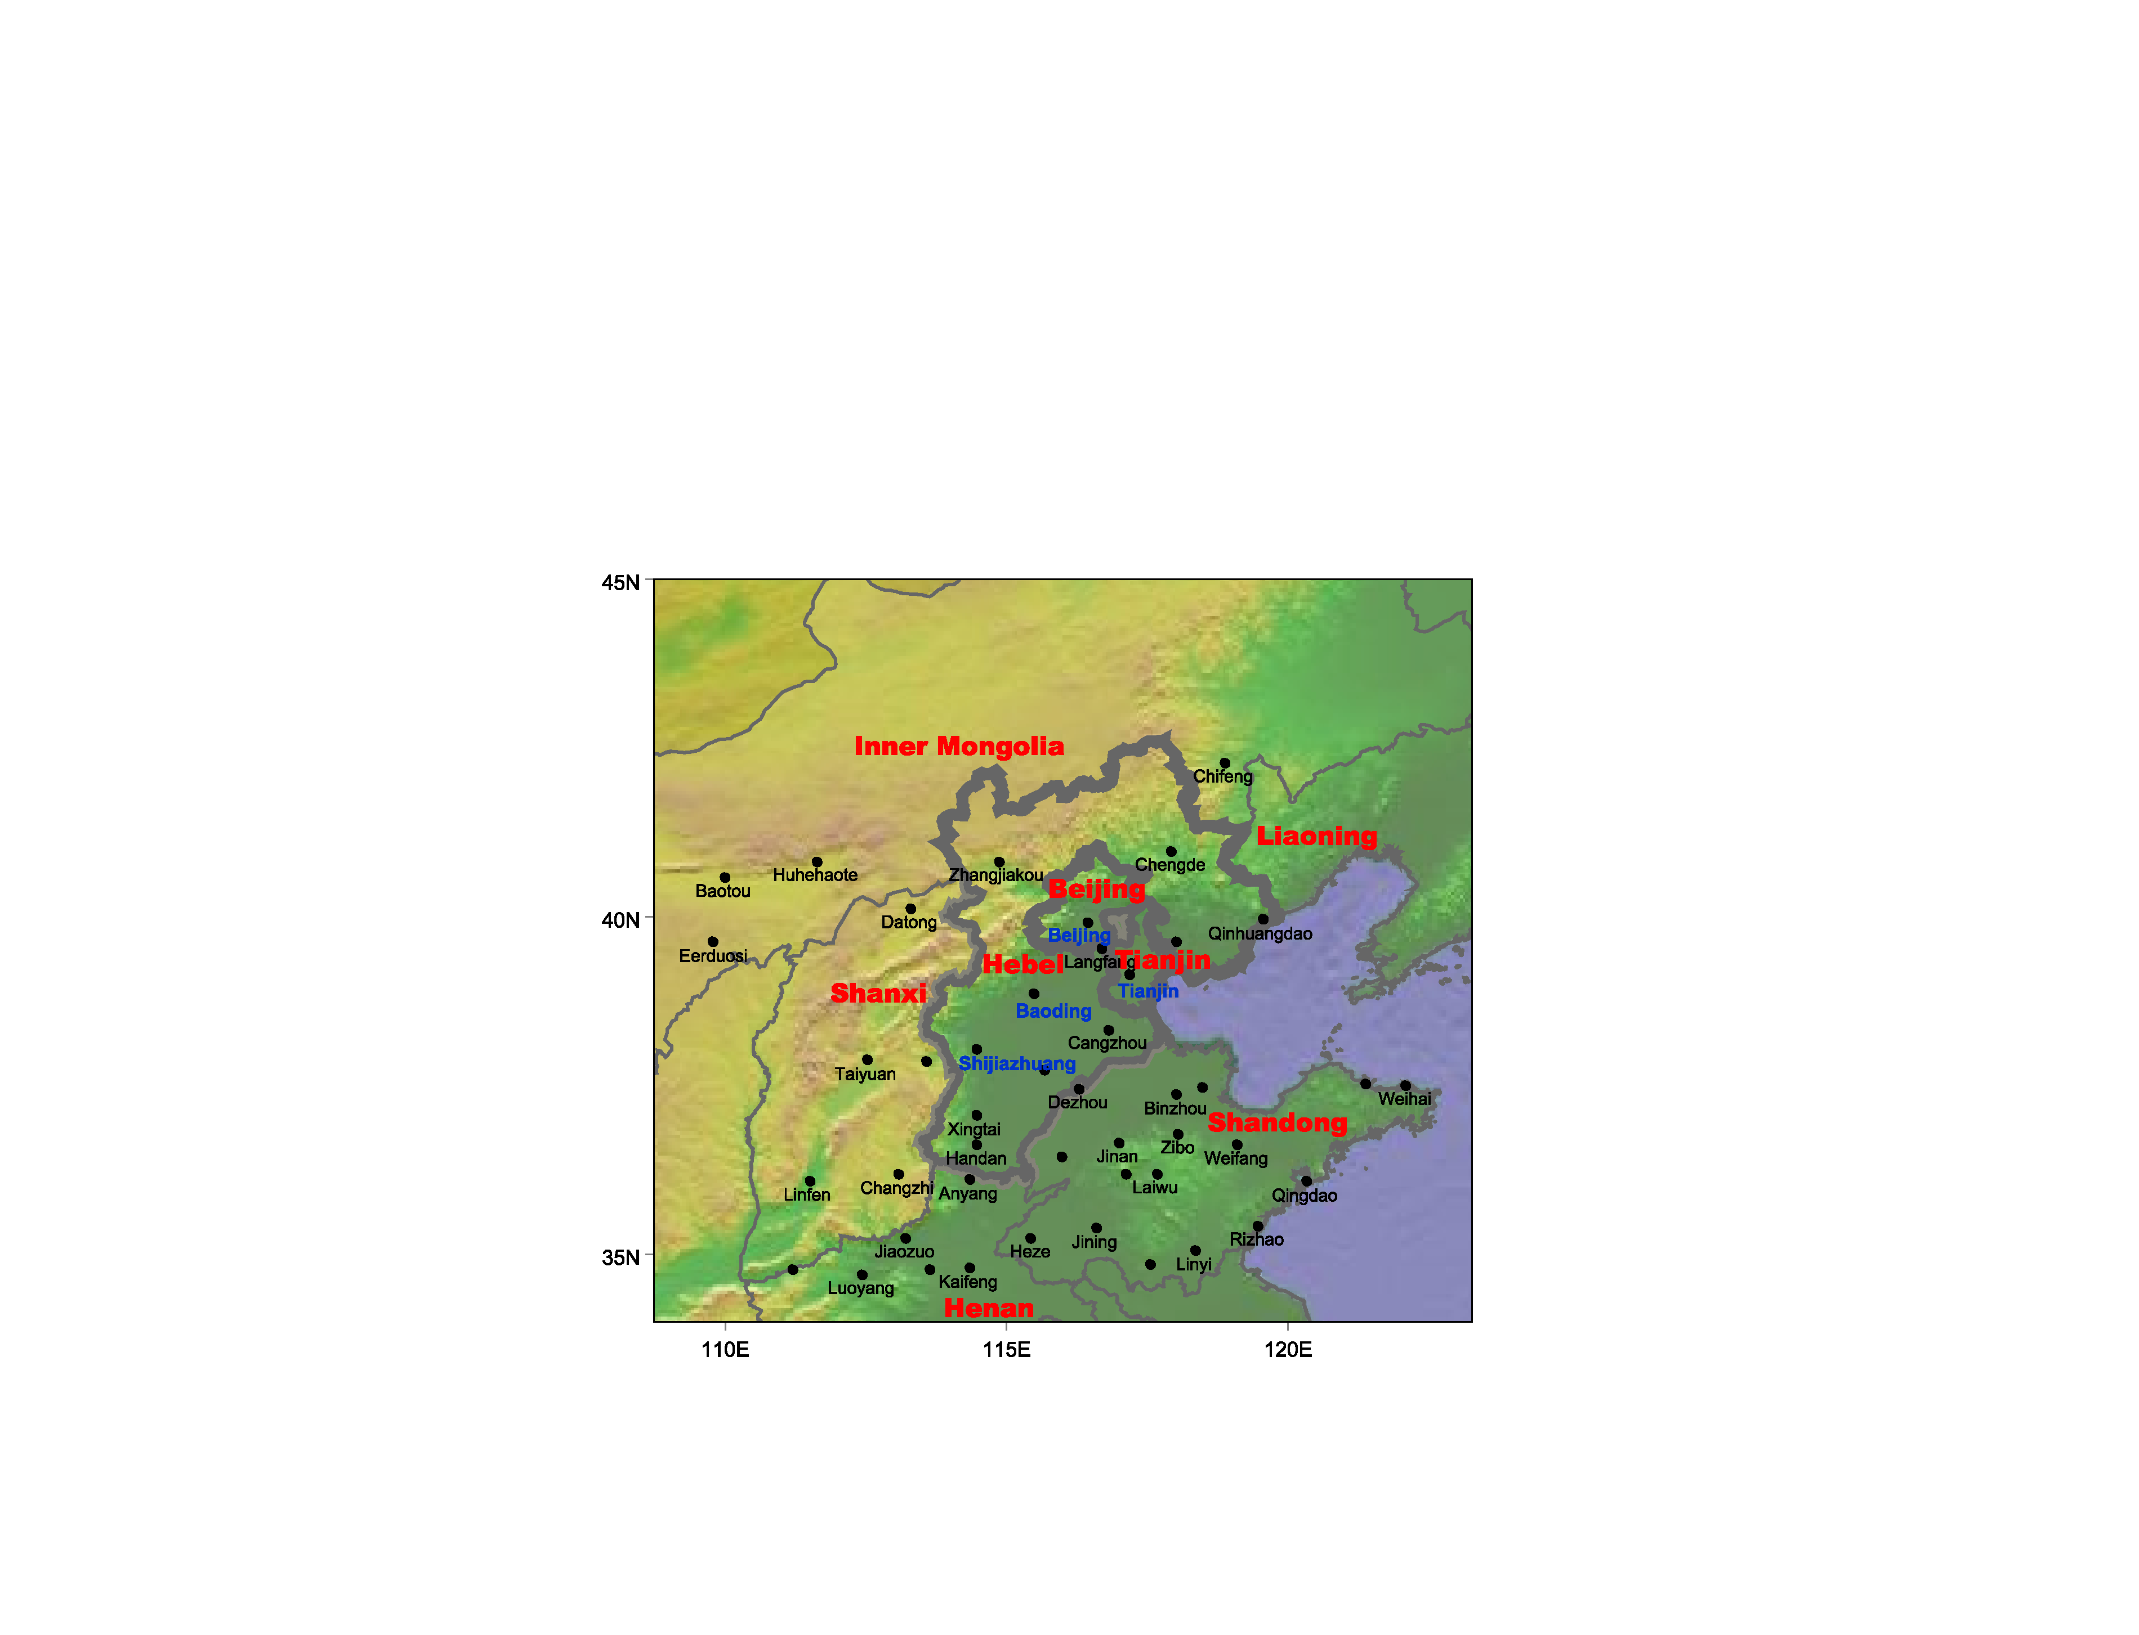
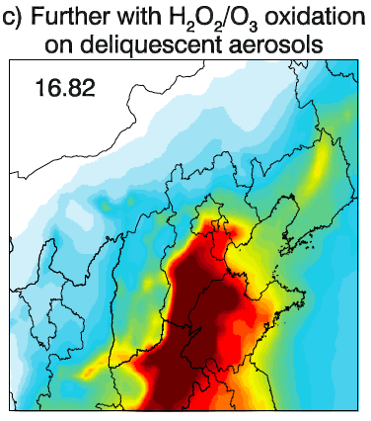
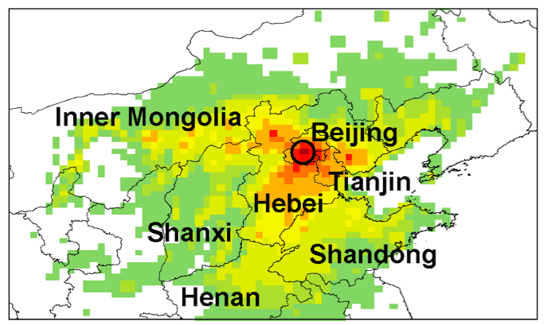
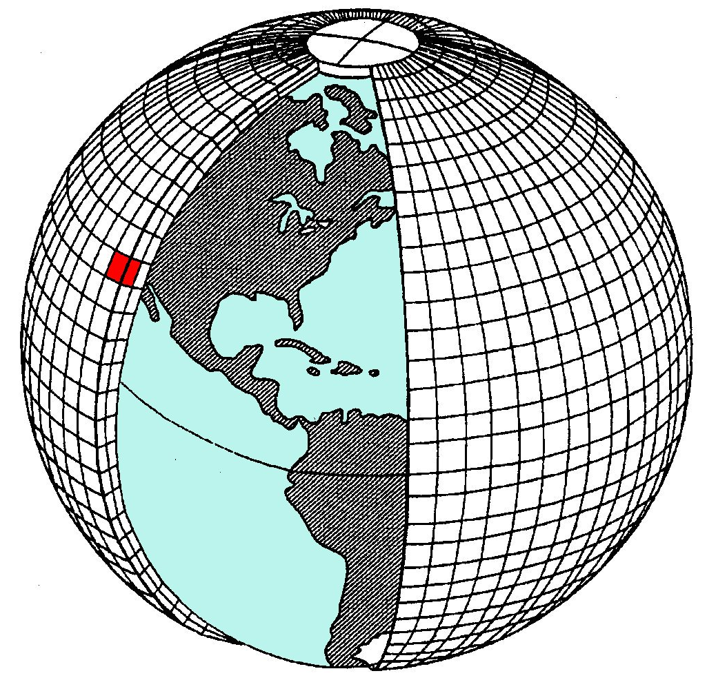
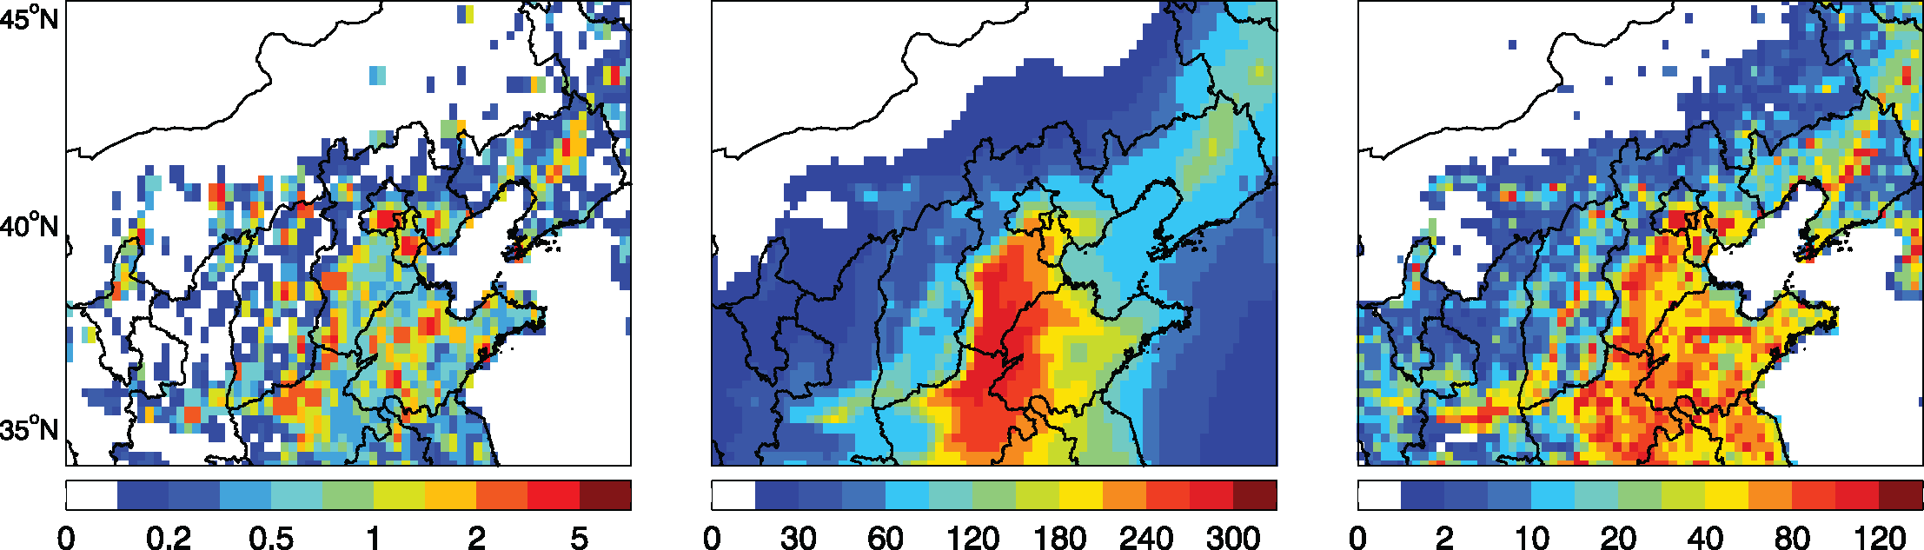
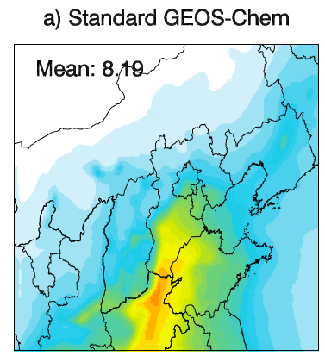
Adjoint Application on PM_{2.5} pollution over China -
Data Assimilation and Source Attribution
The CNEMC Monitoring Sites
Optimized Simulation
Data Assimilation
Improved Source Attribution
Optimized Model
The GEOS-Chem Model and its Adjoint
Adjoint Sensitivity
Emissions
Prior Simulation
Forward Model
L. Zhang, et al., Sources and Processes Affecting Fine Particulate Matter Pollution over North China: An Adjoint Analysis of the Beijing APEC Period, ES&T, 2016.

Slide 34
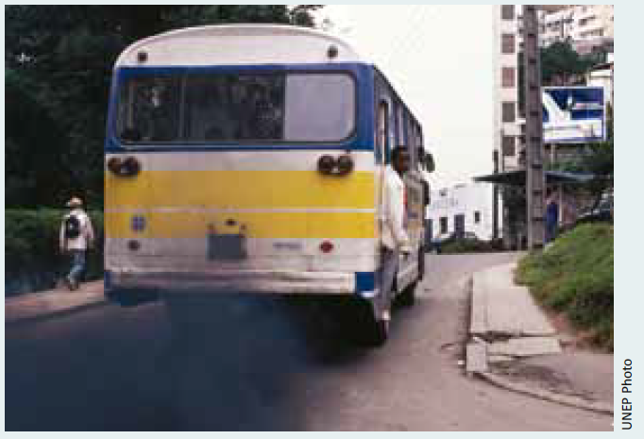
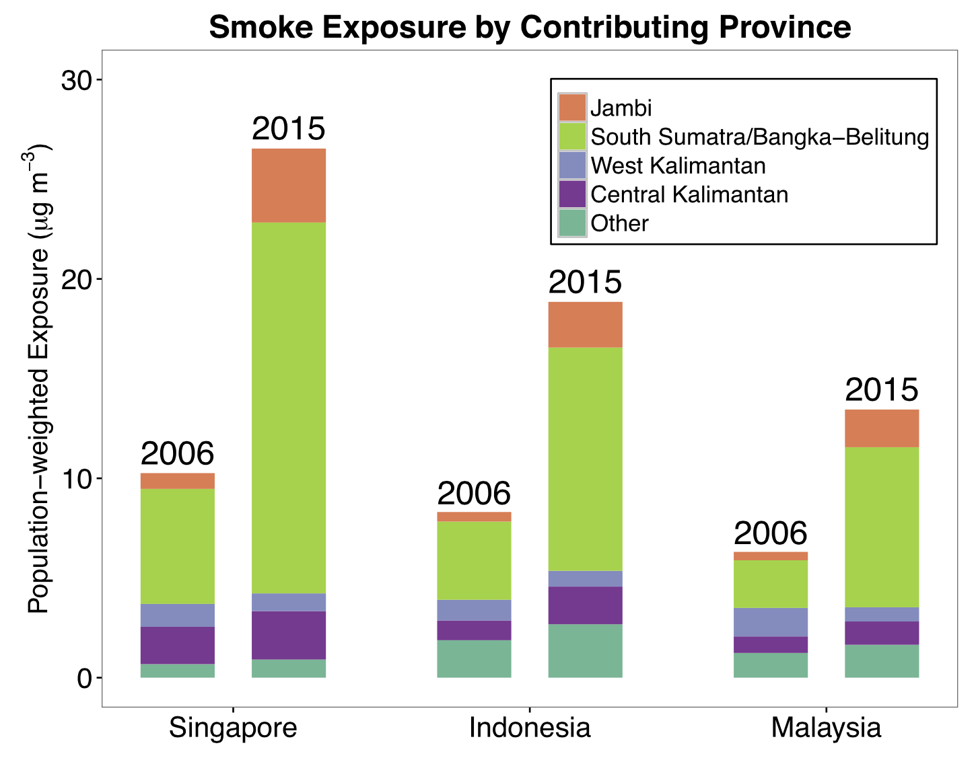
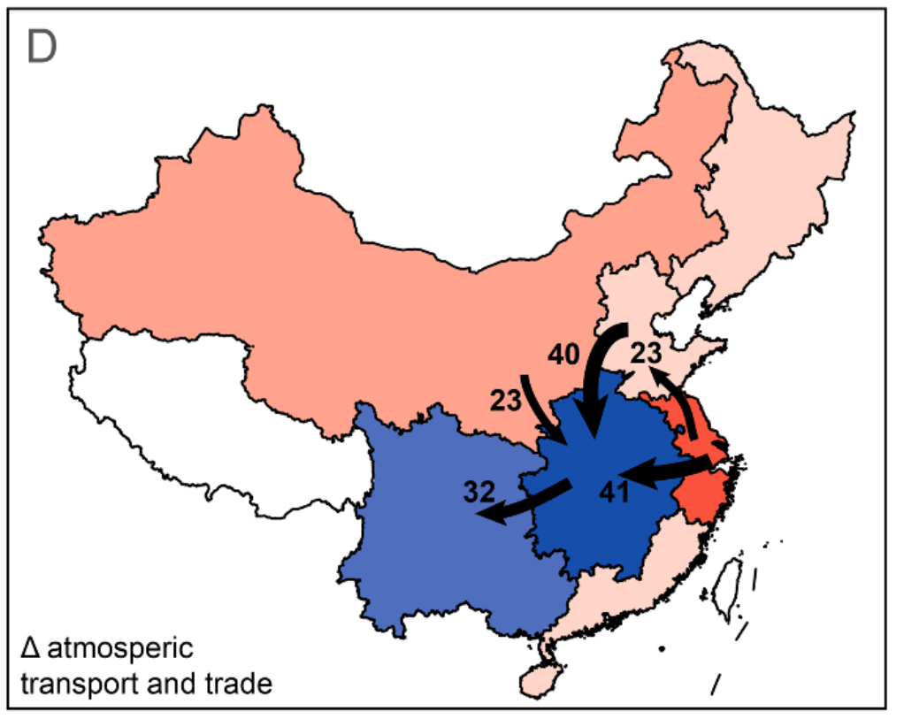
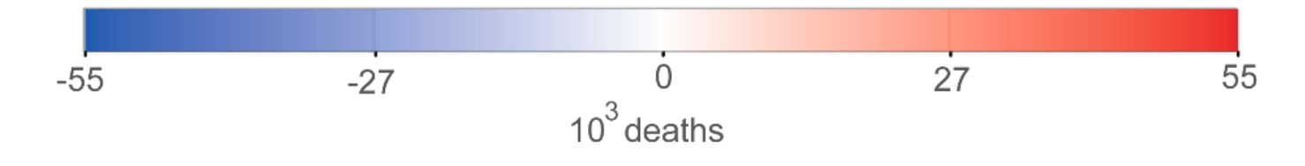
GEOS-Chem adjoint major new directions: health impacts and integrated assessment
(e.g., Dedoussi, MIT; J. Lin and Q. Zhang, Peking/Tsinghua, Baublitz, Columbia; Henderson, EPA; Henze and Lacey, CUB)
LEAP-IBC: rapid emission and scenario assessment toolkit for UNEP
Mitigation
∆Emissions
Response
∆O₃,
∆PM_{2.5}
∆CH₄
Benefits
- health
- climate
- crop yield
e.g. Lacey et al., PNAS, 2017
Koplitz et al., ERL, 2016
Impacts of atm transport vs trade on PM_{2.5} mortality in China
Zhao et al., ACPD, 2017
Notes:
RF(NO_x) = \frac{\partial RE(O_3)}{\partial NO_x} + \frac{\partial RE(CH_4)}{\partial NO_x} + \frac{\partial RE(PM)}{\partial NOx}+\dots

Slide 35
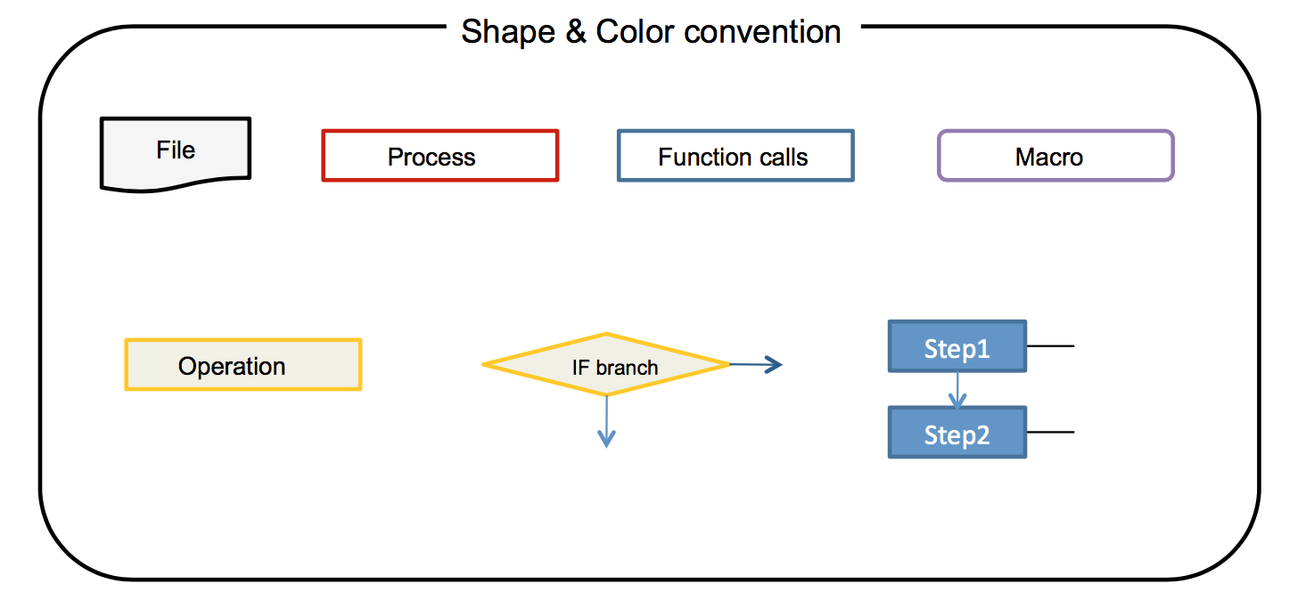
Code flowchart (Meemong Lee)

Slide 36
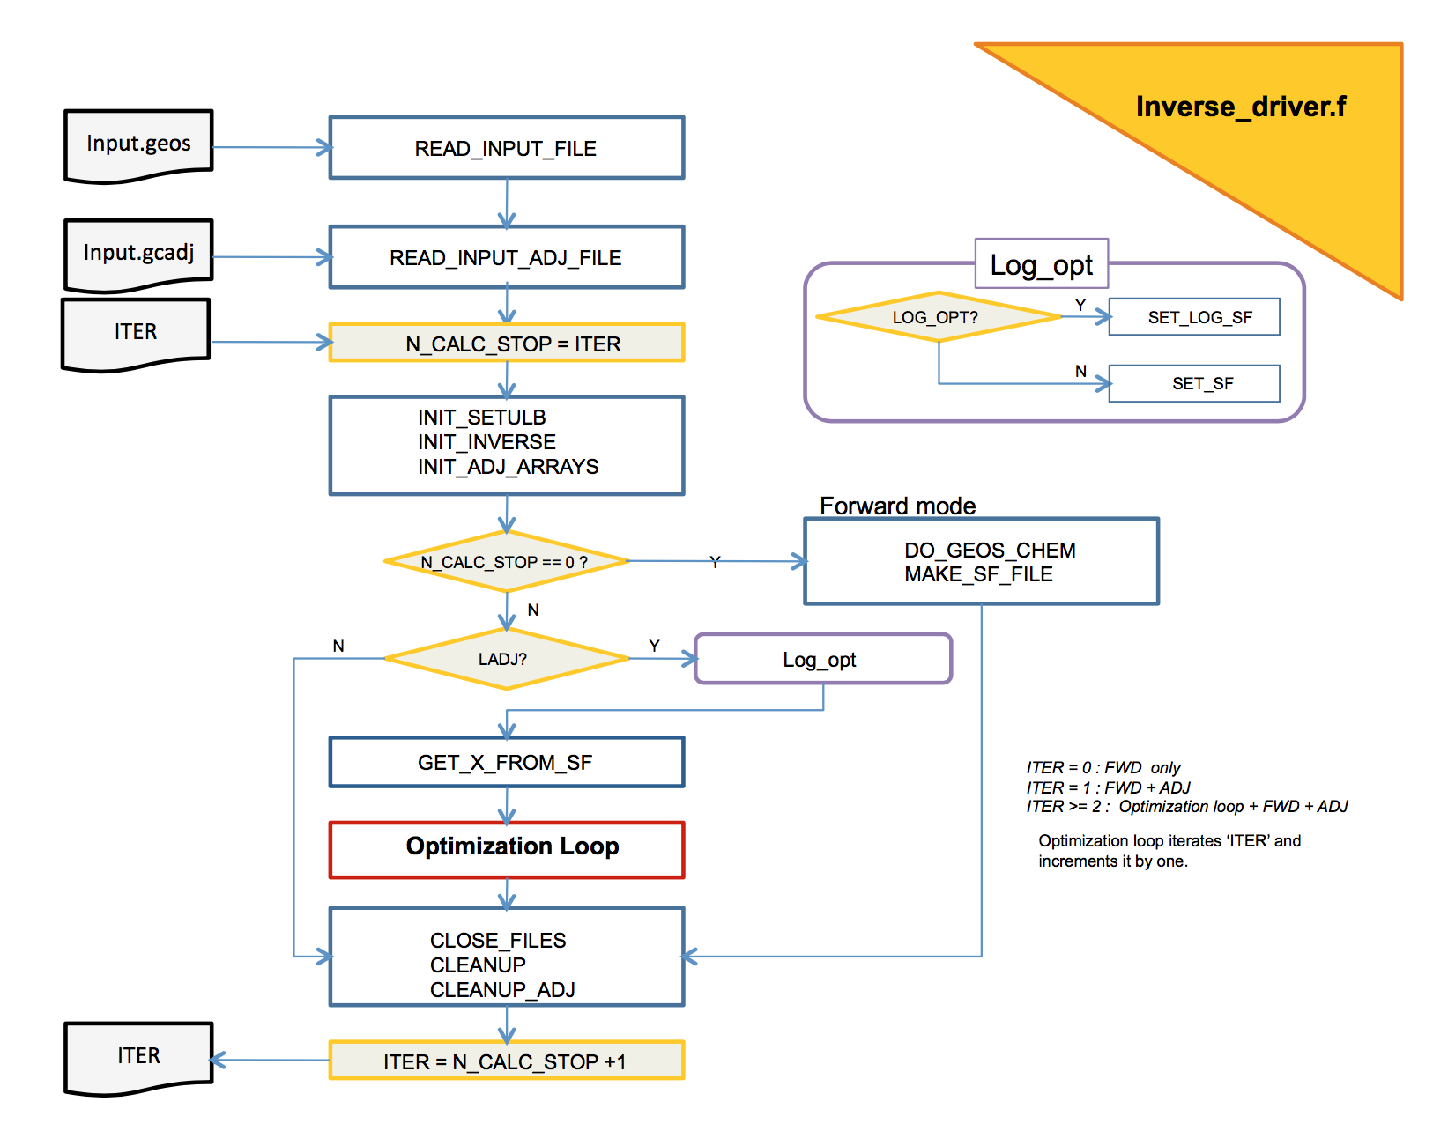

Slide 37
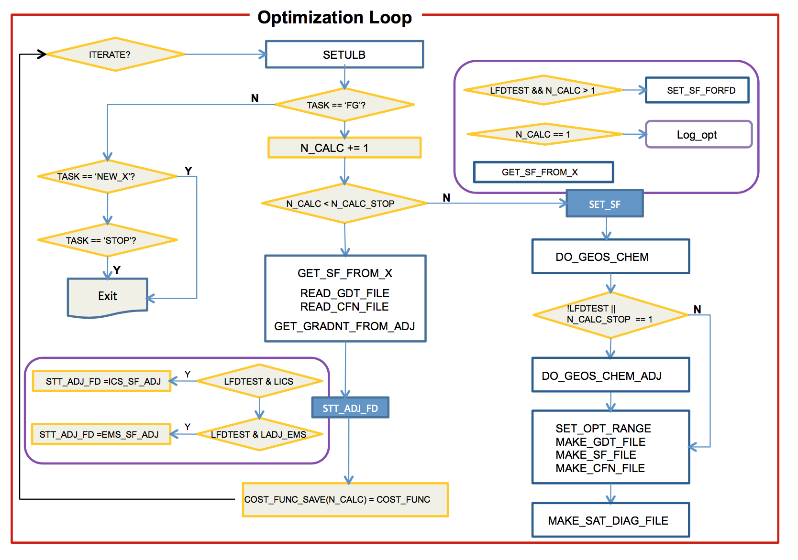

Slide 38
Adjoint clinic slides

Slide 39
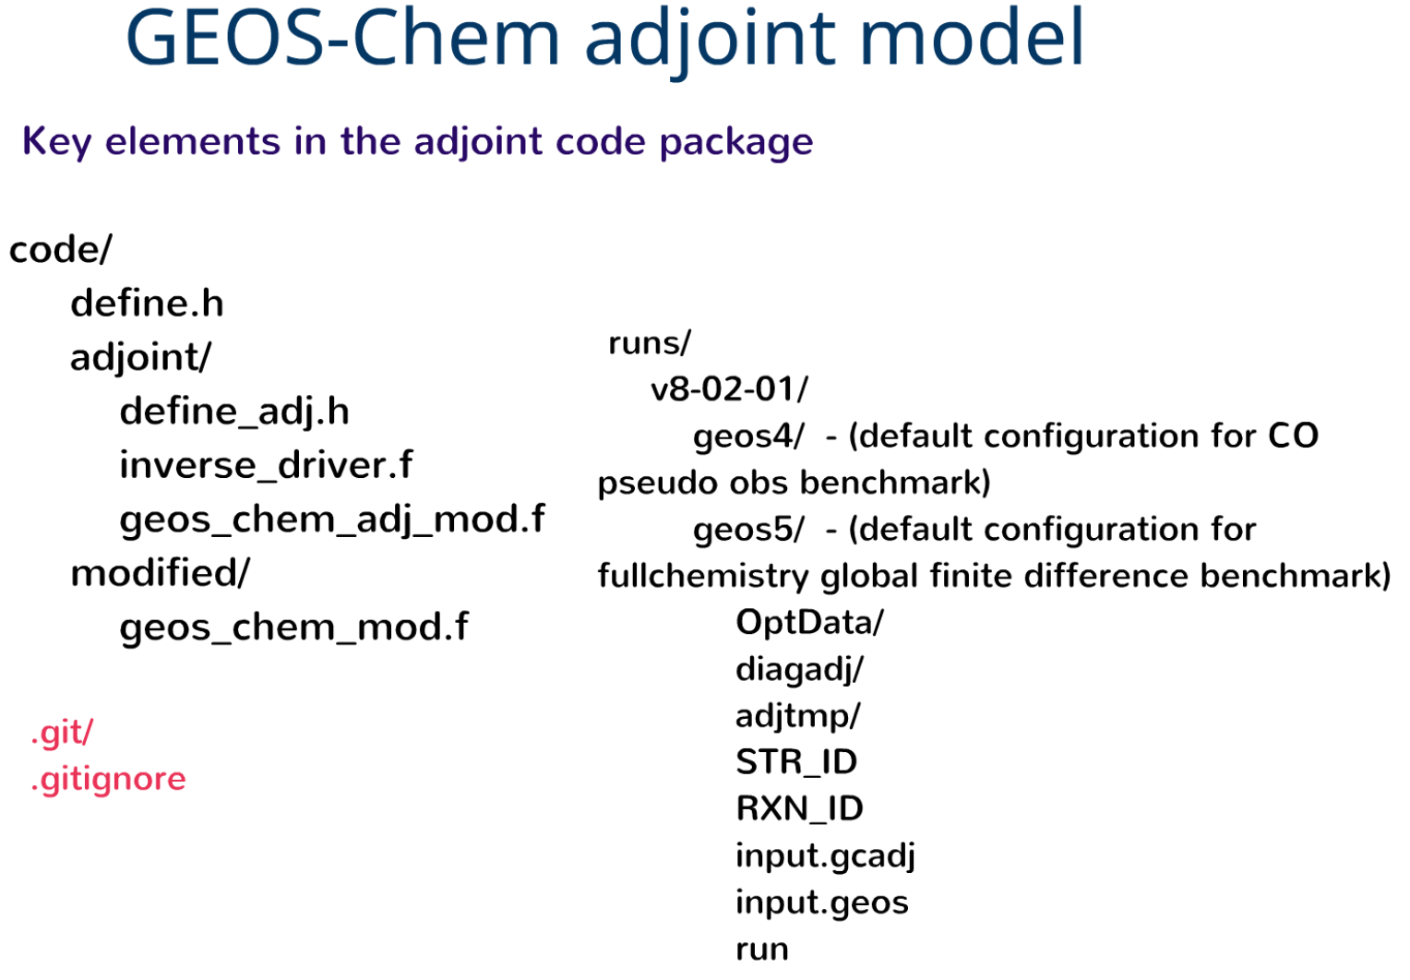

Slide 40
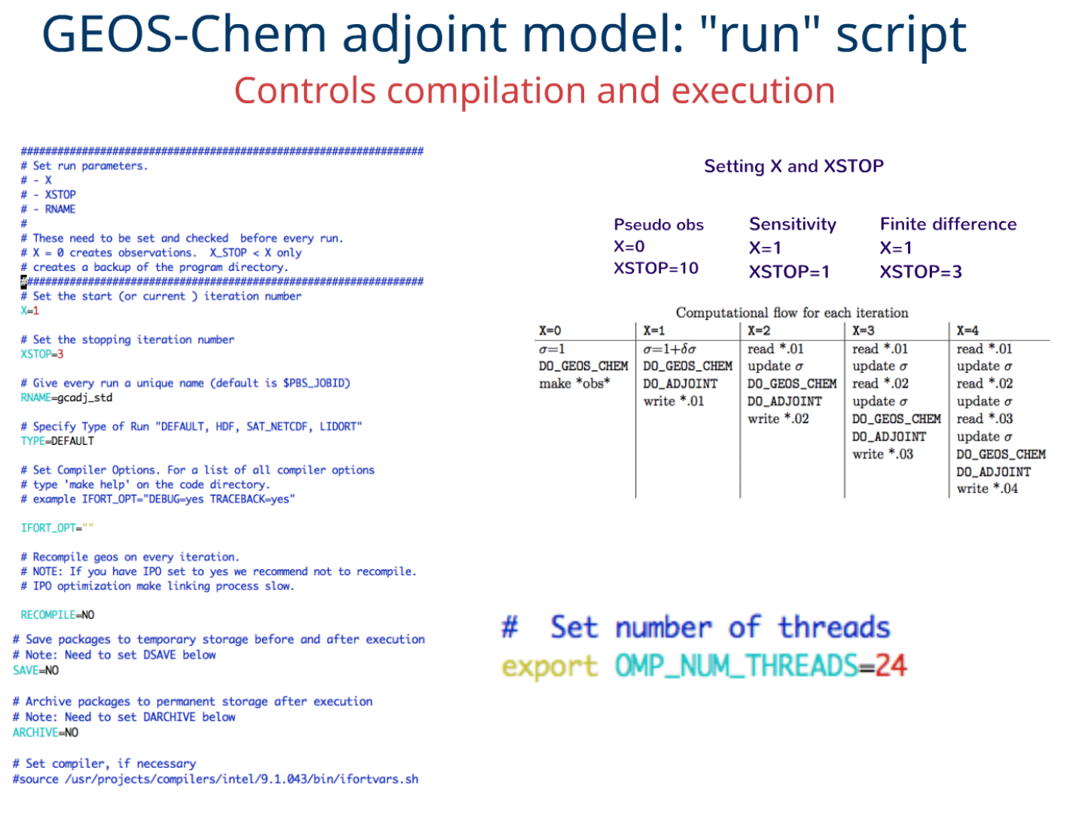

Slide 41
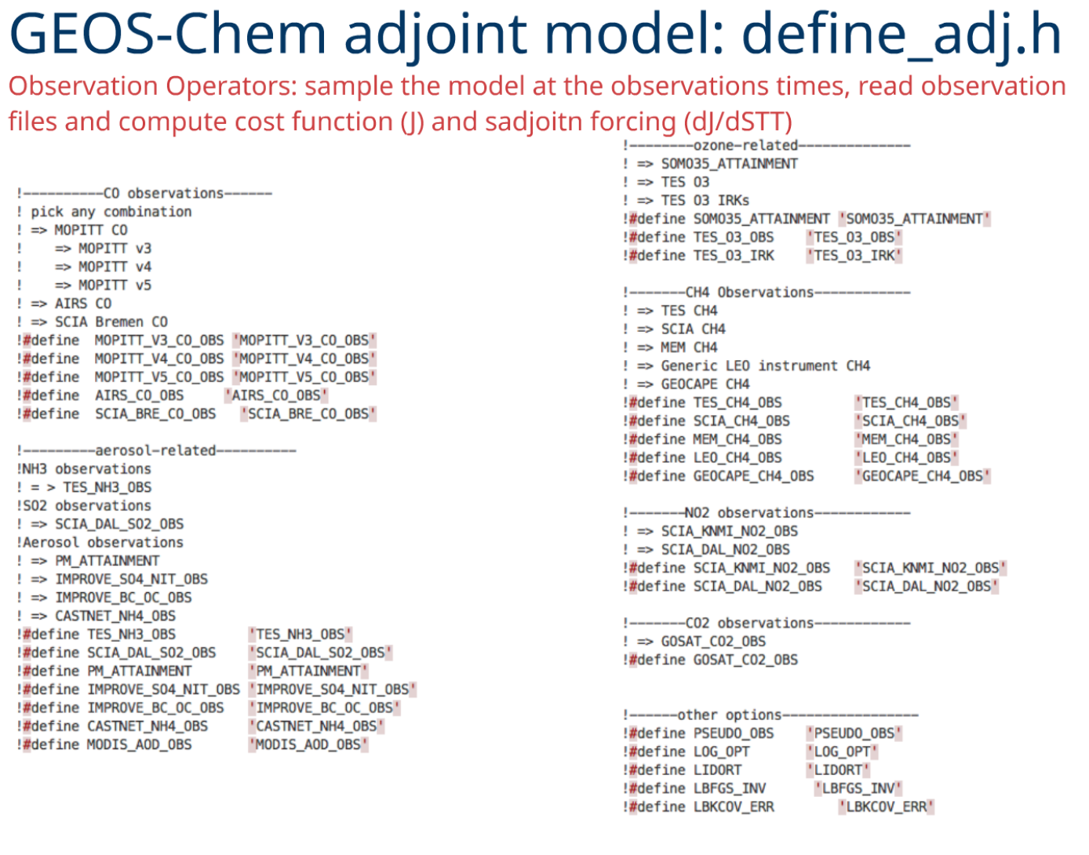

Slide 42
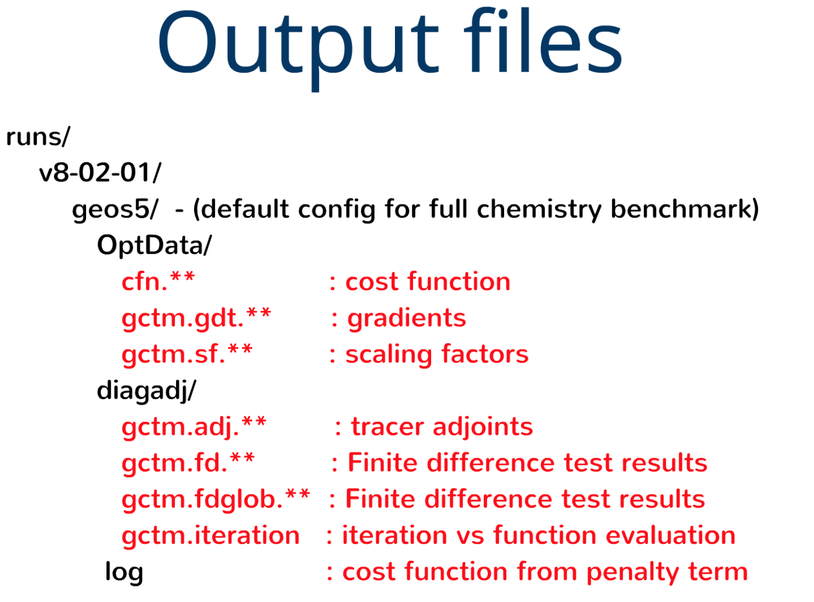

Slide 43
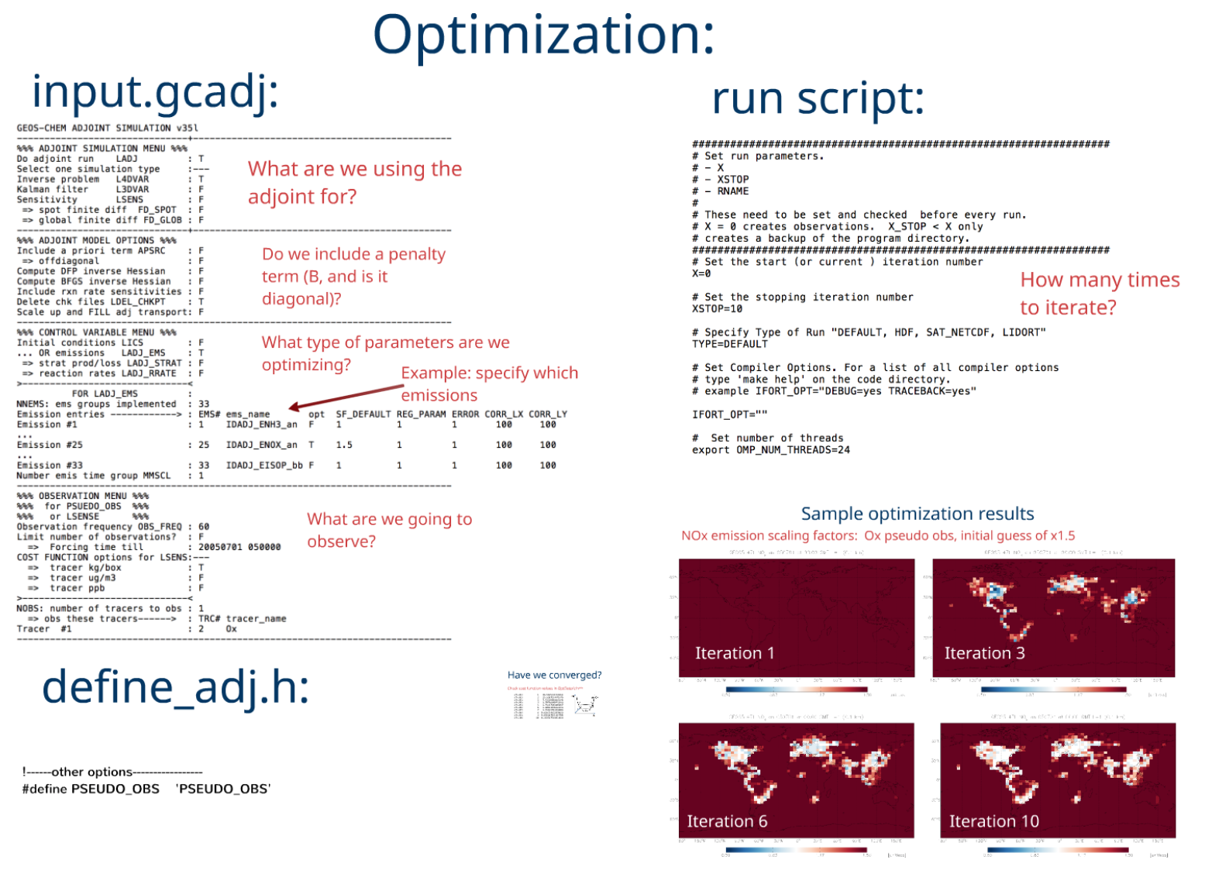

Slide 44
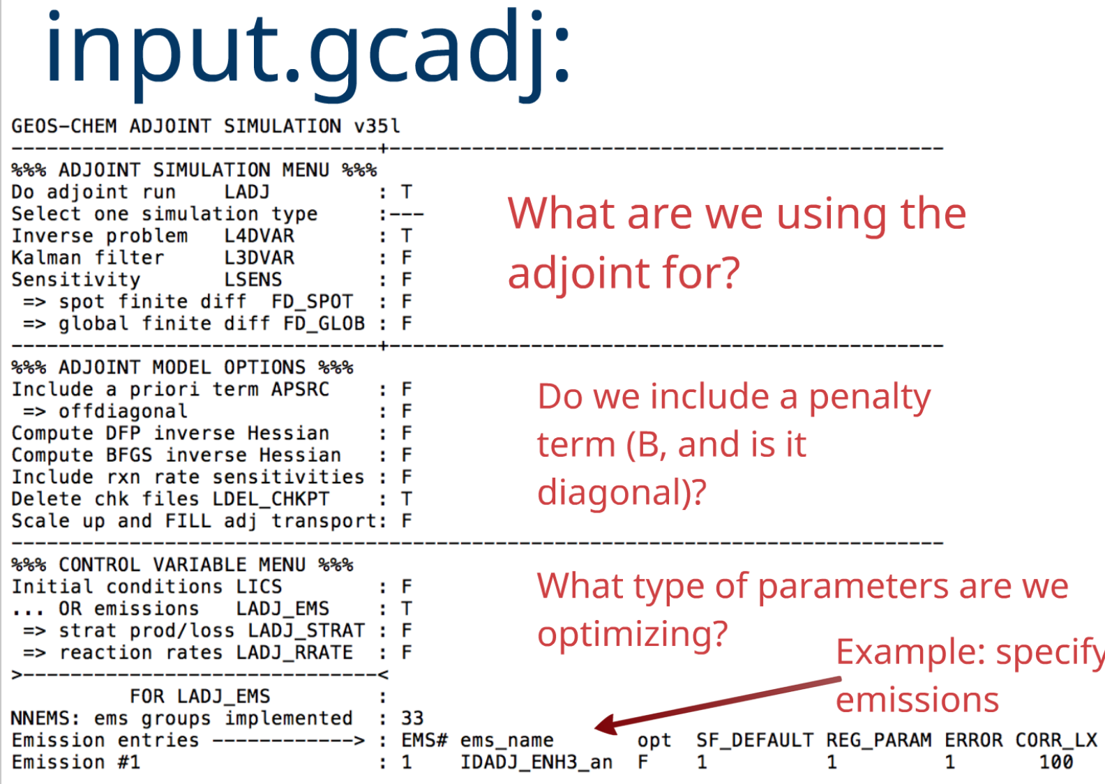

Slide 45
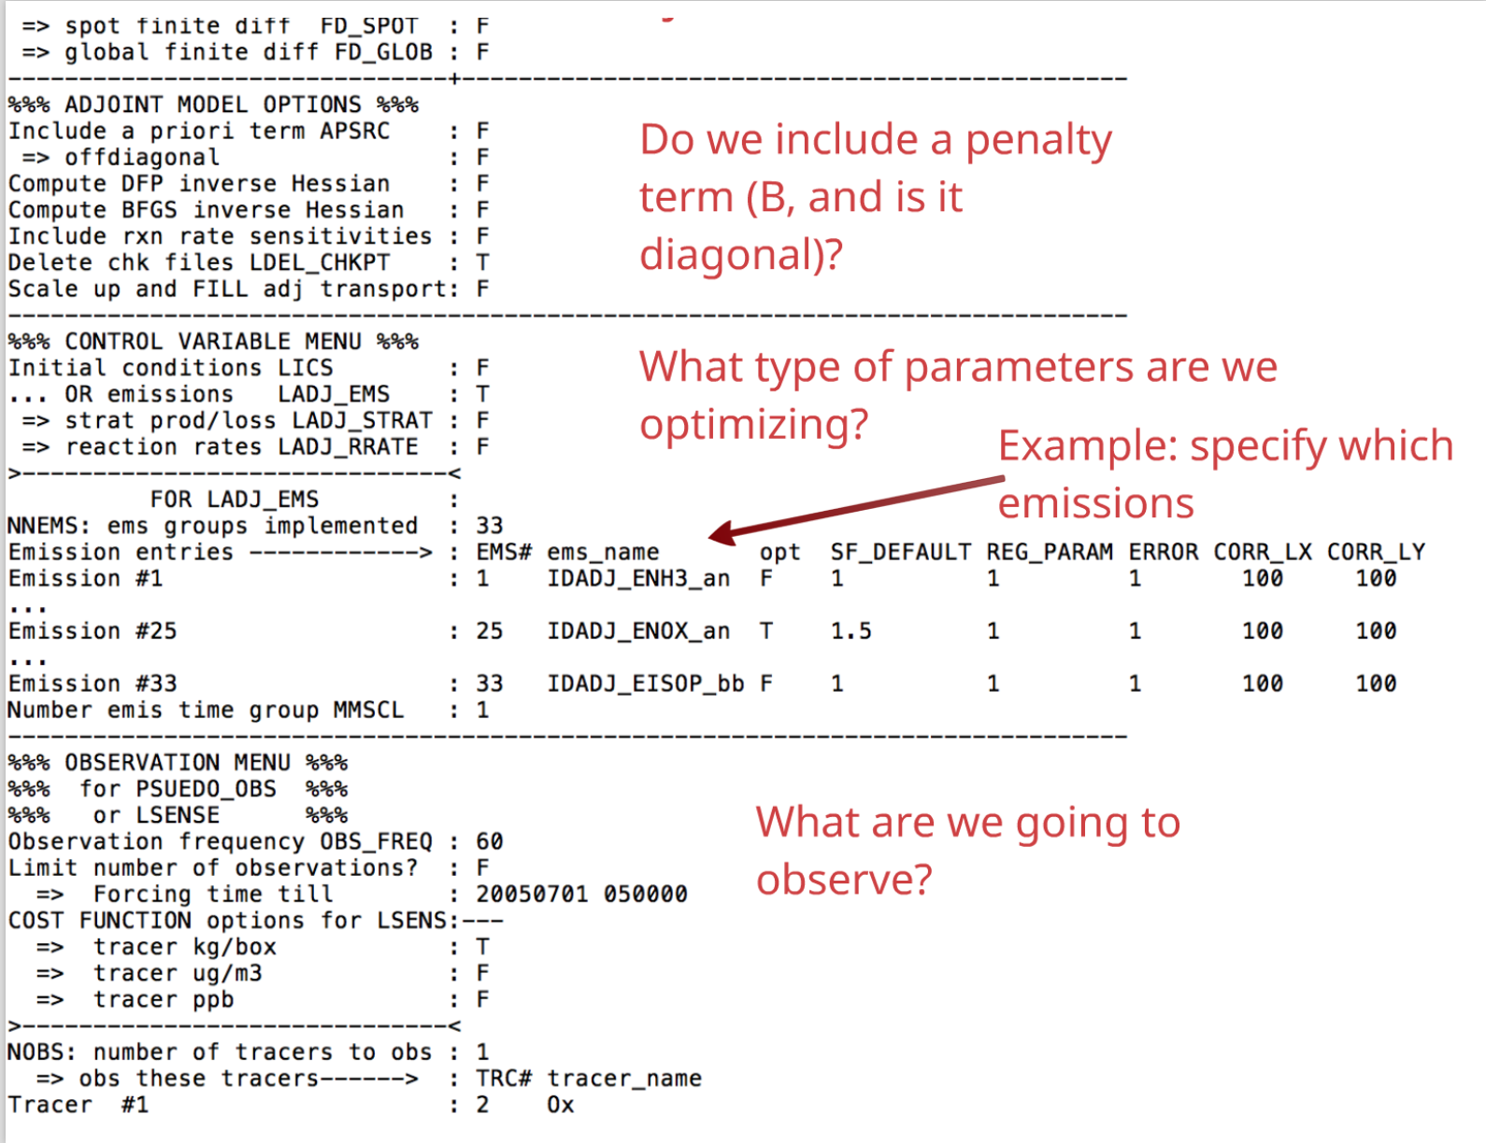

Slide 46
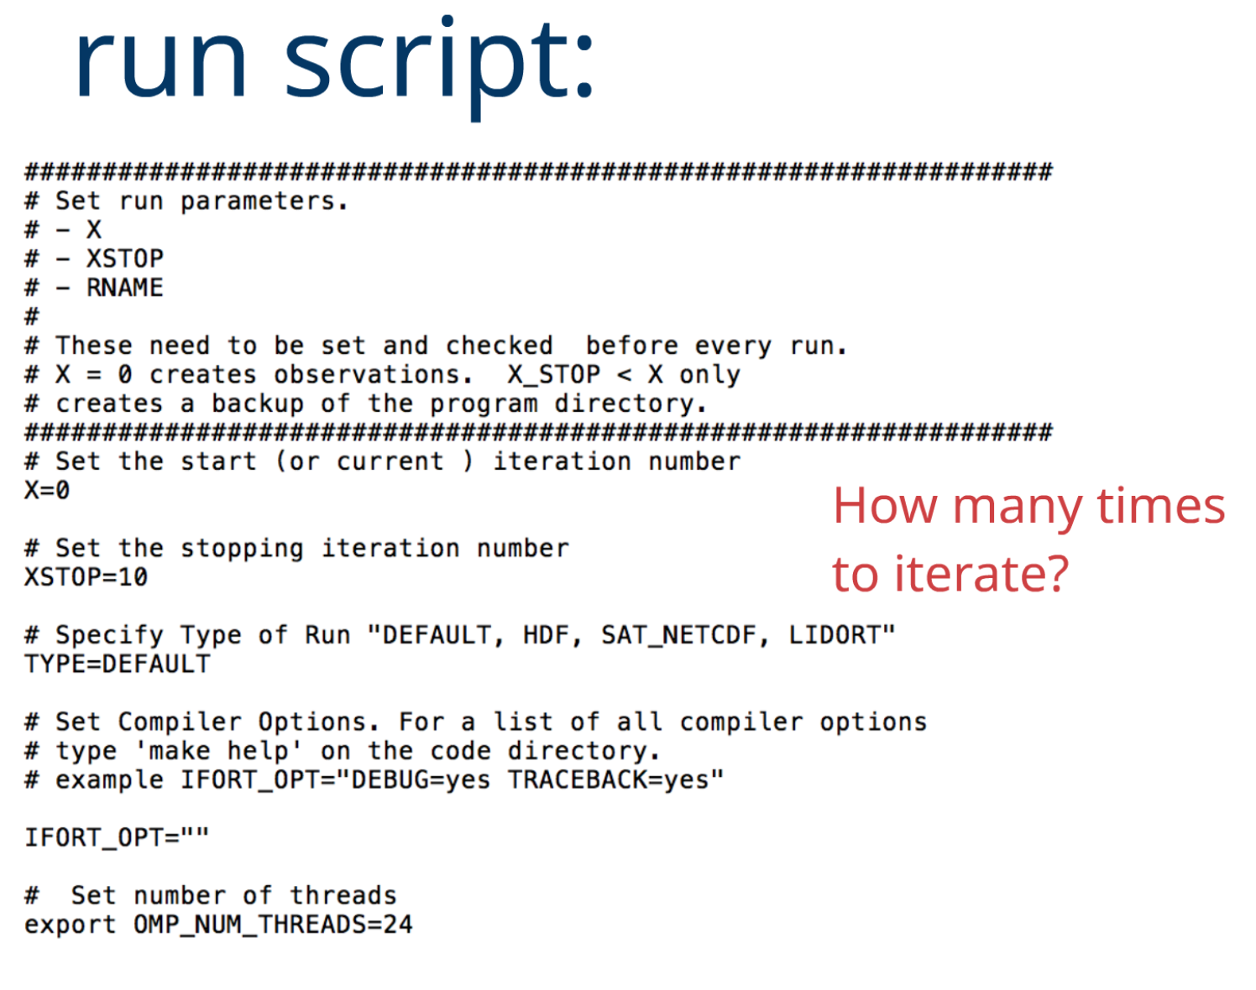

Slide 47
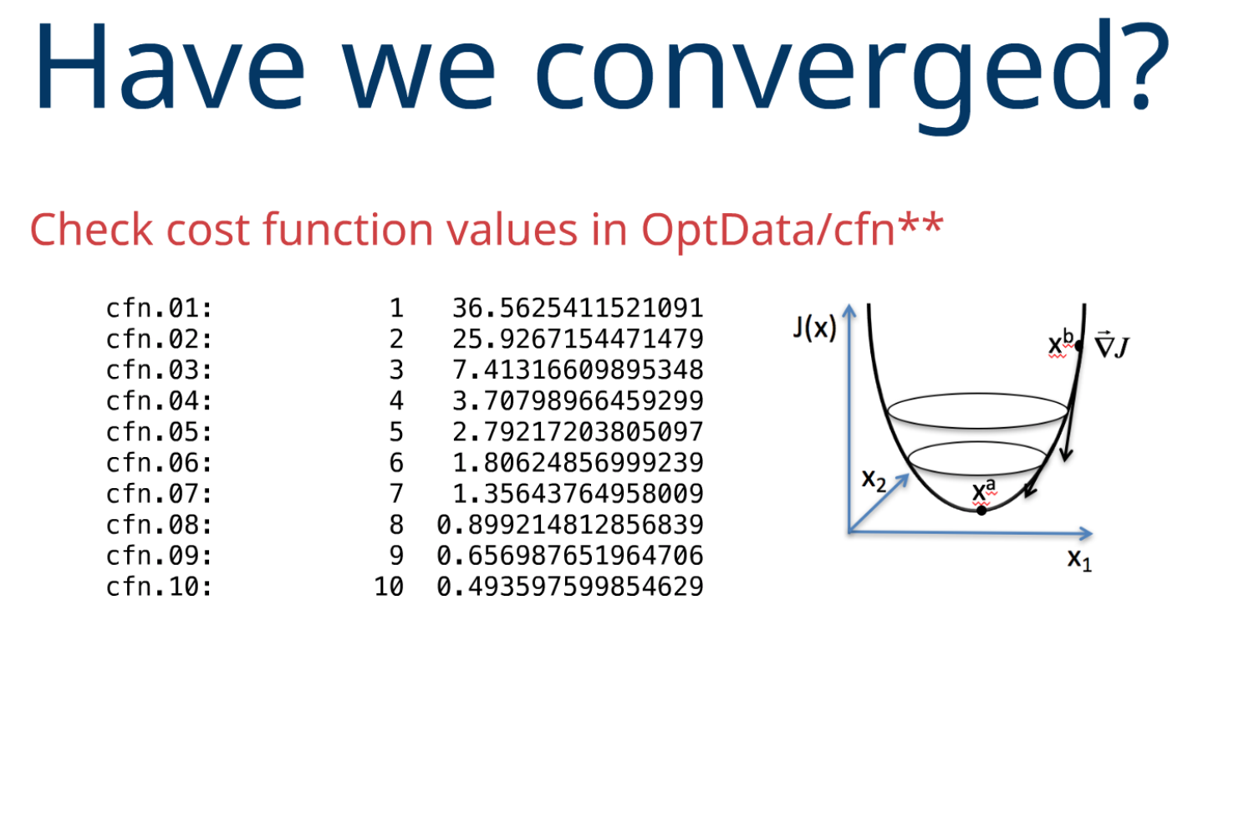

Slide 48
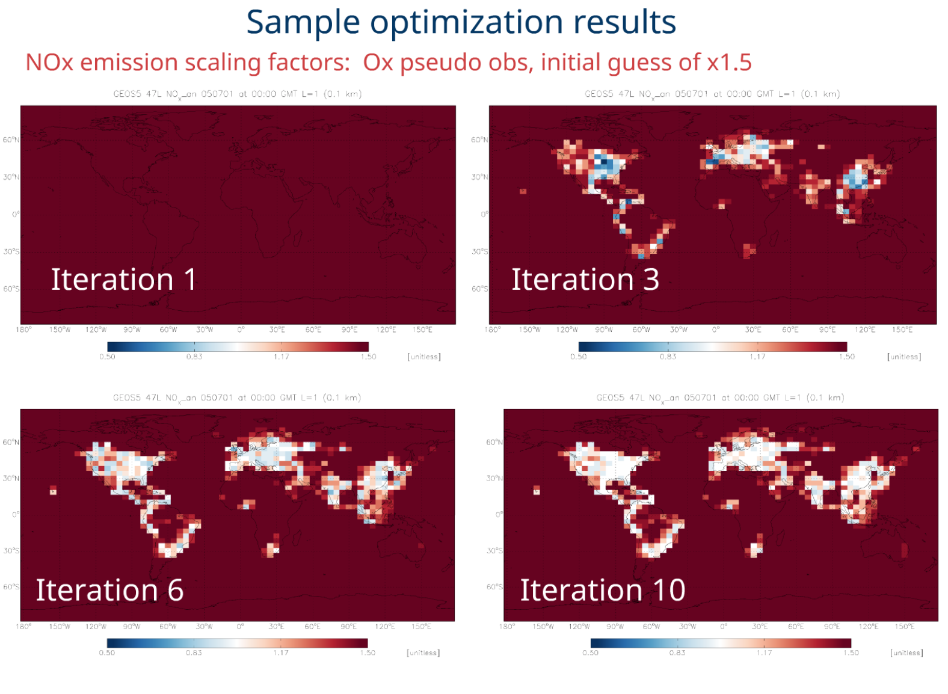

Slide 49
