Slide 1
MUlti-Scale Infrastructure for Chemistry & Aerosols (MUSICA)
Workshop on the integration of GEOS-Chem into NCAR models
July 30-31, NCAR Foothills Lab

Slide 2
Motivation: ACOM scientific objectives
Theme 1: Chemical Weather
In order to enable the next generation of air quality management and prediction systems, develop the scientific knowledge needed to extend the time period of successful regional air quality forecasts to ten days.
In order to facilitate seasonal air quality management and risk assessments, establish new multi-month predictive skills for the frequency of severe regional air pollution episodes.
In order to develop effective air pollution mitigation strategies, attribute the sources of pollutants responsible for adverse effects on human health and ecosystems.
Theme 2: Chemical Climate
In order to improve prediction of the Earth system across scales, quantify the chemical and dynamical coupling mechanisms between the upper and lower atmosphere.
In order to inform mitigation policies, identify the life cycle of short-term climate pollutants (reactive species and aerosols) and their impacts on climate.
In order to characterize the resilience of the Earth system to natural and anthropogenic disturbances, evaluate the role of chemical and biogeochemical feedbacks in the climate system.

Slide 3
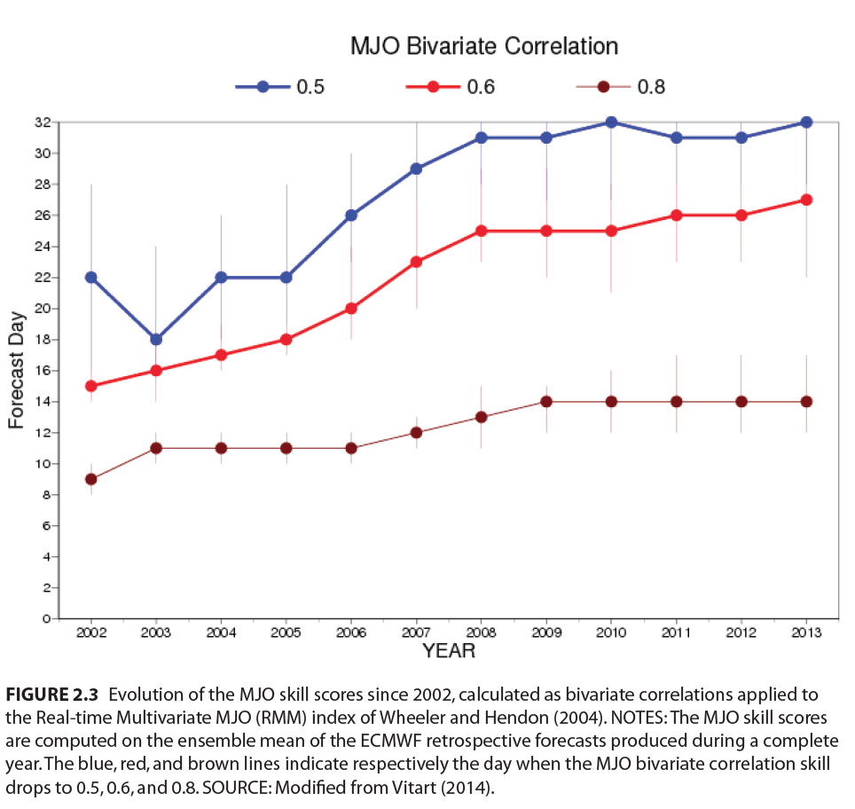
Subseasonal to Seasonal (S2S) prediction
Global teleconnections: 20-day lagged regression of N. American SAT to an index of anomalous convection activity in the tropical Indian Ocean.
National Acadamies http://www.nap.edu/21873
Notes:
These figures illustrate that regional weather, and hence AQ, is affected by global weather patters (MJO correlates well with SAT 2-3 weeks later
Sources: National Academies of Sciences, Engineering, and Medicine. 2016. Next Generation Earth System Prediction: Strategies for Subseasonal to Seasonal Forecasts. Washington, DC: The National Academies Press. doi: 10.17226/21873.

Slide 4
Decadal prediction
QBO
Equatorial zonal mean winds
50 km
Deseasonalized flux anomaly with respect to 1990 (W/m²)
ERAI
0 km
50 km
WACCM
ERBE satellite obs
SD-WACCM with eruptions with sulphate in MAM
SD-WACCM no eruptions
0 km
Months
J. Richter, AMWG meeting, NCAR, 2018

Slide 5
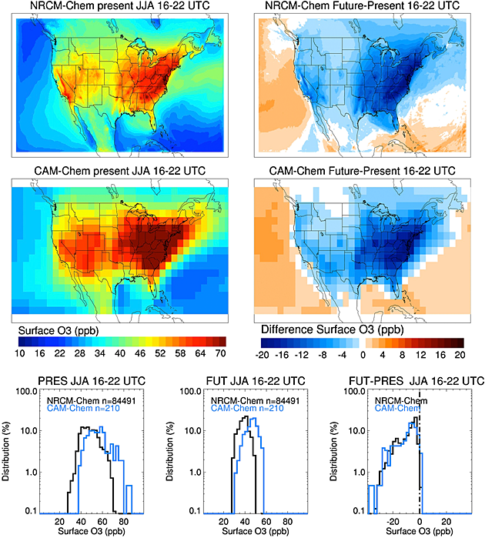
Resolution matters
Summertime ozone over the US.
Ozone overestimated in low res. model over urban areas. Simulations done with the same emissions & identical chemistry.
Pfister et al., 2014
Notes:
These figures illustrate over polluted regions, it’s necessary to have high spatial resolution to correctly calculate composition.
Pfister, G. G., S. Walters, J.-F. Lamarque, J. Fast, M. C. Barth, J. Wong, J. Done, G. Holland, and C. L. Bruyère (2014), Projections of future summertime ozone over the U.S., J. Geophys. Res. Atmos., 119, 5559–5582, doi:10.1002/2013JD020932.

Slide 6
Objective of MUSICA
Within five years develop a computationally feasible global modeling framework that allows for simulation of large-scale atmospheric phenomena, while still resolving chemistry at emission and exposure relevant scales (down to ~4 km). This will can only practically be achieved within a model capable of regional refinement. It will be open source and flexible in order to facilitate community co-development.
MUSICA heavily leverages ongoing activities at NCAR…

Slide 7
Community Earth System Model
Atmosphere
(CAM, CAM-CHEM, WACCM, Data)
FV, SE, dycores
Land
(CLM, DATA)
Driver/COUPLER
River
(RTM, MOSART, DATA)
Ocean
(POP, Data)
Land Ice Sheet
(CISM)
SEA ICE
(CICE, Data)
Notes:
In past infrastructure (no IP) tied to science development (has IP)
Driver does routing of data, regridding, redistribution and mapping

Slide 8
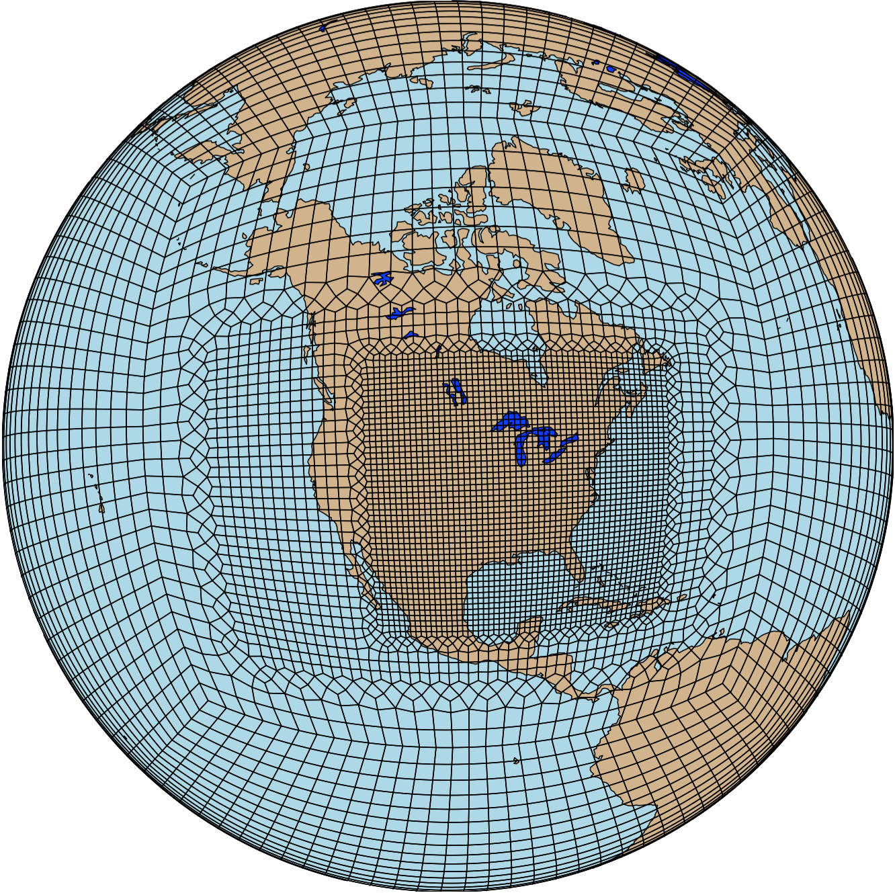
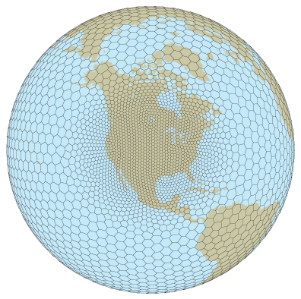
New ‘regionally refined’ options for CESM
Advantages
  Numerically less expensive than running globally at high resolution
  No boundary conditions
  Non-local teleconnections
Via Singletrack
~100km
110km
hydrostatic
non-hydrostatic
14km
16km
Courtesy Colin Zarzycki
Spectral Element dynamical core (CAM-SE)
Model for Prediction Across Scales (CAM-MPAS (v4))

Slide 9
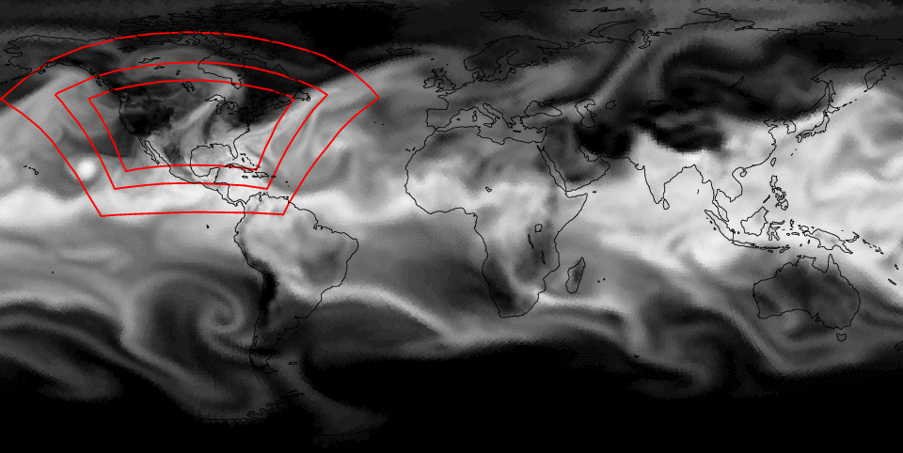
Multi-resolution global simulation
Precipitable water, Sept 23-Oct 3, 111km->14km CAM-SE mesh
Courtesy Colin Zarzycki

Slide 10
CIME coupling infrastructure used in CESM
Inter-component
Model components only communicate via exchange
with a driver/mediator
Intra-component
sub-components only communicate via exchange
with a driver – requires sub-components to be modular
ocean
ATM
Driver/
Mediator
Driver/
Mediator
dynamics
physics
chemistry
atmosphere

Slide 11
CIME brings multiple instance capability and DART data assimilation to CESM
Atmosphere
(CAM)
Land
(CLM)
atm obs
DART
Atmosphere
(CAM)
Land
(CLM)
Atmosphere
(CAM)
Land
(CLM)
CPL
CPL
CPL
River-Runoff
River-Runoff
River-Runoff
Ocean
(POP)
SEA ICE
(CICE)
ocn obs
Ocean
(POP)
SEA ICE
(CICE)
DART
Ocean
(POP)
SEA ICE
(CICE)
Multi-coupler functionality contributed by Rafaelle Montuoro (NOAA/ESMF)
DA will be critical in initializing model forecast simulations
Notes:
CESM uses the DART ensemble Kalman Filter for data assimilation.
Requires CESM to run multiple-instance simulations.
Currently, CESM and DART are run separately, CESM must be stopped and restarted every data assimilation interval (6 hours) – extremely inefficient and expensive use of system resources
Pause/Resume capability of other CESM components will permit them to resume from an assimilated restart file during the model run

Slide 12
A new physics coupling framework (CPF) via singletrack
ATM
Driver/
Mediator
Host Application
Host Cap
dynamics
physics
chemistry
Community Physics
Driver
Physics 1 Cap
Physics 2 Cap
Chem 1 Cap
Chem 2 Cap
…
Physics Scheme 1
Physics Scheme 2
Chem Scheme 1
Chem Scheme 2
Chemistry “suite”

Slide 13
Task 1: Chemistry component development
Objective: Implement gas phase and heterogeneous chemistry in a box model that satisfies the requirements of the CPF
Extends the Model Independent Chemistry Model (MICM)
MICM specifies chemical reactions, photolysis, and solve the associated differential equations.
This will be extended to include heterogeneous chemistry (aerosol and cloud chemistry), aerosol aging (e.g. VBS) and aqueous-phase chemistry.
Will handle a variety of aerosol schemes (BAM, MAM, CARMA, GOCART, MADE/SORGAM, MOSAIC) under the CPF.

Slide 14
Task 2: Regionally refined global model
Objective: Develop a model capable of capturing meteorological variability produced from global scale dynamics (e.g., ENSO, MJO, NAO, QBO) and have sufficient resolution to represent chemical emissions and chemistry over regional to urban scales.
Implementation:
Replace current finite volume dynamical core with spectral element (SE) dynamical core already used in CESM.
Migrate to non-hydrostatic MPAS dynamical core when available
Develop flexible tools for specification of resolution dependent datasets (emissions and initial conditions)

Slide 15
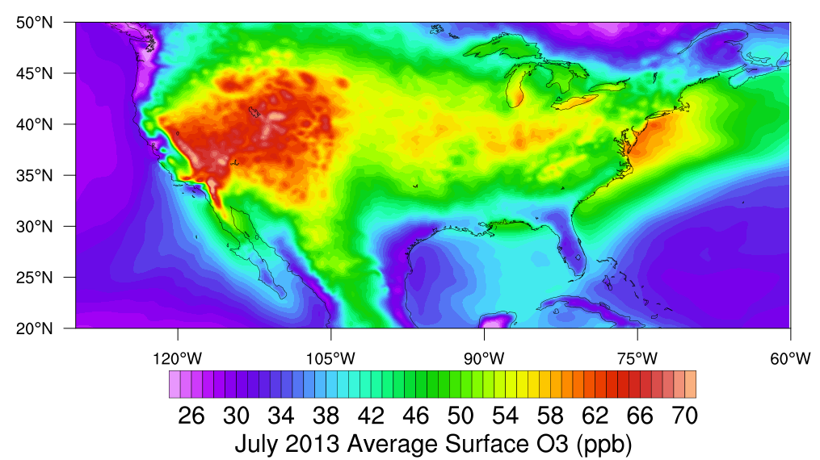
Biogenic Emissions, chemistry, CONUS refinement
Rebecca Schwantes & Forrest Lacey, in development
Notes:
CPF gives flexibility for the coupled model.
Long-term effort to make parameterizations work across scales.
Multi-scale requires significant scientific oversight and offers solutions to long-standing issues.
(high bias in surface ozone, due to nonlinearity of ozone chemistry)
E.g., confirming biogenic emissions from land model. Regridding anthropogenic NO emissions.

Slide 16
Task 3: Integrate chemistry package into host model
Objective: Provide a suite of chemistry packages for the NCAR unified atmospheric model
Implementation:
Define a new interface for chemistry via the community physics framework (CPF)
Integrate MICM via this interface into the unified model
Couple to radiative transfer, moist physics, aerosol packages, wet and dry deposition (requires coupling to other physics packages and other ESM components, e.g., CTSM)

Slide 17
Task 4: Model evaluation
Objective: Define a set of simulation protocols and associated datasets to provide a comprehensive evaluation of the model development at frequent intervals, providing a quantitative appraisal during the MUSICA development cycle.
Benchmarking against large scale field experiments such as SEAC4RS, SOAS, KORUS-AQ, FRAPPE, DC3 etc.
Utilize box model (e.g., GECKO) and large eddy simulations for evaluation
DA can be used for model evaluation as well as providing initial conditions

Slide 18
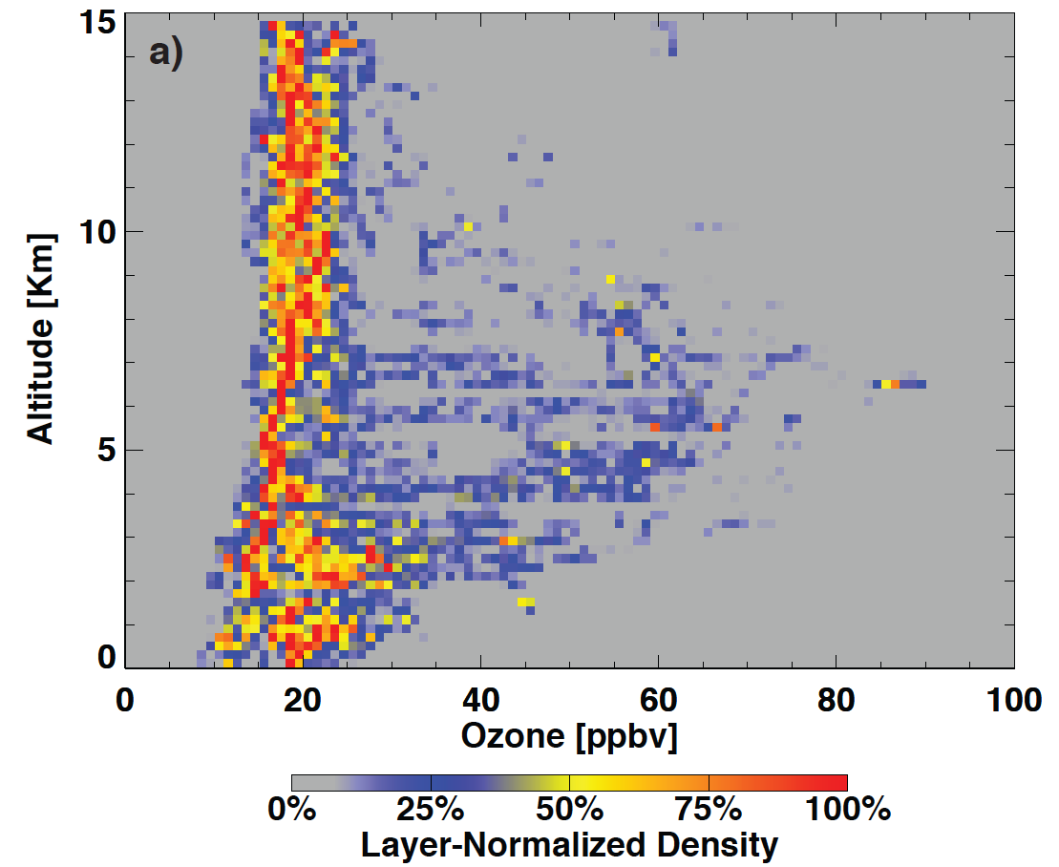
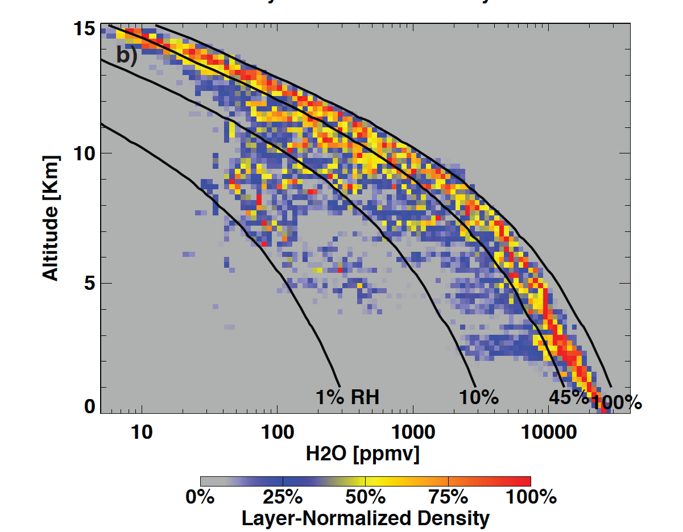
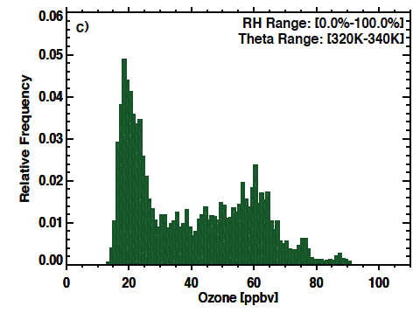
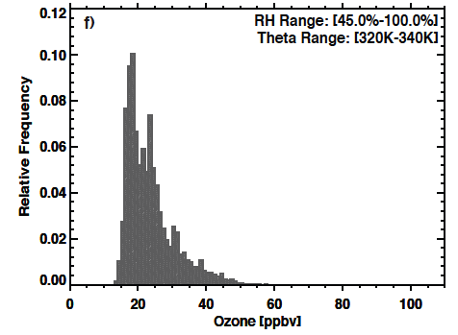
Model evaluation
Data Assimilation
Satellite & in situ observations
CONTRAST: O₃ & H₂O in the TWP
Validation
Fundamentals
Parameterizations
Modeling
A “bi-modal” O₃ distribution in the 320-340 K layer
After excluding RH<45% data the second mode is gone
Weather and climate model development
Laboratory measurements and process models
Notes:
Lower left panels:
A primary mode: Near 20 ppbv up to 15 km, no “near zero” ozone
A secondary mode: enhanced ozone and correlated with dry air. Filamentary layers of ozone possibly related to biomass burning or
transport from upper troposphere
Using the NSF GV, CONTRAST measurements provided the first high accuracy, low detection limit ozone up to 15 km in the remote tropical western pacific (TWP)
TWP ozone exhibits a bi-modal behavior. The primary mode is associated with near saturated air in the mid-troposphere. The secondary mode is formed by ozone-enhanced, water vapor reduced air. The secondary mode is characterized by RH<45%
Based on the humidity behavior, the two modes are controlled by very different processes. The primary mode is considered a convectively controlled mode, the secondary mode is considered to be “non-local”, potentially result of coupling between the tropics and the midlatitude UTLS.
This result is important for understanding what controls the tropical tropospheric ozone

Slide 19
Task 5: Community engagement
Objective: involve key stakeholders through all phases of model design and development.
Hold a kick-off meeting early 2019
Form an advisory panel

Slide 20
MUSICA development timeline
singletrack
T1: Community
Physics Framework
MPAS integration
MUSICA
T2: CAM-CHEM SE regionally-refined
T:4 Global AQ model with regional refinement
T4: Non-hydrostatic capability
T3: integration
MICM
T1: Aerosol model development
T1: Box/single cell model prototype

Slide 21
Deliverables
[month 24] A regionally refined CAM-SE with chemistry.
[month 24] A CPF-compliant box model with aerosol and heterogeneous chemistry
[month 48] A fully interactive hydrostatic global chemistry model capable of regional refinement to 15 km
[month 60] A fully interactive non-hydrostatic global chemistry model capable of regional refinement to <10 km

Slide 22
Question for GEOS-CHEM community: where would you like to draw the dotted line?
Host Application
Host Cap
ATM
Driver/
Mediator
Community Physics
Driver
?
dynamics
physics
chemistry
?
Physics 1 Cap
Physics 2 Cap
Chem 1 Cap
Chem 2 Cap
…
Physics Scheme 1
Physics Scheme 2
Chem Scheme 1
Chem Scheme 2
Chemistry “suite”

Slide 23
Questions?

