Slide 1
CESM2 WACCM / CAM-chem
Simone Tilmes and Doug Kinnison
and the
CAM-chem and WACCM team
Monday July 30th, 2018

Slide 2
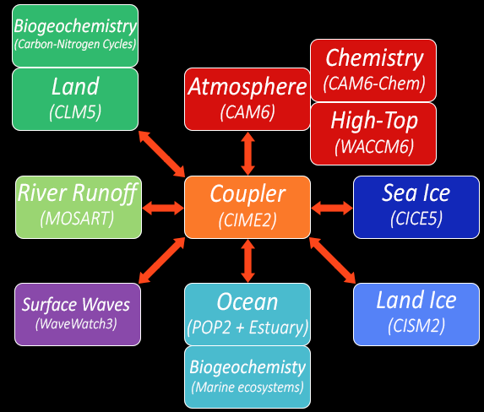
CESM2 model components
Atmospheric Models
CAM
CAM-chem
WACCM
Model can be run in very different configurations
Coupled /prescribed ocean and ice
Coupled or prescribed land
Free running or nudged to meteorological fields

Slide 3
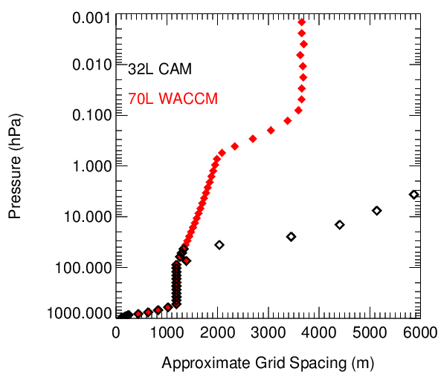
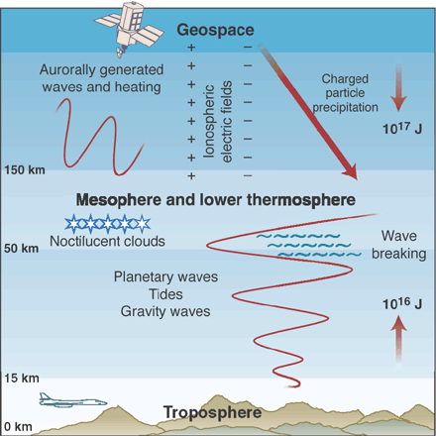
Overview of the atmospheric components of CESM WACCM/CAM/chemistry modeling suite
WACCM/ CAM-chem levels
WACCM X
WACCM top
CAM top
Stratosphere
Unified vertical grid below about 50hPa
Circulation / Transport representation depends on resolution and model top

Slide 4
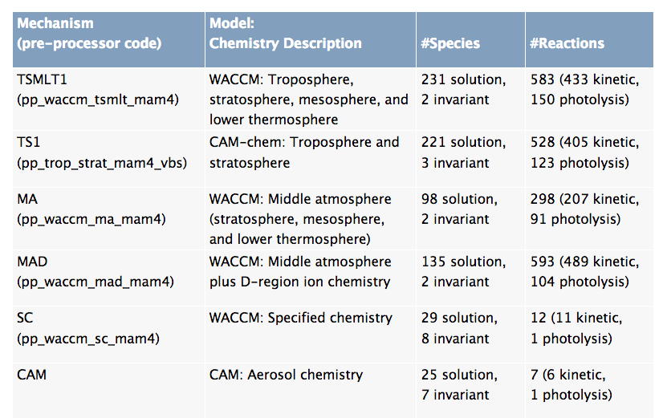
WACCM/CAM-chem unified chemistry
Notes:
10 more species in WACCM to accommodate ion reactions in the upper atmosphere.
4 more reactions in WACCM-SC to account for changes in CFCs in the upper atmosphere, and CH4 for methan oxidation.

Slide 5
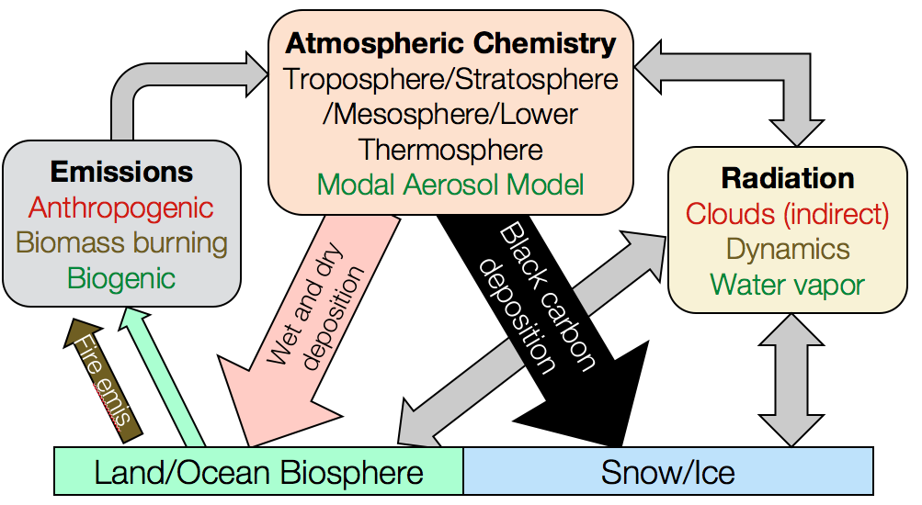
Chemistry-Climate Interactions in CESM2

Slide 6
WACCM/CAM-chem configurations
Standard (CMIP6) Configuration WACCM / CAMchem
1 horizontal resolution, interactive QBO (gravity waves)
Comprehensive chemistry throughout the atmosphere
Aerosol with Modal Aerosol Model; VBS SOA scheme
Prescribed greenhouse gas concentrations, including CO₂, CH₄, N₂O, CFCs etc.
Interactive biogenic emissions, interactive volcanic emissions
Prescribed / interactive fire / biogenic emissions
Extended Configuration
Extended VBS scheme including emission sources
CO tagging and some NOx tagging
Extended very-short-lived halogens, including iodine
Potential to run with extended ion chemistry (MAD)
Notes:
10 more species in WACCM to accommodate ion reactions in the upper atmosphere.
4 more reactions in WACCM-SC to account for changes in CFCs in the upper atmosphere, and CH4 for methan oxidation.

Slide 7
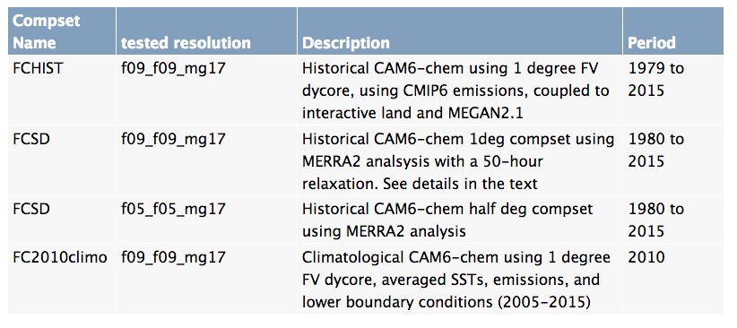
CAM-chem configurations

Slide 8
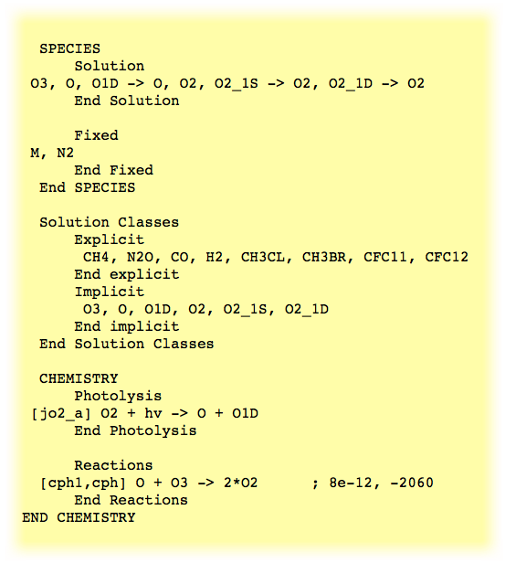
The chemical preprocessor and the mechanism file
The chemistry preprocessor: generates CAM Fortran source code to solve chemistry.
Input: a simple ASCII file listing chemical reactions and rates.
Input files for default chemical mechanisms are in each source code subdirectory for mechanisms under $CCSMROOT/models/atm/cam/src/chemistry/pp_* (i.e. pp_waccm_mozart)

Slide 9
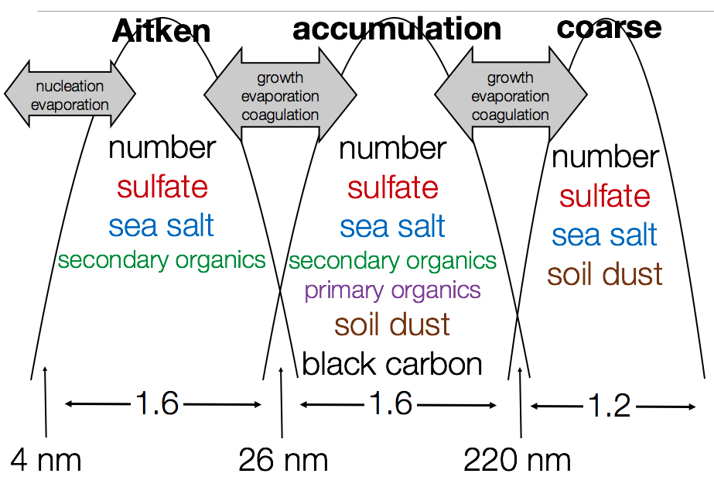
Modal Aerosol Model (MAM)
MAM is coupled to the cloud micro-physics
aerosols are radiatively active
direct and indirect effect is including
Curtesy Mike Mills
MAM4
Liu et al., 2016
-> represent aging of BC

Slide 10
Prognostic Volcanoes
New SO₂ database
Includes amount and altitude of SO₂ injections from eruptive volcanoes
OCS chemistry
Contributes to stratospheric sulfate
Interactive with chemistry, radiation and dynamics
Includes interactive H₂SO₄ and SO₄ formation
Requires comprehensive stratospheric chemistry
Thanks to MikeMills
Results agree very well with observations

Slide 11
New SOA approach in CESM2 CAM-chem, WACCM
More physical approach
Direct coupling to biogenic emission changes from MEGAN
-> couples SOA formation to land use and climate change
-> VBS (volatility bin scheme) only works in full chemistry version at this point
Hodzic et al., 2016

Slide 12
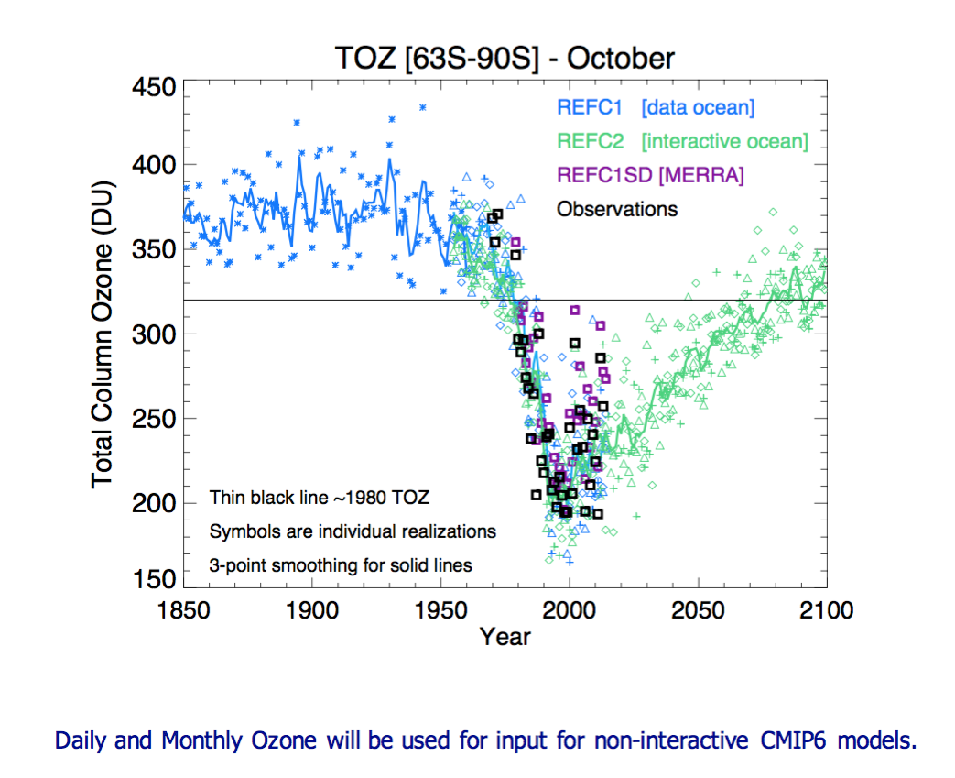
Stratospheric Chemistry / Heterogenous Reactions
Halogen SRC Gases: CFC-11, -12, -113, -114, -115; CCl₄, CH₃CCl₃; HCFC-22, -141b, -142b;
halon 1211, -1301, -2402, -1202, CHBr₃, CH₂Br₂.
Gas-phase rxns: Included in the Ox, HOx, NOx, ClOx, and BrOx families (part of TS1MLT).
231 species, 150 photochemical reactions, 416 thermal.
Heterogeneous rxns: 17 reactions on three aerosol types (NAT, STS, and Water-Ice)
Other Processes: ion-neutral reactions and
chemical potential heating.

Slide 13
Photolysis Approach (combination of inline and LUT)
J (p) = Σ F_{exo} (λ) x N_{flux}(p, λ) x σ (λ) x φ (λ)
λ
<= EUV (LUT)
Inline (33 Bins)
LUT (67Bins)
121 nm
200 nm
750 nm
Inline Calculation:
JO₂ Lyman Alpha
JO₂ SRB
JNO SRB
σ x φ for all other J’s
N_{flux} (p, λ) is funct. of (O₃, O₂)
F_{exo}: Lean (λ) dependent extraterrestrial flux. Modified by the Earth-Sun distance (esfact).
N_{flux} (normalized actinic flux) is based on TUV (Madronich), 4-stream radiative transfer.
LUT: N_{flux} (p, λ) is function of (pressure, col. O₃, SZA, Albedo)
LUT: σ (λ) x φ (λ) is function of ( T, p )
CAM4 SW Heating rates
Heating and Photolysis rates
Cloud correction factor is applied to total J (Madronich).

Slide 14
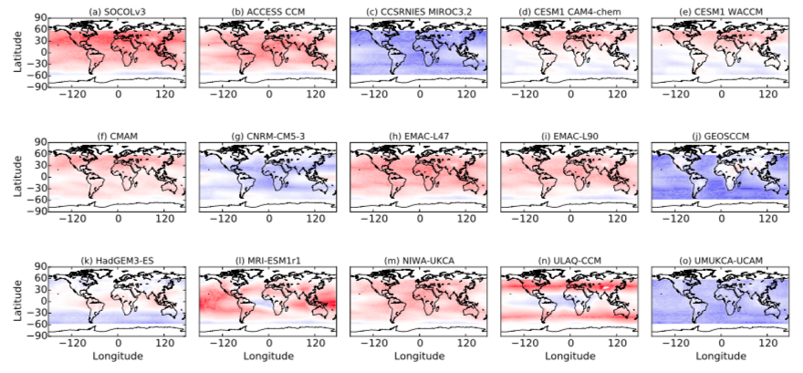
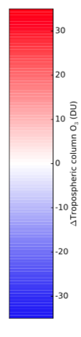
Tropospheric Column Ozone Difference to OMI/MLS
CCMI Comparison (Revell et al., 2018)

Slide 15
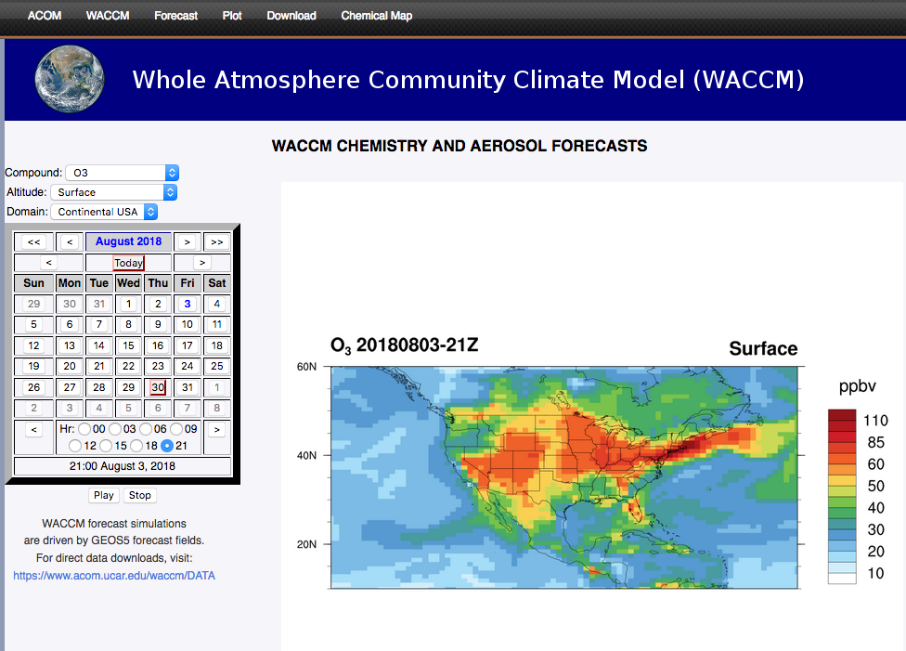
Notes:
10 more species in WACCM to accommodate ion reactions in the upper atmosphere.
4 more reactions in WACCM-SC to account for changes in CFCs in the upper atmosphere, and CH4 for methan oxidation.

Slide 16
Backups

Slide 17
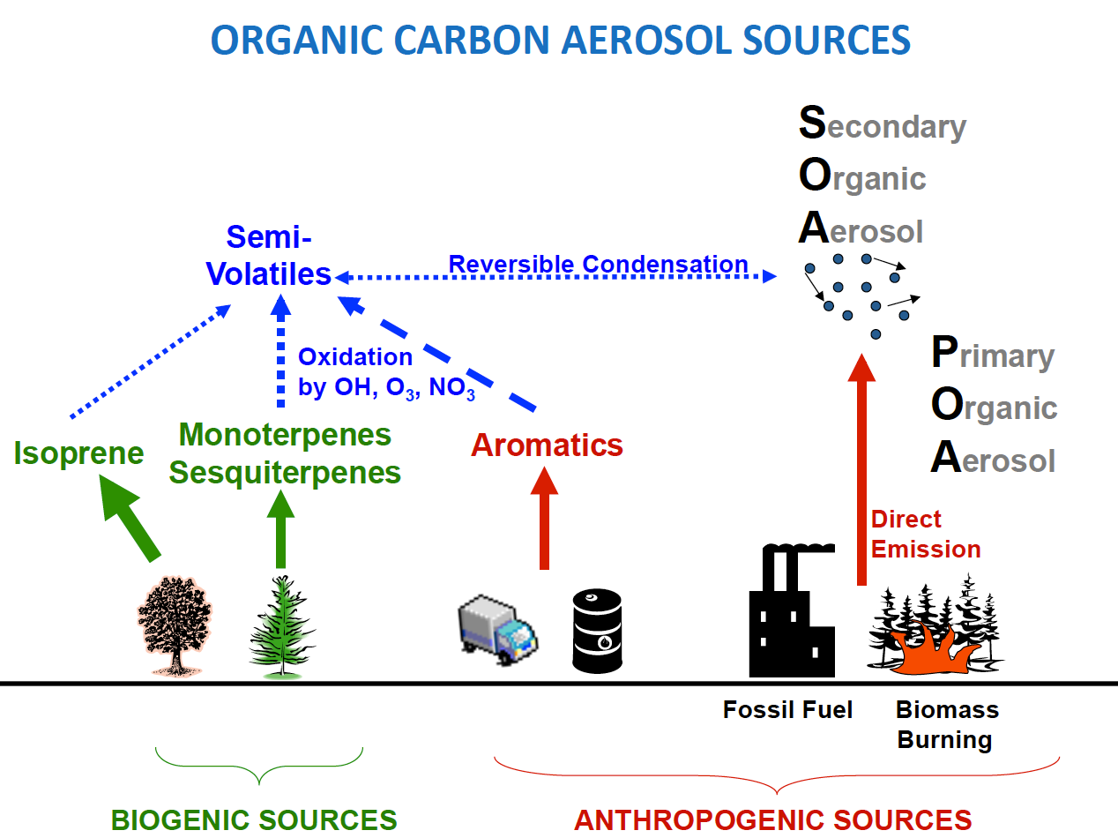
Secondary Organic Aerosol Description
Simplified Chemistry:
SOAG derived from fixed mass yields
no interactions with land
Comprehensive Chemistry:
SOAG formation derived from VOCs using VBS scheme
5 volatility bins
Interactive with land emissions
-> more physical approach
SOAG species
OH
Anthropogenic Source / Fires
Modified after C. Heald, MIT Cambridge

Slide 18
Most of it from biogenic emissions
-> strongly dependent on MEGAN emissions
VBS Budgets 1995-2010
Biogenic, anthropogenic and biomass burning VOC, SIVOC
Lifetime: 4.5 years
chem. Prod.
294Tg/yr
+ Oxidants
Glyoxal uptake
SOA
1.04 Tg
Oxygenated VOC (gas)
0.38 Tg
Net gas-particle
partitioning
Depends on
J values for different chemicals
142 Tg/yr
J _{SOA}
dry
wet
dry
wet
57 Tg/yr
44Tg/yr
108Tg/yr
12 Tg/yr
72 Tg/yr
Values very close to observational estimates!

Slide 19
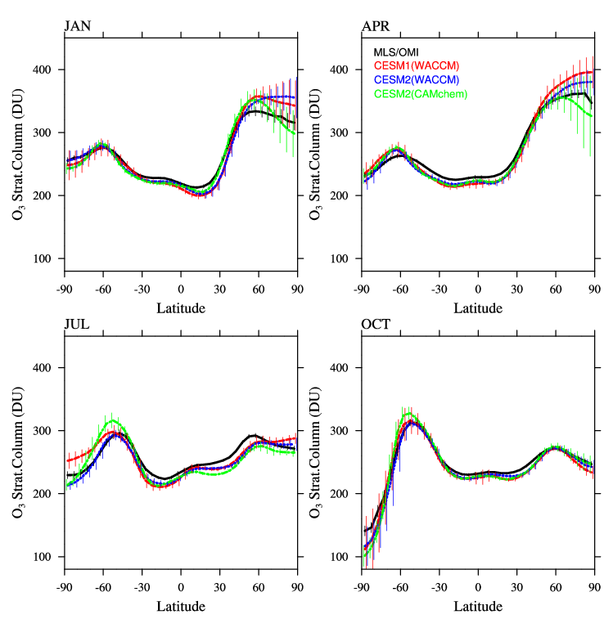
Stratospheric Ozone Column (DU)
January
April
Observations (OMI/MLS)
WACCM1 (CCMI)
WACCM
CAM-chem
July
October
Additional GW tuning for CAM-chem
may be needed

Slide 20
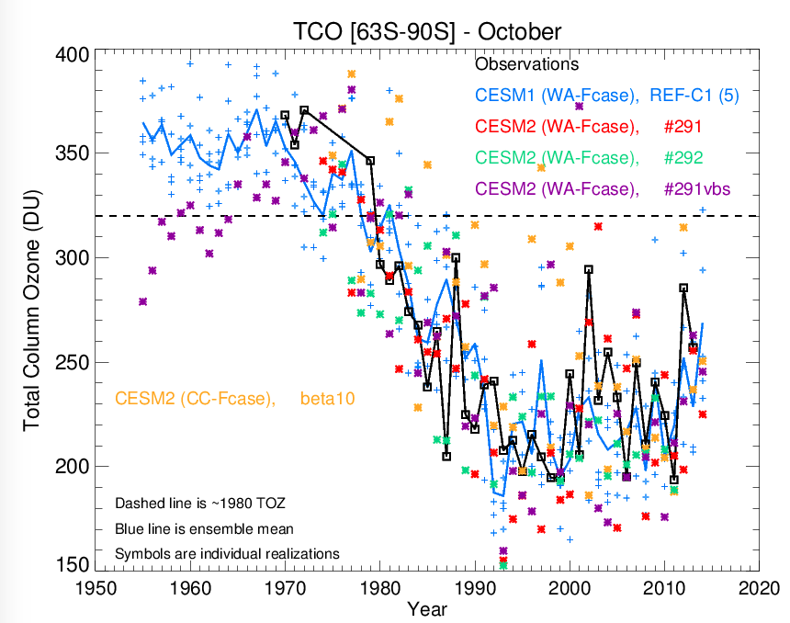
Total Column Ozone 63-90ºS October
Observations
WACCM1
WACCM
WACCM
WACCM
CAM-chem
From Doug Kinnison

Slide 21
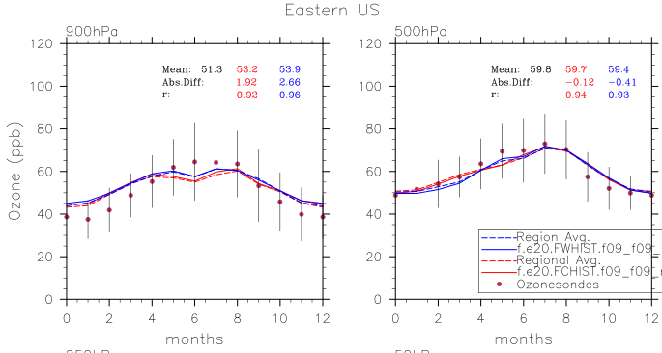
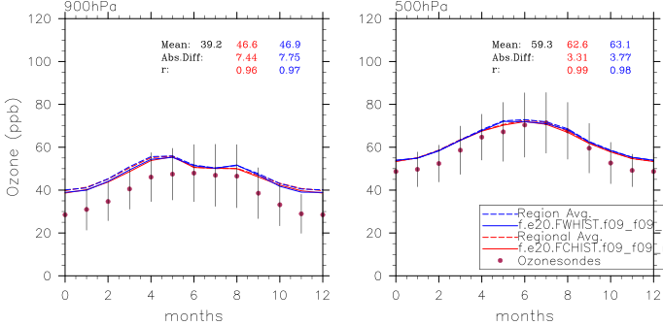
Tropospheric Ozone
Eastern U.S.
Western Europe
900 hPa
500 hPa
900 hPa
500 hPa
Observations
WACCM
CAM-Chem
Ozonesondes
WACCM
CAM-Chem
Very good agreement in summer, high bias in winter northern latitudes

Slide 22
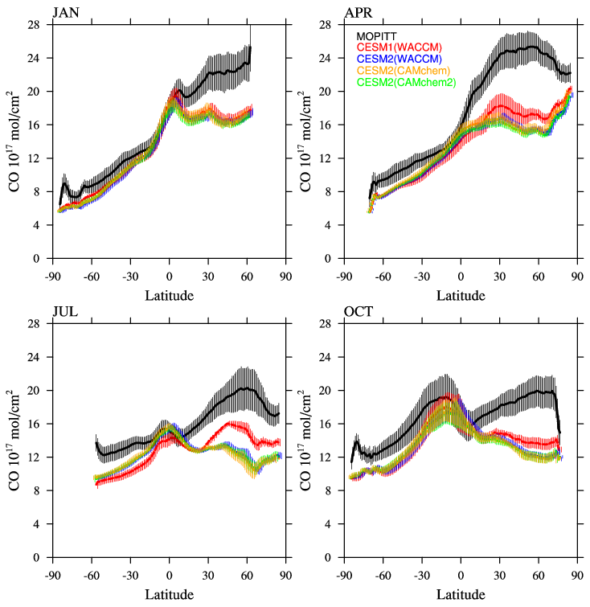
Tropospheric CO
January
April
Observations (MOPITT)
WACCM1
WACCM
CAM-chem
CO is reduced compared to WACCM1
-> new CO emissions are lower
July
October

