Slide 1
Coupling GEOS-Chem to the Community Earth System Model
NCAR | JULY 30 2018
Sebastian D. Eastham

Slide 2
Agenda
The story so far
Software engineering challenges
Moving forwards

Slide 3
The story so far
GC Classic
GEOS-Chem
CESM
GEOS
GEOS-Chem
GEOS-Chem?
GCHP
GEOS-Chem
WRF
GEOS-Chem
GEOS-Chem

Slide 4
CESM-GC: Prototype scope
Objective
Motivation
Implement GEOS-Chem as a chemistry module in CESM 2.0, using CAM-Chem implementation as a template
Limited-scope prototype
Use “unchanged*” GEOS-Chem code
Use as much of GEOS-Chem as possible
Provides GEOS-Chem community a GCM capability, and provides a new chemistry option for the CESM community
Improved probability of success
Improved responsiveness, usability, and ease-of-maintenance
Get the “same GEOS-Chem” as in CTM
*Can still be compiled as stand-alone GEOS-Chem with no modifications (all CESM-related code changes can be integrated back into the main branch)
Notes:
*Can still be compiled as stand-alone GEOS-Chem with no additional code modifications – so all CESM-related code changes can be integrated back into the main branch

Slide 5
Recap: GEOS-Chem as a module
GEOS-Chem Classic
GEOS/GCHP
GEOS-Chem chemistry component converted to allow “grid independent” operation on any grid, and in several different models
Each [I x J] group of columns handled independently, with all information for each group contained in state variables (some issues remain with modules)
J
J
MPI Task
I
I
J
MPI Task
I
N tasks

Slide 6
CAM ↔ CAM-Chem chemistry interface
cam/src/chemistry
CAM
Atmospheric state before chemistry
MOZART
Mechanism (pp_trop_mozart)
chemistry.F90
Chemical tendencies
Chemistry options set through CESM Uses the MOZART interface with multiple mechanisms
Notes:
Ignoring MOZART
Using raw GEOS-Chem
Question: what to do about GC’s inputs? Currently read in an external copy of input.geos

Slide 7
CAM ↔ GEOS-Chem chemistry interface
cam/src/chemistry
CAM
Atmospheric state before chemistry
pp_geoschem
geoschem_src
chemistry.F90
Chemical tendencies
Chemistry options from GC run dir. Uses unchanged GC code dir. (“geoschem_src”)
GEOS-Chem run directory
Notes:
Ignoring MOZART
Using raw GEOS-Chem
Question: what to do about GC’s inputs? Currently read in an external copy of input.geos

Slide 8
Current status and demonstration
“Standard” chemistry (Trop-strat with “complex” SOA)
Fast-JX photolysis scheme
Bulk aerosol scheme with ISORROPIA II equilibrium
Wet scavenging – no dry dep. or (complex) emissions
Surface NO_{x} source

Slide 9
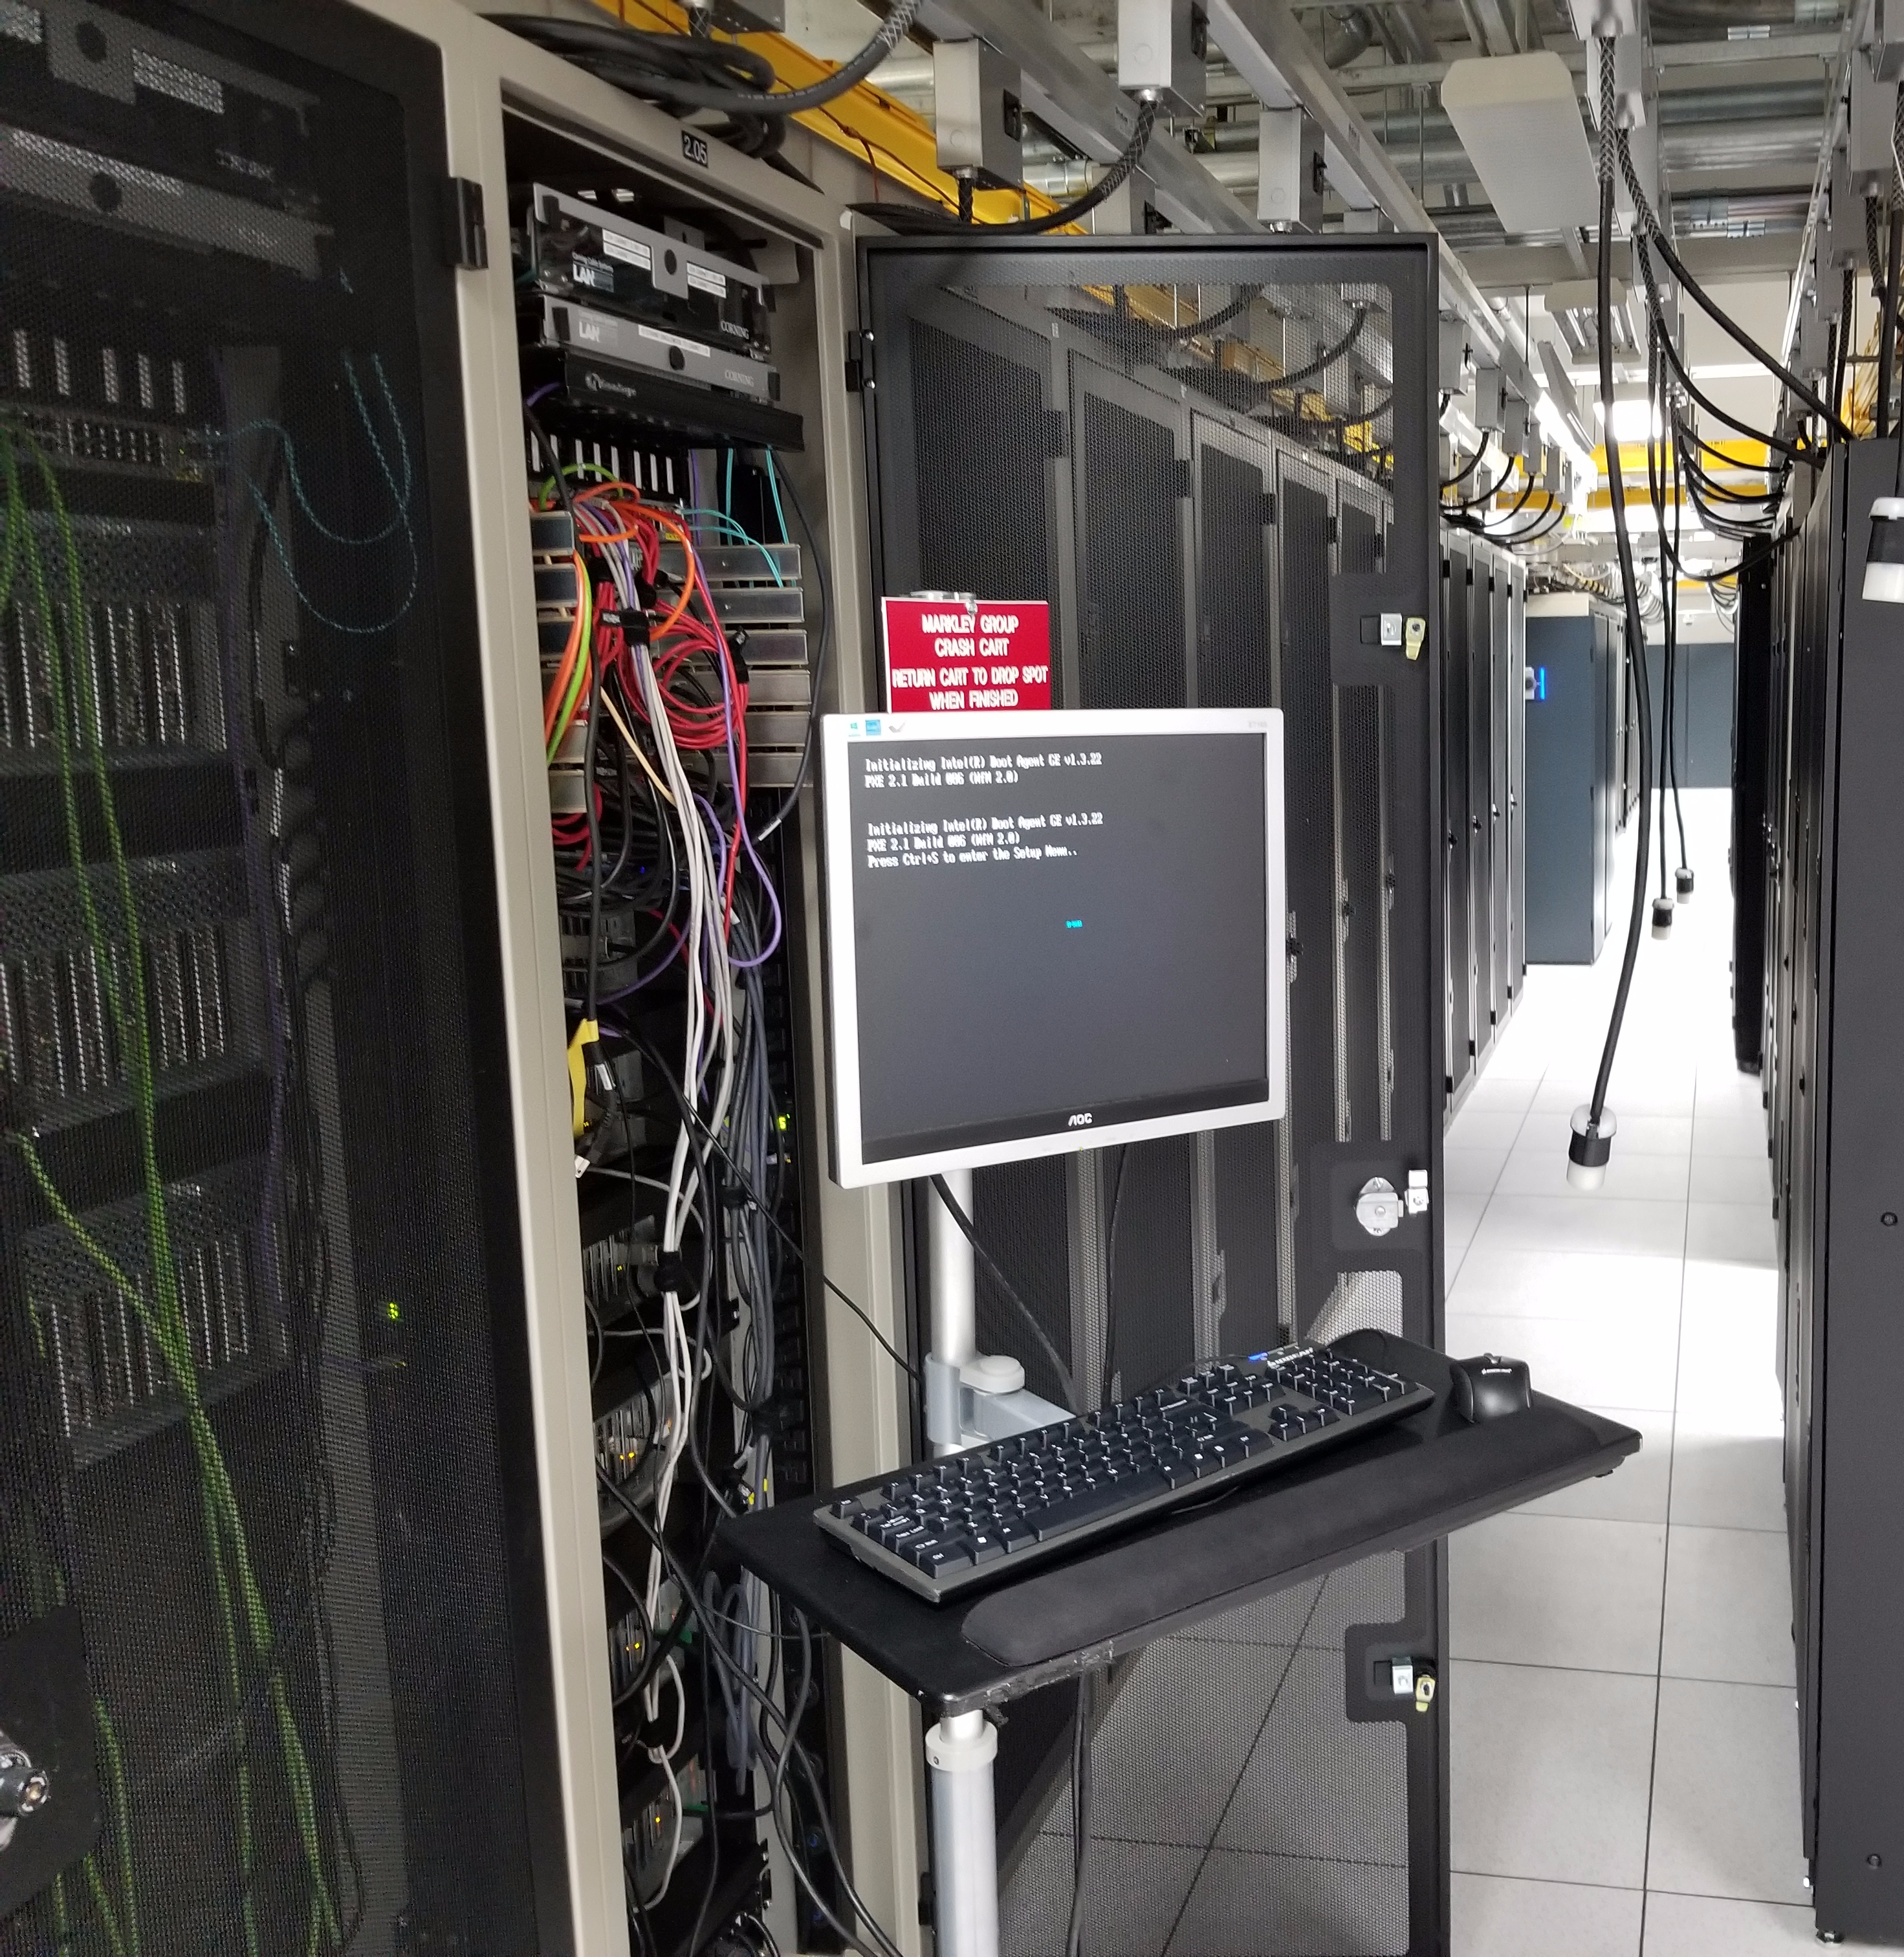
Software engineering challenges

Slide 10
Topics
Following CAM-Chem’s lead
Focusing on CAM interface
Interfacing with CAM:
Convection/PBL mixing
Dry deposition
Emissions
Aerosols
How are these currently done in CAM-Chem?
What implementation maximizes
Utility?
Maintainability?
Usability?
When to defer or be “chemistry-specific”?
Notes:
When should we defer to other ESM components, and when do we want to be GEOS-Chem specific?

Slide 11
When (not) to be chemistry specific?
Want to maintain consistency between offline GEOS-Chem CTMs and the CESM-GC implementation, so
If GEOS-Chem needs data which can be provided by the ESM, then it is requested from the ESM (e.g. land types, LAI, surface conductances…)
If something is computed inside GEOS-Chem (e.g. species-specific deposition velocities), or is external to the ESM (anthropogenic emissions) it should remain GEOS-Chem’s responsibility – and if the ESM can do it better, try to adopt that capability into GEOS-Chem so that consistency is maintained while everyone wins
Notes:
Possible straightforward rule
Still – does not make implementation easy!

Slide 12
Convection and PBL mixing
Both convective transport and convective scavenging calculated internally from standard GEOS output fields
Option: calculate GEOS-like convective fields from CAM output
Questions
How does CAM-Chem do:
Convective transport?
Convective scavenging?
PBL mixing?
Handling multiple schemes?
Have issues with operator splitting been observed in CAM-Chem at higher vertical resolutions?
Convection
Two PBL mixing options in GEOS-Chem (“full”/”non-local”)
Full is simple, non-local is more “met-specific”
PBL mixing
Notes:
When do we become ‘chemistry-specific’?
CAM calculates convective fields, but GEOS-Chem must do the convective transport and scavenging
Historically GEOS-Chem would directly copy the relevant convection code for consistency
Increasingly difficult as GEOS-Chem becomes more independent – plus want to get “GEOS-Chem” chemistry and response
Suggested approach: CESM convective fields and apply to GEOS-Chem convection

Slide 13
Surface processes: dry deposition
CAM
GEOS-Chem
Want to harmonize treatment of land surface and biospheric processes between CLM and GEOS-Chem
What information does CLM need from GEOS-Chem?
Where does CAM expect dry deposition to be handled?
CLM
Notes:
Options impose different issues:
Adapt GIGC to use CLM conductances*
Allow users to retain offline land types
Defer all surface processes to CLM
Issues with a: loss of “GEOS-Chem” behavior, improvements in CLM must be tracked
Issues with b: loss of coupling (!)
Issues with c: total loss of “GEOS-Chem” behavior, loss of GC user community improvements
(see e-mail from Amos Tai)

Slide 14
Surface processes: emissions
CESM
GEOS-Chem uses HEMCO for emissions
Incorporates online (e.g. dust) and offline (e.g. anthropogenic) emissions
Multiple possible implementation options
HEMCO
Offline
Pregridded emissions
GEOS-Chem
CESM
GEOS-Chem
HEMCO
Online
CESM
HEMCO
Online
CAM
Notes:
Could be adapted for use in CESM beyond GEOS-Chem?
Highly simplified emissions scheme in GEOS-Chem, preprocess emissions (lose online capability)
Full integration as part of the GEOS-Chem module
Full integration as a standard CESM component (!) – could handle MEGAN too?

Slide 15
Aerosol treatment
Bulk OC
Bulk NH₄
Bulk SO₄
CAM wants and expects some tracers which GEOS-Chem does not have
How to keep GEOS-Chem aerosol chemistry while
Providing and receiving CAM tracers
Allowing for non-bulk aerosol schemes
Communicating information needed for (eg) radiative transfer
Bulk NO₃
Bulk BC
MAM
Notes:
Again: how is it done in CAM-Chem?

Slide 16
Moving forwards

Slide 17
Summary and next steps
Summary:
Working prototype of CESM-GC within CESM is available
Key objective is to maintain connection to GEOS-Chem main branch
Could provide a two-way channel for improvements between communities
Questions to resolve:
Would HEMCO fit as a generic CESM emissions solution?
When should we (not) be chemistry-specific?
What should the development goals be (e.g. enabling hybrid OpenMP/MPI?)

Slide 18
Sebastian D. Eastham
seastham@mit.edu
LAE.MIT.EDU

Slide 19
Questions? Corrections? Suggestions?

Slide 20
Backup slides

Slide 21
Decomposition I
DOMAIN
TASK
CHUNK
CHUNK
Domain decomposed across N MPI tasks
Each MPI task has X chunks – separate chemistry call is made for each chunk but initialization is done once for each task
Each chunk has Y atmospheric columns
COL
COL
COL
COL
COL
COL
COL
COL
TASK
CHUNK
CHUNK
COL
COL
COL
COL
COL
COL
COL
COL
TASK
CHUNK
CHUNK
COL
COL
COL
COL
COL
COL
COL
COL
TASK
CHUNK
CHUNK
COL
COL
COL
COL
COL
COL
COL
COL
TASK
CHUNK
CHUNK
COL
COL
COL
COL
COL
COL
COL
COL
Example decomposition
Notes:
First, a pure SW eng challenge – and a relatively easy one to fix

Slide 22
Decomposition II
TASK
We can treat each task’s grid as being [1 x Y] in GEOS-Chem
Single Input_Opt per task, array of State_Met and State_Chm objects
Module variables are the major remaining obstacle – ideally would move all into State_X
CHUNK
CHUNK
COL
COL
COL
COL
COL
COL
COL
COL
State_Met(1) State_Chm(1)
State_Met(2) State_Chm(2)
Drydep_Mod
Input_Opt
Error_Mod
State_Chm_Mod
UCX_Mod
Pressure_Mod
C2H6_Mod
Each of these modules (and more!) has persistent variables which have to be rewritten at each time step because of the chunk structure

