Slide 1
WRF-GC: on-line two-way coupling of WRF and GEOS-Chem
model structure and preliminary results
Tzung-May Fu (tmfu@pku.edu.cn), Haipeng Lin, Xu Feng,
Heng Tian, Yaping Ma, Lijuan Zhang
Department of Atmospheric and Oceanic Sciences
Peking University
Atmospheric Chemistry & Climate @ Peking University
www.phy.pku.edu.cn/atmoschem/

Slide 2
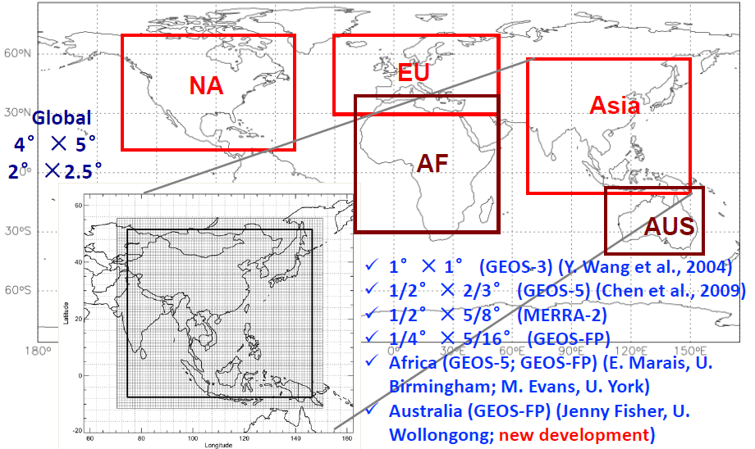
Motivation: How can GEOS-Chem users benefit from a WRF-GC coupled model?
Fairly easy to jumpstart research on multi-scale meteorology / chemistry interactions
WRF provides a powerful and flexible grid system, including nested grids and moving nest grids, at resolutions from ~100 km to ~3 km
Both hindcast and forecast capabilities driven by NCEP, EC, CESM, ANYWHERE
WRF hindcasts can be nudged with observations to mimic assimilated meteorological fields at high resolution
Atmosphere-land-water-ecosystem studies may be more achievable, taking advantage of the fact that many other models are already coupled to WRF
Current GC high-resolution simulation capability:
Only over some areas and only some of the time

Slide 3
Motivation: What about current CESM / WRF / WRF-Chem / other model users?
GEOS-Chem is a state-of-the-science, well-documented, traceable, benchmarked, GCST-supported chemical module for gases and aerosols, backed by a large atm chemistry community
GEOS-Chem provides a “standard” mechanism that is suitable for most applications, but still customizable
GC as an abstraction layer can provide consistency when coupled to current and future NCAR models from global to local scales, that can be easily maintained
Further adoption of WRF by the large chemistry and meteorology communities for chemical / AQ applications (scientific and operational)
WRF-GC
CESM2-GC

Slide 4
Development guideline: A coupling structure that is easy to use, massively parallel, and ready for the future
Very specific goal: regional GEOS-Chem simulations with online meteorology
We designed a coupling structure with minimal changes to either model, such that either parent model could be updated independently
GEOS-Chem High Performance (GCHP) technology is used, allowing WRF-GC to run in massively parallel architectures for high performance
We further “columnized” GC so that it can operate as a stateless, grid-independent column model that can be fully driven by external models, which will also ease the development of future coupling projects with GC
We plan to make the Coupler open access

Slide 5
WRF-GC Architectural Overview
Data structures managed by the state management module and ingested by the respective parent models (WRF, GC) in their native format
Conversion performed after each timestep loop by the state conversion module
ESMF not used
Updated “columnized” GC code that is truly stateless and grid-independent (horizontal & vertical)
WRF-GC
Coupling Component
WRF v3.9.1
(Standard Model, EM Core, Distributed Memory)
State Conversion Module
GEOS-Chem Column Code v11-02c
(Grid-Independent, MPI-enabled)
Physics
Distributed Memory Pool
Chemistry
WRF grid
GC state
Dynamics
Deposition
Input / Output
Emissions (HEMCO)
Horizontal Transport
PBL mixing
State Management Module
Convective transport
WRF-to-Chemistry Bindings
WRF-GC Chemistry Driver
New bindings replace the “chem” part of WRF-Chem, which is isolated from the rest of WRF
Chemistry output currently in WRF
WRF Timestep Loop
“One-step” compilation of the coupled models

Slide 6
Review of development efforts
Creating a chemistry abstraction layer for the WRF Model
Isolating the GEOS-Chem Column Code from GCHP:
Reduced ESMF/MAPL dependencies;
Stateless, grid-independent operation fully driven by external model;
Conversion of meteorology & chemistry variables between WRF and GC
Creation of a state management module further abstracting WRF and GC data structures into the coupler, allowing for easier development of multi-domain work & coupling of GC with other models
Accepts IC/BC from previous WRF-GC run outputs and MOZART4-GEOS5 output files using the mozbc tool (BC from CESM-GC in the future?)
PBL mixing and vertical convective transport in GC using meteorological data from WRF

Slide 7
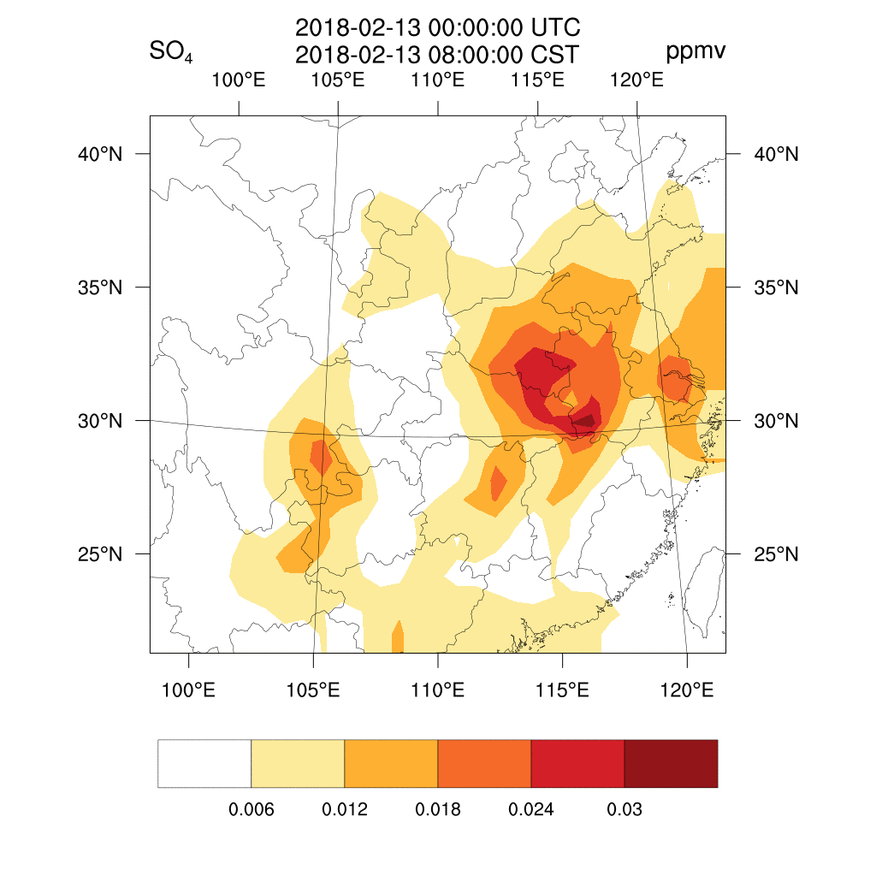
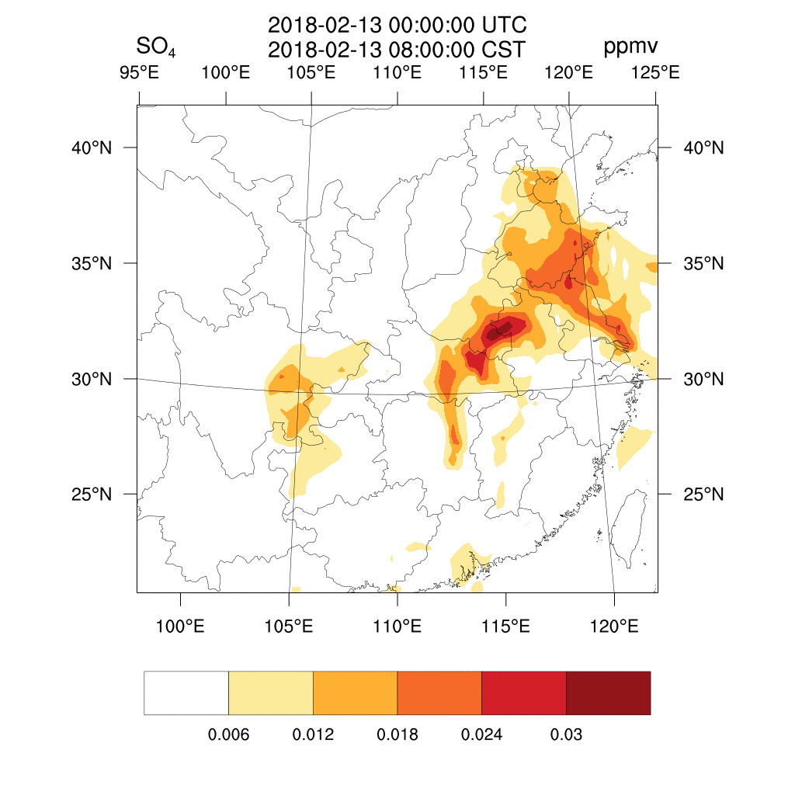
GEOS-Chem now entirely driven by WRF (1 way coupling)
81x81km
27x27km
WRF-GC Model, Version 1805.18 (WRF 3.9.1.1, GEOS-Chem v11-02c)
© 2018 Peking University Atmospheric Chemistry & Climate Group

Slide 8
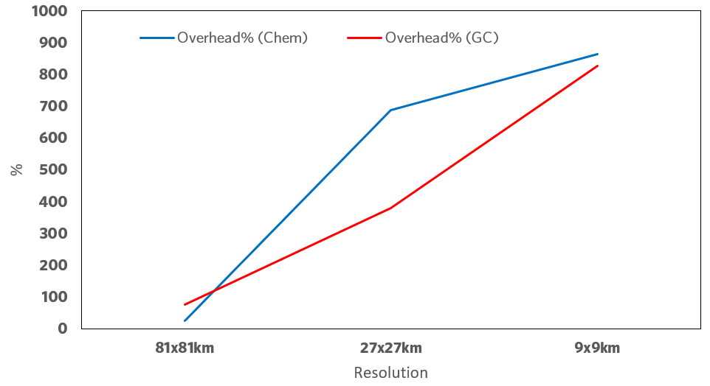
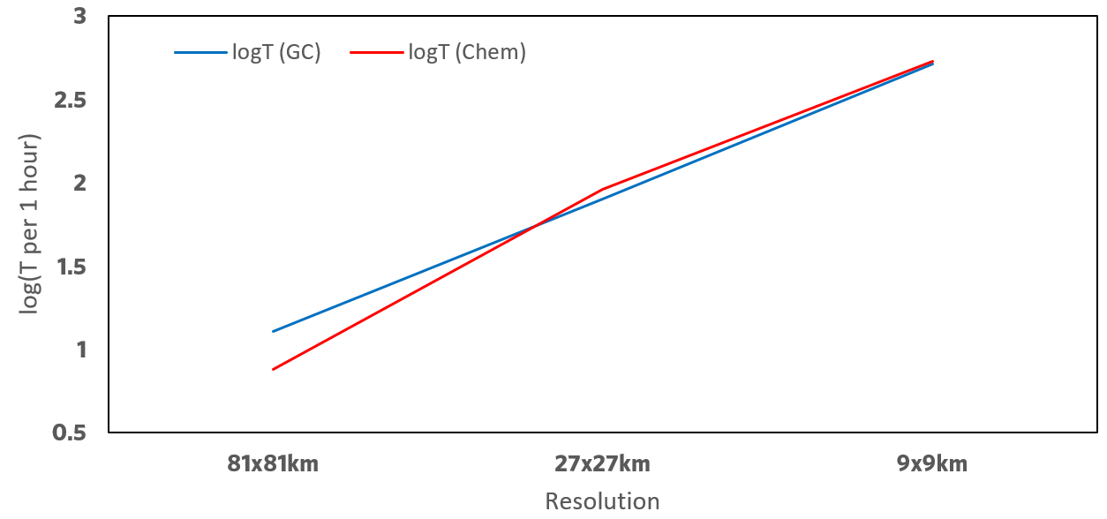
Performance: WRF-GC vs. WRF-Chem
A mixed bag, depending on resolution
At 27x27km (~c360, highest res supported by GCHP), WRF-GC is notably faster than WRF-Chem (CBMZ) by a factor of 2
At other resolutions: mixed results
Overhead percentage for chemistry calculations = (Chem+WRF)/WRF for two models
log(Time per 1 hour model time) for two models at different resolutions

Slide 9
Challenges ahead
HEMCO may not work properly online with nested grids: HEMCO offline + WRF-chem emis driver?
Output / analyses: Python tools developed for GC?
Aerosol feedbacks:
Aerosols in standard GC are mostly bulk. Size segregated aerosol modules APM and TOMAS in GC (may need to involve their developers)
Binding for aerosol feedbacks will be in the Coupler. Goal is to develop a more general binding for aerosol mass / size / number / composition to connect to WRF (may need to involve WRF developers and contact persons)
Grid-independency in WRF-GC
Technical issues (Haipeng Lin)
Assumptions behind chemical mechanism may not be appropriate at different resolutions (a science problem)
Compatibility with NCAR model development efforts: CPF compliancy? Don’t want multiple WRF-GC!

Slide 10
Tentative timeline
Incorporation of updated grid-independency changes into standard GC (Haipeng Lin, this summer)
Robust one-way coupling (static nested-grids, limited physical options) by the end of 2018 / early 2019 (Xu Feng, on-going)
Basic two-way coupling (aerosol feedback based on bulk aerosol mass) by mid-2019 (Xu Feng, on-going)
Tentative beta release of the Coupler by mid- or late-2019 (static nested grids, limited physical options)
More complex two-way coupling (w/ aerosol size information from GC-APM / GC-TOMAS) by ???

Slide 11
Applications:
Air quality forecasts
Direct and indirect effects of aerosols
Interactions between air quality with small-/meso-scale/boundary layer meteorology
Nonlinearity of chemistry, parameterization of sub-grid chemistry processes
Downscaling of climate – chemistry simulations
Atmosphere-land-water-ecosystem studies may be more achievable, taking advantage of the fact that many other models are already coupled to WRF
WRF-Hydro
WRF-CFD
WRF-ROMS
WRF-Fire

