Slide 1
Gabriele Pfister and Mary Barth
NCAR/ACOM
WRF and WRF-Chem
in a nutshell
Workshop on the integration of GEOS-Chem into NCAR models
July 30-31, 2018

Slide 2
WRF
Numerical weather prediction and atmospheric simulation system designed for research and operational applications.
Supported as a common tool for the university/research and operational communities (> 40,000 users worldwide).
ARW Dynamical Core
Fully compressible, Euler nonhydrostatic, run-time hydrostatic option available. Conservative for scalar variables
Terrain-following, dry hydrostatic-pressure, with vertical grid stretching permitted. New: hybrid sigma pressure
Periodic, open, symmetric, or specified Lateral Boundary Conditions
Top Boundary Conditions: Gravity wave absorbing. Constant pressure level at top boundary. Rigid lid option.
Polar stereographic, Lambert conformal, Mercator, and latitude-longitude projections.
One-way interactive, two-way interactive, and moving nests.
Grid (analysis) and observation nudging

Slide 3
WRF
Numerical weather prediction and atmospheric simulation system designed for research and operational applications.
Supported as a common tool for the university/research and operational communities (> 40,000 users worldwide).
Physics
Microphysics schemes ranging from simplified physics to sophisticated mixed-phase physics.
Cumulus parameterizations: Adjustment and mass-flux schemes.
Surface physics: Multi-layer land surface models ranging from simple thermal model to full vegetation and soil moisture models. (incl. Noah, RUC, CLM-4)
Boundary Layer: Turbulent kinetic energy prediction or non-local K schemes.
Radiation: LW and SW schemes with multiple spectral bands, also simple SW scheme. Cloud effects and surface fluxes included.

Slide 4
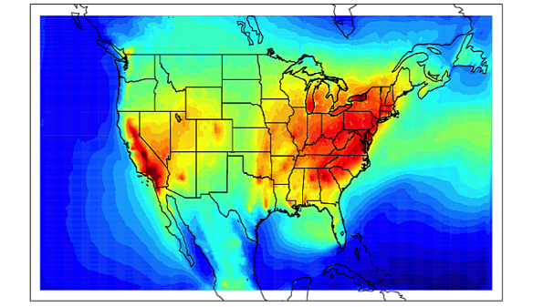
WRF-Chem
Air quality and chemistry-climate from regional to cloud resolving scales
Ideally suited to study feedbacks between chemistry and meteorology
Ideally suited to study air quality at urban to regional scales
Chemistry
Chemistry is online, embedded within WRF
Consistent: all transport done by meteorological model
Same vertical and horizontal coordinates (no interpolation), No interpolation in time
Same physics parameterization for subgrid scale transport
Capability of feedback from chemistry to meteorology
Dry deposition, coupled with the soil/vegetation scheme.
Wet deposition coupled to microphysics
Aqueous phase chemistry coupled to some of the microphysics and aerosol schemes.
Four choices for photolysis schemes (incl. TUV) coupled with hydrometeors, aerosols, and convective clouds
Biogenic, fire, sea salt, dust, volcanic emissions, and lightning-NOx coupled to meteorology
- Some inconsistencies between land model and biogenic and fire emissions
- No Stratospheric Chemistry
JJA Daily 8-hour maximum ozone

Slide 5
Gas Phase Chemistry Options
WRF-Chem Kinetic PreProcessor (KPP) reads chemical reactions and rate constants from ASCII input files and automatically generates code for chemistry integration using the Rosenbrock solver (Solver is accurate and conserves mass of trace gases)
KPP is applied to gas-phase chemistry
KPP inputs for MOZART chemistry options come directly from the Chemistry Café
Aerosol and aqueous chemistry computed subsequently to gas chemistry
Also a few non-KPP gas phase scheme
Regional Acid Deposition Model, 2nd generation (RADM2)
Regional Atmospheric Chemistry Mechanism (RACM)
Mainz Isoprene Mechanism (RACM-MIM)
Earth System Research Laboratory (RACM-ESRL, RACM-MIM)
Carbon-Bond Mechanism version Z (CBM-Z)
Carbon-Bond Mechanism (CB05)
Model of Ozone and Related Chemical Tracers (MOZART-V4, -T1)
Statewide Air Pollution Research Center (SAPRC99)
Common Reactive Intermediates gas-phase Mechanism (CRIMech)
Tracer Options (in both WRF and WRF-Chem)
( )

Slide 6
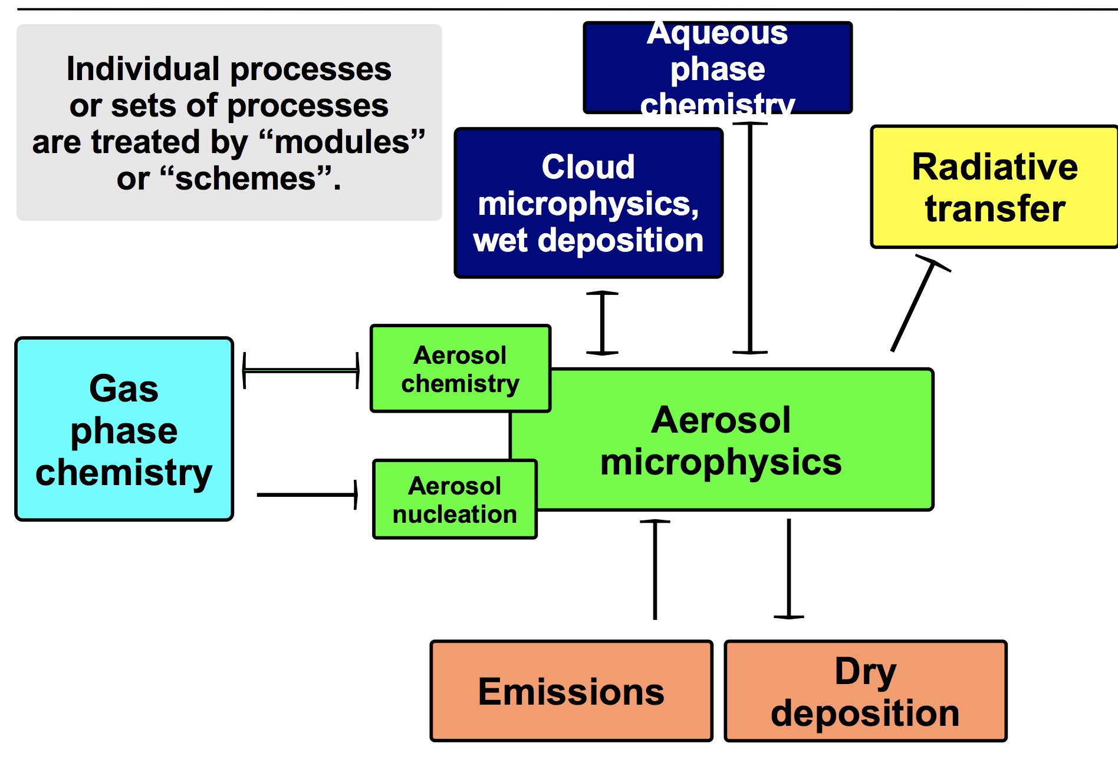
Aerosol Options
GOCART | Bulk | No size information for sulfate, BC, OC Size information for dust and sea salt No secondary organic aerosol (SOA), no nitrate aerosols
MADE | Modal | 3 log-normal modes Inorganic, organic aerosols, SOA
MAM | Modal | 3 or 7 log-normal modes Inorganic, organic aerosols, SOA, sea salt, BC, mineral dust Simple sectional (bin) scheme for volcanic ash aerosol
MOSAIC | Sectional | 4 or 8 bins Inorganic, organic aerosols, SOA
No KPP for aerosols

Slide 7
The Registry
Text based file(s) for preprocessor (real), WRF and WRF-Chem
Used with cpp to auto generate source
Controls/defines Variables (I/O, comms, nesting), Communications, namelist options
Types of entry:
Dimensions that are used to define arrays in the model
State variables and arrays in the domain structure
Local variables and arrays in solve
Derived types that are subtypes of the domain structure
E.g. registry.chem
# Chem Scalars
state real so2 ikjftb chem 1 - i0{12}rhusdf=(bdy_interp:dt) "so2" "SO2 mixing ratio" "ppmv"
state real sulf ikjftb chem 1 - i0{12}rhusdf=(bdy_interp:dt) "sulf" "SULF mixing ratio" "ppmv"
state real no2 ikjftb chem 1 - i0{12}rhusdf=(bdy_interp:dt) "no2" "NO2 mixing ratio" "ppmv"
state real no ikjftb chem 1 - i0{12}rhusdf=(bdy_interp:dt) "no" "NO mixing ratio" "ppmv"
state real o3 ikjftb chem 1 - i0{12}rhusdf=(bdy_interp:dt) "o3" "O3 mixing ratio" "ppmv"
……
#package mozart_mosaic_4bin_vbs0_kpp chem_opt==201 - chem:o3,o1d_cb4,o,no,no2,no3,n2o5,hno3,hno4,so2,ho,ho2,h2o2,sulf,co,hcho,ch3ooh,ch3o2,ch4,h2,eo2,ch3cooh,c2h4,n2o,ch3oh,aco3,acet,mgly,paa,gly,c3h6ooh,pan,mpan,macr,mvk,c3h6,etooh,prooh,acetp,xooh,onitr,isooh,acetol,glyald,mek,
eto2,open,alkooh,mekooh,tolooh,terpooh,ald,mco3,c2h5oh,eo,c2h6,c3h8,pro2,po2,aceto2,bigene,bigalk,eneo2,alko2,
isopr,iso2,mvko2,mvkooh,hydrald,xo2,c10h16,terpo2,tol,cres,to2,xoh,onit,isopn,dms,nh3,nume,den,voca,vocbb,smpa,
smpbb,biog1_c,biog1_o,meko2,so4_a01,no3_a01,cl_a01,nh4_a01,na_a01,oin_a01,oc_a01,bc_a01,hysw_a01,water_a01,
smpa_a01,smpbb_a01,biog1_c_a01,biog1_o_a01,num_a01,so4_a02,no3_a02,cl_a02,nh4_a02,na_a02,oin_a02,oc_a02,bc_a02,
hysw_a02,water_a02,smpa_a02,smpbb_a02,biog1_c_a02,biog1_o_a02,num_a02,so4_a03,no3_a03,cl_a03,nh4_a03,na_a03,
oin_a03,oc_a03,bc_a03,hysw_a03,water_a03,smpa_a03,smpbb_a03,biog1_c_a03,biog1_o_a03,num_a03,so4_a04,
no3_a04,cl_a04,nh4_a04,na_a04,oin_a04,oc_a04,bc_a04,hysw_a04,water_a04,smpa_a04,smpbb_a04,biog1_c_a04,biog1_o_a04,num_a04,ca_a01,ca_a02,ca_a03,ca_a04,co3_a01,co3_a02,co3_a03,co3_a04

Slide 8
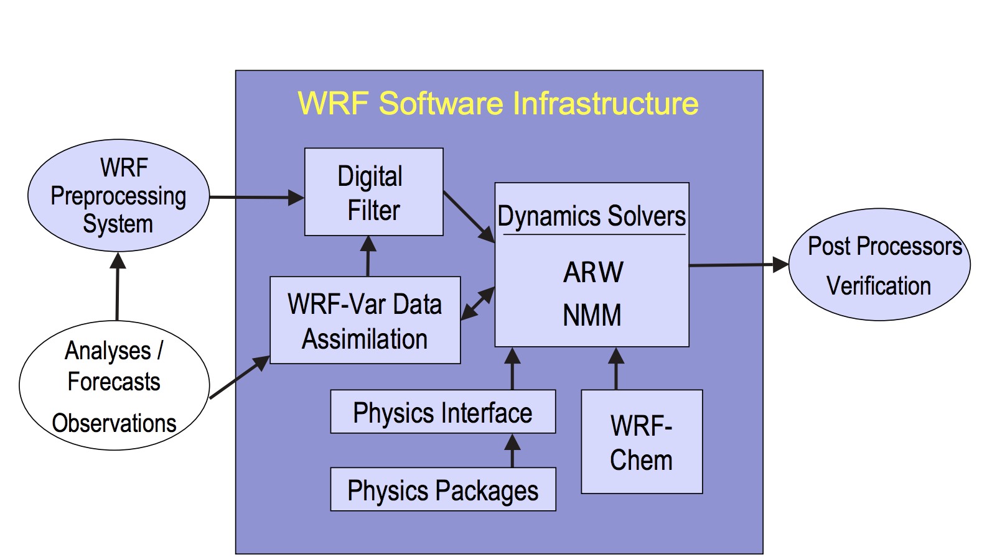
WRF Preprocessing System (WPS)
Defines domains
Interpolates time-invariant terrestrial data to coarse and nested grids (e.g., terrain height and soil type)
Interpolates time-varying meteorological fields from another model (e.g. GFS, ECMWF) onto coarse grid

Slide 9
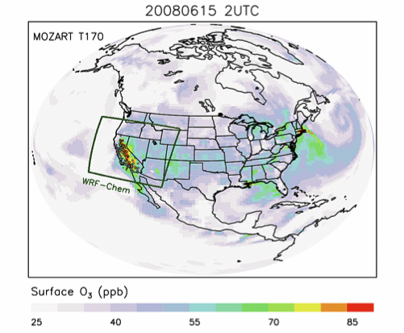
ACOM WRF-Chem Pre-Processing Tools
Tool | Description
mozbc | Creates time-space varying lateral boundary and initial conditions from a global chemistry model (MOZART-4 and WACCM, available 2007-present; also adapted for RACM and can be modified for other global models)
UBC | Sets chemical upper boundary conditions from climatology
bio_emiss | Creates static inputs for online biogenic emissions with MEGAN
fire_emiss | Creates fire emission inputs for WRF-Chem when running with plumerise and also for fire emission inputs for MOZART-4 and CAM-Chem. Fire emission inventory is based on FINN (available 2002-present)
anthro_emiss | Creates anthropogenic emissions files from global emission inventories (to be released soon: option to use regional SMOKE output)
aircraft_emiss | Creates WRF-Chem ready aircraft emissions files from a global inventory
exo_coldens | Creates overhead O3 and O2 columns for photolysis calculations
season_wesley | Creates input files to consider seasonality in Wesley dry deposition
NCAR/ACOM User Forum/Help Desk:
https://www2.acom.ucar.edu/wrf-chem/discussion-forum

Slide 10
Namelist: WRF
&time_control
start_year = 2014, 2014,
start_month = 08,08, 01,
start_day = 12,12, 24,
start_hour = 06,06, 12,
start_minute = 00, 00, 00,
start_second = 00, 00, 00,
end_year = 2014,2014, 2000,
end_month = 08,08, 01,
end_day = 13,13, 25,
end_hour = 06, 06, 12,
end_minute = 00, 00, 00,
end_second = 00, 00, 00,
io_form_auxinput5 = 2,
frames_per_auxinput5 = 1, 1, 1,
auxinput5_inname = 'wrfchemi_d<domain>_<date>',
auxinput5_interval_m = 60, 60, 60,
io_form_auxinput6 = 2,
frames_per_auxinput6 = 1, 1, 1,
auxinput6_inname = 'wrfbiochemi_d<domain>',
auxinput6_interval_h = 360, 360, 360,
io_form_auxinput7 = 2
frames_per_auxinput7 = 1, 1, 1,
auxinput7_inname = 'wrffirechemi_d<domain>_<date>',
auxinput7_interval_m = 60, 60, 60,
/
&domains
/
&physics
mp_physics = 8, 8, 3,
ra_lw_physics = 4, 4, 1,
ra_sw_physics = 4, 4, 1,
sf_sfclay_physics = 7,7, 1,
sf_surface_physics = 7,7, 2,
bl_pbl_physics = 7,7, 1,
cu_physics = 5, 5, 0,
cu_diag = 1, 1,
cugd_avedx = 1
/
&dynamics
non_hydrostatic = .true., .true.,
chem_adv_opt = 2,2 , 1,
scalar_adv_opt = 2,2 , 1,
&fdda
/
&bdy_control
/
&grib2
/
&chem
kemit = 10,
chem_opt = 201,201
bioemdt = 1.2, 0.4,
photdt = 1.2, 0.4
du_at_grnd = 285.,
scale_o3_to_du_at_grnd = .true.,
chemdt = 1.2, 0.4,
io_style_emissions = 2,
emiss_inpt_opt = 102, 102,
emiss_opt = 10,10
emiss_opt_vol = 0, 0,
chem_in_opt = 1, 1,
phot_opt = 4, 4
gas_drydep_opt = 1, 1,
aer_drydep_opt = 1,1
bio_emiss_opt = 3, 3,
ne_area = 210,
gas_bc_opt = 1, 1, 112
gas_ic_opt = 1, 1,
aer_bc_opt = 1, 1,
aer_ic_opt = 1, 1,
gaschem_onoff = 1, 1,
aerchem_onoff = 0, 0
wetscav_onoff = 1, 1,
cldchem_onoff = 0, 0,
vertmix_onoff = 1, 1,
chem_conv_tr = 1, 1,
conv_tr_wetscav = 1, 1
conv_tr_aqchem = 0, 0,
seas_opt = 0,
dust_opt = 0,
dmsemis_opt = 1,
n2o5_hetchem = 1
biomass_burn_opt = 2,2
plumerisefire_frq = 30, 30,
scale_fire_emiss = .true., .true.,
have_bcs_chem = .true., .true.,
aer_ra_feedback = 0, 0,
aer_op_opt = 1,1
opt_pars_out = 1,
have_bcs_upper = .false.,.false.
fixed_ubc_press = 100., 100.,
fixed_ubc_inname = 'ubvals_b40.20th.track1_1996-2005.nc',
emi_inname = 'wrfchemi_d<domain>_<date>'
/

Slide 11
Namelist: WRF-CHEM
&time_control
start_year = 2014, 2014,
start_month = 08,08, 01,
start_day = 12,12, 24,
start_hour = 06,06, 12,
start_minute = 00, 00, 00,
start_second = 00, 00, 00,
end_year = 2014,2014, 2000,
end_month = 08,08, 01,
end_day = 13,13, 25,
end_hour = 06, 06, 12,
end_minute = 00, 00, 00,
end_second = 00, 00, 00,
io_form_auxinput5 = 2,
frames_per_auxinput5 = 1, 1, 1,
auxinput5_inname = 'wrfchemi_d<domain>_<date>',
auxinput5_interval_m = 60, 60, 60,
io_form_auxinput6 = 2,
frames_per_auxinput6 = 1, 1, 1,
auxinput6_inname = 'wrfbiochemi_d<domain>',
auxinput6_interval_h = 360, 360, 360,
io_form_auxinput7 = 2
frames_per_auxinput7 = 1, 1, 1,
auxinput7_inname = 'wrffirechemi_d<domain>_<date>',
auxinput7_interval_m = 60, 60, 60,
/
&domains
/
&physics
mp_physics = 8, 8, 3,
ra_lw_physics = 4, 4, 1,
ra_sw_physics = 4, 4, 1,
sf_sfclay_physics = 7,7, 1,
sf_surface_physics = 7,7, 2,
bl_pbl_physics = 7,7, 1,
cu_physics = 5, 5, 0,
cu_diag = 1, 1,
cugd_avedx = 1
/
&dynamics
non_hydrostatic = .true., .true.,
chem_adv_opt = 2,2 , 1,
scalar_adv_opt = 2,2 , 1,
&fdda
/
&bdy_control
/
&grib2
/
&chem
chem_opt = 201,201
bioemdt = 1.2, 0.4,
photdt = 1.2, 0.4
du_at_grnd = 285.,
scale_o3_to_du_at_grnd = .true.,
chemdt = 1.2, 0.4,
io_style_emissions = 2,
emiss_inpt_opt = 102, 102,
emiss_opt = 10,10
emiss_opt_vol = 0, 0,
chem_in_opt = 1, 1,
phot_opt = 4, 4
gas_drydep_opt = 1, 1,
aer_drydep_opt = 1, 1
bio_emiss_opt = 3, 3,
gas_bc_opt = 1, 1, 112
gas_ic_opt = 1, 1,
aer_bc_opt = 1, 1,
aer_ic_opt = 1, 1,
gaschem_onoff = 1, 1,
aerchem_onoff = 0, 0
wetscav_onoff = 1, 1,
cldchem_onoff = 0, 0,
vertmix_onoff = 1, 1,
chem_conv_tr = 1, 1,
conv_tr_wetscav = 1, 1
conv_tr_aqchem = 0, 0,
seas_opt = 0,
dust_opt = 0,
dmsemis_opt = 1,
n2o5_hetchem = 1
biomass_burn_opt = 2,2
plumerisefire_frq = 30, 30,
have_bcs_chem = .true., .true.,
aer_ra_feedback = 0, 0,
aer_op_opt = 1,1
opt_pars_out = 1,
have_bcs_upper = .false.,.false.
/

Slide 12
ACOM provided WRF-Chem Diagnostics Tools
Trajectories
Calculate trajectories online during runtime from specified times/locations
Output of meteorological and chemical parameters
Tendencies of Trace Gases
Output tendencies for a few trace gases of chemistry, horizontal and vertical advection & vertical mixing
Calculated as the difference before and after the module call
Integrated Reaction Rates (IRR)
Similar to IRR in CMAQ
Accumulates the reaction rates for each reaction in the gas-phase chemistry mechanism
Output controlled by namelist
Analysis with Process Analysis tool PERMM (Will Vizuete, UNC)
"Tracking" output
Output vertical profiles of prescribed meteorological and chemical species at a set of prescribed times and horizontal coordinates at each timestep (e.g. for comparison to aircraft observations)

Slide 13
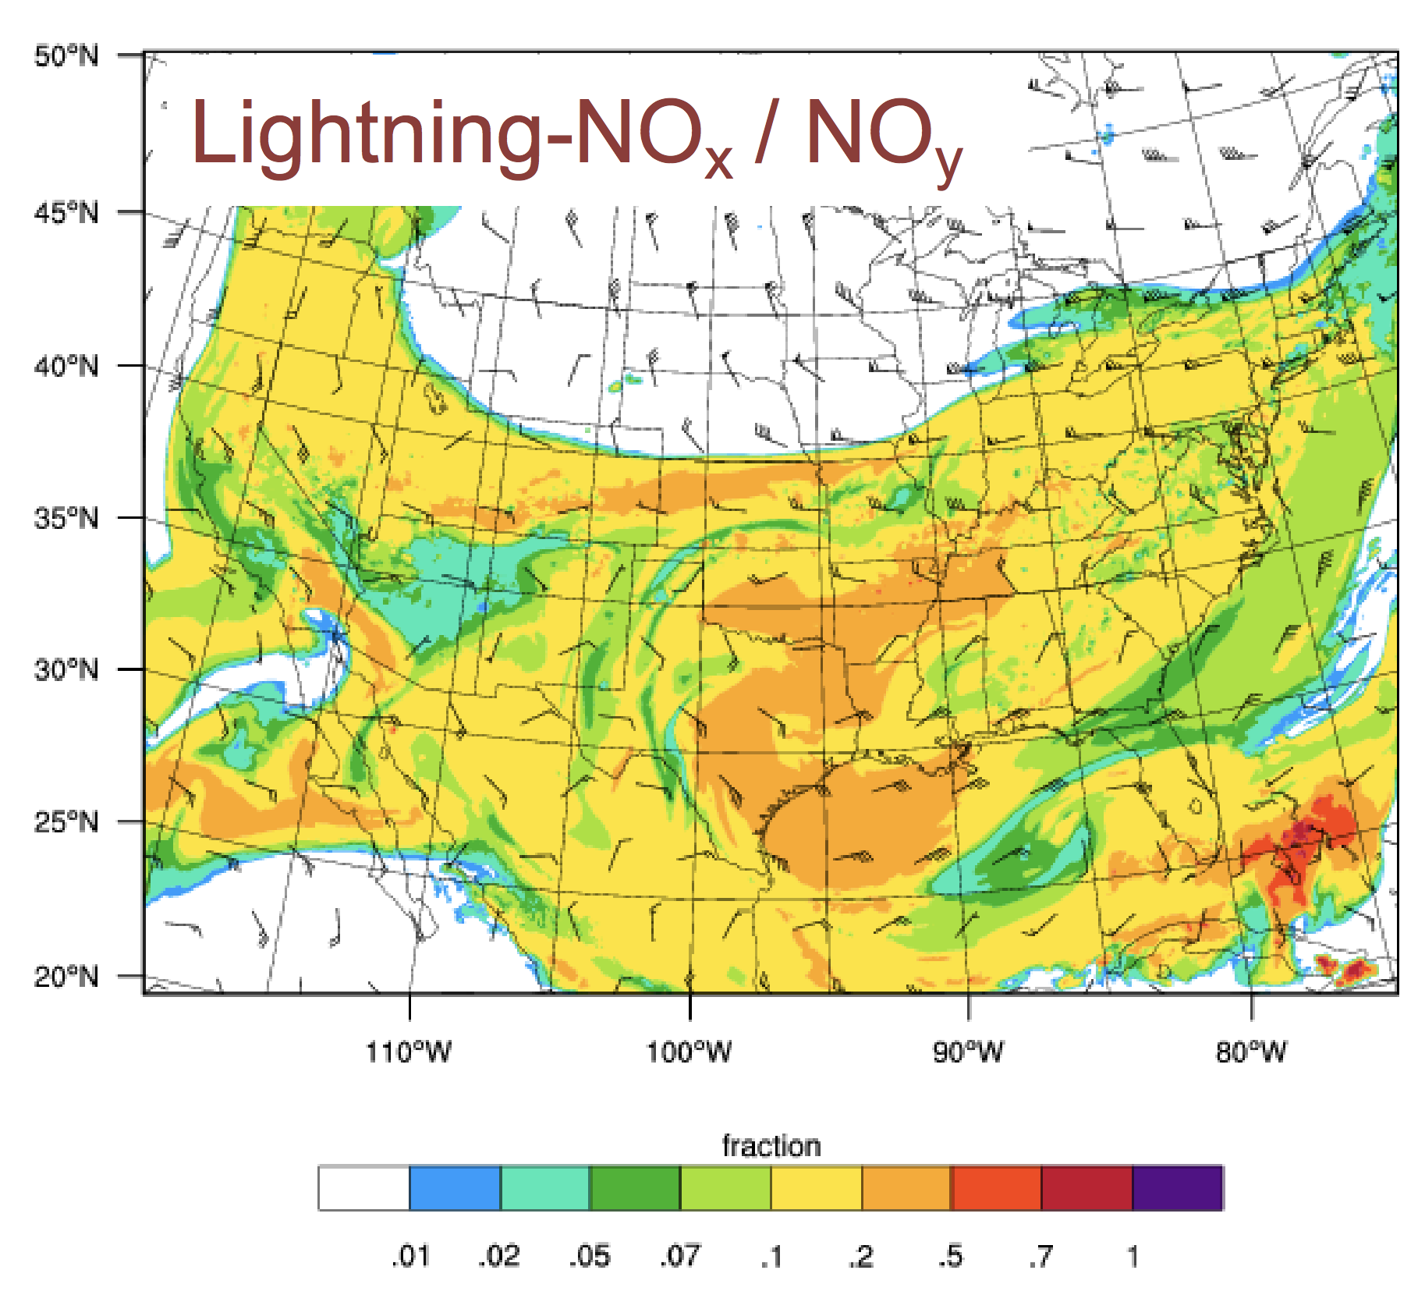
Recent Applications at NCAR/ACOM
Field Project Forecasting (usually tracer forecasts)
KORUS-AQ, FRAPPE, SEAC4RS, NOMADSS, DC3
Chemistry-Climate Studies
North America (future air quality)
South Asia (future air quality)
Effect of stratospheric ozone recovery on air quality
Model Intercomparisons – AQMEII
Analysis
Air Quality: FRAPPÉ and KORUS-AQ analysis
Deep Convection: Wet scavenging, lightning-NO_{x}, O₃ formation in upper troposphere (DC3, SEAC⁴RS)
Effect of cloud prediction on radiation and ozone production (SEAC⁴RS)

Slide 14
WRF and WRF-Chem
Numerical weather prediction and atmospheric simulation system designed for research and operational applications.
Supported as a common tool for the university/research and operational communities (> 40,000 users worldwide).
Air quality and chemistry-climate from regional to cloud resolving scales
For more information including Publication Lists:
WRF-NCAR http://www2.mmm.ucar.edu/wrf/users/
WRF-Chem NOAA https://ruc.noaa.gov/wrf/wrf-chem/
WRF-Chem NCAR https://www2.acom.ucar.edu/wrf-chem
Annual Tutorials @ NCAR: Summer (WRF), Winter (WRF & WRF-Chem)
WRF Evaluation Tool: http://www2.mmm.ucar.edu/wrf/users/downloads.html

Slide 15
Extras

Slide 16
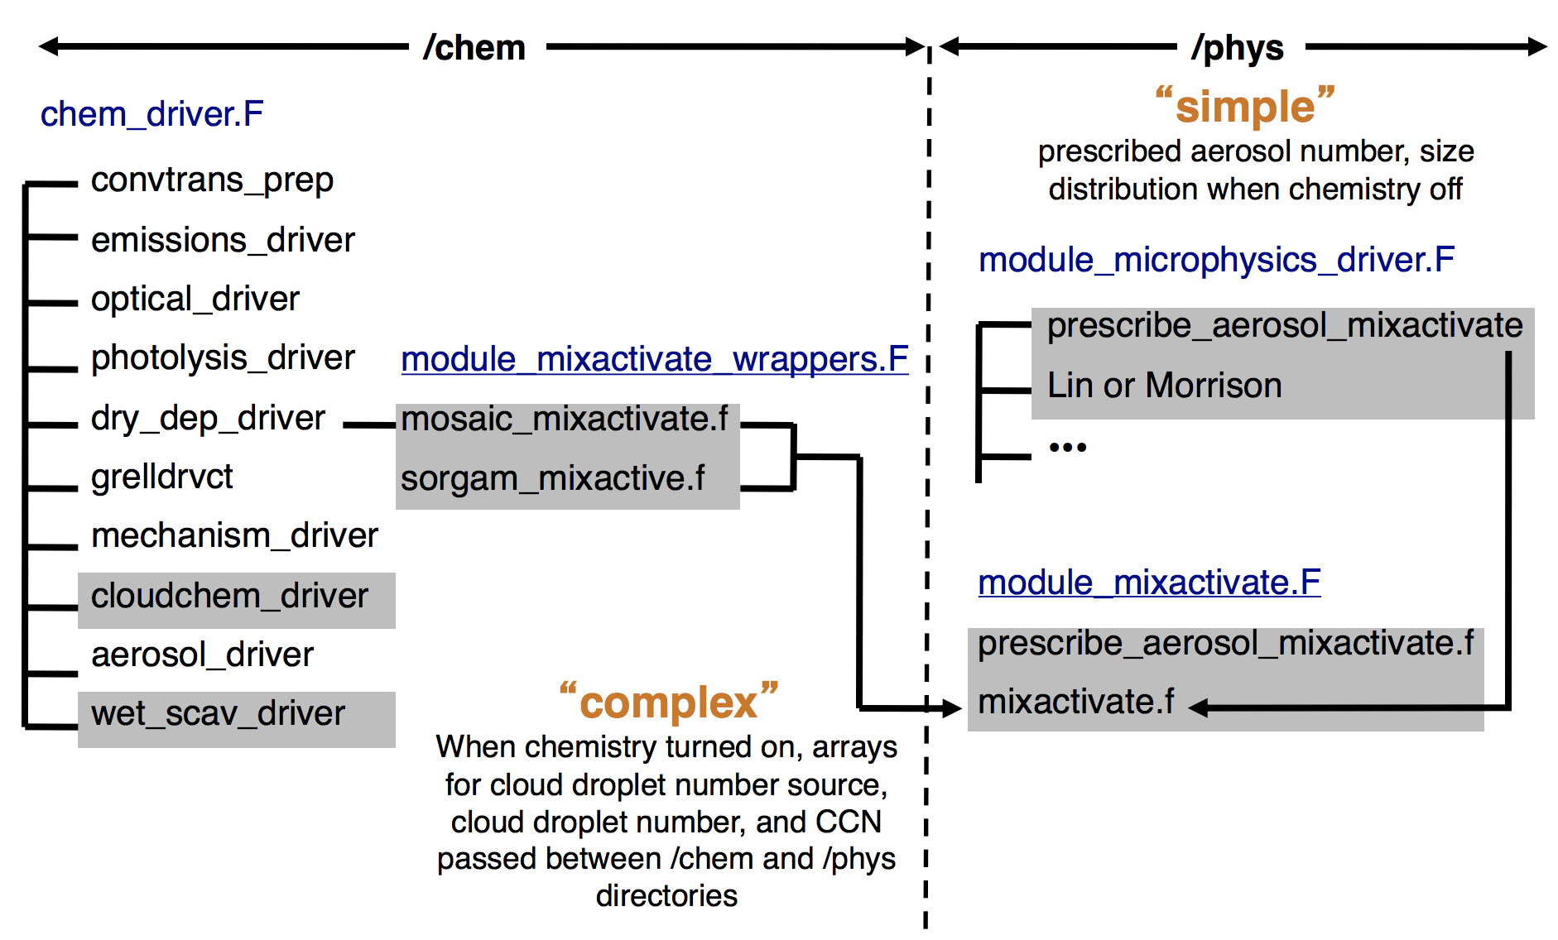
Aerosol Implementations
Aerosol-Cloud Interactions

