Slide 1
Coupling of GEOS-Chem to NASA GEOS
Lizzie Lundgren
GEOS-Chem Support Team

Slide 2

GEOS-Chem in NASA GEOS Overview
The Goddard Earth Observing System Model, Version 5 (GEOS-5 or GEOS) is an Earth Science model developed by the NASA Global Modeling and Assimilation Office (GMAO)
GEOS adheres to the modular architecture of the Earth System Modeling Framework (ESMF) to enable flexible connection of model components
Work to develop GEOS-Chem as ESMF compliant software for use in GEOS began ~2011, ultimately leading to High Performance GEOS-Chem (GCHP)
GEOS-Chem is now a functional module within the GEOS system used by GMAO scientists and Harvard students with NASA accounts
GEOS-Chem
Source: GMAO
Notes:
GEOS-5 flagship application is GEOS-FP: assimilate met, information (satellite data, sondes, etc) every 6 hours, and do a 10-day forecast twice a day. It has no chemistry.

Slide 3
Motivation for incorporating GEOS-Chem into GEOS
GMAO benefits from the scientific advances contributed to the off-line model by the GEOS-Chem community
GEOS-Chem benefits from NASA scrutiny of the model, particularly comparison with performance of other GEOS modules to identify potential areas for improvement
Improves GEOS chemical data assimilation, particularly in the troposphere
Provides GMAO the option to use an up-to-date chemistry model that does not need to be maintained in-house
Enables GMAO to develop new products, such as air quality forecasts, observation system simulation experiments (OSSE), chemical data assimilation and reanalysis
Strengthens GMAO’s partnership with one of the main users of their products
Unlike CESM, GEOS is not a community model, limiting impact of the coupling. However, it demonstrates successful coupling of GC to an ESM.

Slide 4
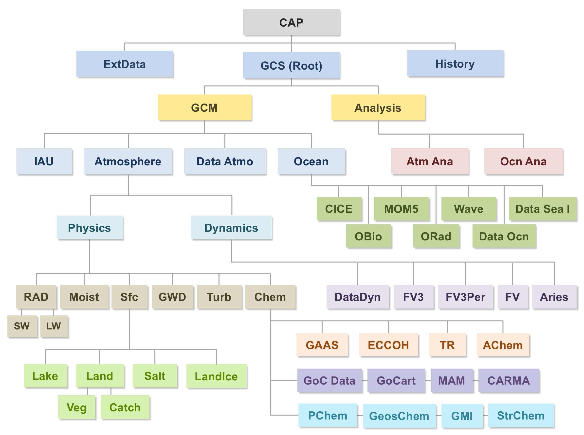
GEOS-Chem is one of several chemistry options in GEOS
Source: GMAO
Notes:
Purple are aerosol modules while blue are gas phase chemistry.

Slide 5
GEOS-Chem is integrated into the GEOS source code as an ESMF Gridded Component
GEOSagcm
CARMAchem_GridComp
GEOSpchem_GridComp
src
GMIchem_GridComp
GEOSgcs_GridComp
GOCART_GridComp
GEOSgcm_GridComp
GEOSCHEMchem_GridComp
GEOSagcm_GridComp
MATRIXchem_GridComp
GEOSphysics_GridComp
StratChem_GridComp
GEOSchem_GridComp
GEOSachem_GridComp
The modularity of GEOS-Chem is enabled by the gridded component infrastructure built into GCHP
MAMchem_GridComp

Slide 6
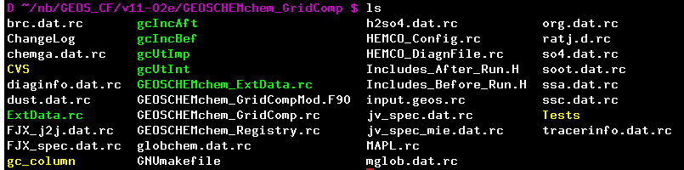
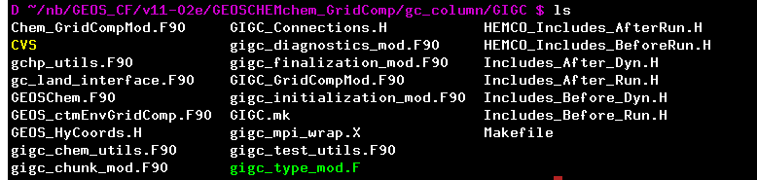
GEOS uses regular GEOS-Chem files available on GitHub in the GEOS branches
Run config and grid comp files
Subset of GEOS-Chem files
Subset of GCHP files

Slide 7
Successful coupling stems from dedicated collaboration between
GMAO and GCST
Each organization has one person invested in the interface
  Christoph Keller (GMAO) for GEOS interface with GEOS-Chem
  Lizzie Lundgren (GCST), formerly Mike Long, for GEOS-Chem interface with GEOS
Combining both perspectives better identifies and addresses the challenges of coupling:
  Continuous integration of updates received from a broad GEOS-Chem user community
  Special handling of GEOS-Chem components in GEOS compared to the offline model
  Differing version control systems
  Divergent versions of GEOS-Chem files in GEOS and offline model
GMAO closely follows updates added to GEOS-Chem and incorporates them
Mutually agreed upon set of preprocessor switches isolate ESM-specific code
Collaboratively developed linking system to use GC git files within GEOS
GCST maintains GEOS branches in GC git repos for easy and frequent merges

Slide 8
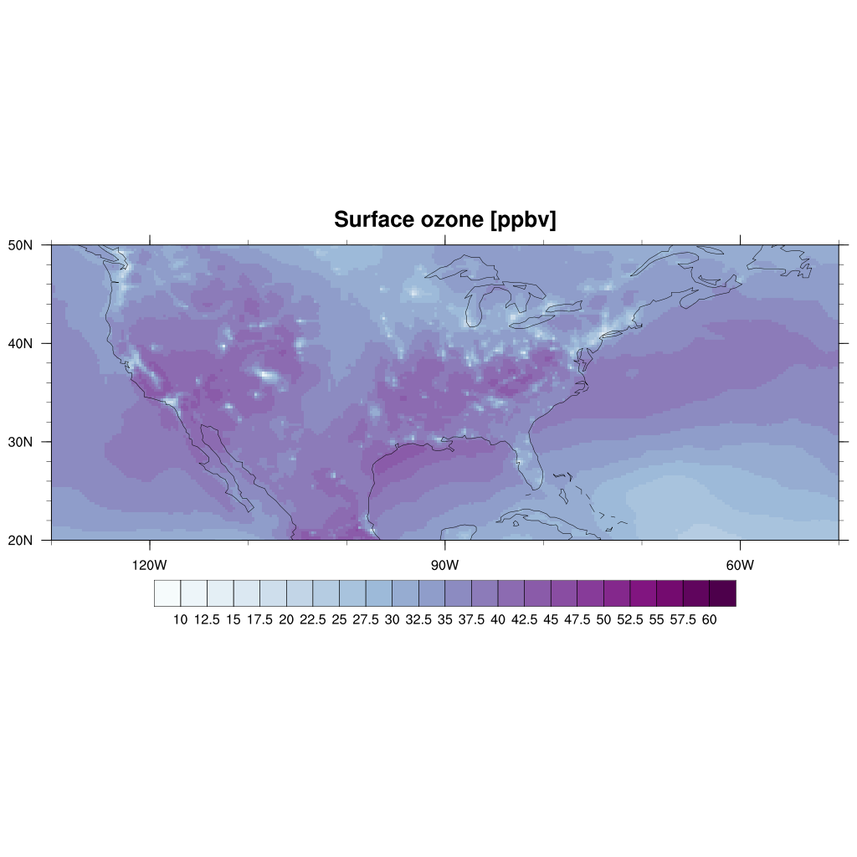
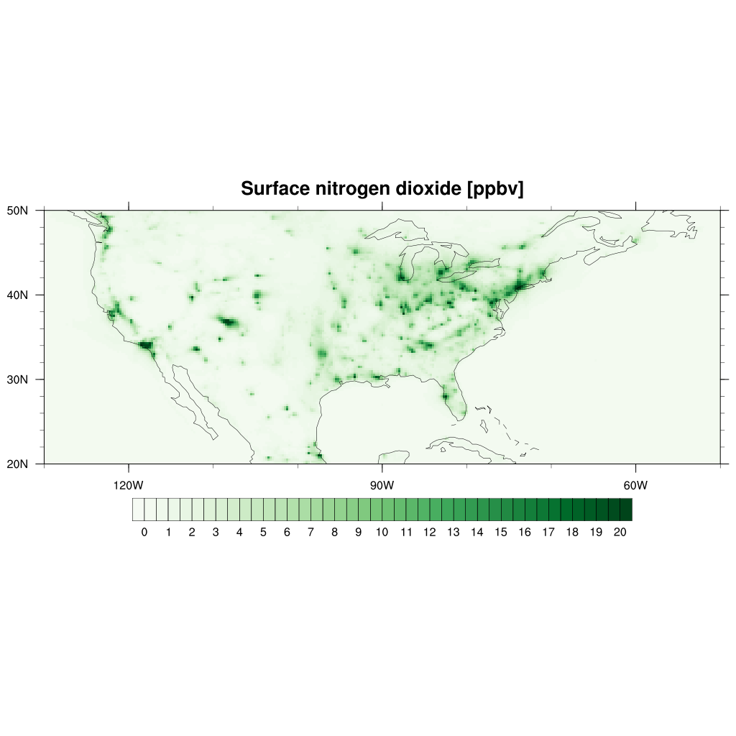
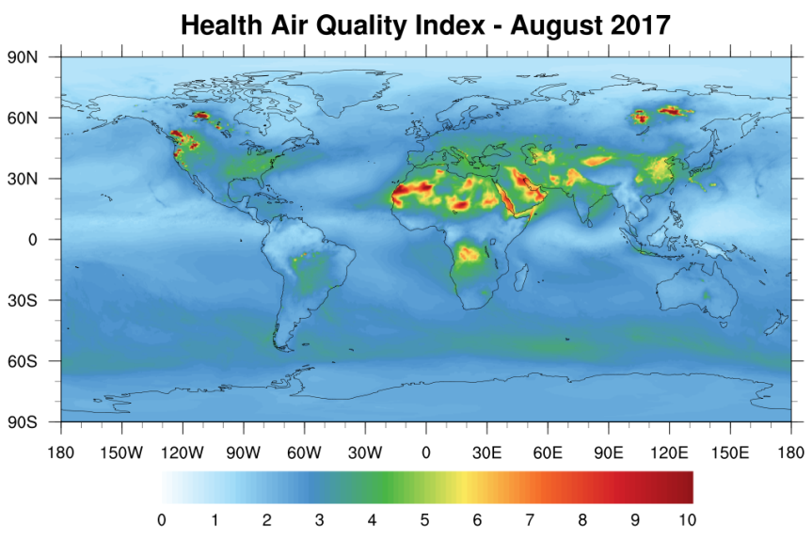
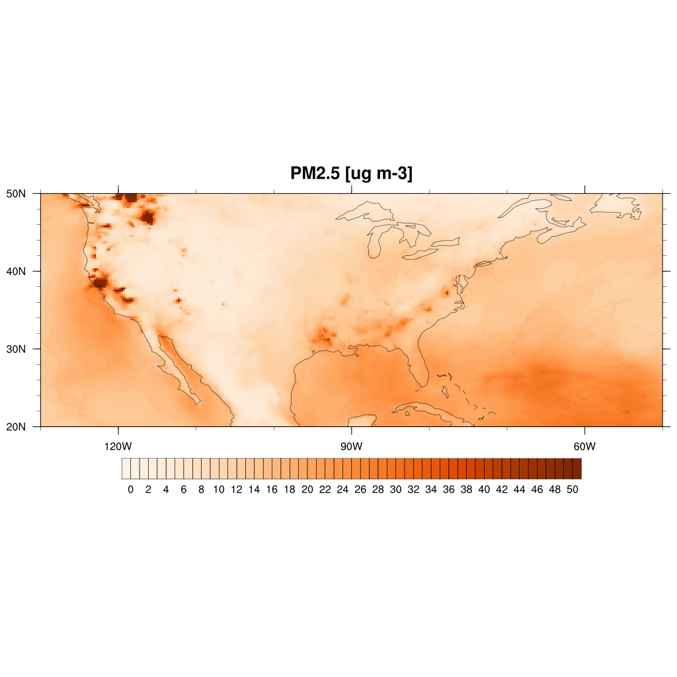
Example of GEOS application using GEOS-Chem:
GMAO daily air quality forecast product
GEOS composition forecast model (GEOS-CF) is a version of the GEOS Earth System Model that includes GEOS-Chem chemistry
Produces global, high-resolution air quality data in near real-time
Model concentrations of key air pollutants are in good agreement with independent surface observations and ozone sondes
Model outputs are being used outside of NASA to generate global maps of human health
Ozone
Nitrogen dioxide
Particulate matter
Source: GMAO

Slide 9
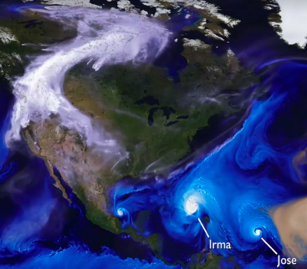
GEOS - FP
GEOS - CF
GEOS - Chem
220 reactive species, 720 reactions, run at cubed sphere c360 (25x25 km), one 5-day forecast per day
Source: GMAO
Notes:
For GEOS-CF we basically do the same as for GEOS-FP: we first run a one-day 'hindcast', where we assimilate all available observations. Then we run a 5-day forecast. We do this once a day. By doing the assimilation we make sure that our model stays in line with observations. The assimilation is done in replay mode, but I don't think this matters for this talk. it's just a cheaper way of doing the assimilation but currently we don't assimilate any chemical species (only the met variables).
Take observations from previous day, recompute met based on these, and generate met 5 days into the future online while running chemistry.
GEOS-Chem does not currently feed back into GEOS-5.

Slide 10


Near real-time air quality forecasting using the NASA GEOS model
Christoph. A. Keller^{1,2}, K. E. Knowland^{1,2}, L. E. Ott², E. Saunders^{2,3}, J. Liu⁴, B. N. Duncan⁴, S. Pawson²
1 Universities Space Research Association (USRA)/GESTAR, 2 Global Modeling and Assimilation Office, NASA/GSFC, 3 Space Systems and Applications, Inc. (SSAI), 4 Atmospheric Chemistry and Dyamics Laboratory, NASA/GSFC
XXXX-XXXX
GEOS-CF model overview
A version of the GEOS Earth System Model that includes reactive chemistry
Uses the GEOS-Chem chemical module
220 reactive species, 720 reactions
Run at cube-sphere c360 (~25x25 km²)
One 5-day forecast per day
Summary
The GEOS composition forecast model (GEOS-CF) is a new GMAO product that produces daily global air quality forecasts in near real-time at unprecedented horizontal resolution of 25 km².
Validation
Good agreement between GEOS-CF and surface observations & ozone sondes over North America, Europe and Asia. GEOS-CF likely underestimates air pollution in areas with limited information on precursor emissions (Africa, S. America).
High-resolution surface ozone map produced by GEOS-CF
Comparison of GEOS-CF ozone against ozone sondes
Ozone forecast against surface observations (Mexico City)
Trinidad Head
Sapporo
Payerne
Hohenpeissenberg
Legionowo
Goose Bay
Edmonton
Churchill
What is next?
A chemistry model based on machine learning is currently being explored as an alternative to the numerical chemical solver. Such a model has the potential to speed up forecasts by a factor of 10-100.
Snapshot of surface ozone [ppbv] on August 15, 2017 at 20:00 UTC
Resolution matters
Results from a ultra-high resolution simulation with atmospheric chemistry at 12 km² show the importance of model resolution to resolve air quality features. GEOS-CF has higher horizontal resolution than any other global air quality model.
Sondes
GEOS-CF
Application: mapping air quality
The Health Air Quality Index (HAQI) is a function of O₃, NO₂, and PM2.5. GEOS-CF model output is used by scientist at NYU and UNICEF to refine HAQI for children. HAQI values range from 0 (clean air) to 10 (severely polluted).
Modeled and observed CO concentrations at Denver, CO
Health Air Quality Index for November 4, 2017
Comparison of surface concentration predicted by GEOS-Chem (black) and a machine learning algorithm (random forest, red). Courtesy of Mat Evans (York University)
E-mail: christoph.a.keller@nasa.gov | Web: gmao.gsfc.nasa.gov
Notes:
This poster was presented internally at GMAO but I was given permission to show it. Christoph Keller has given at least 10 public talks on the content in this poster.

Slide 11
Ongoing NASA research and development using GEOS-Chem
Air quality monitoring using GEOS-CF:
  Running since March 2017 (currently in test mode)
  Daily global air quality forecasts will be available to the public starting late 2018
  New partnerships and projects enabled with public data release
Nature runs for OSSEs
Research projects:
  2-5 year simulation to collect statistics
  Full chemical data assimilation system for trace gases (O₃, NO₂, CO)
  Machine learning for chemistry solver
  Coupling GEOS-Chem chemistry with GOCART aerosol assimilation/radiation
  Investigating impact of vertical resolution on dynamics and chemistry
Ongoing collaboration with GEOS-Chem Support Team
  Christoph Keller (GMAO) has GEOS-Chem GitHub permissions
  Lizzie Lundgren (GCST) has developer permissions at NASA
Also interested in chemistry-climate interactions

Slide 12
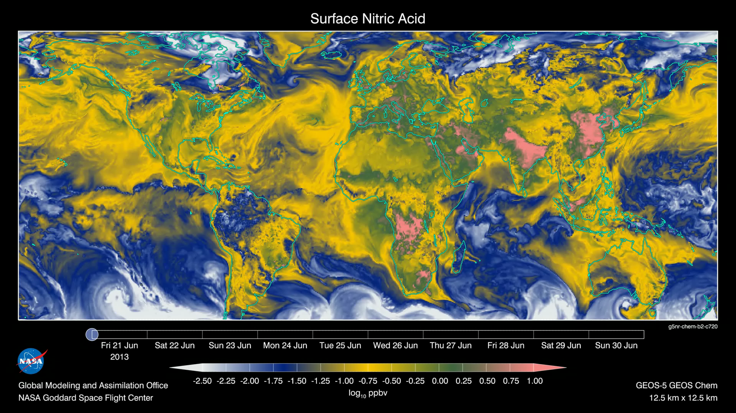
Questions / Discussion
C720 GEOS-5 nature run using GEOS-Chem
Notes:
C720 nature run with GEOSCHEMchem

Slide 13
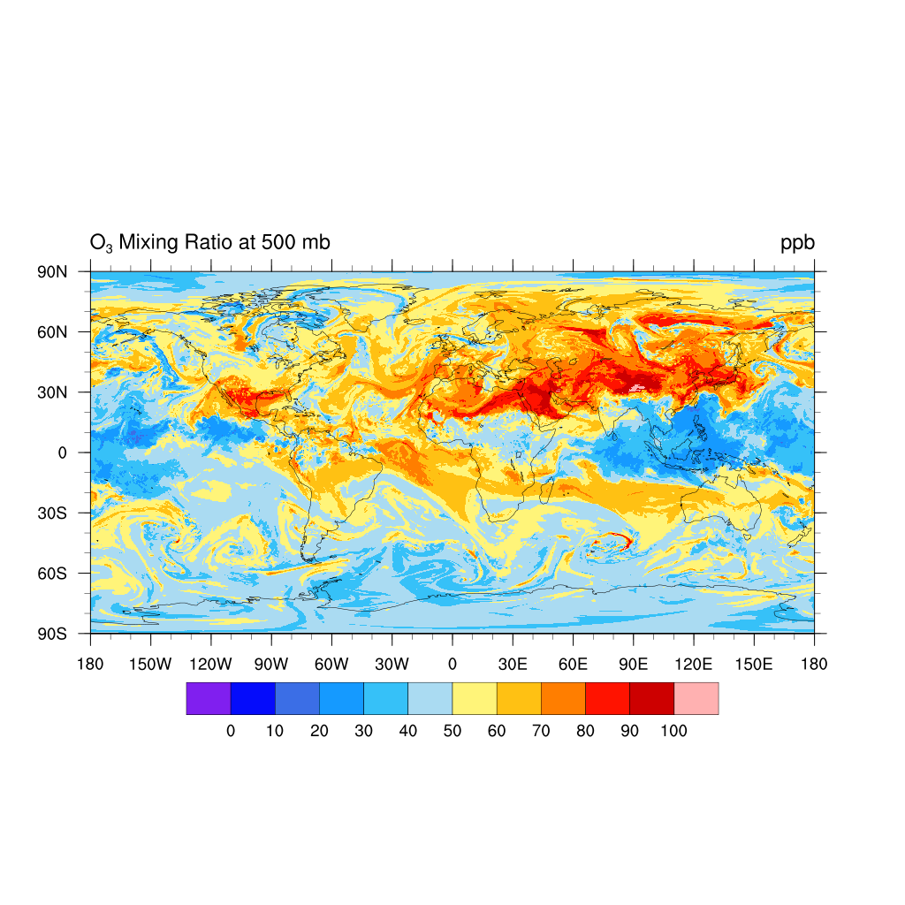
Full-year tropospheric chemistry simulation at c720 (~12 km) resolution using on-line GEOS-Chem in NASA GEOS-5 ESM
August 1, 2013 0Z
Hu et al., GMD 2018

Slide 14
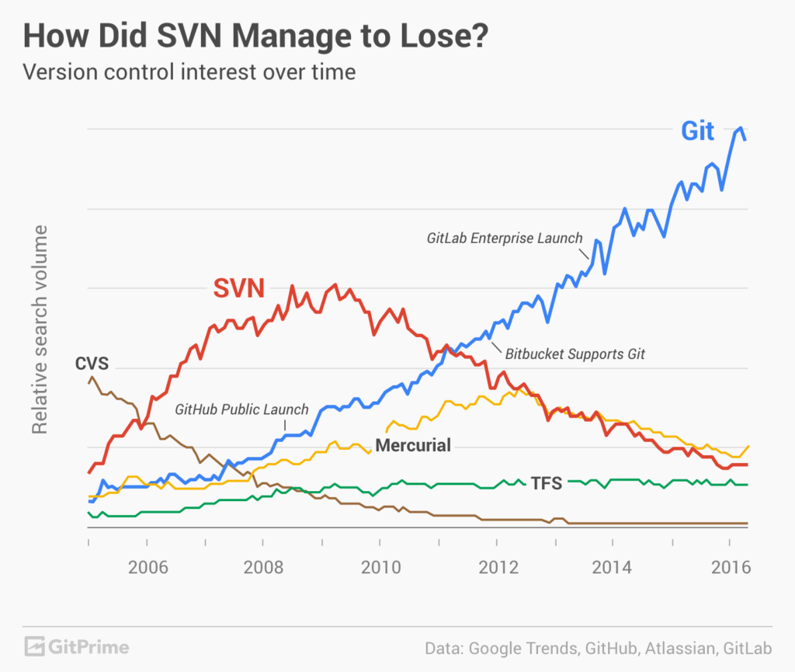
Version Control
GCST develops GEOS-Chem using git
GMAO develops GEOS-5 using CVS
GMAO will migrate to git but not for a couple years, although it may occur sooner
Going between these two systems is not simple
Notes:
This and the next few slides are from my MDS presentation on my collaboration with Christoph to develop a better system for concurrent development of GEOS-Chem offline and GEOS-Chem in GEOS

Slide 15
Problems from GMAO Perspective
GEOS-Chem changes rapidly
  New science and structural updates in gc_bleeding_edge
  Lots of structural updates to GCHP, e.g. diagnostics
  Run directory updates to accompany changes
Changes are not always readily understood
Manual updates are time-consuming
GEOS-Chem updates only partially make it into GEOS-5, widening the gap between GEOS-5 and GEOS-Chem over time

Slide 16
Problems from GCST Perspective
Receive updates built on an old version
Receive updates not necessarily appropriate for new version
GEOS-Chem becomes cluttered with GEOS-5-only code
Widening gap between GEOS-5 and GEOS-Chem raises concern for future updates
GEOS-5 updates only partially make it into GEOS-Chem, widening the gap between GEOS-5 and GEOS-Chem over time

Slide 17
Collaboration Goals
Target end result:
  Easily merge GEOS-Chem version updates into GEOS-5
  Easily merge GEOS-5 updates into GEOS-Chem
Strategy:
  Bring GCHP files in GEOS-5 up-to-date
  Put common files under git version control in the same repos
  Abstract or isolate (and clearly mark) GEOS-5 only code
  Work towards identical base code in both branches
  Develop a fool-proof pipeline for using GEOS-Chem git repo source code directly in GEOS-5
  Work towards coordinated and frequent code transfers between GMAO and GCST using these branches

