Slide 1
Understand the aerosol composition in ATAL with integrated modeling and observations from field campaigns
Mian Chin and colleagues, NASA Goddard Space Flight Center
Yunqian Zhu and NCAR group
4/27/2021, NCAR UTLS group meeting

Slide 2
ACCLIP aerosol science questions
What are the aerosol chemical, microphysical, and optical properties in the major Asian Summer Monsoon anticyclone (ASMA) outflow airmass in the UT and LS over the western Pacific (i.e., ASMA eastward shedding area)?
Is there a distinct chemical signature that reflects the location of surface sources and chemical processes in the ASMA eastward outflow?
What are the aerosol loading and chemical composition in the ASMA eastward outflow that are different from those in the ASMA core, in the westward outflow, and the background airmasses in the UT and LS?
How to put the ACCLIP aerosol and related observations into a broader spatial and temporal context of the characteristics of ATAL and their connections with the monsoon strength and climate variability?
[ Figure adapted from CLIVAR, https://www.clivar.org/asian-australian-monsoon]

Slide 3
1. What we have learned from the 2020 dry run with model forecast and “flight planning”
Eastward eddy shedding from the core ASMA occurs frequently in the summer
Over the North Pacific ACCLIP flight area, most encountered continental airmass in the UT is from East Asia which often mixed with older airmass from South Asia
There are distinctive dynamic features of airmasses from South Asia and East Asia with information on different aerosol composition
The ASMA frequently sending BL-generated pollutants to the LS with several pathways
Typhoon can perturb the UTLS aerosol composition

Slide 4
2020 summer dry run of model forecast from 3 global chemistry transport models in support of ACCIP
(http://catalog.eol.ucar.edu/acclip_2019)
Model | Spatial resolution & meteorology | Aerosol and related species
NCAR WACCM | 1°×1°×110L, nudged with GEOS-FP meteorology | Mass concentrations of BC, OA, sulfate, nitrate, dust, SO2, CO, accumulation and Aitken mode aerosols
NASA GEOS-FP | 0.25°× 0.25°× 72L, GEOS-FP meteorology | Mass concentrations of BC, OA, sulfate, nitrate, dust, SO2, CO Tagged CO: CO_AS, CO_BB Aerosol extinction profile (not in catalog)
ECMWF CAMS | 40-km horizontal resolution, ECMWF meteorology | Mass concentrations of BC, OA, sulfate, nitrate, dust, SO2, CO Tagged CO: CO_EA, CO_SA
There are also meteorological forecasts from NCEP GFS and NCAR WRF ARW with regional tracers, and Lagrangian model RDF TRAJ3D with GFS winds

Slide 5
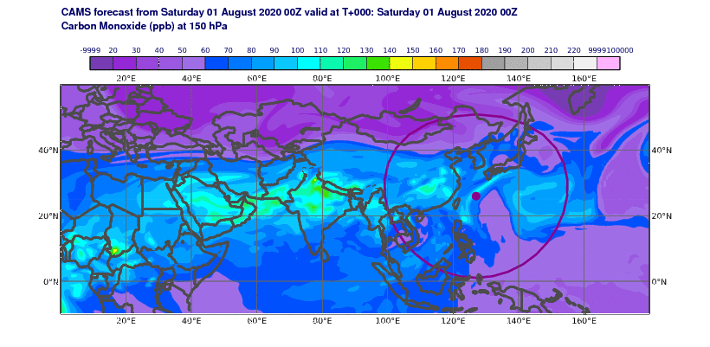
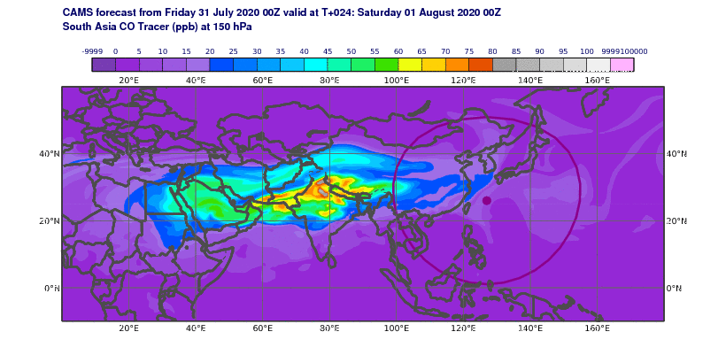
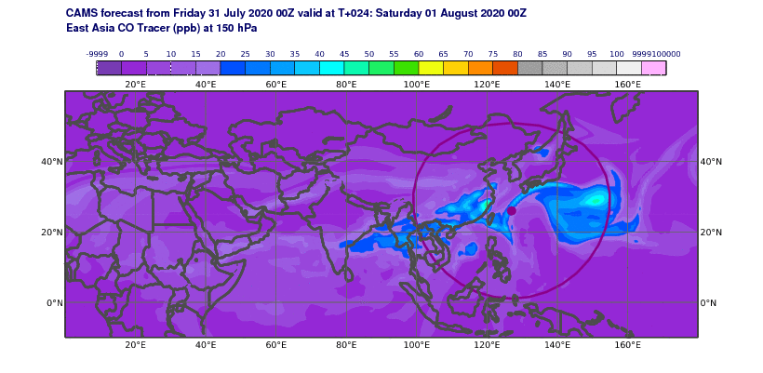
Eastward eddy shedding from the core ASMA occurs frequently in the summer. Over the North Pacific ACCLIP flight area, most sampled continental airmass in the UT is from East Asia with younger age than air mass from South Asia
Total CO
CO from South Asia
CAMS forecast of CO at 150 hPa, from 2020-08-01 to 2020-08-31:
Total CO and tagged CO originating in South Asia and East Asia
CO from East Asia

Slide 6
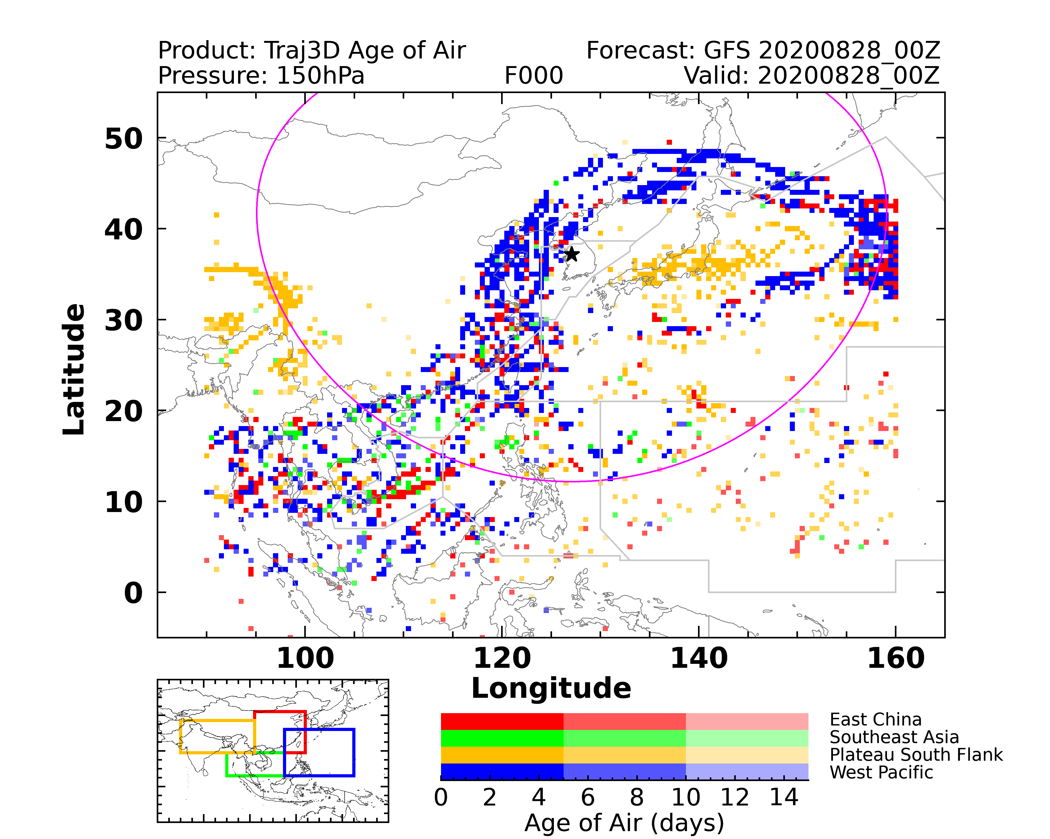
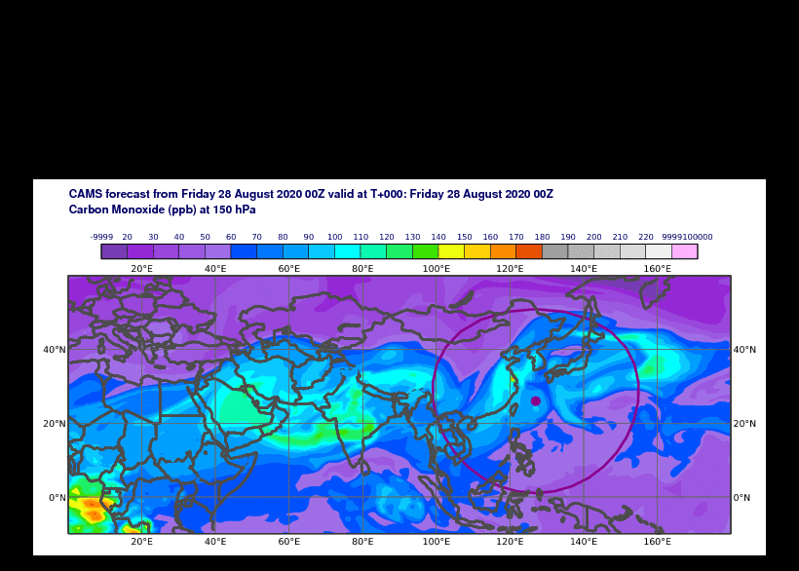
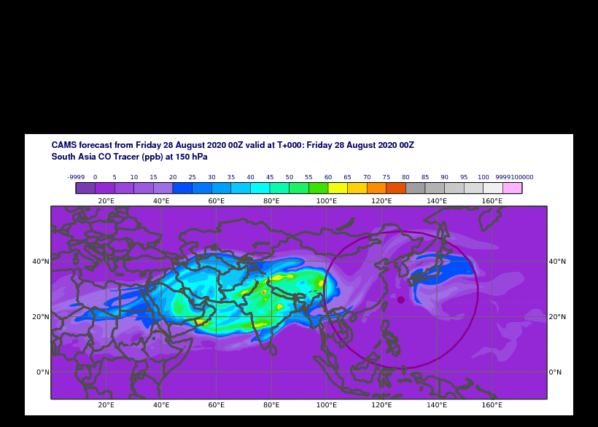
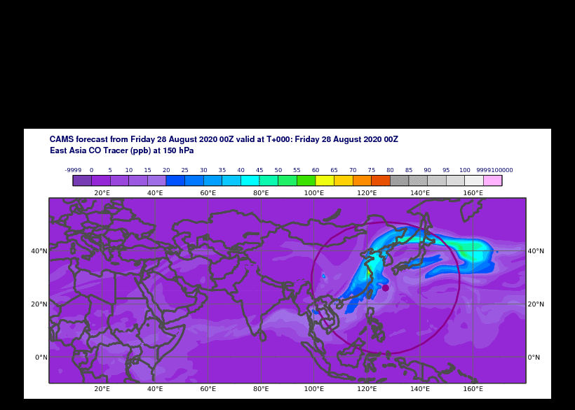
Distinct dynamic features from EA and SA:
Typically, SA air mass dominates the core of ASMA but EA air mass circles around the core
Both SA and EA air masses shed to the east and west, but WP is more influence by the EA air mass whereas Arabia Peninsula and E Africa more influence by the SA air mass
CAMS CO 150 hPa 2020-08-28
CAMS CO_SA 150 hPa 2020-08-28
CAMS CO_EA 150 hPa 2020-08-28
GEOS-i33p2 BC 150 hPa 2018-08-11
GEOS-i33p2 BC_SA 150 hPa 2018-08-11
GEOS-i33p2 BC_EA 150 hPa 2018-08-11

Slide 7
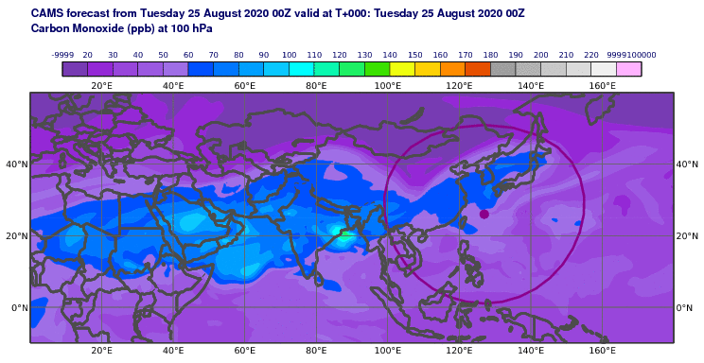
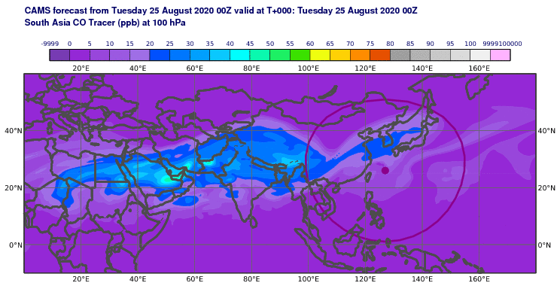
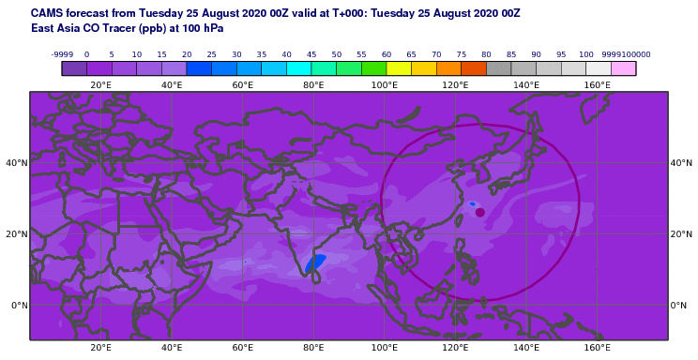
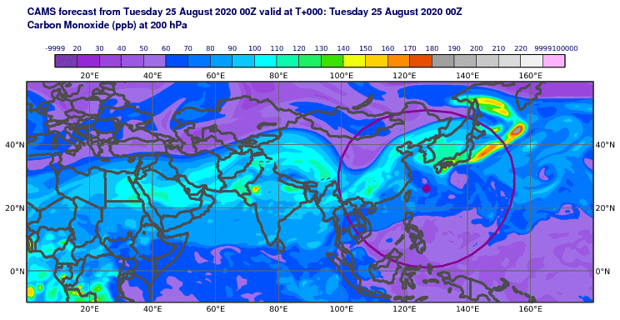
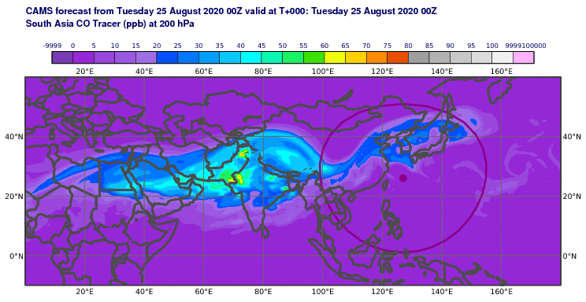
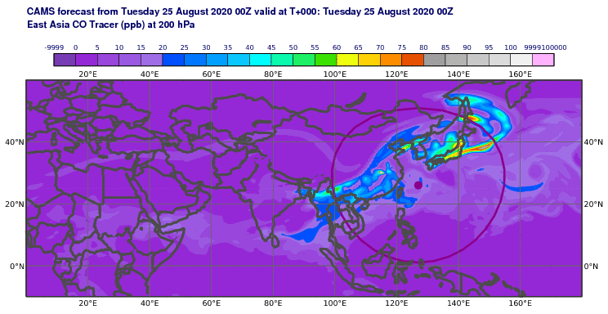
Distinct dynamic features from EA and SA:
In general, SA airmass reaches higher altitudes than the EA airmass over the W Pacific
CAMS CO 100 hPa 2020-08-25
CAMS CO_SA 100 hPa 2020-08-25
CAMS CO_EA 100 hPa 2020-08-25
CAMS CO 200 hPa 2020-08-25
CAMS CO_SA 200 hPa 2020-08-25
CAMS CO_EA 200 hPa 2020-08-25
At 200 hPa, CO_SA is lower than CO_EA in the W Pacific in the northern half of the ACCLIP area
At 100 hPa, CO_SA is higher than CO_EA

Slide 8
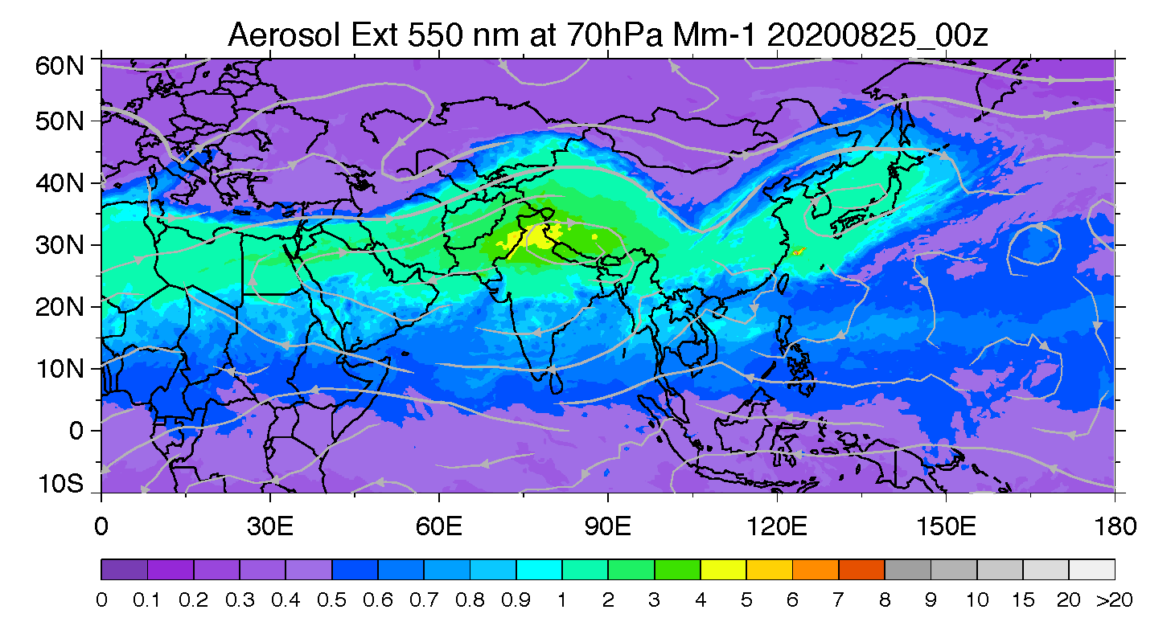
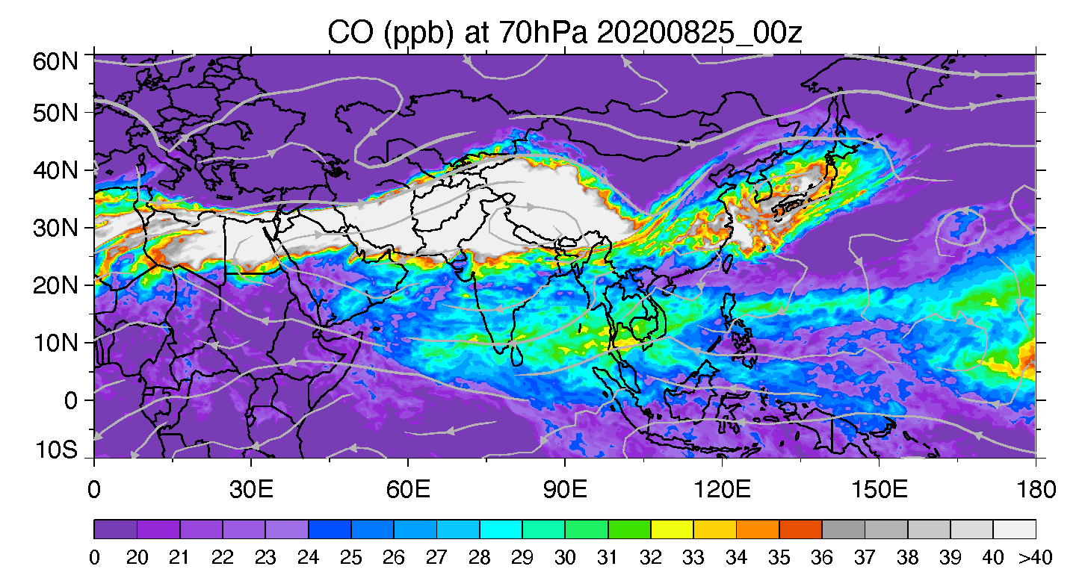
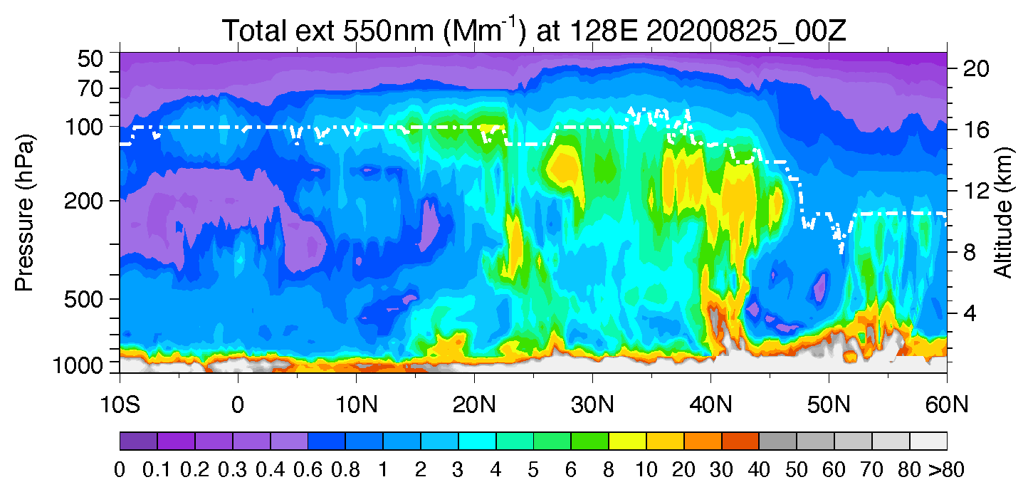
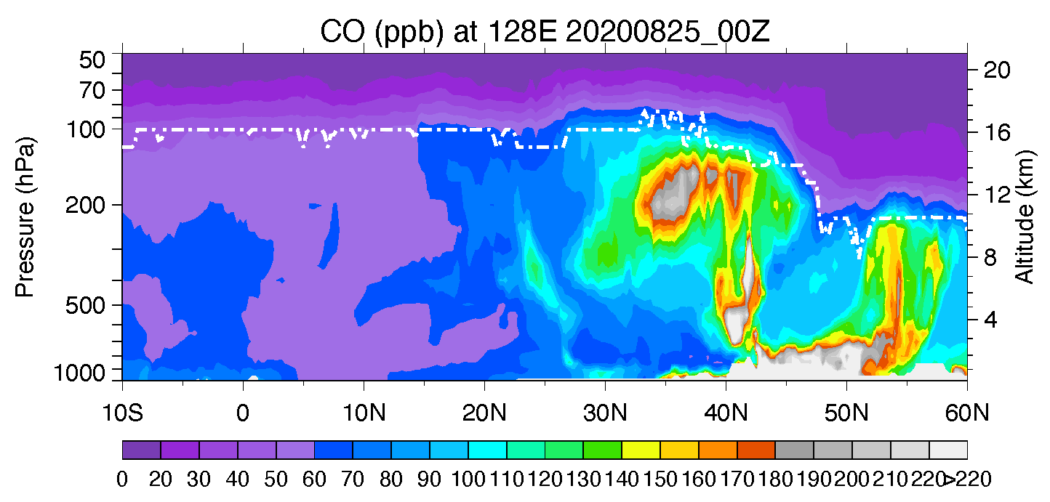
LS: ASM system frequently sending surface generated material to the lower stratosphere – GEOS-FP, 2020-08-25
Aerosol extinction 550 nm (Mm⁻¹)
CO (ppb)

Slide 9
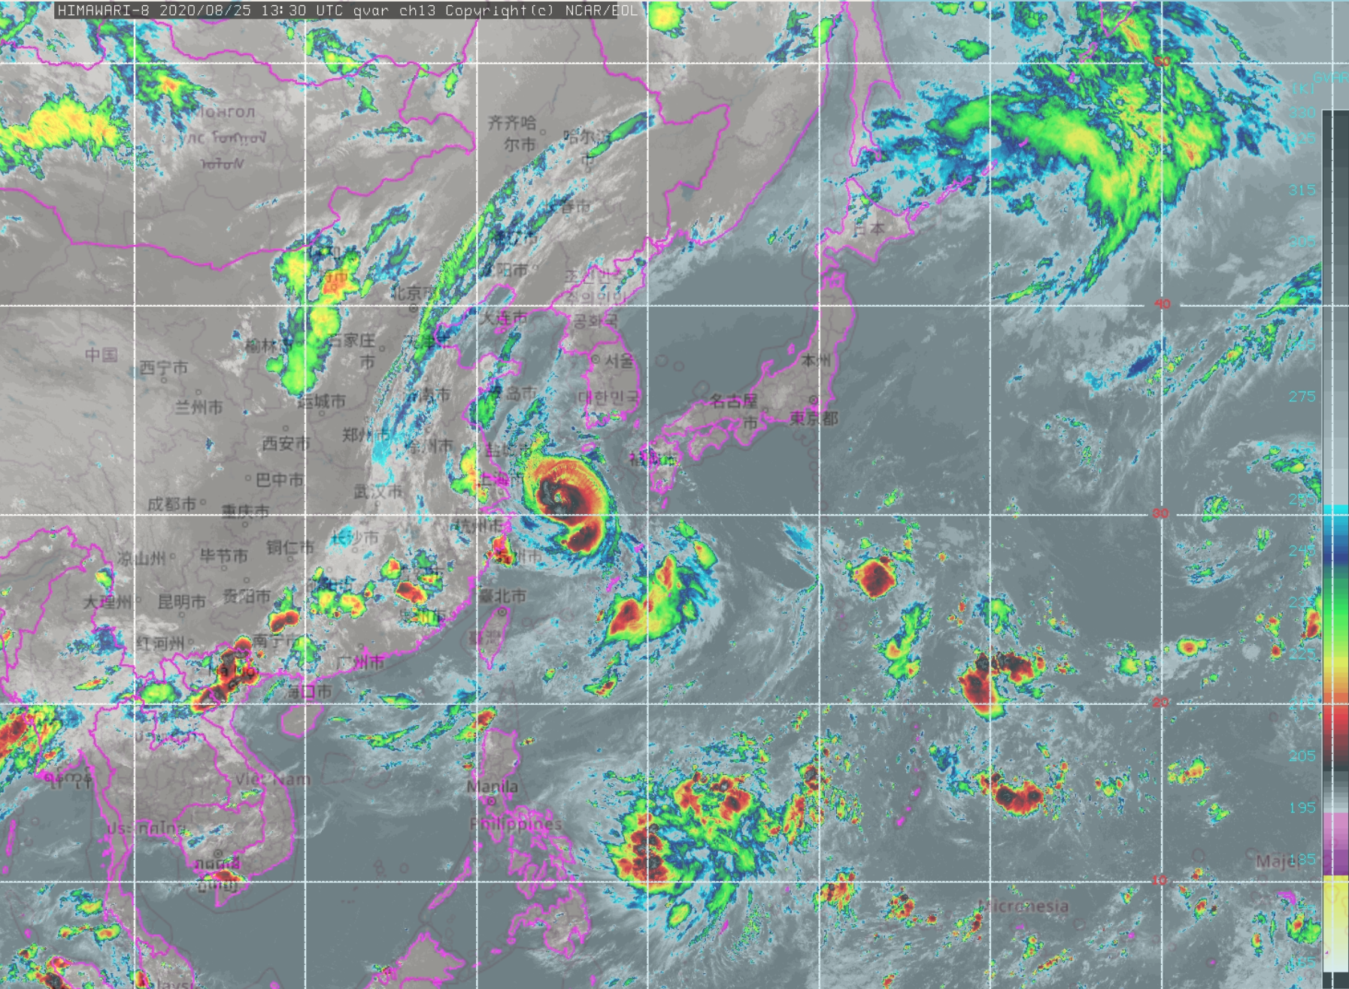
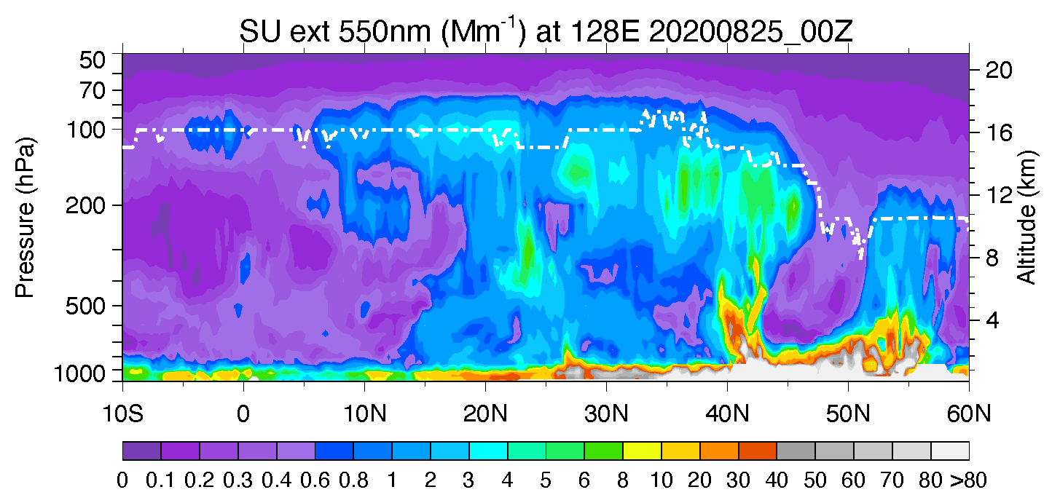
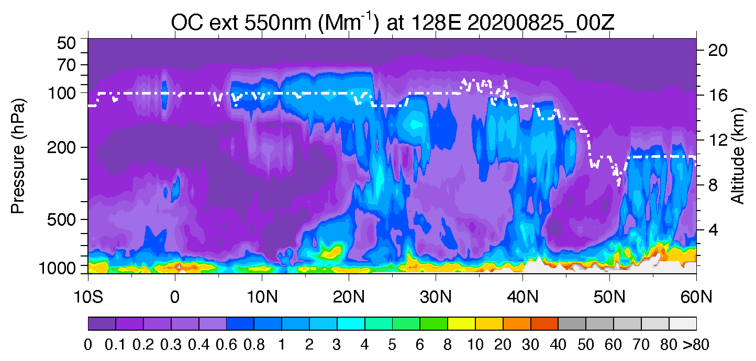
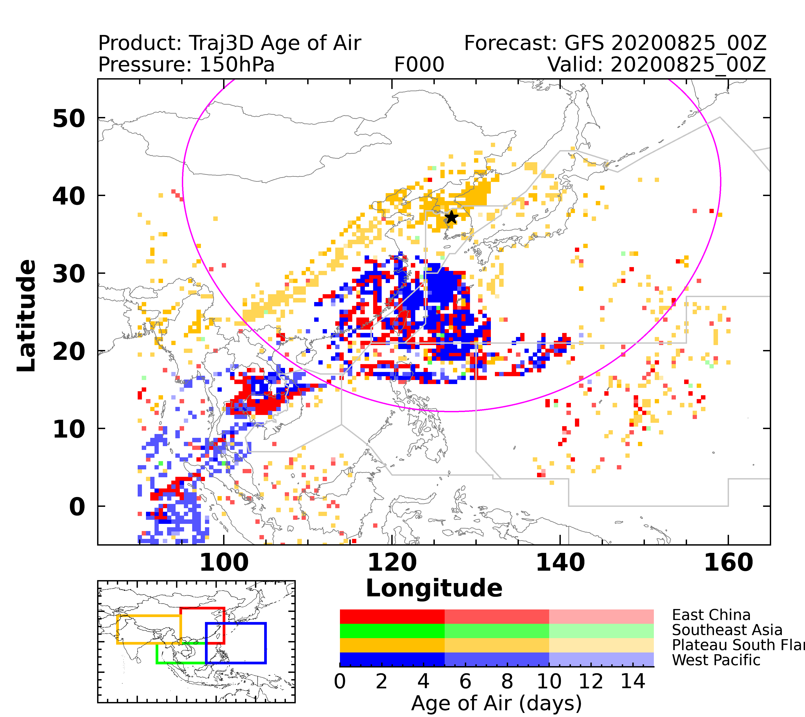
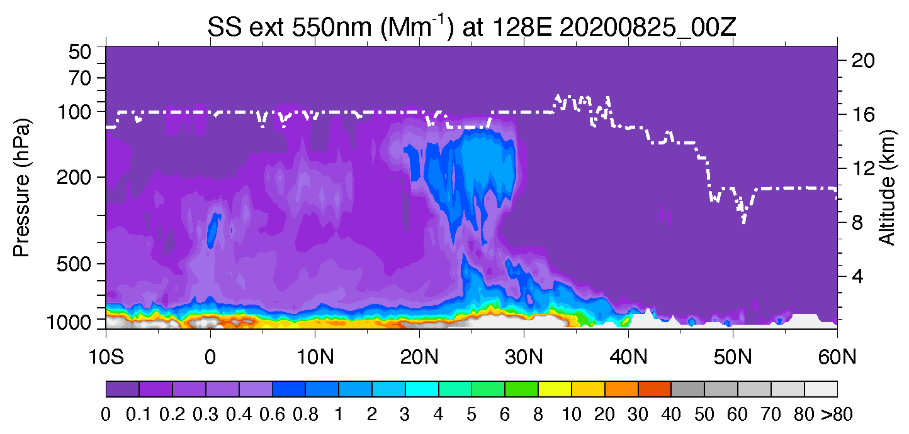
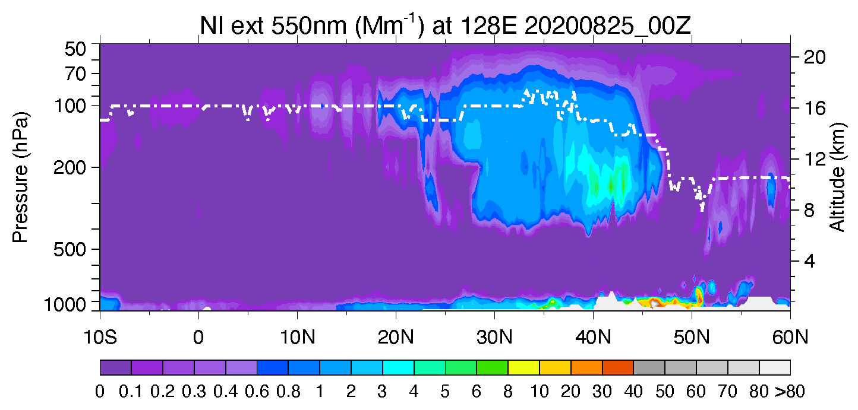
Typhoon can perturb the UTLS aerosol composition – lat-height aerosol species extinction profiles at 128E from GEOS-FP, 2020-08-25
Typhoon Bavi
Sulfate
OA
3 chimneys?
Sea salt
Nitrate
Typhoon Bavi lifting sea salt high
S. Asia airmass?

Slide 10
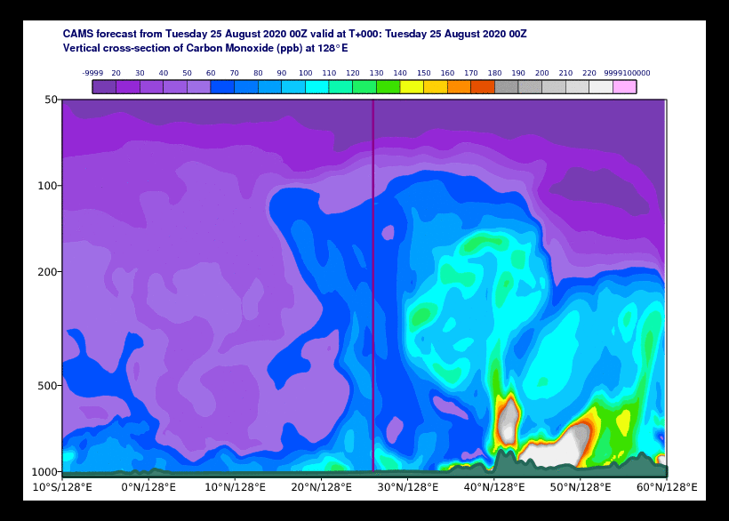
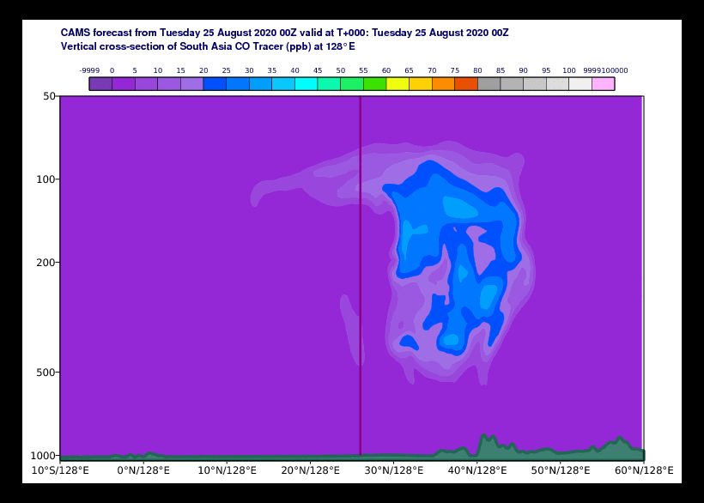
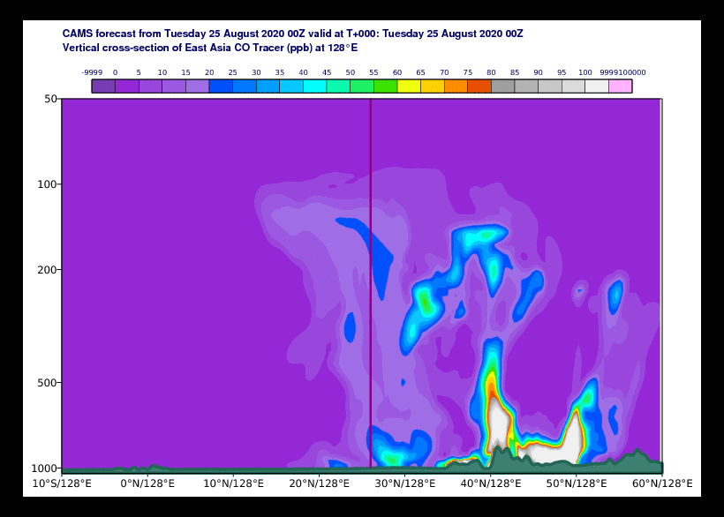
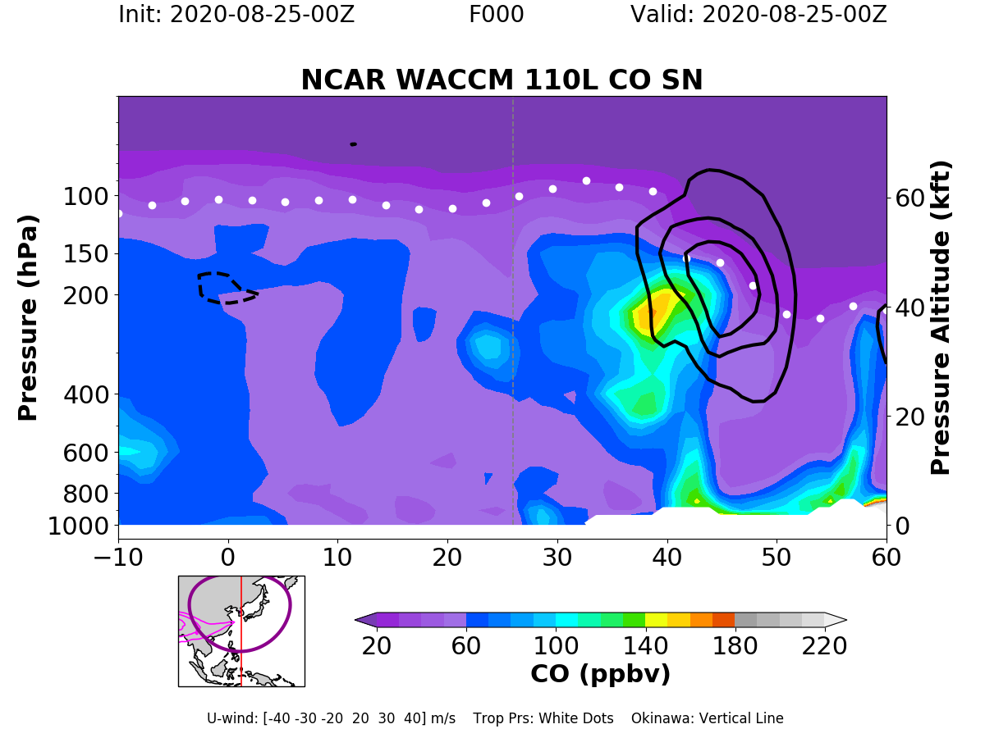
LS: airmass from SA is easier getting into the stratosphere over the W Pacific than airmass from EA
CAMS CO
128E 2020-08-25
CAMS CO_SA 128E 2020-08-25
CAMS CO_EA 128E 2020-08-25
GEOS-FP CO 128E 2020-08-25
WACCM CO 128E 2020-08-25

Slide 11
2. Models need to be evaluated with observations
The three models agree on general features and magnitudes on CO in the UTLS, but show large differences in aerosol composition
Models need to have pre-ACCLIP evaluation with observations, particularly with in-situ aircraft data in the ASM region in the UTLS in order to be helpful to support the ACCLIP field experiments and be credible for the integrated model-observation analysis the understand the ATAL and its impact

Slide 12
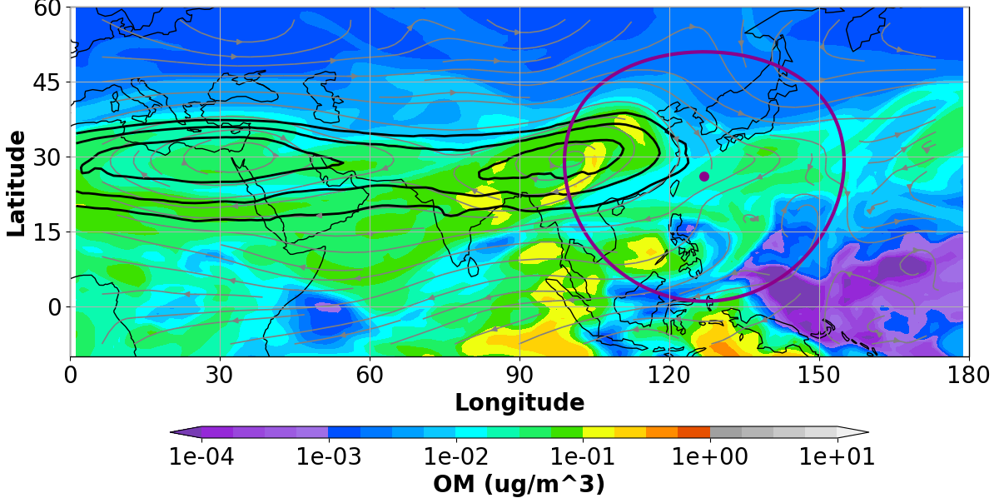
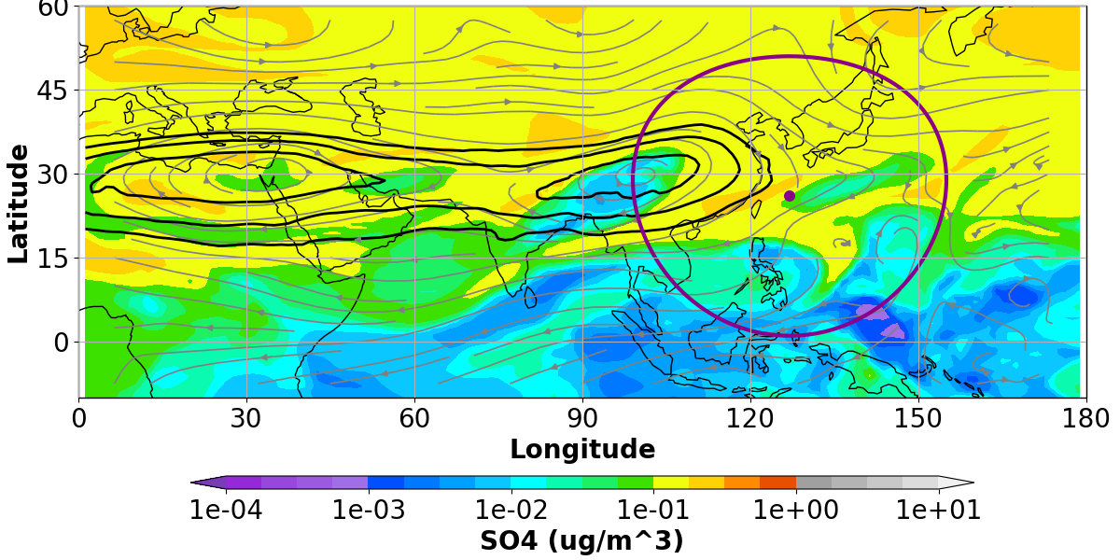
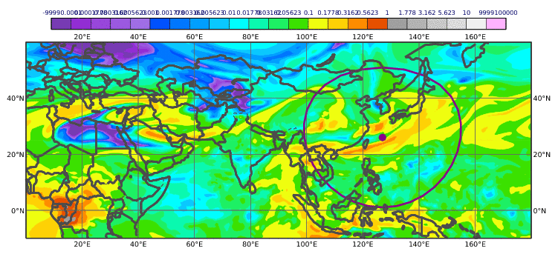
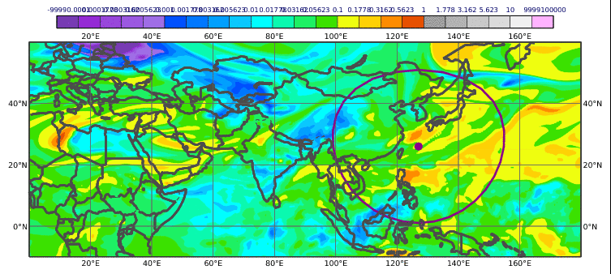
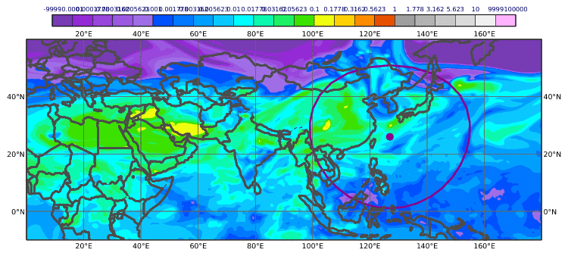
Model evaluations urgently needed: models can be widely different in ATAL composition and distributions
Stratospheric sulfate??
150 hPa features are quite different among three models
WACCM and GEOS are more similar in large scale features, although the magnitudes are different
CAMS aerosol distributions are very different from other two models
WACCM OA 150 hPa 2020-07-24
WACCM SO₄⁼ 150 hPa 2020-07-24
GEOS-FP OA 150 hPa 2020-07-24
GEOS-FP SO₄⁼ 150 hPa 2020-07-24
GEOS-FP NO₃⁻ 150 hPa 2020-07-24
CAMS OA 150 hPa 2020-07-24
CAMS SO₄⁼ 150 hPa 2020-07-24
CAMS NO₃⁻ 150 hPa 2020-07-24

Slide 13
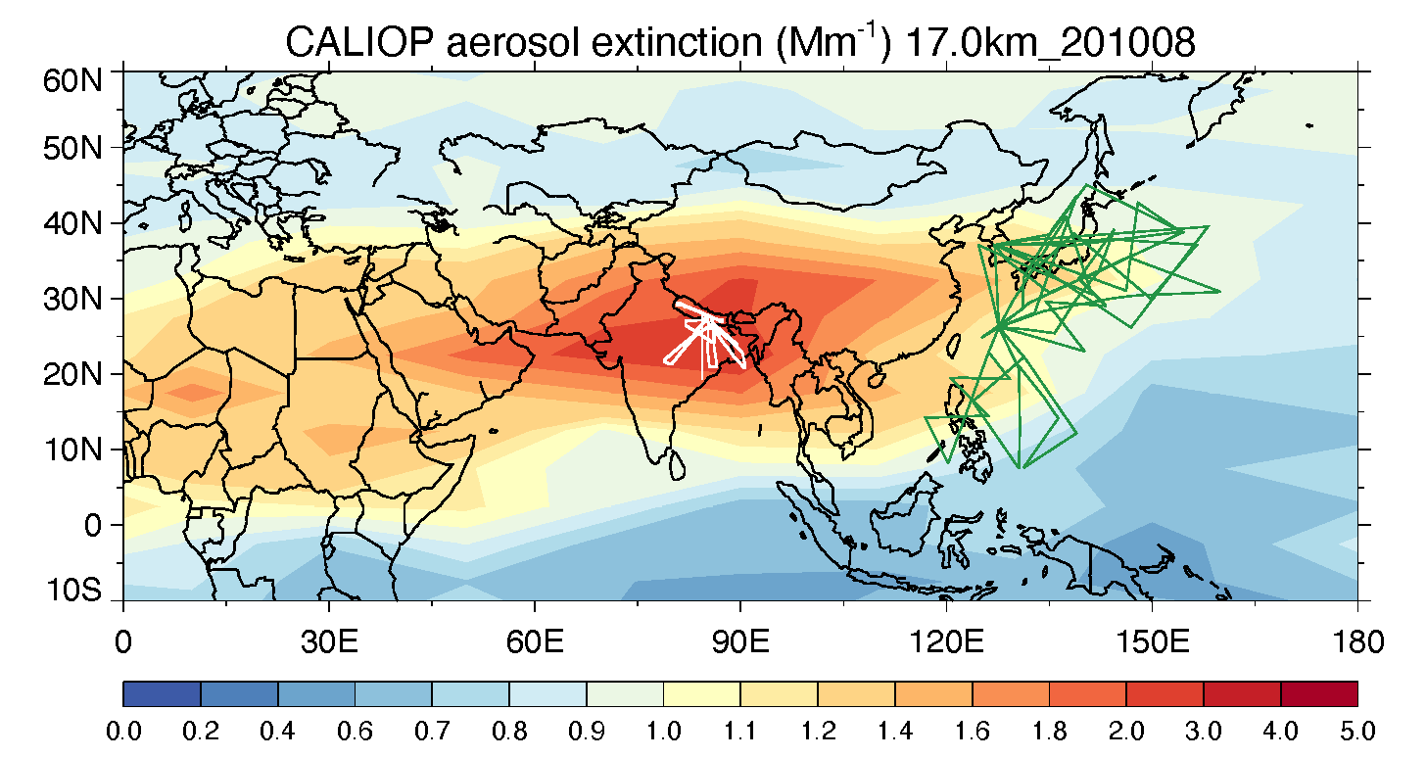
Recent and near future aircraft observations of aerosols and related species in the ASM region for model evaluation and for integrated analysis
Field program | Major aerosol relevant species | Spatial area | Time period
OMO | CO, SO₂, OH, Aitken aerosol (CN) | Middle East – Indian Ocean, between 4 – 14 km altitudes | July-Aug 2015
StratoClim | CO, SO₂, OCS, H₂SO₄, NH₃, NH₄⁺, SO₄⁼, NO₃⁻, OA, aerosol particle size, optical property, particle number concentration | Indian subcontinent, troposphere to LS | July-Aug 2017
ACCLIP | CO, H₂O, SO₂, NH₃, NH₄⁺, SO₄⁼, NO₃⁻, BC, OA, aerosol particle size, particle number concentration | Western Pacific/Korea, troposphere to LS | July-Aug 2022
StratoClim
Jul-Aug 2017
ACCLIP
Jul-Aug 2022
(dry run 2020 GV)
OMO
Jul-Aug 2015
(general area)
We can learn a lot from those aircraft measurements about the origin of the ATAL composition in different parts of the ASMA, similarities and differences between airmasses from different regions, transport pathways from PBL to LS, chemical processes, and climate implications

Slide 14
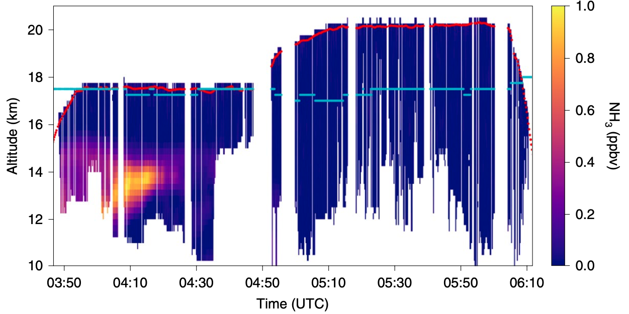
Model evaluation needed: GEOS-i33p2 monthly simulations of SO₄⁼, NO₃, OA, and NH₃ concentrations with ballpark numbers from StratoClim
SO₄⁼ (ng m⁻³)
OA (ng m⁻³)
Stratospheric (OCS oxidation)
S. Borrmann presentation
(StratoClim: ~100-600 ng/m³ at ~150 hPa)
Volcanic
(StratoClim: ~200-600 ng/m³ at ~150 hPa)
S. Borrmann presentation
NO₃⁻ (ng m⁻³)
NH₃ (pptv)
Höpfner et al., 2019
(StratoClim: ~100-250 ng/m³ at ~150 hPa)
(StratoClim July 31, 2017: 0-~600 pptv at ~150 hPa)
Höpfner et al., 2019

Slide 15
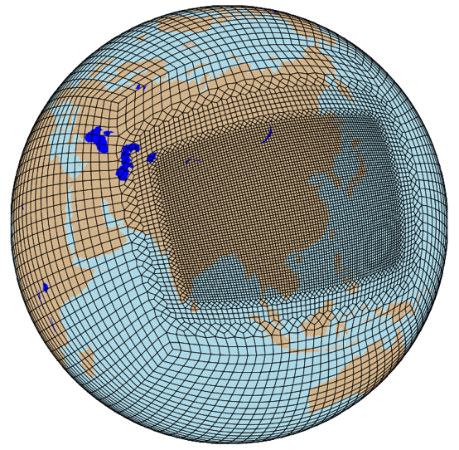
New model development at NCAR: Regional Refinement for ASM
CESM2.2 CAM6-chem with 32L (MUSICA V0)
Cube sphere grid; SE dycore; resolution around 1 degree down to a fine resolution of 0.25 degree.
Cover the ASM deep convection; anticyclone over the Tibetan Plateau and eastward eddy shedding over the WP region.
Allows for better representation of regional processes and chemistry of surface emissions.
At finer resolution, emissions and chemistry are more accurately represented.
Cover both natural and anthropogenic emission sources from South and East Asia.
Pollutants are simulated at a finer scale.
~100km
~50km
~30km
VRM_Editor
Figure courtesy of Shawn Honomichl, NCAR
Notes:
Jun slide
For now, from previous talks and LUISA’s talk we know that MUSICA is A new model framework of CAM6-chem, which enable chemistry and aerosol to be simulated at a finer resolution.
The capability of regional refinement allows for representation of convective processes within the ASM and typhoons. Likewise, the model is capable of resolving chemistry at emission and exposure relevant scales while also incorporating fully interactive tropospheric and stratospheric chemistry and aerosols⁶
The regional refined grid designed for ASM research covers the anticyclone over the Tibetan Plateau and eastward eddy shedding over the WP region, which includes both natural and anthropogenic emission sources from South and East Asia.
At finer resolution, emissions and chemistry are more accurately represented.
Pollutants are simulated on human exposure-relevant scales

Slide 16
Dry run 2021
CESM2/MAM refined grid model (Jun Zhang, Simone Tilmes and others)
SE dycore; resolution around 1 degree down to a fine resolution of 0.25 degree over ASM region.
32 Vertical resolution
Interactive stratospheric sulfate aerosols with volcanic forcing
3 modes MAM aerosol model including sulfate, dust, sea salt, BC, POM.
SOA (Tilmes 2019). Modeled SOA has been validated during the ATOM period.
The aiken mode from 15 nm to 53nm, accumulation mode from 58 nm to 0.27 um, and coarse mode from 0.8 um to 3.65 um.
Output include particle number densities, particle compositions (mixing ratio) for each mode. Aerosol Extinctions at 550 nm. (350nm and 1020 nm are available but currently not in the dry run catalog).

Slide 17
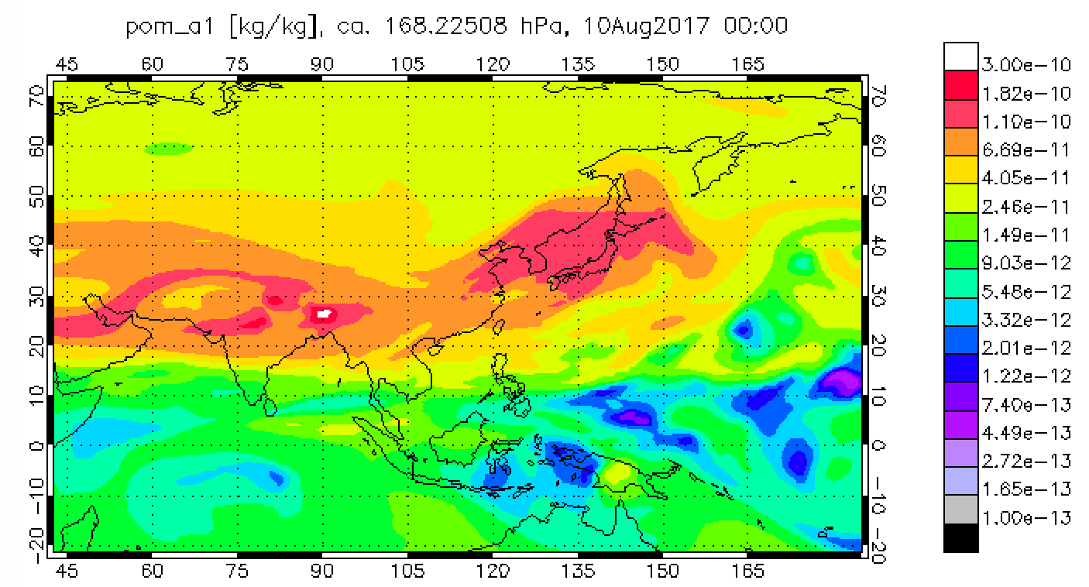
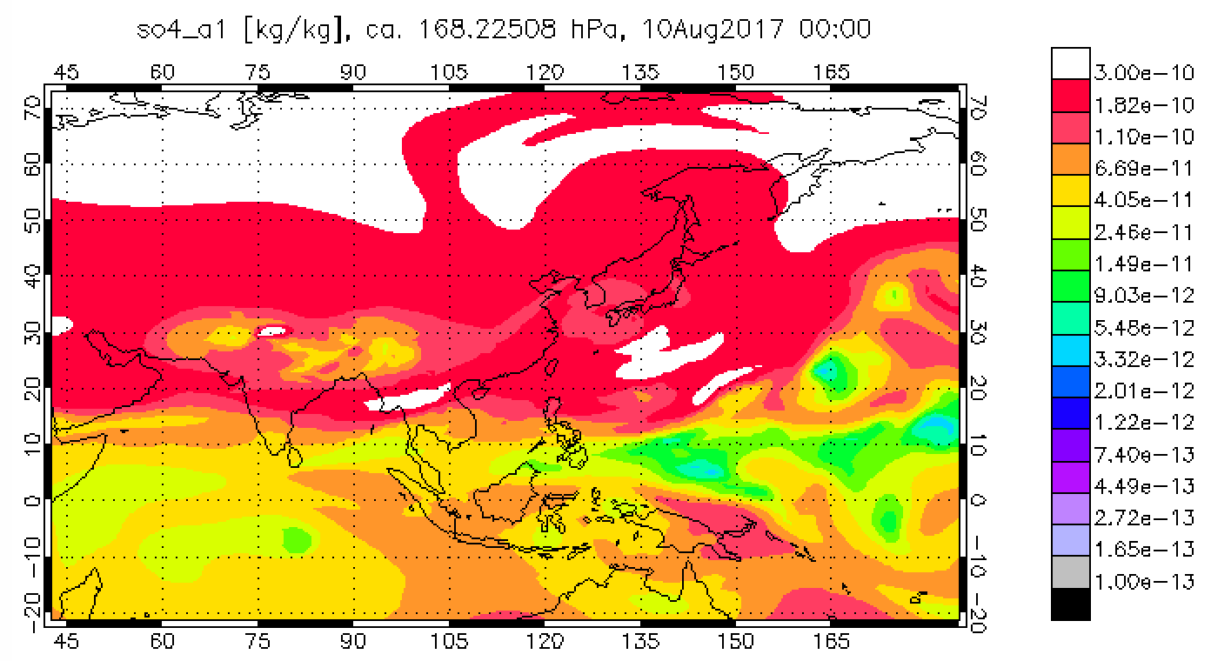
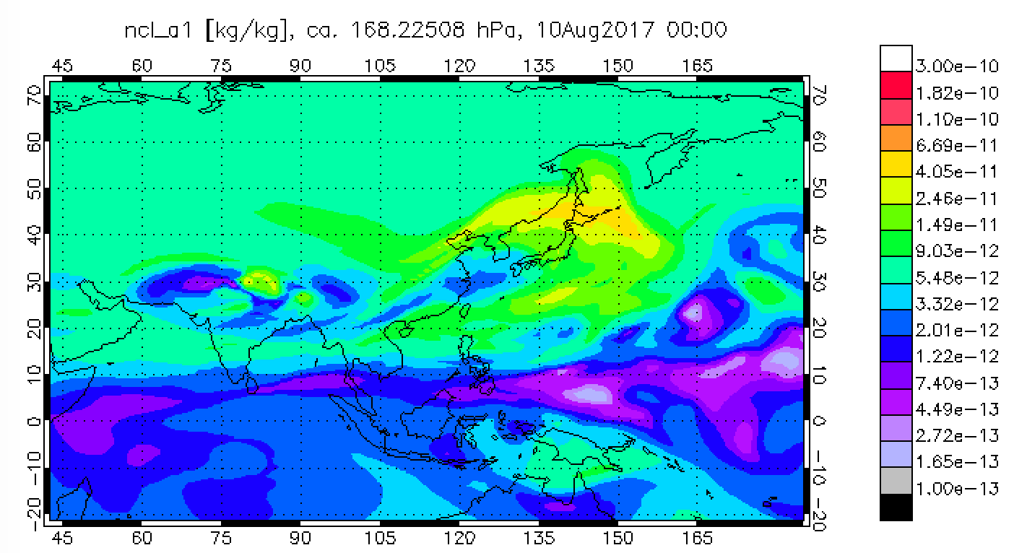
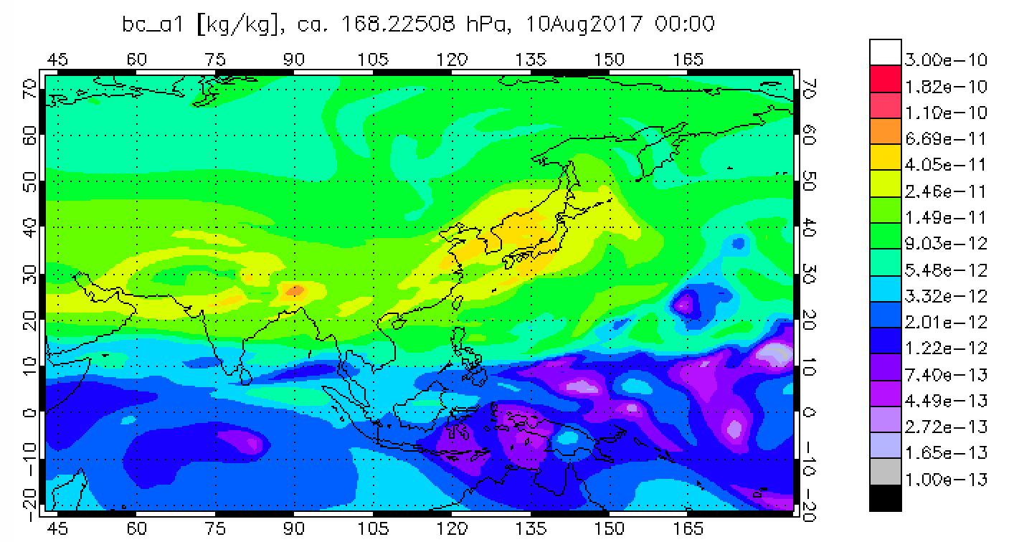
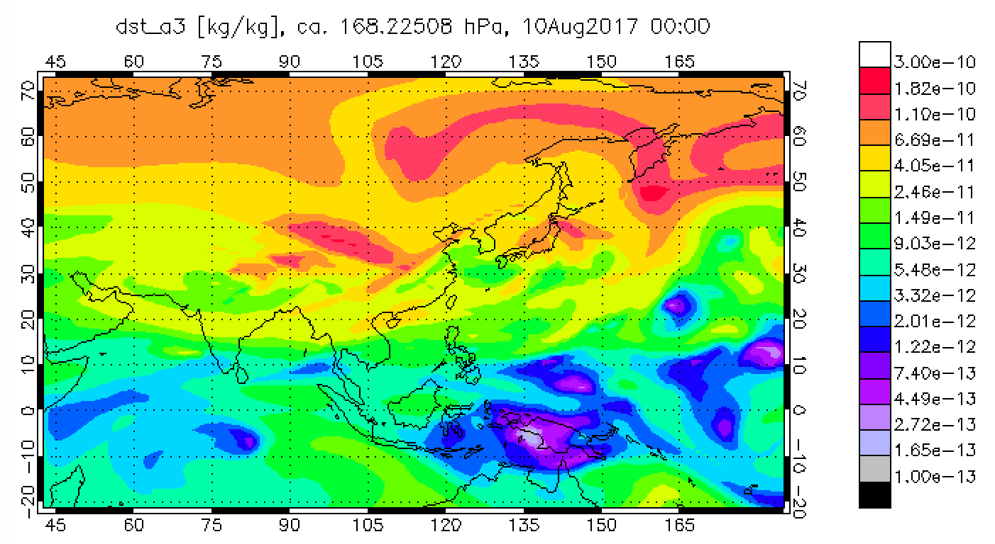
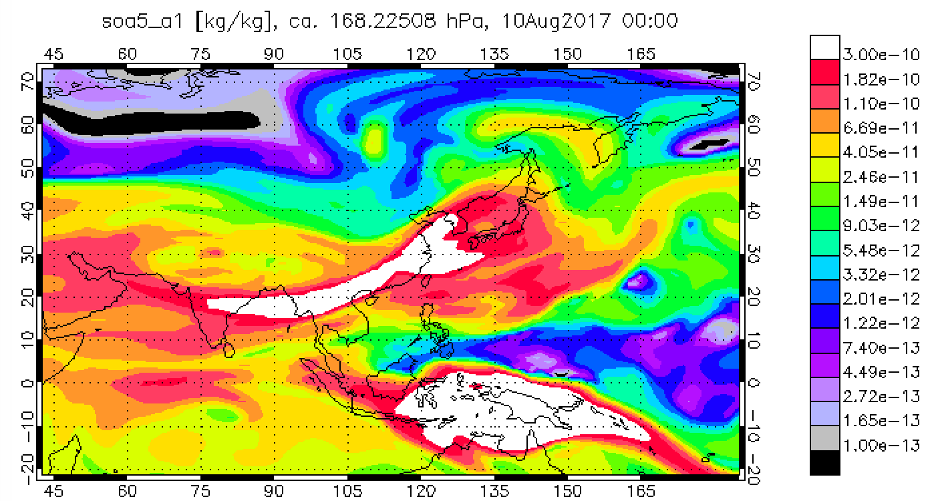
POM
Sulfate
Refined grid model
Particle concentration
Sum of the 3 modes
unit [kg/kg]
2017- August-10
168 hPa
Meteorology nudged with MERRA-2
Sea Salt
BC
Dust
SOA

Slide 18
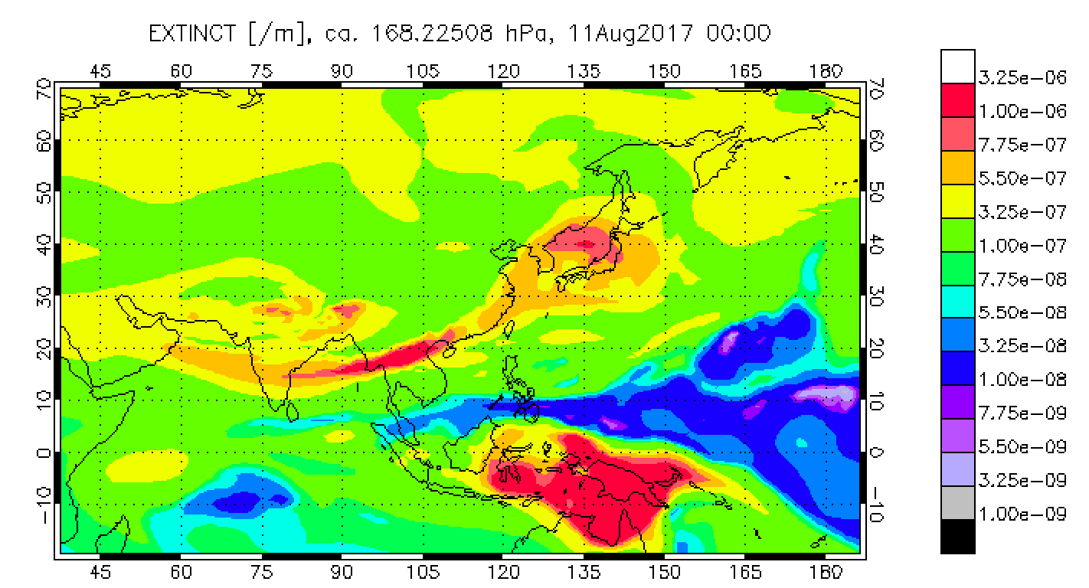
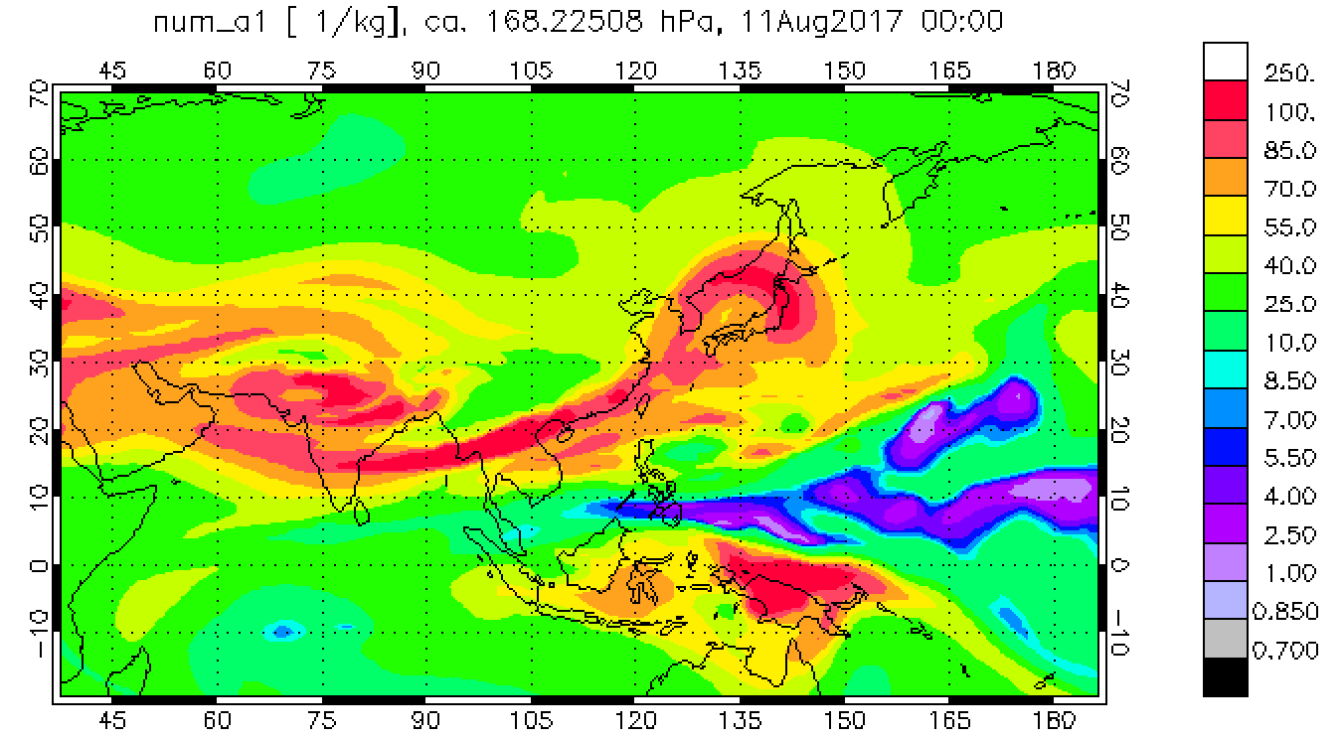
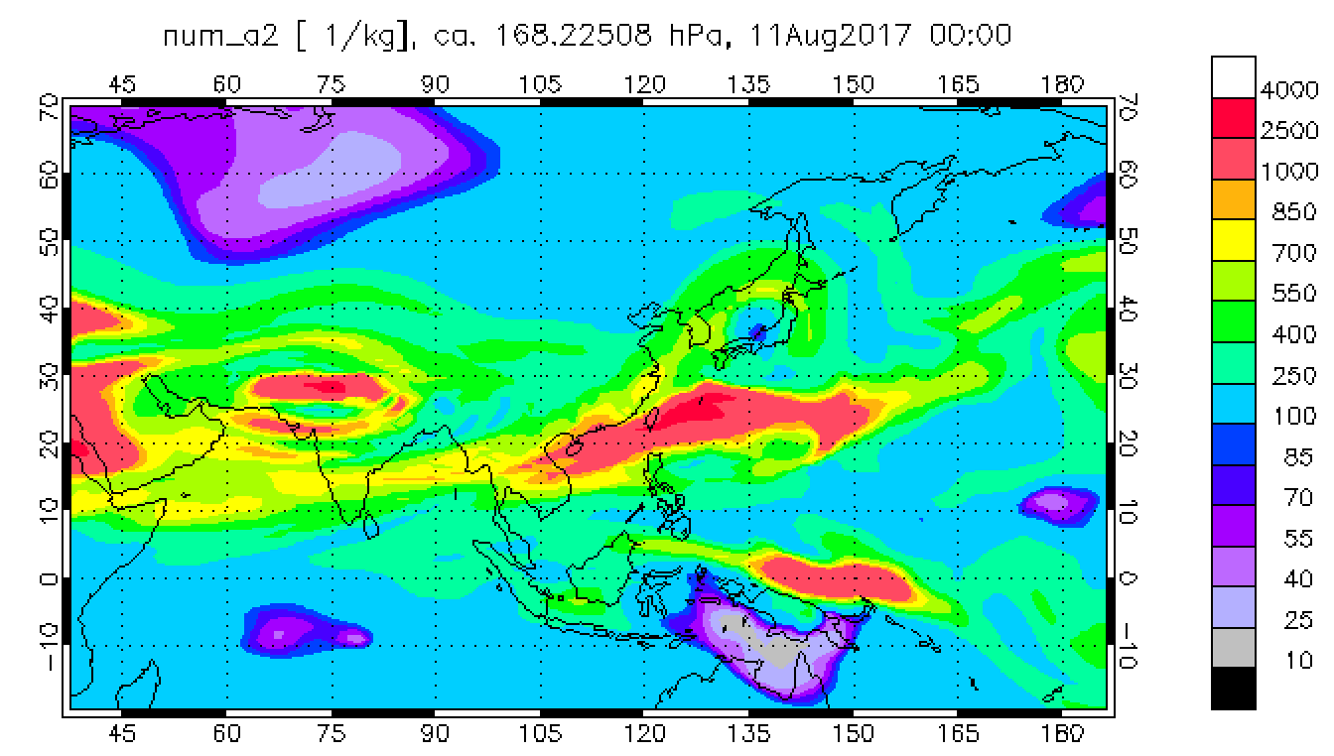
Extinction [1/m]
2017- August-10
168 hPa
Accumulation Mode number density [#/cm3]
Aitken Mode number density [#/cm3]

Slide 19
Ongoing Model Development for UTLS aerosol simulation
CESM2/CARMA model (Simone Tilmes, Mike Mills, and Yunqian Zhu)
We are implementing the CESM1/CARMA tropospheric/stratospheric model (Yu et
al. 2015) into CESM2/CARMA. The model includes:
FV core, 2x2 degree
56 level resolution for CAM6/CARMA run
Interactive stratospheric sulfate aerosols with volcanic forcing
Tropospheric aerosols including POM, BC, sulfate, dust, and sea salt (Yu et al. 2015). The particle is internally mixed. The CESM1 version of the model has been validated against POPS at the ASM region (Yu et al. 2017).
SOA (Tilmes 2019). Modeled SOA has been validated during the ATOM period.
Output includes 20 particle bins. Particle radius ranges from 0.8 nm to 7 um. Particle number densities, particle compositions (mixing ratio) for each particle size. Aerosol Extinctions at 350, 550, 1020nm.
CESM1/CARMA model (Pengfei Yu and Yunqian Zhu)
FV core, 2x2 degree, 56 level resolution
Based on Yu et al. 2015 including POM, BC, sulfate, dust, and sea salt
Adding nitrate growth at UTLS regions following Lin and Tabazadeh 2001
Adding ammonia and nitrate near the surface (future)
We plan to conduct the validations of the models starting this summer.

Slide 20
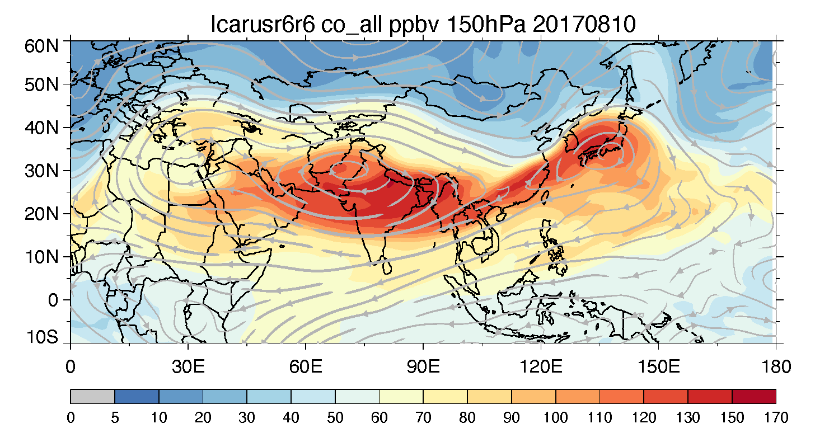
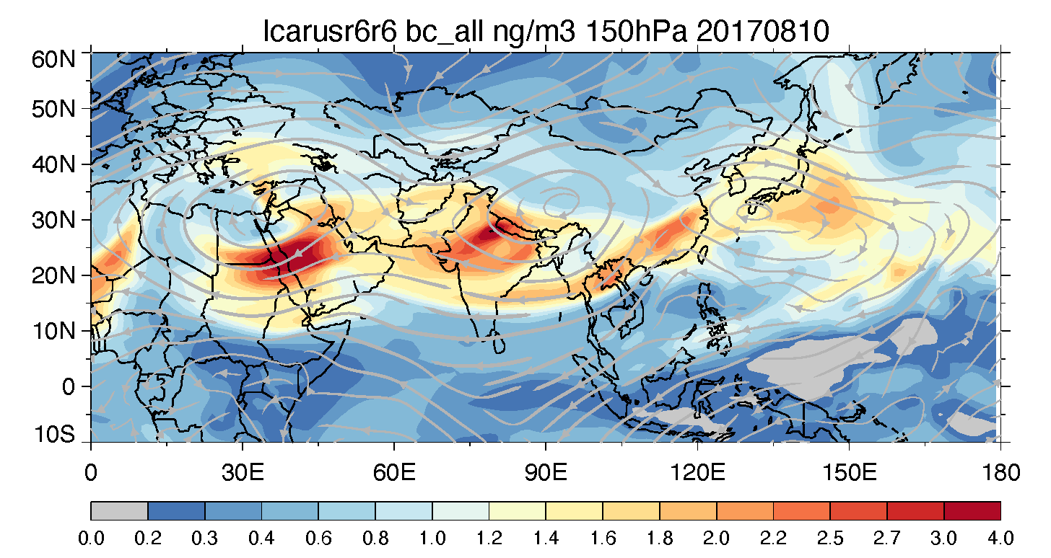
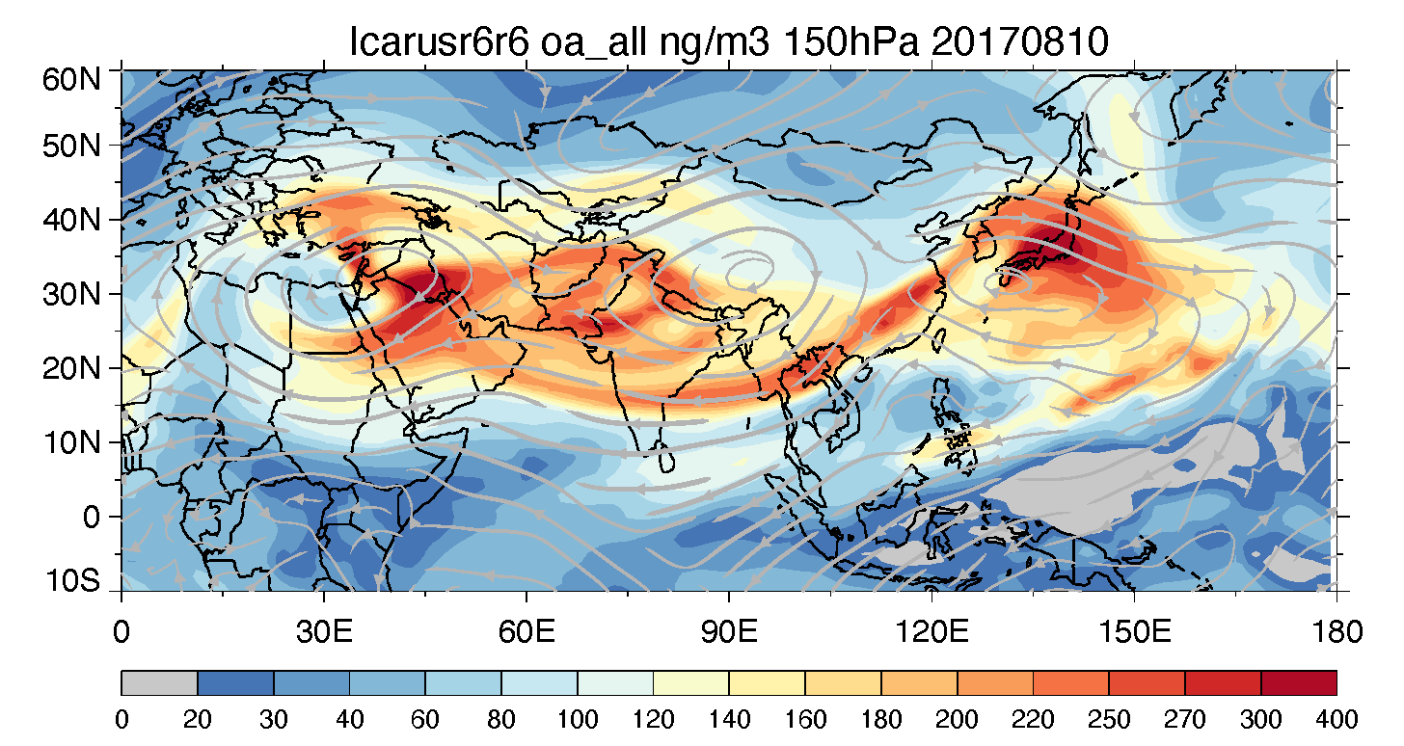
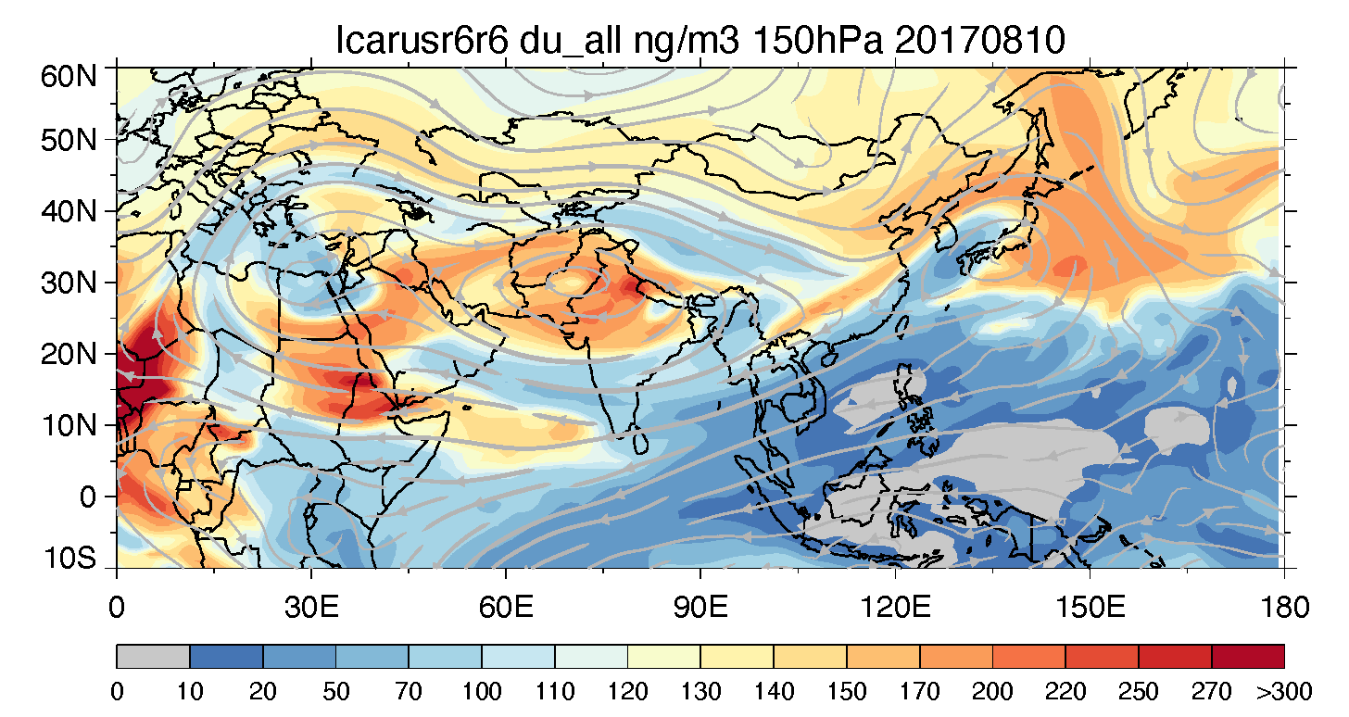
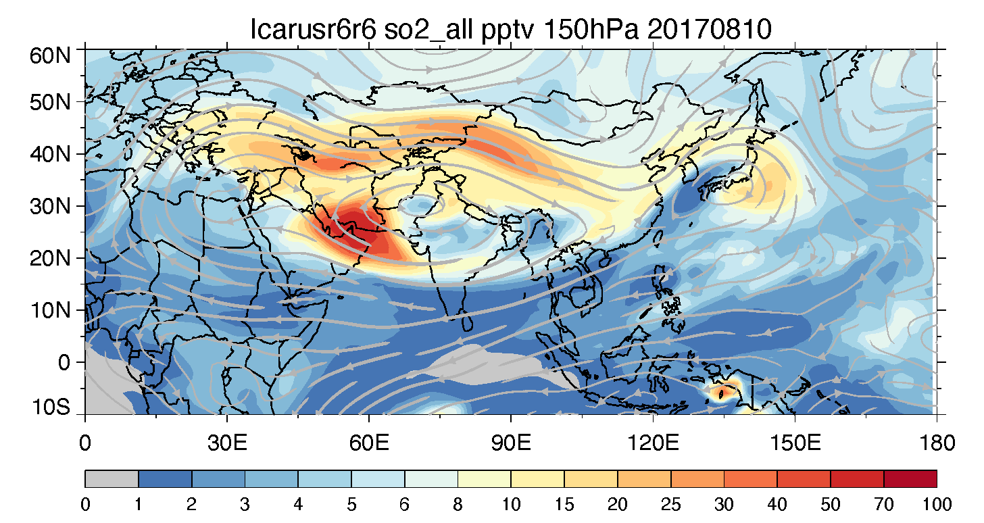
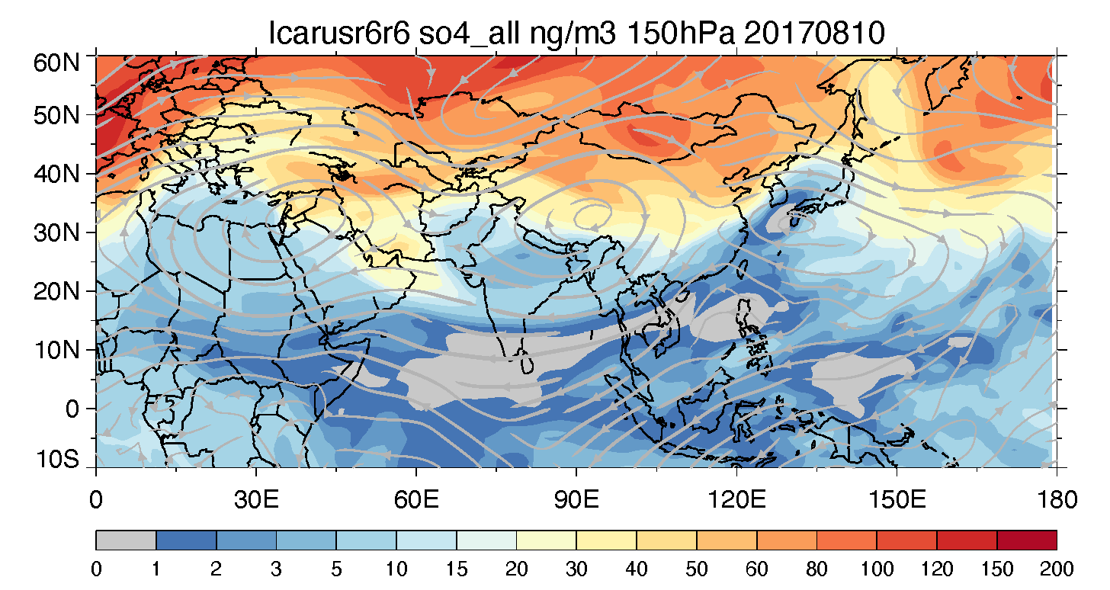
GEOS-i33p2 simulations – 2017-08-10, 150 hPa
CO
(Same date as CESM2/MAM simulation – see Yunqian’s slides on p.17-18)
Need in-situ data to evaluate!
BC
OA
Dust
SO2
SO4=
NO3-
Stratospheric background sulfate

Slide 21
Discussion
What models should do to better support the ACCLIP and aerosol objectives?
Pre-ACCLIP: dry runs with tagged EA and SA regions consistent among the models, model evaluations
During-ACCLIP: forecast, flight planning
Post-ACCLIP: integrated analysis on ATAL formation and maintenance, transport pathways from PBL to UTLS, chemical transformation, new particle formation, removal processes, and placing ACCLIP and other aircraft observations into larger spatial and temporal context
Campaign data access and engaging larger community
AeroCom has ongoing multi-model experiments on model intercomparisons, evaluation, and analysis of past aircraft data, including ATom, ORACLES, HIPPO, ARCTAS, etc. ACCLIP/StratoClim/OMO would make a significant impact in that regard
ACAM activities

